Slide 1


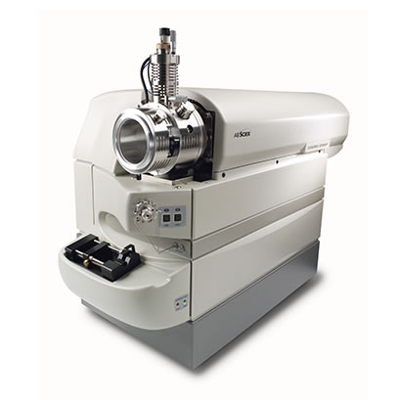
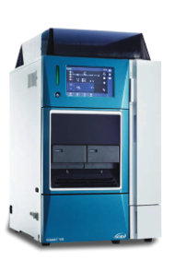
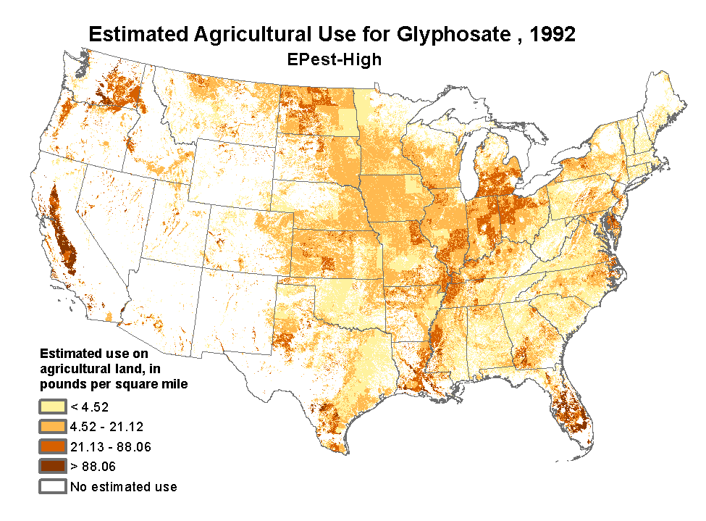
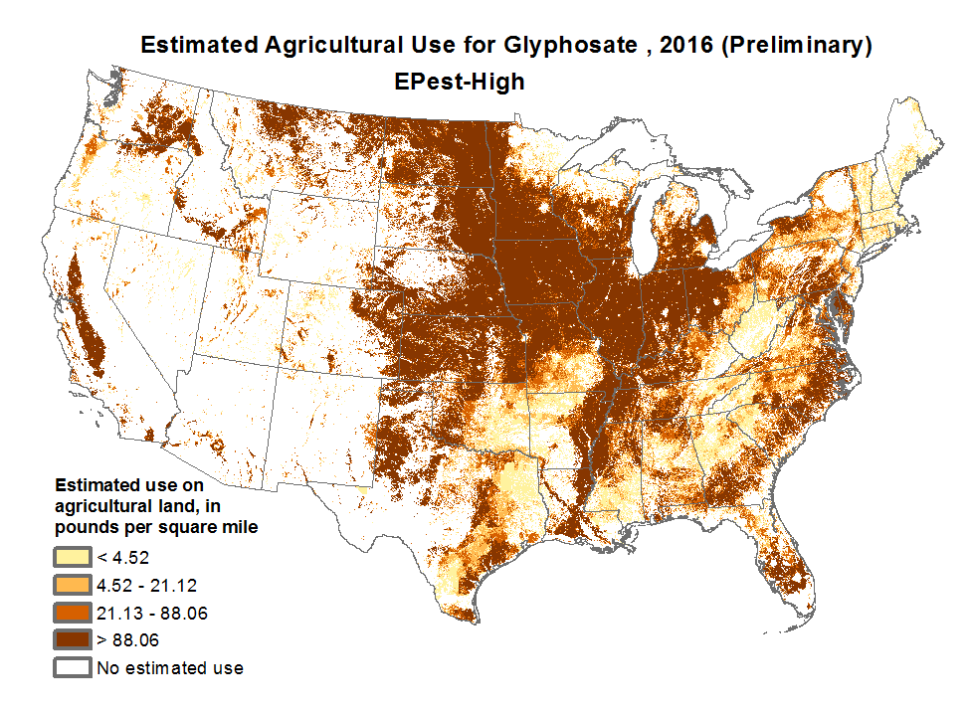
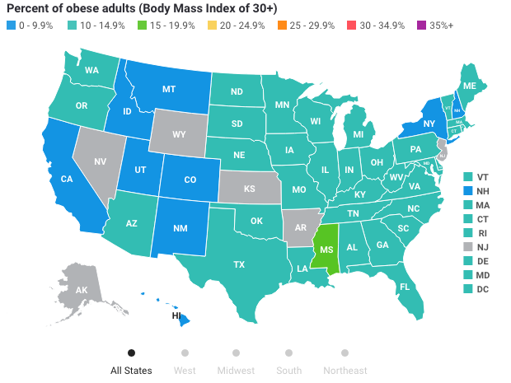
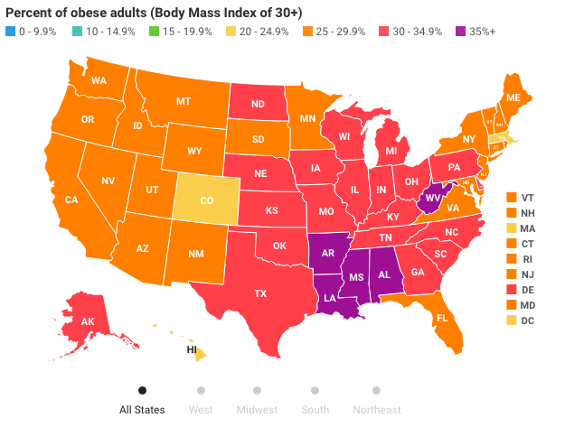
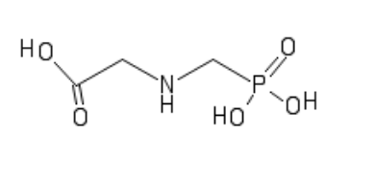

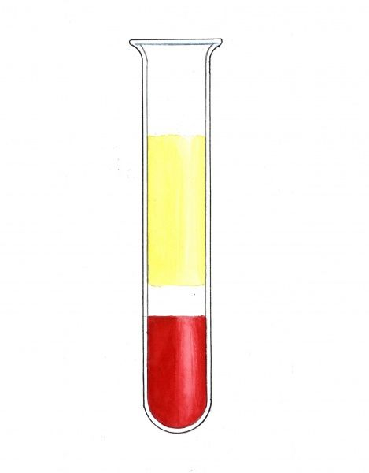
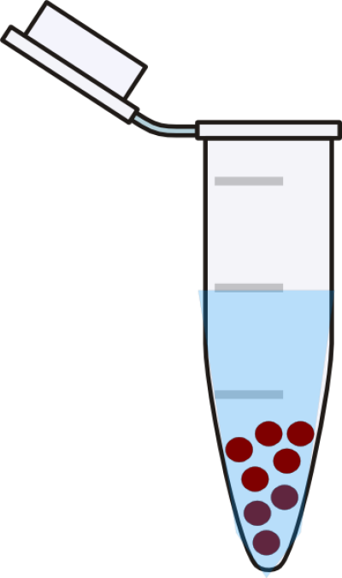
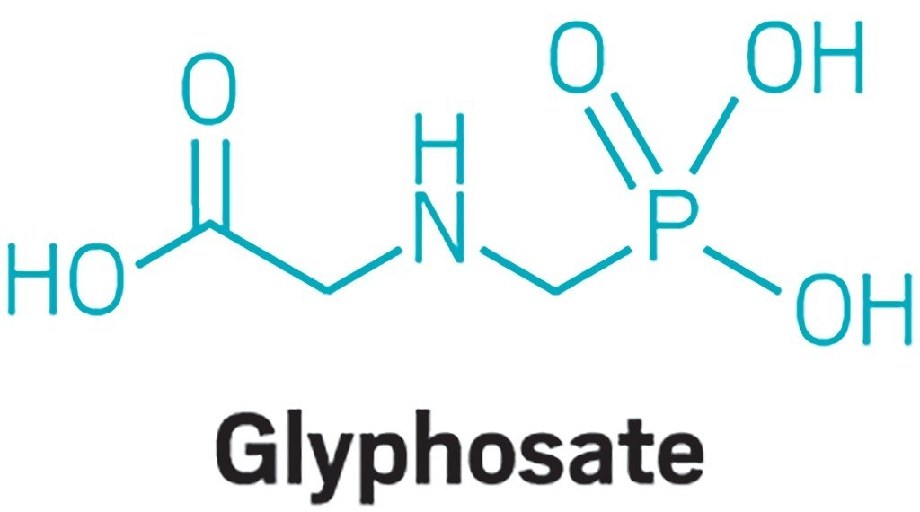
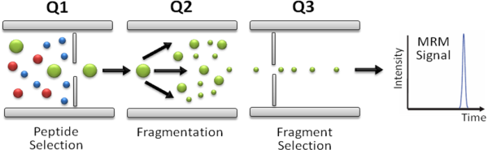
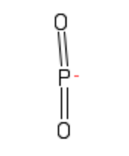
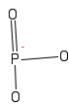
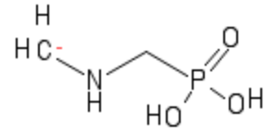
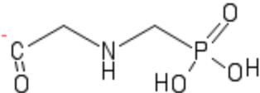
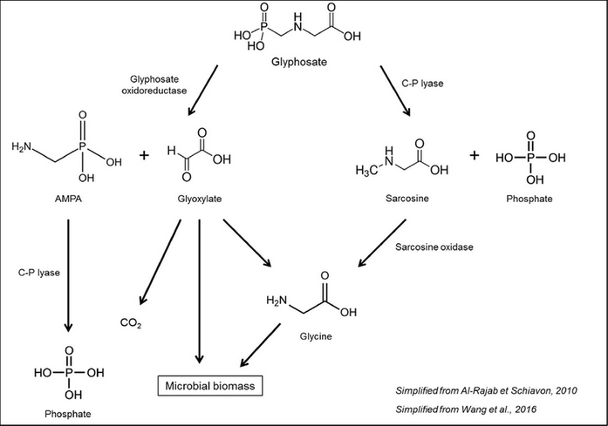
Do Pesticides cause Obesity and Diabetes?
Elliott Z¹, Buccini P¹, Wooten A², Kew K², Pories W¹
¹Department of Surgery, Brody School of Medicine at East Carolina University, Greenville, North Carolina
²Department of Biochemistry and Molecular Biology, Brody School of Medicine at East Carolina University, Greenville, North Carolina
Background
Liquid Chromatography / Mass Spectrometry (LC/MS) Method
Plasma Results
We have an epidemic of obesity that presents with serious health and economic consequences.
Obesity is the most common disease in the U.S. that has developed rapidly in only a matter of decades.^{1,2}
Glyphosate (RoundupTM) is a popular pesticide with private and commercial use that has dramatically increased in recent decades.^{3,4}
The geographic distribution and rise of obesity and glyphosate over time are similar (Fig 1).⁵
Recent evidence suggests that chronic glyphosate/AMPA (Fig. 2) exposure causes hepatorenal toxicity and oxidative stress.⁶
Our previous LABS study has 4700+ blood samples from across the country (Fig.1) with multiple time points before and after bariatric surgery (6, 12, 24, 36, 48, 60, 72 months).
These samples give us the power to determine if there is a regional relationship between obesity and pesticide use once a method of validation is established.
Table 1: Mass spectrometry parameters.
Parameter | Unit | Parameter | Unit
Ionization Mode | Negative | Gas Source 1 | 25
Ion source Voltage | 4500 | Gas source 2 | 25
Curtain gas | 25 | Declustering potential | -35
Temperature | 150ºC | Collision energy | -5.5
181 ng/mL
Table 2: LC gradient parameters. Samples and standards were transferred in autosampler vials. Hypersil Gold AQ (50 x 3 mm) maintained at 33°C. The flow rate was 0.3 mL/min and 20 µL of sample was injected.
Concentration (ng/mL)
113 ng/mL
Time (min) | %A – Water with 0.5% formic acid | %B- Methanol
3 | 99 | 1
6 | 10 | 90
7 | 10 | 90
8 | 99 | 1
10 | 99 | 1
Fig. 2. AB Sciex Exion liquid chromatography/AB Sciex 3200 triple quadrupole mass spectrometer (LCMS) utilized for quantitative method analysis.
Control Plasma 1 Control Plasma 2 Spiked Plasma 1 Spiked Plasma 2
Fig 4: Glyphosate was detected in spiked serum samples. However, minimal levels were detected in the control plasma samples.
Experimental Methods
Blood Withdrawal:
Blood was pulled from 2 subjects and centrifuged
2 mL of each subject’s plasma and serum were
placed into 5 serum vials and 5 plasma vials.
Vials were stored at -80 ℃
Glyphosate Dilution:
Standard solutions in µg/mL
  100
  10
  5
  2.5
Methanol Crash and Spike:
Supernatant was collected after centrifuging
4 x vials:
100 μL plasma or serum
400 μL methanol
50 μL water
LC/MS:
Negative ionization mode
Multiple Reaction Monitoring
1
0.5
0.1
0.005
4 x vials :
100 μL plasma or serum
400 μL methanol
50 μL of 5 μL/mL glyphosate
Glyphosate
Fig. 1 Comparison of obesity prevalence vs. glyphosate prevalence over 20 years. Stars denote locations of LABS sites. National Water-Quality Assessment (NAWQA) Project and The State of Obesity
Method Validation Plan
METHOD DEVELOPMENT and VALIDATION CRITERIA
Fig. 5 Example of extracted ion chromatogram from Spiked Plasma 1 with a calculated concentration of 113 ng/mL based on the calibration curve.
LIMIT of DETECTION
LIMITS of QUANTITATION
MATRIX EFFECTS
ION SUPPRESSION
FALSE POSITIVE INVESTIGATION
PRECISION and ACCURACY
SAMPLE STABILITY
Conclusions
COMPARISION to ACCEPTANCE CRITERIA
A method was developed to detect Glyphosate and AMPA in plasma that was consistent with other literature.⁸
Glyphosate was not detected in the control serum, control plasma, or spiked serum. However, Glyphosate was detectable in spiked plasma.
Although AMPA is found in soil and groundwater, AMPA was not detected in control serum or plasma and was detected in spiked serum or plasma.
Due to the polar nature of the molecule, the compound was not well retained in the specific column that was used. Further optimization using different types of columns will be investigated.
An improved methodology may be able to detect glyphosate in thousands of plasma samples from regions all over the U.S.
Glyphosate Standard Method Development Results
1
168.0→78.8
168.0→149.9
2
[M-H]⁻
168.0→63.0
Objective
168.0→124.0
The purpose of this experiment is to develop and validate an analytical method for measuring glyphosate and AMPA in human plasma. We hypothesize that pesticides may act as an environmental factor in the prevalence of obesity due to their similar insidious prevalence and geographical distribution.
4
3
Fig. 3 Method development for a 5 ng/mL glyphosate standard showing fragmentation, retention time, and a calibration curve. Fragmentation pattern observed matched reported structures from the literature.⁸ Calibration concentration range was from 5-500 ng/mL. The 5 ng/mL provided a signal-to-noise ratio ~30 indicating an estimated detection limit of 0.2 ng/mL.
Future Work
References
Acknowledgements
The methodology will be improved in future experiments for optimal results.
  Future experiments may be able to detect Glyphosate at concentrations as low as 0.2 ng/mL.
  A column with a higher degree of polarity will be used to increase sample retention.
1. Hales CM, Carroll MD, Fryar CD, Ogden CL. Prevalence of Obesity Among Adults and Youth: United States, 2015-2016. NCHS Data Brief. 2017 Oct;(288):1-8. PubMed PMID: 29155689.
2. Engin A. The Definition and Prevalence of Obesity and Metabolic Syndrome. Adv Exp Med Biol. 2017;960:1-17. doi: 10.1007/978-3-319-48382-5_1. Review. PubMed PMID: 28585193.
3. Anadón A, Martínez-Larrañaga MR, Martínez MA, Castellano VJ, Martínez M, Martin MT, Nozal MJ, Bernal JL. Toxicokinetics of glyphosate and its metabolite aminomethyl phosphonic acid in rats. Toxicol Lett. 2009 Oct 8;190(1):91-5. doi:10.1016/j.toxlet.2009.07.008. Epub 2009 Jul 14. PubMed PMID: 19607892.
4. Williams GM, Kroes R, Munro IC. Safety evaluation and risk assessment of the herbicide Roundup and its active ingredient, glyphosate, for humans. Regul Toxicol Pharmacol. 2000 Apr;31(2 Pt 1):117-65. Review. PubMed PMID: 10854122.
5. Noori JS, Dimaki M, Mortensen J, Svendsen WE. Detection of Glyphosate in Drinking Water: A Fast and Direct Detection Method without Sample Pretreatment. Sensors (Basel). 2018 Sep 5;18(9). pii: E2961. doi: 10.3390/s18092961. PubMed PMID: 30189680; PubMed Central PMCID: PMC6163928.
6. Mesnage R, Defarge N, Spiroux de Vendômois J, Séralini GE. Potential toxic effects of glyphosate and its commercial formulations below regulatory limits. Food Chem Toxicol. 2015 Oct;84:133-53. doi: 10.1016/j.fct.2015.08.012. Epub 2015 Aug 14. Review. PubMed PMID: 26282372.
7. AminoMethylPhosphonic Acid (AMPA) in natural waters: Its sources, behavior and environmental fate. - Scientific Figure on ResearchGate. Available from: https://www.researchgate.net/figure/Main-glyphosate-biodegradation-pathways-in-the-environment_fig3_315770620 [accessed 27 Jul, 2019]
8. Schreiber, A., & Jin, W. (2016). LC-MS Quantification of Underivatized Glyphosate and other Polar Pesticides. SCIEX. Retrieved July 30, 2019.
We acknowledge the support of the Brody School of Medicine Mass Spectrometry Core at East Carolina University and the instrument that was sponsored by the Golden Leaf Foundation.
We would like to thank the Brody Research Distinction Track for the opportunity to present this work.
Fig. 2 Biodegration pathway of glyphosate and AMPA in soil⁷

