Slide 1
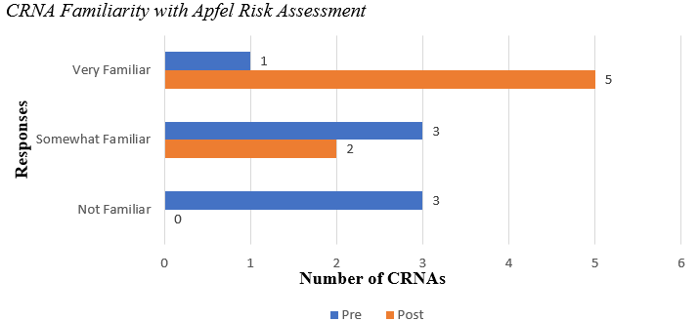
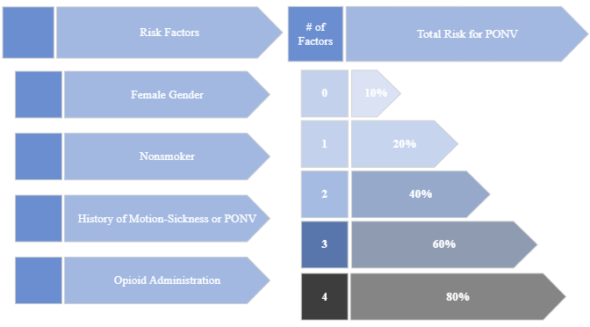
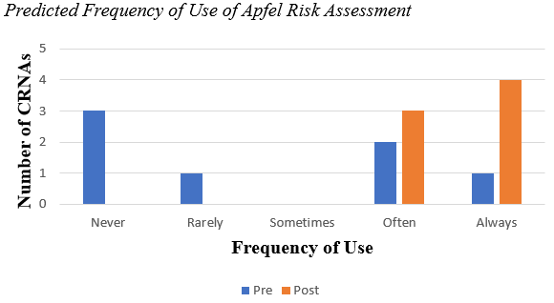
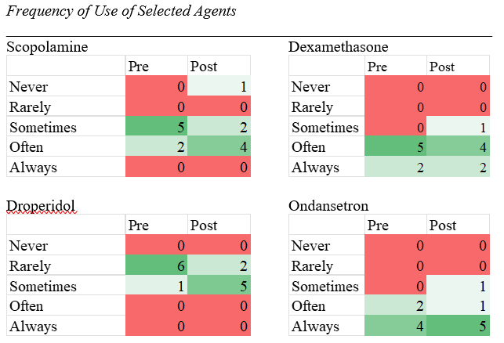
Postoperative Nausea and Vomiting: A Quality Improvement Project
Greg Cornish, BSN, SRNA
Maura McAuliffe, PhD, CRNA, FAAN, Project Chair
Nurse Anesthesia Program
College of Nursing, East Carolina University
Greenville, North Carolina 27858
cornshj21@students.ecu.edu
INTRODUCTION
RESULTS
DISCUSSION
Up to 30% of patients undergoing surgery may experience PONV (Hegarty et al., 2016)
Up to 80% of high-risk patients may experience PONV (Apfel et al., 2012).
Apfel et al. (2012) identified five significant risk factors for PONV. Overall risk increases with each additional factor.
The 2020 Consensus Guidelines, endorsed by both the AANA and the ASA, recommend a risk-based prophylaxis approach using the Apfel score (Gan et al., 2020).
Low-risk patients should receive two antiemetic drug classes. High-risk patients should receive three or four drug classes (Gan et al., 2020).
The purpose of this QI project was to assess the CRNAs’ knowledge, preferences, and practices for managing PONV and whether they perceived a PONV Quick Refence Guideline as a useful tool for their practice.
Figure 1
7 CRNAs completed both pre- and post-surveys.
The CRNAs indicated increased familiarity with the Afpel score on the post-test (Figure 1).
Participants stated they would be more likely to use the Apfel score on the post-test (Figure 2).
The CRNAs indicated increased willingness to use droperidol following project implementation (Table 1).
The CRNAs stated that an official PONV protocol or algorithm would be “useful” (3) or “very useful” (4).
Most participants stated “no” or “unsure” when asked if there was a department protocol for PONV prophylaxis.
On the post-survey, six of the seven participants described the QRG to be “somewhat” or “very” useful.
Note: n=7
Figure 2
CONCLUSIONS
The CRNAs’ unanimous view that a department protocol for PONV prophylaxis would be useful is consistent with findings in the literature.
The project findings suggest the organization would receive a good return on investment if it sponsored the QI project.
Other institutions have seen substantial reduction in the incidence of PONV (Dewinter et al., 2018) and cost benefits as well (Dzwonczyk et al., 2012).
The small sample size, short implementation period, and time burden on participants inherent to the project represent limitations and potential sources of bias.
A QI project focused on nonpharmacological interventions for PONV or one focused on risk-scoring systems are promising avenues for future study.
Note: n=7
Table 1
METHODS
REFERENCES
Pre-intervention, Post-intervention design using a single Plan, Do, Study, Act (PDSA) cycle (IHI, 2022) methodology.
Plan: A comprehensive literature search and synthesis of the evidence formed the basis for creation of an educational presentation and Quick Reference Guide (QRG).
Do: Willing participants received links to a Qualtrics pre-survey along with the QRG and educational PowerPoint presentation. Post-survey links went out two weeks later.
Study/Act: Survey data was collected and analyzed, and the findings disseminated.
Apfel, C. C., Philip, B. K., Hooper, V. D., Radke, O. C., Ruiz, J., Kovac, A., Cakmakkaya, O. S., Shilling, A., Shi, Y., Leslie, J. B., Allard, M., Turan, A., Windle, P., & Odom-Forren, J. (2012). Who is at risk for postdischarge nausea and vomiting after ambulatory surgery? Anesthesiology, 117(3), 475-486. https://doi.org/10.1097/ALN.0b013e318267ef31
Dewinter, G., Staelens, W., Veef, E., Teunkens, A., Van de Velde, M., & Rex, S. (2018). Simplified algorithm for the prevention of postoperative nausea and vomiting: A before-and-after study. British Journal of Anaesthesia, 120(1), 156-163. https://doi.org/10.1016/j.bja.2017.08.003
Dzwonczyk, R., Weaver, T. E., Puente, E. G. & Bergese, S. D. (2012). Postoperative nausea and vomiting prophylaxis from an economic point of view. American Journal of Therapeutics, 19 (1), 11-15. doi: https://10.1097/MJT.0b013e3181e7a512
Gan, T. J., Belani, K. G., Bergese, S., Chung, F., Diemunsch, P., Habib, A. S., Jin, Z., Kovac, A. L., Meyer, T. A., Urman, R. D., Apfel, C. C., Ayad, S., Beagley, L., Candiotti, K., Englesakis, M., Hedrick, T. L., Kranke, P., Lee, S., Lipman, D., . . . Philip, B. K. (2020). Fourth consensus guidelines for the management of postoperative nausea and vomiting. Anesthesia and Analgesia, 131(2), 411-448. https://doi.org/10.1213/ANE.0000000000004833
Hegarty, A. T., Buckley, M. A., & McCaul, C. L. (2016). Ambulatory anesthesia and postoperative nausea and vomiting: Predicting the probability. Ambulatory Anesthesia, 3, 27-35 http://dx.doi.org/10.2147/AA.S54321
Institute for Healthcare Improvement. (2022). The IHI Triple Aim. https://www.ihi.org/resources/Pages/HowtoImprove/default.aspx
Note: n=7. Red indicates low quantity. Shades of green indicate higher quantity.

