Slide 1
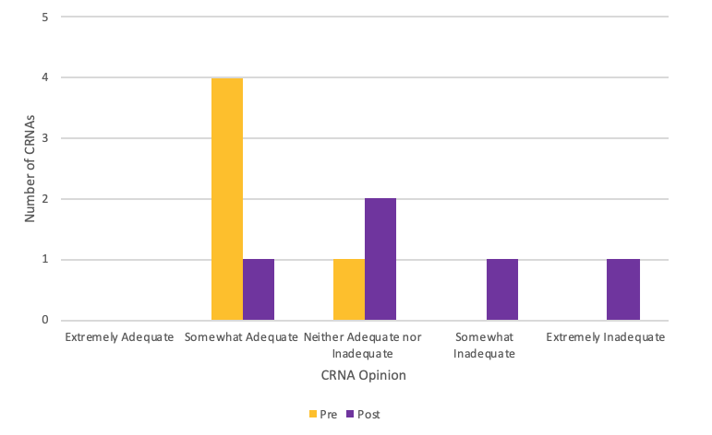
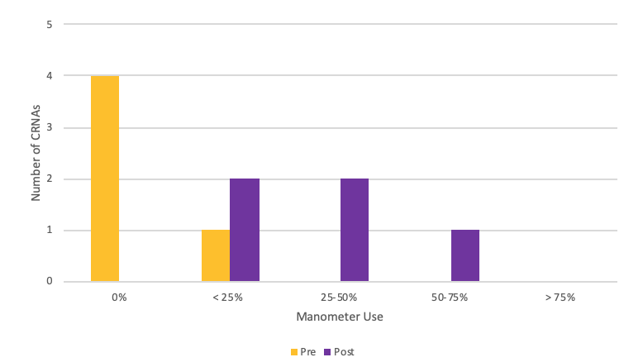
Assessing Anesthesia Providers’ Perceptions of Adequacy of Endotracheal Tube Cuff Pressure Assessment Techniques: A Doctor of Nursing Practice Project
Charlotte Brown, BSN, SRNA
Travis Chabo, PhD, CRNA, Project Chair
Nurse Anesthesia Program
College of Nursing, East Carolina University
Greenville, North Carolina 27858
brownch12@students.ecu.edu
ABSTRACT
RESULTS
DISCUSSION
Endotracheal tube (ETT) cuff pressure management is an important intraoperative patient care intervention. Current practices include several subjective measurement methods as well as an objective measurement method (manometer device). The purpose of this quality improvement project was to assess anesthesia providers’ perceptions of perioperative usefulness of subjective and objective assessment for obtaining adequate endotracheal tube cuff pressures. Upon conclusion of this project, perceptions regarding subjective assessment of endotracheal tube cuff pressures shifted towards feelings of inadequacy and neutrality while opinions regarding the manometer shifted towards a consensus of greater perceived adequacy.
Opinion on Subjective Assessment of ETT Cuff Pressure: Pre- and Post-Intervention (n=5)
This quality improvement (QI) project increased the awareness of ETT cuff pressure monitoring amongst the participating CRNAs and allowed the CRNAs to assess their perceptions of adequacy regarding the subjective and objective methods of ETT cuff pressure monitoring.
In alignment with the support for objective ETT cuff pressure measurement by Hockey et al. (2016), the participating anesthesia providers developed more favorable opinions towards objective ETT cuff pressure measurement upon conclusion of the project implementation period.
This QI project had a negative impact on the opinions of adequacy regarding the commonplace (subjective) ETT cuff pressure measurement methods.
INTRODUCTION
CONCLUSIONS
Appropriate inflation is necessary in preventing adverse effects associated with under- and over-inflated ETT cuffs in intubated patients. A cuff pressure reading between 20–30 centimeters of water (cm H₂O) is commonly regarded as being safe for the intubated patient; cuff pressures above or below this range render the intubated patient at risk for complications not limited to tracheal stenosis, mucosal ischemia, micro aspiration, and inadequate ventilation (Hockey et al., 2016). At a small rural hospital in eastern North Carolina, as in most other surgical settings, a specific policy directed toward anesthesia provider management of the ETT cuff has not been delineated. This has led to personal preference of the CRNAs being the determining factor for the chosen cuff pressure measurement method.
Increased familiarity with and knowledge of the manometer device likely contributed to observed changes in perceptions regarding subjective and objective ETT cuff pressure measurement methods.
Through provider education and direct provision of manometers, perceptions of the manometer device became more favorable and estimates of future use increased.
The observed increase in appreciation for the manometer device may hold significance in future implementation efforts by the organization to evolve a standard of care for ETT cuff pressure management.
Future anesthesia department discussions regarding the patient safety issue of ETT cuff pressure monitoring should expect success if centered around education about the topic and if access to objective measurement devices is ensured.
Manometer Use: Pre- and Post-Intervention (n=5)
METHODS
Pre-survey/intervention/post-survey methodology
First three stages of the Plan-Do-Study-Act (PDSA) cycle
Direct provision of manometers to the participating CRNAs at the start of the two-week implementation period
Data collection via anonymous initial and follow-up surveys
Data analysis via Excel software
REFERENCE
Hockey, C. A., van Zundert, .A.J., & Paratz, J. D. (2016). Does objective measurement of tracheal tube cuff pressures minimise adverse effects and maintain accurate cuff pressures? A systematic review and meta-analysis. Anaesthesia and Intensive Care, 44(5), 560-570. https://doi.org/10.1177/0310057X1604400503

