Slide 1
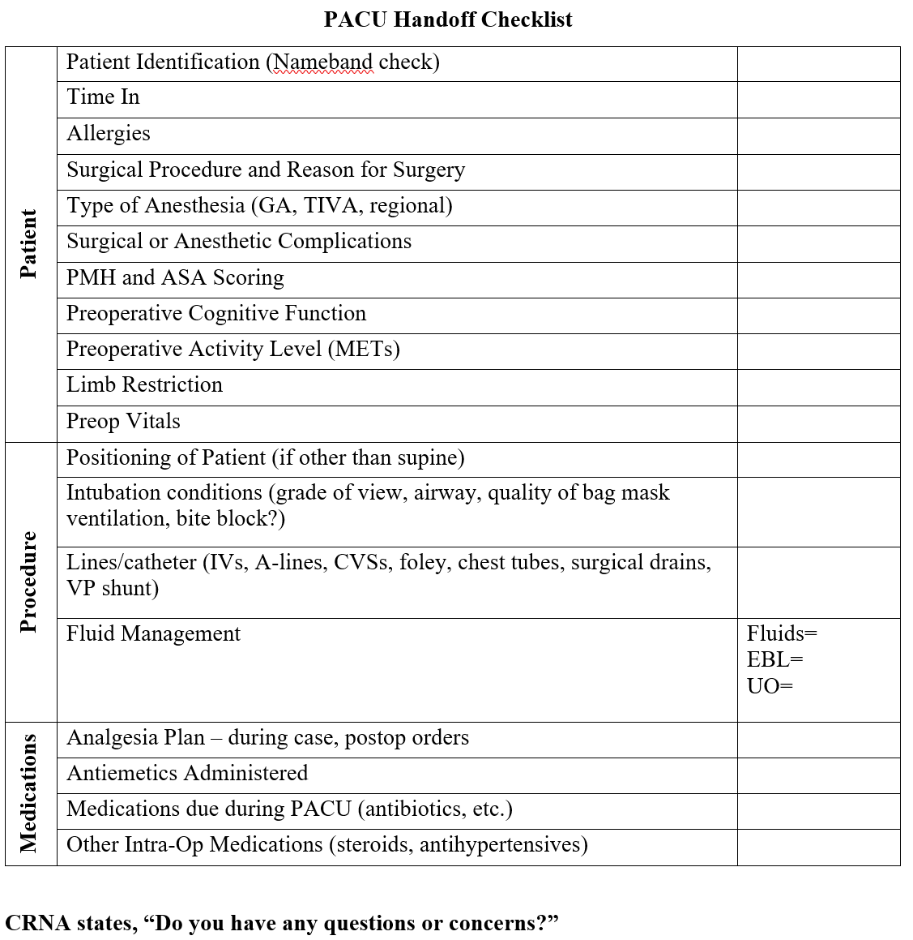
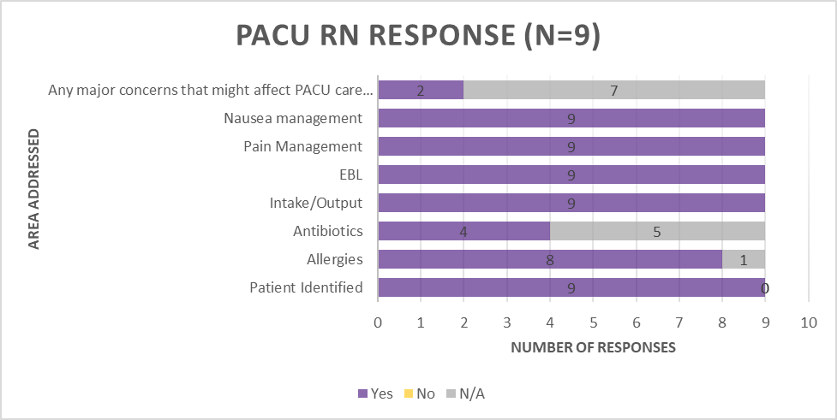
A Quality Improvement Project: Implementation of a Standardized Handoff Report for Nurse Anesthetists in the Post-Operative Setting
Jennifer H Young, BSN, SRNA
Maura McAuliffe, PhD, CRNA, FAAN, Project Chair
Nurse Anesthesia Program
College of Nursing, East Carolina University
Greenville, North Carolina 27858
hundleyj19@students.ecu.edu
ABSTRACT
RESULTS
THE HANDOFF TOOL
This quality improvement project assessed the perceptions of CRNAs and PACU nurses in a small, rural hospital regarding use of a standardized handoff report. The handoff tool led to a complete report without missing information, but the CRNAs and PACU nurses did not want to adopt this tool into their practice.
INTRODUCTION
Ineffective handoff report contributed to almost 80% of serious events and 35% of sentinel events between 2004 and 2014 (Lee et al., 2016)
Handoff protocols improve the amount of handoff information passed and organizational outcomes (Keebler et al., 2016)
Communication errors result in increased length of hospital stay, unnecessary treatments, and even death
Standardized reporting systems are shown to have more consistent and systemic transitions of patient care (Dahlquist et al., 2018)
METHODS
The project was completed using a pre-test and post-test design
Pre-intervention survey using Qualtrics emailed to participating CRNAs at rural hospital
Standardized handoff tool introduced to CRNAs via PowerPoint presentation
Standardized handoff tool implemented for 3 weeks in the PACU
Survey completed by PACU nurses after each use of standardized handoff tool
Post-intervention survey using Qualtrics emailed to participating CRNAs
DISCUSSION
A CRNA recommended “specific mention of paralytics and reversal administration”
A CRNA recommended “I would remove time in, ASA scoring, preop activity level, limb restriction”
All PACU responses reported no pertinent information was left out
Even with small participant numbers, the project had 100% participation
REFERENCES
CONCLUSIONS
Anesthesia Patient Safety Foundation. (2021). Perioperative multi-center handoff collaborative. https://www.apsf.org/patient-safety-resources/perioperative-multi-center-handoff-collaborative/
Dahlquist, R., Reyner, K., Robinson, R., Farzad, A., Laureano-Phillips, J., Garrett, J., Young, J., Zenarosa, N., & Wang, H. (2018). Standardized reporting system use during handoffs reduces patient length of stay in the emergency department. Journal of Clinical Medicine Research, 10(5), 445-451. http://doi.org/10.14740/jocmr3375w
Keebler, J. R., Lazzara, E. H., Patzer B. S., Palmer, E. M., Plummer, J. P., Smith, D. C., Lew, V., Fouquet, S., Chan, Y., & Riss, R. (2016). Meta-analyses of the effects of standardized handoff protocols on patient, provider, and organizational outcomes. Human Factors, 58(8), 1187-1205. https://doi.org/10.1177/0018720816672309
Lee, S. H., Phan, P. H., Dorman, T., Weaver, S. J., & Pronovost, P. J. (2016). Handoffs, safety culture, and practices: Evidence from the hospital survey on patient safety culture. BMC Health Services Research, 16(254). https://doi.org/10.1186/s12913-016-1502-7
Overall, participants do not recommend adopting this handoff tool
These findings align with current literature of finding this tool too extensive and increasing length of handoff report
Future studies could include a larger number of participants
Recommend designing a standardized handoff tool specific to unit and facility

