Slide 1
Rainfall and River
Forecasts
The Processes and Products
Jeff Dobur, NWS Peachtree City, GA
Michael Moneypenny, NWS Raleigh, NC

Slide 2
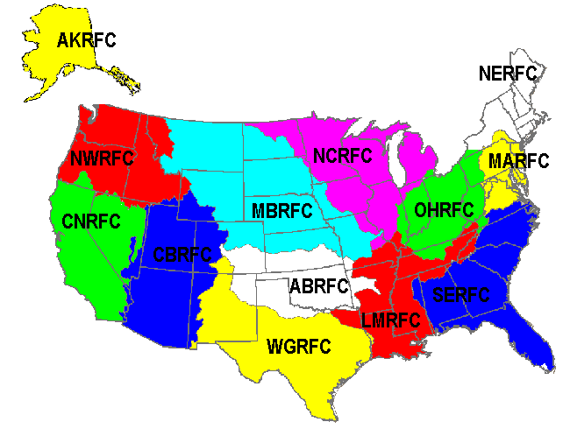
River Forecast
Centers

Slide 3
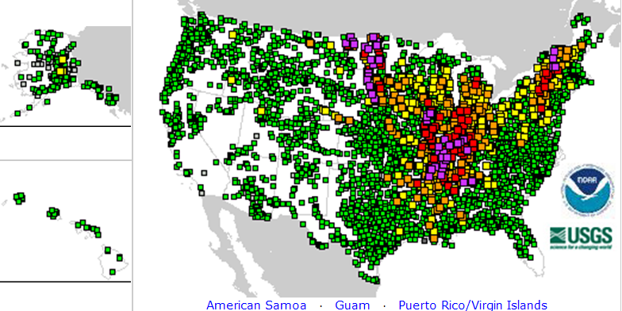
River Gages and Forecasts

Slide 4
River Forecasts – How are they created?
Basic Forecast Process
Basin
Watershed
Observed
Precipitation
Future
Precipitation
Upstream Flow
SAC-SMA Model
Rain to Runoff
Unit Hydrograph
Runoff to Flow
Basin Local Flow
Total Flow
(cfs)
River Gage
Rating Curve
Stages to Flows
Forecaster
Modification
Forecast
To WFO

Slide 5
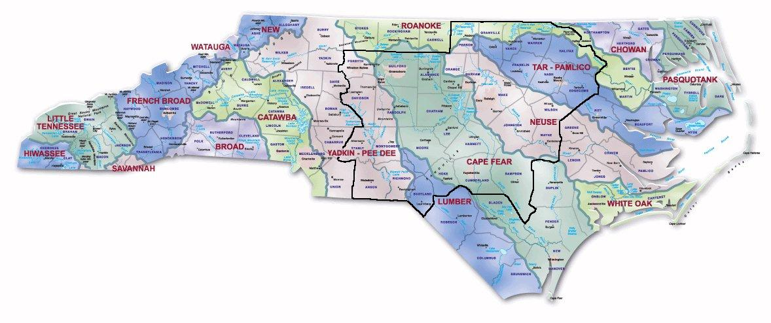
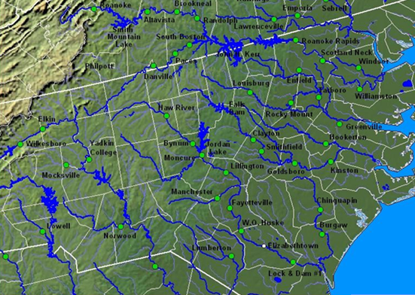
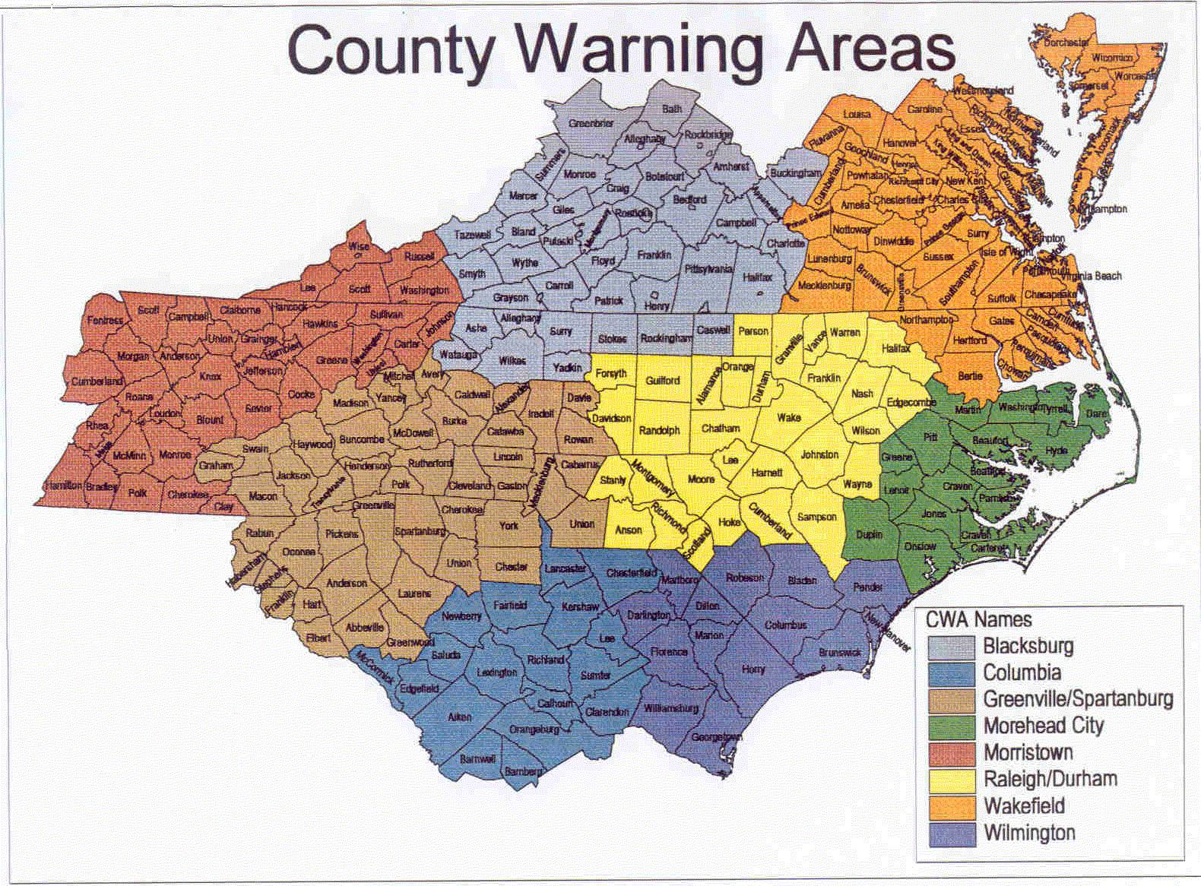
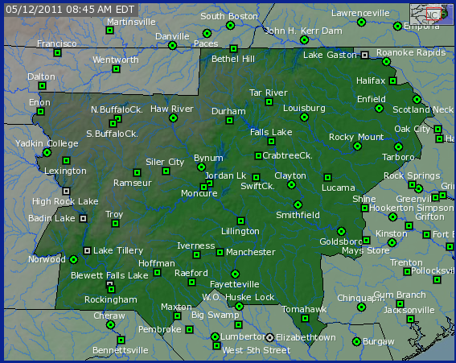
River Forecast Points

Slide 6
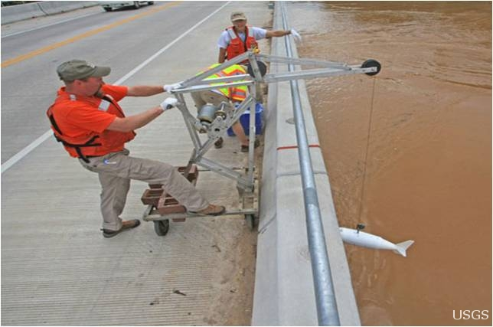
The U.S. Geological Survey Performs
Flow Measurements at Each Forecast Point

Slide 7
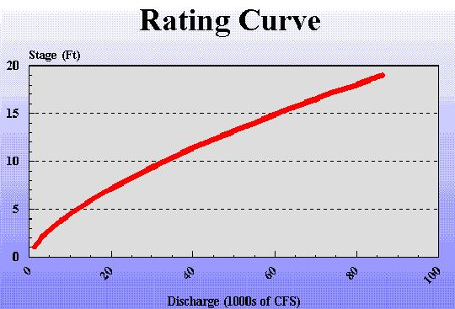
To Produce Rating Curves
Volume of Flow is Converted to Stage

Slide 8
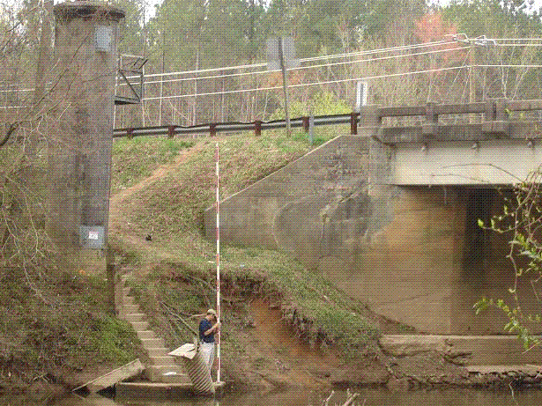
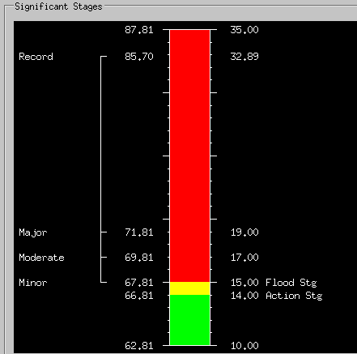
River Forecast Points
The NWS Surveys
Each Site
to Determine
Impacts

Slide 9
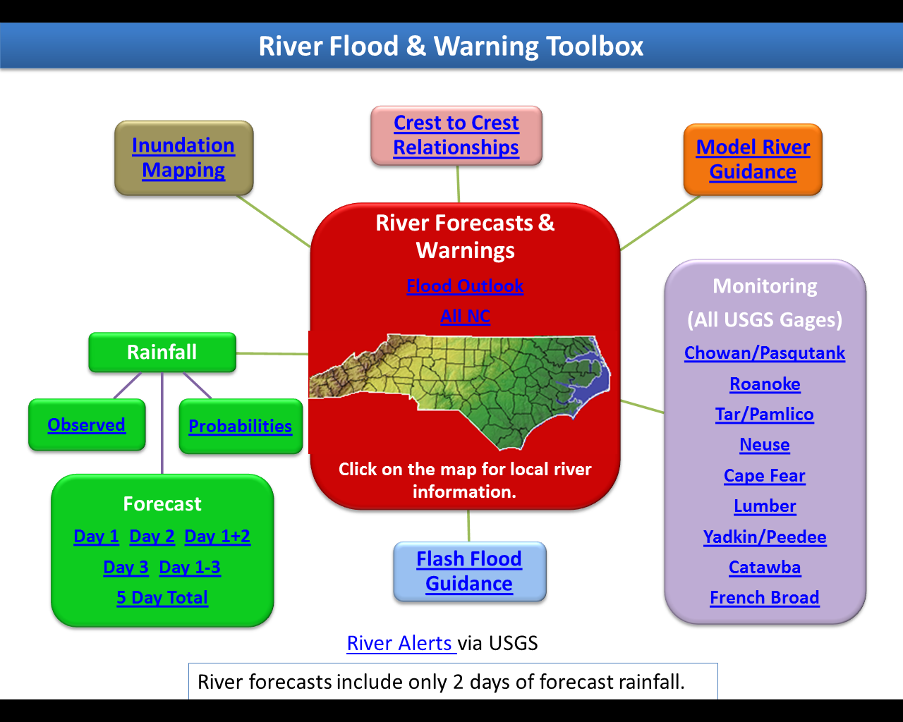

Slide 10
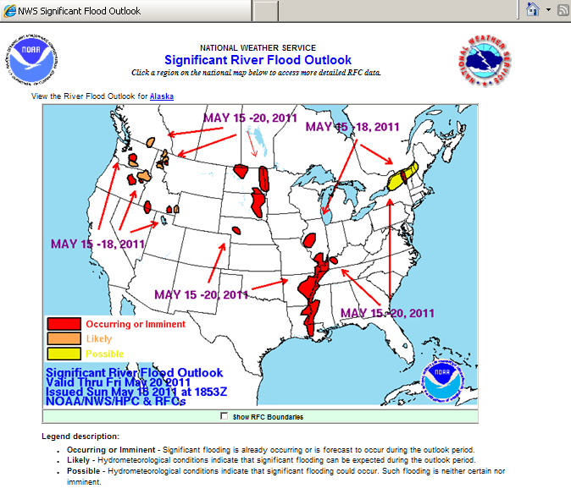

Slide 12
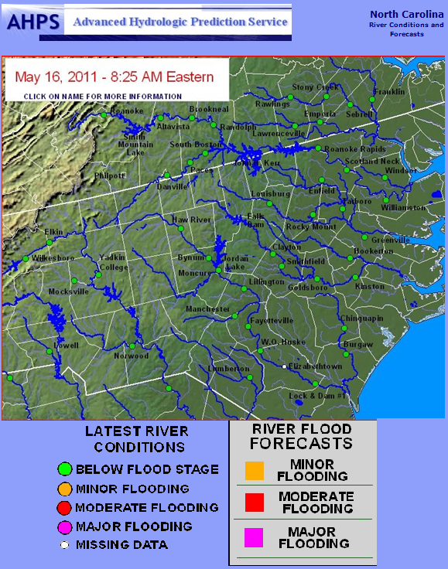

Slide 14
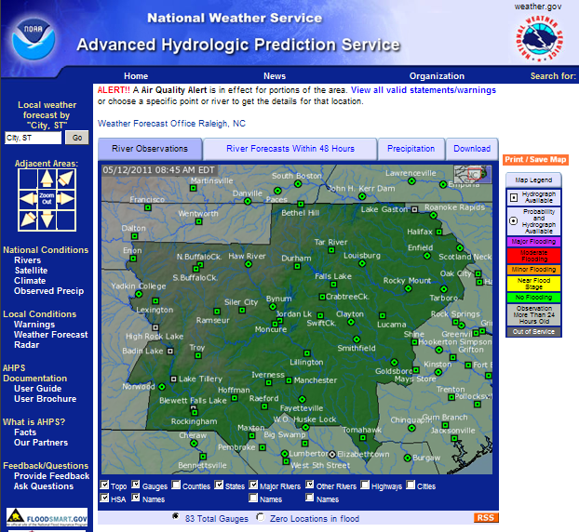

Slide 15
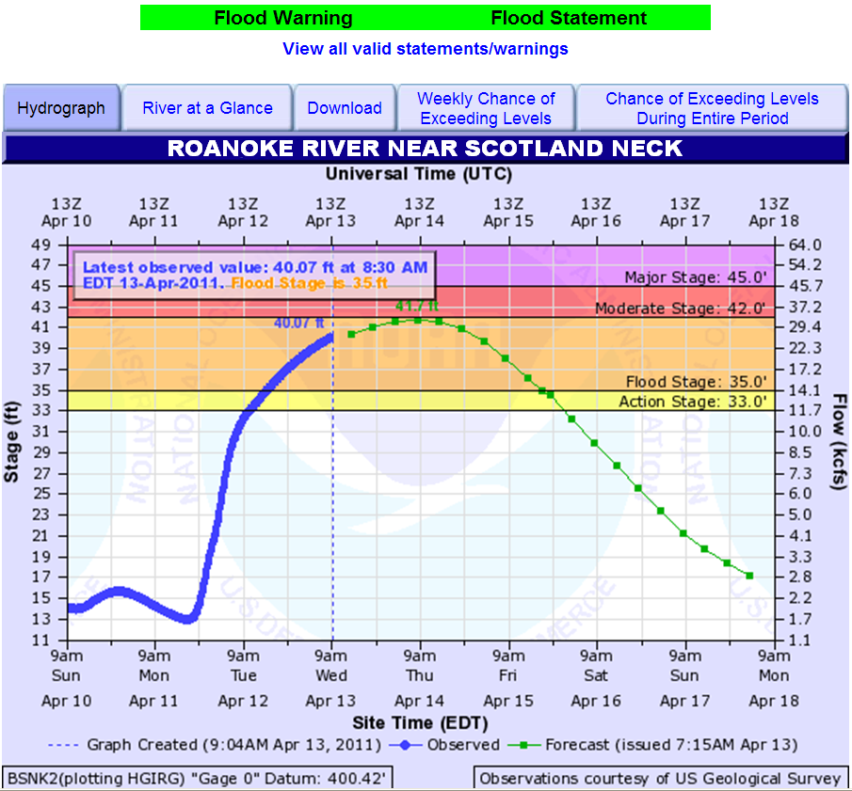

Slide 17
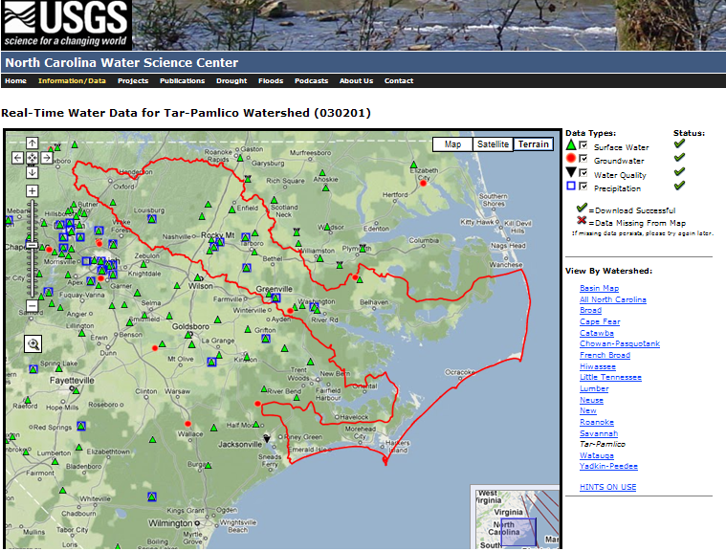

Slide 19
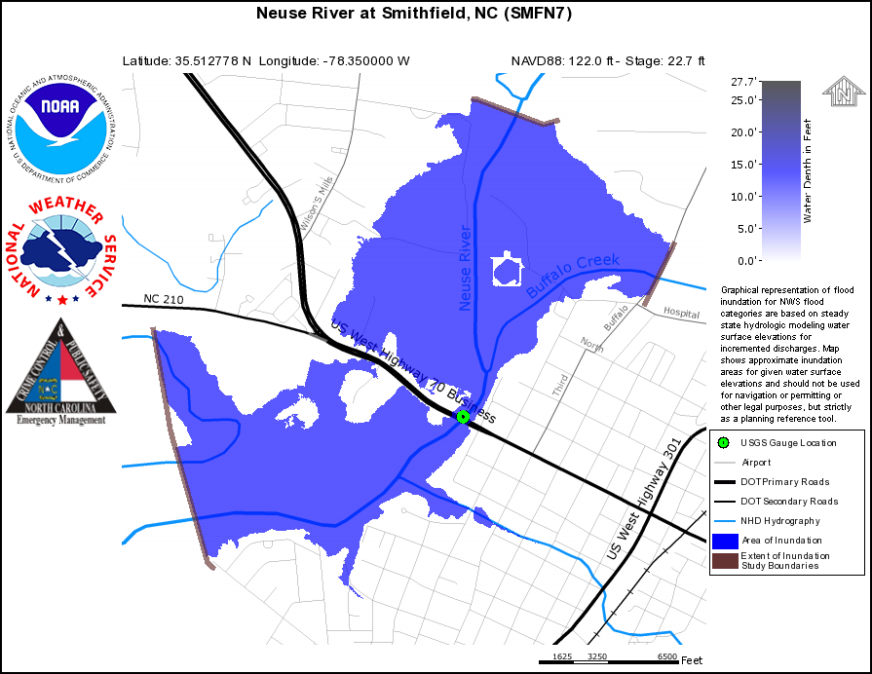
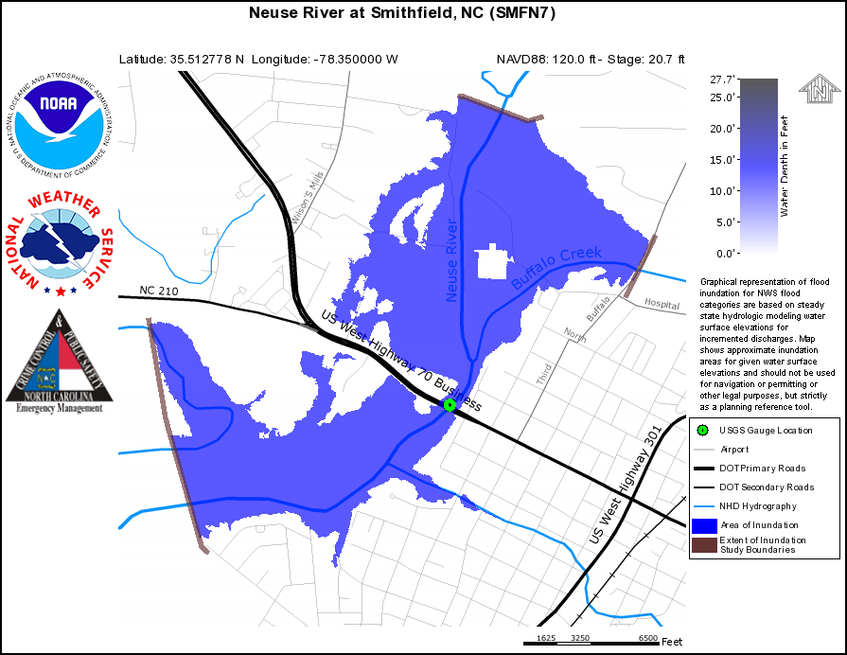
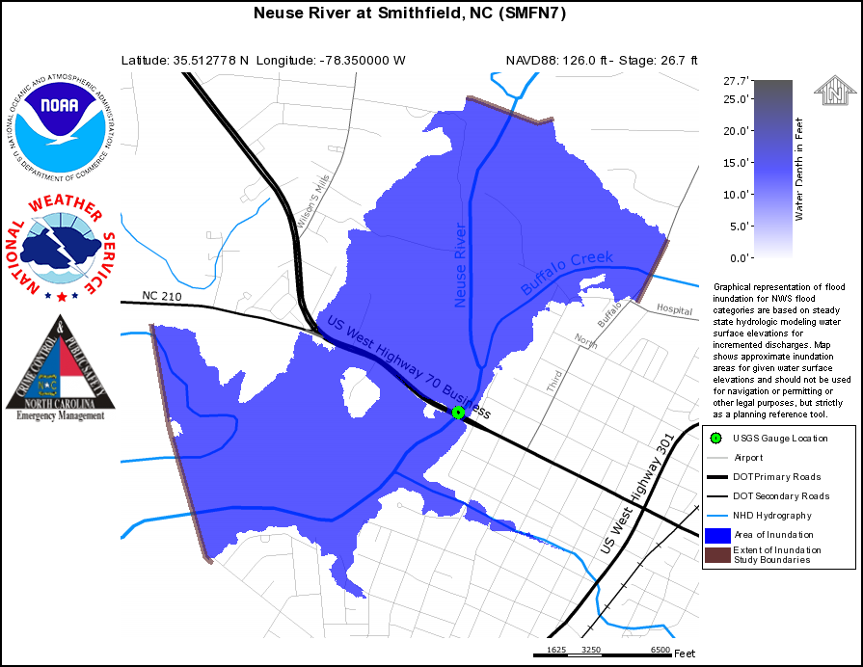
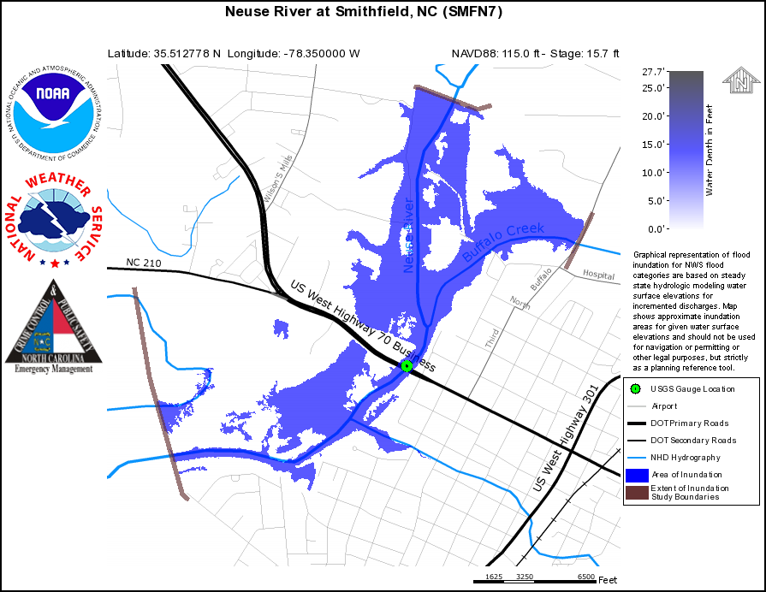
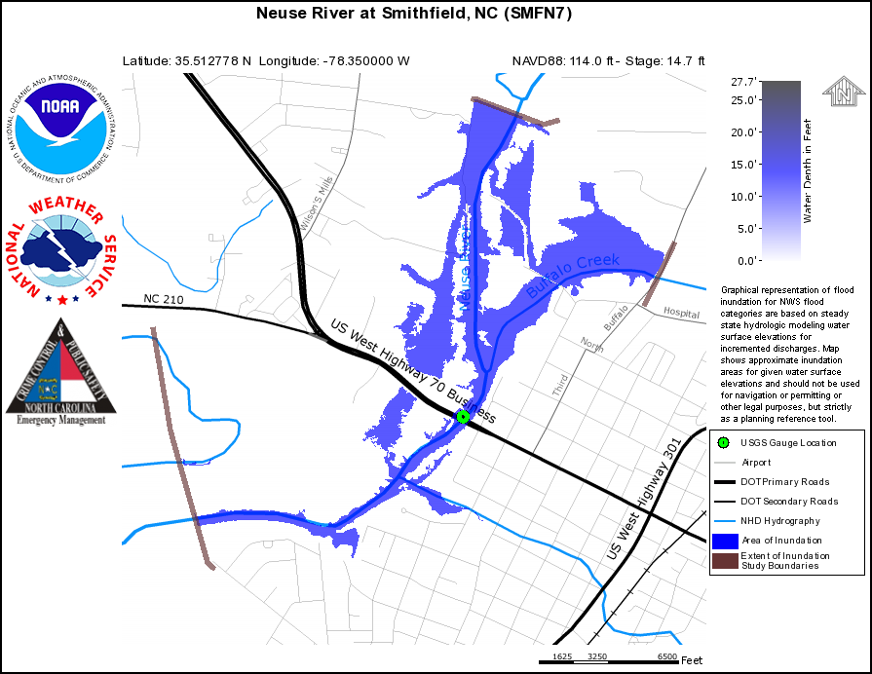
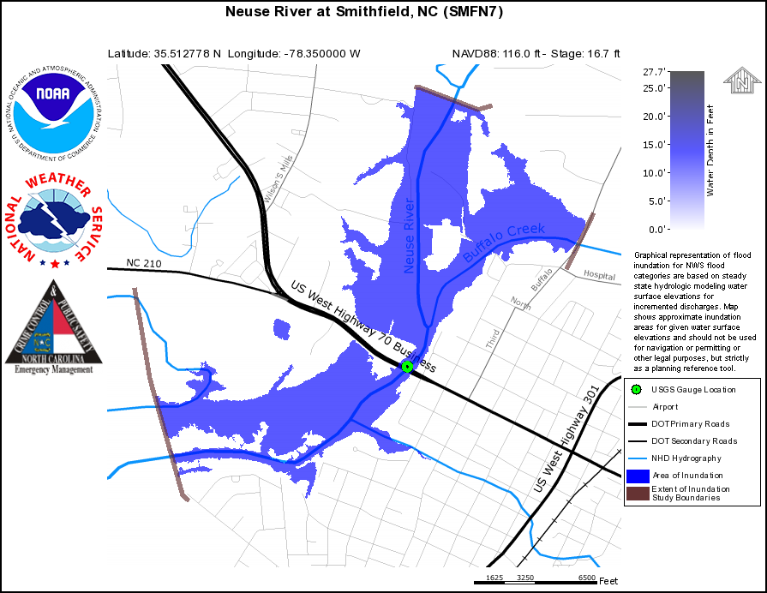
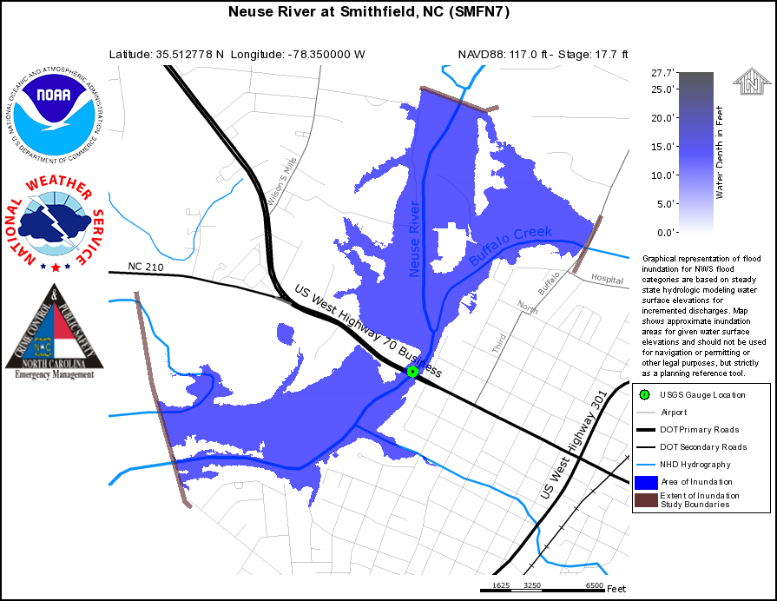
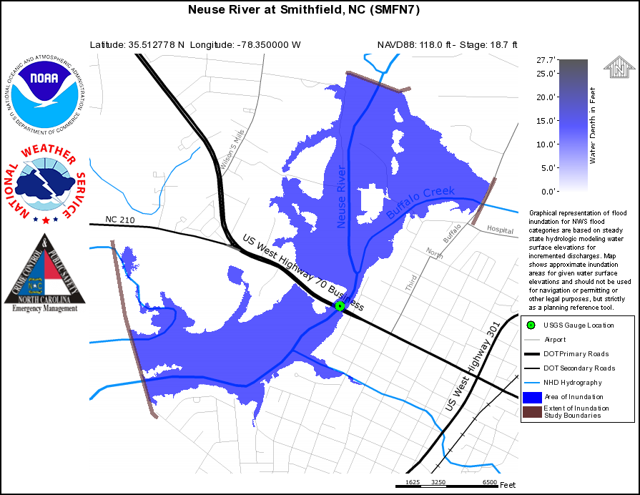
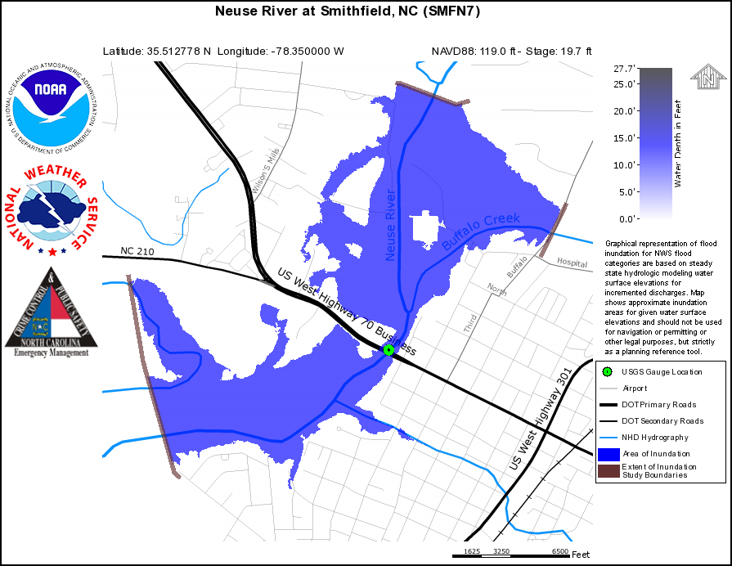
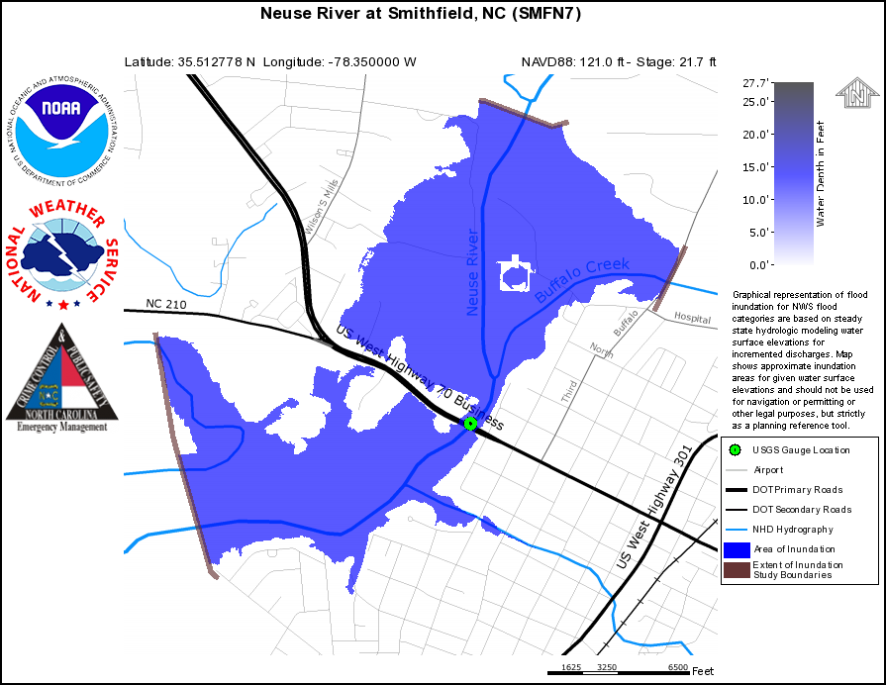
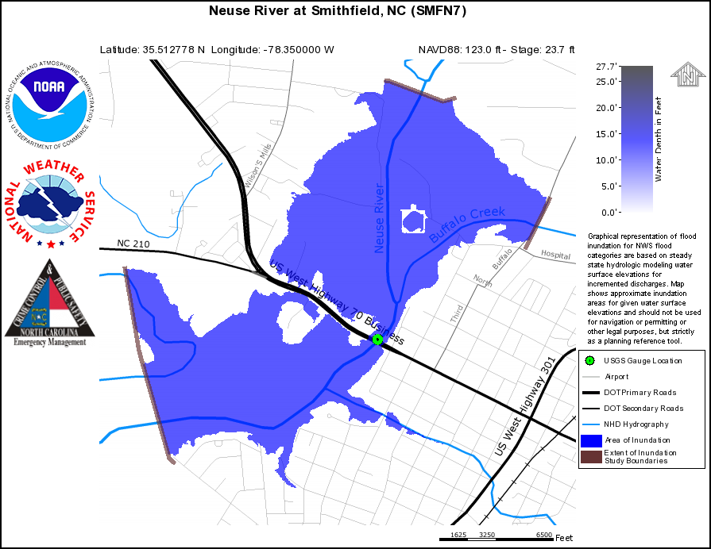
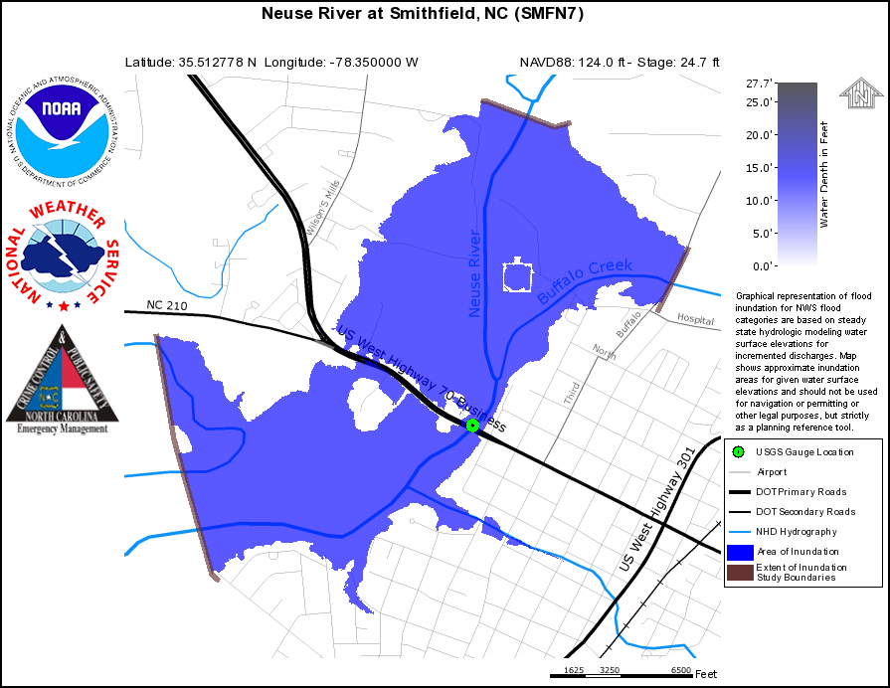
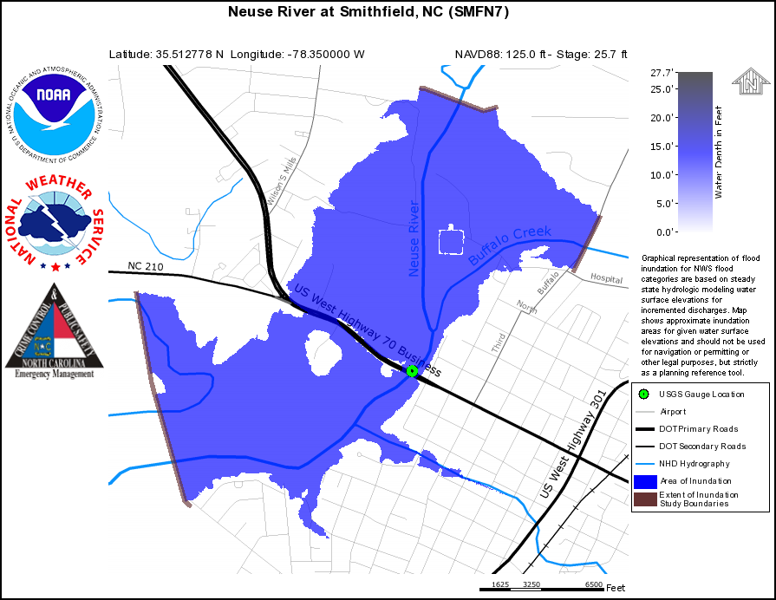
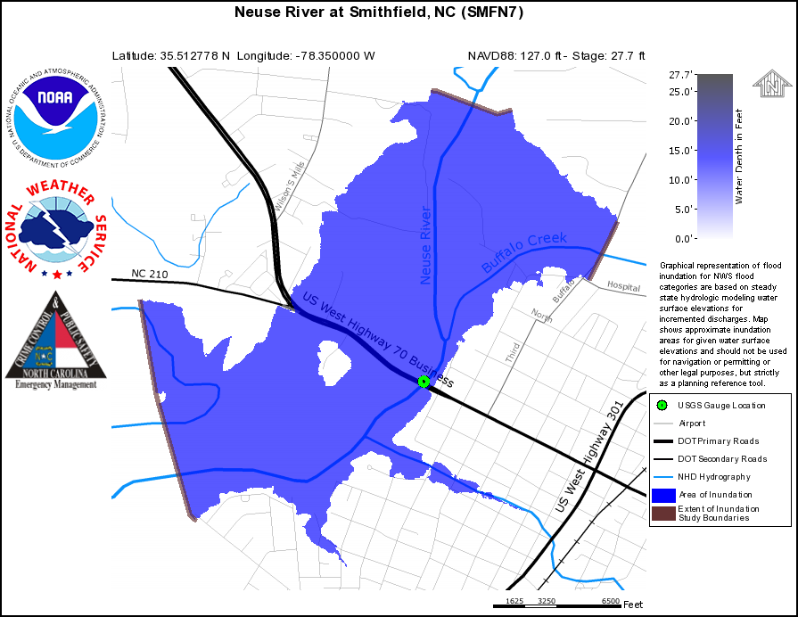

Slide 20
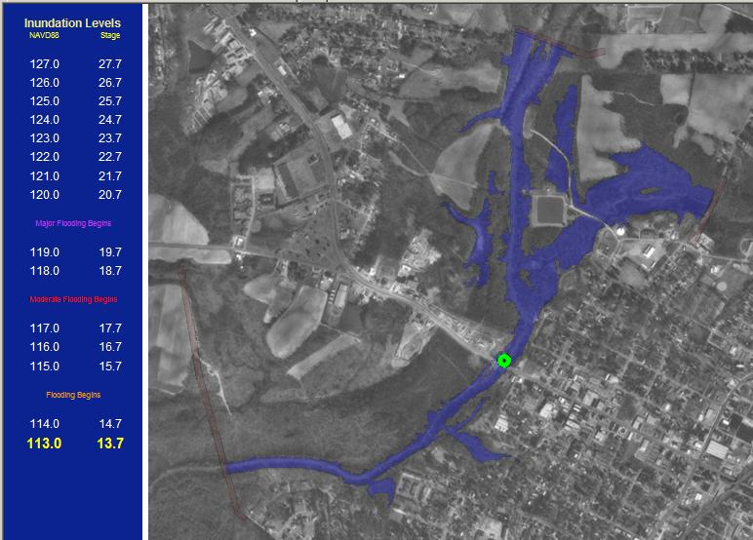
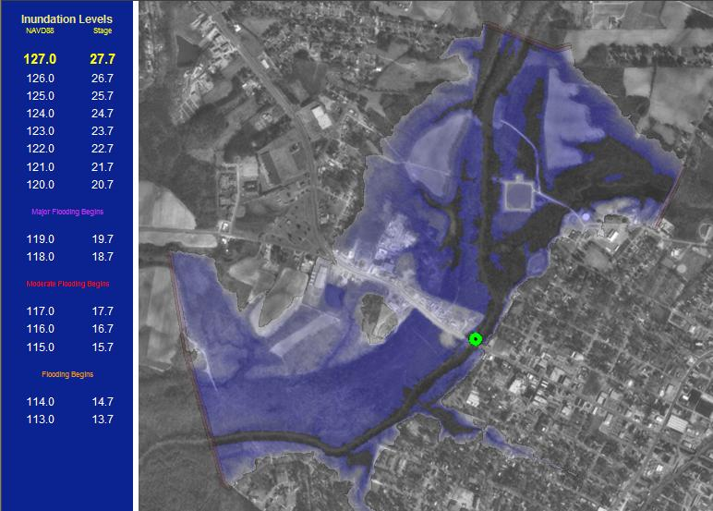
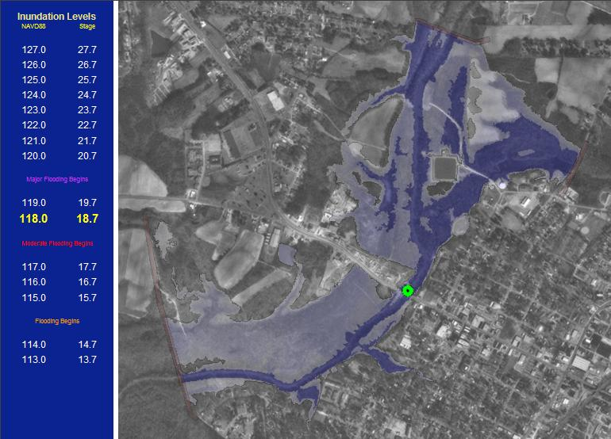
NWS Inundation Mapping

Slide 21
NC Flood Inundation
Mapping Network http://fiman.nc.gov
Available for sites other than NWS Forecast Points
Need to request a Login & Password

Slide 22
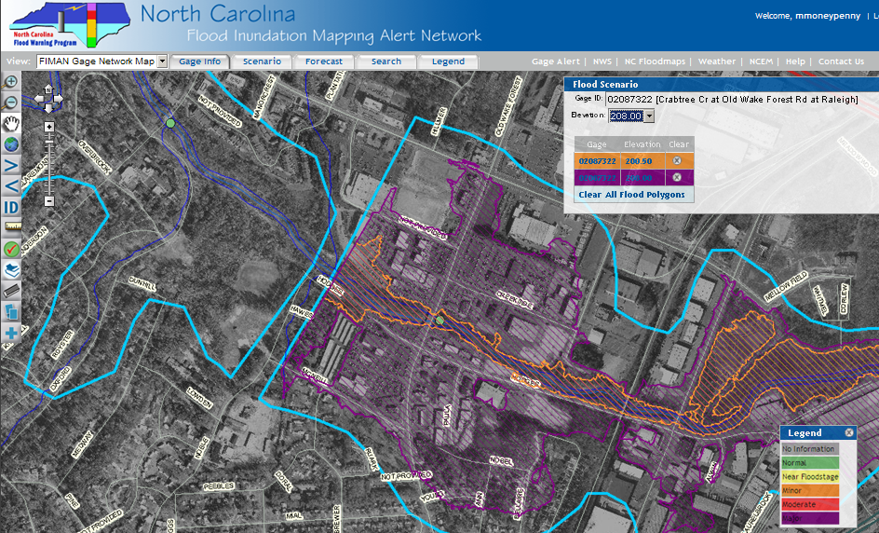
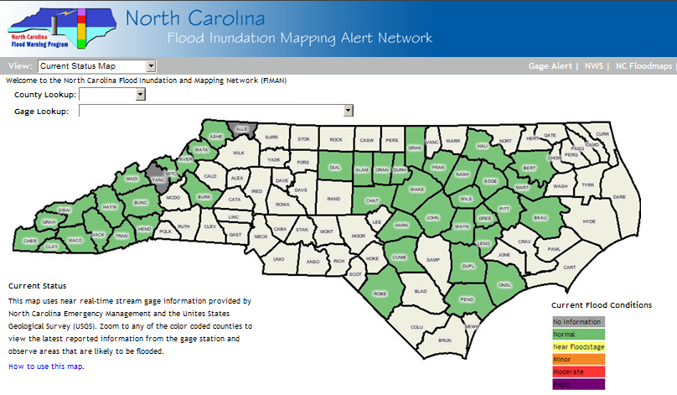
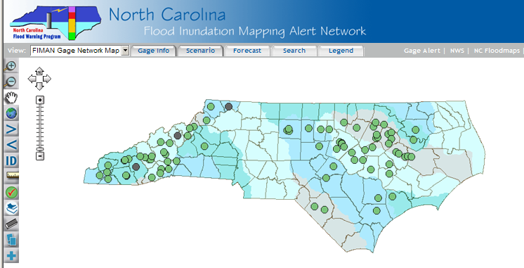
FIMAN

Slide 24
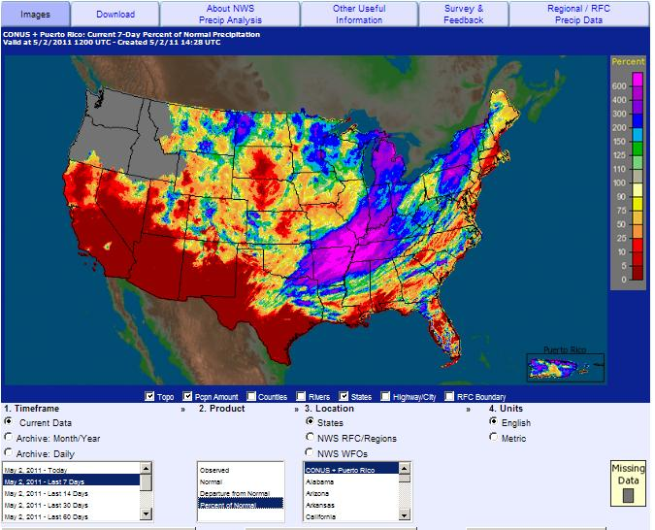
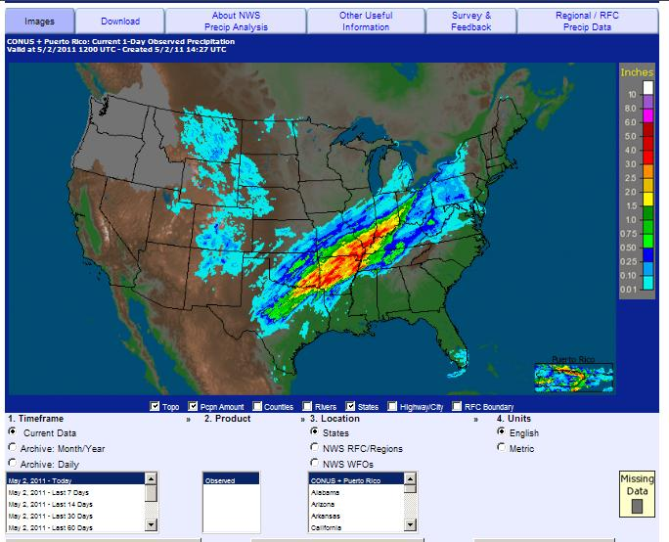
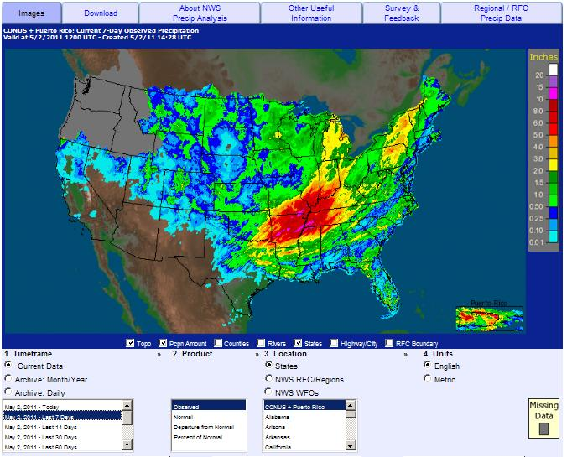
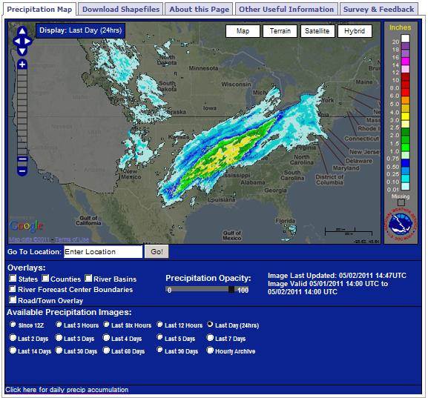
Observed Rainfall

Slide 26
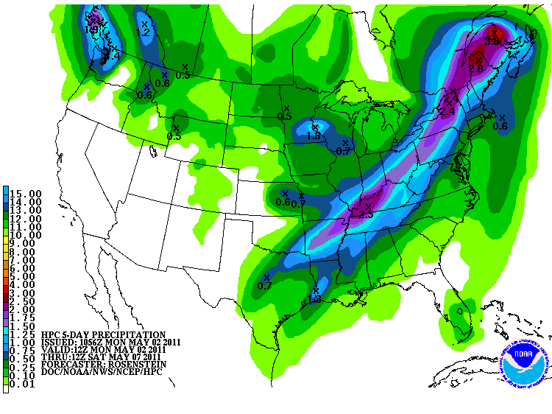
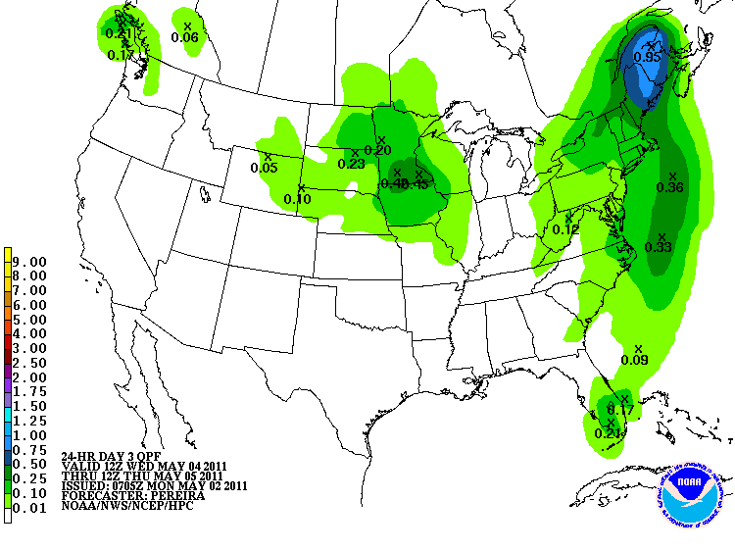
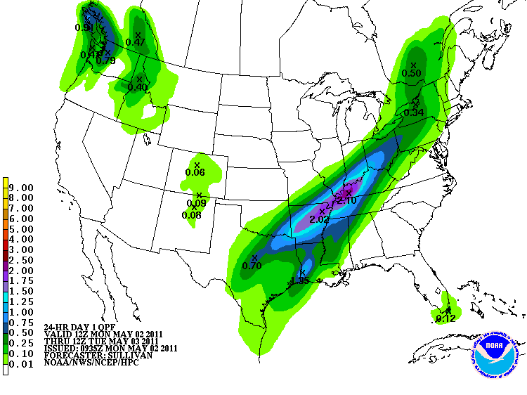
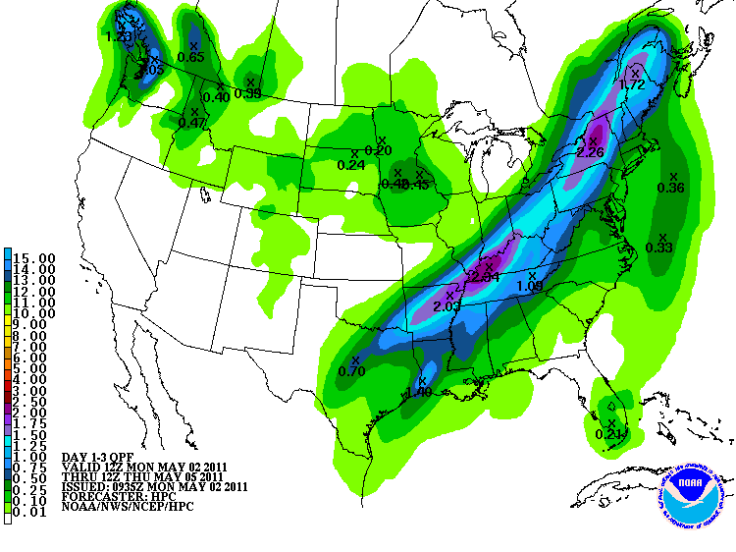
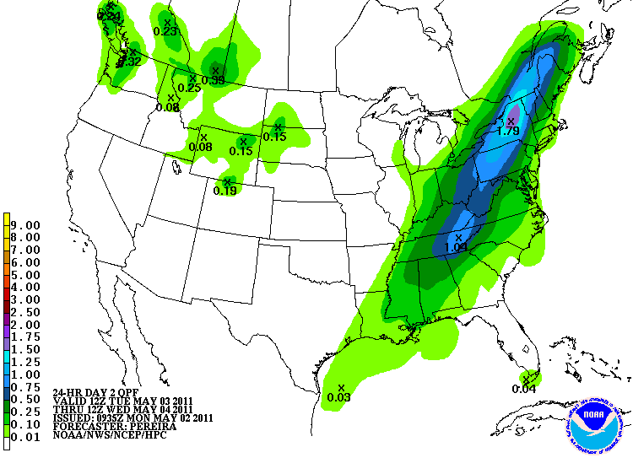
Forecast Rainfall

Slide 27
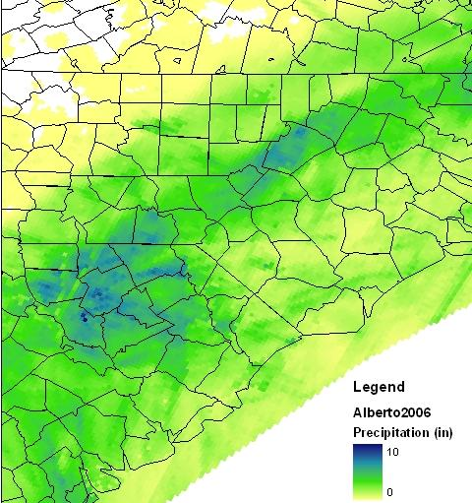
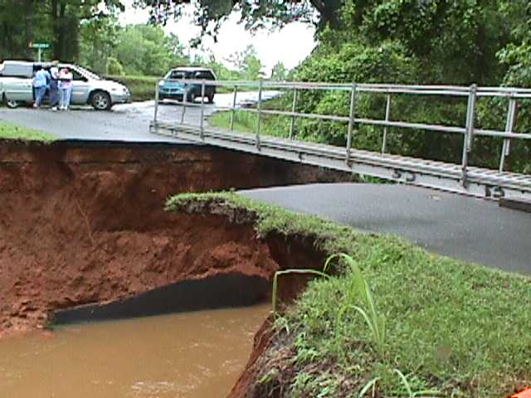
Factors Impacting Rainfall Distribution in Landfalling and Evolving Tropical Cyclones
Tropical Storm Alberto
Storm track and location
Time of day – core rainfall overnight/ outer band rainfall during day
Storm size – the bigger the storm, the more it rains at any given spot
Storm motion – slower moving storms typically produce more rain at any given spot
Nearby synoptic-scale features (i.e. fronts)
Heaviest rainfall usually occurs along and 75 miles either side of the storm track
Different with every system

Slide 28
It’s all about interactions!
Forecasting Schematic for Heavy Events

Slide 29
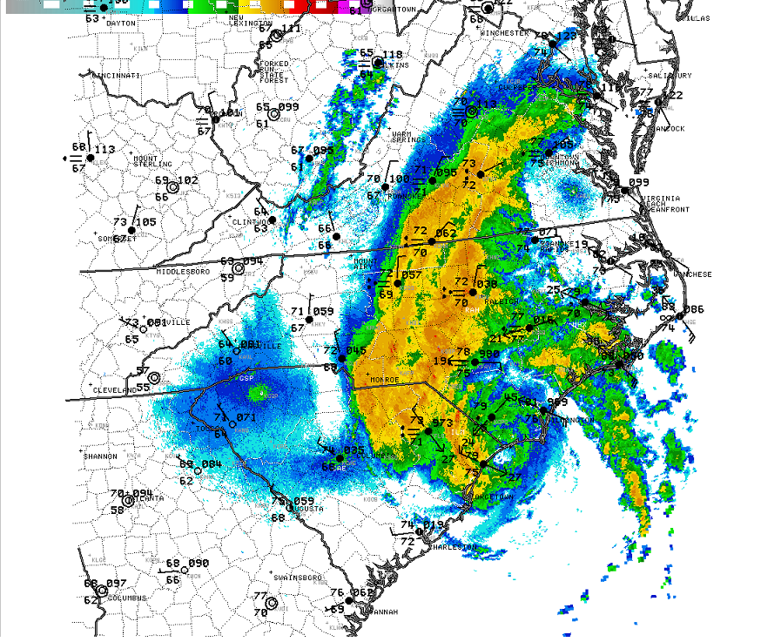
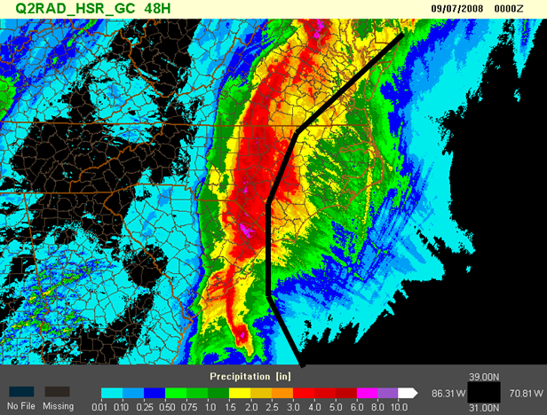
Hanna interacted with a cold front and upper level disturbance shifting the rainfall swath left of track.
Tropical Storm Hanna
72
83

Slide 30
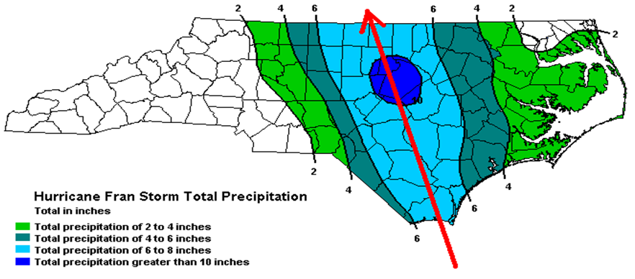


Hurricane Fran – Along Track Heavy Rainfall

Slide 31

Ernesto Example

Slide 33











Slide 35






Slide 37

Crest to Crest Relationships

Slide 39

MMEFS
Multi Meteorological Model Ensemble Forecast System
What is MMEFS?
Short-term Hydrologic Ensemble Forecasts generated from using the QPF values from the associated meteorological model ensemble data.

Slide 40

MMEFS
Multi Meteorological Model Ensemble Forecast System
How does MMEFS work?
Hydrologic Model
Meteorological Precipitation (QPF) Ensembles
Forecast
Streamflow Ensembles
No Forecaster Intervention

Slide 41
MMEFS
Multi Meteorological Model Ensemble Forecast System
Why do we have MMEFS
?
Uncertainty
our inability to know for sure
risk
Notes:
Why do we have MMEFS?
The answer is simply uncertainty. In any forecast, whether that be for the stock market or river forecasting…there is always a level of uncertainty…or risk that our expected value may differ from the true or observed value. The amount of uncertainty in a forecast can depend on one or more factors surrounding the forecast.

Slide 42

MMEFS
Multi Meteorological Model Ensemble Forecast System
Why do we have MMEFS?
Reservoirs?
Estimating Past Rainfall?
Stage to Flow Relationship?
Uncertainty in River Forecasting
What’s Upstream?
River Gage Observations?
Future Rainfall?
Extreme Forecasts?
Notes:
So to is true with river forecasting. When looking at the overall process of what goes into a river forecast there are many variables that pose risk to the ability of forecasting accurately. From the way reservoirs operate to estimating past and future precipitation and more…trying to perfectly predict a river stage on a routine basis can be a tough business. In addition…the ability to measure and convey the uncertainty surrounding a forecast can also be a valuable asset to the forecast.

Slide 43
MMEFS
Multi Meteorological Model Ensemble Forecast System
Why do we have MMEFS?
Reservoirs?
Estimating Past Rainfall?
Stage to Flow Relationship?
Uncertainty in River Forecasting
What’s Upstream?
River Gage Observations?
Future Rainfall?
Extreme Forecasts?
Notes:
The Multi Meteorological Model Ensemble Forecast System or MMEFS attempts to do this with one particular variable of the process….Future Rainfall. MMEFS as you would see better in the “What is MMEFS and How does it work Question” uses the multiple forecasts for future precipitation that is presented in the meteorological ensembles data to capture the uncertainty in both magnitude and timing of future precipitation. This difference thus translates into the streamflow forecast uncertainty. When the meteorological model ensembles show a wide spread of solutions and thus high uncertainty…the streamflow forecasts would also show this high uncertainty and vice versa.

Slide 44
MMEFS
Multi Meteorological Model Ensemble Forecast System
Why do we have MMEFS?
Uncertainty in River Forecasting
Future Rainfall?
MMEFS attempts to capture the uncertainty in both time and magnitude of the future precipitation and its influence on hydrologic response.
Notes:
This is the advantage of MMEFS and why we have it. It is not the official forecast which is the best estimate of the whole process but rather a forecast that can give us a feel for the potential for flooding beyond 2 days. It presents one insight into river flood risk based on the uncertainty of expected precipitation.

Slide 45

http://www.srh.noaa.gov/serfc/?n=mmefsfaq

