Slide 1



East Carolina University
Life History, Disease Salience, and the Behavioral Immune System
Emily Lagnese and Dr. Michael Baker
Department of Psychology, Thomas Harriot College of Arts and Sciences
Notes:
Life History, Disease Salience, and the Behavioral Immune System

Slide 2


LIFE HISTORY, DISEASE SALIENCE, & DISEASE AVOIDANCE
How would you respond if you knew you were about to meet someone who could be sick?
Page 02
Notes:
- How would you respond if you knew you were about to meet someone who could be sick?
- For example, what would you do if you were asked to set up two chairs in a room to meet someone for the first time after you just listened to an audio recording of them coughing?
This is what participants in our experiment were asked to do
- what we were interested in measuring was how a person's personality traits and life experiences can impact their behavioral response to this scenario

Slide 3

LIFE HISTORY, DISEASE SALIENCE, & DISEASE AVOIDANCE
Behavioral Immune System
  First line of defense against disease
  How a person acts to avoid getting sick
Page 03
Notes:
- Every person has what psychologists refer to as a behavioral immune system
- a preliminary line of defense against potential disease
- behaviors, prompted by the desire to stay healthy, that we as humans perform to avoid getting sick
- such as choosing not to sit next to a person who is coughing, sneezing, or exhibiting other signs of illness
- Emotions and personality traits each play a role in the individualized expression of disease avoidance

Slide 4

LIFE HISTORY, DISEASE SALIENCE, & DISEASE AVOIDANCE
Life History Theory
  Age
  Sex
  Relationship Status
  Parent Status
  Childhood Environmental Stability
Page 07
Notes:
Life history theory provides an evolutionary biology framework that psychologists use to understand the trade-offs that organisms make throughout their lives in order to successfully survive and reproduce
It considers the traits listed here, and how a person’s environment and life experiences can interact to influence how they weigh the costs and benefits of each decision they make
childhood unpredictability, one of life history traits, can impact a person's sense of control over the outcome of their behaviors

Slide 5
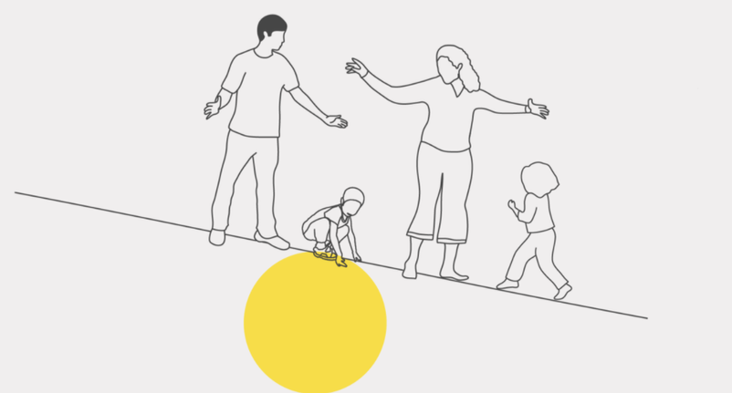
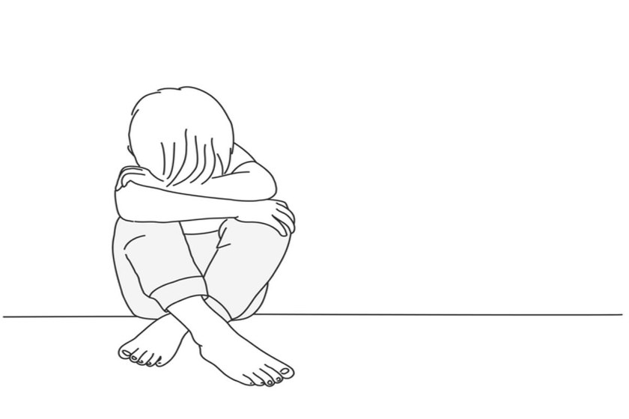
LIFE HISTORY, DISEASE SALIENCE, & DISEASE AVOIDANCE
Childhood Unpredictability
Predictable Environment
  Consistent caregiver(s) at home
  Family life was generally consistent and predictable from day-to-day
Unpredictable Environment
  Often chaotic at home
  Could not predict which of many caretakers (e.g., babysitters, nannies, neighbors, family) would be home
Page 08
Notes:
- Childhood unpredictability can be characterized as an unstable and inconsistent household environment
- Stability enables the development of healthy adult attributes and social skills, while instability can negatively impact a person's functional abilities well into adulthood
- Unstable environments can lead to difficulties in developing physical, emotional, and social skills
- While there is variance in what individuals perceive to be stable and consistent home lives, measures of unpredictability attempt to understand the impact that regular inconsistencies in a person’s childhood environment can have on them as an adult, which can be evident in the decisions and trade-offs they make

Slide 6
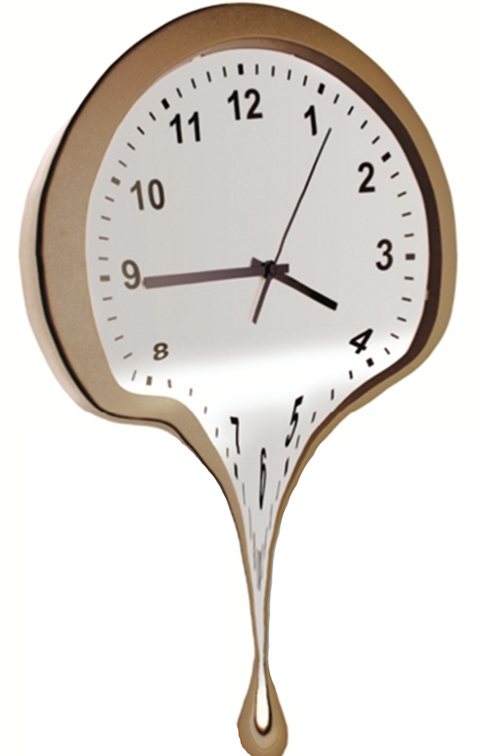
LIFE HISTORY, DISEASE SALIENCE, & DISEASE AVOIDANCE
Time Perspective Theory
  Past Negative: past negative experiences influence someone to focus on the good they missed out on
  Past Positive: connects family, identity, and self; a very nostalgic view of one’s past
  Present Fatalistic: doesn’t matter what you do, life happens to you, and you have little control over what happens to you
  Present Hedonistic: focuses on life’s pleasures
  Future: looking forward to future challenges and goals
Page 04
Notes:
- Each person also has an individualized view of time, called time perspective
- theory suggests that a person’s past experiences unconsciously influence their present and future decision-making skills
- five perspectives, broken down into three different time categories: past, present, and future
- For some, decisions are always past-oriented: they base their decisions on memories of past experiences and solely rely on previous outcomes to make choices
- For others, decisions are present-oriented: what can I get right now?
- People who are future-oriented are focused on what will be: they concentrate on anticipated consequences or rewards
- The past and present categories are then broken down into two different perspectives, positive and negative, as you can see here, resulting in five individual time perspectives

Slide 7

LIFE HISTORY, DISEASE SALIENCE, & DISEASE AVOIDANCE
Fundamental Social Motives
  Self-Protection: motivation to defend oneself against aggression
  Disease Avoidance: motivation to avoid contagion
  Affiliation: need to belong
  Status-Seeking: dominance and prestige
  Mate Acquisition: get into relationship
  Mate Retention: maintain relationship
  Kin Care: take care of family
Page 05
Notes:
- When placed into social situations, there are distinct behaviors people perform in order to gain something from that social interaction
- how do humans behave in order to reach these social goals listed here?
- The fundamental social motives inventory attempts to measure the individual differences in levels of motivation each person presents in a social situation
- The fundamental social motives also suggest that human behaviors (when in social settings) can be influenced by personality traits and past experiences, and even help predict future decision making

Slide 8

LIFE HISTORY, DISEASE SALIENCE, & DISEASE AVOIDANCE
Disease Avoidance
  High Risk vs. Low Risk
  Decisions regarding health
Page 06
Notes:
- Disease avoidance, one of the fundamental social motives, is both a conscious and subconscious behavioral response which incorporates an individual’s understanding of risk-taking and its correlation to the future reward
- For example, if you have low levels of disease avoidance, you are more likely to take risks with your health, prioritizing the instant gratification of engaging in social events over the possible future costs of getting sick

Slide 9
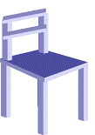

LIFE HISTORY, DISEASE SALIENCE, & DISEASE AVOIDANCE
Methods and Procedure
Voice Introduction
Chairs
Questionnaires
Control Condition: no coughing introduction
Experimental Condition: same introduction but with frequent coughing
Fundamental Social Motives
Time Perspective
Childhood Unpredictability
Life History
Page 09
Notes:
Now, think back to my initial hypothetical situation in which you were about to meet a potentially sick individual
How could your time perspective, fundamental social motives, and life history impact your behavioral immune system’s response to meeting someone who could be sick? How do these measures influence your levels of disease avoidance?
That is exactly what we were hoping to find out
- We developed an experiment in which we brought participants into a lab and told them a cover story → that they were going to be a part of a study about first impressions. Participants were told that there was another participant down the hall, and that they would be meeting them after each person created either a written or audio introduction for the other to read or listen to
Each participant was actually presented with either the control condition, a pre-recorded introduction participants listened to where another person plainly introduced themselves, or the experimental condition, the same audio introduction, except this time, the person was consistently coughing
Here is a clip from the experimental condition PLAY
After participants listened to the voice introduction, they were asked to set up two chairs in the room that were pushed up against a wall, that would be used for them and the other participant when they came to the room to meet one another
- The disease salience manipulation, coughing, served as the manipulated independent variable
- Participants’ behavioral immune response served as the dependent variable, which we attempted to measure by measuring the distance between the chairs that participants were asked to arrange
- We believed that a greater chair distance MOVE CHAIRS would indicate high levels of disease avoidance, and a lesser chair distance would indicate low levels of disease avoidance
- Basically, if you don’t want to get sick after listening to someone cough their way through an introduction, you’ll most likely set the chairs up far apart. If you aren’t as concerned about getting sick, you’ll place them closer together
- After moving the chairs, participants completed the questionnaires listed and then were dehoaxed

Slide 10
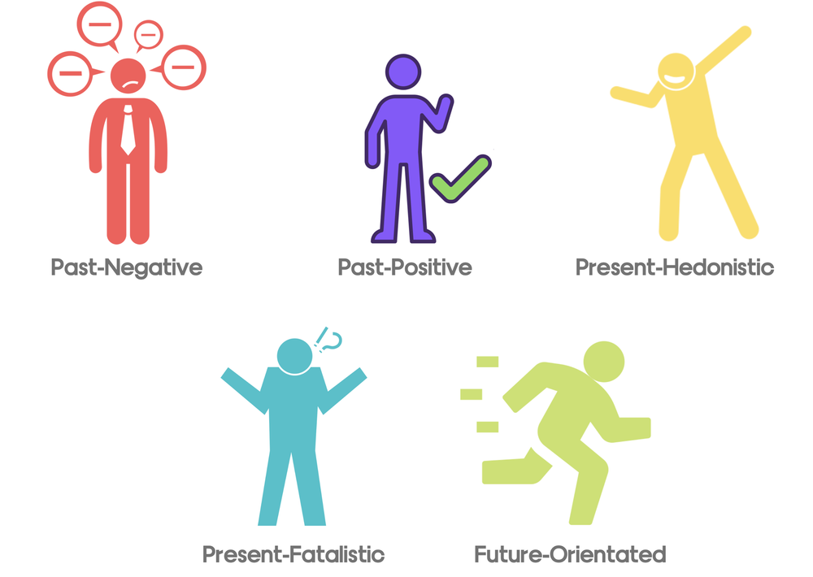

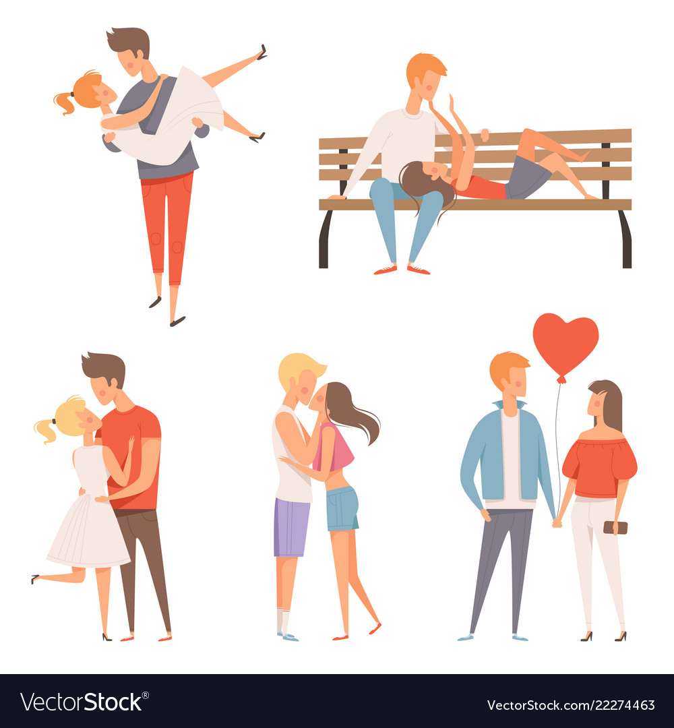
LIFE HISTORY, DISEASE SALIENCE, & DISEASE AVOIDANCE
Hypotheses
Mate Seeking Motivation
Present Fatalism Time Perspective
Childhood Unpredictability
Page 10
Notes:
- We hypothesized that a person high in present fatalism, the negative present time perspective in which individuals believe themselves to be “helpless” and have little control over the outcome of their life, would present low levels of disease avoidance in the experimental conditions because they do not feel they have control over whether they will get sick
We also predicted that participants who have high levels of mate-seeking motivation, the fundamental social motive that involves finding a partner, would display low levels of disease avoidance, due to their prioritization of mating over health
Lastly, we hypothesized that participants who had high levels of childhood unpredictability would present low levels of disease avoidance because a person who grew up in an unpredictable environment would not believe themselves to have much control over the outcome of situations

Slide 11
LIFE HISTORY, DISEASE SALIENCE, & DISEASE AVOIDANCE
Present Fatalism Time Perspective
Results
  (F(3, 250)) = 1.427, p < .235
  R = .017
2
No significant main effect or interaction of disease avoidance motives, childhood unpredictability, and disease salience on chair distance
Mate Seeking Motivation
  (F(3, 250)) = .402, p < .752
  R = .005
2
  Total (n = 257) undergraduate participants
    26.8% identified as male
    64.2% identified as female
    8.5% chose not to report their gender identity
    1 genderqueer individual
  Standard Deviation (SD) = 1.985
  Medium-size effect (d = 0.5)
Childhood Unpredictability
  (F(3, 250)) = .619, p < .007
  R = .007
2
Page 11
Notes:
- unfortunately, after collecting data from 257 total participants, none of our predictions were supported by the data. all the multiple linear regressions I calculated did not yield significant interactions between each variable
- the results are listed here
- it is possible that age was a limitation in our study → 89% of our participants were 18-20 year olds
- there was also a significant gender imbalance. There were more than twice as many females than male participants. if we wanted to study sex differences, we would not have had enough male participants to accurately represent that population
- another possible limitation of this study was the strength of the manipulation. if the coughing was not a strong enough effect, participants might not have related coughing to a potential contagion. the disease salience cue could have had no impact at all on chair distance
- Another possible limitation could have been if a type two error occurred, and we simply failed to find an effect. this could be due to our manipulation not being strong enough, an insufficient sample size, OR there was an effect but it was too small to find
- despite not finding significant main effects in our initial hypotheses, we did conduct an exploratory analysis

Slide 12

LIFE HISTORY, DISEASE SALIENCE, & DISEASE AVOIDANCE
Exploratory Analysis
Mate Retention Motivation
  (F(3, 95)) = .3.400, p < .021
  R = .097
  Participants' chair distance increased by .572 meters (1.88 feet) as a function of the condition in which they were assigned
2
Significant interaction between mate retention motivation and disease salience on chair distance
  "It is important to me that my partner is emotionally loyal to me"
  "If others were romantically interested in my partner, it would bother me"
  Mate Retention only measured in participants in a relationship
Page 12
Notes:
- the exploratory analysis revealed a significant correlation between mate retention motivation, one of the fundamental social motives, and chair distance.
- mate retention motivates indicate how invested in and how attached a person is to their current relationship
and can also relate to a person's relationship attachment style
- the results from our exploratory study reveal that participants who scored high in mate retention motives placed their chairs farther apart in the experimental condition than individuals who did not score high in mate retention
- These results do not apply to the whole sample, as there were fewer participants in this analysis because mate retention was only measured in people who were in a relationship at the time of the study
- because this is an exploratory analysis as opposed to an apriori prediction it's important to be cautious in how we interpret it. This is not causal, just correlational
- however, these results could indicate a correlation between being in a relationship and being highly motivated to maintain that relationship, therefore being more cognizant of potential threats to one’s immune system and behaving in a way that will avoid getting sick

Slide 13
LIFE HISTORY, DISEASE SALIENCE, & DISEASE AVOIDANCE
Acknowledgements
Dr. Michael Baker
Grace Roberts
Kayla Cooper
Gwen Metrey
Mykala Black
Charlie Collins
Ian Hope
Ashton Perret-Gentil
Page 13
Notes:
I would like to thank my research advisor and mentor, Dr. Baker, and my fellow research lab members

Slide 14
Questions?
Notes:
lastly, I would like to thank you, the audience, for your time and attention.

