Slide 1
Developing Engaged Citizens
Through Service:
Innovative Models for Reflection and Dialogue
Megan Farley
Christina Harrison
Dennis McCunney
Kursten Pickup

Slide 2
Presentation Goals
Share history of reflection practices facilitated by Loyola Center for Community Service & Justice
Show results of program evaluation and implementation of new reflection model and discuss tentative conclusions
Simulate one component of a facilitated reflection
Share a community partner perspective on witnessing student learning through reflection

Slide 3
Approaching the Problem
A reflection working group was formed to address concerns about attendance, quality, and overall participation in reflection. The committee set out to:
Examine models and theories of learning through experience and reflection
Evaluate current reflection and educational model
Develop goals for the new reflection model
Develop/outline a plan for implementation

Slide 4
Theoretical Background
Experiential Education/John Dewey:
We learn from every experience—whether positive or negative
“I had the experience, but I missed the meaning.”
Educative experience: when critical reflective thought creates new meaning, leading to growth & ability to take action
Notes:
Christina

Slide 5
Theoretical Background (cont.)
David Kolb and Kurt Lewin:
concrete experience → reflective observation → abstract conceptualization → active experimentation
Borton’s Reflective Model:
What? (identify, describe, self-awareness)
So What? (analyze, evaluate)
Now What? (synthesize, plan action)
Notes:
Christina

Slide 6
Goal: Critical Consciousness
Deeper awareness of self
Deeper awareness of & perspective of others
Deeper awareness of & perspective of social issues
Awareness of potential to make change
Social justice orientation (vs. charity)
**Rooted in the work of Paolo Freire
Notes:
CHRISTINA

Slide 7
Reflection
The process by which participants mentally and emotionally synthesize direct service and the learning components
Active, persistent and careful consideration of any belief or supposed knowledge in the light of the grounds that support it. (John Dewey)
Notes:
CHRISTINA

Slide 8
Conclusions of Reflection Working Group
Need to build in reflection as an integral and essential component of service—no apologies
Need to redefine “reflection” for students or avoid the word
Service is a responsibility and a privilege
Notes:
CHRISTINA

Slide 9

The Service Thing
Biweekly Community Questions
Ongoing Service
Enroll
Kick-off
Group Reflections
Preparation
Mid-semester
Final
Celebration of Service
Evaluation
*New model implemented in Fall 2010
Notes:
DENNIS

Slide 10
Reflection Structure
Three group reflections each semester; Facilitated by student leaders
  Opening
  What?
  So What?
  Now What?
  Closing
Biweekly community questions
  Online but private for group members
  Questions provided to student leaders
Notes:
MEGAN

Slide 11
Reflection Attendance: Former Model
Random sampling of sites and semesters
Notes:
MEGAN

Slide 12
Reflection Attendance: New Model
Random sampling of sites; data from first semester of implementation
Notes:
MEGAN

Slide 13
Learning Outcomes: Former Model
**Fall 2009 Data; 161 respondents
My community service experience . . .
[A great deal] [Some] [Only a little] [Not at all]
...allowed me to become an active member in my community.
62.7% (101) 33.5% (54) 2.5% (4) 1.2% (2) 161
...increased my sense of social responsibility.
69.6% (112) 26.1% (42) 4.3% (7) 0.0% (0) 161
...increased my understanding of the Jesuit value of "men and women for and with others."
64.0% (103) 28.0% (45) 5.6% (9) 2.5% (4) 161
...gave me skills that I can use in my future career.
53.4% (86) 33.5% (54) 10.6% (17) 2.5% (4) 161
...caused me to reflect on my faith and/or spirituality.
32.9% (53) 31.1% (50) 21.7% (35) 14.3% (23) 161
...caused me to think about some ideas or points of view that I had never considered.
58.4% (94) 31.7% (51) 8.1% (13) 1.9% (3) 161
...enhanced my ability to think reflectively.
43.5% (70) 39.1% (63) 11.2% (18) 6.2% (10) 161
...helped me recognize the inherent value and dignity of each person.
71.4% (115) 24.2% (39) 4.3% (7) 0.0% (0) 161
Notes:
MEGAN

Slide 14
Learning Outcomes: New Model
Notes:
MEGAN

Slide 15
Learning Outcomes: Former Model
On Reflections: “This semester it was with the Caroline Center group. It was not as largely attended as it was last semester. I felt like it would have been better to have more people present. However, it was nice to hear about the experiences of the people and to talk about what we encountered and what we felt about their situations.”
On Awareness: “I already knew that there were people in these situations and felt for them. However, actually being at the center let me make connections on a more personal level. When these people are your “friends”, it is harder to see them struggle and you want to do anything you can to help them. You know that you can impart knowledge on them, and you just wish that you could make it easier for them. But sometimes you can’t and you have to accept it, which is the hardest part.”
On Connecting The Dots: “I attended two reflections during my service experience. Both were excellent ways to reflect and comment upon the broader topic of education and draw parallels between trends in education - discovering ways to lessen the achievement gap, charter school education, racial influences in education- and my tutoring experience at Cristo Rey.”
Notes:
MEGAN

Slide 16
Learning Outcomes: New Model
**The data show consistent themes of: 1) Expanded awareness about social issues, 2) Expanded awareness about people in Baltimore, 3) Inspiration to respond to social problems, 4) Awareness about stereotypes and injustices
On Reflections: “This semester it was with the Caroline Center group. It was not as largely attended as it was last semester. I felt like it would have been better to have more people present. However, it was nice to hear about the experiences of the people and to talk about what we encountered and what we felt about their situations.”
On Awareness: “My work with RYP has truly affected the way I view Baltimore, the idea of community, and my own goals and spirituality and so much more.
On Connecting The Dots: “I attended two reflections during my service experience. Both were excellent ways to reflect and comment upon the broader topic of education and draw parallels between trends in education - discovering ways to lessen the achievement gap, charter school education, racial influences in education- and my tutoring experience at Cristo Rey.”
Notes:
MEGAN

Slide 17
Student Leaders: Former Model
Difficulty of creating a challenging and open space:
”Reflections my first year were safer, maybe because of my confidence level... Later I felt like I had better facilitation skills”
“A typical reflection had some students who were interested but shy, some who were too vocal, some who were comfortable, some who were there only to get their service learning hours, etc. I think this dynamic was compounded by the fact that the students weren’t all comfortable with one another or used to reflecting; it wasn’t always possible to really delve deeply into students’ experiences in one evening.”
Frequency:
“I think the conversations didn’t go as deep as they could have because the reflections were only held once a semester, not all the volunteers knew each other before sitting down together, and it was sometimes a person’s first reflection. While the reflections served an important purpose, they could have done more.”
Attendance, Participation, and Appreciation of Structure:
“Before TST, attendance seemed to be low no matter what I did.”
Notes:
MEGAN

Slide 18
Student Leaders: New Model
Participation and engagement were strong:
“I never had a problem getting people to participate, and my experience as a reflection leader changed my view on how important it really was”
Confidence as a facilitator:
“I had a different experience as just a participant... but when I became a reflection leader -- being responsible for it -- I had a totally different perspective on the importance of reflection as part of the process”
“As a first year leader, first I was nervous and not sure what to do, and I relied a lot on the resources we were given in training, so I followed step by step and then I could slowly add my own stamp.”
Structure provides accountability as well as freedom:
“Having the structure to start provided comfort that was helpful”
Notes:
MEGAN

Slide 19
Some Tentative Conclusions
Students come to recognize the importance of community
  Developing relationships
  Sharing ideas with one another
  Learning and growing together
Students find meaning through “connecting the dots” between their experience and the broader context
Substance was not significantly different, but attendance was much higher (so more could participate, engage, and benefit!)
New structure gave student leaders confidence to be creative
New structure has forced us to use available data because we have more of it
Notes:
MEGAN

Slide 20
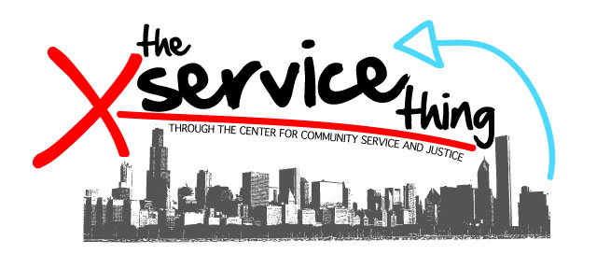
Reflection Simulation – “So What?”
Notes:
MEGAN

Slide 21
Community Partner Observations
Notes:
MEGAN

Slide 22
Questions, Comments and Discussion
Notes:
MEGAN

Slide 23
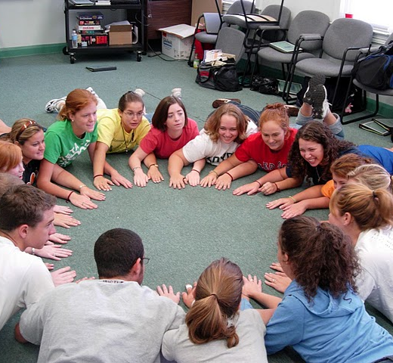
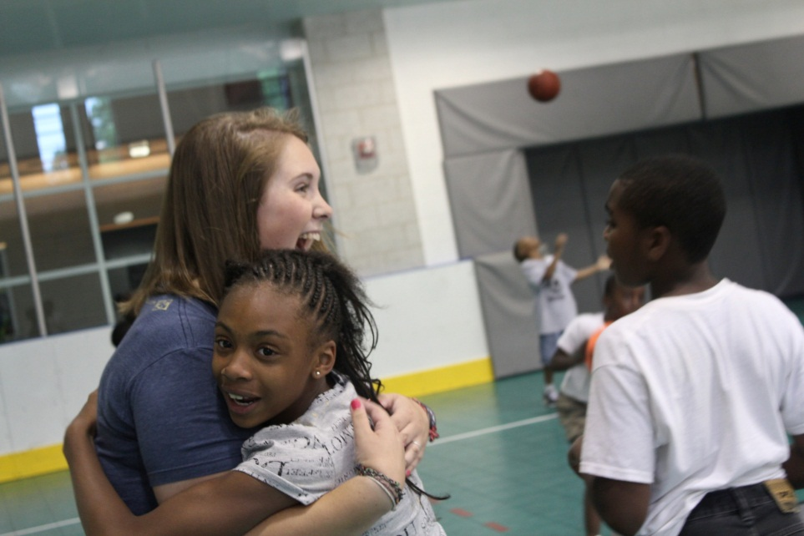
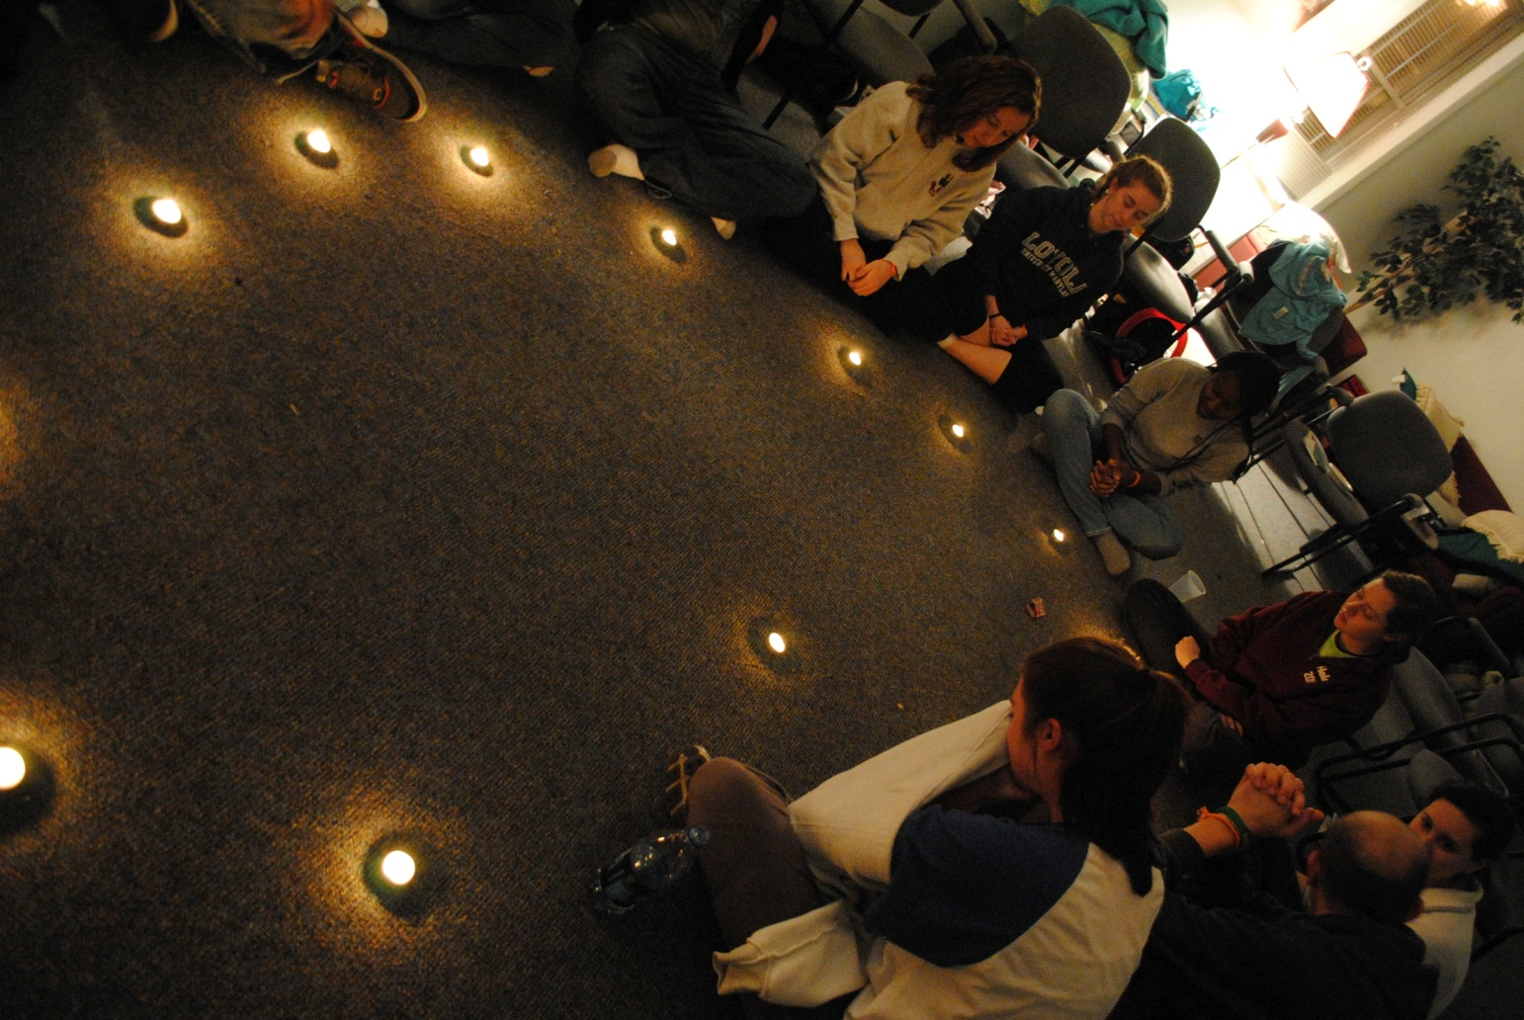
"Picture in your mind the thousands of graduates we send forth from our Jesuit universities every year. How many of those who leave our institutions do so with both professional competence and the experience of having, in some way during their time with us, a depth of engagement with reality that transforms them at their deepest core? What more do we need to do ensure that we are not simply populating the world with bright and skilled superficialities?"
-Adolfo Nicolas, S.J., Superior General of the Society of Jesus
Notes:
MEGAN- Build your own Reflection Activity

Slide 24
"In Jesuit education, the depth of learning and imagination encompasses and integrates intellectual rigor with reflection on the experience of reality together with the creative imagination to work toward constructing a more humane, just, sustainable, and faith-filled world.
-Adolfo Nicolas, S.J.
Notes:
MEGAN- Build your own Reflection Activity

