Slide 1
Particle motion and sound propagation near boundaries
Mark W. Sprague, Phillip DeVille, and Joseph J. Luczkovich
East Carolina University
Greenville, NC, USA

Slide 2
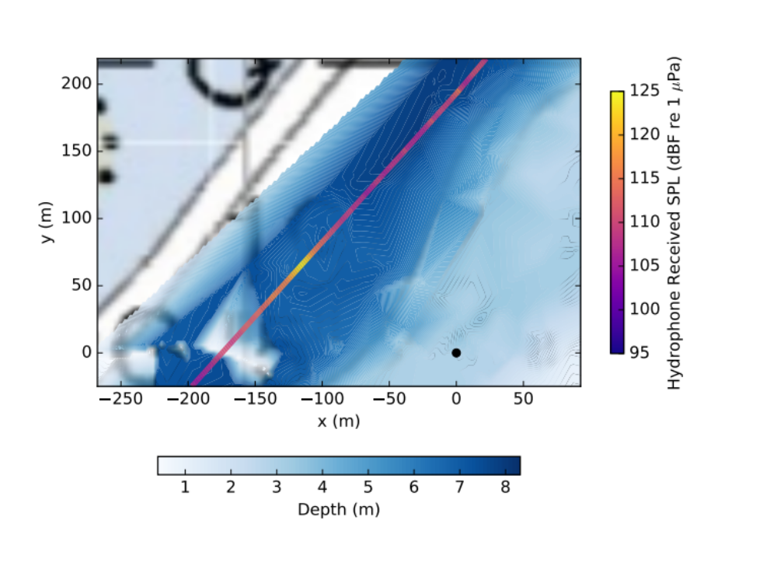
Fish in very shallow water (depth ≤ 10 m)
Boundaries affect sound propagation
Pressure/particle velocity relationship complicated near boundaries
Sound from deeper channels propagates into very shallow fish nesting areas
What is the particle velocity?
Do fish even detect the sound?

Slide 3





Spatial change in velocity
→ Temporal change in pressure
Temporal change
in pressure
Density
Spatial change
in velocity
Sound speed

Slide 4


Spatial change in pressure
→ temporal change in velocity
Temporal change
in velocity
Spatial change
in pressure
Density
Low p
High p
Low p
High p
Low p

Slide 5
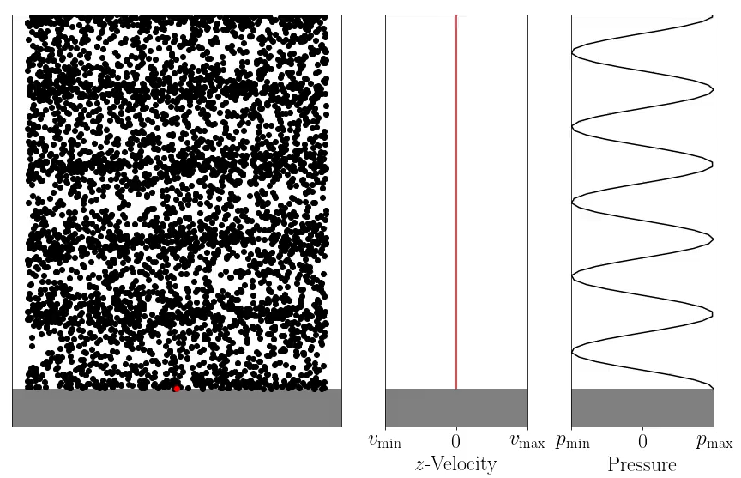
Hard Boundary
Simulation: Downward propagating plane wave of constant frequency
At boundary
Zero normal velocity
  Fish do not detect sound
Maximum pressure
  Hydrophone detects sound
Throughout water column:
Standing wave
Pressure and velocity nodes at different locations

Slide 6
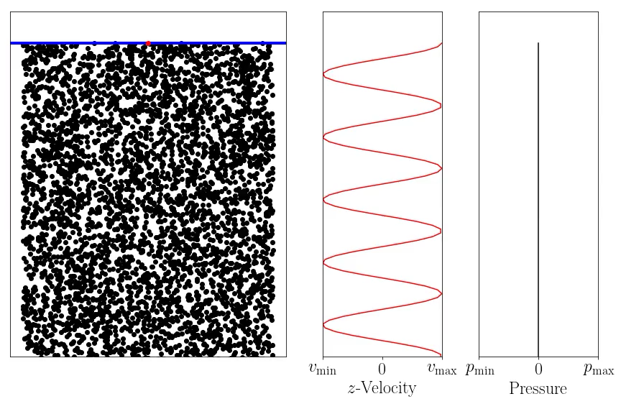
Pressure-release Boundary (Surface)
Simulation: Plane wave of constant frequency
At boundary
Zero pressure fluctuation
  Hydrophones do not detect sound
Maximum of normal velocity
  Fish detect sound
Throughout water column
Standing wave
Pressure and velocity nodes at different locations

Slide 7
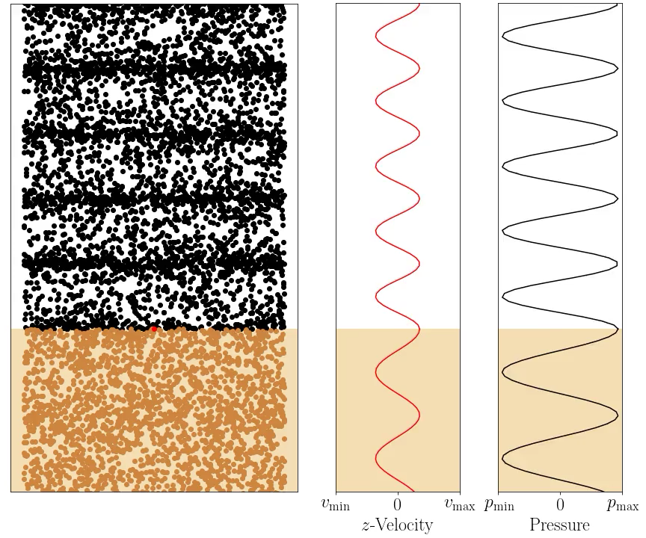
Soft Boundary (sand)
Simulation: Downward propagating plane wave of constant frequency
At boundary
Pressure and normal velocity continuous
Normal velocity nonzero
  Hydrophones and fish detect sound (different levels)
Throughout water column
Propagating wave

Slide 8
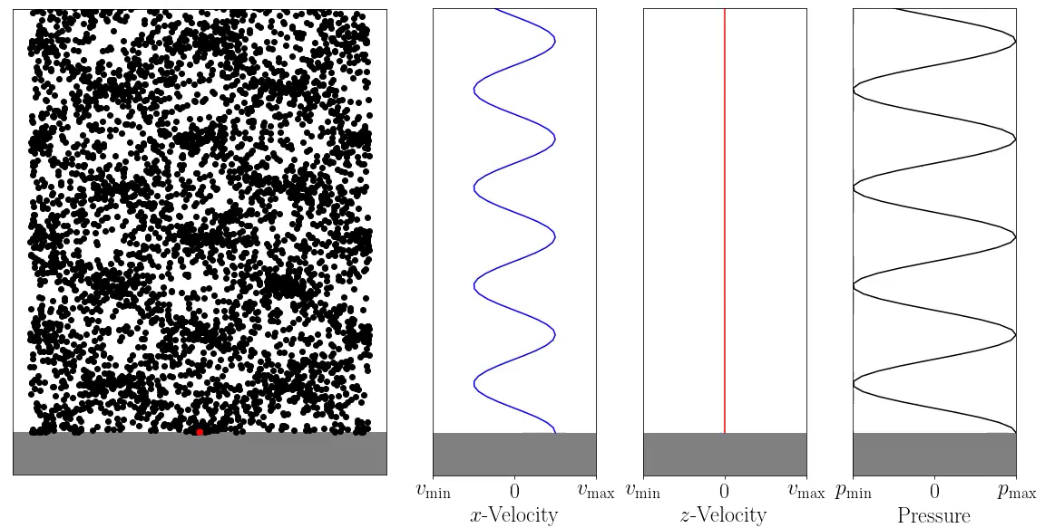
Hard Boundary, propagation at angle
Simulation: Wave of constant frequency, 30° to normal
At boundary:
Zero normal velocity (v_{z})
Maximum parallel velocity (v_{x})
  Fish detect sound
Maximum pressure
  Hydrophones detect sound
Perfect reflection

Slide 9
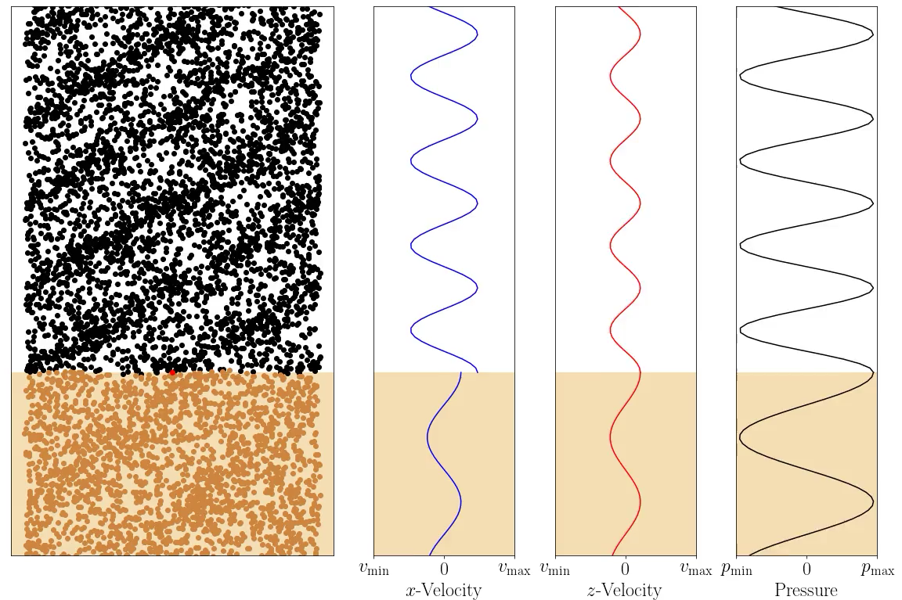
Soft Boundary (sand), propagation at angle
Simulation: Wave of constant frequency, 30° to normal
At boundary:
Parallel velocity (v_{x}) discontinuous
Pressure and normal velocity (v_{z}) continuous
Fish and hydrophones detect sound
Partial reflection, partial transmission

Slide 10
Modelling Propagation with the FDTD
1 m
1 m or 2 m
10 m
Finite difference time domain
  Pressure differences
  ➞ Particle velocity changes
  Particle velocity differences
  ➞ Pressure changes
Propagation from 10 m deep channel
➞ Shallow area (1 m or 2 m)
Sandy bottom
Source: 1 m deep in channel

Slide 11
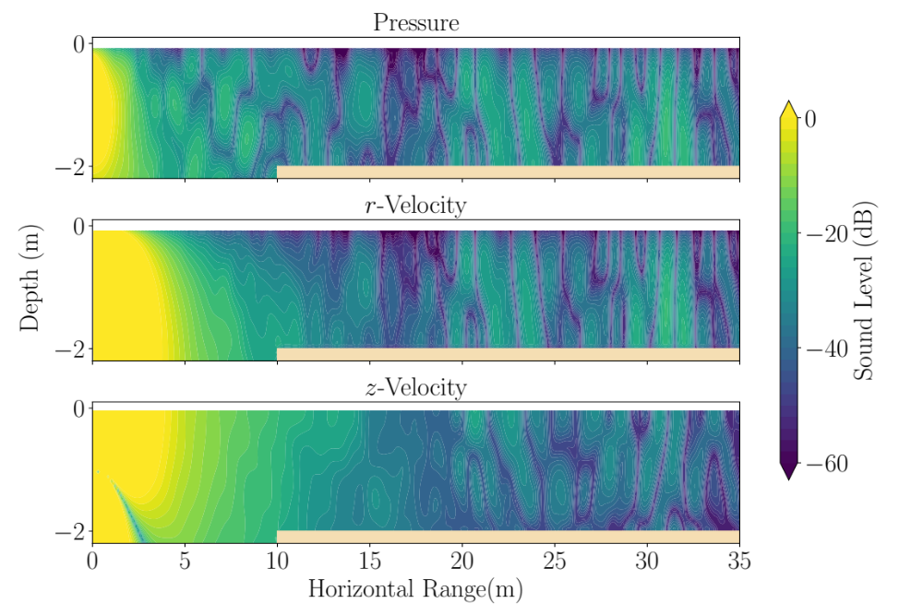
Propagation – 2m deep, 100 Hz

Slide 12
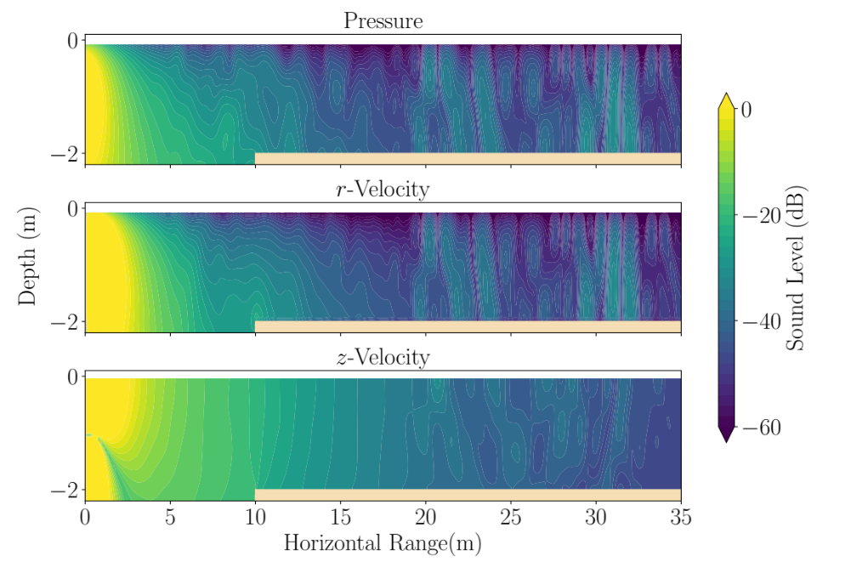
Propagation – 2m deep, 400 Hz

Slide 13
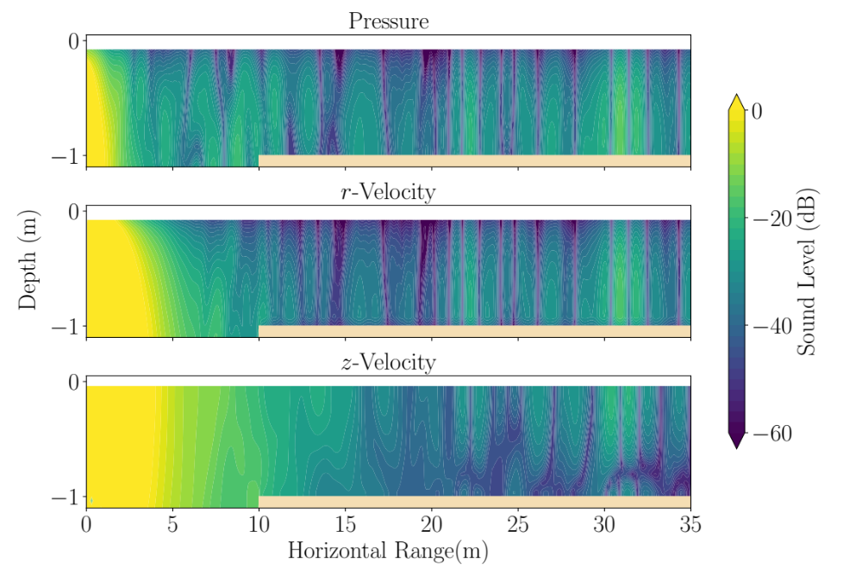
Propagation – 1m deep, 100 Hz

Slide 14
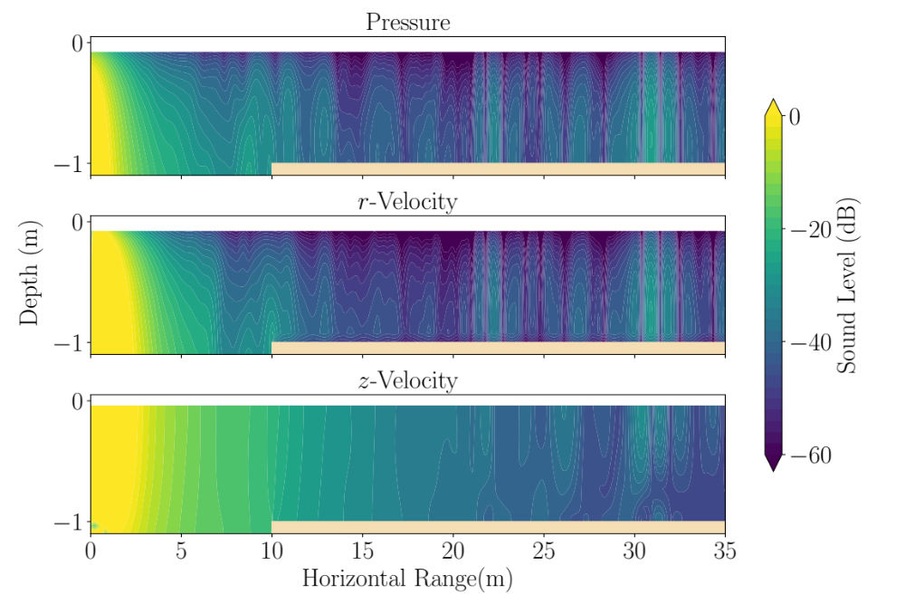
Propagation – 1m deep, 400 Hz

Slide 15

Conclusions
Propagating sound waves have pressure and particle velocity fluctuations
Deep channel ➞ Shallow water propagation at bottom
Hydrophone measurements reported at AN2016 are relevant
  Significant sound exposure near vessel channels
Sound propagation modelling is useful for understanding pressure and particle velocity

Slide 16
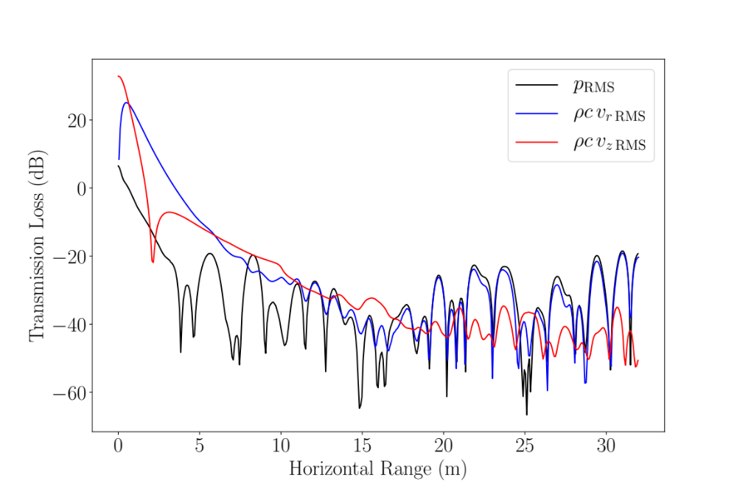
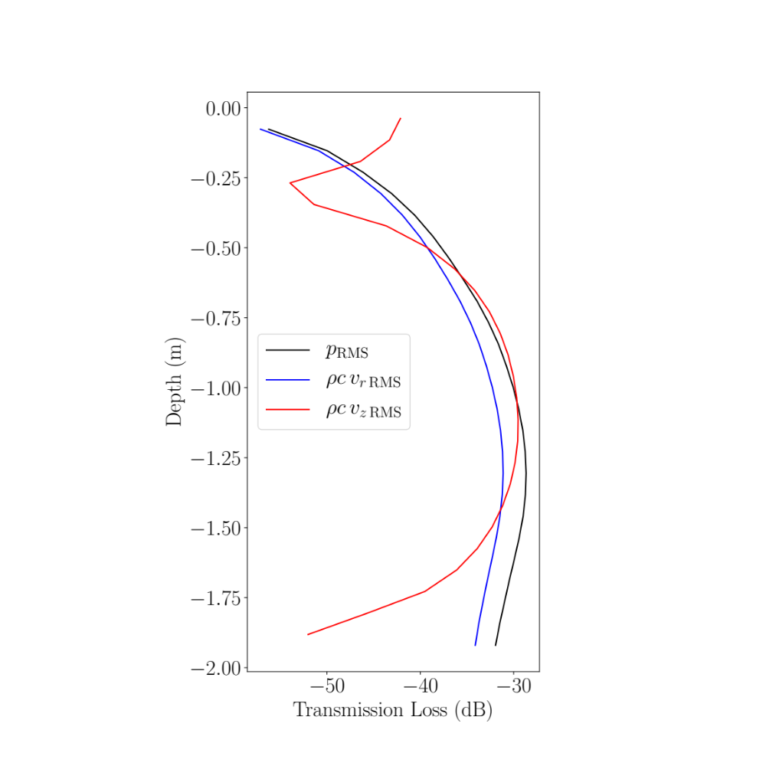
100 Hz, 1.75 m Depth
100 Hz,
30 m Range

Slide 17
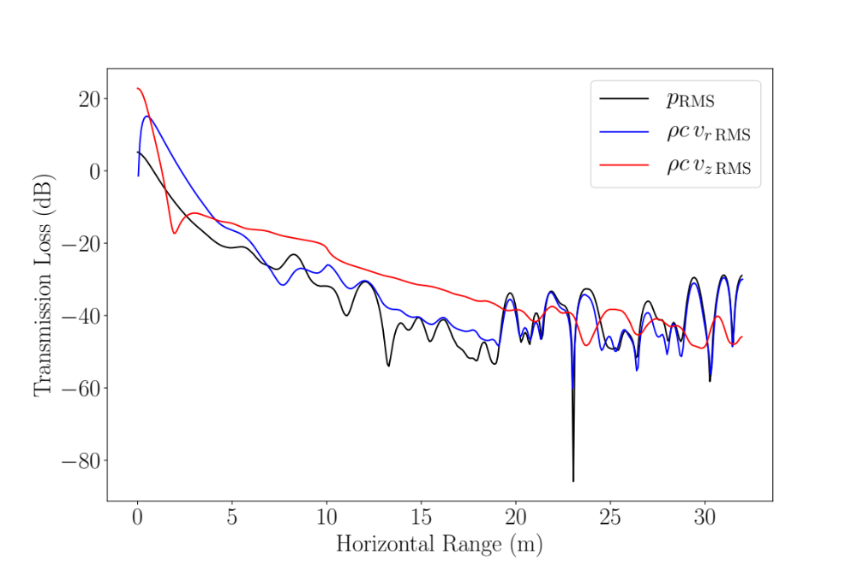
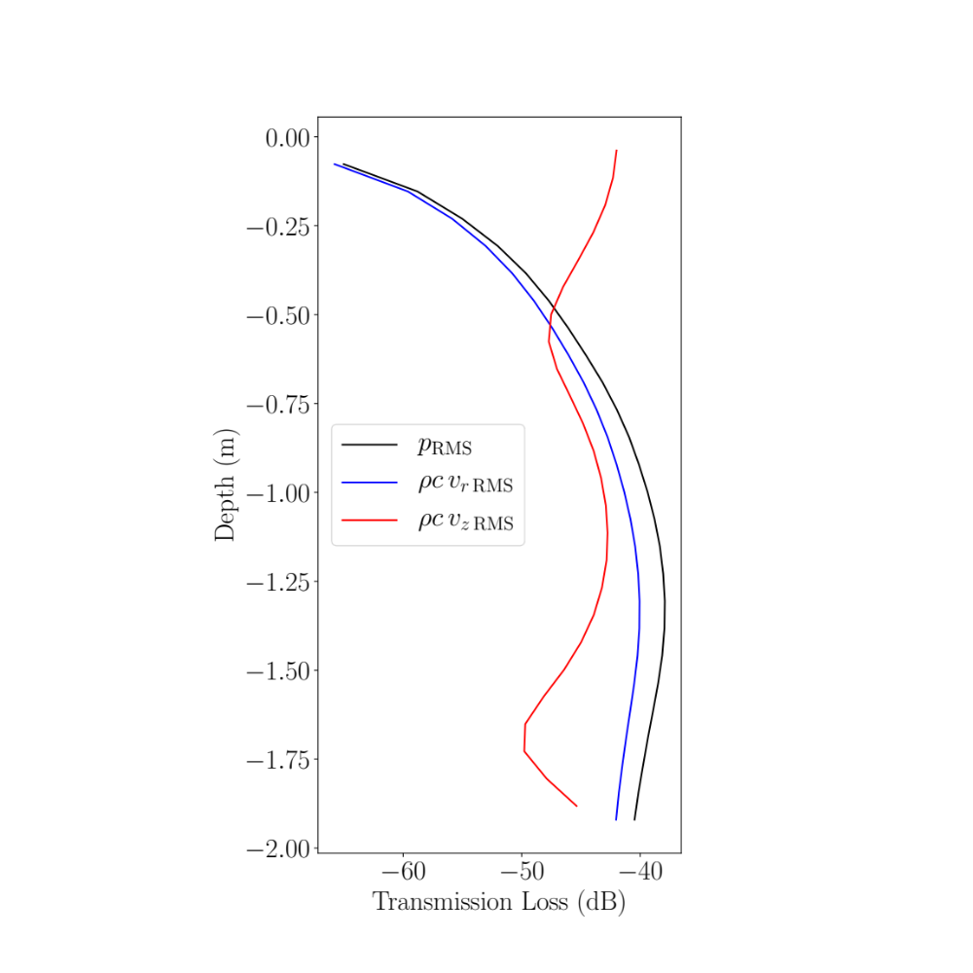
400 Hz,
30 m Range
400 Hz, 1.75 m Depth

Slide 18
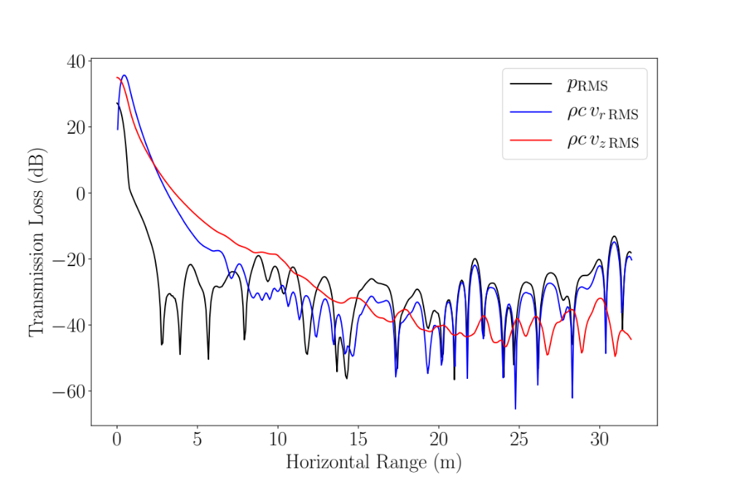
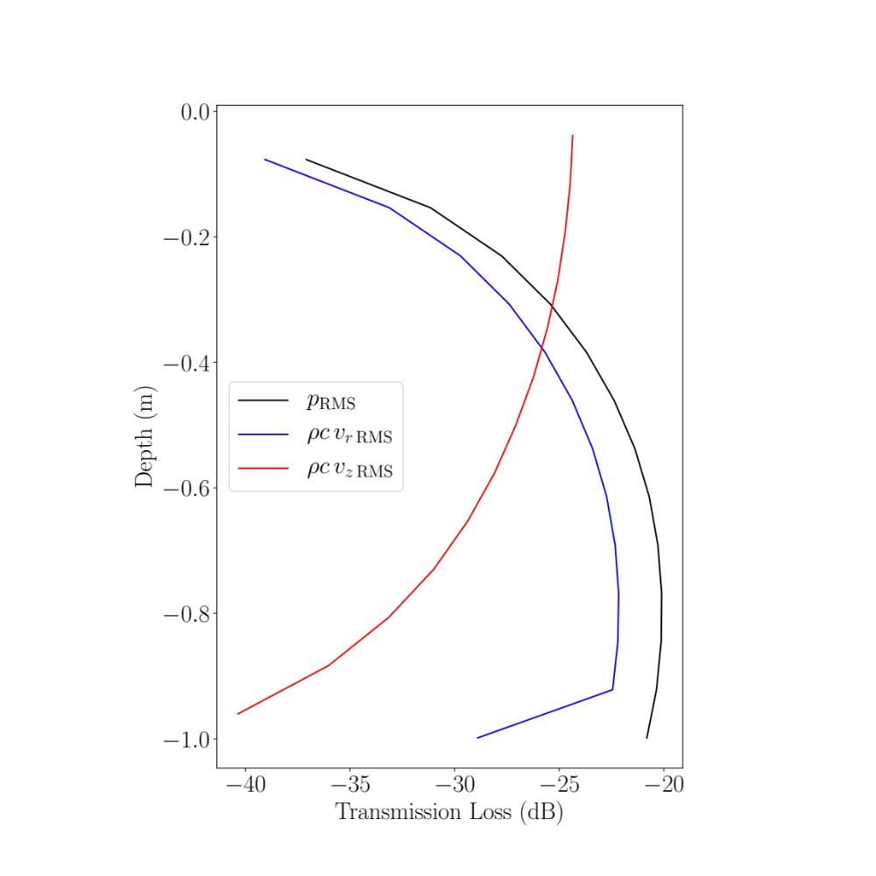
100 Hz,
30 m Range
100 Hz, 0.75 m Depth

Slide 19
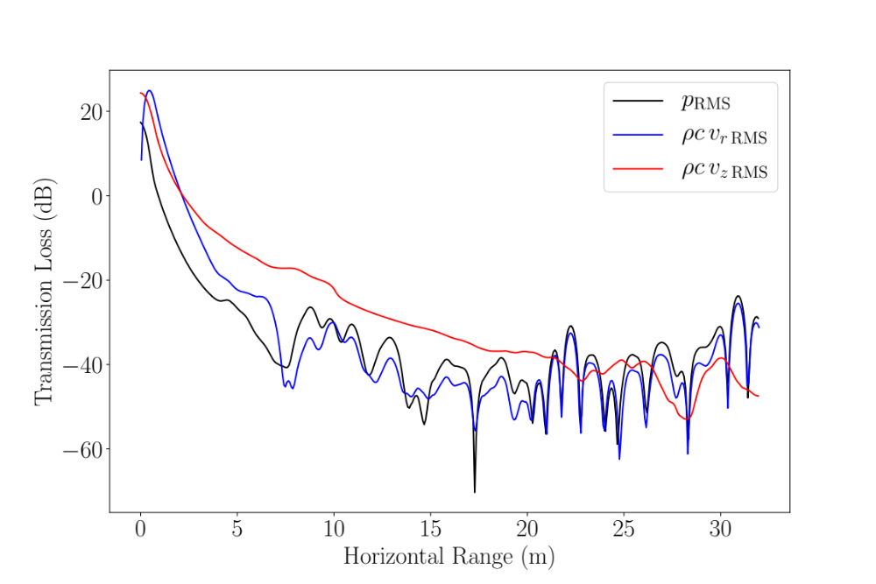
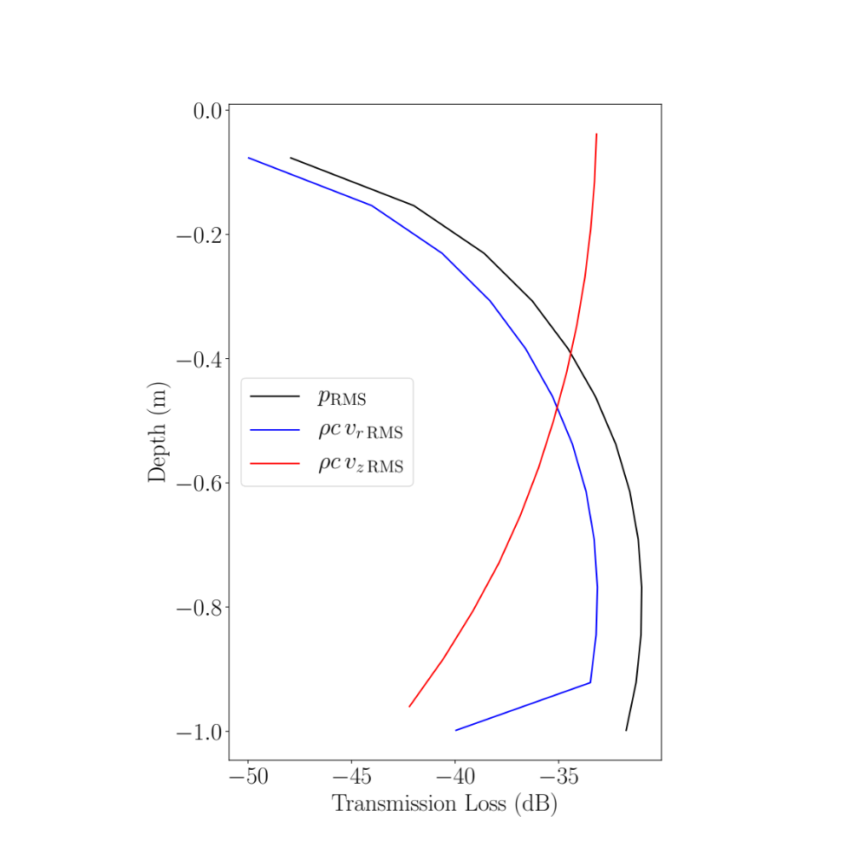
400 Hz,
30 m Range
400 Hz, 0.75 m Depth

