Slide 1
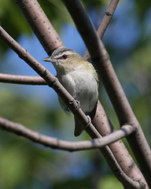

Electronic Theses and Dissertations Workshop
Tom McConnell
Associate Dean
The Graduate School
Jeanne Hoover
Scholarly Communication Librarian
Academic Library Services
Image by Seabamirum, hosted on Flickr
Notes:
.

Slide 2
Communicate with your Mentor/Advisor!
  This is your Thesis or Dissertation, at this stage of near completion, ensure your final steps go smoothly
  Communicate with your Graduate Program Director
  Stressful times, so work constructively
  Always takes longer to write than planned
  Always takes longer to schedule defense
  Always takes longer to obtain signatures
  Therefore, anticipate and be prepared

Slide 3
From the Grad School website for current students, choose the link “Vireo—Theses & Dissertations” to find
  Forms, including the Non-Exclusive Distribution License
  Formatting Manual
  Due dates
  Link to the Vireo Guide
  Link to the Vireo System

Slide 4

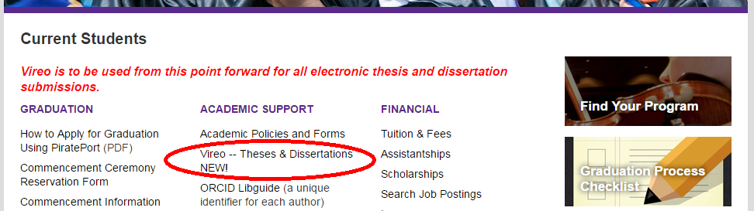
Step 1: Select "Current Students" on ecu.edu/gradschool
Step 2: Select “Vireo—Theses & Dissertations

Slide 5
Formatting Manuscript
http://www.ecu.edu/cs-acad/gradschool/Vireo-ETD-Informational-Pages.cfm
Manual of Basic Formatting Requirements-required sections and order
  One inch margins
  No page number on first page of each section
  IRB/IACUC Permission Letters in Appendices
  Regardless of style manual used, format prefatory pages per instructions in Manual
  Times New Roman or Arial 10-12 point font
File size- limited to 1000 MB or submit on a CD
Embed fonts
Convert to PDF

Slide 6
Prior to Beginning the Submission Process
Decide upon publishing agreement and any restrictions in consultation with adviser
Determine department’s preference for paper copy, CD or E-copy
Save your signature page with committee member signatures & your signed ECU Non-exclusive Distribution License to your computer as PDF documents (for later uploading to submission site)
To submit, go to:
https://vireo.ecu.edu/

Slide 7
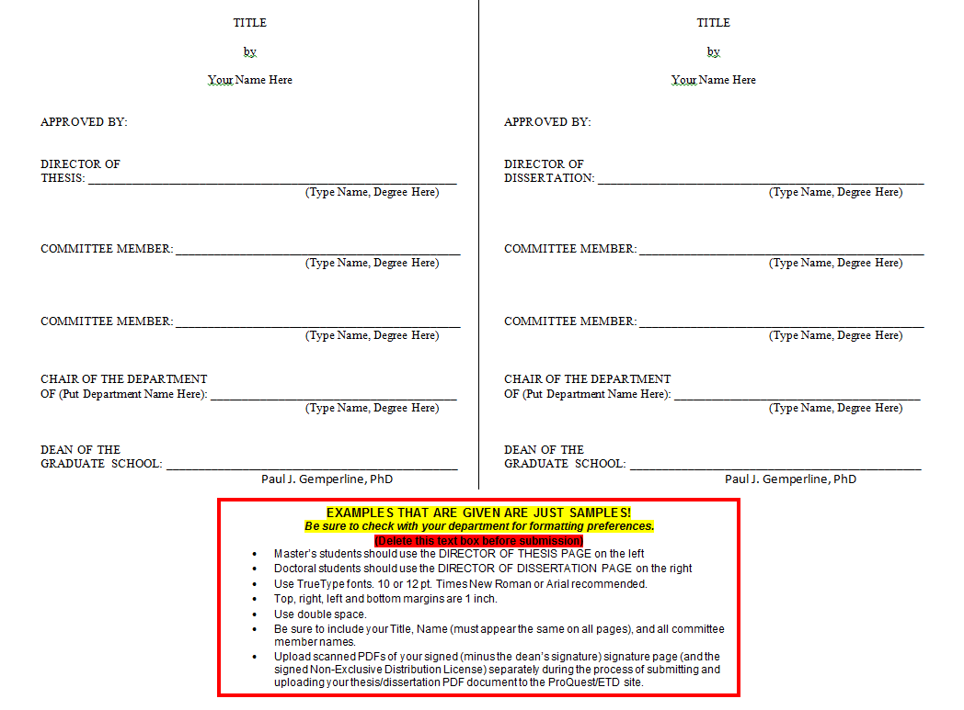

Slide 8
NON-EXCLUSIVE DISTRIBUTION LICENSE
The undersigned (“the Author”) hereby grants to East Carolina University (“ECU”) the non-exclusive right to reproduce, distribute, display, and, transmit, in whole or in part, the author’s thesis or dissertation (“the Work”) in such tangible electronic formats as may be in existence now or developed in the future, including, but not limited to, electronic distribution and display of the Work via the World Wide Web. The Author further grants to ECU the right to retain one or more copies of the Work, in any format, whether electronic or hardcopy, for nonprofit educational use and archival purposes. The Author retains all copyright rights in the Work and nothing herein shall be construed as an assignment of the Author’s copyright rights in the Work to ECU.
The Author represents and warrants that the Work is his/her original work and that he/she has the legal right to grant this license to East Carolina University. The Author further represents and warrants that the Work does not contain any libelous, defamatory, or unlawful material and that the work does not infringe upon or violate any third-party’s copyright, patent, or other proprietary right.
If the Work contains content for which the Author does not own the copyright, the Author represents and warrants that he/she has obtained all necessary permissions from the copyright holder to use the content. The Author further represents and warrants that he/she has obtained all necessary rights to permit ECU to reproduce and distribute third party materials contained in any part of the Work. The Author shall clearly identify and acknowledge such third party content in the Work. ECU may elect not to distribute and/or publish the Work for any reason, including for a determination that all necessary rights of third parties have not been secured by the Author.
The Author hereby agrees to indemnify, hold harmless, and release ECU and all of its officers, officials, administrators, agents and employees from and against all third party claims of damages, demands, actions, or causes of actions, which arise from or are in any way connected to this Agreement and/or the Work as submitted for publication.
If the Work was sponsored or supported by any entity or organization external to ECU (the “Sponsor”), the Author represents and warrants that he/she has complied with all requirements of the Sponsor for the Work (such as a right of review of the Work prior to its publication or other contractual obligation with the Sponsor).
East Carolina will use reasonable efforts to ensure that the Author’s name remains clearly associated with the submission and that no alterations of the content are made.
I agree to the terms of the Non-Exclusive Distribution License.
________________________________ _________________
Author Signature Date
________________________________
Print Name
___________________________________________________________
Title of Work
I have consulted with my thesis or dissertation adviser (__Yes __No) concerning potential intellectual property and/or prior publication issues related to the electronic distribution of my Work as verified by the signature below.
________________________________________________
Acknowledgment of Thesis or Dissertation Adviser

Slide 9
Publishing Decisions
Work displayed in two databases:
  ECU’s Institutional Repository-The Scholarship
  ProQuest Subscription Database or Open Database
Two publishing agreements:
  ECU Institutional Repository (ECU IR)
  ProQuest Database
Publishing agreements state how your work will be displayed and when:
  Open Access: full-text available to everyone for free
  or Limited access (Campus Access)
  Immediate access or delayed access (embargo)
Notes:
Your ETD is deposited to ProQuest after we deposit it to the institutional repository. It will be released to ProQuest subscribers on the same embargo schedule you select in the Vireo upload form. ProQuest has provided access to theses and dissertations from instutitions around the country for more than 70 years, with online access since 1997. There are several advantages to you in this deposit to ProQuest, including the creation of a preservation copy outside the institution, access to a global audience of subscribers, and the fact that ProQuest imports its ETDs into the Turnitin database to help prevent plagiarism of your work.

Slide 10
ECU IR and ProQuest: Immediate or Delayed Access
You can choose to release your work immediately, or you can delay release. The time period will be the same on both agreements. Your choices :
    Six months
    One year
    Two years
At conclusion of the embargo period, you may request an extension if needed.
  You are responsible for contacting ProQuest.
Notes:
Tom—I changed the text to read that the time period for embargo will be the same (b/c we transmit the info to ProQuest—the student doesn’t have to do anything for an initial embargo in ProQuest, but they are responsible for contacting ProQuest if they want to extend their embargoes.

Slide 11
Reasons to Delay Access
Patent pending or patentable rights in the work
Funding source restricts immediate access
You’re planning to submit the work to a journal that considers a thesis/dissertation to be a prior publication
You’re planning to publish it as a monograph without significant changes
Your T/D adviser, committee chair, etc. advises you to delay access (with good cause, see above)
Creative works (publishing concerns, see above)
Notes:
If you need to extend an embargo, email scholarlycomm@ecu.edu to extend it in the institutional repository. You are responsible for contacting ProQuest if you want to extend the embargo in ProQuest.

Slide 12
Journal Policies
Many journals accept articles even though the work previously appeared in a T/D
  Elsevier: e.g., Advances in Applied Mathematics, Cognitive Psychology: “Submission of an article implies that the work described has not been published previously (except in the form of an abstract or as part of a published lecture or academic thesis)”
  Springer: e.g., Fisheries Science: “Submission… implies: that the work described has not been published before (except in form of … a thesis)
Check the journal’s Instructions for Authors !!

Slide 13
ECU Institutional Repository:
Open or Campus Access
Open Access- the entire work will be available for viewing and downloading worldwide for free.
Campus Access - access will be limited to current ECU faculty, students and staff (authenticated by PirateID).
  Unable to access after you graduate and no longer have active PirateID.

Slide 14
ECU’s Non-Exclusive Distribution Agreement
In addition to the unrestricted display of the bibliographic information and the abstract, I agree that the Work will be available in ECU’s Institutional Repository* with the following status:
Part A: (STEP 1)
Check the option below that corresponds to WHEN you want your work to be released for viewing in the Institutional Repository. (Select one)
______I want my work to be available IMMEDIATELY according to my
publishing choice in Part B.
OR
______ I would like access to the full text of my work and any
supplementary material TO BE DELAYED for the period of time
indicated below. At the end of the embargo, I want my work
released according to my publishing choice in Part B.
______ 6 month embargo
______ 1 year embargo
______ 2 year embargo

Slide 15
Electronic Distribution Options:
Part B: (Step 2)
Check the option that corresponds to how you want your work displayed: OPEN ACCESS OR CAMPUS ACCESS ONLY:
________1. OPEN ACCESS: Release the entire Work for worldwide access via the internet on the scheduled indicated in Part A.
OR
________2. RESTRICTED CAMPUS ACCESS ONLY:
Display the entire Work for access only by ECU faculty,
students, and staff (access authenticated by valid PirateID)
    on the schedule indicated in Part A. I understand that with
this option I will be unable to view my work in the Institutional Repository once I graduate from ECU and no longer have an active Pirate ID.

Slide 16
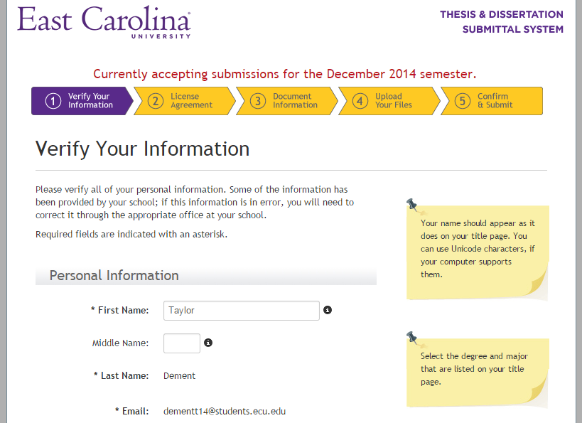
Step 1: Verify Your Information
Notes:
Note: ORCID field now present. Say anything about ORCID?

Slide 17
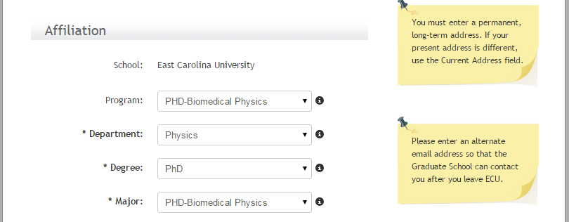
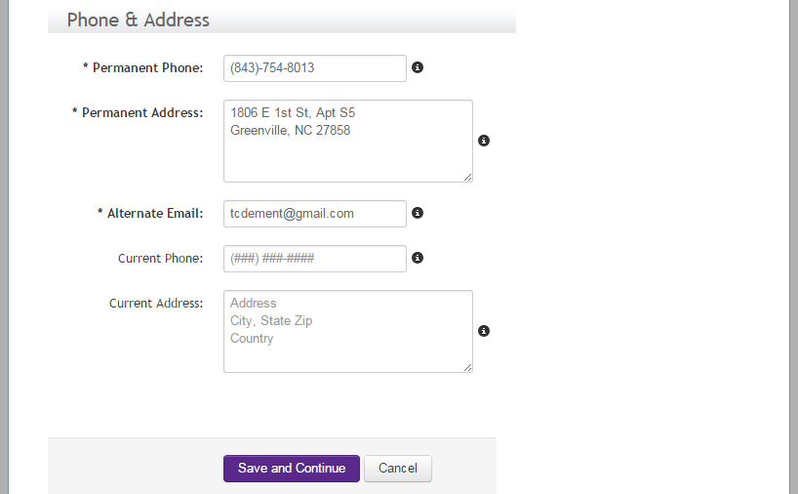
Step 1: Verify Your Information

Slide 18
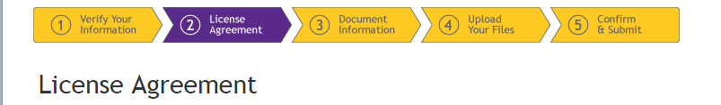
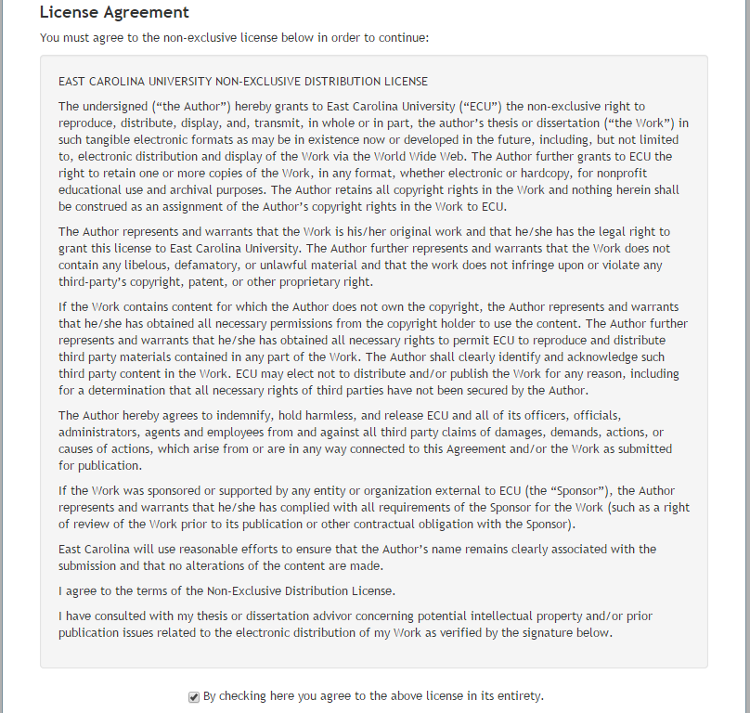
Step 2: License Agreement
East Carolina University Non-Exclusive Distribution License

Slide 19
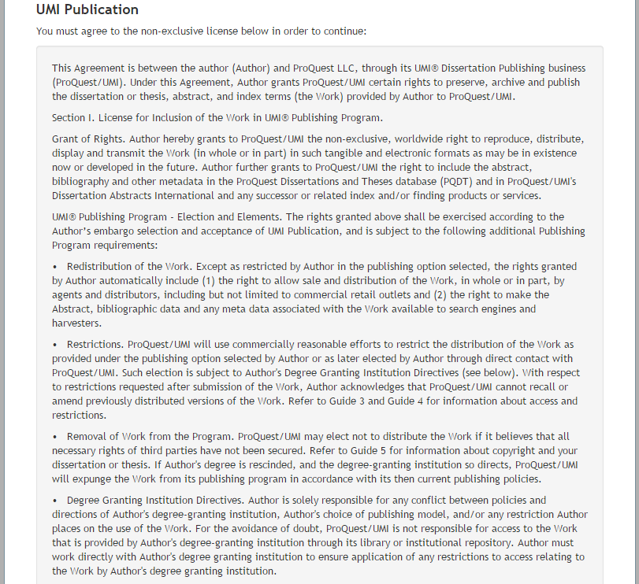
Step 2: License Agreement
UMI Publication Part 1

Slide 20
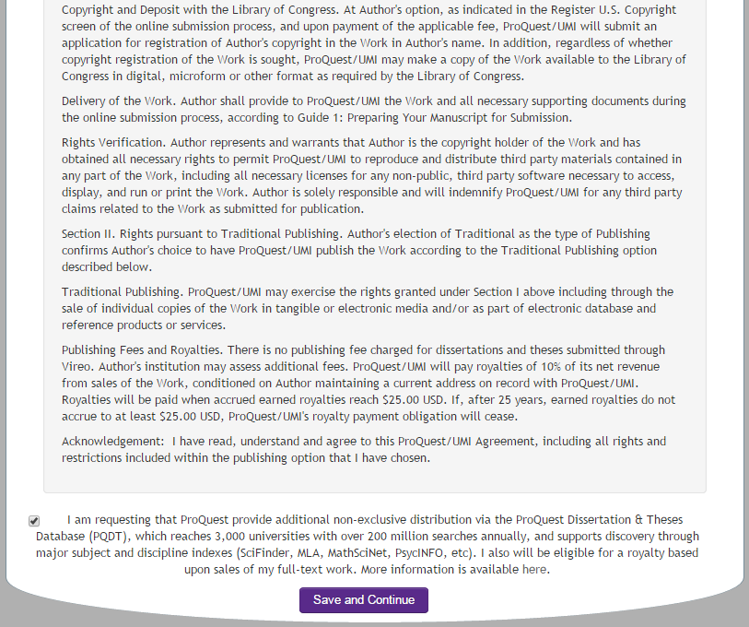
Step 2: License Agreement
UMI Publication Part 2

Slide 21
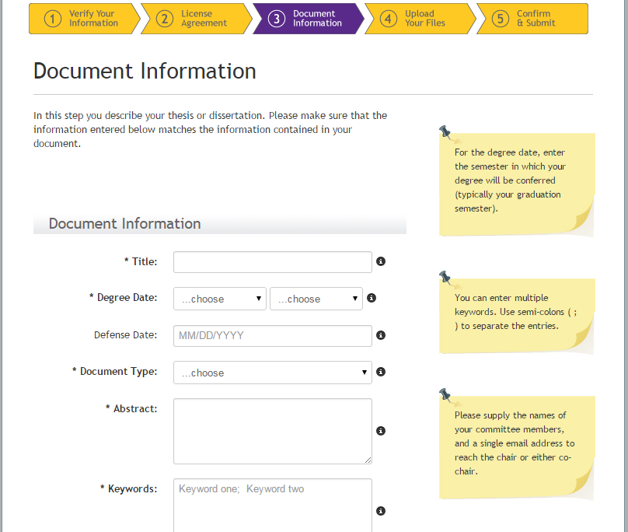
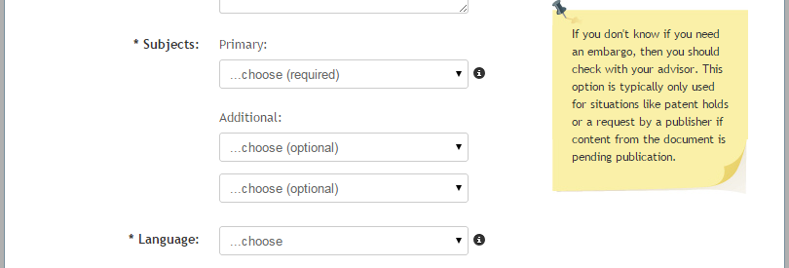
Step 3: Document Information

Slide 22
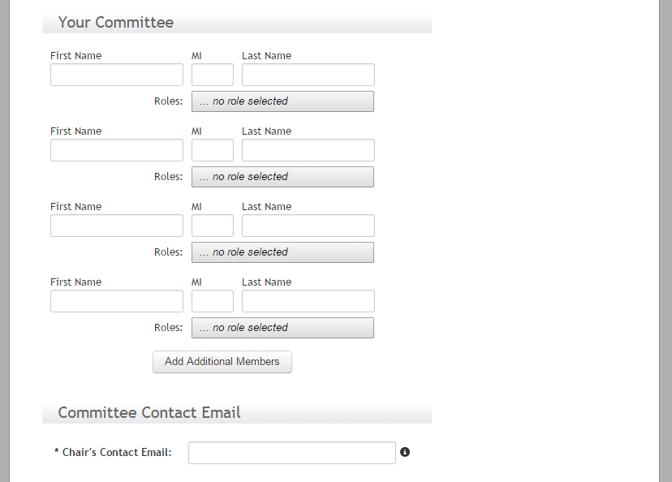
Step 3: Document Information
Your Committee

Slide 23
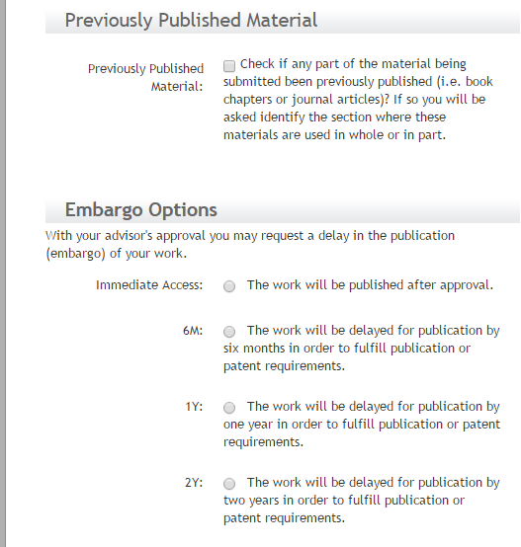
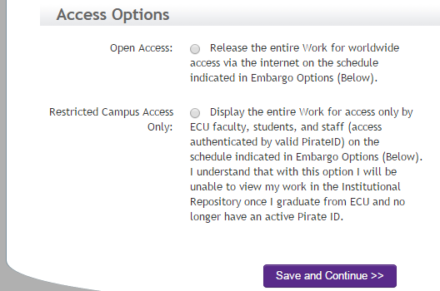
Step 3: Document Information
Publishing Options

Slide 24
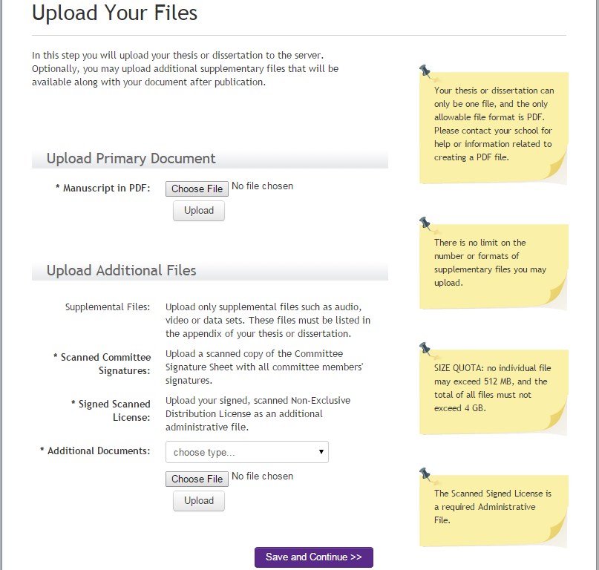
Step 4: Upload Your Files

Slide 25
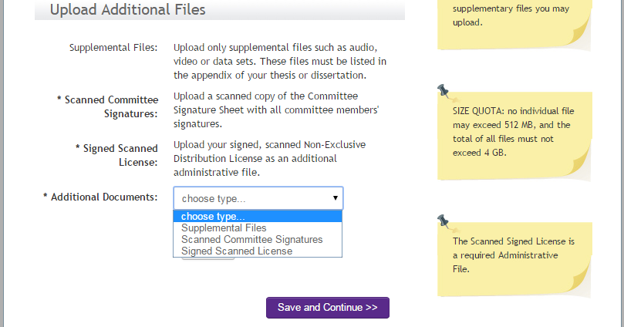
Step 4: Upload Your Files
Select from the drop down to individually upload Scanned Committee Signatures and Signed Scanned License, as well as any Supp files you need to add.

Slide 26
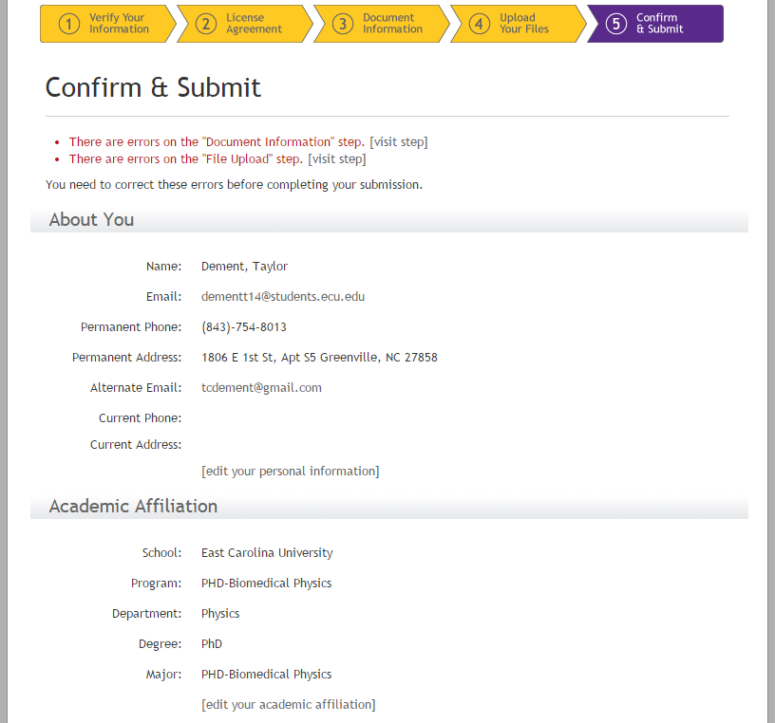
Step 5: Confirm and Submit
Errors will appear here
Check Information
Part 1

Slide 27
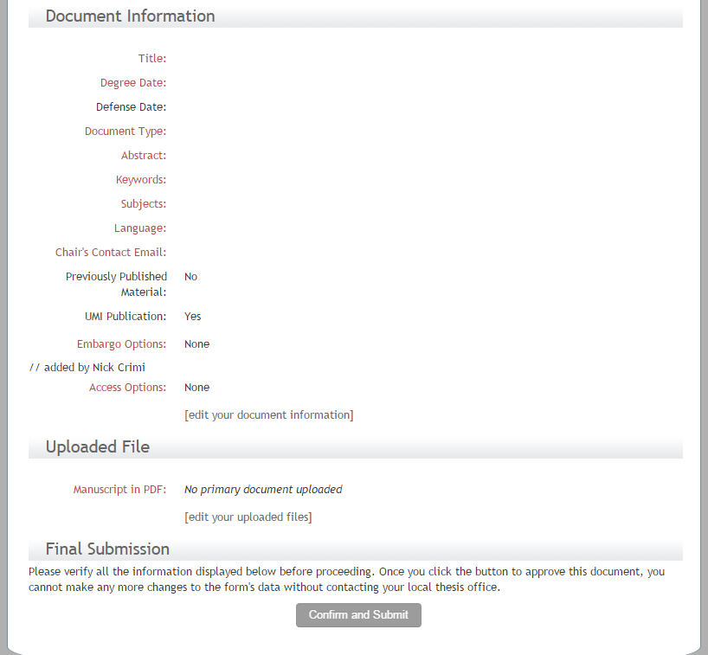
Step 5: Confirm and Submit
Part 2

Slide 28
Other Options for Ordering Bound Copies of Your Thesis/Dissertation
Thesisondemand.com:
http://www.thesisondemand.com
PrintonDemand.com:
http://www.printondemand.com

Slide 29
In-Office Processing
Email confirmation of receipt of manuscript
Allow one week for format review
If formatting revisions are needed , you will be notified via email of specific revisions
Final email notice indicating manuscript has been accepted
Notification sent to Registrar’s Office and your committee chair
Upon verification of your graduation, manuscript sent to ProQuest and The ScholarShip

Slide 30
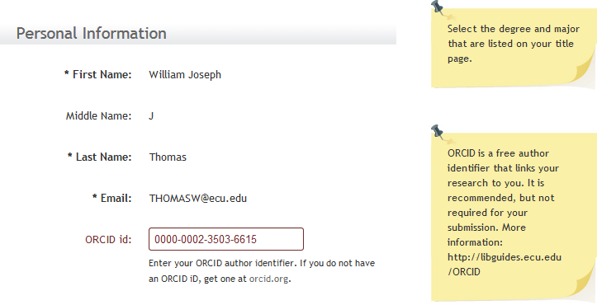
New Field in Vireo: ORCID

Slide 31

ORCID: Unique Researcher ID
Register with a username and password
Link your scholarly works (articles, book chapters, presentations, etc.)
ORCID remains consistent whether you change names or institutions
Journal publishers are using ORCID during submission process
Federal funders are using ORCID during application process

Slide 32
What is Copyright?
Bundle of property rights to a creative work, including rights to:
  Reproduce
  Make derivative works
    e.g. movies and plays based on a novel
  Distribute
  Perform publicly
  Display publicly
  Transmit digitally
http://copyright.ecu.edu

Slide 33
Copyright Duration
Personal Authors & Joint-Authors
  life of author(s) + 70 years
  OR – until you sign it away
Corporate Authors
  95 years after publication - OR (the lesser of) -
  120 years after creation
Duration has changed over time
Notes:
1790: 14 years, renewable for 14 more years
1831: 28 years, renewable for 14 more years
1909: 28 years, renewable for 28 more years
1978: Life + 50 years
1998: Life + 70 years; 95/120 rule for corps.

Slide 34
Two Sides of Copyright
You most often own the copyright in your work.
  ECU and/or grant agencies might own the rights.
  Joint authorship
The owner controls how a work is used and by whom.
You often use someone else’s works.
Your use must be permitted to be legal.
  By law
    public domain
    fair use
  By the owner directly
  By the owner’s agent

Slide 35
Your Copyright
Copyright privileges vest immediately upon creation of your work in fixed, tangible form.
No notice or registration is required.
Registration is required before you can file an infringement lawsuit or receive statutory damages or attorney’s fees.
Registration also ensures that the facts of the copyright are on the public record
Notes:
–
Copyright privileges vest immediately upon creation of your work in a tangible form without the requirement of notice or registration.
Registration of your copyright is technically optional but still recommended.
In the US, registration is required before you can file an infringement lawsuit and/or be awarded damages in an infringement lawsuit.
Another advantage is that there is a public record of your copyright to the Work

Slide 36
Registering Your Copyright
You can register your copyright online with the U.S. Copyright Office for $35.
  Online form: http://copyright.gov/eco
  For more information, see U.S. Copyright Office FAQs: http://www.copyright.gov/help/faq/
Notes:
You also have the option of filing your own copyright registration with the U.S. copyright Office For a $35 fee. These are the URLs for the online form and additional information about copyright.

Slide 37
Copyright Page
Whether or not you register, you should include a copyright notice on your thesis or dissertation.
  Appears after title page
  Examples
    Copyright 2011, Jan Student
    © 2011, Jan Student
This identifies the work as yours and declares your intention to exercise your legal rights.
Notes:
Whether or not you register your Copyright, ProQuest and the US Copyright office recommend that a copyright notice by included in your manuscript.
It appears customarily just after the Title page.
The Guide /Manual on the GS website has example of copyright page formatting

Slide 38


Using Copyrighted Works
Fair Use
Permissions
Fair Use is an exemption to activities that are otherwise illegal
If your use goes beyond “fair” you must have permission
Public Domain / Creative Commons Licensed Works

Slide 39
Some Examples of Fair Use
Research and scholarship – e.g. quoting a short passage or using images in a scholarly, scientific, or technical work for illustration or clarification of the author's observations
Criticism and comment – e.g. quoting or excerpting a work in a review or criticism for purposes of illustration or comment
News reporting- e.g. summarizing an address or article, with brief quotations, in a news report

Slide 40
Extensive Use of These Materials May Trigger a Fair Use Analysis
Images, illustrations and artwork
Long quotations (paragraphs)
Poetry and music lyrics
Dialog from a play or novel
Diagrams
Copies of test instruments and surveys
Unpublished materials

Slide 41
Conducting a Fair Use Analysis
Complete a fair use worksheet.
  Purpose of the use
  Nature of the work
  Amount of the work used
  Effect of the use on the market
Keep a copy of the worksheet to show good faith effort to comply with the law.
Notes:
Find Fair Use worksheets on the Copyright guide (under Tools; UNC system worksheet under Resources).

Slide 42
Requesting Permission
If beyond fair use, you must ask permission.
Who the owner is can be complicated.
  Books: often the author owns the copyright
  Articles: often the publisher owns the copyright
  Images: varies
    images in books and journals are frequently not owned by the authors or publishers of the books or journals
  Music, Movies, etc.: sometimes multiple owners
Request permission in writing.
  State what you want to use & that it is for inclusion in a T/D that will be posted in an IR & in ProQuest
Notes:
If you ask permission and don’t hear back, I wouldn’t use it.

Slide 43
Permissions
Allow time for copyright owners to respond.
  usually days or weeks; sometimes longer
For permission, you might have to
  complete forms or a contract
  pay copyright royalties
  agree to certain methods of citation
  agree to restrictions on the use of the material
If your request is denied (or you can’t comply),
  you can reference the work instead of including it
  search for other related material to include
Notes:
Once again—if you don’t hear back, don’t use it.

Slide 44
What About Your Own Previously Published Materials?
Did you transfer/assign your copyright to the journal, editor, or publisher?
  Doing so was/is the standard practice with many.
Read your publication agreement, check the site’s website, or contact the journal directly
  Many publishers do allow reuse in T/Ds, but not all.
  Some require acknowledgement of the prior publication, so you’ll cite yourself.
  Some might require payment or significant changes to the document.

Slide 45
If You Haven’t Published Yet…
Investigate the journals in your field.
  Find out if republishing content is permitted.
  Tell the journal your intention is to republish the work or to include a revision in your thesis/dissertation.
Make sure you retain your rights to your work. You can:
  Negotiate the publishing agreement
  Publish under a license
  Add an Author Addendum
Notes:
The SPARC Author Addendum is one example of a legal instrument that modifies the publisher’s standard agreement.

Slide 46
Copyright Officer Services
Advice on fair use & consultations
  TAs: Class handouts, showing media, course reserves, etc.
Assistance with obtaining any needed permissions
Help understanding publisher agreements/licenses
Determine ECU’s potential ownership of your works
Presentations for classes, offices, and groups
Referral to other legal resources
Website http://copyright.ecu.edu

Slide 47
Resources:
Graduate School ETD Page: http://www.ecu.edu/cs-acad/gradschool/ETD-Vireo.cfm
Library Guide to Vireo Deposit: http://libguides.ecu.edu/vireo
Vireo: https://vireo.ecu.edu/

Slide 48
Questions?
Contact us:
Tom McConnell: mcconnellt@ecu.edu /252-328-5792
Jeanne Hoover: hooverj@ecu.edu /252-328-2261
Marquerite Latham: bassm@ecu.edu /252-328-5792 disspub@umi.com or
800-521-0600 Ext. 7020
Link http://thescholarship.ecu.edu/handle/10342/4361

