Slide 1
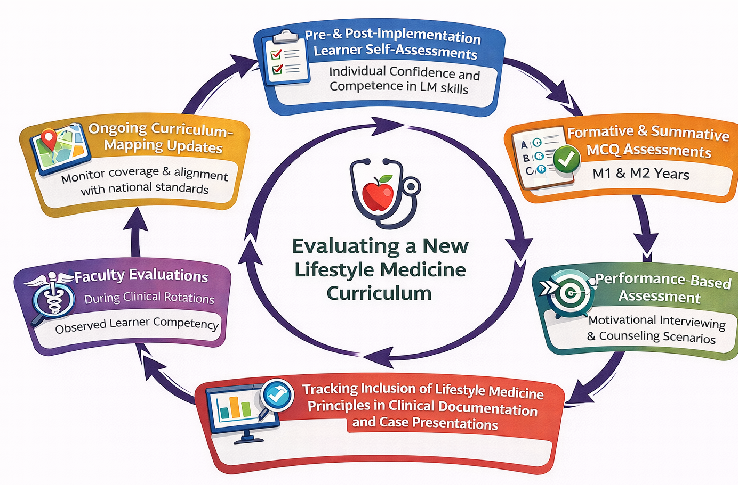
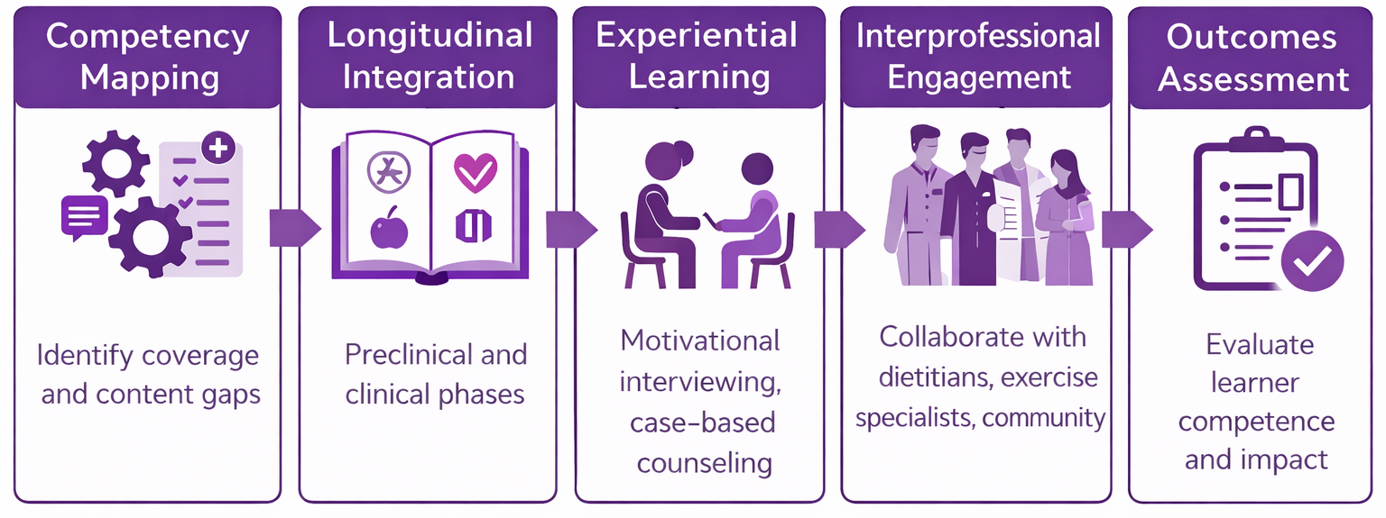
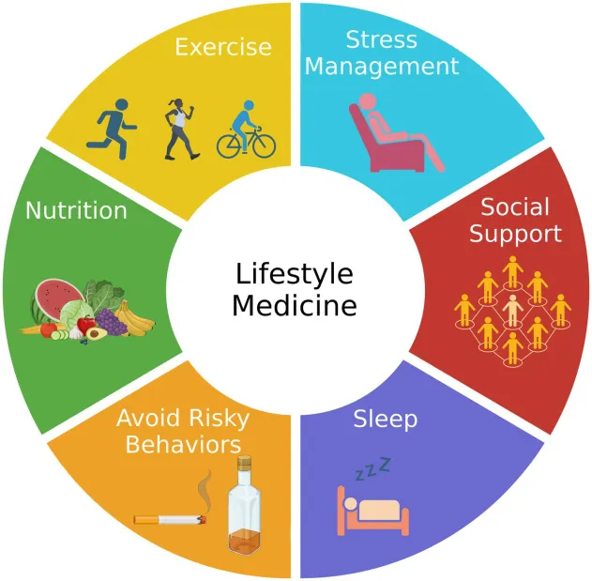
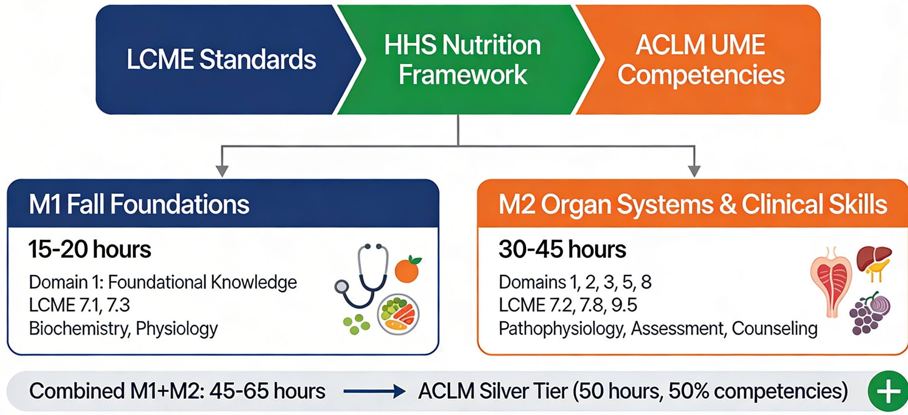
From Fragmentation to Integration: Working Towards a Competency-Based Model for Lifestyle and Preventive Medicine Education
Kori L. Brewer, PhD and Annette Greer PhD
On behalf of the Lifestyle & Preventive Medicine Workgroup
Kori L. Brewer, Ph.D.
Dept. of Emergency Medicine
East Carolina University
Greenville, North Carolina 27858
brewerk@ecu.edu
Kay Craven (FM), Brenda Leigh (ECUH), Suzanne Lazorick (PubHealth), Espen Spangenburg (ACB), Hannah Florida (PM&R), David Michael (ECUH), Skye Reece (Pharm/tox), Kathy Kolasa (FM)
RATIONALE/NEED
PROCESS
EVALUATION PLAN
Lifestyle medicine offers evidence-based strategies to prevent, treat, and reverse chronic disease.
Most medical schools currently provide limited and fragmented instruction on the core pillars of Lifestyle Medicine (LM).
There is a significant gap between current medical education and the growing burden of preventable chronic disease and evolving patient expectations.
Create an interdisciplinary team with expertise in educational pedagogy, basic sciences, clinical practice and preventive health strategies.
2) Use Competencies defined by the American College of Lifestyle Medicine and U.S. Department of Health & Human Services towards the following:
OBJECTIVES
IMPACT/LESSONS LEARNED
1) Integrate disease prevention and health promotion into BSOM’s existing medical training through a competency-based, longitudinal LM curriculum that aligns to national standards
2) Position BSOM to have lifestyle medicine curriculum certified by the American College of Lifestyle Medicine
RESULTS
Structured mapping is critical
Integration must be intentional and goal-driven
Early faculty engagement supports rapid implementation
Linking educational strategies to national competencies supports standardization and helps define measurable outcomes.
Collaborative partnerships—both interprofessional and community‑based—enhance the authenticity of skill development and reinforce the importance of prevention within clinical practice.
Workgroup composed of representatives from 8 different departments across 2 institutions
Initial curriculum mapping identified scattered exposure to LM concepts.
Basic nutrition content is currently most frequently covered in both foundational and clinical years.
Substantial gaps exist in behavior‑change counseling, and structured skill‑based training.
To Date:
  8 hours of LM content focusing on the 6 pillars scheduled into the Fall of M1 year, purposefully aligning with existing nutrition and preventive health content.
  OSCE cases
  M4 electives focused on nutrition (FM9409) and Lifestyle Medicine (LSTM9410) approved and available for current M4 students
  Standardized skill‑based activities, and assessment tools development underway.
  Longitudinal integration points identified across both preclinical and clinical phases.
TARGET GOAL
Prepare BSOM graduates to deliver high‑quality, preventive, patient‑centered care while contributing to national goals to reduce chronic disease and improve population health.
ACKNOWLEDGEMENTS
LPM Workgroup Members: Kay Craven (FM), Espen Spangenburg (ACB), Brenda Leigh (ECU Health), Suzanne Lazorick (PubHealth), Hannah Florida (PM&R), David Michael (ECU Health), Skye Reece (Pharm/tox), Kathy Kolasa (FM)
We thank institutional faculty, the Office of Faculty Affairs and Leadership Development, and the ACLM for guidance in aligning curriculum with national competencies. Additional appreciation to community partners contributing to experiential learning components.
The 6 Pillars of Lifestyle Medicine
Arora S, Santiago JA, Bernstein M and Potashkin JA (2023) Diet and lifestyle impact the development and progression of Alzheimer’s dementia. Front. Nutr. 10:1213223. doi: 10.3389/fnut.2023.1213223

