Slide 1
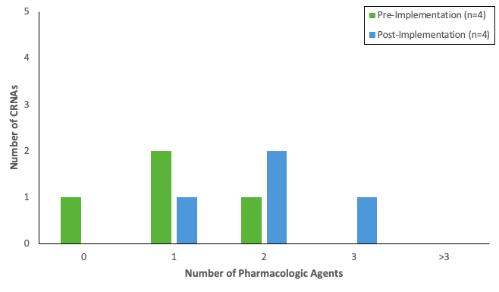
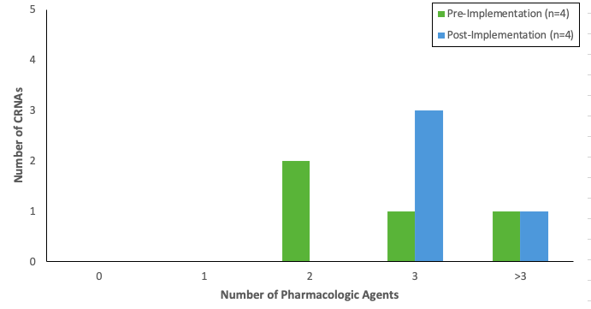
Postoperative Nausea and Vomiting (PONV): A Quality Improvement Project
Caleb Woolard, BSN, SRNA
Maura McAuliffe, PhD, CRNA, FAAN, Project Chair
Nurse Anesthesia Program
College of Nursing, East Carolina University
Greenville, North Carolina 27858
woolardca12@students.ecu.edu
INTRODUCTION
RESULTS
DISCUSSION
PONV is a common complication following anesthesia affecting 30% of patients, and 80% of those at high risk ¹
Associated with longer hospital stays and increased healthcare costs¹
Using a risk assessment can help identify those at high risk of developing PONV²
Risk factors include:
  Female gender
  Non-smoking
  History of PONV
  Use of postoperative opioids²
Prevention of PONV is a part of the Merit-Based Incentive Payment System
Providing PONV education and prevention strategies has been shown to reduce hospital expenses³
Figure 1
Number of Pharmacologic Agents Used for Low-Risk Patients
Figure 2
Number of Pharmacologic Agents Used for High-Risk Patients
Upon comparing the results of the pre- and post-implementation surveys, increases were noted in the participants’:
  Perceived confidence levels in using the Apfel risk assessment for PONV
  Overall willingness to incorporate the risk assessment into practice and reduce the percentage of PONV occurrences
  Use of various antiemetic drugs when managing high and low risk PONV patients (see Figure 1 and 2)
Project results further demonstrated:
  Increased awareness of the importance of PONV prophylaxis
  Increased understanding of the cost-savings of PONV prophylaxis
Limitations of the project included small sample size and short duration of implementation
CONCLUSIONS
METHODS
The project findings suggest:
  Educational interventions may be a cost-effective method of contributing to a reduction in PONV occurrences
  An association between providing continuing education on PONV prophylaxis/treatment and reported willingness of participants to incorporate guidelines into their practice
  An increased reported use of recommended PONV prophylaxis/treatment options, which may improve patient outcomes and reduces healthcare costs
  This project could be used as a pilot to aid/inform future QI projects with the aim of PONV prophylaxis/treatment
A single plan, do, study, act cycle was completed using a pre- and post-implementation survey design⁴
Participants (CRNAs) were:
  Asked to complete a pre-implementation survey
  Asked to view a PowerPoint presentation with audio providing information about PONV prophylaxis management/treatment
  Provided an electronic, printable, one-page Quick Reference Guide summarizing information in the PowerPoint presentation
  Invited to keep the Quick Reference Guide resource readily available and use over a two-week period as an evidence-based resource to support their clinical practice
  Asked to complete a post-implementation survey after the two-week period
Participants perceptions of the usefulness of the Quick Reference Guide served as the outcome measure for this project
REFERENCES
Gan, T. J., Belani, K. G., Bergese, S., Chung, F., Diemunsch, P., Habib, A. S., Jin, Z., Kovac, A. L., Meyer, T. A., Urman, R. D., Apfel, C. C., Ayad, S., Beagley, L., Candiotti, K., Englesakis, M., Hedrick, T. L., Kranke, P., Lee, S., Lipman, D., … Philip, B. K. (2020). Fourth consensus guidelines for the management of postoperative nausea and vomiting. Anesthesia & Analgesia, 131(2), 411–448. https://doi.org/10.1213/ane.0000000000004833
Thomas, J., Maple, I., Norcross, W., & Muckler, V. (2019). Preoperative risk assessment to guide prophylaxis and reduce the incidence of postoperative nausea and vomiting. Journal of PeriAnesthesia Nursing, 34(1), 74–85. https://doi.org/10.1016/j.jopan.2018.02.007
Dzwonczyk, R., Weaver, T. E., Puente, E. G., & Bergese, S. D. (2012). Postoperative nausea and vomiting prophylaxis from an economic point of view. American Journal of Therapeutics, 19(1), 11–15. https://doi.org/10.1097/mjt.0b013e3181e7a512
Melnyk, B. M., & Fineout-Overholt, E. (2019). Evidence-based practice in nursing and healthcare: A guide to best practice. Wolters Kluwer, (4th ed.)

