Slide 1
Using Narratives to Teach Nursing Content
Ann Schreier, PhD, RN
Scholar Teacher Award Presentation

Slide 2
Background
Oncology nursing
  Peter Bent Brigham, Stanford University Medical Center
Experience let to interest in symptom management and conviction that through research, we can learn a more effective way to assist persons with cancer to experience a better quality of life
Hospice nursing
Pain management

Slide 3
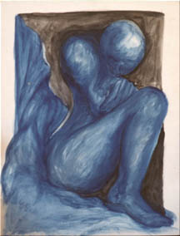
Personal Professional Stories
Developing a passion for relieving human suffering from salient clinical experiences
Notes:
I was working as a nursing student between my junior and senior year. One night shift about 3 am, as I was checking on my patients, a gentleman said to me: “please help me die”. In a typical student fashion, I said let me get the nurse. He grabbed my hand and said please, please help me die. So I replied and said I can’t do that but why do you want to die. So I listened to his story of pain and his journey with cancer. I did get the nurse and she did provide him with medication …. I will never forget that man’s face and how unbearable pain can be at times that one might want to choose death. I feel perhaps that led me on my journey of clinical care, scholarship and to research on symptom management. The story drives my work and teaching of nursing students that the important work we do is to provide symptom management

Slide 4


Another story
The need to provide health education in terms that the client can understand
Health literacy
Notes:
Here is a story that I share with my students. As a nurse on the Cancer Research Unit at Stanford, I was caring for a 16 year old young man. He had been diagnosed with Stage IV Hodgkin’s disease. He was to start on his chemotherapy regimen and the physician’s had come in to talk with him about the treatment. As they were relating to him the long-term effects of therapy, they told him that he would be infertile. I noticed that his eye’s widened at that point. The physician’s finished talking with him and left the room. I asked him if he had understood what they had said and he replied not really. I then said that I noticed you reacted to the work infertile, do you know what that means? He shook his head no and I said it means that you won’t be able to have children but you will be able to have sex. He let out a huge sigh and said ‘thank God’.
I use this as a lessen to make sure in all of our discussions with client’s that we speak in plain language and verify that they understand.
This type of story is one that student’s tend not to forget!

Slide 5
Doctoral work
Education intervention for persons undergoing treatment for Hodgkin’s Disease
Examined Parson’s sick role theory and postulated that a more active role during illness

Slide 6
ECU College of Nursing
Education intervention- self care behaviors for women receiving breast cancer radiation and/or chemotherapy
  Collaborator: Dr. Susan A. Williams, CON
Quality of life in breast cancer survivors
  Collaborators: Dr. Marieke VanWilligen, Sociology; Dr. Ken Wilson, Sociology, Dr. Susan A. Williams, CON

Slide 7
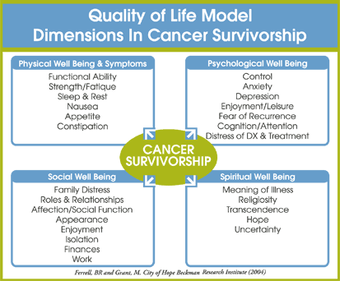
Theoretical model for holistic quality of life

Slide 8
Promoting health
Nursing involves caring for individual, family, group and populations
Interactive system
Populations
Community
Family
Individual
Notes:
Often the focus is the individual but it is important to recognize that each individual resides in a family, that resides in a community that is part of a population.
Health behaviors are highly influenced by family community and population

Slide 9
Case Studies
Concept that is emphasized is Holism and quality of life
Client presented in a particular setting (hospital, clinic or home)
Students provided with basic history and data that would likely be obtained in setting
Physical
Well-being
Psychological
Well-being
Client
Social
Well-Being
Spiritual
Well-Being
Notes:
Faculty prompts the students by ask specific questions to elicit aspects of the client’s well being. What are the physical symptoms that client is experiencing, the patient will be taking a certain drug, what outcome would you expect, what are potential side effects, what instructions are needed? What is the state of the person’s psychological well-being? What has been observed about the client’s mental status? What questions would you ask?

Slide 10
Case study example
Physical
well-being
Symptoms: SOB, Fatigue,
Pallor
Lab results: ↓RBC, H/H, iron
Medication: Iron
Diet: what foods contain iron
Psychological
Well-Being
Recent loss of mother
Listless
Interaction with father
Client
Female
14 years old
Social
Well-Being
Oldest girl in family of 3 children
Mother died less than year ago
Father relies on her to cook &
do housework
What is their social support system?
Economic situation
Spiritual
Well-Being
Expressions of grief
Religion
Notes:
With data gathered, students create a concept map with a set of nursing diagnoses

Slide 11
#1
Imbalanced Nutrition: less than body requirements
r/t inadequate iron in body AEB paleness, fatigued appearance and client’s verbal report of ‘being tired all the time’.
Rationale: client needs to consume more iron as there is insufficient iron in her body and in order to combat iron loss during menstruation.
Candy, 13 year old female. Lives with father and younger sister, mother died 7 years ago. Close family relationship. Father works 12 hour shifts. Candy takes care of the house, gets herself and younger sister to school and prepares dinner. Good student until last semester when grades declined. Began menses 2 years ago, regular 28 day cycle. Pale, fatigued appearance, complains of fatigue. Vitals: temperature 35.9 C (96.6 F), pulse 116, respirations 30, BP 90/60. Lab values: hemoglobin 10g/dL, hematocrit 28%, TIBC 450mg/dl, serum iron 24 mcg/L. Diagnosis of iron-deficiency anemia.
Fatigue
r/t inadequate oxygen delivery to the tissues AEB paleness, client’s expression of ‘being tired all the time’, fatigued appearance.
Interrupted Family Processes
r/t Mother’s death, change in family relationships (i.e., client’s role as family caregiver) AEB client caring for younger sister, preparing family meals, getting herself and younger sister ready for school.
Rationale: Client’s role as family caregiver after mother’s death is superseding client’s family role as child.
Rationale: client’s fatigue is directly related to disease process.

Slide 12
Concept Map
Candy’s chief medical diagnosis: iron deficiency anemia
Priority assessments: Hb 10g/dl, pulse of 116, respirations of 30, body temp of 96.6, Hct 28%, TIBC 450 mg/dl, serum iron 24 mcg/L, and pale skin.
Fatigue r/t decreased oxygen supply to the body, increased cardiac output aeb pulse 116, respirations 30, pale skin, and temperature of 96.6 degrees.
Caregiver role strain r/t amount of activities aeb changes in school performance and lack of time to meet personal health needs.
Priority diagnosis
Imbalanced nutrition: less than body requirements r/t iron deficiency aeb Hb 10 g/dl, Hct 28%, TIBC 450 mg/dl, and serum iron 24 mcg/L.
Rationale: Correcting the iron deficiency can be done efficiently with iron supplementation and inclusion of iron rich foods to the patient’s diet. This will help alleviate the symptoms of fatigue, increased heart rate, increased respirations, pale skin, and lowered temperature

Slide 13
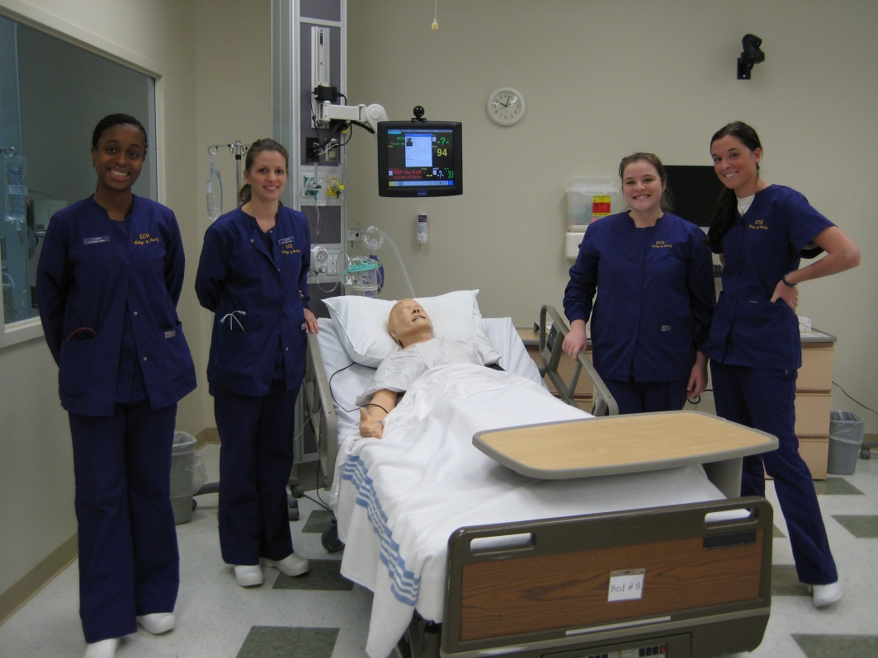
Simulations with high fidelity manikins
Admission Date: November 8,2012
Today’s Date: November 9,2012
Brief Description of Patient:
Name: Mary Allen | Gender: F
Age: 84 | Race: White
Ht.: 64 in. | Wt.: 50 kg
Religion: Baptist | Phone: 252-555-6008
Major Support: Daughter
Allergies: penicillin | Immunizations: N/A
Attending Physician/Team: Orthopedic Surgery
PMH:
HTN, managed w/ HCTZ
Osteoporosis, managed w/ calcium & vitamin D
HPI:
Fractured L hip as she was leaving church Sunday morning. s/p ORIF on Nov. 8 @ 1100 & admitted to unit @ 1400 on same day. Currently has IV, foley catheter, & continuous pulse oximetry.
Social Hx:
Lives independently & able to manage household w/o help. Husband died 3 years ago. Active in her community.
Primary Dx: L hip fracture
Surgeries/Procedures: ORIF, L hip

Slide 14
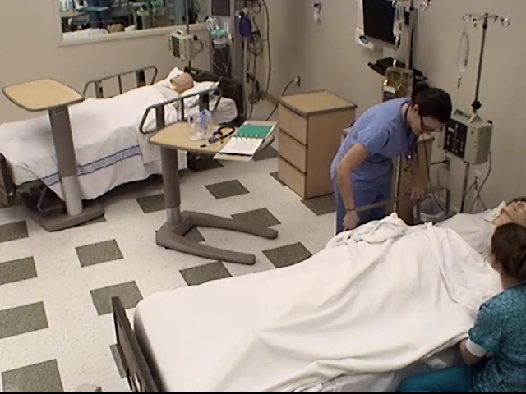

Slide 15
Discussion of debriefing
The debriefing provided an opportunity for students to evaluate their own actions and describe what they would do differently the next time
Students were able to determine that Acute Pain as keystone diagnosis or priority.
Students identified that pain management interventions would improve cognition and stabilize the vital signs.

Slide 16
REFLECTION
Need to assess mental status; review chart, teach patient to CDB, raise HOB more; do full assessment
FRAMING
OUTCOME STATE
O2 sat≥95
BP normal
PAIN ≤3
Pt oriented and calm
PRESENT STATE
Post op pt. hip ORIF
HR 99, O2 sat 91, BP 163/92
Pain 7 on scale of 1 to 10, patient agitated and confused
JUDGEMENT
Pain reported 3/10
O2 sat 93
BP normal
Pt calmer
CUE LOGIC
Acute Pain
TESTING
Assessment and vital signs
DECISION MAKING
Administer O2 at 2 L NC; Pain medications, educated patient regarding pain management, educated family re: home care, pain management; Removed restraints once pt. calm; Raised HOB for comfort and breathing

Slide 17
Confidence before and after simulation
(Scale 0= not at all 5=extremely confident)
Question | Before | After | Change
Focused assessment Mental Status assessment Critical Thinking ability Communication Interventions Pain Management | 2.72 2.68 2.4 2.6 2.36 2.27 | 3.76 3.88 3.72 3.6 3.48 4.0 | +1.02 +1.28 +1.32 +1.0 +1.12 +1.73
Notes:
Following simulation, students were asked to rate their confidence in focused assessment, mental status assessment, critical thinking ability, communication, administering interventions and pain management before and after the simulation experience

Slide 18
Conclusion
By using stories or narratives in various forms, students learn how to apply nursing concepts in context and translate this ability to clinical application

