Slide 1

Notes:
fdd

Slide 2

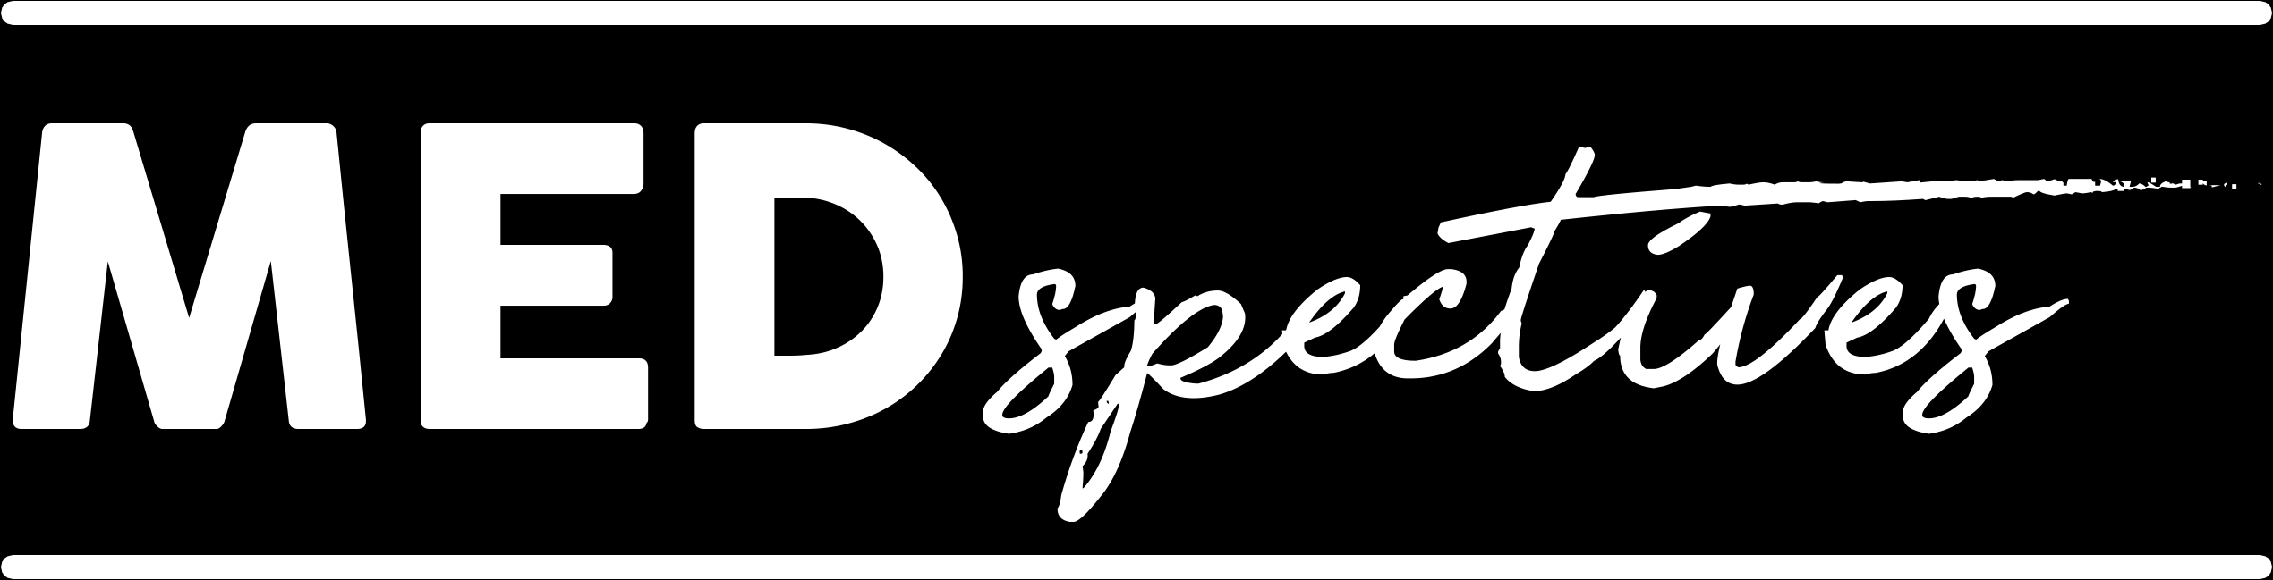
The Podcast of Medical Stories
Notes:
Welcome to Medspectives, the podcast about healthcare professionals, the stories of their practice, and their diverse perspectives into the world around us. I'm your host, Arvind Rajan, what you just heard is the podcast intro I roll for every episode. Today I'm excited to be presenting to you my reflection on the past 8 months I spent working on this project, how it changed my life, and how it will continue to do so well into the future.

Slide 3
TABLE OF CONTENTS
BACKGROUND
01
THE PROJECT
02
METHODOLOGY
03
RESULTS
04
Why should people care?
What is Medspectives?
How?
What have I learned?
Notes:
ToC - I'll be sharing my entire journey, from my initial inspiration, the details of what Medspectives is, how exactly I did it, and the countless lessons I learned.

Slide 4
01
BACKGROUND
A lot of news coverage, from the wrong people.
The harsh realities were hidden behind faceless numbers.
I wanted to know the perspectives of the health professionals sacrificing their lives to fight the pandemic.
Notes:
BG - The inspiration behind Medspectives came during quarantine. My parents had the TV running all the time with news about COVID, and I noticed that most of the news was coming from news anchors and politicians, instead of from the frontline workers that were sacrificing their lives every day to fight this disease. I wanted to know their perspectives, beyond what could be covered in news stories, and straight from the source. I also was frustrated with the media's fixation on the numbers regarding COVID. As important as it was, this focus seemed to hide the realities of individual patients from the public.

Slide 5
THE PROJECT
“THE PODCAST
02
about health professionals,
the stories of their practice, and their diverse perspectives into the world around us.
“
Notes:
The Project - with the growing emergence of podcasts during the pandemic, I realized that this platform was potent in providing extended takes on the experiences of health professionals, and thus Medspectives was born. As you heard in the beginning, it is the podcast about health professionals, the stories of their practice, and their diverse perspectives into the world around us. While it has been mainly COVID focused, it has gradually shifted to encompass much much more.

Slide 6
GOALS/IMPORTANCE
AWARENESS
UNDERSTANDING
STORYTELLING
About what health professionals go through.
Of the diverse perspectives of health professionals.
Sharing anecdotes in the field that increase interest.
Notes:
GOALS - While we all knew that health professionals were having a tough time on the frontline, I wanted to raise awareness about just how difficult it is and highlight the struggles that they faced. As a future healthcare professional, I wanted to understand the experiences of healthcare professionals, from paramedics to physicians, in different parts of the world to ultimately gain a greater understanding of the field. I also think health professionals tell some of the most interesting stories, and wanted Medspectives to be a place where they could share them.

Slide 7
METHODS
POST
RESEARCH
06
01
EDITING
05
REACH OUT
02
04
CONVERSATION
03
PLAN/SCHEDULE
03
Upload to Anchor, and promote on Instagram/Facebook
Identify health professionals.
The most time-consuming step.
I’ve sent out about 100 DM’s, emails, etc.
The best part!
health professionals are busy!
Notes:
METHODS - Every episode/conversation I had essentially went through 6 stages. 1st, I would find health professionals, then reach out to them. This was done on social media or via email, which was a daunting process that I will discuss in more detail later in this presentation. We would then find a time in their busy schedule where they were available, and I would further plan what kind of questions I would be asking them depending on what they've done or what their specialty is. Then, number 4, which is the best part, we talked! This part was harder in the beginning, but it only got easier and easier. Step 5, was editing - this took an extremely long time in the beginning, but I've been able to do it much more efficiently as I've gotten more used to it. Step 6 was to post it, and share it on social media. I also posted conversation snippets throughout the week on social media.

Slide 8
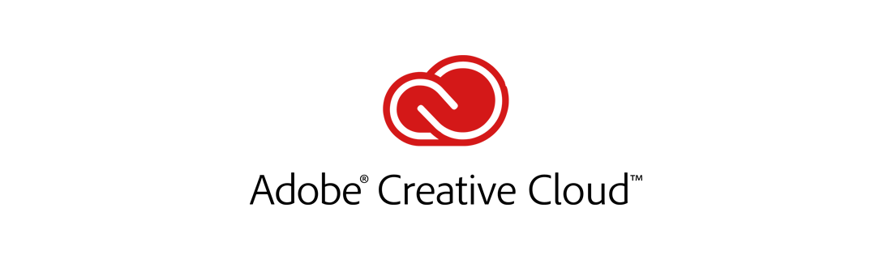
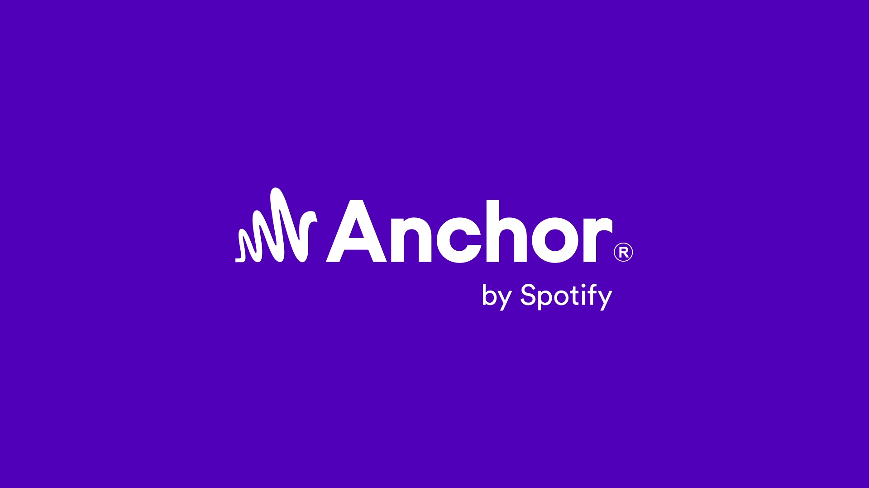
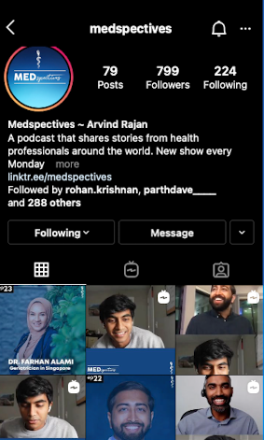
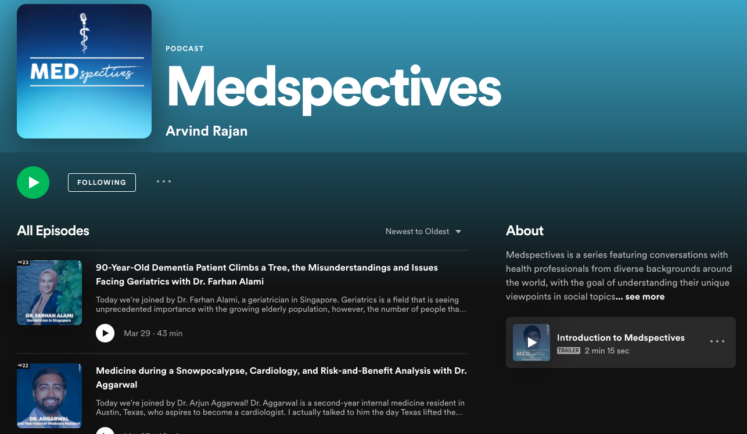
MATERIALS
SOFTWARE
Anchor.fm – Free Podcast Hosting
Instagram – Outreach/Publicity
Adobe Audition + Premiere Pro - Editing
Zoom – Meetings
HARDWARE
Microphone
Laptop
Camera
Notes:
MATERIALS - Running the podcast didn't cost much financially. I used Anchor.fm which is a free podcast hosting platform that shared Medspectives on all podcasting platforms. I used Instagram to grow an audience and provide updates. I used Adobe Audition to edit the audio, and Adobe Premiere to edit the video segments, which are both provided through ECU. I used Zoom to meet with my guests and recorded the video and audio through it. I used my laptop and a camera I already had, and bought a microphone for the podcast.

Slide 9
RESULTS
What did I learn?
Notes:
RESULTS - now comes the interesting part - what did I learn?

Slide 10
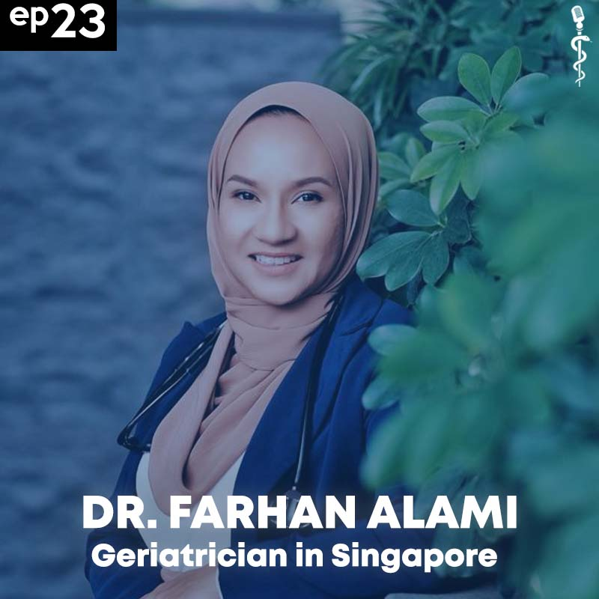
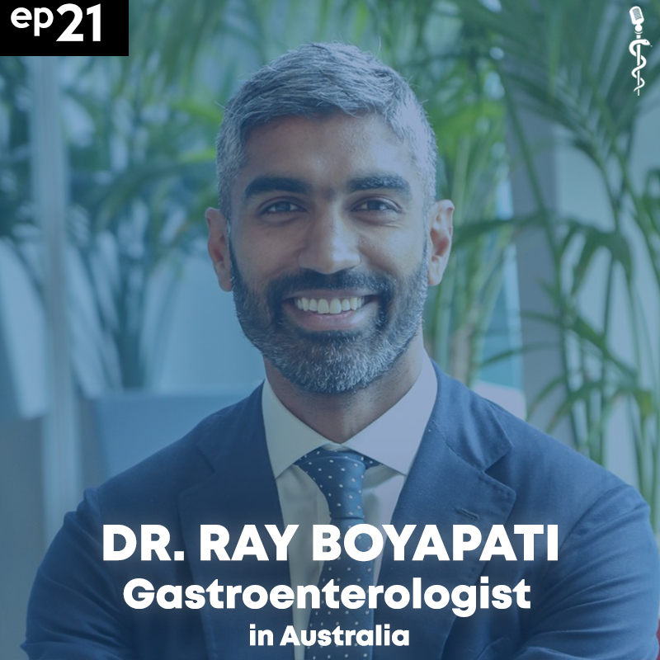
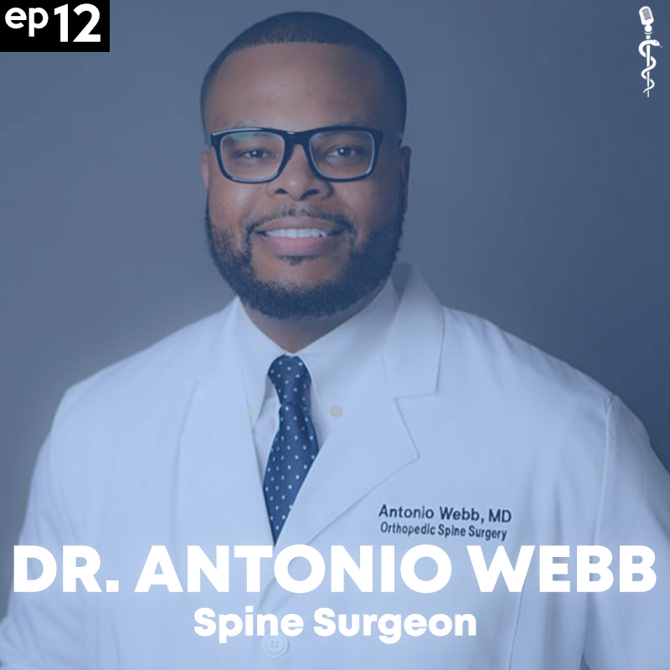
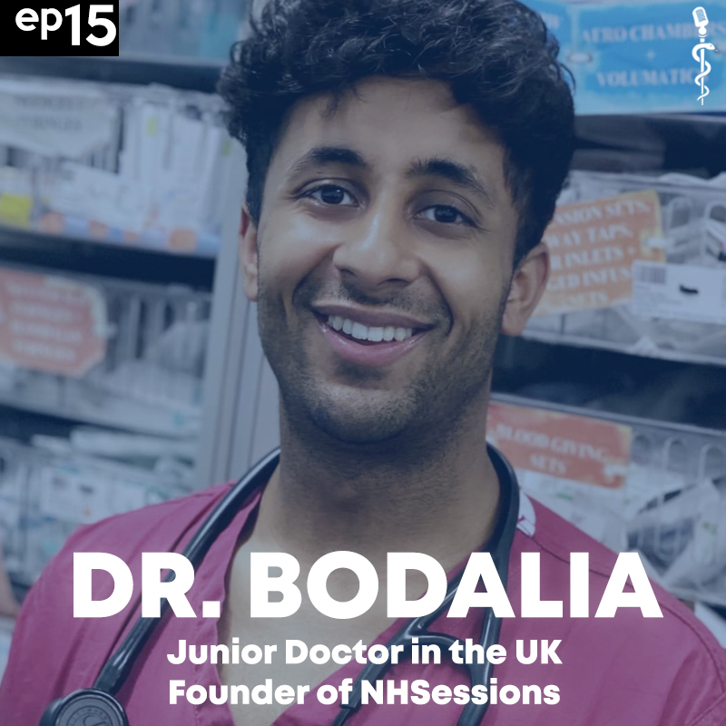
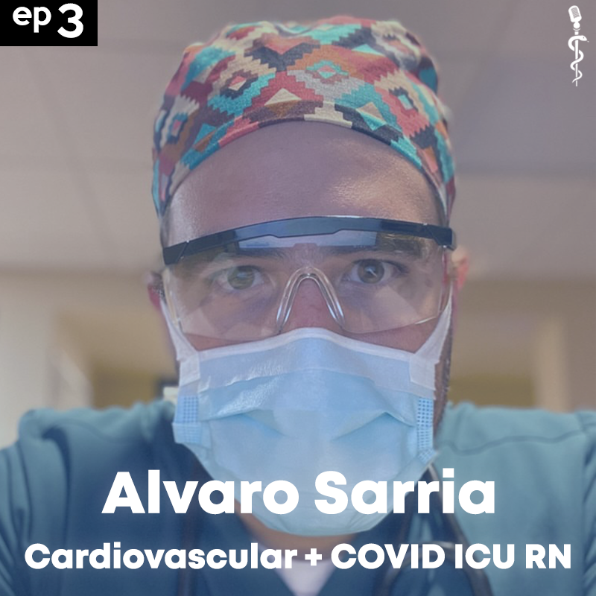
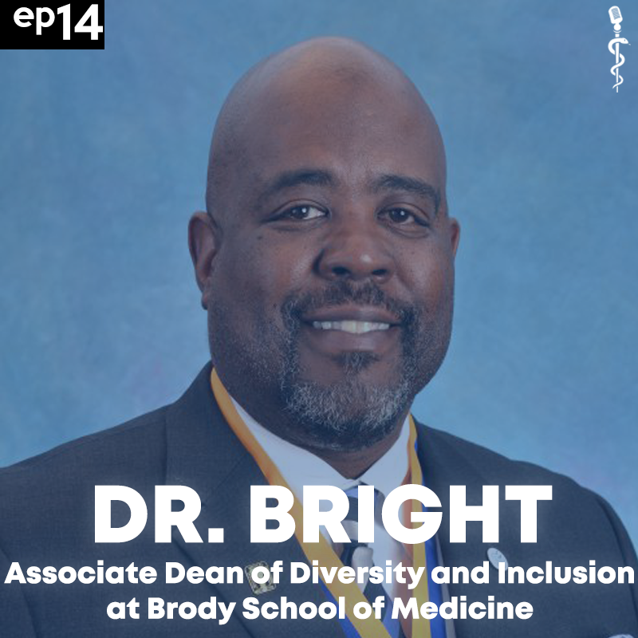
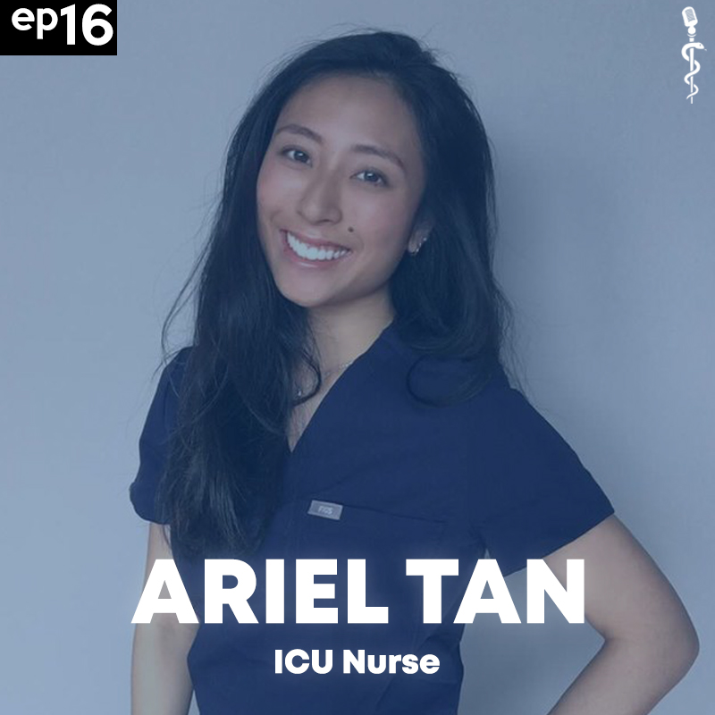
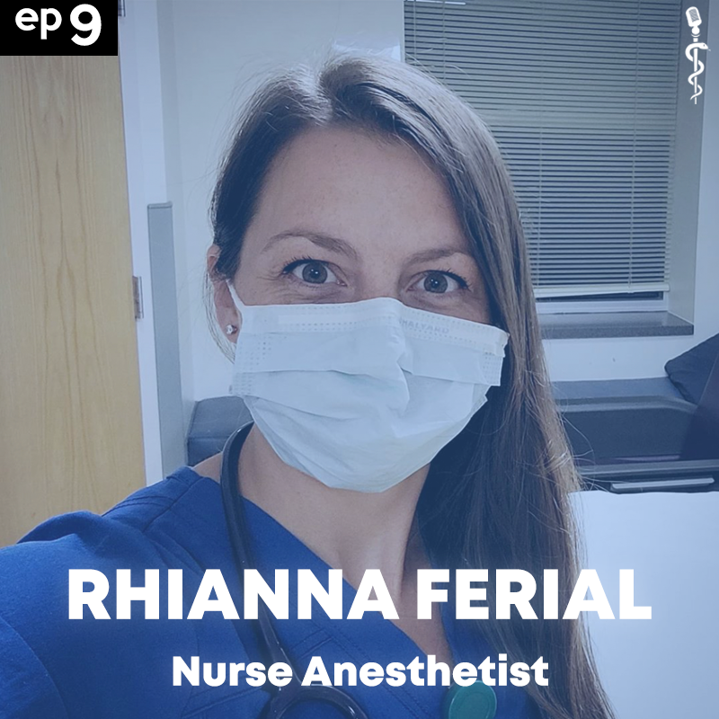
SOME OF THE GUESTS
Notes:
SOME OF THE GUESTS - well first, I was able to make connections and friends with physicians, paramedics, and nurses all around the world. As of this presentation, I have published 23 episodes, and as you can see they span all sorts of specialities from all kinds of locations.

Slide 11
CHALLENGES
Discovering
Conversing
Time Commitment
Notes:
CHALLENGES - This journey, as rewarding as it's been, has been challenging. In the initial stages, I didn't know how to find people to interview - what would I even ask? I remember asking some Brody medical students for recommendations and connections, and that was how I landed my first couple interviews with Brody physicians. I still remember that the first conversation I had back in July was with Dr. Juan March, an emergency medicine physician at Vidant, and listening back to it, it sounds like I was straight interviewing him, and it didn't sound very conversational at all. I think part of it was that I felt a sense of like relative incompetence - obviously an experienced physician knows a lot more than me, but I think I wasn't comfortable enough yet to make the conversation flow as well. Listening to my more recent episodes I feel like I've gotten much more comfortable with my guests and I think this skill will really help me once I'm in medical school to connect with all kinds of physicians and professionals. Medspectives also quickly became a very large time commitment. especially in the beginning when I was trying to figure out the best way to do things, and the most efficient ways to edit the episodes, it took me a long time to establish a system. But eventually, I was able to make a system, and plan things out much better which has enabled me to balance medspectives on top of being a fulltime student.

Slide 12
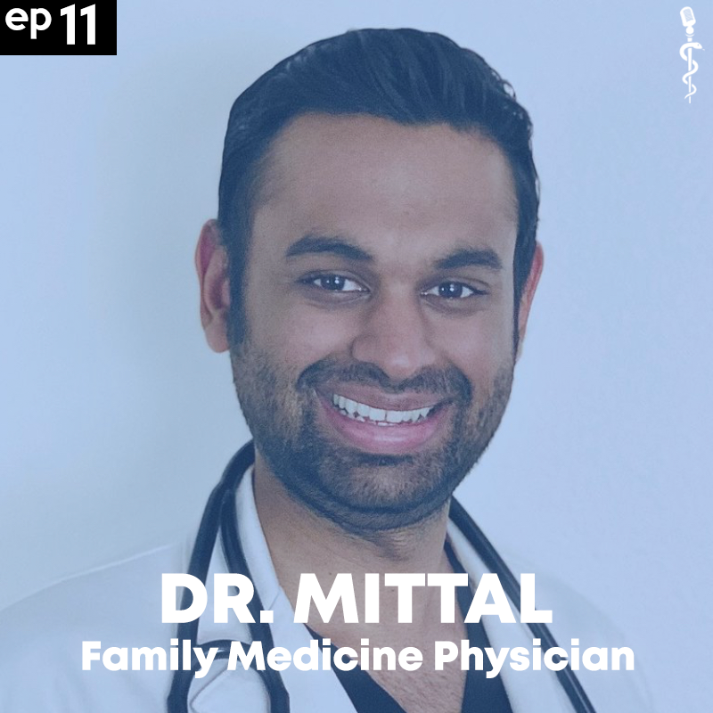
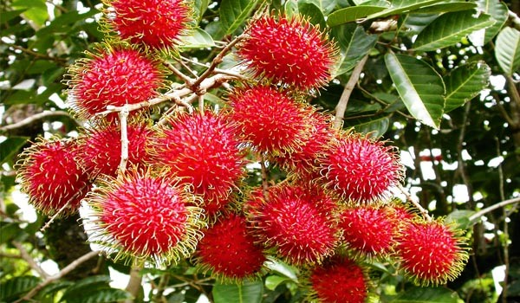
MEDICAL STORIES
HEARTBREAKING
EYE-OPENING
UNBELIEVABLE
INSPIRING
- Feeling of powerlessness against COVID
- 14-year-old suffers from a heart attack without knowing
- 90-year-old dementia patient climbs tree seasonally
- Overcoming the odds and becoming a physician
Notes:
STORIES - now, stories, this is probably the best part! I could talk to you all day about these stories, but I want to share four different stories that highlight four different emotions. During a global pandemic, the feeling of heartbreak has been widespread. The third person I interviewed was Alvaro, a COVID ICU nurse in Arizona, and he shared a story that captured this sentiment and that I think about to this day. He told me about a COVID patient who was in her 70s, that also had comorbidities like congestive heart failure. Alvaro was wearing a full suit of PPE, and the patient could only see his eyes, but she held him and said, "Please don't let me die." Almost fresh out of nursing school, and thrown into a pandemic to treat patients with this unknown condition. What kind of reassurance could Alvaro give? He shared his feeling of powerlessness and the reality was really heartbreaking. I've heard some eye-opening stories. Dr. Mittal told me about a 14-year-old patient who had come in after a softball tournament because she had some chest pain. Turned out she had a heart attack from a rare condition called kawasaki disease where blood vessels become inflamed. It's said to be connected to the presence of a rash some years prior to the damage, but she had to get airlifted to get open heart surgery done. I've heard some frankly unbelievable stories. Dr. Farhan is a geriatrician, and she told me about a 90 year old dementia patient she had that would climb a rambutan tree whenever it bore fruit. Despite his family's attempts to stop him, he would always find a way to climb the tree. The family finally had to just cut down the leaves before it bore fruits so he wouldn't climb it. I've heard inspiring stories. Dr. Antonio Webb, grew up in a dangerous part of Shreveport, Louisiana, and watched his friends and relatives go in and out of jail. He noted how easily he could have been among them, but he overcame the odds, and joined the military as a medic. After he left the military, he suffered from PTSD, but never gave up on his dreams to becoming a physician. He had to take retake the MCAT twice, until he finally got in. He now is a spine surgeon and inspires students all across the world to keep working hard on their dreams to becoming a physician. And that's just four of many many many more stories.

Slide 13
NETWORKING
Internationally
Across Specialties
Mentorship
Notes:
NETWORKING - I've learned just how willing healthcare professionals are to support students on their career into medicine. The doctors and nurses I've talked to have pushed me to pursue new opportunities and give me connections with other doctors. I've gained mentors from the UK, Singapore, Australia, and all across the US, and these people have genuinely made a huge difference in my life, and in my future.

Slide 14
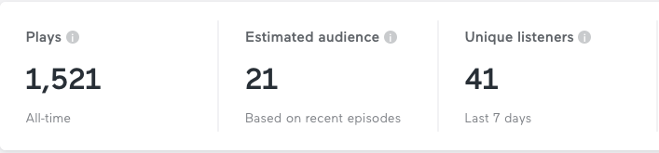
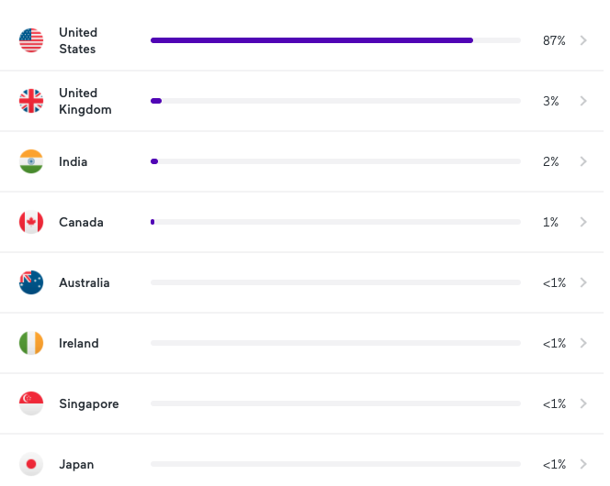
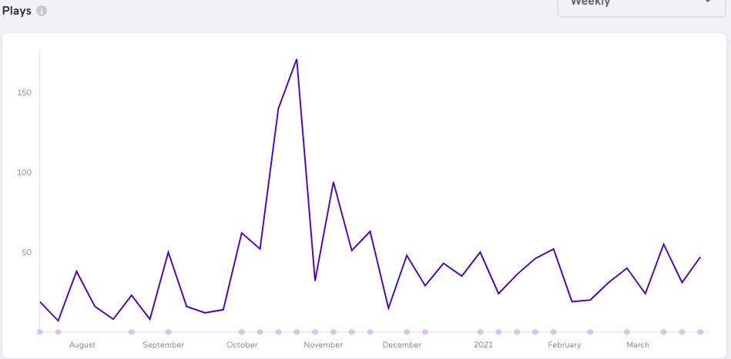
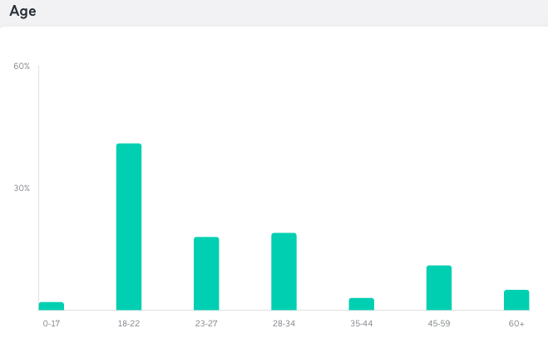
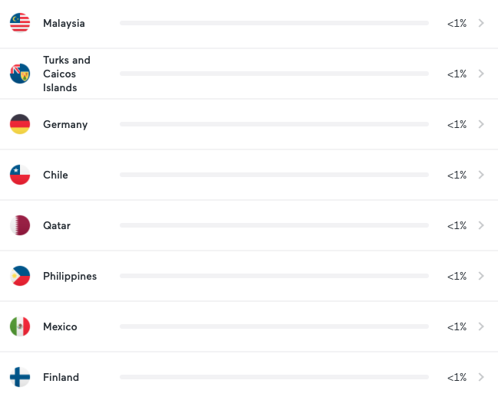
REACH
Notes:
REACH - in terms of numbers and performance, here you can see with full transparency the performance of the podcast. As I said earlier, I have made 23 episodes as of now, and have amassed about 1,521 plays within it all. As you can see, podcast growth is difficult, but I am extremely thankful for everyone that tunes in and enjoys listening as much as I enjoy talking to these people. It is crazy to me how people all across the world have listened to it, and across all different age groups.

Slide 15
THE BIG PICTURE
The Emergence of Digital Scholarship.
Notes:
THE BIG PICTURE - I think the implications of this project warrant a look at the big picture of what this is a part of. And this concept is digital scholarship, or the use of digital evidence, methods of inquiry, etc. to achieve scholarly and research goals. Now while this podcast isn't tailored specially for healthcare providers, it is a venue through which healthcare knowledge is being disseminated to the general public. In medicine, this is called FOAMed, or free open access medical education, and it has been seeing major leaps and bounds, especially during the pandemic. The reality is that information that used to be exclusive to professionals in a certain career, is now accessible to a greater audience, in many cases for free. I hope Medspectives can contribute to this availability of free knowledge, and I hope to continue growing it for many years to come.

Slide 16
CONCLUSIONS
REINFORCED MY DECISION TO PURSUE MEDICINE
OPENED NEW DOORS AND OPPORTUNITIES
Notes:
CONCLUSIONS - In conclusion, the last 8 months of Medspectives have changed my life. Conversing with all these health professionals has reinforced my decision to pursue medicine, and has enabled me to stay curious about the boundless field. It has also opened countless doors through the wonderful people I've met through it, and I'm excited to meet these people in person as we -fingers crossed! - begin to put this pandemic behind us.

Slide 17
THANKS!
Thank you to my mentor Dr. Eagan and all the kind health professionals that allowed me to talk with them!
Do you have any questions?
rajana18@students.ecu.edu
https://www.instagram.com/medspectives/
linktr.ee/medspectives
Please keep this slide for attribution
Notes:
I would like to thank my mentor Dr. Eagan for her unconditional support and guidance on this project and thank you so much for listening to this presentation and giving me the opportunity to reflect.

