Slide 1
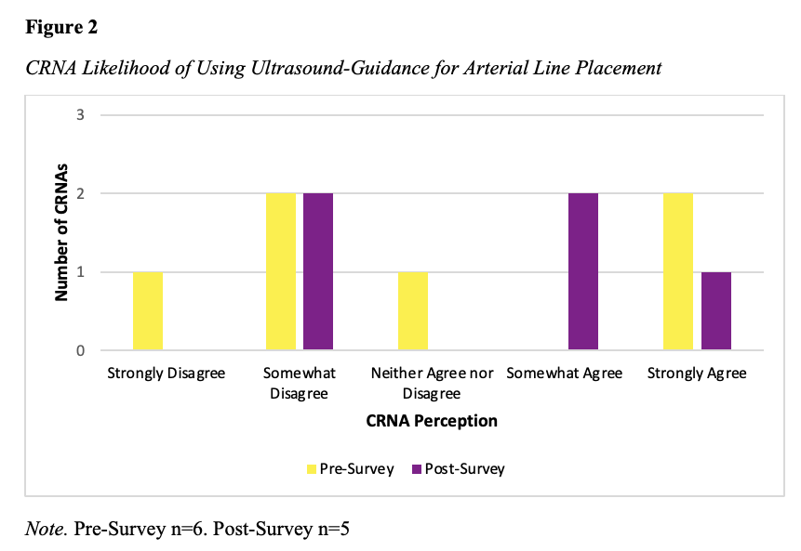
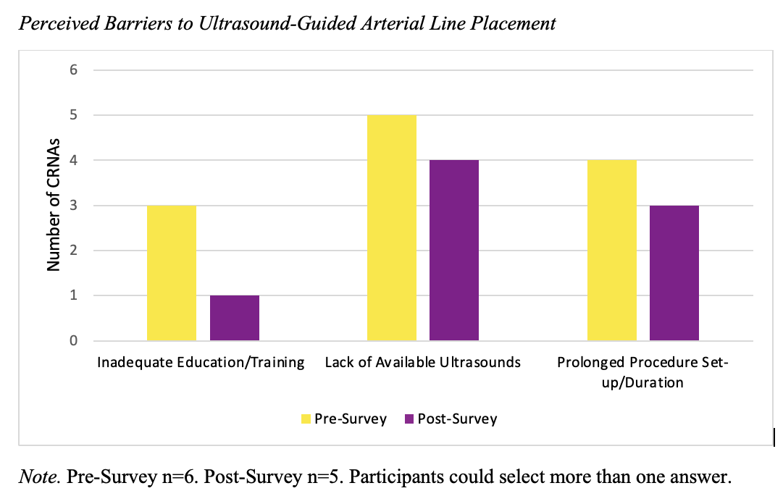
Anesthesia Providers’ Perceptions of Ultrasound-Guided Arterial Line Placements: A DNP Project
Laura Pearce, BSN, SRNA
Travis Chabo, PhD, CRNA, Project Chair
Nurse Anesthesia Program
College of Nursing, East Carolina University
Greenville, North Carolina 27858
pearcela13@students.ecu.edu
INTRODUCTION
RESULTS
DISCUSSION
The use of anatomic landmarks for arterial line placements can be challenging³
Ultrasound guidance (USG) is associated with increased first-attempt success and decreased procedure time⁵
USG has also been shown to decrease surgical delays due to difficult line placements²
Anesthesiologists would like to use USG more frequently and would like to receive training to increase their comfort level¹
The AANA endorses USG to achieve vascular access⁴
The purpose of this DNP quality improvement project was to develop, implement, and evaluate the perceived adequacy of an educational resource designed specifically for anesthesia providers to improve awareness and utilization of ultrasound for arterial line placement.
Figure 1
Pre- and post- intervention surveys demonstrated a general increase in confidence levels and likelihood of use for USG arterial line placements
Three participants responded that their awareness of the benefits of USG increased following the intervention
Four participants reported a lack of available ultrasounds and prolonged procedure set-up/duration as barriers to utilization of ultrasound
Only one participant reported inadequate education/training as a barrier following the implementation period
Limitations included a small sample size, short implementation period and limited opportunities for arterial line placements
CONCLUSIONS
The educational resource was beneficial in increasing knowledge of USG for most participants
The educational tool is an effective and inexpensive method to increase use of USG amount CRNAs
Lack of available machinery and prolonged procedure set-up/duration are barriers that impact current and future use of ultrasound for arterial line placements
Recommendations for future studies:
    Larger sample size
    Longer implementation period
    Increased access to ultrasound machines
    Hands-on ultrasound workshop to complement educational tool
    Project site policies and procedures addressing USG for arterial line placement
METHODS
Figure 2
A single Plan, Do, Study, Act cycle was completed using pre- and post-survey design
Participating CRNAs were emailed a pre-intervention survey using Qualtrics
Participants were asked to view an informational voice-over PowerPoint
They were also provided an electronic and printed summative handout for quick reference
Copies of the handout were laminated and attached to ultrasound equipment in the facility
Following the two-week implementation period, CRNAs were asked to complete the post-intervention survey using Qualtrics
Data was analyzed using Microsoft Excel
REFERENCES
1. Chui, J., Lavi, R., Hegazy, A. F., Jones, P. M., Arellano, R., Yang, H., & Bainbridge, D. (2019). Identifying barriers to the use of ultrasound in the perioperative period: A survey of southwestern Ontario anesthesiologists. BMC Health Services Research, 19(1), 214. https://doi.org/10.1186/s12913-019-4040-2
2. Fatima, H., Chaudhary, O., Krumm, S., Hamza Mufarrih, S., Qaisar Qureshi, N., Oren-Grinberg, A., Bose, R. R., Huang, L, Mahmood, F., & Matyal, R. (2021). Workflow of ultrasound-guided arterial access. Journal of Cardiothoracic and Vascular Anesthesia, 35(6), 1611-1617. https://www.clinicalkey.com/#!/content/playContent/1-s2.0-S1053077020313641?scrollTo=%23hl0000354
3. Gibbons, R. C., Zanaboni, A., Saravitz, S. M., & Costantino, T. G. (2020). Ultrasound guidance versus landmark-guided palpation for radial arterial line placement by novice emergency medicine interns: A randomized controlled trial. Journal of Emergency Medicine, 59(6), 911-917. https://doi.org/10.1016/j.jemermed.2020.07.029
4. Pitman, J. S., Buscemi, M., Funk, E. M., Weaver, S., Thompson, J. A., & Falyar, C. (2023). Incorporating evidence-based ultrasound-guided vascular access (USGVA) standards into the nurse anesthetist armamentarium: A quality improvement project. Journal of Perianesthesia, 38(4), 564–571. https://doi.org/10.1016/j.jopan.2022.11.014
5. Wang, A., Hendin, A., Millington, S. J., Koenig, S., Eisen, L. A., & Shiloh, A. L. (2019). Better with ultrasound: Arterial line placement. Critical Care: Special Features, 157(3), 574-579. https://doi.org/10.1016/j.chest.2019.08.2209

