Slide 1
The therapeutic effect of Rho kinase inhibitor Y-27632 on protection from chemotherapy-induced peripheral neuropathy in mouse model
Zachary Elliott
Department of Anatomy and Cell Biology
Brody School of Medicine
April 17, 2018
1

Slide 2
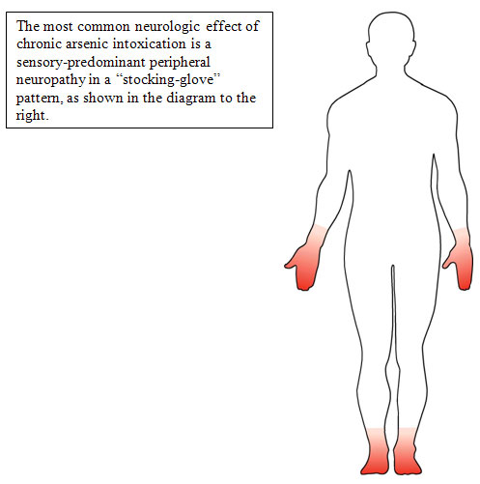
Outline
Background information
  Chemotherapy-induced peripheral neuropathy (CIPN)
  Cisplatin (mechanism of action)
  Previous investigation
  RhoA pathway
Research hypothesis
Approaches
Results
Conclusion
Future direction
Acknowledgement
CIPN

Slide 3
Chemotherapy-Induced Peripheral Neuropathy (CIPN)
CIPN is a condition that affects 30~40% of patients undergoing chemotherapy.
Clinical symptoms of CIPN:
  Acute or chronic pain
  Numbness (“Stocking-glove” distribution)
  Tingling
  Sensitivity of cold and heat
CIPN usually increases in severity as chemotherapy continues and ceases its progression at the end of treatment.
Except Cisplatin

Slide 4
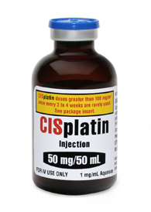
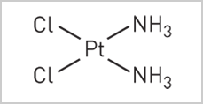
Cisplatin
First member of a class of platinum-based chemotherapy drugs
Used to treat various forms of cancer including testicular, ovarian, cervical, bladder, head and neck, lung, breast, prostate and colorectal.
The inherent cytotoxicity of cisplatin is not limited to tumor tissue, which result in:
  Depressed immune system
  Hair loss
  Nausea
  Vomiting
  Fatigue

Slide 5
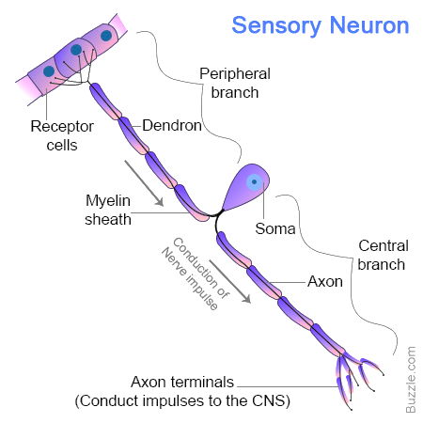
Cisplatin Mechanism Of Action
Non-mitotic cells
Sensory Neuron
Neurons are not a mitotic population of cells.

Slide 6

Mechanism
p75 Neurotrophin
Receptor
Extracellular
Intracellular
GDI
GEF
RhoA
Rho kinase/ROCK
Actin cytoskeleton organization

Slide 7
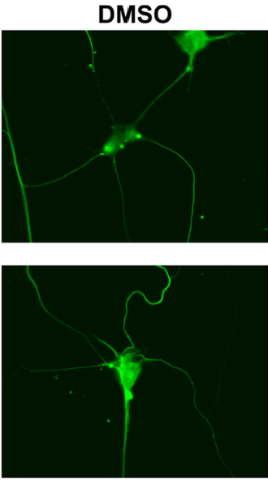
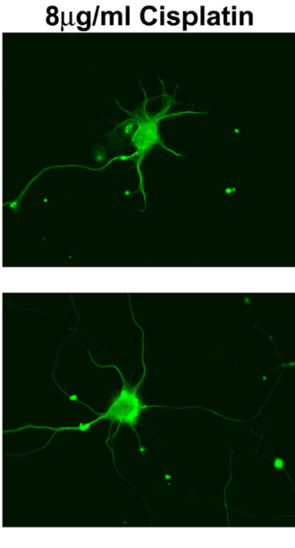
Previous Investigations
β-tubulin III
p75 Neurotrophin
Receptor
LM11A-31
Extracellular
Intracellular
RhoA
LM11A-31
James et al. (2010) NeuroToxicology, 31 (2), 188-194.

Slide 8
Target of Interest: RhoA Pathway
p75 Neurotrophin
Receptor
Extracellular
Members of Small GTPases.
Activity is tightly controlled by positive and negative regulators.
Rho kinase (ROCK)
Clinic Implications
Cardiovascular disease
  Hypertension
  Atherosclerosis
Neurological problems
  Traumatic brain and spinal cord injury
  Stroke
  Alzheimer’s disease
Cancer
  Leukemia, breast, lung, colon, gastric, bladder, and testicular
Intracellular
GDI
GEF
RhoA
Rho kinase/ROCK
Actin cytoskeleton organization

Slide 9
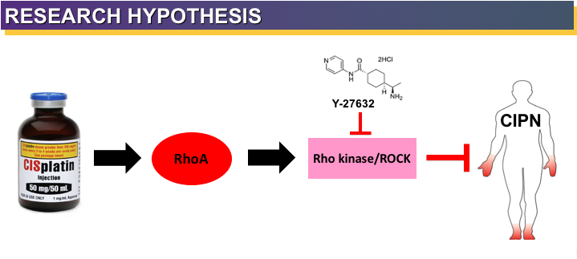

Slide 10
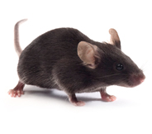
Pharmacological treatment
Female mice
(C57BL6/J strain)
n=40
Female mice
(C57BL6/J strain)
n=10
Female mice
(C57BL6/J strain)
n=10
Female mice
(C57BL6/J strain)
n=10
Female mice
(C57BL6/J strain)
n=10
Saline
Cisplatin
Y-27632
Cis + Y-27632

Slide 11
Pharmacological treatment
Saline
200 uL
Cisplatin
6 mg/g cisplatin weekly for 4 weeks
Y-27632
30 mg/g Y-27632 weekly for 4 weeks
Cis + Y-27632
6 mg/g cisplatin and 30 mg/g Y-27632 weekly for 4 weeks

Slide 12
Result: Y-27632 helps maintain mouse’s body weight and slowed down the cisplatin-induced weight loss in Cis+Y-27632 group of mice.
Values represent mean±sem. *p<0.05, **p<0.0001, relative to Saline. •p<0.05, ••p<0.0005, •••p<0.0001, relative to Y-27632. Δp<0.05, ΔΔp<0.0005, ΔΔΔp<0.0001, relative to Cisplatin.

Slide 13
Approaches
CIPN mouse model
Pharmacological treatment
Von Frey monofilament assay
Peripheral nerve function analysis
Acetone evaporation assay
Immuno-histological analysis
Footpad tissues
Body Weight measurements
Touch sensitivity evaluation
Pain sensation evaluation
Interepidermal nerve fibers (IENFs) density

Slide 14
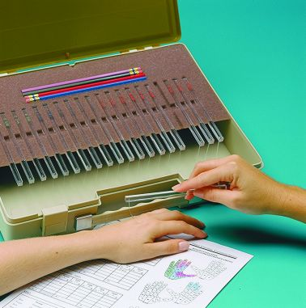
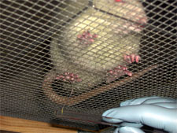
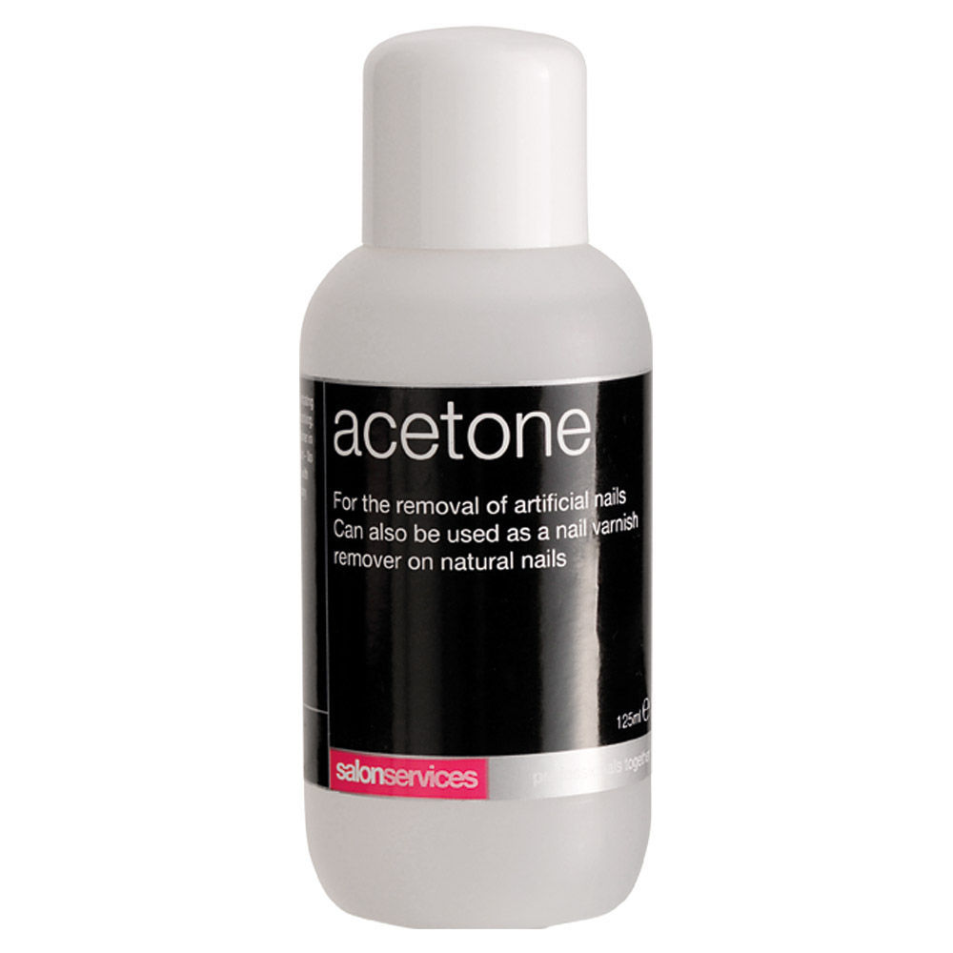
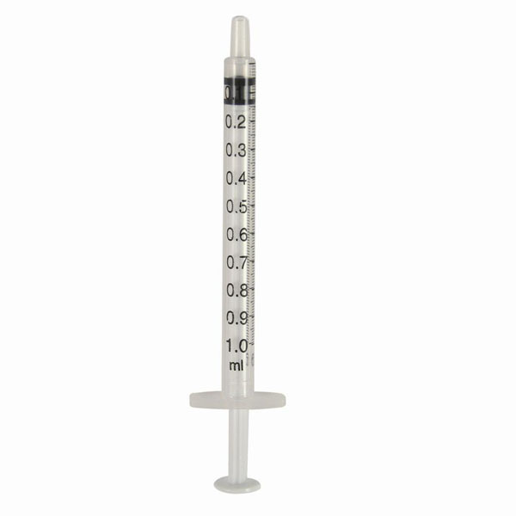
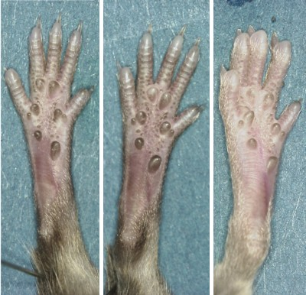
Von Frey monofilament assay
Acetone evaporation assay
50 μl
acetone
Measure the time of licking or shaking the hind paw from each mouse
1ml syringe

Slide 15
Result: Cisplatin-induced reduction of touch sensitivity was ameliorated by Y-27632 while the pain sensation was not affected by all treatments
Force = Touch Sensitivity
Values represent mean±sem. *p<0.05, **p<0.005, ***p<0.001, relative to Cisplatin

Slide 16
Result: Cisplatin-induced reduction of touch sensitivity was ameliorated by Y-27632 while the pain sensation was not affected by all treatments
Time(s) = Pain sensation

Slide 17
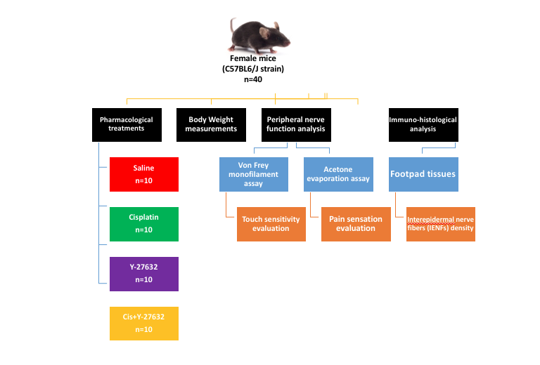

Slide 18
Intraepidermal nerve fibers (IENFs) Density
S-100: myelinated nerve fibers marker (Aβ)
CGRP: nociceptive nerve fibers marker (C)
IENFs Density = Number of IENFs
Length of epidermis
Notes:
CGRP=Calcitonin gene-related peptide

Slide 19
Result: Y-27632 protected touch sensory associated-IENFs from being destroyed by cisplatin treatment, while nociceptive IENFs were not affected by drug treatments
S-100
a.Saline
b.Y-27632
c.Cisplatin
d.Cis+Y-27
Values represent mean±sem. **p<0.01, relative to Saline, Y-27632 and Cis+Y-27632

Slide 20
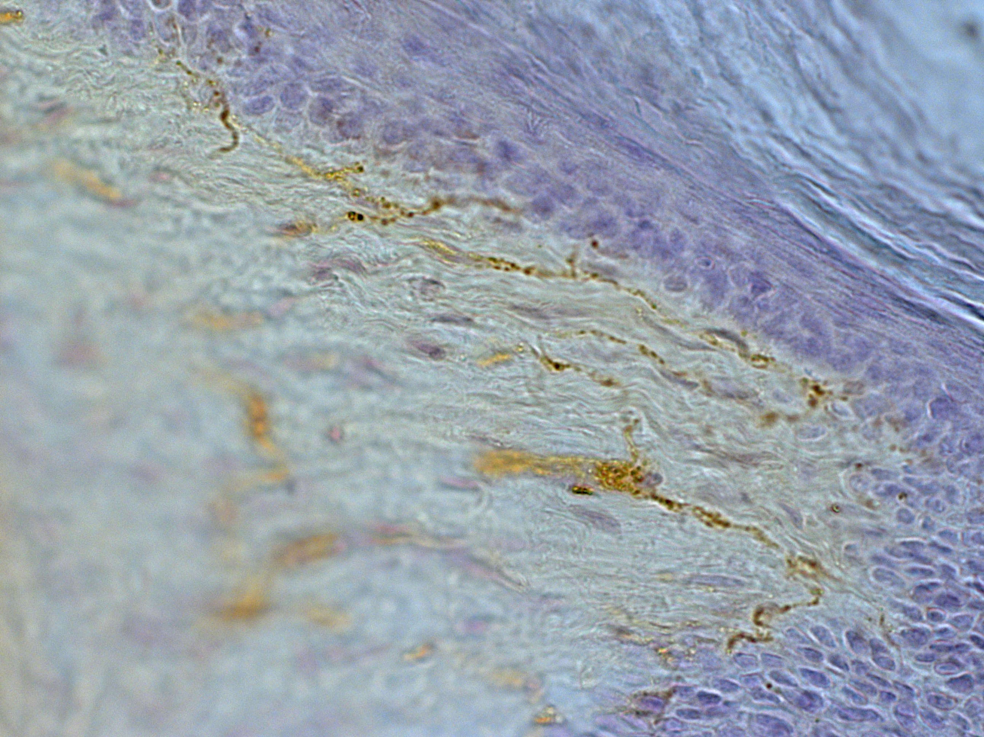
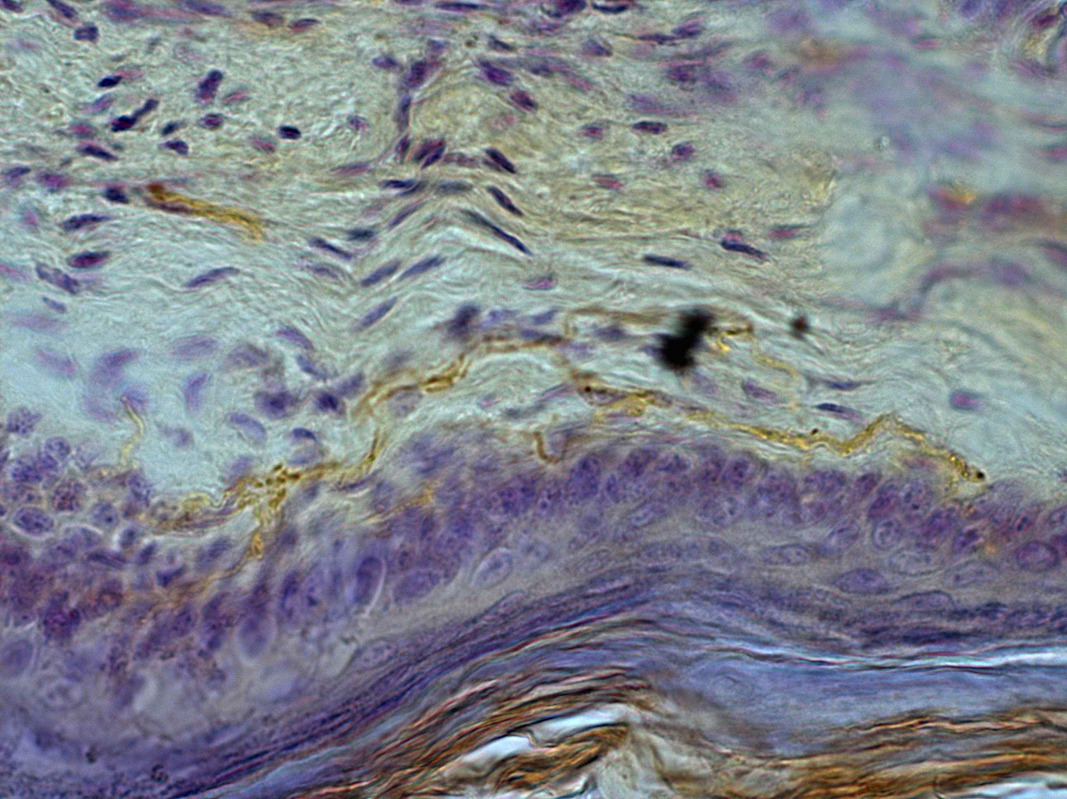
Result: Y-27632 protected touch sensory associated-IENFs from being destroyed by cisplatin treatment, while nociceptive IENFs were not affected by drug treatments
CGRP
a. Saline
b.Y-27632
c.Cisplatin
d.Cis+Y-27

Slide 21
Conclusion
Employment of Y-27632 in the treatment regimen reduced the risks of peripheral neuropathy in cisplatin-treated mice, which also promoted Y-27632 as a potential adjuvant for cisplatin treatment.
By creating CIPN mouse model, we showed the potential clinical benefit for suppression of RhoA pathway in preventing CIPN.
Future experiments may study effects of Von Frey on larger mammals over a longer trial.

Slide 22
References
Boyette-Davis, J., & Dougherty, P. (2011). Protection against oxaliplatin-induced mechanical hyperalgesia and intraepidermal nerve fiber loss by minocycline. Experimental Neurology, 229(2), 353-357. doi:10.1016/j.expneurol.2011.02.019
Friesland, A., Weng, Z., Duenas, M., Massa, S. M., Longo, F. M., & Lu, Q. (2014). Amelioration of cisplatin-induced experimental peripheral neuropathy by a small molecule targeting p75NTR. NeuroToxicology, 45, 81-90. doi:10.1016/j.neuro.2014.09.005
James, S. E., Dunham, M., Carrion-Jones, M., Murashov, A., & Lu, Q. (2010). Rho kinase inhibitor Y-27632 facilitates recovery from experimental peripheral neuropathy induced by anti-cancer drug cisplatin. NeuroToxicology, 31(2), 188-194. doi:10.1016/j.neuro.2009.12.010
Ta, L. E., Low, P. A., & Windebank, A. J. (2009). Mice with Cisplatin and Oxaliplatin-Induced Painful Neuropathy Develop Distinct Early Responses to Thermal Stimuli. Molecular Pain, 5. doi:10.1186/1744-8069-5-9

Slide 23
Acknowledgements
Taylor Leposa
Yi Zhu
Christi Boykin
Qun Lu^{, 3}

Slide 24


Acknowledgements
We wish to acknowledge the technical assistance from Joani Zary Oswald and the members of Dr. Lu and Dr. Verbanac Labs. This study is supported in part by grants from National Cancer institute CA111891 and CA165202 and the Harriet and John Wooten Foundation for Alzheimer’s Diseases Research.

Slide 25
Questions?

