Slide 1
OERs and Alt-Texts in Technical Services: How to Get the Job Done
Course-Adopted Texts at Joyner Library,
East Carolina University
Cindy Shirkey
Head, Collection Development
Joyner Library, ECU
shirkeyc@ecu.edu
Lisa Barricella
Head, Monographic Acquisitions
Joyner Library, ECU
barricellal@ecu.edu

Slide 2
What are Alt-Texts
Course-adopted texts (CATs)
Freely available
Can be articles or books from library
Can be open access

Slide 3
Examples of Alt-Texts
Two places you can find open textbooks are at Oapen http://www.oapen.org/home and Open Textbook Library https://open.umn.edu/opentextbooks/
Some examples of ECU CATs:
  Bloodchild and Other Stories by Octavia Butler
  Encyclopedia of Urban Legends by Jan Brunvand
  Job Search Handbook for People with Disabilities by Daniel Ryan

Slide 4
Classes Using CATs
Lower level and upper level courses
From anthropology to theatre
Both on-campus and distance ed

Slide 5
Bookstore Cooperation
Reluctant partners at first, but now willingly participate
We ask them for “The List”: spreadsheet with resource, author, edition, publication year, course, section, instructor

Slide 6
The List
The raw list needs to be cleaned up
It needs to be searched in Serials Solutions to see if we could have access to the titles
Then it gets searched in Gobi to see what type of license we could buy for each title: we’re primarily interested in unlimited license e-books

Slide 7
Buy-in from Faculty
Send faculty emails
  Ask if they’d be willing to let students use electronic version
  Most say yes
  A few say no
    Royalties
    Students should own book for future reference
    Concerns about access
    Absence of content in online that is included in print
    Image Quality

Slide 8
Getting the Item
We purchase the item like any other e-book
Activate it in Serials Solutions
Update the LibGuide: http://libguides.ecu.edu/coursetexts
Catalog it so it’s in our catalog

Slide 9
Projected Savings
Track number of courses, sections, number of students and bookstore cost and library cost and you can come up with an estimated savings amount
The library spent $6,141.77
It saved approximately $241,876.66
Involved 144 professors
235 class sections
167 titles in all, some of which were already held by ECU

Slide 10
Usage
What types of usage are we seeing
  User sessions
  Number of pages viewed
  Pages printed
  Full title downloads

Slide 11
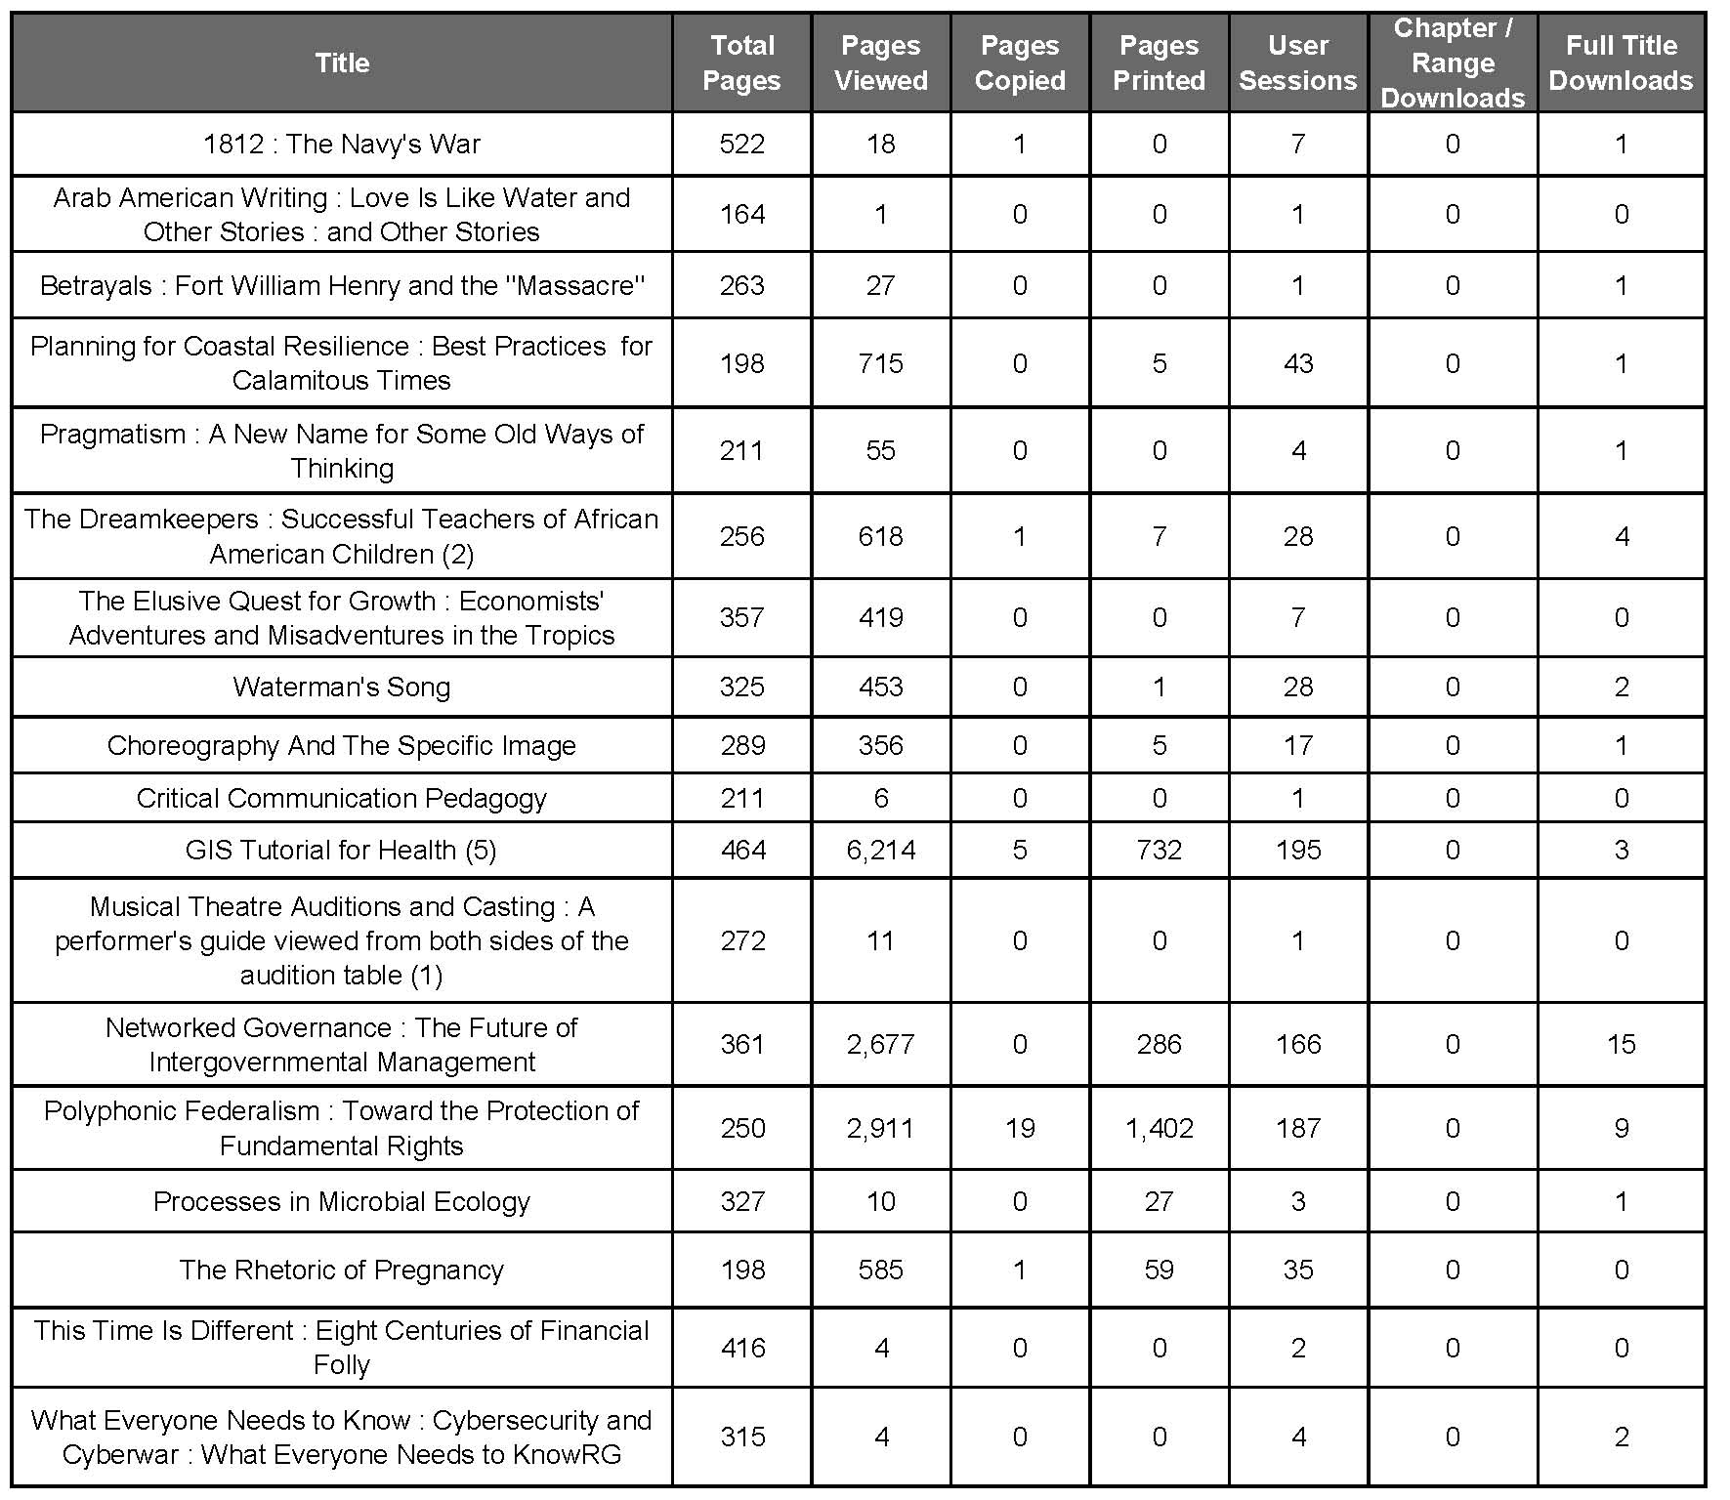

Slide 12
What We’ve Learned
Editions matter
Nothing with course access codes
EBL concurrent license has worked
Added publishers: JSTOR, ProjectMuse
Least DRM possible
Some always fall through the cracks and we have to pick them up later
Remember to count repeating courses over multiple semesters when calculating cost savings

Slide 13
For the Future
Would a 3 concurrent user license be ok for a small seminar class?
Make LibGuide into something better
  Database driven replacement
Reference:
Patrick L. Carr, James D. Cardin & Daniel L. Shouse (2016) Aligning Collections with Student Needs: East Carolina University's Project to Acquire and Promote Online Access to Course-Adopted Texts, Serials Review, 42:1, 1-9, DOI: 10.1080/00987913.2015.1128381

