Slide 1
Linked data in ECU digital collections
Patricia Dragon
East Carolina University
North Carolina Library Association
October 16, 2019

Slide 2

ECU digital collections
Developers
Project managers
Metadata experts
Curators
Archivists
Preservation experts
Digitization experts
Student workers
Grant staff
Notes:
Background on who we are: ECU Digital Collections operational at least 18 years, have built a large collection. Cross-departmental team of which my dept is a small part (locate metadata). Catalyst was a dual migration: digital collections homegrown to Couch DB, open source software offered by Apache similar to Fedora; manuscript collection guides Archivists’ Toolkit to ArchivesSpace.

Slide 3
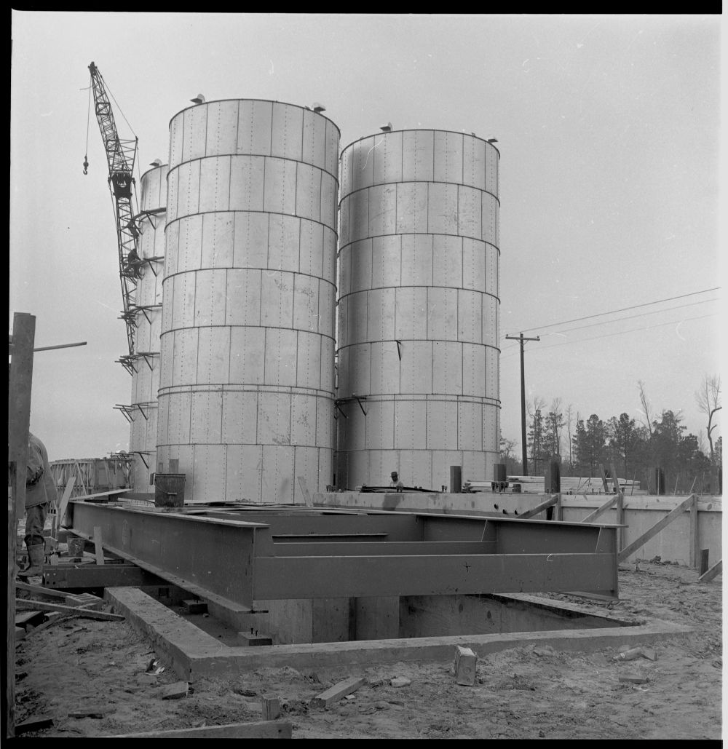
Goals of the project (for cataloging)
Reduce silo work
Increase correspondence between Digital Collections and Manuscript Collection guides
Bring them both closer in line with LCNAF and LCSH
Create a clear database of record for local authorities
Farmville FCX silos
Notes:
Though it was not the main reason for migrating, we believe migration will improve workflow for catalogers. Right now we work in silos. Catalogers work in a number of different databases. Have to do similar things (describe materials) in all these databases. Many names and subjects are shared. Right now the effort of ensuring agreement between silos falls on the cataloger to do manually, what about names that are not in the LCNAF, where there is no clear database of record? Goals of the project (slide).

Slide 4
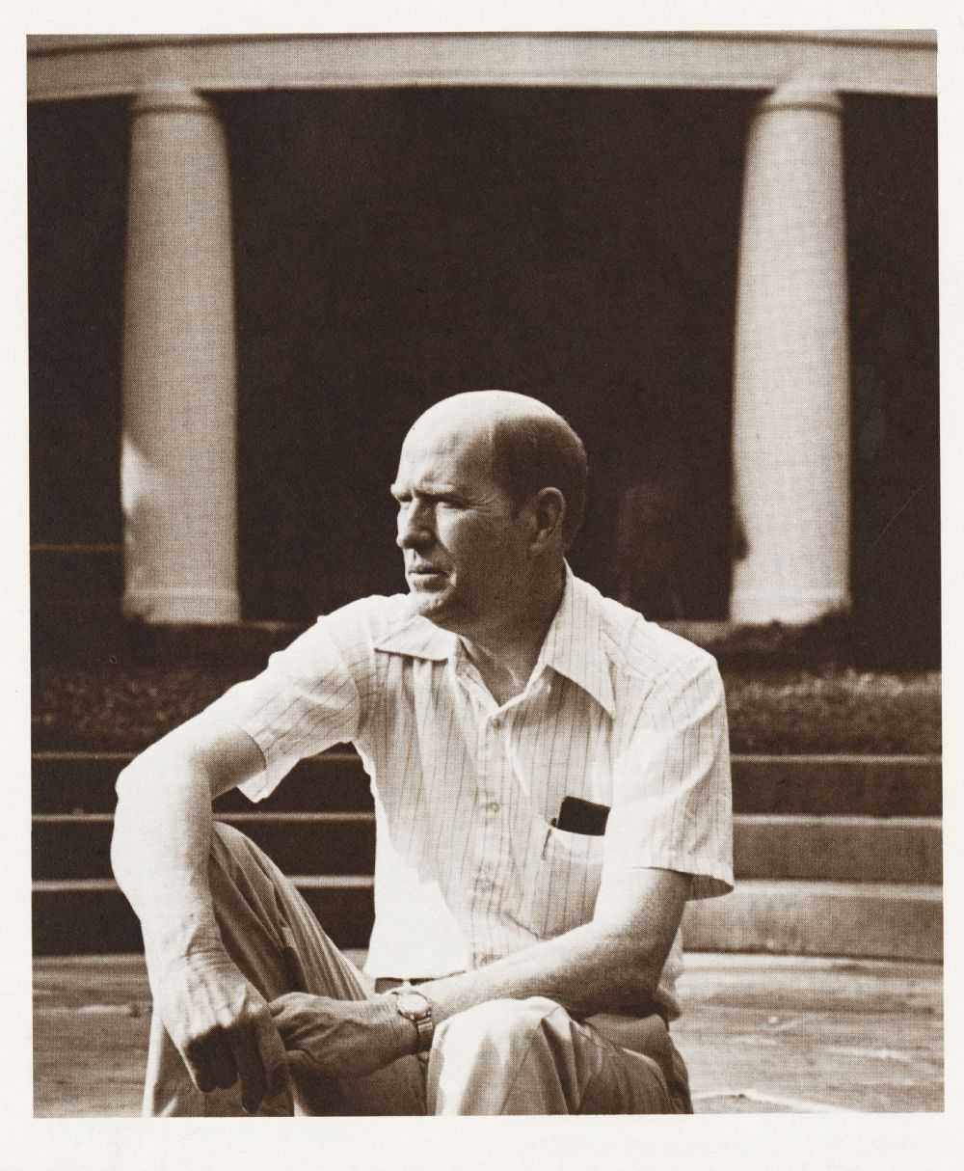
Linked data
Label | URI
Ammons, A. R., 1926-2001 | http://id.loc.gov/authorities/names/n79081537
Reynolda House Museum of American Art | http://id.loc.gov/authorities/names/no2013044619
Poets, American | http://id.loc.gov/authorities/subjects/sh85103735
Winston-Salem, N.C. | https://www.wikidata.org/wiki/Q49227
photographs | http://vocab.getty.edu/aat/300046300
still image | http://purl.org/dc/dcmitype/StillImage
In copyright - Educational use permitted | http://rightsstatements.org/vocab/InC-EDU/1.0/
A.R. Ammons
Notes:
How can we make the silo situation better? Employ linked data and let the data do some of the work for us. As you know, one of the principles of linked data is to use uniform resource identifiers (URIs) to refer to things in lieu of text strings or labels. So what are we linking to (slide)? Advantage of things over strings: Makes it so that a change can be made in a central location, then all resources linking to the central location can be updated more easily by virtue of the links. Focus on names and subjects.

Slide 5
Authority database
Authority Database
Digital Collections
Manuscript Collection Guides
External URIs
Names
Subjects
Notes:
Developer created a local authority database that stands separate from digital collections and separate from ArchivesSpace, but will connect to both. Authority database contains names and subjects, external URIs (if available) to id.loc.gov. It will be a centrally maintained source for authority data for both digital collections and manuscript collections.

Slide 6
Loading the data
Export
From old manuscript subject database
Reconcile
Open Refine
A LOT of human intervention
Load data
Into Couch DB
Velkr0 via flickr CC BY 2.0
Notes:
Subjects from manuscript collection guides have been loaded. The way the database was populated was by exporting subjects from old subject database and running it through the reconciliation process (reconciliation=matching) against LCSH in Open Refine. Several iterations of reconciliation were done. Cataloger also checked the matches that were made to make sure they were correct. Then the data was loaded into the authorities database, including the URIs.

Slide 7
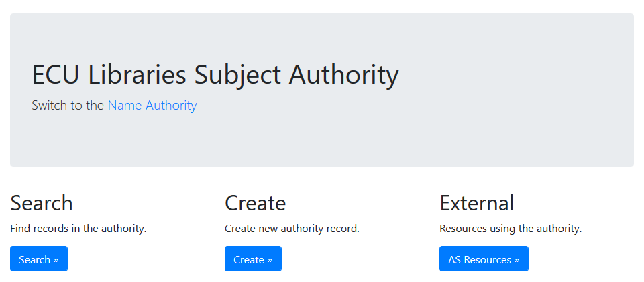
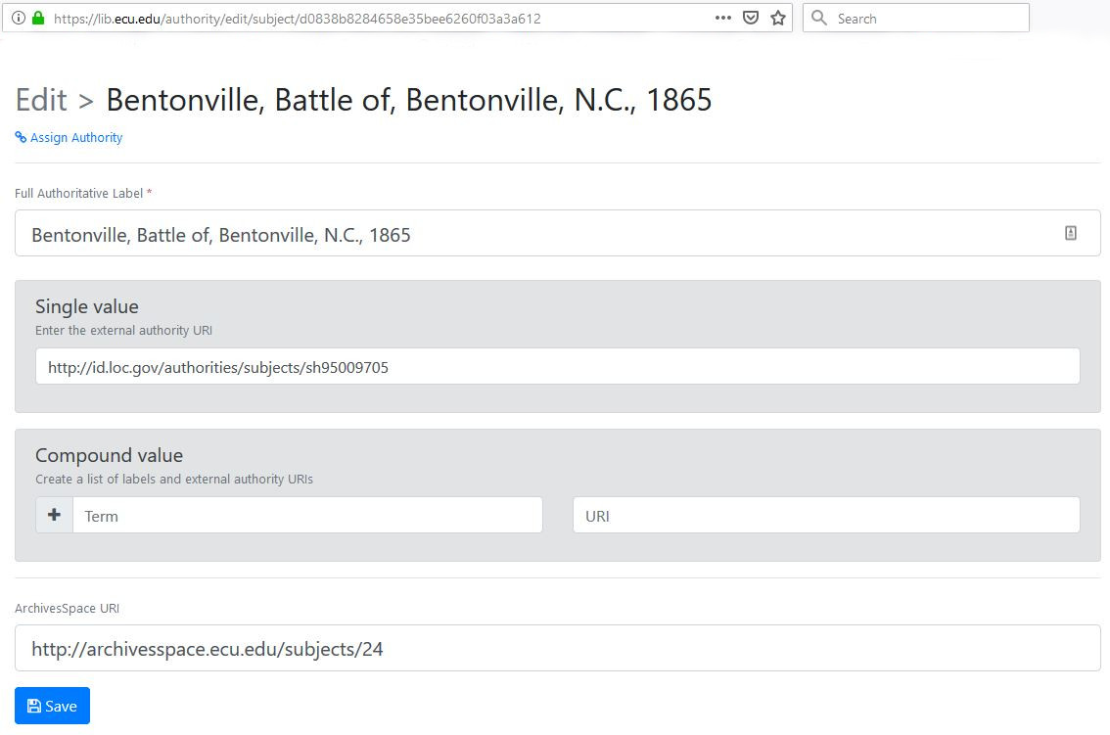
Working in the authority database
Notes:
So this is what the subject authority database looks like. This is what the cataloger sees. Can search, edit, or create a new subject and assign it to a resource. Here is an example of a subject. Note label, external URI, link to subjects in ArchivesSpace, local URI in address bar.

Slide 8
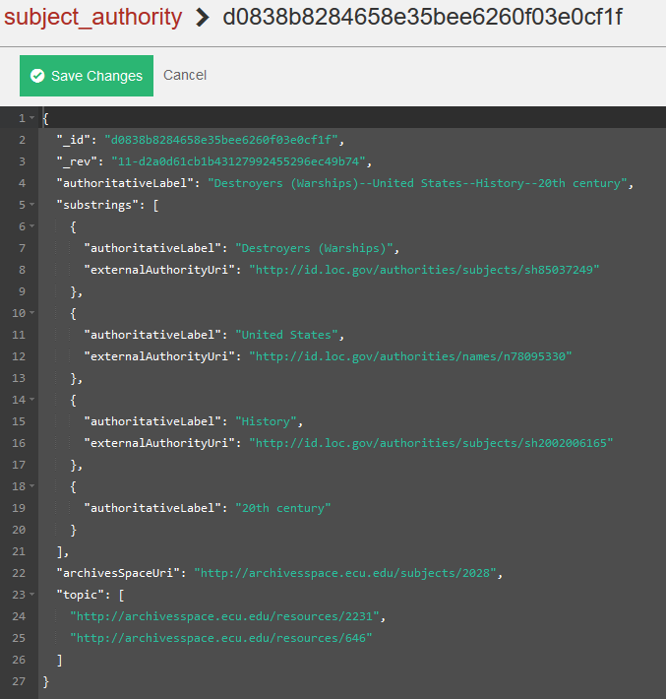
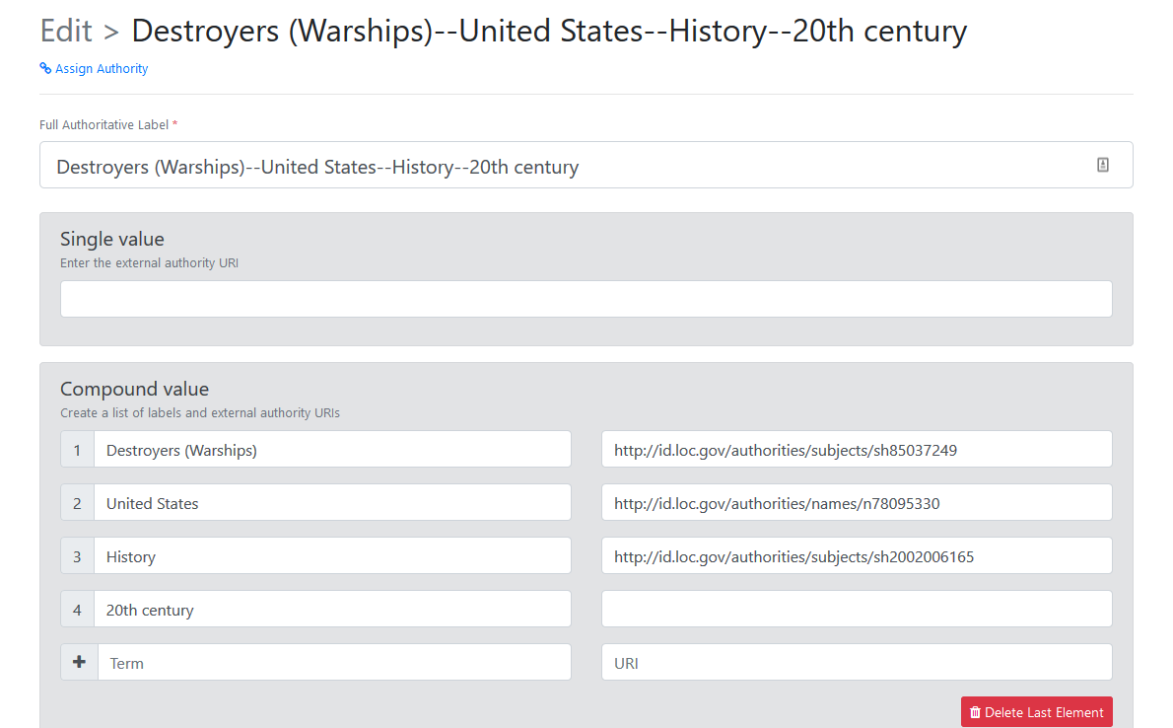
Compound subjects
Destroyers (Warships)--United States--History--20th century
Notes:
What to do with compound subject headings not represented in their entirety by one URI? Answer: compound URIs. What if there is more than one way to compound the URIs? For instance: Destroyers (Warships)—United States—History—20th century
We were not sure how many URIs to use. Asked around, even from some leading linked data people, and they could not answer. Ultimately decided to keep the free floater History—20th century together. Many linked data projects use FAST so they don’t have the subdivision problem. We have always used LCSH pre-coordinated strings and did not want to sacrifice their preciseness.

Slide 9
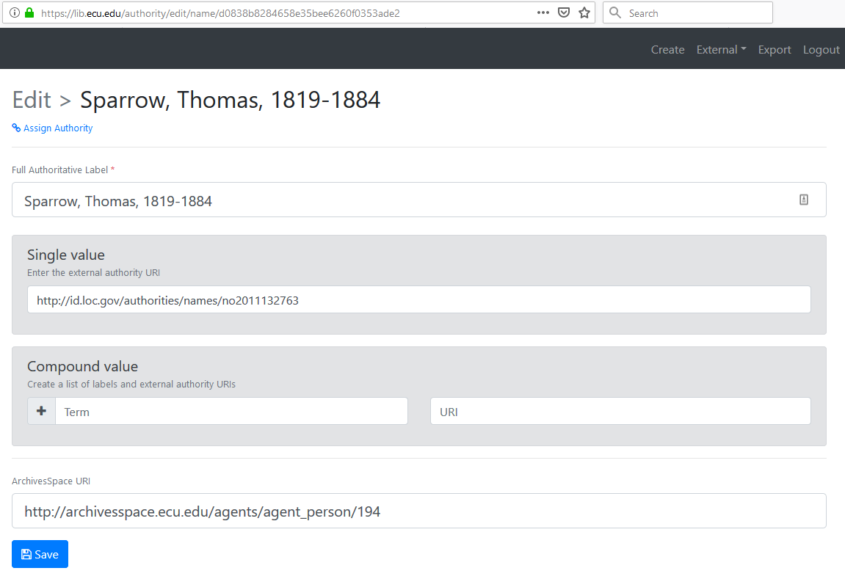
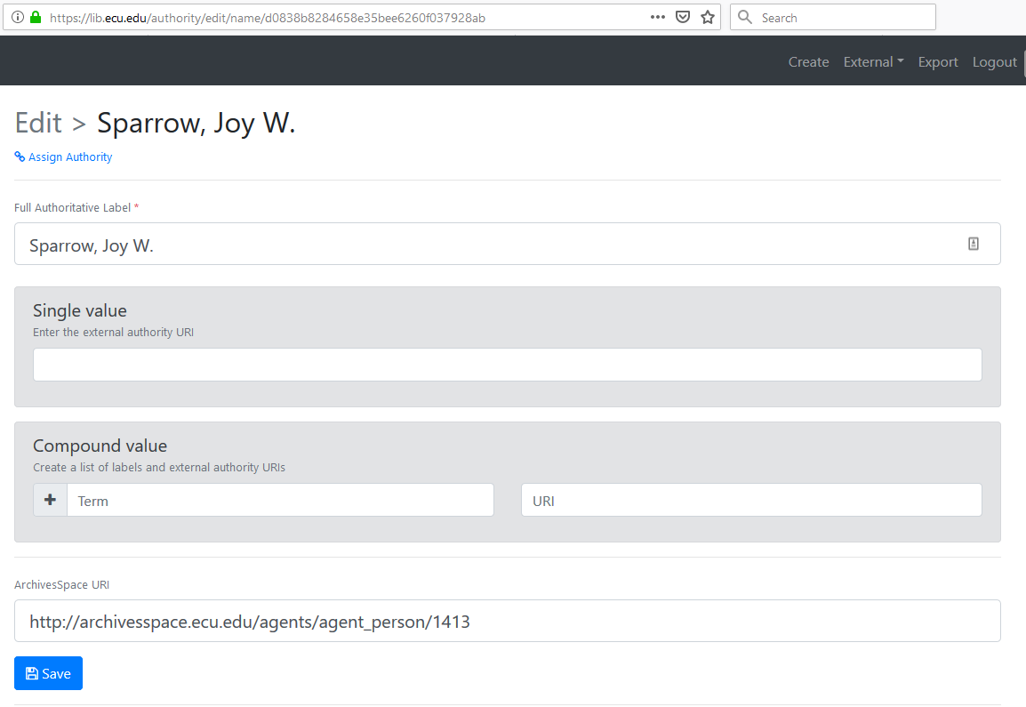

Name authority
Notes:
Names. The names that have an external URI (like the one on the left) will have it. On right is a name without an external URI. Many names won’t have them because they are not in the LCNAF.

Slide 10
Proposed names workflow
Manu.Coll.
Adds creator name in ArchivesSpace.
Cataloging
Adds ArchivesSpace URI from “agents” list to authority database.
Adds authority URI to ArchivesSpace “agents” list.
Cataloging
Republishes the guide, if changes were made.
Cataloging
Runs report to find newly added names.
Creates new name in authority database if it’s not already there.
Notes:
Schematic of new workflow for adding creator names. Would be possibility of automating some of this but we wanted to see first about volume of new names.

Slide 11
Advantages
Consistency between Digital Collections and Manuscripts
Names controlled by Cataloging
“Automatic” authority checking
Quality control
Get candidates for NACO process
Notes:
Consistency: Same pool of names used for both AS and DC.
Pool of names is controlled by cataloging and linked to external URIs.
“Automatic” authority checking: We would be able to run a reconciliation process on a regular basis to see if name label string matches with external URI
Enables us to more easily perform large scale quality control (b. 1865 to 1865-).
Enables us to see which names are not LCNAF authorized and consider creating NAF records, or we can more easily get together a list of non LCNAF names for a local authorities project.

Slide 12
Issues
Time saver?
Ongoing maintenance of URIs
Communication challenges
Notes:
Does it save time? Don’t know. It’s a multi-step procedure to add links.
Some that have compound URIs now may change to having single URIs for the entire string later, as LC moves away from free-floaters and toward separate authorities for everything. How will we handle?
Perhaps most challenging, migration project has involved knitting together several repositories that were separate, which is great technologically speaking, but linked data doesn’t take care of the communication between people who have historically had control over their own data.

Slide 13
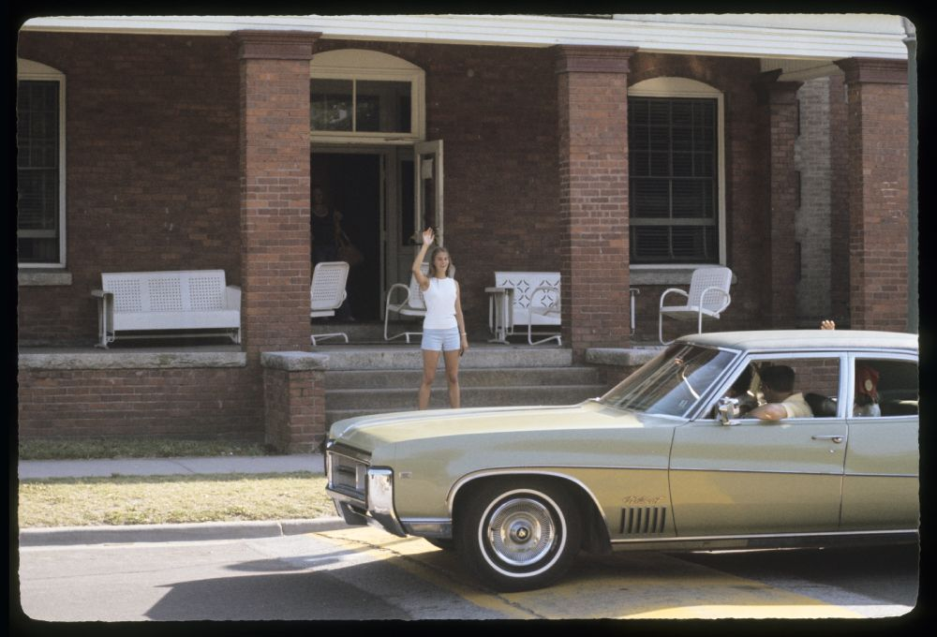
Thank you
Send comments or questions to dragonp@ecu.edu
Waving goodbye
Notes:
Thanks for listening to my talk about this work in progress. Comments, questions….

