Slide 1
Innovations in health sciences librarianship
Kerry Browder, MSLS
November 11,2013

Slide 2
Two [ very ] different innovations:
Using online video conferencing technologies to provide virtual ‘in-person’ reference services
The creation and use of a Massive Open Online Course (MOOC) to deliver education to students

Slide 3
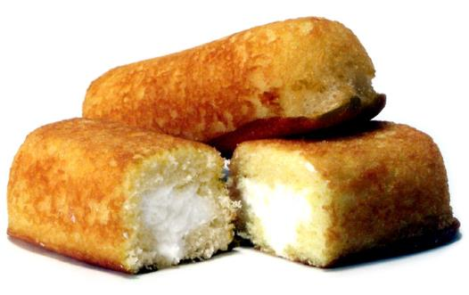
Commonality: Adapting to change, sustaining programs
Demographic changes
Changed (and changing) expectations about the delivery of information resources and services
( learning from Twinkies)

Slide 4
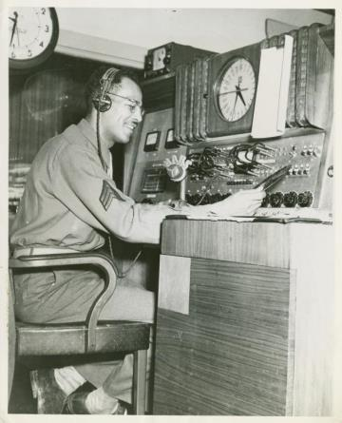
Virtual ‘face-to-face’ Reference services--
The newcomer in the healthy arsenal of digital reference services.
United States Army. (1947). Radio station manager. New York Public Library. Retrieved from http://digitalgallery.nypl.org/nypldigital/dgkeysearchdetail.cfm?strucID=612712&imageID=1260303

Slide 5
Reference Services: preferences among users
Source: Chow, A. S., & Croxton, R. A. (2012). Information-Seeking Behavior and Reference Medium Preferences. Reference & User Services Quarterly, 51(3), 246-262.

Slide 6
Virtual “in Person” reference: mixing the best of several worlds
Remote face-to face interaction: non-verbal cues
Screen-sharing
Moving library service ‘outside of the cube’

Slide 7
“I want to know if the change in government standards and guidelines on women’s health care in Nigeria resulted in a reduction in maternal mortality there. Can you help me with this?”
“I can’t meet you any day before 7 P.M. Can you meet me in the evening?”

Slide 8
Practical implementation
Promote, promote, promote:
  Social media
  Visibility on the library website
Use as a follow-up method of reference service
Probably not for factual questions like:
“how many ducks are in North Carolina?”*
*actual reference question received at a health sciences library last year

Slide 9
Massive Open Online Course (The MOOC) for outreach and education in health sciences libraries
History:
Antecedents
Birth—2008 neologism
MOOCs and Libraries

Slide 10

Advantages of the Mooc:
Self-paced learning
Participatory
Support a ‘flipped classroom’

Slide 11
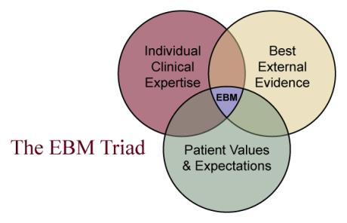
A mooc on health information literacy: supporting evidence-based practice
Supporting the acquisition of skills allowing students to acquire the ‘best external evidence’
Florida State University, College of Medicine. (n.d.). The Evidence-based Medicine Triad. Retrieved from http://med.fsu.edu/index.cfm?page=medicalinformatics.ebmTutorial

Slide 12
Highlights from a study on health information literacy among preprofessional health students:
Most preprofessional health students intend to develop their information literacy skills, including:
  information evaluation skills,
  knowledge of citations and plagiarism, and
  library skills
Some students report that a trip to the library is a barrier to using library resources.
Source: Ivanitskaya, L. V., Hanisko, K. A., Garrison, J. A., Janson, S. J., & Vibbert, D. (2012). Developing health information literacy: a needs analysis from the perspective of preprofessional health students. Journal of the Medical Library Association : JMLA, 100(4), 277–283. doi:10.3163/1536-5050.100.4.009

Slide 13
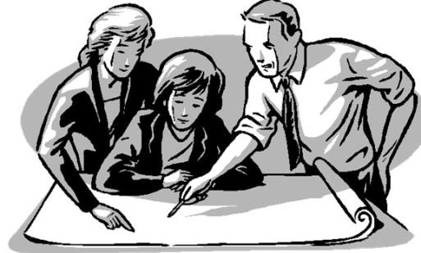
Implementation:
Choose and then learn the technology
Collaboration:
  With faculty to discuss content
  With fellow librarians
Promote
Monitor and evaluate!

Slide 14
Thank you!
Questions?
(and a couple of other citations)
Frand, J. L. (2000). The Information-Age Mindset: Changes in Students and Implications for Higher Education. EDUCAUSE Review, 35(5), 15–24.
Prensky, M. (2001). Digital Natives, Digital Immigrants Part 1. On the Horizon, 9(5), 1–6. doi:10.1108/10748120110424816

