Slide 1
Total Health for
Music Librarians

Slide 2
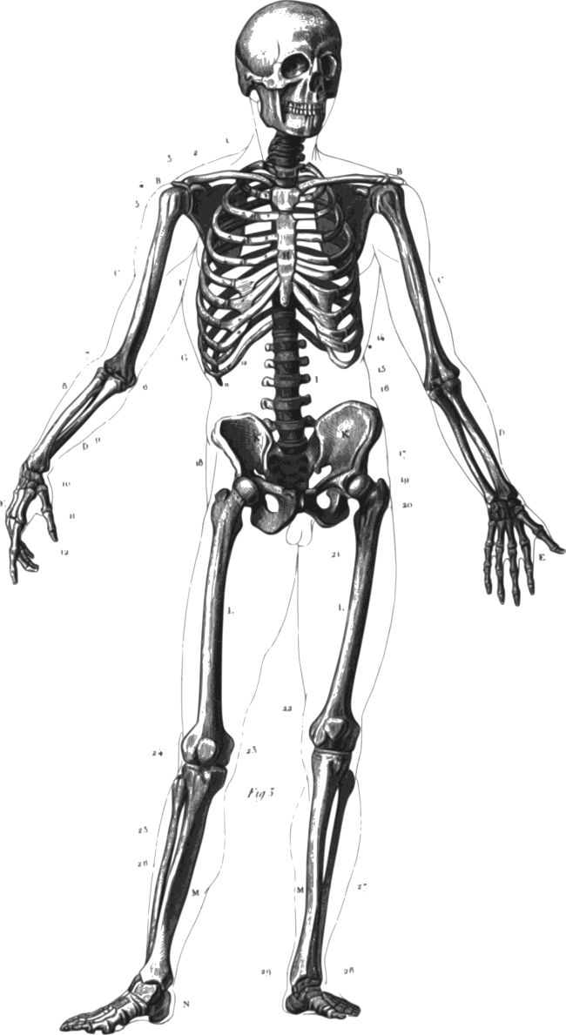
The jaw bone’s connected to the what bone?!

Slide 3
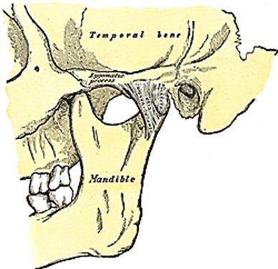
Go With Your Gut
Temporomandibular Joint (TMJ) Syndrome

Slide 4
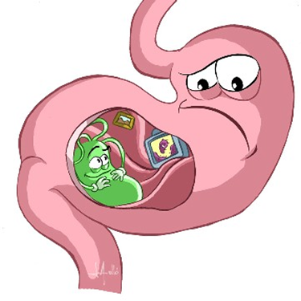
Go With Your Gut

Slide 5
Go With Your Gut
Davis, William. Wheat Belly Total Health. Emmaus, PA: Rodale Publishing, 2014.
Perlmutter, David. Grain Brain. New York: Little, Brown, & Co., 2013.
Watson, Brenda. The Skinny Gut Diet. New York: Harmony Books, 2014.

Slide 6
Use It, or Lose It
Total-Health Approach to Physical Activity
  strength training
  aerobic activity
  flexibility
Ideal Physical Activity Routine
  5-10 minutes of aerobic activity, or gentle no-hold stretching
  30-45 minutes of balanced strength training
  long-hold stretching
  don’t forget 20-30 minutes of aerobic activity either before or after strength training

Slide 7
New Variations on Old Themes
Theme: massage therapy
  Variation #1: neuromuscular therapy (NMT)
  Variation #2: NMT St. John method
Theme: chiropractic
  Variation: atlas orthogonal chiropractic
    the atlas bone must be aligned first
    adjustments to the atlas are made with a sonic wave

Slide 8
Heart and Soul
Energy healing
Meditation
Reading:
  Alexander, Eben. Proof of Heaven. New York: Simon & Schuster, 2012.
  Cannon, Dolores. The Three Waves of Volunteers and the New Earth. Huntsville, AR; Ozark Mountain Publishing, 2011.
  Grof, Stanislov, and Christina Grof. The Stormy Search for Self. Los Angeles: J. Tarcher, 1990.

