Slide 1
Overview
Root of bioelectric signals
Neuroengineering
  Analysis of neural action potentials
Introduction of various bioelectric signals
ECG and arrhythmias
How does the human body create electricity?

Slide 2
Types of Bioelectric Signals
Electromyogram (EMG)
Electroencephalogram (EEG)
Magnetoencephalogram (MEG)
Electrocardiogram (ECG)

Slide 3
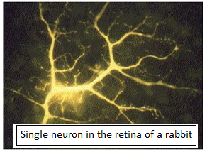
Root of Bioelectric Signals
Excitable cells
  Bioelectric signals are a result of electro-chemical activity of excitable cells (58)
  Muscle/nerve/gland cells can
  be stimulated to create a tiny
  electric current
  The electric current,
    in neurons, is used to transmit signals
    In muscles, is used to initiate contraction

Slide 4
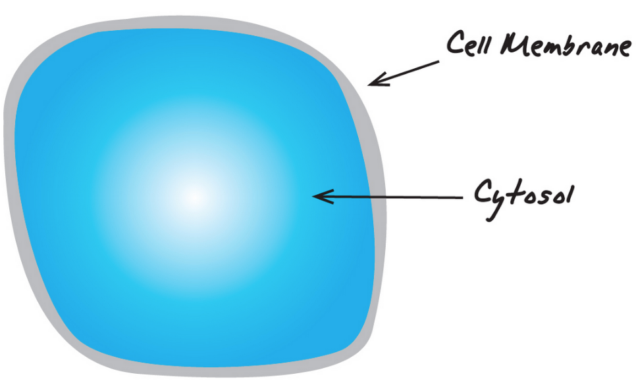
Cell Membrane
A thin film-like structure that separates the cytosol from the extracellular fluid
Acts as a selectively permeable barrier
  Some particles such as sodium N⁺/potassium K⁺ ions can pass through
  Others cannot pass through or very difficult
Can be modeled as a leaky capacitor with some resistance
An electrical potential across the cell membrane is not equal to zero

Slide 5
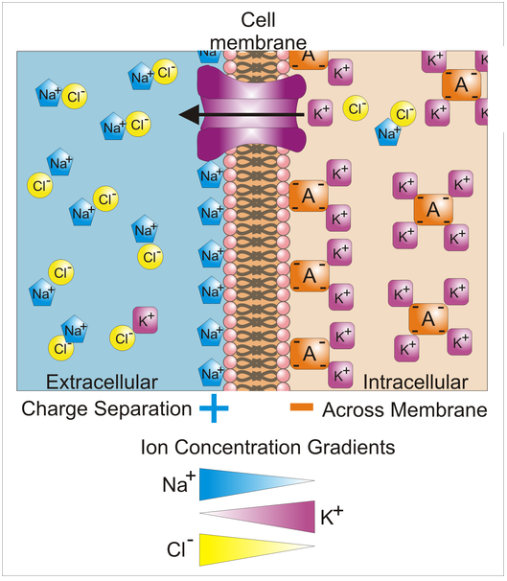
Resting Potential of Cells
An electrical charge across the cell membrane
  The interior potential is negative w.r.t the exterior potential (from -70 mV to -80 mV)
  K⁺ in the cytosol (intracellular fluid) is as much as 20 times higher than that in the extracellular fluid
  Na⁺ in the extracellular fluid is as much as 10 times greater than that in the cytosol
What maintains this negative resting potential?
  Sodium-potassium pump (59)
    transports 3 Na⁺ ions out of the cell
    for 2 K⁺ ions pumped into the cell
    fueled by cellular energy

Slide 6
How to Estimate the Resting Potential
Resting potential can be estimated given
  Surrounding temperature
  Permeability coefficients for Na⁺, K⁺, Cl⁻ ions
  Intracellular and extracellular concentrations of Na⁺, K⁺, Cl⁻ ions
Goldman-Hodgkin-Katz formulation
  Refer to Equation 4.2 in pp. 128
  Example 4.1

Slide 7
Action Potential of Excitable Cells
Depolarization of the cell membrane
  Result of activation of gated sodium channels by (60)
    Mechanical stimuli such as stretching or sound waves
    Neurotransmitters such as acetylcholine
  Resting potential is reduced due to the facilitated diffusion of sodium into the cell
  An action potential is generated if the resting potential reaches the threshold voltage (e.g. -50 mV)
  The action potential travels along the membrane at a constant velocity
  The cell membrane cannot respond to another stimulus during depolarization (61)
    This refractory period sets an upper limit to the maximum firing frequency
    For example, 1ms of the refractory period means the maximum 1000 APs/s
Action potential is all-or-nothing type of signal (63)
  Its strength is an intrinsic property of the cell (strong stimulus ≠ large AP)

Slide 8
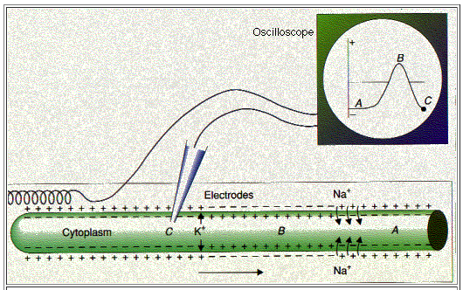
How to Measure Action Potentials
An AP travels from the left to the right
Region A is about to be depolarized by rapid diffusion of Na⁺ into the cell
Region B is depolarized, i.e. the polarity is reversed
Region C is repolarized after the AP swept past the intracellular electrode

Slide 9
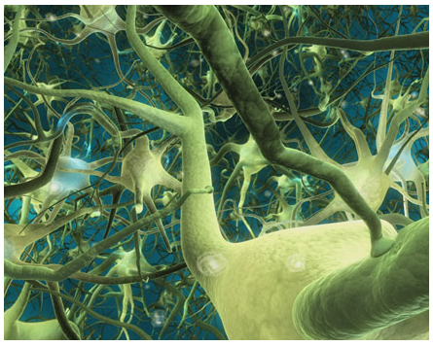
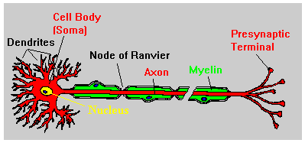
Neurons
The axon in the vertebrate is insulated (i.e. myelinated) by a sheath of myelin (64)
  The myelin sheath is interrupted by nodes of Ranvier
    Node of Ranvier
  The rapid diffusion of sodium ions occurs only at these nodes of Ranvier
  APs do not travel along the axon, rather they jump from one node to the next
  This results in fast propagation of APs

Slide 10
Neuroengineering
Neuroengineering
  An interdisciplinary research area that utilizes neuroscience and engineering methods in order to
    Analyze neurological functions
    Design solutions to problems associated with neurological dysfunction
  Scope (65)
    Brain-Machine Interfaces (BMI)http://www.youtube.com/watch?v=gnWSah4RD2E
    Neural prostheses
    Neural signal processing
    Neuroimaging
Neural action potentials (vs. Morse Code)
  The basic signal in neuron-to-neuron communication
  An important topic in many fields of neuroengineering

Slide 11
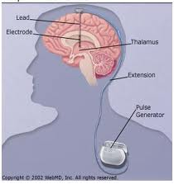
Neural Action Potentials
Two major divisions of neural engineering where APs are the most critical topic
  Neural recording
    Understand how the brain functions
    Brain-Machine Interface (BMI)
    Advanced machine control
  Neural stimulation
    Block unwanted signals (pain and hunger)
    Bridge broken nerve fibers (spinal cord injury & amputees)
    Return neural population to normalcy (deep brain stimulation for Parkinson’s disease)
Challenge
  Need to figure out how information is transmitted in the brain

Slide 12
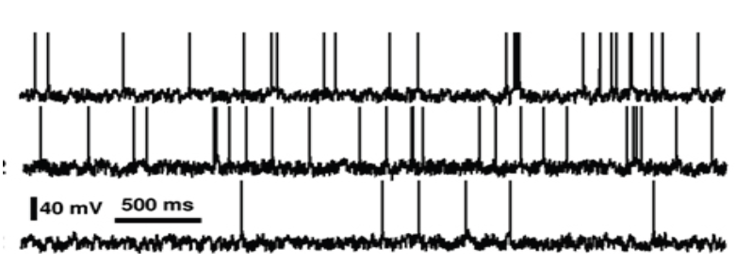
Neural Recording
How is intended information coded in neural recording?
  Temporal coding
    Precise AP timing (on a millisecond time scale) is a significant element
  Rate coding
    Information is contained in the firing rate of the neuron
    Successfully utilized for the BMI experiments with primates
  Population coding
    The distribution of many neurons carries out reliable information
  Sparse coding

Slide 13
Electromyogram
Measurement of the muscle’s electrical activity
EMG potentials range from 20uV up to 2mV (67)
Typical firing rate of muscle motor unit is 6-30Hz
Surface EMG or intramuscular (needle) EMG
  Intramuscular EMG is very focal but invasive
  Surface EMG is more common
The strength of the muscle contraction is proportional to the number of APs and their firing rate (66)
Abnormal EMGs (subject-specific pattern)
  Increased/decreased duration of APs
  Decreased number of APs
EMG applications
  Control prosthetic devices (simpler than EEG-based BMI)
  Realize a wearable cockpit (no joystick or handle)

Slide 14
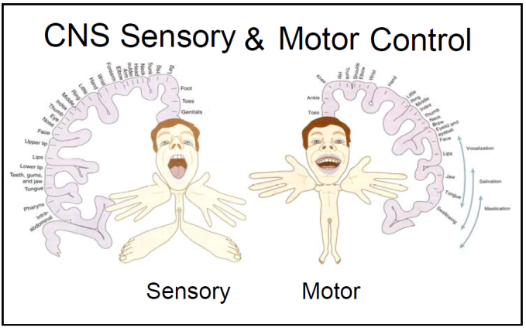
Electroencephalogram
EEG originates from the electrical activity of the central nervous system (CNS), i.e. the brain
The range of EEG signals is in µV (68)
Brain
  Is floating in cerebral spinal fluid (CSF)
  Consists of cerebrum, cerebellum, and brainstem
  Ascending (afferent or sensory) nerve tracts
  Descending (efferent or motor) nerve tracts
  Cerebral cortex
    Called “grey matter”
    Outer layer of the cerebrum
    Neurons and unmyelinated fibers (70)
    Comprises about 2/3 of the brain
    Plays a critical role in memory, attention, thought, and consciousness

Slide 15
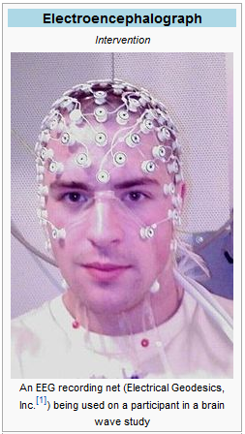
Electroencephalogram
Measurement of the electrical activity along the scalp (69)
  Summation of the synchronous activity of many pyramidal neurons
  Voltage oscillation due to ionic current flows in the brain
  Can observe frequency-band-specific wave patterns
Clinical applications
  Detect and predict the epileptic activity
  Study insomnia
  Diagnose coma/brain death
General applications
  Classify images (evoked potentials)
  Implement an automatic speller (e.g. P300)
  Trait worry study

Slide 16
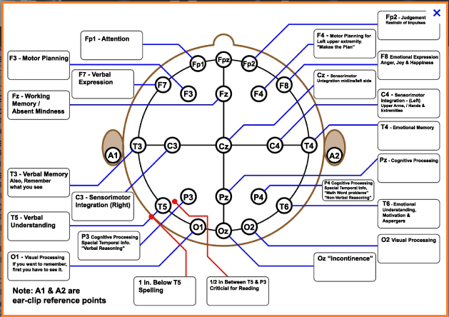
EEG Electrode Map

Slide 17
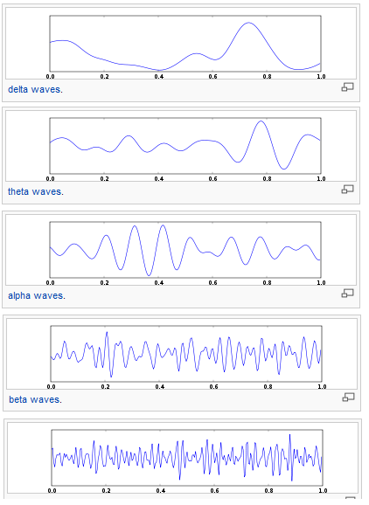
Wave Patterns in EEG (71)
Delta
  0~4Hz
  Highest amplitude
Theta
  4~7Hz
  Observed in young children
Alpha
  8~12Hz
  Observed when the eyes are closed (i.e. relaxation)
Beta
  13~30Hz
  Observed when the eyes are open (i.e. excitation)
Gamma
  30~100Hz
  Observed when recalling a memory
  Reduced amplitude associated with cognitive decline
How to obtain different EEG patterns
  Apply a band-pass filter to raw EEG signals
  Not trivial to remove EMG and/or ECG interference

Slide 18
Spectrum of EEG Wave Patterns
EEG Hacker

Slide 19
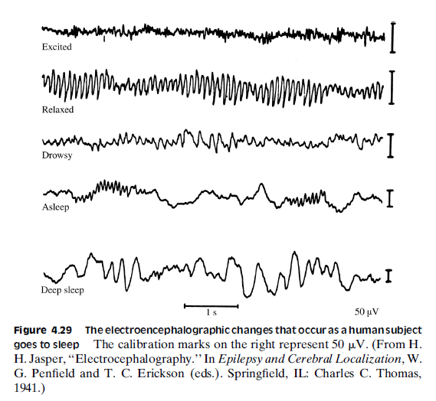
Sleep Patterns & EEG
Beta pattern
Alpha pattern
Theta and Delta

Slide 20
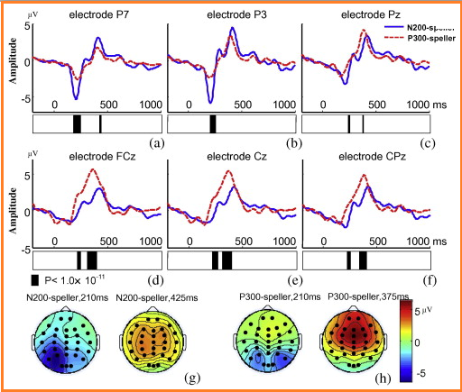
Timing Analysis in EEG
P300 speller (72)
  Event-related potential (ERP)
  Cerebral wave propagation on the cortex after visual stimulation
  P300 Demonstration

Slide 21
Timing Analysis in EEG
Deception detection (simply, lie detection)
  Standard method: Polygraph (blood pressure, pulse, respiration, and skin conductivity) since 1921
  EEG-based ERP analysis
    Subjects are presented faces and/or crime scenes
    The amplitudes of P300 or P100 become large when they are recognized
    Subjects cannot deceive this deception detection method since their brain cannot lie.

Slide 22
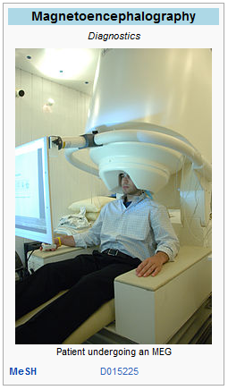
Magnetoencephalogram
Measurement of the bio-magnetic field around the brain
  Bio-magnetic filed induced by synchronized intracellular neuronal currents (recall Maxwell’s equations) (73)
100 million times weaker than the earth
magnetic field
  Detectable MEG involves 50k~100k active neurons
Using the superconductive device,
MEG can be measured after removing
the effect of the earth’s magnetic field (74)
Challenging inverse problems
  Given data (MEG), the source location needs to be
  estimated
Clinical applications
  Detect and localize epileptic activities
  Localize brain tumors (combined with MRI data)

Slide 23
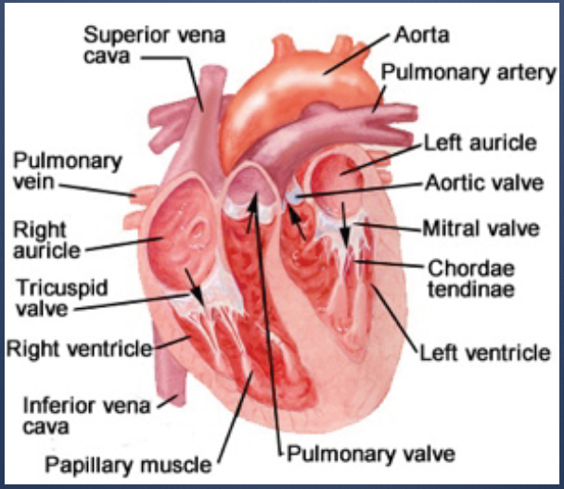
Introduction to the Heart
Anatomy
  Collection of muscles and nerves
  Four chambers and valves
Specialized conduction
system (75)
  Sinoatrial node (main pacemaker)
  Atrioventricular node (check-point)
  Bachmann’s bundle (left artium)
  Right bundle (right ventricle)
  Left bundle (left ventricle)
Three pacemakers (76)
  SA node: 60~100 bpm
  AV node: 40~60 bpm
  Purkinje fibers: 30~40 bpm

Slide 24
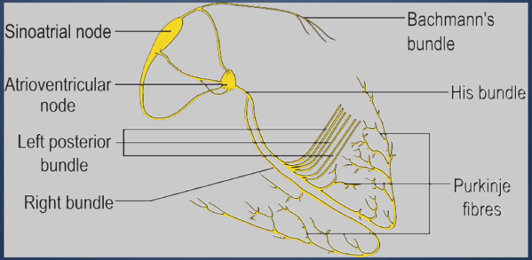
Introduction to the Heart
Anatomy
  Collection of muscles and nerves
  Four chambers and valves
Specialized conduction
system
  Sinoatrial node (main pacemaker)
  Atrioventricular node (check-point)
  Bachmann’s bundle (left artium)
  Right bundle (right ventricle)
  Left bundle (left ventricle)
Three pacemakers (76)
  SA node (normal sinus rhythm): 60~100 bpm
  AV node (first back-up generator): 40~60 bpm
  Purkinje fibers (second back-up generator): 30~40 bpm

Slide 25
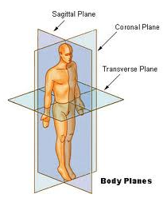
Introduction to ECG (77)
Measurement of the electrical heart activity
  EKG Demo
Voltage measurement leads
  Bipolar
    Potential difference between two leads
  Unipolar
    Potential difference between a lead and the ground
Six channels from three limb leads
  Einthoven’s triangle
  On the coronal plane
  Three bipolar + three unipolar
Six channels from six precordial leads
  On the transverse plane
  All unipolar

Slide 26
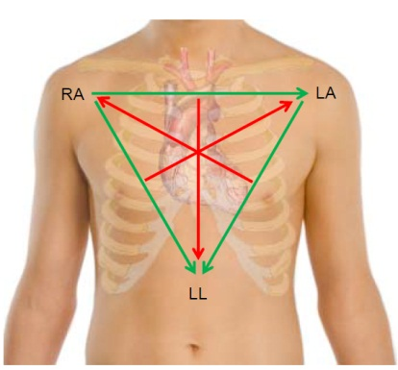
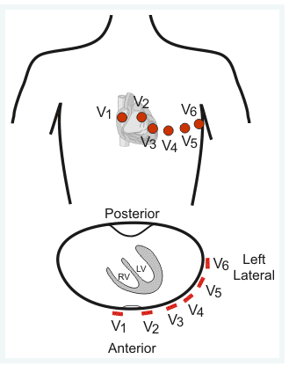
12-Channel ECG
Einthoven’s triangle for three limb leads
Six precordial leads

Slide 27

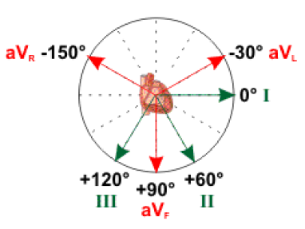
6 Coronal Plane Channels (78)
3 bipolar channels
  Channel I: LA-RA
  Channel II: LL-RA
  Channel III: LL-LA
3 unipolar channels
  aVR: RA-mean(LA+LL)
  aVL: LA-mean(RA+LL)
  aVF: LL-mean(RA+LA)
Angles
  0 ⁰(I), 60 ⁰(II), 120 ⁰(III)
  -30⁰(aVL), 90 ⁰(aVF), -150⁰(aVR)

Slide 28
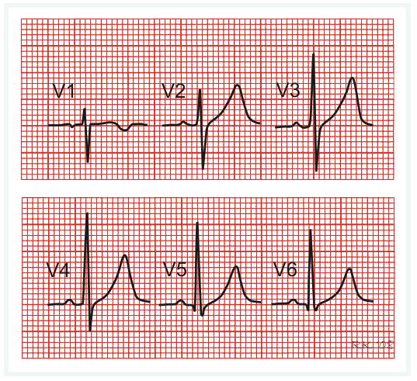
6 Transverse Plane Channels
6 precordial channels
  V1: 4th intercostal & right sternal
  V2: 4th intercostal & left sternal
  V4: 5th intercostal & mid-clavicular
  V3: between V2 and V4
  V5: anterior axillary line
  V6: mid-axillary line

Slide 29
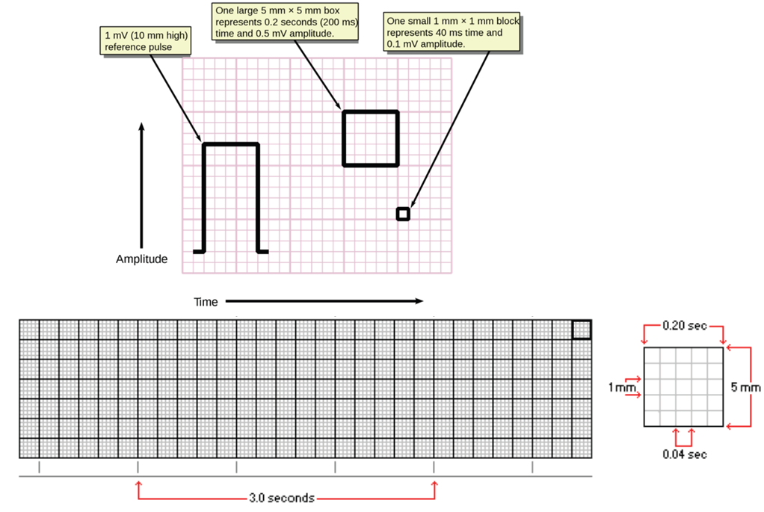
ECG Paper

Slide 30
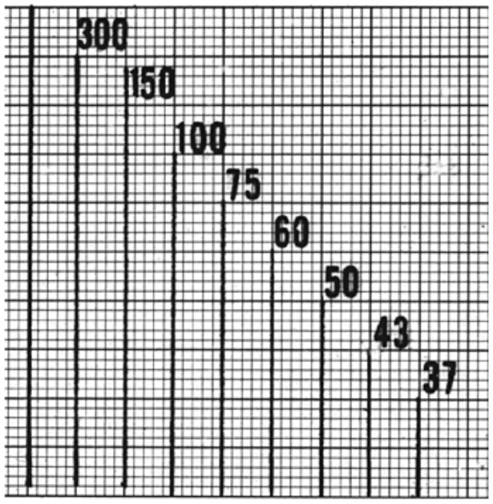
ECG Heart Rate

Slide 31

Types of Arrhythmia (79 & 80)
  Sinus bradycardia
  Sinus tachycardia
  Atrial flutter
  Atrial fibrillation
  1st degree atrioventricular block
  2nd degree atrioventricular block
    Mobitz type I
    Mobitz type II
  3rd degree atrioventricular block
  Premature ventricular contraction
  Ischemia
  Ventricular fibrillation

Slide 32
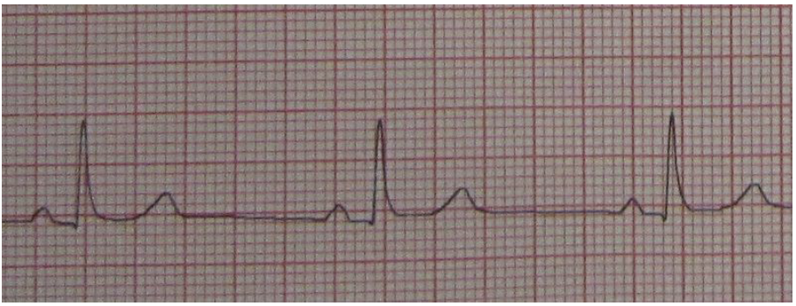
Sinus Bradycardia
Sinus (normal) rhythm at a rate less than 60 bpm
  Could be a normal finding in a healthy person
Brady arrhythmia describes any abnormally slow rhythm

Slide 33
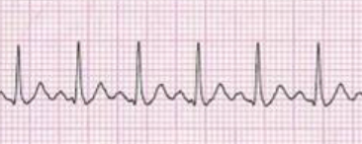
Sinus Tachycardia
Sinus rhythm at a rate greater than 100 bpm
  Usually a response to normal physiological situations
Tachy arrhythmia describes any abnormally fast rhythm

Slide 34
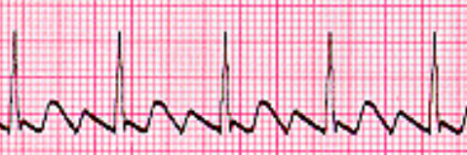
Atrial Flutter
P-waves replaced with sawtooth F-waves
May appear similar to atrial fibrillation
However, the ventricular rate is quite regular

Slide 35
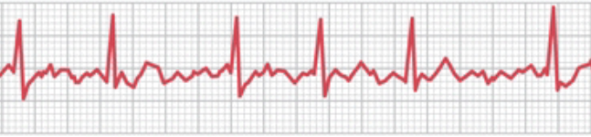
Atrial Fibrillation
Most common cardiac arrhythmia
Referred to as A-fib
Rapid and chaotic activity of RA
  350-600 bpm
  Faster than the refractory time of AV node
  AV node conducts heart beats every now and then
QRS complexes are totally irregular
P-waves appear as sawtooth or may be absent

Slide 36
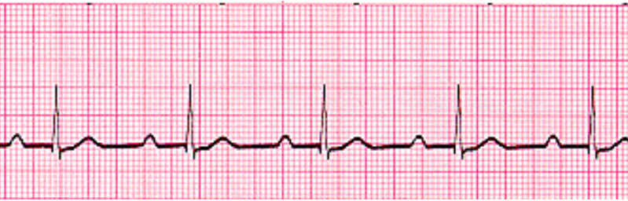
1st Degree Atrioventricular Block
Sinus rhythm at a regular rate
Prolonged PR-intervals (>0.2 seconds)
Conduction through the AV node is slow
  Due to the increased refractory time of the AV node

Slide 37
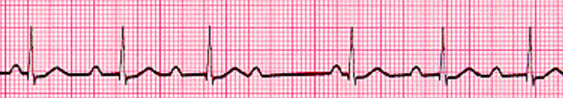
2nd Degree Atrioventricular Block
(Mobitz Type I)
Heart rate is regularly irregular
The atrial rhythm (P-wave) is regular
Progressive lengthening of PR-intervals until QRS is dropped
  Due to the AV node conduction variability
Often, represents a benign condition

Slide 38
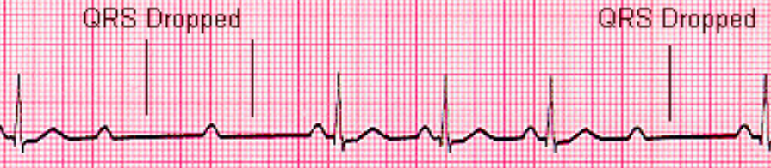
2nd Degree Atrioventricular Block
(Mobitz Type II)
Heart rate is regular
QRS without lengthening of PR-intervals
  2:1 block
  3:1 block
AV node is on its way to breaking
Often, considered as a precursor to complete heart block

Slide 39
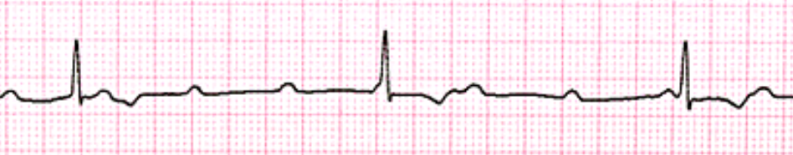
3rd Degree Atrioventricular Block
Total dissociation between P-waves and QRS complexes
APs generated in the SA node do not propagate
The first back-up pacemaker is activated
P-waves on the first rhythm
QRS complexes on the second rhythm

Slide 40
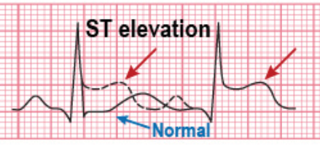
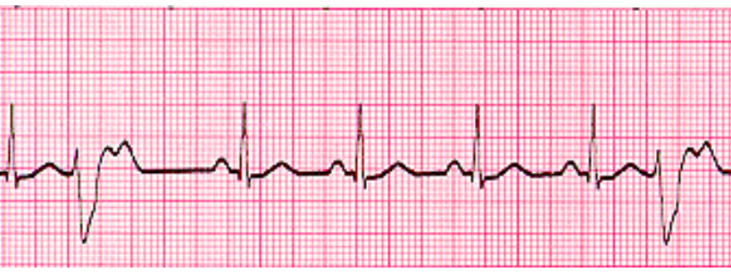
Premature Ventricular Contraction
Called, ventricular ectopic beat
Broad QRS complex without any correlation with a P wave
The ventricles contract first
Feels like a skipped heart beat

Slide 41
Myocardial Ischemia
Lack of blood supply to the heart muscle
  Due to coronary heart disease (CHD)
Associated with ST-segment elevation
Can lead to myocardial infarction if untreated

Slide 42

Ventricular Fibrillation
Rapid, totally uncoordinated ventricular contractions
Loss of consciousness less than 1-minute
Causes acute myocardial infarction
The ventricles contract first
Often the last stage of the cardiac deterioration
Shock is the only method to break the cycle

