Slide 1
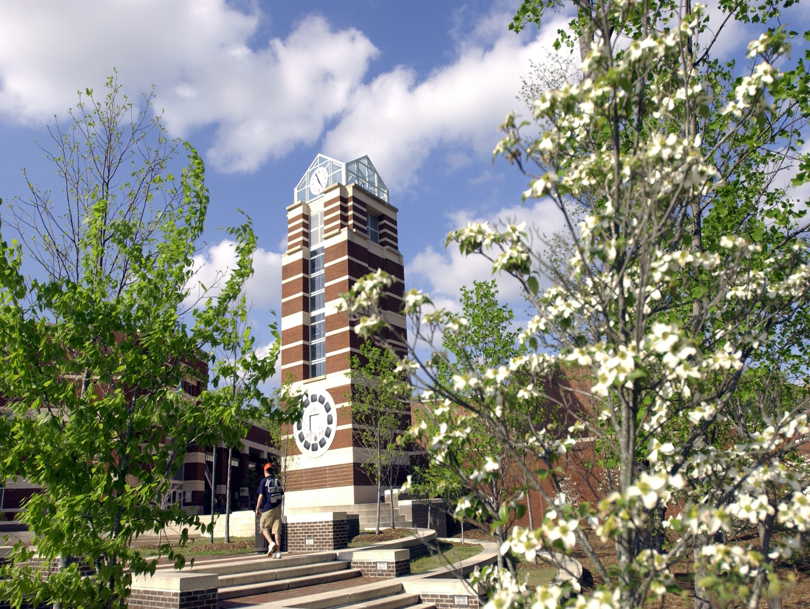
Inventorying Our Audiovisual Materials
Alston Cobourn
North Carolina Preservation Consortium
November 6, 2023
Notes:
Hi everyone, I’m Alston Cobourn and I’m the Head of University History and Records at East Carolina University. For background, this department consists of both university archives and records management.

Slide 2
The Project
Inventory all of the audiovisual materials in the University Archives collection
Impetus:
Desire to prioritize digitization of AV materials
Notes:
Today I’m going to share about an ongoing project to inventory all of the audiovisual materials in the university archives collection. We all know that audiovisual media is dying a relatively quick death and that it is only going to become harder to digitize such media as the equipment used to do so ages. Therefore we wanted to develop a plan for digitizing the AV in our collection and we saw the inventory as a means to that end with two sub-goals.

Slide 3
Sub-Goal 1: Know What We Have
Improve intellectual control
Find unprocessed items
Ensure we have documented a content description and location for all items
Notes:
First, we wanted to improve our intellectual control over the materials. We have pockets of AV in the stacks that are known to us and in some cases even well described. But we were also sure that additional av items are scattered throughout unprocessed parts of the collection, although we were unsure of how many. Conducting an inventory of the stacks is allowing us to find all the audiovisual materials and document both their content and their location. Our intention was to later on use this content information as a factor in digitization prioritization.

Slide 4
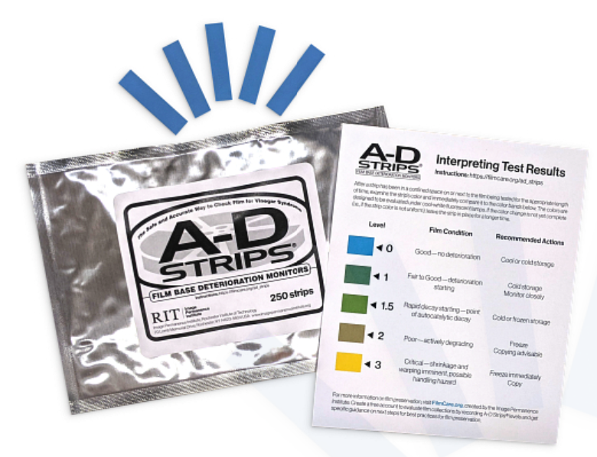
Sub-Goal 2:
Know Its Condition
Collect condition information about the media through visual inspection and testing
Notes:
Second, we wanted to collect information about the physical condition of the av items so we could use that data as a factor in prioritizing our preservation efforts. We were interested the condition of all parts of the media item, so for example with a VHS cassette, we wanted to know as much as we could about the condition of the magnetic media inside it as well as that of the outer shell and the turning parts inside the shell. We were also interested in whether or not the item had appropriate housing and if so, its condition.

Slide 5
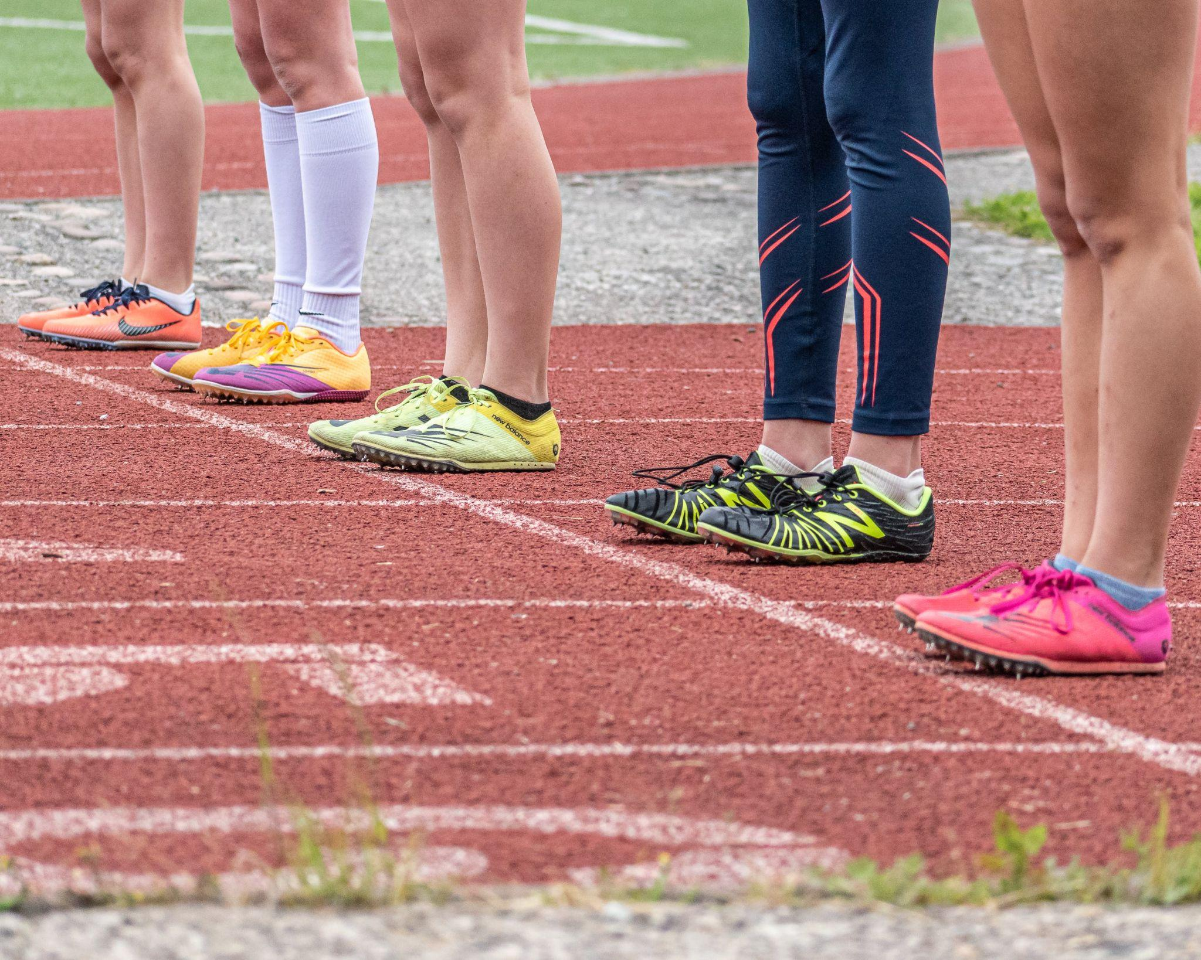
Inventory Process
Ready
Creating the Google form
Photo by Gonzalo Álvarez Balcazar: https://www.pexels.com/photo/people-wearing-running-shoes-standing-on-the-track-14585532/
Notes:
First we had to create the mechanism by which we would record the data. Originally I created an excel spreadsheet but after trying this out we switched to a google form because we thought it would be easier for student workers to use. Thought very carefully about which fields to include. Essentially we set it up for users to record all the info written on the outside of the box containing the media, any info written on the media itself, location information, information about its format, condition information, and a notes field
We also had to acquire an ipad from our IT department so the student would be able to access the form from within the stacks.

Slide 6

Set
Training student worker
Photo by nappy: https://www.pexels.com/photo/man-wearing-white-sweater-and-black-shorts-about-to-run-936094/
Notes:
We decided this project would be appropriate for our MLS intern and future Graduate Assistants. We asked the library’s conservator to provide basic training about how to spot certain types of decay in old film and magnetic tape. He also helped identify appropriate reading materials and provided a quick guide document that he uses with his own student assistants.

Slide 7
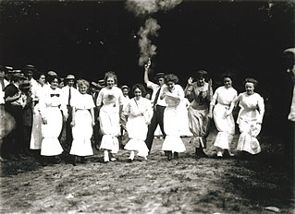
Go
Looking through boxes and recording data
Missouri History Museum, circa 1912, http://images.mohistory.org/image/98CF86AE-261D-150A-2D31-EA431AAB635A/original.jpg
Notes:
Then we were ready to embark. Our Intern and then subsequent graduate assistants began opening each box, giving it a through but still relatively quick look, to find any media items. When they found a media item, they would fill out the form with its information to the best of their ability, asking questions of myself or the assistant archivist as needed. They would fill out the form for each media item in the box and then move on to reviewing the next box. The students found it helpful to use a cart as a table in the stacks while surveying materials. For boxes that contained only media and therefore many items that needed to be recorded, on GA found it easier to bring the box out of the stacks and utilize a table and chair the our main workroom.
We are now ¾ of the way through the stacks. But we have already found probably about 90% of the media in the stacks because we know for sure there is no media in a sizeable chunk of the remaining boxes, for example the oversized boxes containing our student newspapers.

Slide 8
Setting Digitization Priorities
Planning for the long haul
Reviewing data
Look at content info to identify those most significant, fit in with ongoing efforts to diversify our collections
Look at condition information to identify those most at risk
Notes:
So as you remember our overarching goal was to use this survey to help us set digitization priorities. Our intention is to plan for the long haul, so not identifying one project, planning it, and doing it and then starting over identifying, planning, and executing another project, but rather to look at this data and our previously existing descriptive information and to identify all the digitization projects that need to occur in order to have digitized everything from the collection that we want to and to plan out steps for each of those now so that we can start the highest priority one and then relatively easily move straight on to the next one in the list without a long time gap in between and then just continue down the queue in that fashion.
This summer we made the decision to begin reviewing the survey data, identifying projects, planning and prioritizing digitization even though we are not completely finished with the survey. This was for three reasons, first we do not currently have a GA assigned to the project so we do not know how much longer it will take to complete. The one who was working on it graduated last spring and our current GA has been needed to help with some records management tasks. Secondly, we recognized that some of the items were inventoried several years ago as covid caused us to have a big gap in our student workforce, and time is literally of the essence with these older media. Third, as i said on the last slide, we know we have found most of the media.
So when we started looking at the survey we looked at content information to identify those most significant and those that fit with our ongoing efforts to increase access to the diversity in our collections
As i mentioned earlier we did have content information about some of our AV collection but the inventory was really crucial is identifying the materials scattered in unprocessed collections that we otherwise realistically may not have found for 3, 5, 7 more years.
We also reviewed the condition information collected so far so we could prioritize items in worst condition if the content warranted keeping. Fortunately, none of the items were marked as being in serious peril. However, we need to take into account that the items inventoried at the very beginning were done so several years ago now, so most likely their condition has diminished somewhat since. For example, the audio reels in from our Communications Office from the 1970s showed some vinegar syndrome but were not in terrible shape when inventoried however that was 4 years ago, so since much of their content does have long term historical, they are towards the top of our project list. There is a lot of valuable historical content in those Communications reels, so we placing those items in the top half of our list.

Slide 9
Lessons Learned
Double check your data fields
Think carefully about how much specificity
Going through collection in consistent order
Continuity of student workers
Decided we need to start prioritizing and digitizing without waiting till end
Notes:
Over the course of this project we’ve learned many lessons
Make sure your data collection instrument has all the fields you will need; you can add later but your data for the items you’ve already inventoried will be incomplete and require extra effort to fill in the gaps. I also recommend always including a notes field; it has been very helpful for us. It can also help accommodate if something comes up that you weren’t expecting
We realized part of the way through that we really didn’t need so much specificity in the form related to media types but changing it midstream really would have been messy. We found that the specificity tended to confuse the student workers and many of the media types simply don’t exist in our collection. Having them record that the item was some sort of closed magnetic media cassette containing video would have been sufficient instead of trying to have them determine if it was it was a Helical SV-201 cassette by (Sony) or a TCR 100 "Quad" (RCA). Other/Unknown 2" wide video tape is what has been marked most frequently
The second student who worked on this project did not move through the aisles in a linear fashion as they’ve been instructed but instead jumped around some. So definitely make sure you emphasize the importance of the linear progression, make sure you have a clear way for the person doing the survey to mark visually where they have stopped, check in often to make sure they are still on track with this. In the case of our GA, it worked out fine because she did have a good memory and the GA that followed her was very detail oriented and thorough so she went back through the part of the stacks in question and double checked. It didn’t take too long but it would have been ideal to not have had to do that at all
Unfortunately the pandemic in spring 2020 caused the university to decree all student workers be let go, so the project was paused. It was awhile before we were able to rehire our students and then we were trying to play catch up on a lot of projects so we did not have a GA go back to this project for about a year. Two lessons- student workers may come and go not as you expect and sometimes you just have to flexible and patient

Slide 10
Successes
11,085 items inventoried to date
We’ve found hidden items
We’ve been able to start digitizing strategically
and diversify our digital collections
Notes:
Overall we’ve been very pleased with the project and it has yielded real benefits. We have inventoried 11,085 items so far. We have found approximately 900 hidden items. And we have gotten far enough along in reviewing the data and planning that we have been able to start digitizing strategically. We just started digitizing the first set of materials in the last month. They are part of our general video recordings collection. All of the highest priority items from one series which are being digitized in house as well as 8 reels from a different series that are all heavily spliced and therefore being outsourced because they will be pretty labor intensive.

Slide 11
Questions?
Comments?
Alston Cobourn
Head, University History and Records
3400A Joyner Library
cobourna18@ecu.edu
252-328-4090
Notes:
I’ve put my contact info here so you can find me later if you’d like. Thanks.

