Slide 1
Navigating 21st Century Digital Scholarship:
Open Educational Resources (OERs), Creative Commons, Copyright and Library Vendor License
Heather Seibert, Research and Scholarly Communications
East Carolina University seiberth17@ecu.edu
Open Educational Resources (OERs), Creative Commons
All slides in this section of the presentation are
CC BY SA

Slide 2
What are OERS
Creative Commons
  History
  Types
  Where to look
  Giving Credit/Citation
  Creating a License
  Court Cases
Wrapping up

Slide 3
Retain
Reuse
Revise
Remix
Redistribute
Open Educational Resources (OER)
are teaching, learning and research materials in any medium that reside in the public domain or have been released under an open license that permits no-cost access, use, adaptation and redistribution by others.
-OER Commons
OER
Notes:
Retain – the right to make, own, and control copies of the content (e.g., download, duplicate, store, and manage)
Reuse – the right to use the content in a wide range of ways (e.g., in a class, in a study group, on a website, in a video)
Revise – the right to adapt, adjust, modify, or alter the content itself (e.g., change an example or translate the content into another language)
Remix – the right to combine the original or revised content with other material to create something new (e.g., incorporate the content into a mashup)
Redistribute – the right to share copies of the original content, your revisions, or your remixes with others (e.g., give a copy of the content to a friend)

Slide 4
Includes:
Textbooks
Syllabi
Curricula
Tests
Projects
Animation
Video
Audio
Lecture notes
And MORE

Slide 5







































Notes:
General Search
Google advanced Search
CC Search (Creative Commons Search)
Photo: Wikimedia Commons
Fliker
Pxabay
Open Clip art Library
Fotopedia
Video
You Tube: Creative Commons Search
TED Talks
Al-Jazeera CC Respository
Music?
CCMixter
Free Music Archive
Sound Cloud
General Education?
OER Commons
The Orange Grove
Lectures/Tutorials?
Open Yale
MIT
Khan Academy
Open textbooks?
Open Textbook Library
BC Campus
College Open Textbooks
CK-12
Course Components?
OERu
Complete Courses?
OCW Open Courseware Consortium Search
MIT Open Courseware
Saylor

Slide 6
Copyright
Fair Use
Classroom Use Exemption (17 U.S.C. §110(1))
TEACH Act (17 U.S.C. 110(2)
Public Domain
Creative Commons License

Slide 7


Copyright
Creative Commons

Slide 8

Creative Commons is a license applied to a work is already under Copyright
It’s not separate from copyright, instead it is a way to easily share copyrighted work.

Slide 9
Creative Commons meets copyright standards in the US and Internationally
  LEGAL CODE: Legal tool and in a language and text format Lawyers know
  HUMAN READABLE: A format that the average person can Read and Understand the key terms and conditions
  MACHINE READABLE: Includes a summary of the key freedoms and obligations written in a format that software systems, search engines and other technology can understand.

Slide 10
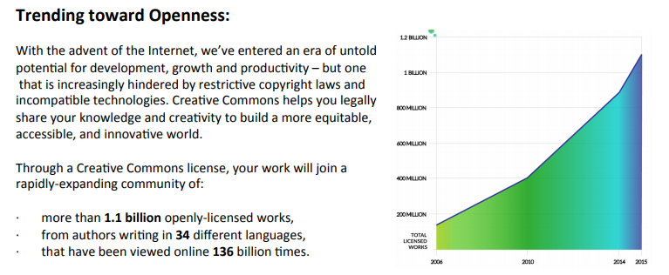
1.1 Billion Openly-Licensed Works
34 + Different Languages
136 Billion views

Slide 11


Slide 12
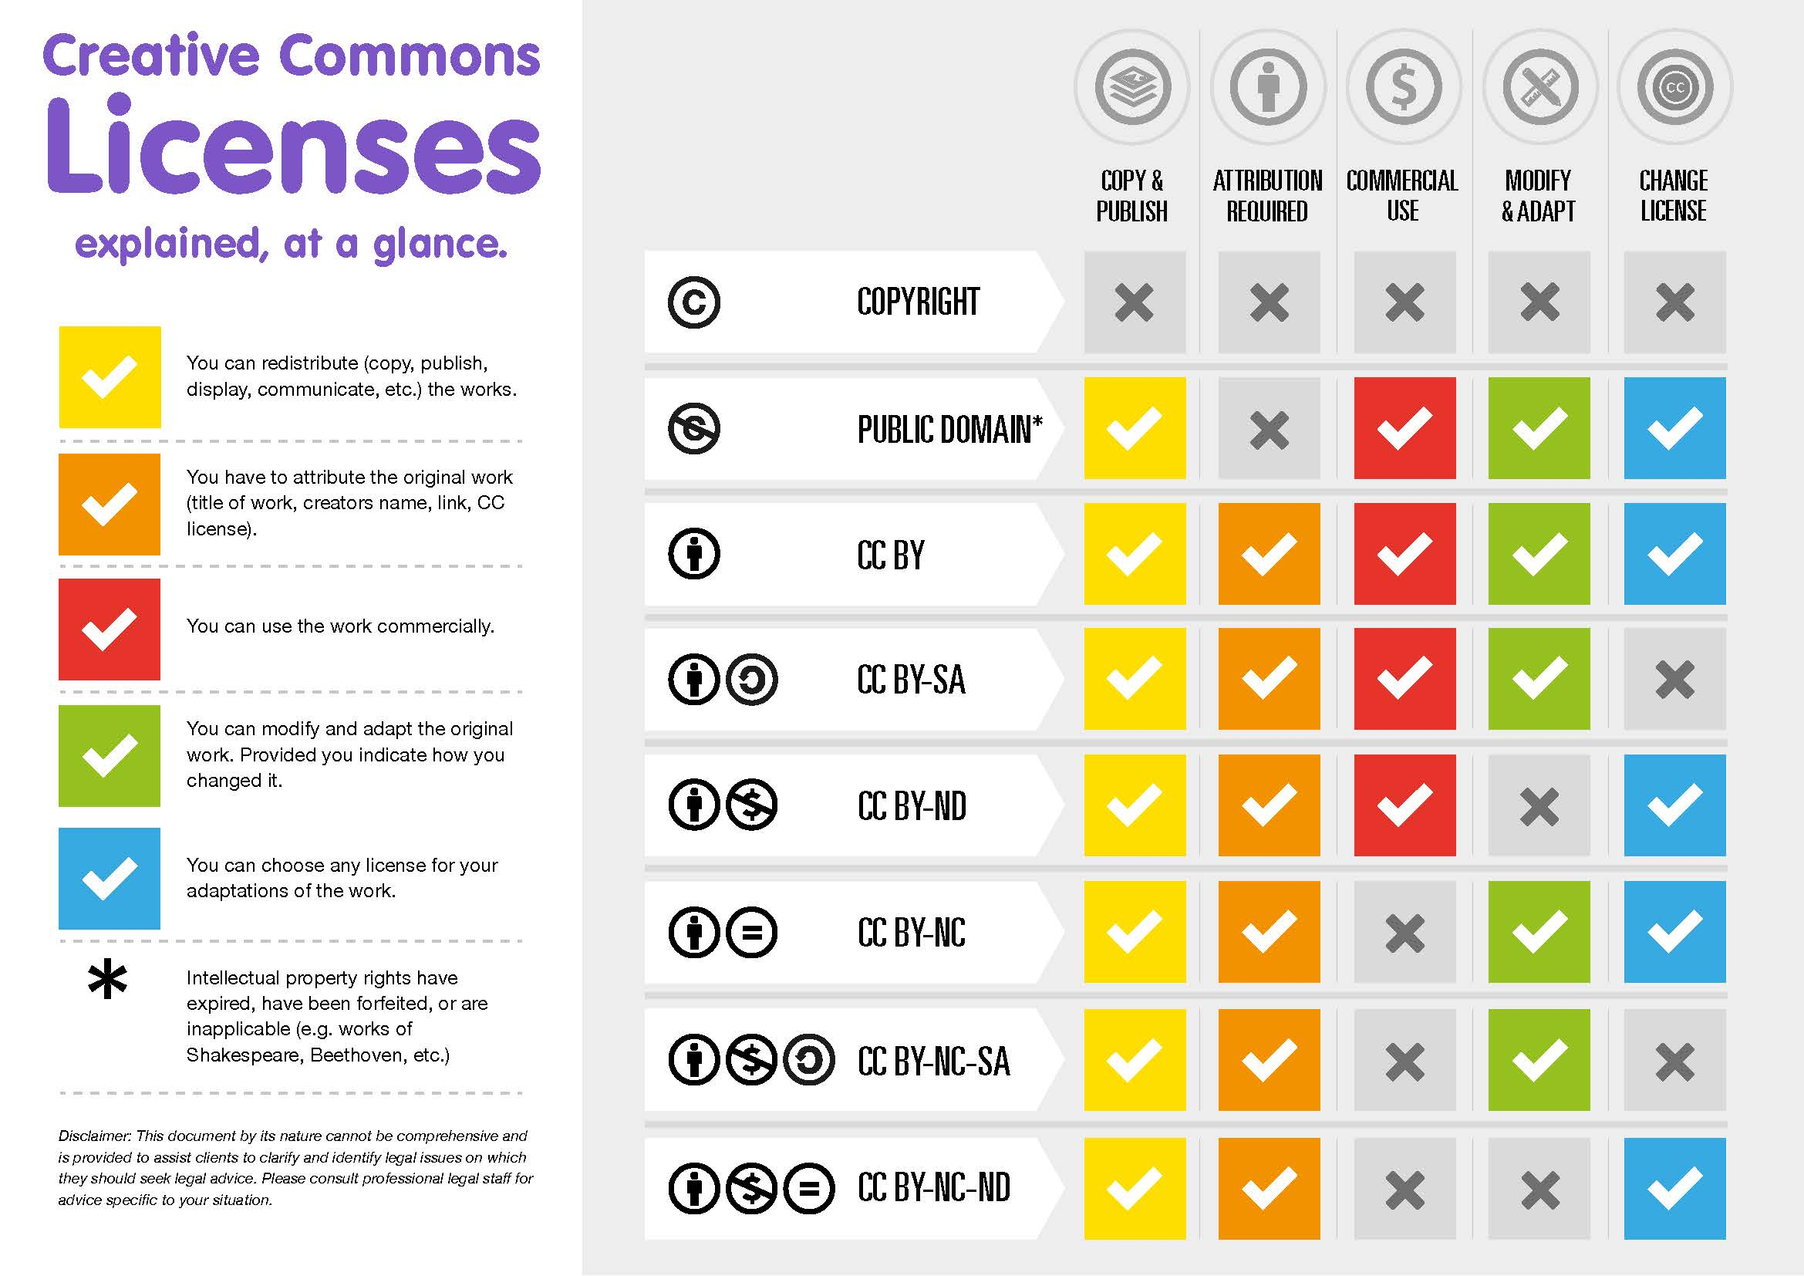

Slide 13
You probably have seen materials Licensed under CC and don’t realize it!

Slide 14
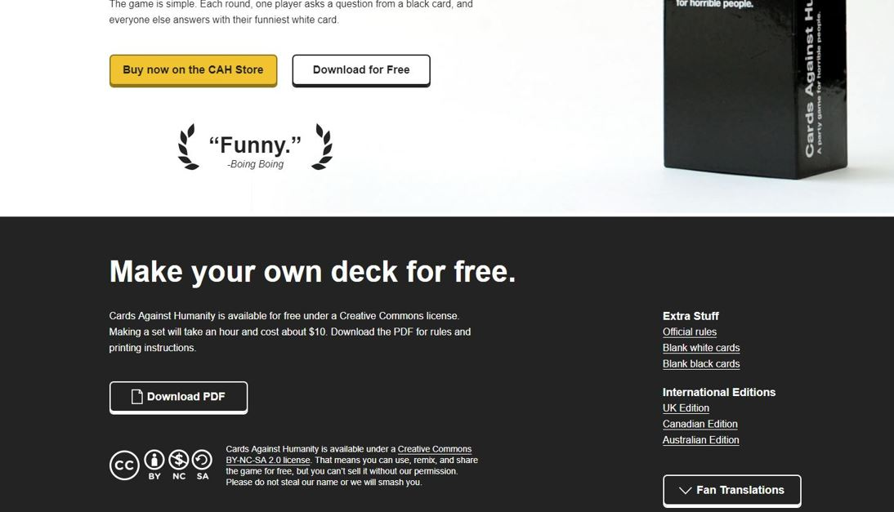
Notes:
Can be found everywhere

Slide 15
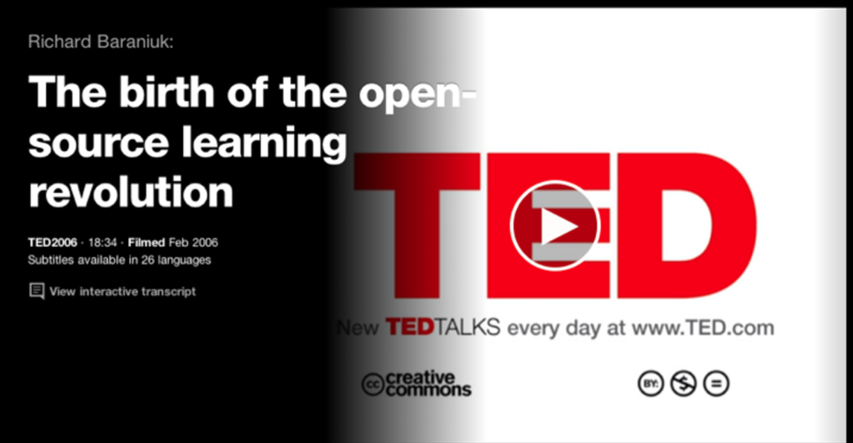
Notes:
Have to show the entire video

Slide 16
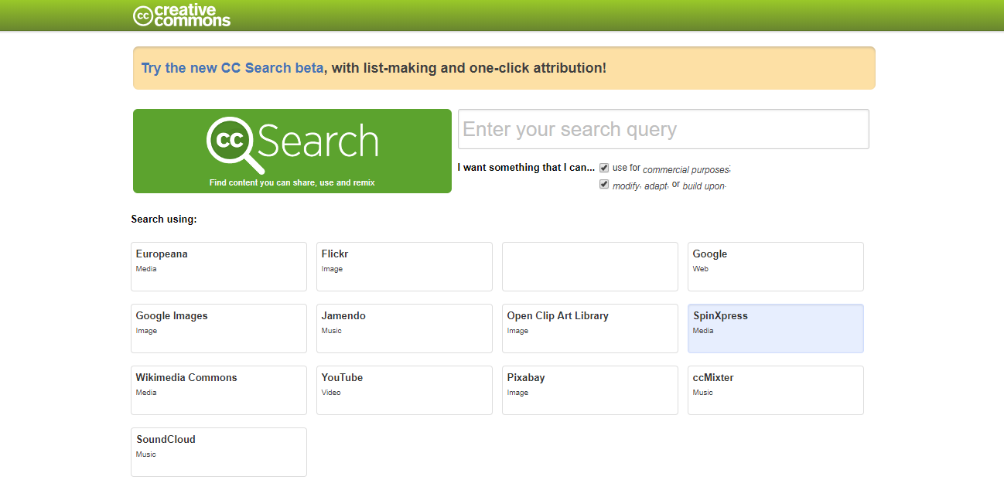
Creative Commons Search

Slide 17
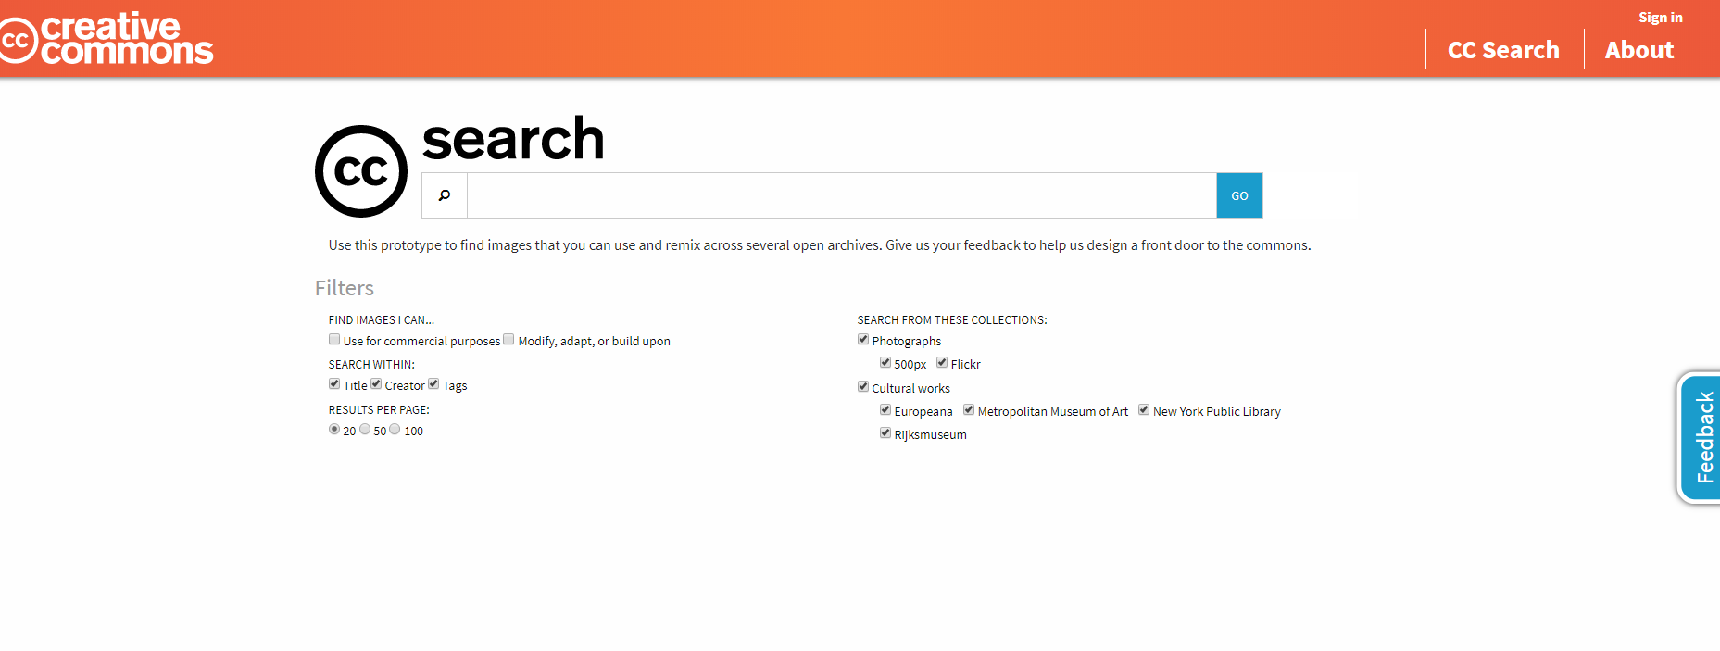
Creative Commons Search Beta Site

Slide 18
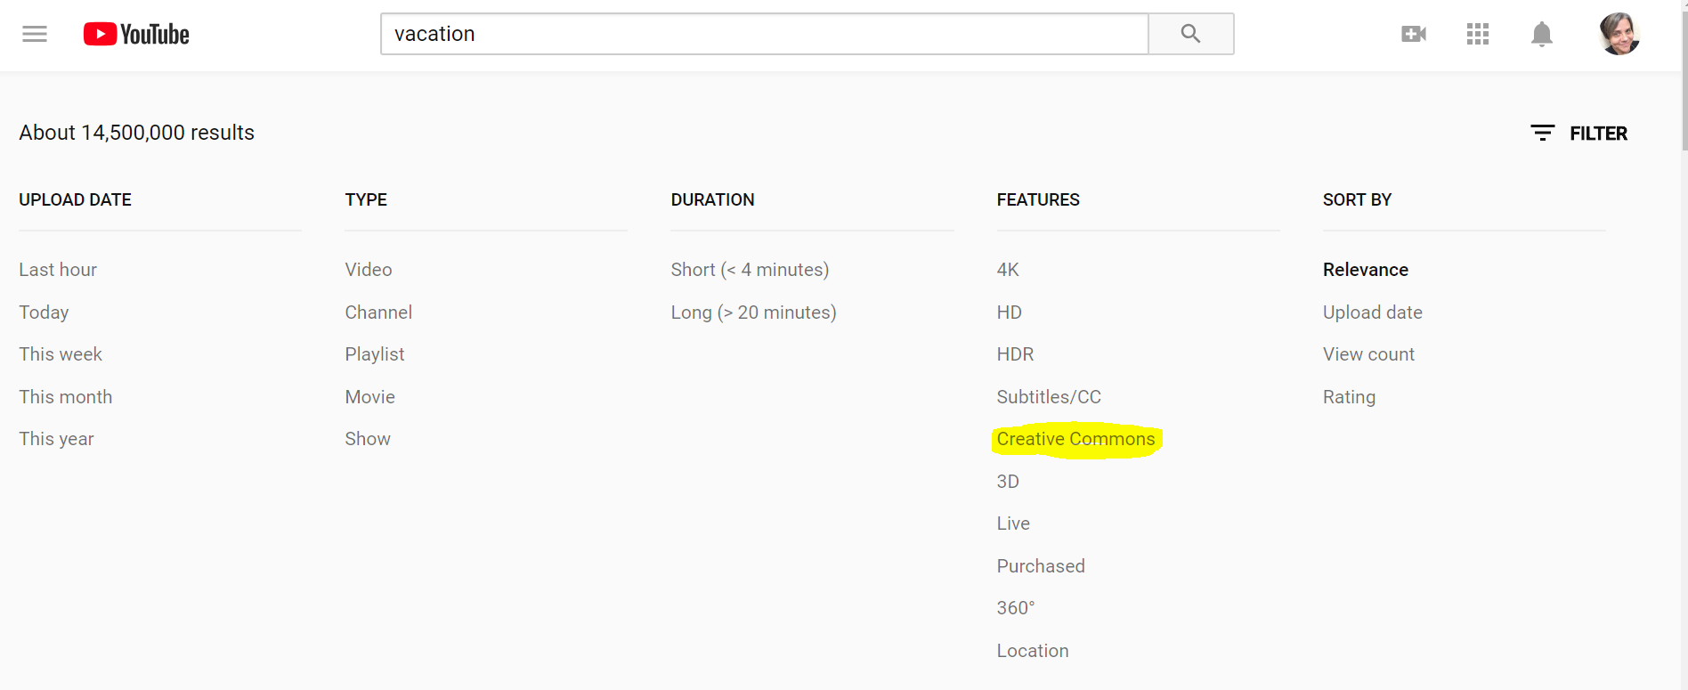
Youtube: can filter results after searching

Slide 19
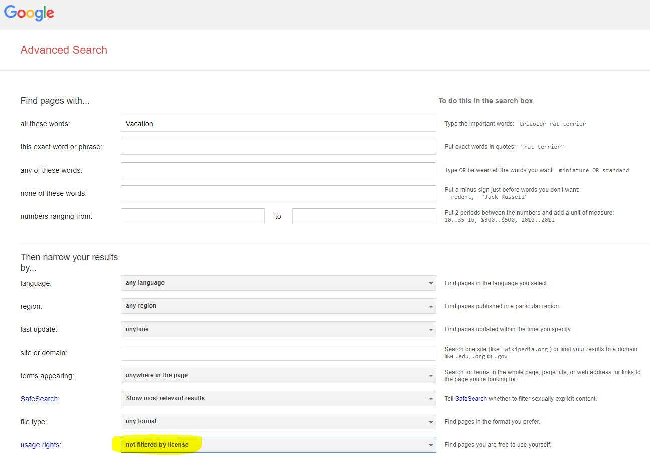

Slide 20
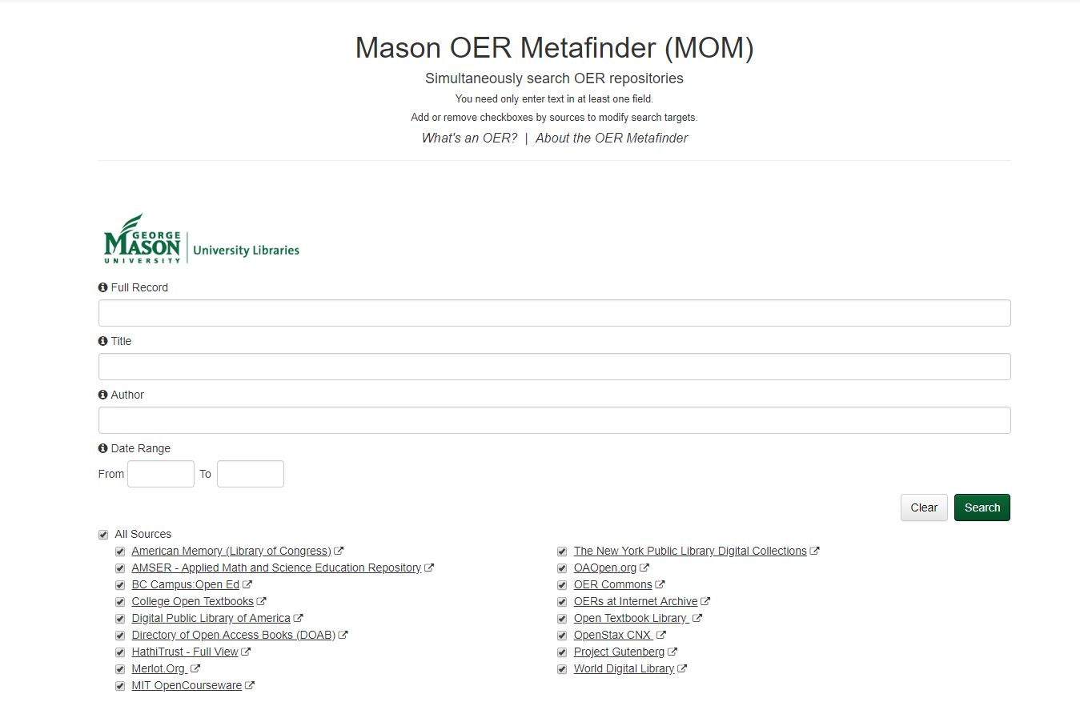

Slide 21
Giving Credit/Citation
credit the creator;
provide the title of the work;
provide the URL where the work is hosted;
indicate the type of license it is available under and provide a link to the license (so others can find out the license terms); and
keep intact any copyright notice associated with the work
Be sure to include as derivative (if you do)
APA requires citation in three areas
  In text
  By the figure
  In the references

Slide 22
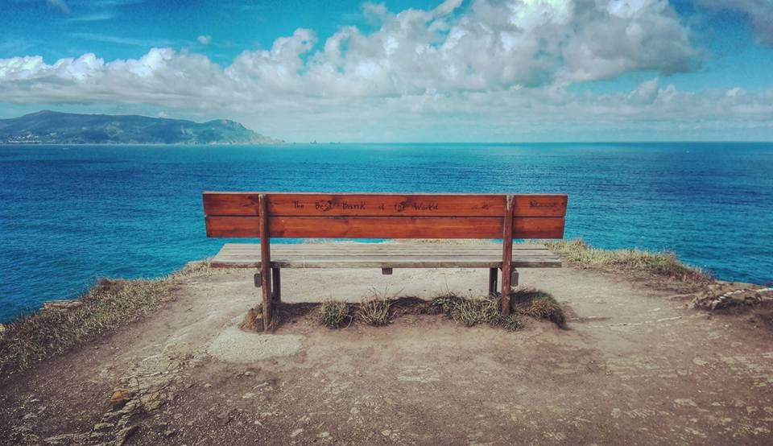

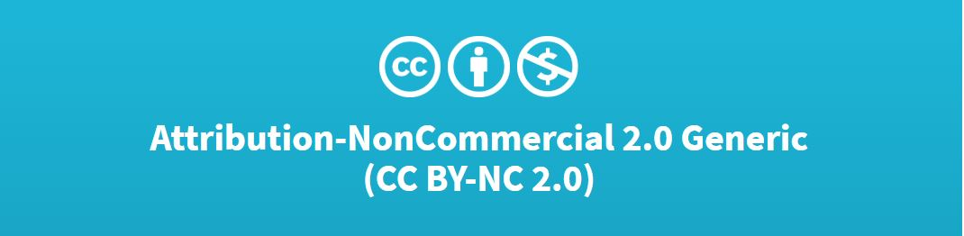
“Bench with a view”by eltpics
Or
“Bench with a view”by eltpics
CC-BY-NC 2.0

Slide 23
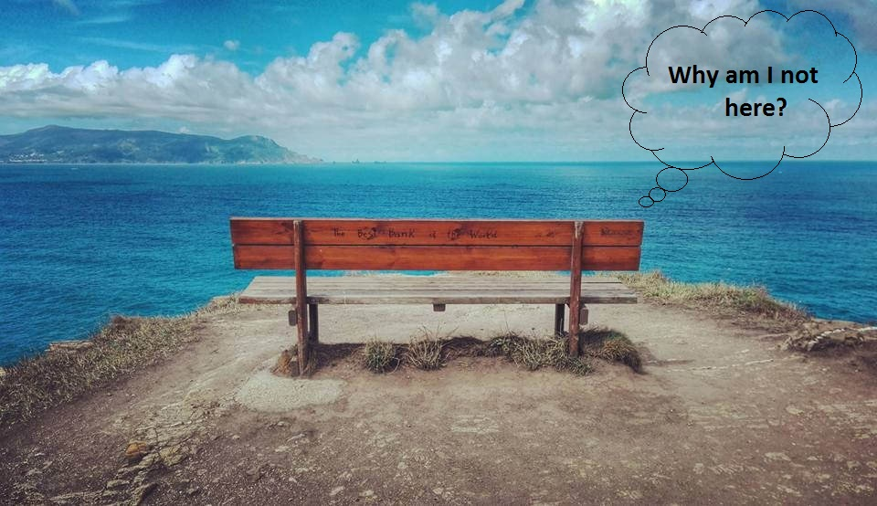
This work, “I need a vacation”, is a derivative of “A Bench with a View” by eltpics, used under CC BY NC. “I need a vacation” is licensed under CC BY NC by Heather Seibert.
Figure 1. I need a vacation, Heather Seibert, 2018, NASIG slides. Under Creative Commons Attribution-Share-Alike – non commercial 4.0

Slide 24
APA Reference List
Eltpics. (2016). “Bench with a View.” flickr. https://www.flickr.com/photos/eltpics/30877770544/

Slide 25

CC0

Slide 26

Snow Day
by Heather Seibert CC BY NC SA

Slide 27
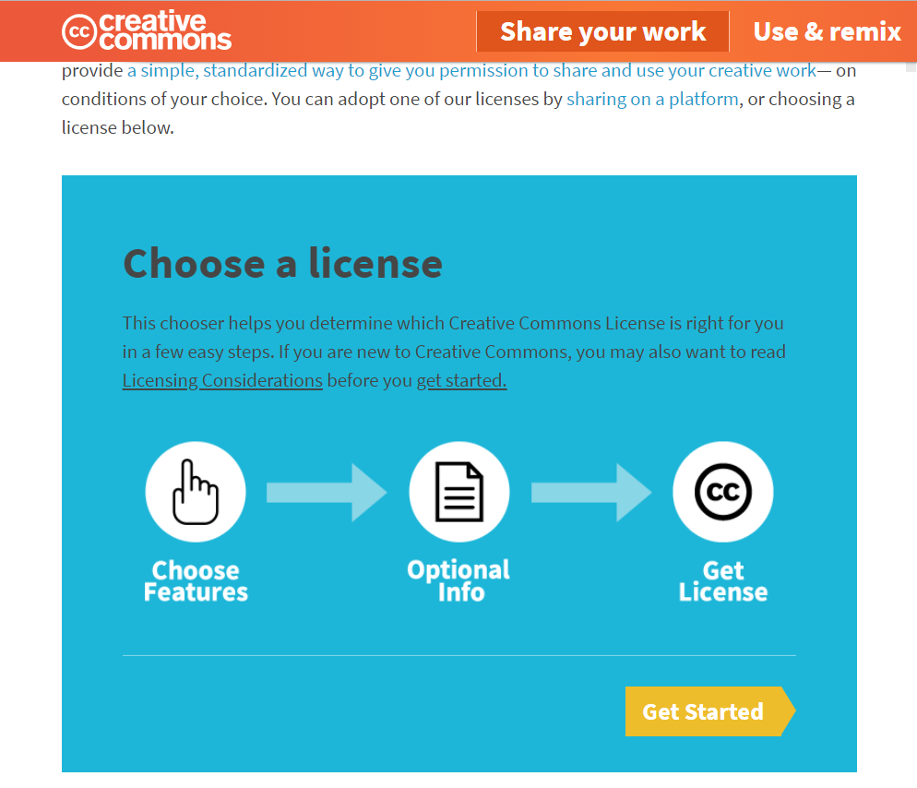
Creative Commons

Slide 28
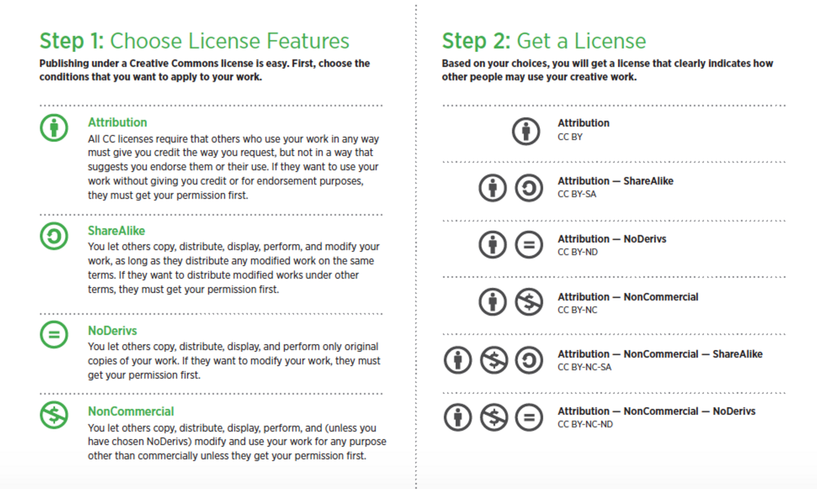
Creative Party CC BY SA 4.0
Creative Party CC BY SA 4.0

Slide 29
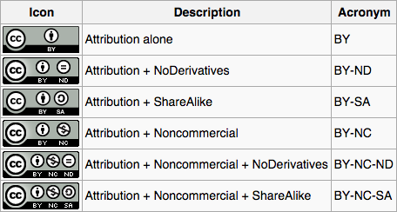

Slide 30
There are still LEGAL consequences with Creative Commons just as there are to Copyright.
Creative Commons does not replace copyright!
Pay attention and know your CC License

Slide 31
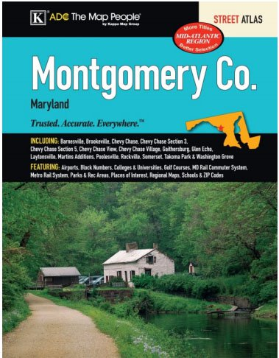
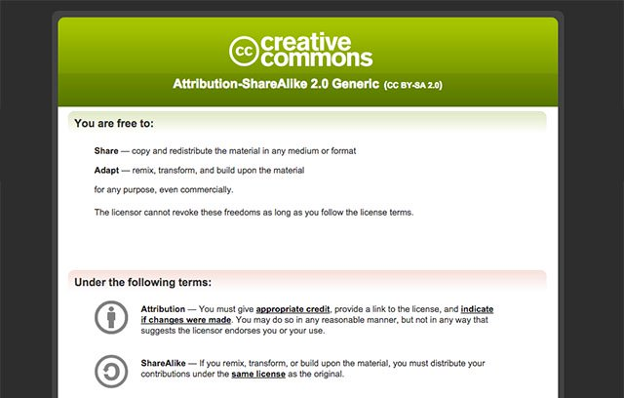
Art Dragulis v. Kappa Map Group LLC.
*Be aware of your CC license

Slide 32
Great Minds (GM) : K-12 Curriculum for Schools published under the CC BY-NC-SA 4.0
FedEx. School Representatives used FedEx to print materials for classroom distribution
Dismissed in 2017 on the grounds that FedEx was not making profit on materials only on printing services
Great Minds v. FedEx
2016

Slide 33
Copyright — all rights reserved — and the public domain — no rights reserved. CC license helps you keep your copyright while allowing for certain use of your work— a “some rights reserved” copyright. - Benefits
provides global recognition
has international application
easy to understand, find and choose
remix ready
remix ready
assists with internal rights management
reduces license proliferation
offers integrity in its licensing model
supports community building & a culture of sharing
provides access to infrastructure & support materials.
*Creative Commons is legally sound.

Slide 34
About The Licenses - Creative Commons. (2014). from https://creativecommons.org/licenses/
Benefits of Using OER. (2018). Retrieved from https://oer.psu.edu/benefits-of-using-oer/
Best practices for attribution - Creative Commons. (2018). Retrieved from https://wiki.creativecommons.org/wiki/Best_practices_for_attribution
Creative Commons — Attribution-ShareAlike 4.0 International — CC BY-SA 4.0. (2018). Retrieved from https://creativecommons.org/licenses/by-sa/4.0/legalcode
Creative Commons and Creative Professionals | Mathys+Potestio. (2018). Retrieved from http://mathys-potestio.com/creative-commons-creative-professionals/
Downloads | The Universal Logo For Human Rights. (2016)). Retrieved from https://www.humanrightslogo.net/en/download
Education / OER. (2017). Retrieved from https://creativecommons.org/about/program-areas/education-oer/
form, C. S. L. C. (2015, June 16). What are Creative Commons licenses? Retrieved from https://www.wur.nl/en/article/What-are-Creative-Commons-licenses.htm

Slide 35
History. (2016). Retrieved from https://creativecommons.org/about/history/
How to give attribution. (2016). Retrieved from https://creativecommons.org/use-remix/get-permission/
Is New York’s decision to spend $8 million on OER a turning point? | Inside Higher Ed. (2018). Retrieved from https://www.insidehighered.com/digital-learning/article/2017/04/19/new-yorks-decision-spend-8-million-oer-turning-point
Kravets, D. (2017, February 27). Odd lawsuit fails to ding FedEx for allowing copies of CC-licensed material. Retrieved from https://arstechnica.com/tech-policy/2017/02/odd-lawsuit-fails-to-ding-fedex-for-allowing-copies-of-cc-licensed-material/
Permissions Guide For Educators | OER Commons. (2018). Retrieved from https://www.oercommons.org/authoring/5800-permissions-guide-for-educators/view

Slide 36
Photographer Loses Copyright Suit Over CC-Licensed Photo on Flickr. (2018) from https://petapixel.com/2015/08/24/photographer-loses-copyright-suit-over-cc-licensed-photo-on-flickr/
Seibert, H. (2016) Research Guides: Open Educational Resources: Home. Retrieved from http://libguides.ecu.edu/c.php?g=168838&p=1107859
Share your work. (2018) .Retrieved from https://creativecommons.org/share-your-work/
The Educator’s Guide to Copyright, Fair Use, and Creative Commons. (2017, January 20). Retrieved from https://www.theedublogger.com/2017/01/20/copyright-fair-use-and-creative-commons/
What’s the Difference Between Copyright and Creative Commons? (2013, November 22). Retrieved from https://www.workmadeforhire.net/the-rest/whats-the-difference-between-copyright-and-creative-commons/

