Slide 1

Collaborating to Analyze E-Journal Use Data
A discussion of cross-institutional cost-per-use analysis projects within the UNC System
Virginia Bacon & Patrick Carr
East Carolina University
Notes:
Photo from Flickr user procsilas used under a Creative Commons license. (I need to look up how to do this attribution again)

Slide 2
Outline
Introduction
2011 four-institution pilot project
2012 UNC system-wide project
Conclusions and moving forward
Questions

Slide 3
COUNTER
Sets a standard for e-resource use data collection and reporting
Clear definitions of use measurements
Allows cross-platform comparisons
Imperfect but powerful

Slide 4
The importance of using this data to measure and evaluate use is growing.
Notes:
Photo from Flickr user procsilas used under a Creative Commons license. (I need to look up how to do this attribution again)

Slide 5
Cost-per-use
An e-resource’s annual subscription cost divided by the use of the resource over the term of the subscription period
A powerful tool for assessing return on investment
Must be contextualized with qualitative data

Slide 6
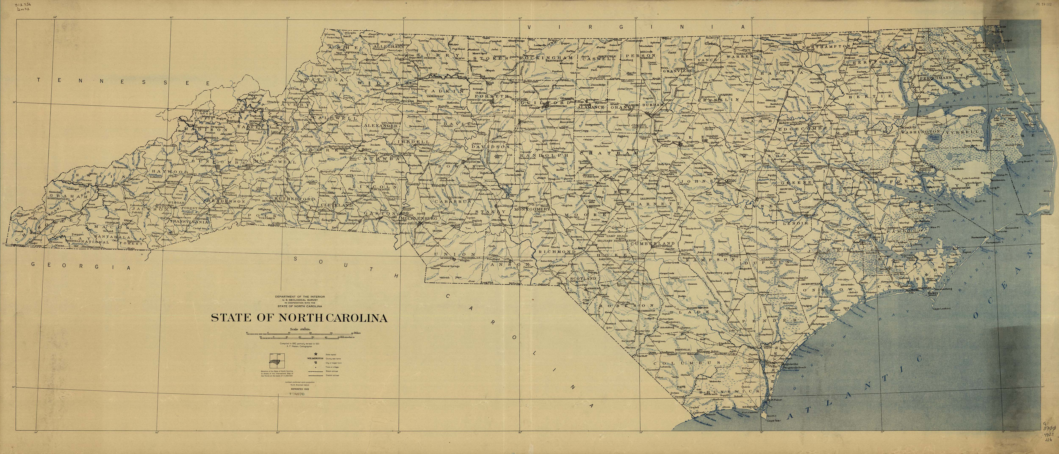
What might we discover if we compare e-resource use data across institutions?
Notes:
Image from Flicker user uconnlibrariesmagic

Slide 7
ECU
UNC Charlotte

Slide 8
UNC Greensboro
ECU
UNC Charlotte
UNC Wilmington

Slide 9
For additional data: http://hdl.handle.net/10342/3143
Notes:
Image from Flicker user uconnlibrariesmagic

Slide 10
Now what?
Notes:
Image from Flicker user uconnlibrariesmagic

Slide 11
UNC system-wide survey

Slide 12
UNC system schools*
Appalachian State University
East Carolina University
Elizabeth City State University
Fayetteville State University
NC Agricultural and Technical State University
North Carolina Central University
NC State University
UNC Asheville
UNC Chapel Hill
UNC Charlotte
UNC Greensboro
UNC Pembroke
UNC Wilmington
Western Carolina University
Winston-Salem State University
* Two system schools, UNC School of the Arts and North Carolina School of Science and Mathematics, were not included in this project.
Notes:
Image from Flicker user uconnlibrariesmagic

Slide 13
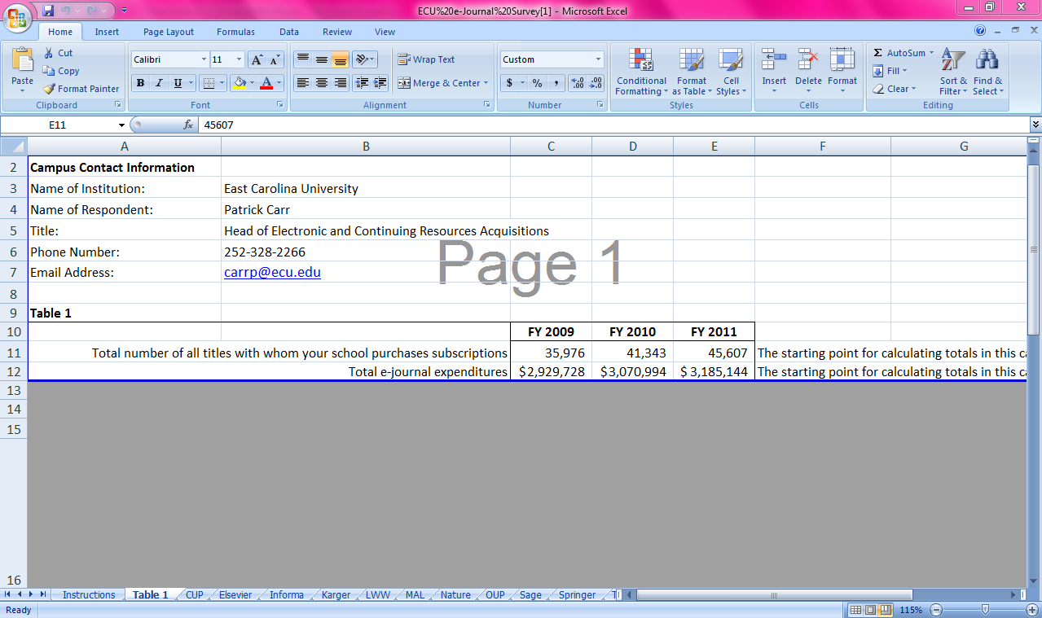
Table 1
Notes:
So, after learning about the project in early May, we got official word to begin on May 18, 2012
Only a couple of weeks to gather and submit the data – June 4th
Started by participating in a conference call with reps from various UNC Libraries and Tim Bucknall
Discussed processes for gathering the data and reviewed the survey instrument
Spreadsheet with 3 tables
Table 1: expenditures and title counts from FY 2009-2011 for e-journals

Slide 14
Cambridge University Press
Elsevier
Informa Healthcare
Karger
Lippincott, Williams, & Wilkins
Mary Ann Liebert
Nature Publishing Group
Oxford University Press
SAGE
Springer
Taylor & Francis
Wiley-Blackwell
World Scientific
Publishers
Notes:
Table 2 divided up by publishers
Variety of different publishers

Slide 15
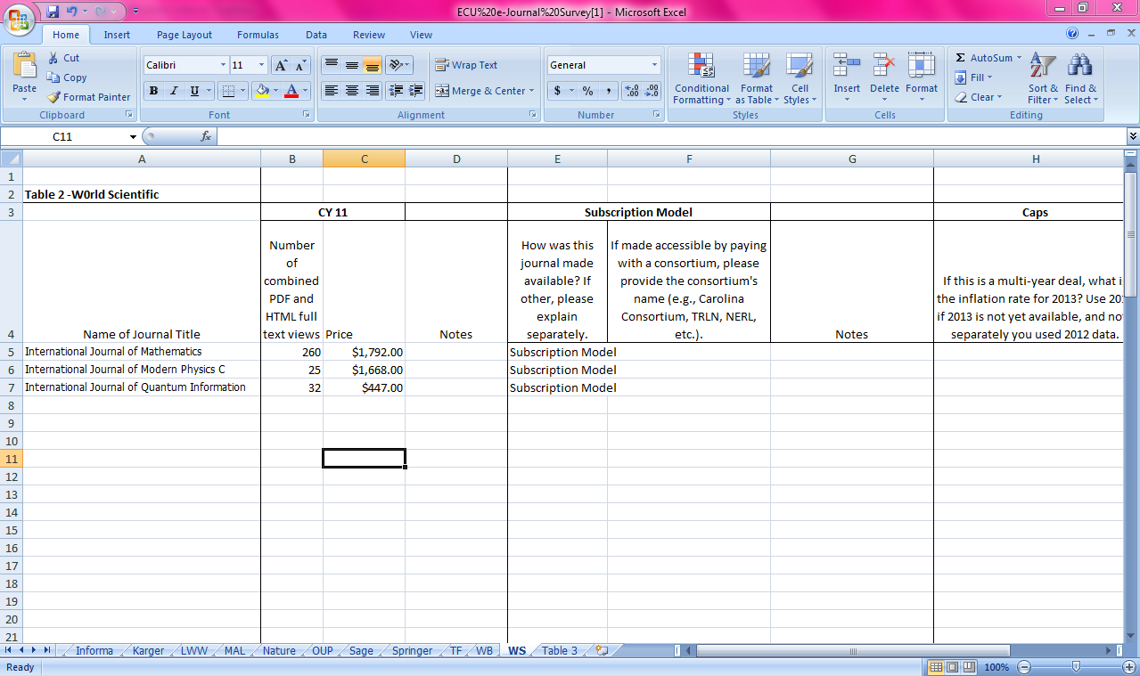
Table 2
Notes:
Table 2 asked for information regarding 2011 fiscal year expenditures, titles, article downloads, subscription models, and price caps for 13 publishers

Slide 16
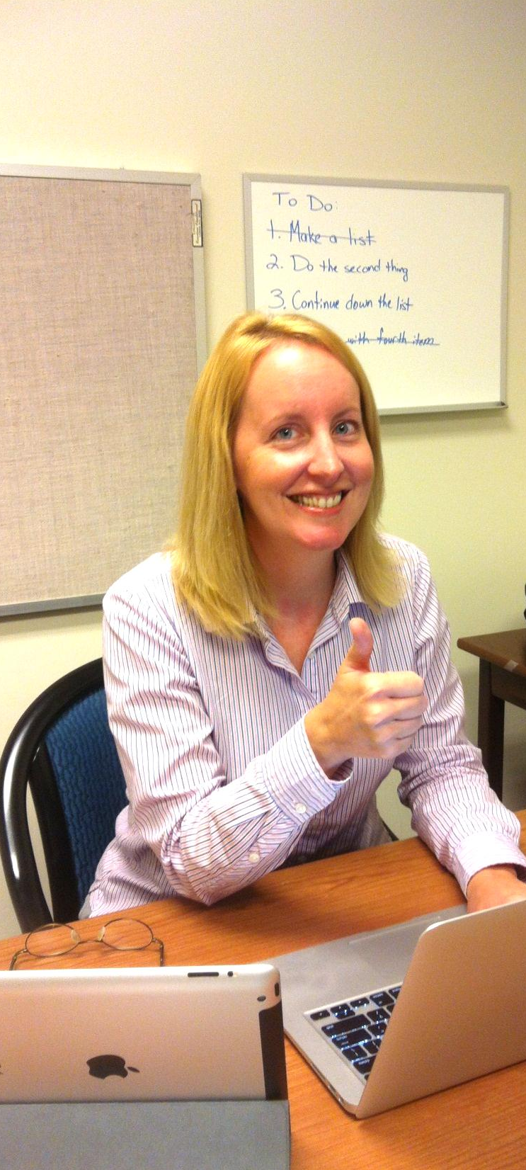
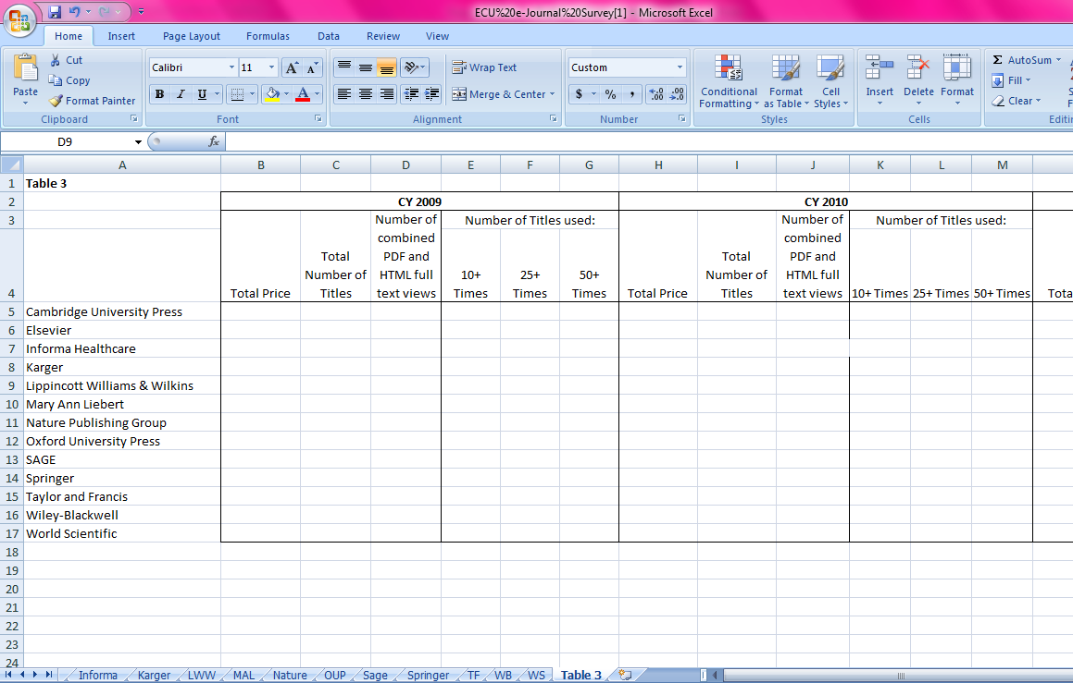
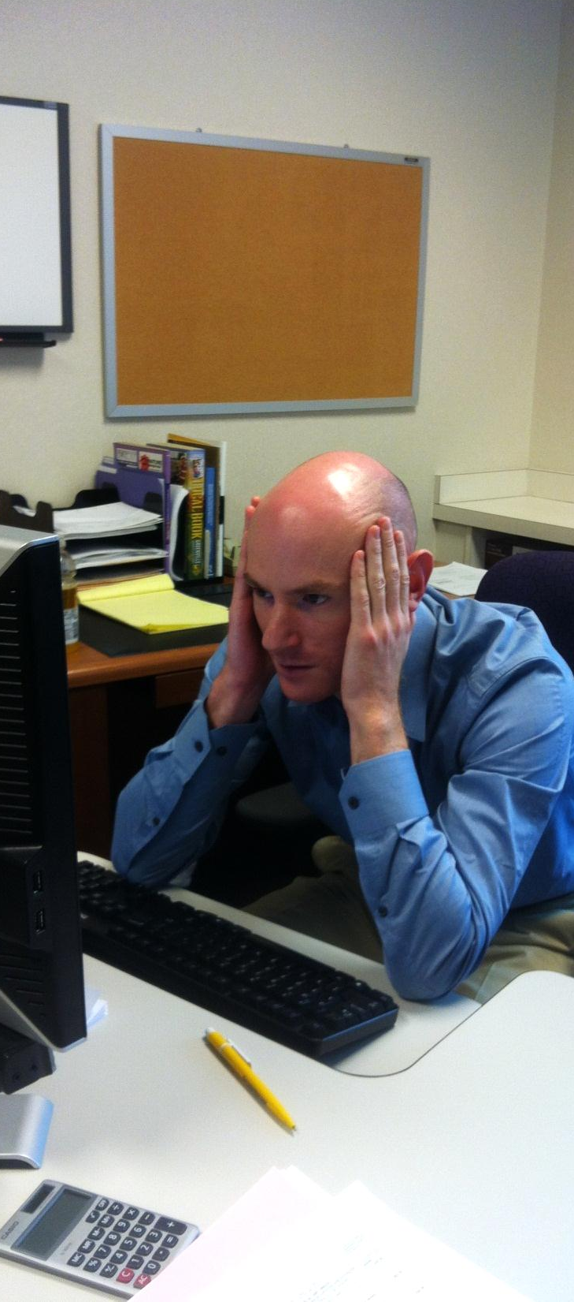
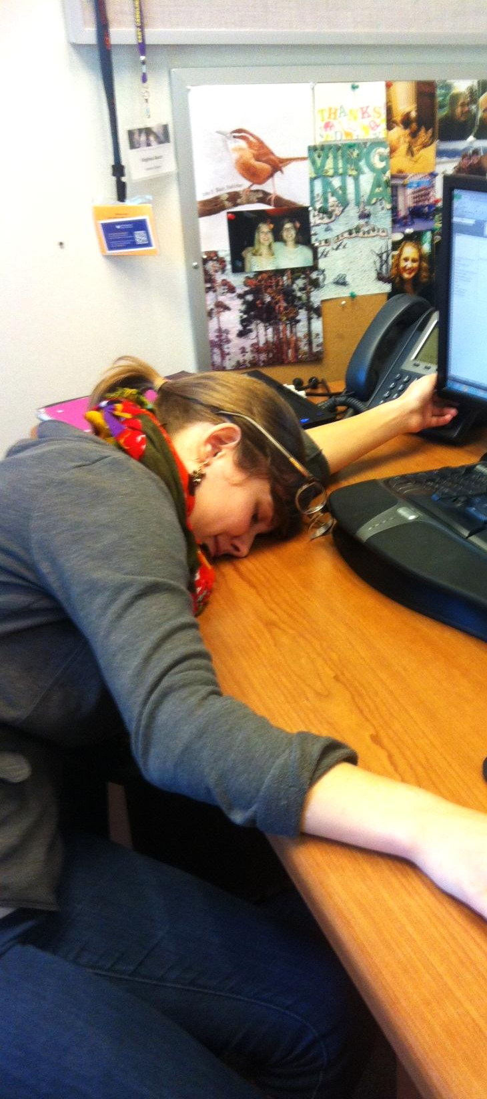
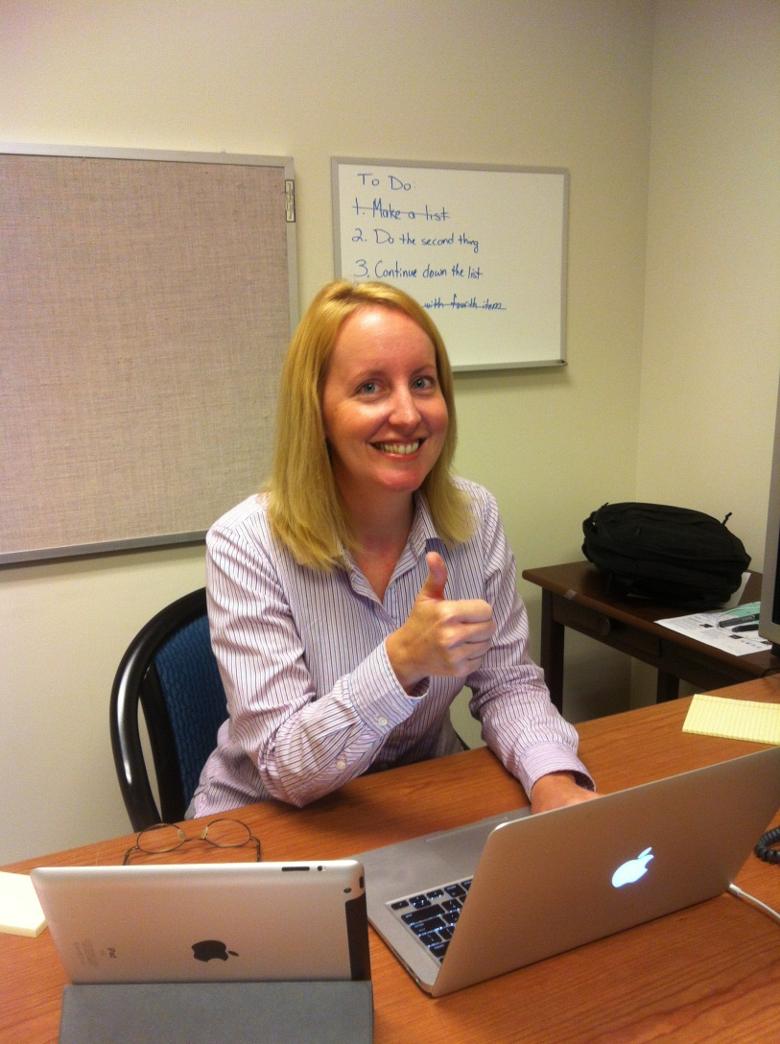
Table 3
Notes:
Table 3: information about title counts, overall use, number of HUTs, etc.
UNC G librarians helped us out with data collection by working directly with publishers to collate and distribute draft versions of the cost and use data for all the libraries’ that were within Carolina Consortium deals
We still had a lot of work to do – Beth K, Patrick C, Virginia B all contributed – we were pretty tired by the end
So we submitted the data by June 4, and then it was taken into the hands of the accounting firm to collate and analyze the data the system libraries had submitted
Results of their analysis came out in an August 2012 report, which attempts to establish a “performance baseline” for the libraries
Primary measure of performance being changes in cost relative to changes in access

Slide 17

If the libraries are performing well, increases in expenditures should result in increases in access.
Notes:
In other words, if the libraries are performing well, increases in expenditures should result in increases in access.
From Flickr user danmachold

Slide 18
Metrics for access
Increases to the numbers of titles and uses
Growth in cost-per-title (CPT) and cost-per-use (CPU) that is lower than growth in expenditure (as well as decreases in CPT and CPU)
Increases in the number of highly used titles (HUTs)
Notes:
But what do they mean by “access”? Used differently in report than how we normally use the term access in libraries.
Defined access using the following measures – increase in access = (3 bullet points)
General idea is that the more you pay, the more “access” you should be getting in terms of lower CPU, CPT, and higher use, more titles and more HUTs

Slide 19
Overall findings
From 2009-2011, there was a:
17% increase in e-journal expenditures
10% increase in titles
6% increase in CPT
18% increase in use
1% decrease in CPU
25-33% increase in HUTs
Notes:
Only “bad” finding is the increase in CPT, but it is well below the growth in expenditures, so that’s good

Slide 20
Elsevier: $7.2 million
Wiley-Blackwell: $3.6 million
Springer: $2.1 million
Taylor & Francis: $1.5 million
SAGE: $1.3 million
Notes:
Expenditures system-wide for some of the major publishers – you can see why UNC GA wants to make sure we’re reining in our costs – these packages aren’t inexpensive.

Slide 21
Nature: $1.15
LW&W: $1.61
Oxford UP: $1.88
Karger: $33.00
World Scientific: $83.08
Notes:
Lowest and highest average CPUs – big range

Slide 22
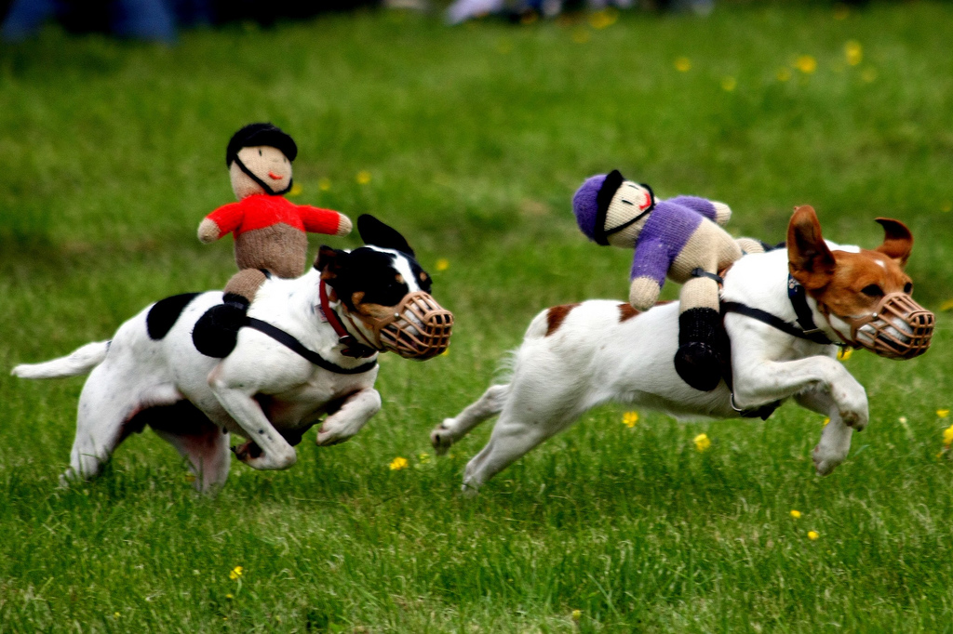
UNC System expenditures (+5%)
E-Journal price increases (+9%)
Notes:
From Flickr user garryknight

Slide 23
How do we maintain our lead?
Notes:
From Flickr user garryknight

Slide 24
1: Develop an online repository in which UNC libraries can share expenditure and access data
Notes:
From Flickr user garryknight

Slide 25
2: Procure purchases of common library products using SciQuest
Notes:
From Flickr user garryknight

Slide 26
3: Develop a standard template and checklist for e-journal licensing
Notes:
From Flickr user garryknight

Slide 27
4: Evaluate and pursue strategies to promote the publication of the results of UNC research in Open Access venues
Notes:
From Flickr user garryknight

Slide 28
5: Develop a system-wide plan to contain expenditures and expand access
Notes:
From Flickr user garryknight

Slide 29
System-wide plan
Give special attention to four “high-risk” publishers: Elsevier, Wiley-Blackwell, Taylor & Francis, and Oxford University Press
Reduce annual growth in expenditures to the point that it parallels growth in use
Lower annual growth in CPU and CPT to the point that it is less than annual growth in expenditures
Reduce annual changes in CPU or CPT
Notes:
Explain what high-risk publishers are
Read other bullet points
So I’ve just reviewed what the accounting firm hired by UNC GA thought about the data, and now Patrick is going to discuss what we think about both the report and the system data
From Flickr user garryknight

Slide 30

Notes:
Flickr user: nickwheeleroz

Slide 31
Imperfections
Emphasis on number of accessible titles and CPT
Notes:
Flickr user: nickwheeleroz

Slide 32
Cambridge University Press CPT
Notes:
Flickr user: nickwheeleroz

Slide 33
Cambridge University Press CPU
Notes:
Flickr user: nickwheeleroz

Slide 34
Imperfections
Emphasis on number of accessible titles and CPT
Inconsistent data collection methods among system schools
Notes:
Flickr user: nickwheeleroz

Slide 35

Good
enough.

Slide 36
Report Recommendations
Developing a shared repository of use data
SciQuest procurement software
Developing system-wide licensing guidelines
Promote Open Access publishing
Develop a system-wide plan to contain expenditures and expand access
Notes:
From Flickr user garryknight

Slide 37
5: Develop a system-wide plan to contain expenditures and expand access
Notes:
From Flickr user garryknight

Slide 38

Are these publishers really “high-risk”?
Notes:
From Flickr user xavierbt

Slide 39
Context is everything.
Notes:
From Flickr user xavierbt

Slide 40

LWW CPU
NC Central: $117
NC A&T: $287
WSSU: $399
System Average: $1.61
UNC CH: $0.85
ECU: $1.56
Notes:
From Flickr user Therese Tjernström

Slide 41
Oxford University Press
CPU % increase: 10%
CPU $ increase: $0.18
CPU 2009: $1.70
CPU 2011: $1.88
Notes:
From Flickr user xavierbt

Slide 42
Taylor & Francis
System CPU: $13.31
But this high CPU is due to the fact that many of the system libraries only have individual subscriptions and do not subscribe to a T&F ‘big deal’ package.
Notes:
From Flickr user xavierbt

Slide 43
Lower CPU does not always equal a better deal.
Notes:
From Flickr user xavierbt

Slide 44
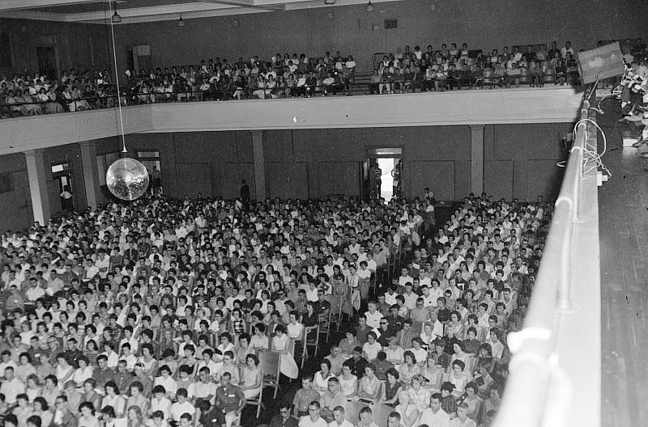
The larger the school, the lower the CPU.
Notes:
From Flickr user xavierbt

Slide 45
Enrollment by school
Average CPU by school
Notes:
From ECU digital collections: http://digital.lib.ecu.edu/encore/ncgre000/00000005/00004997/00004997_ac_0001.jpg

Slide 46
Are publishers’ pricing models fair?
Notes:
From ECU digital collections: http://digital.lib.ecu.edu/encore/ncgre000/00000005/00004997/00004997_ac_0001.jpg

Slide 47
Enrollment by school
Downloads per enrolled student
Notes:
From ECU digital collections: http://digital.lib.ecu.edu/encore/ncgre000/00000005/00004997/00004997_ac_0001.jpg

Slide 48
Schools by Carnegie Classification
School | Carnegie Classification | 2011-2012 Full-text downloads | Student Enrollment Fall 2011 | DPES
North Carolina Central University | Master's | 18,776 | 7,587 | 2.47
UNC Pembroke | Master's | 18,233 | 5,477 | 3.33
Elizabeth City State University | Baccalaureate | 12,686 | 2,772 | 4.58
Fayetteville State University | Master's | 31,133 | 5,199 | 5.99
Winston-Salem State University | Master's | 35,414 | 5,765 | 6.14
UNC Wilmington | Master's | 105,980 | 12,321 | 8.60
Western Carolina University | Master's | 72,650 | 8,343 | 8.71
Appalachian State University | Master's | 145,872 | 16,654 | 8.76
UNC Charlotte | Research | 223,258 | 22,630 | 9.87
NC A&T State University | Research | 110,023 | 10,063 | 10.93
UNC Greensboro | Research | 214,738 | 16,855 | 12.74
UNC Asheville | Baccalaureate | 67,464 | 3,466 | 19.46
East Carolina University | Research | 484,984 | 24,588 | 19.72
NC State University | Research | 1,248,504 | 30,950 | 40.34
UNC - Chapel Hill | Research | 2,350,522 | 26,837 | 87.59
Notes:
From ECU digital collections: http://digital.lib.ecu.edu/encore/ncgre000/00000005/00004997/00004997_ac_0001.jpg

Slide 49
Enrollment by school
Downloads per enrolled student
Average CPU by school
Notes:
From ECU digital collections: http://digital.lib.ecu.edu/encore/ncgre000/00000005/00004997/00004997_ac_0001.jpg

Slide 50

In the future…
Establish a working group to act on recommendations
5 year expenditure plan
  4% reduction by year 3
  8% reduction by year 5
Notes:
So what is the future of this project?
UNC Libraries have formed a working group of 6 – representatives from 6 of the libraries – to work on the recommendations
Includes establishing the data repository, developing the system wide plan, and exploring open access and templates for common licensing guidelines
Concerning the system wide plan for improving e-journal purchasing ROI - 5 year expenditure plan – relative to national journal inflation rates
From Flickr user walt74

Slide 51
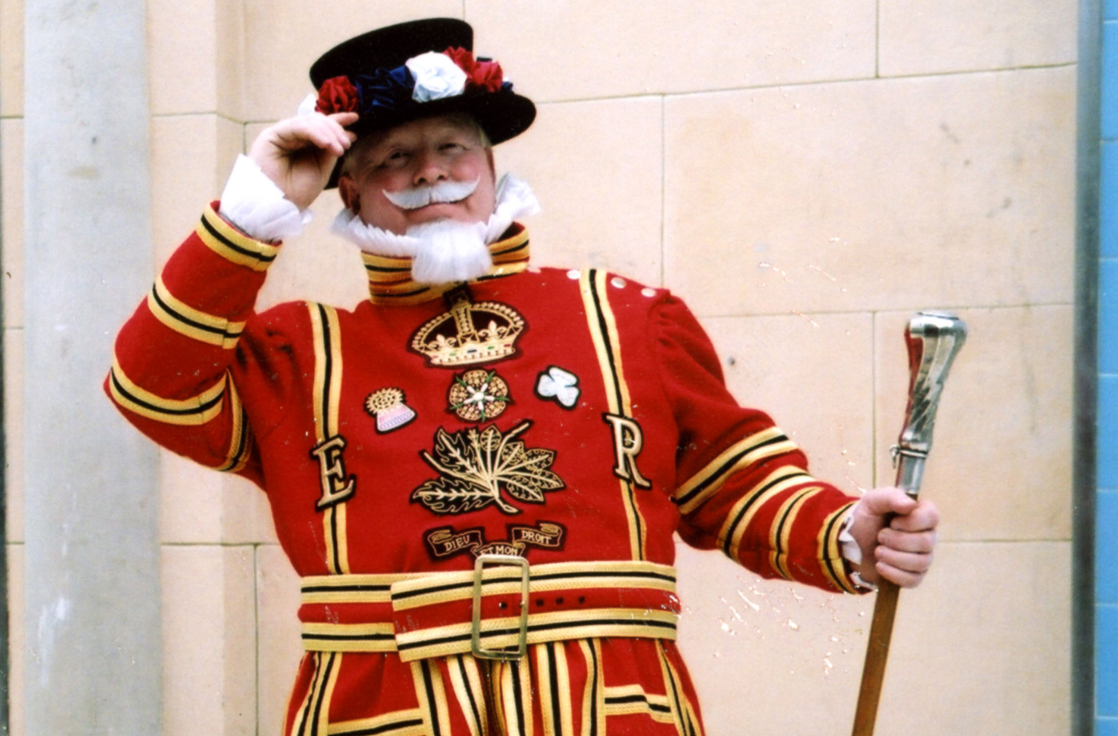
A tip of the hat.
Notes:
Organizer of the system-wide e-journal survey and authors of the report deserve a tip of the hat- a crucial first step
http://www.thememan.co.uk/images/Yeoman2.jpg

Slide 52
Our Final Recommendations
Notes:
Photo from Flickr user procsilas used under a Creative Commons license. (I need to look up how to do this attribution again)

Slide 53
1: Carry out cross-institutional CPU analyses of e-journal collections to contextualize and maximize ROI
Notes:
http://www.thememan.co.uk/images/Yeoman2.jpg

Slide 54
2: Develop consistent calculation guidelines and centralized data collection
Notes:
http://www.thememan.co.uk/images/Yeoman2.jpg

Slide 55
3: Avoid and/or sidestep confidentiality clauses in licenses
Notes:
http://www.thememan.co.uk/images/Yeoman2.jpg

Slide 56
4: Strive to improve ROI by working to enhance the discoverability of e-journal collections
Notes:
http://www.thememan.co.uk/images/Yeoman2.jpg

Slide 57
5: Use cross-institutional analyses to make institution-level assessments rather than system-level assessments
Notes:
http://www.thememan.co.uk/images/Yeoman2.jpg

Slide 58
6: Lobby publishers to develop pricing models that factor in research intensiveness as well as enrollment
Notes:
http://www.thememan.co.uk/images/Yeoman2.jpg

Slide 59
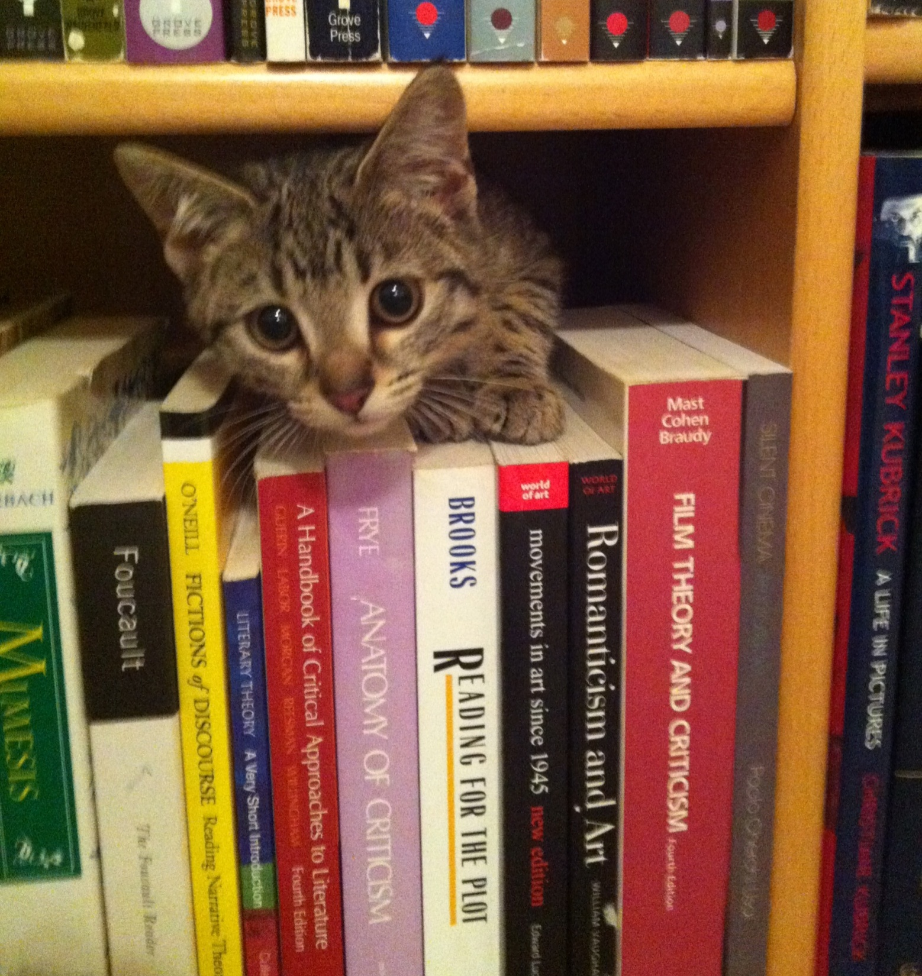
Questions?
Virginia Bacon Patrick Carr
baconv@ecu.edu carrp@ecu.edu

