Slide 1
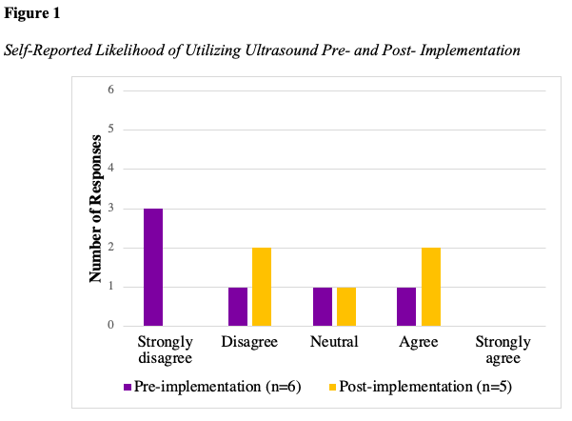
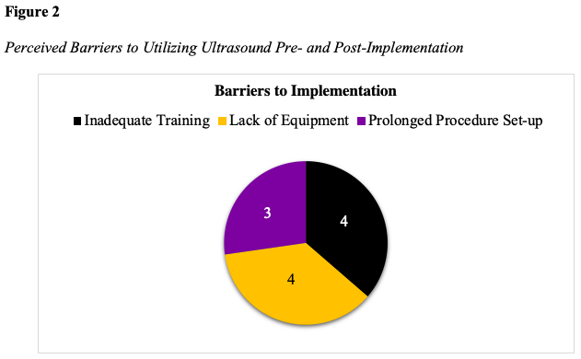
Anesthesia Providers’ Perceptions of Ultrasound-Guided Arterial Line Placement: A Doctor of Nursing Practice Project
Allison Rogers, BSN, SRNA
Travis Chabo, PhD, CRNA, Project Chair
Nurse Anesthesia Program
College of Nursing, East Carolina University
Greenville, North Carolina 27858
lennona15@students.ecu.edu
INTRODUCTION
RESULTS
DISCUSSION
Numerous studies support ultrasound-guided arterial cannulation over the traditional palpation technique.
    Improved first-attempt success rates.
    Decreased procedural complications.
    Decreased procedural time.
Despite multiple studies supporting ultrasound guidance, no formal processes are followed.
CRNAs use clinical judgment and personal preference when placing arterial lines.
Purpose: To develop, implement, and evaluate the perceived adequacy of an educational resource designed specifically for anesthesia providers for improving awareness and utilization of ultrasound for arterial line placement.
Six CRNAs completed the pre-implementation survey.
Five CRNAs completed the post-implementation survey.
Majority of participants had over ten years of experience.
Utilization of ultrasound for arterial line insertion did not increase over the implementation period.
CRNAs reported several barriers towards implementation
    Inadequate education and training
    Lack of available ultrasound equipment
    Prolonged procedure set-up and duration
Overall confidence and likelihood of using ultrasound for arterial line placement increased.
CONCLUSIONS
Limitations:
    Small sample size.
    Offsite rotation during post-implementation phase.
Recommendations:
    Directly conversing with participants.
    Increasing project duration.
    Future educational opportunities including workshops.
Implications:
    Potential cost savings.
Sustainability:
    Ultrasound equipment and availability intraoperatively
METHODS
Pre- and post-implementation survey design using Qualtrics.
A single plan-do-study-act (PDSA) quality improvement cycle.
Created an evidence-based practice tool and voiceover PowerPoint and emailed to participants.
Educational tool placed on all ultrasound machines within the main operating room during the two-week implementation phase.
Survey included Likert-type scales and one open-response question.
Survey assessed participants’ perceptions of the educational tool and adequacy of the resource.
Data analysis of survey questions was used to determine the participants’ perceptions of the educational intervention.
Dissemination of findings to participating organization to assist with continuing cycles.
REFERENCES
Bhattacharjee, S., Maitra, S., & Baidya, D. K. (2018). Comparison between ultrasound guided technique and digital palpation technique for radial artery cannulation in adult patients: An updated meta-analysis of randomized controlled trials. Journal of Clinical Anesthesia, 47, 54–59. https://doi.org/10.1016/j.jclinane.2018.03.019
Cho, S.-A., Jang, Y.-E., Ji, S.-H., Kim, E.-H., Lee, J.-H., Kim, H.-S., & Kim, J.-T. (2021). Ultrasound-guided arterial catheterization. Anesthesia and Pain Medicine, 16(2), 119-132. https://doi.org/10.17085/apm.21012
Chui, J., Lavi, R., Hegazy, A. F., Jones, P. M., Arellano, R., Yang, H., & Bainbridge, D. (2019). Identifying barriers to the use of ultrasound in the perioperative period: A survey of southwestern Ontario anesthesiologists. BMC Health Services Research, 19(1), Article 214. https://doi.org/10.1186/s12913-019-4040-2
Kiberenge, R. K., Ueda, K., & Rosauer, B. (2018). Ultrasound-guided dynamic needle tip positioning technique versus palpation technique for radial arterial cannulation in adult surgical patients: A randomized controlled trial. Anesthesia & Analgesia, 126(1), 120-126. https://doi.org/10.1213/ane.0000000000002261
Wang, A., Hendin, A., Millington, S. J., Koenig, S., Eisen, L. A., & Shiloh, A. L. (2020). Better with ultrasound. Chest, 157(3), 574–579. https://doi.org/10.1016/j.chest.2019.08.2209
Yu, Y., Lu, X., Fang, W., Liu, X., & Lu, Y. (2019). Ultrasound-guided artery cannulation technique versus palpation technique in adult patients in pre-anesthesia room: A randomized controlled trial. Medical Science Monitor, 25, 7306–7311. https://doi.org/10.12659/msm.916252

