Slide 1
Increasing Awareness
Through my Passion for the Arts
Bina Amin
Research & Creativity Week
April 3, 2019

Slide 2
Senior Honors Proposal: Outline
Raas
My Passion
Forming the Team/Dance
Cultural Awareness
Internal Awareness
Food For Thought
Acknowledgements

Slide 3
What is a Raas?

Slide 4
Raas: Significance
Purpose
Impact
Passion
Why?
What?
On Campus
Within dancers
Process
How?

Slide 5
Purpose/Background

Slide 6
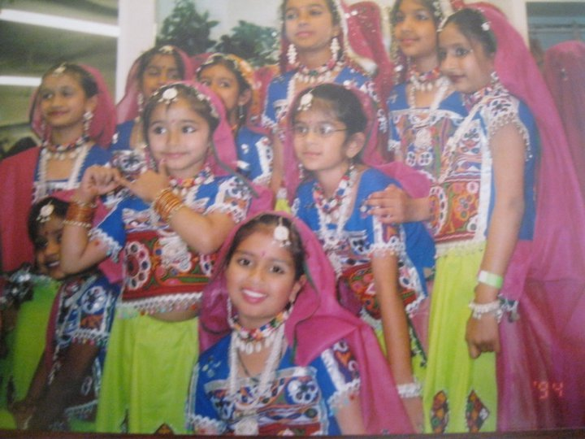
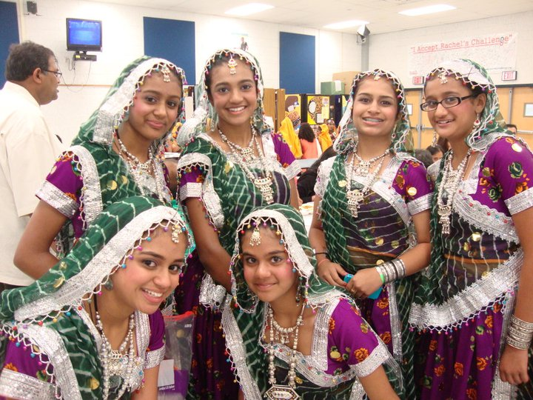
My Passion

Slide 7
Process: The Routine
Recruitment
Team Bonding
Theme
Music Selection
Choreography
Costume/Props
Performance

Slide 8
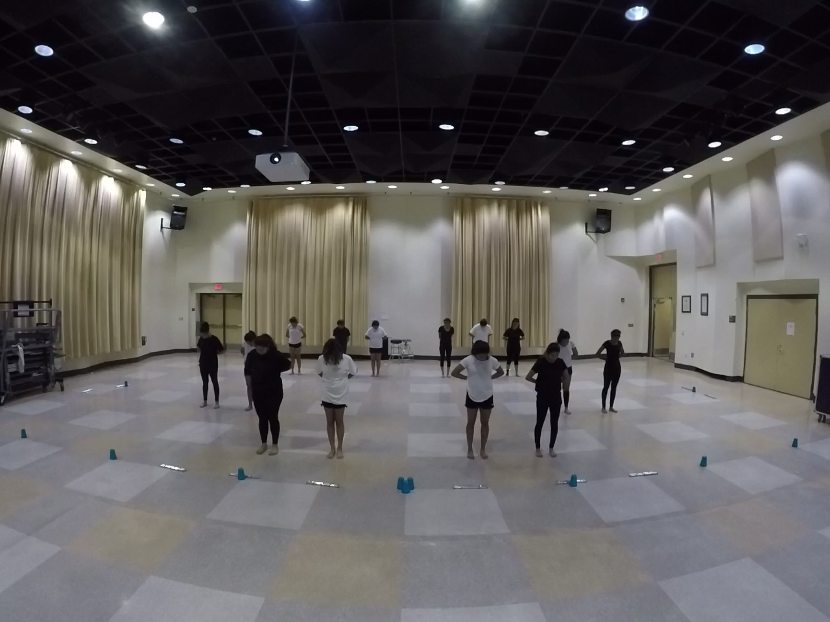
Beginning: Practice

Slide 9
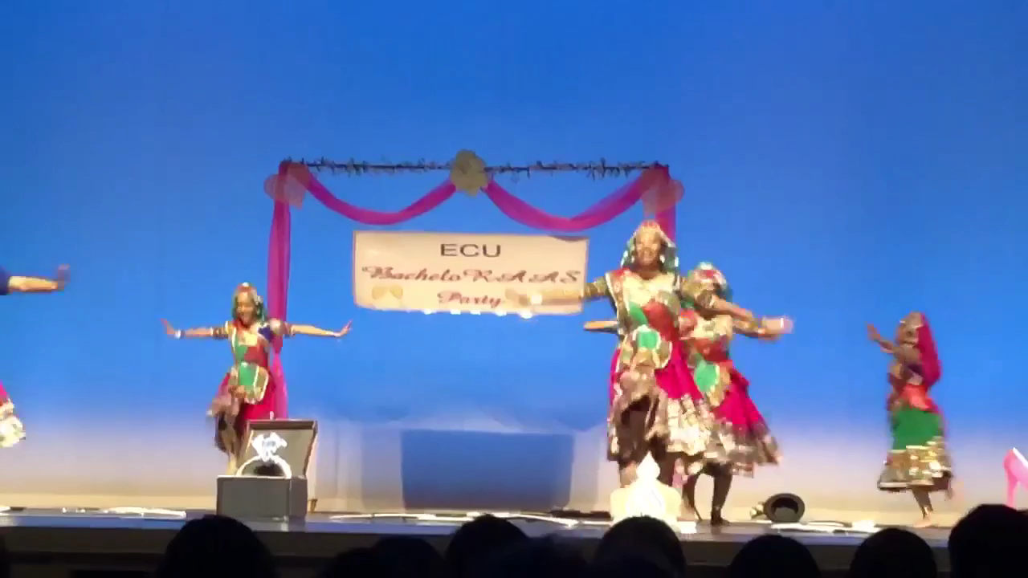
End: Performance

Slide 10
Impact on Campus
Small Group
Organization
Club Sport

Slide 11
Impact: Internal
“Raas has taught me that through patience, hard work, and dedication you can do anything you put your mind to. It’s also taught me to get of my comfort zone and to never stop dancing.” -Khushbu Patel
“I feel as if being a part of this team has changed me for the better. I have learned to be considerate of everyone and everything people might be going through. I have learned to communicate better. I have learned to manage my time and to compromise to make everything work between all the members of raas.” –Roshni Patel
”I joined the team to make friends that shared my interests, to enjoy dancing after high school, become a better dancer and to have a a close family-like relationship with the team, being away from home.” -Tanvi Rane
Raas has taught me how to deal with a large team on a daily basis. Sometimes issues come up, and have learned how to cope with the stress with the help of the people on the team. I have also learned that it is okay to express yourself fully with the use of artistic dancing. –Hiral Gajera
I joined because I wanted to meet new people who have the same interest in me and are able to relate with me about my culture, traditions, and beliefs. I joined because I love my culture, I love being Indian, I love all types of Indian dancing, and I love teaching others about the Indian culture. -Megan Dalsaniya

Slide 12
Food for Thought

Slide 13

Acknowledgements
Dancers
Club Sports
SHP Mentor, Tara Kermiet

Slide 14
Questions?

Slide 15
Surveys
Pre ECU Raas Survey:
Why did you decide to join the team?
What do you hope to gain from your experience?
Post ECU Raas Survey:
What have you accomplished/learned from being a part of this team this year?
How has being a part of the Raas team helped you become a better version of yourself?

