Slide 1
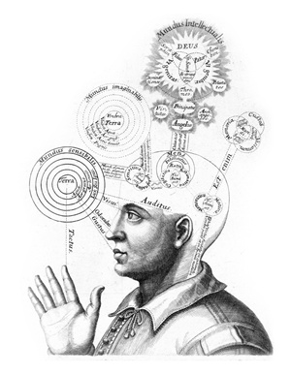
Are You Curious Yet?
Exploiting the brain’s untapped power to promote learning
Jamie Perry, PhD

Slide 2

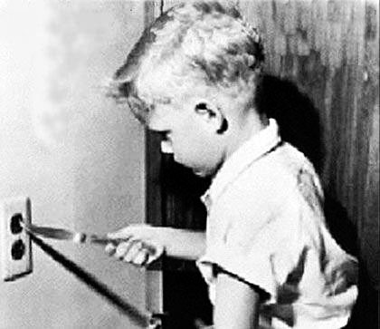
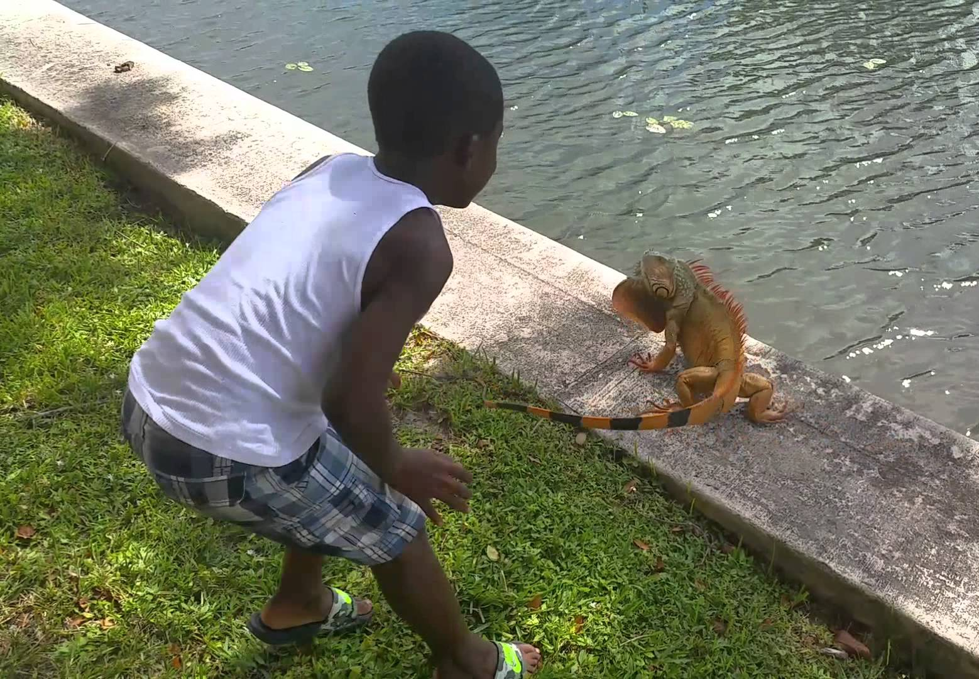
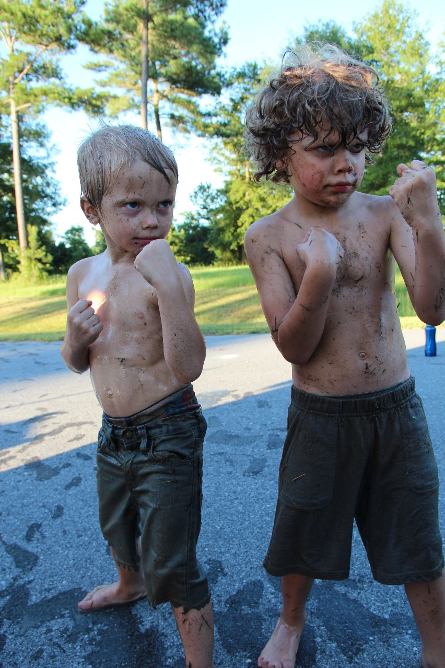
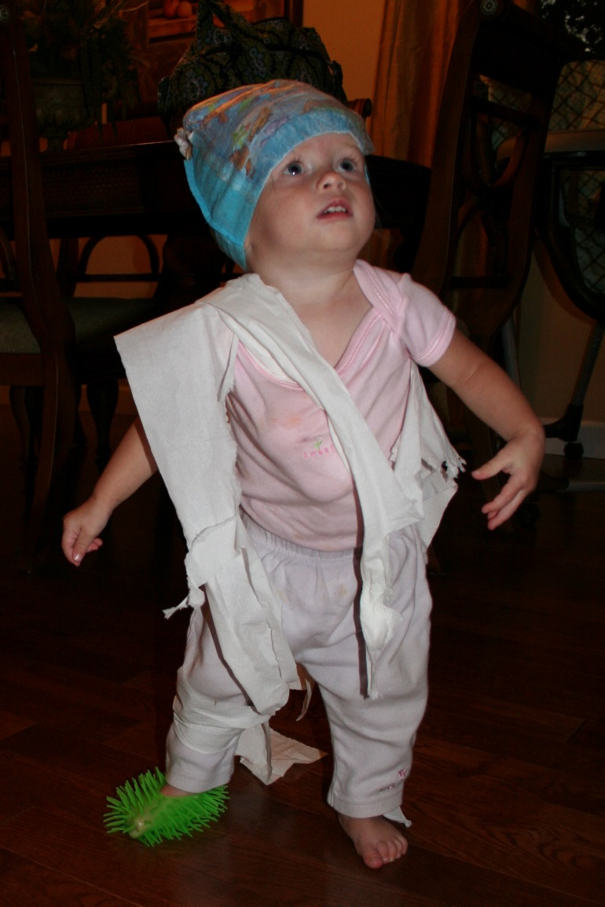
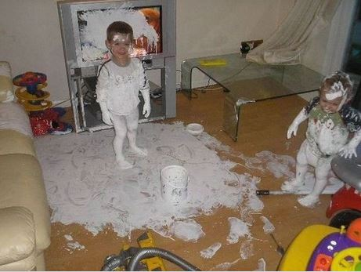
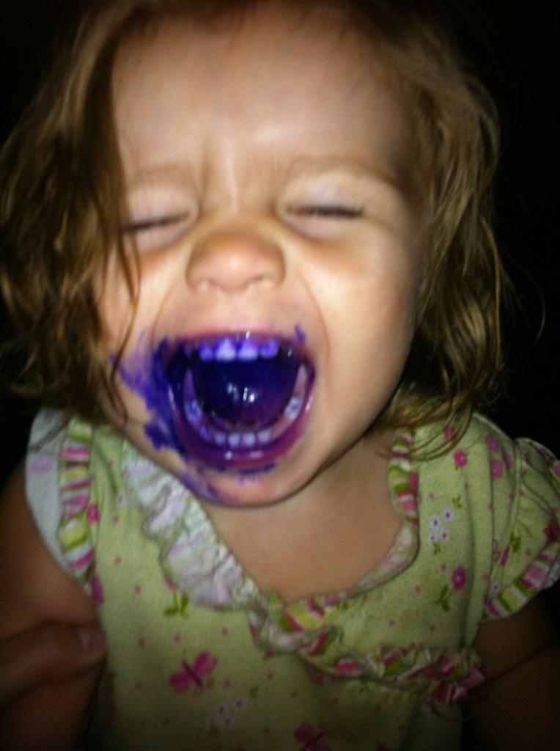
Notes:
I would like for you each to think of a time in your life that you were curious, maybe it was a time you were curious to know what would happen if you touched the hot coil burner of the electric stove, or push the red button, or …
My guess is that you all recalled something that you also remembered the outcome to. You remember vividly what you did, what the outcome was, and who was involved. Likely most of you formulated ideas of your childhood.
Unfortunately, something happens as we get older in that we go from this, to this (show picture of learning through exploration to learning in the classroom)
We stop exploring, and start memorizing
We stop asking why and we start to believe in more things as truth or facts
We stop … and we start …
Likely, the one thing

Slide 3

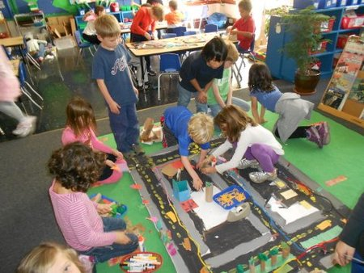

Slide 4
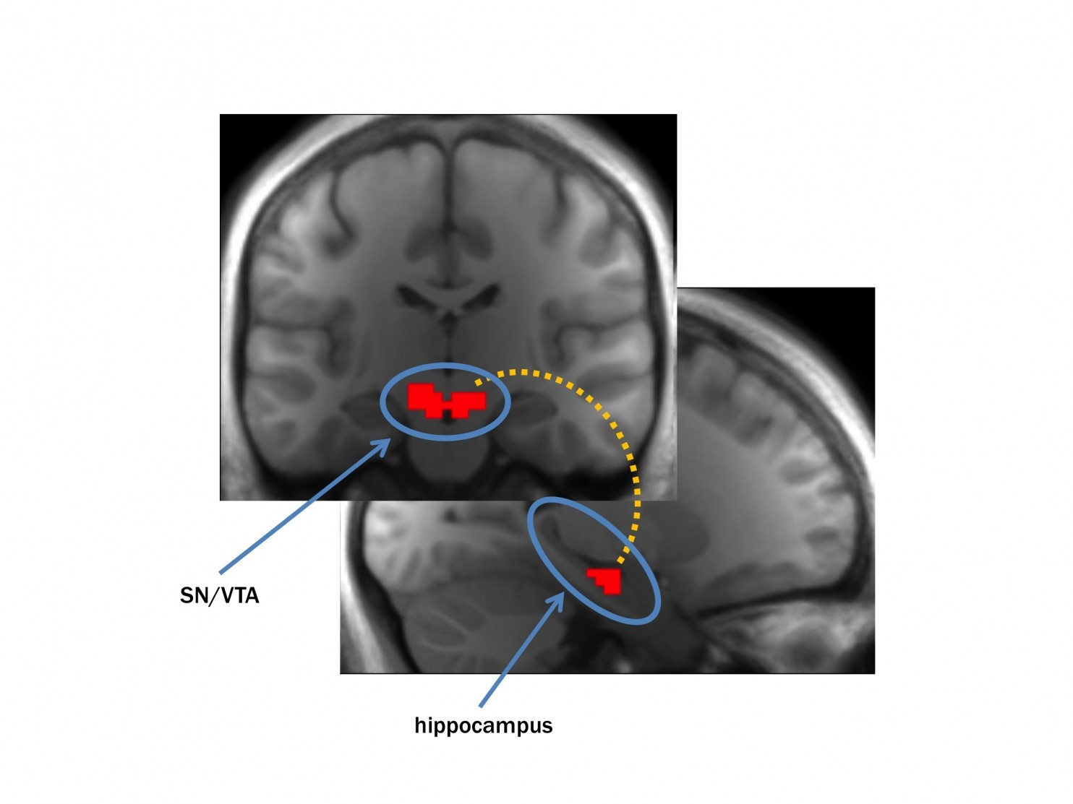
The Brain & Curiosity
Gruber et al. (2014)
  Curiosity puts the brain in a state that is ready to learn
  Curiosity stimulates the hippocampus, which is involved in memory
  Curiosity piques our internal reward system (via dopamine) giving motivation for learning
    Once curiosity is aroused, memory is improved during learning for important and unimportant details
Gruber M, Gelman B, Ranganath C. “States of Curiosity Modulate Hippocampus-Dependent Learning via the Dopaminergic Circuit.” Neuron. 2014.

Slide 5
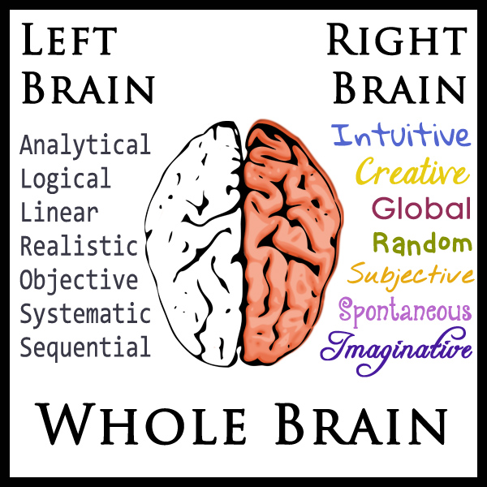
The Brain & Curiosity
Curiosity is a whole brain process
  Interest (left and right hemisphere)
  Preparation (left hemisphere)
  Incubation (right hemisphere)
  Illumination (right hemisphere)
  Verification (left hemisphere)
  Application (left and right hemisphere)
www.homeschoolwithlove.com/2013/09/24/left-brain-right-brain-whole-brain-learning/
Right hemisphere is considered to be essential to the beginning of the creative process

Slide 6
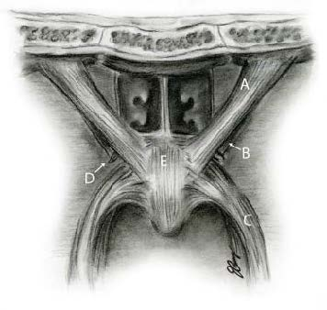
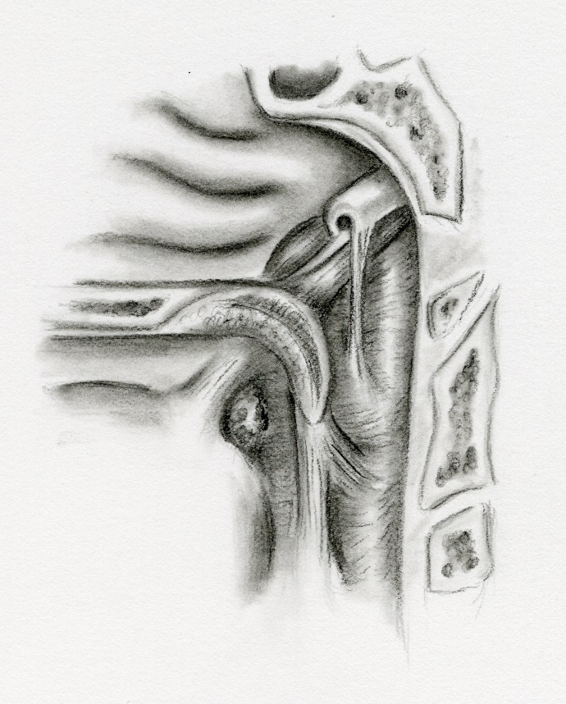
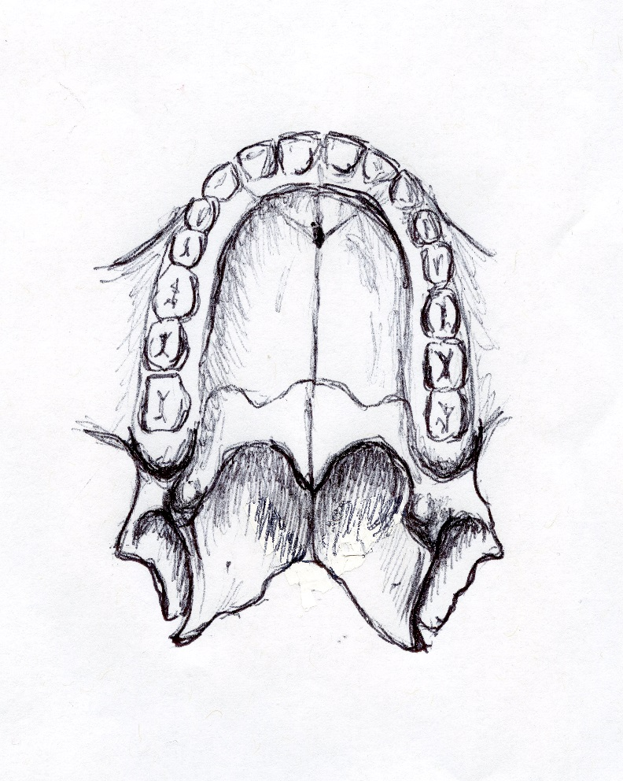

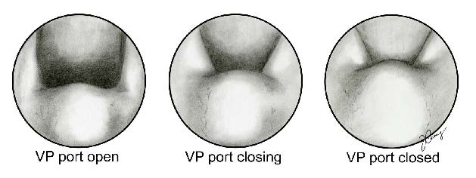
My Journey
People who have nurtured my curiosity
Opportunities to see things as they exist & challenge what I see

Slide 7
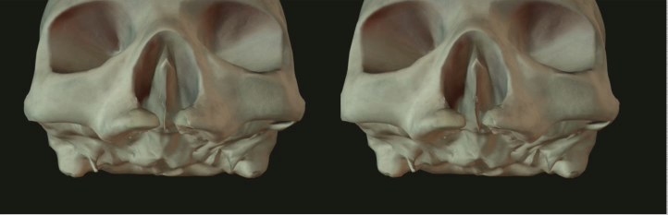
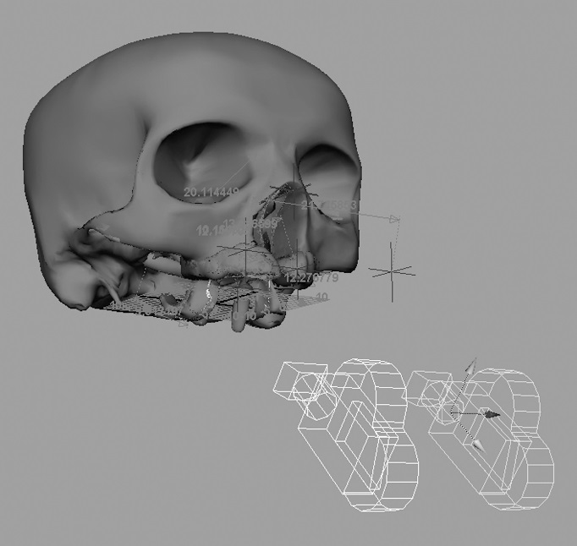
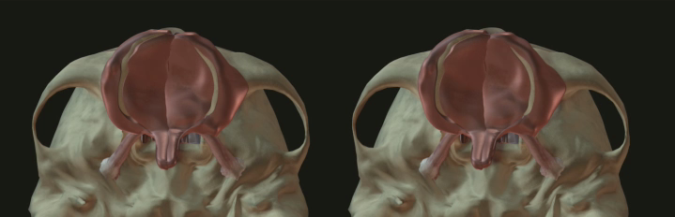
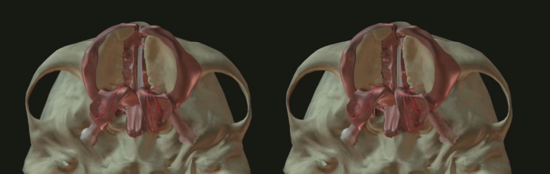
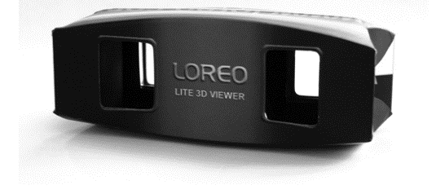

Slide 8
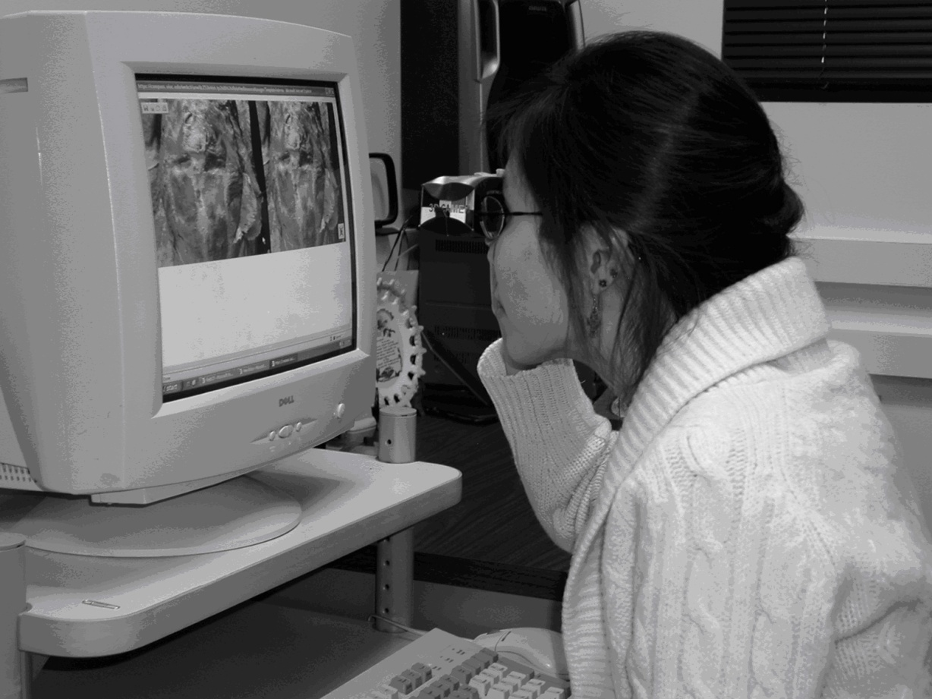
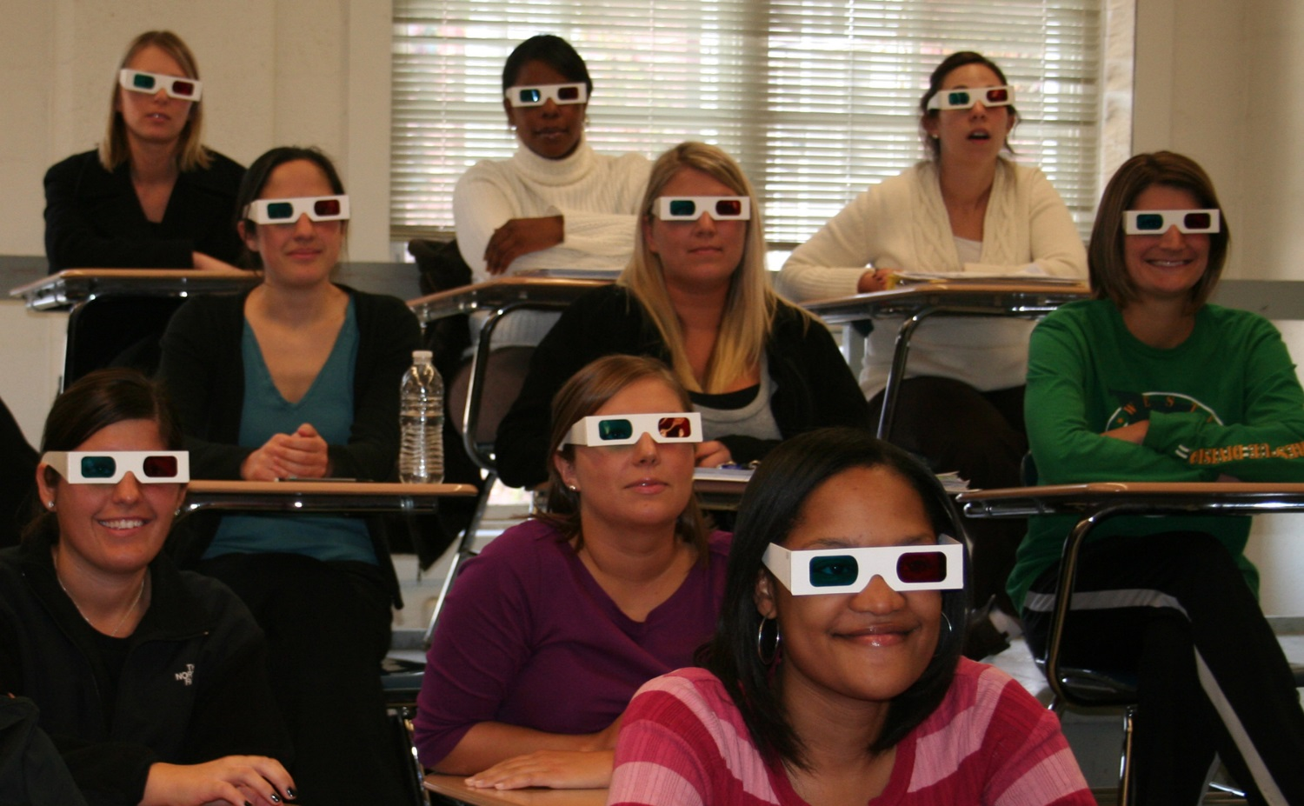
Perry J, Kuehn D, & Langlois R (2007). Teaching anatomy of the speech mechanisms through computer based stereoscopic images. Journal of College Science Teaching, 36(4), 18-23.
Perry JL, Cunningham D, Kuehn D, & Gamage J. (2010). Do 3D stereoscopic computer animations improve student learning of surgical procedures? International Journal of Instructional Media, 38(4).
.
Notes:
Through this project, I became fascinated with the use of curiosity to promote learning.

Slide 9
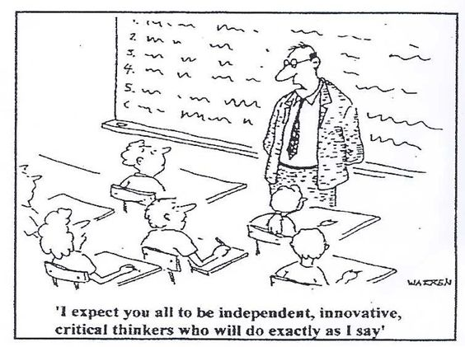
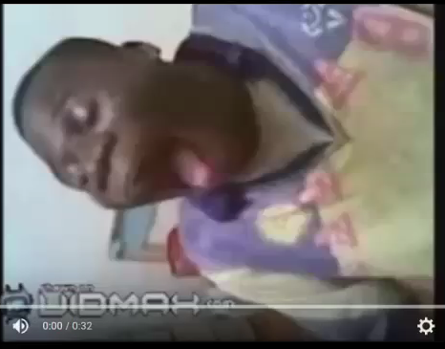
Curiosity in Teaching
Model curiosity to the students
  It is about the student’s curiosity, not mine
  Some things are absolute, but many things are totally negotiable and ever changing
  Wandering questions are good
  Leave students with the job of finding out how or why something happens
Notes:
Model curiosity:
-You have to first recognize that it is not about what makes YOU curious, but what you think might make them curious.
-Emphasize that some things are truth/fact but most is negotiable.
-One of my favorite things to do while teaching anatomy is to show videos and ask students to find out why or how things happen. This is actually one that seems to draw the most interest. It has absolutely nothing to do with learning about the muscles related to speech, but my students never forget the tissue properties associated with elasticity.

Slide 10
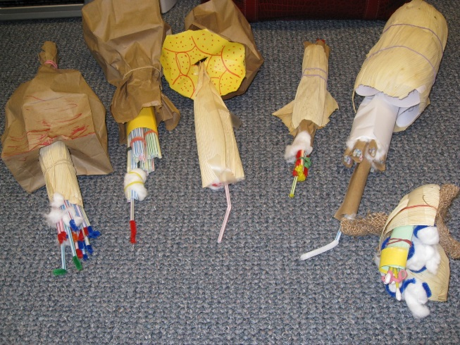
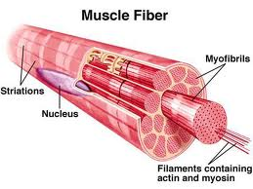
Curiosity in Teaching
Model curiosity to the students
  It is about the student’s curiosity, not mine
  Some things are absolute, but many things are totally negotiable and ever changing
  Wandering questions are good
  Leave students with the job of finding out how or why something happens
Use the right hemisphere through art to promote curiosity and learning
Notes:
Even though I acknowledge not all students are artists, I often use art to get students to be creative in building models or making things to better conceptualize anatomy. This is supposed to be muscle & students do amazing after they build their own model.

Slide 11
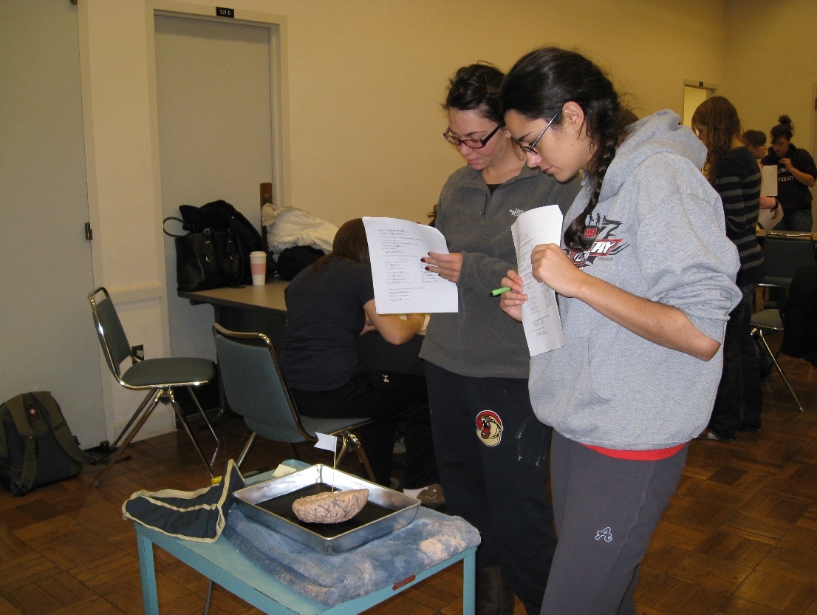
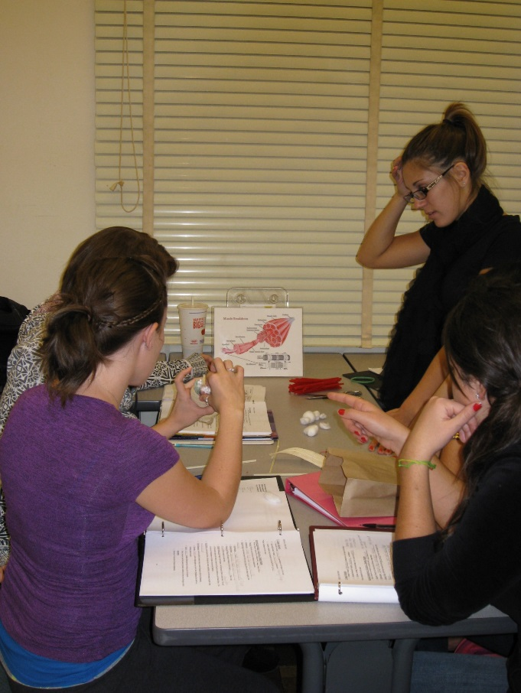
Curiosity in Teaching
Model curiosity to the students
  It is about the student’s curiosity, not mine
  Some things are absolute, but many things are totally negotiable and ever changing
  Wandering questions are good
  Leave students with the job of finding out how or why something happens
Use the right hemisphere through art for learning
Encourage interactive creativity & curiosity
Notes:
And the last piece is to encourage interactive creativity and curiosity. Believe it or not your students’ peers will have more in common with each other than they will with you. For that reason, they are really the best at piquing curiosity among each other.
This is one of my favorite labs. I create stations where students rotate among stations where they range from labeling structures, solving a problem, to examining household items and labeling the types of joints they are while they learn the different joint systems of the body. These are some of the hardest classes to run when you teach anatomy or large classes. For that reason, I use a lot of undergrad students who volunteer their time to set up & run these out of class learning stations.

Slide 12
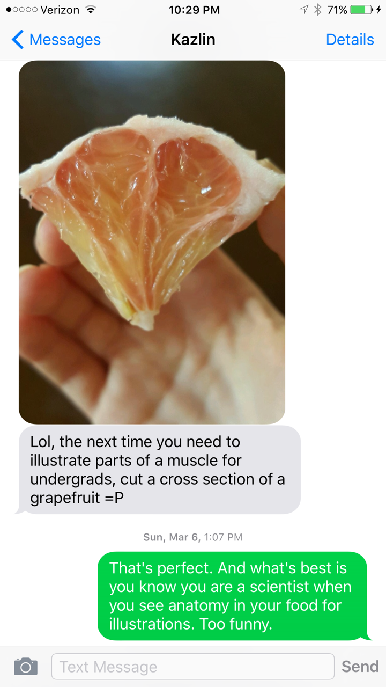
Evidence of Curiosity
Thank You
Notes:
The evidence of curiosity is easy to spot. This text message received from my PHD student is a good indication that she is learning through the power of curiosity.
Thank you-

