Slide 1

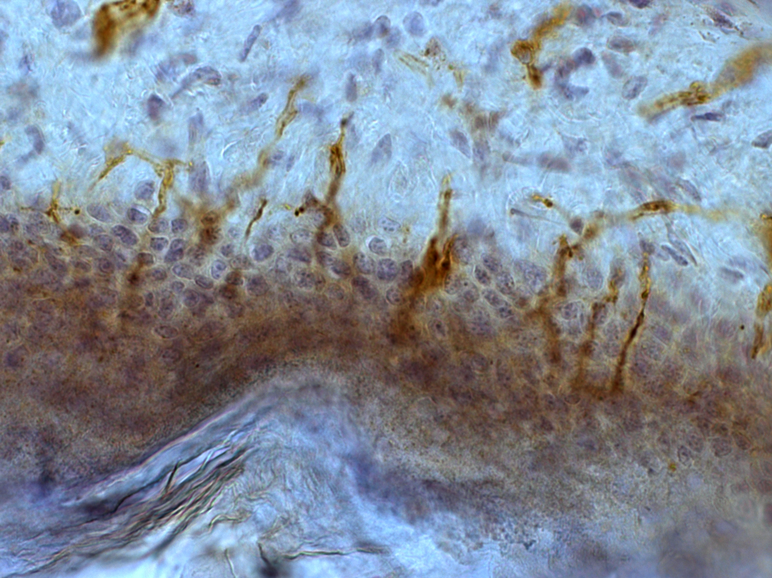
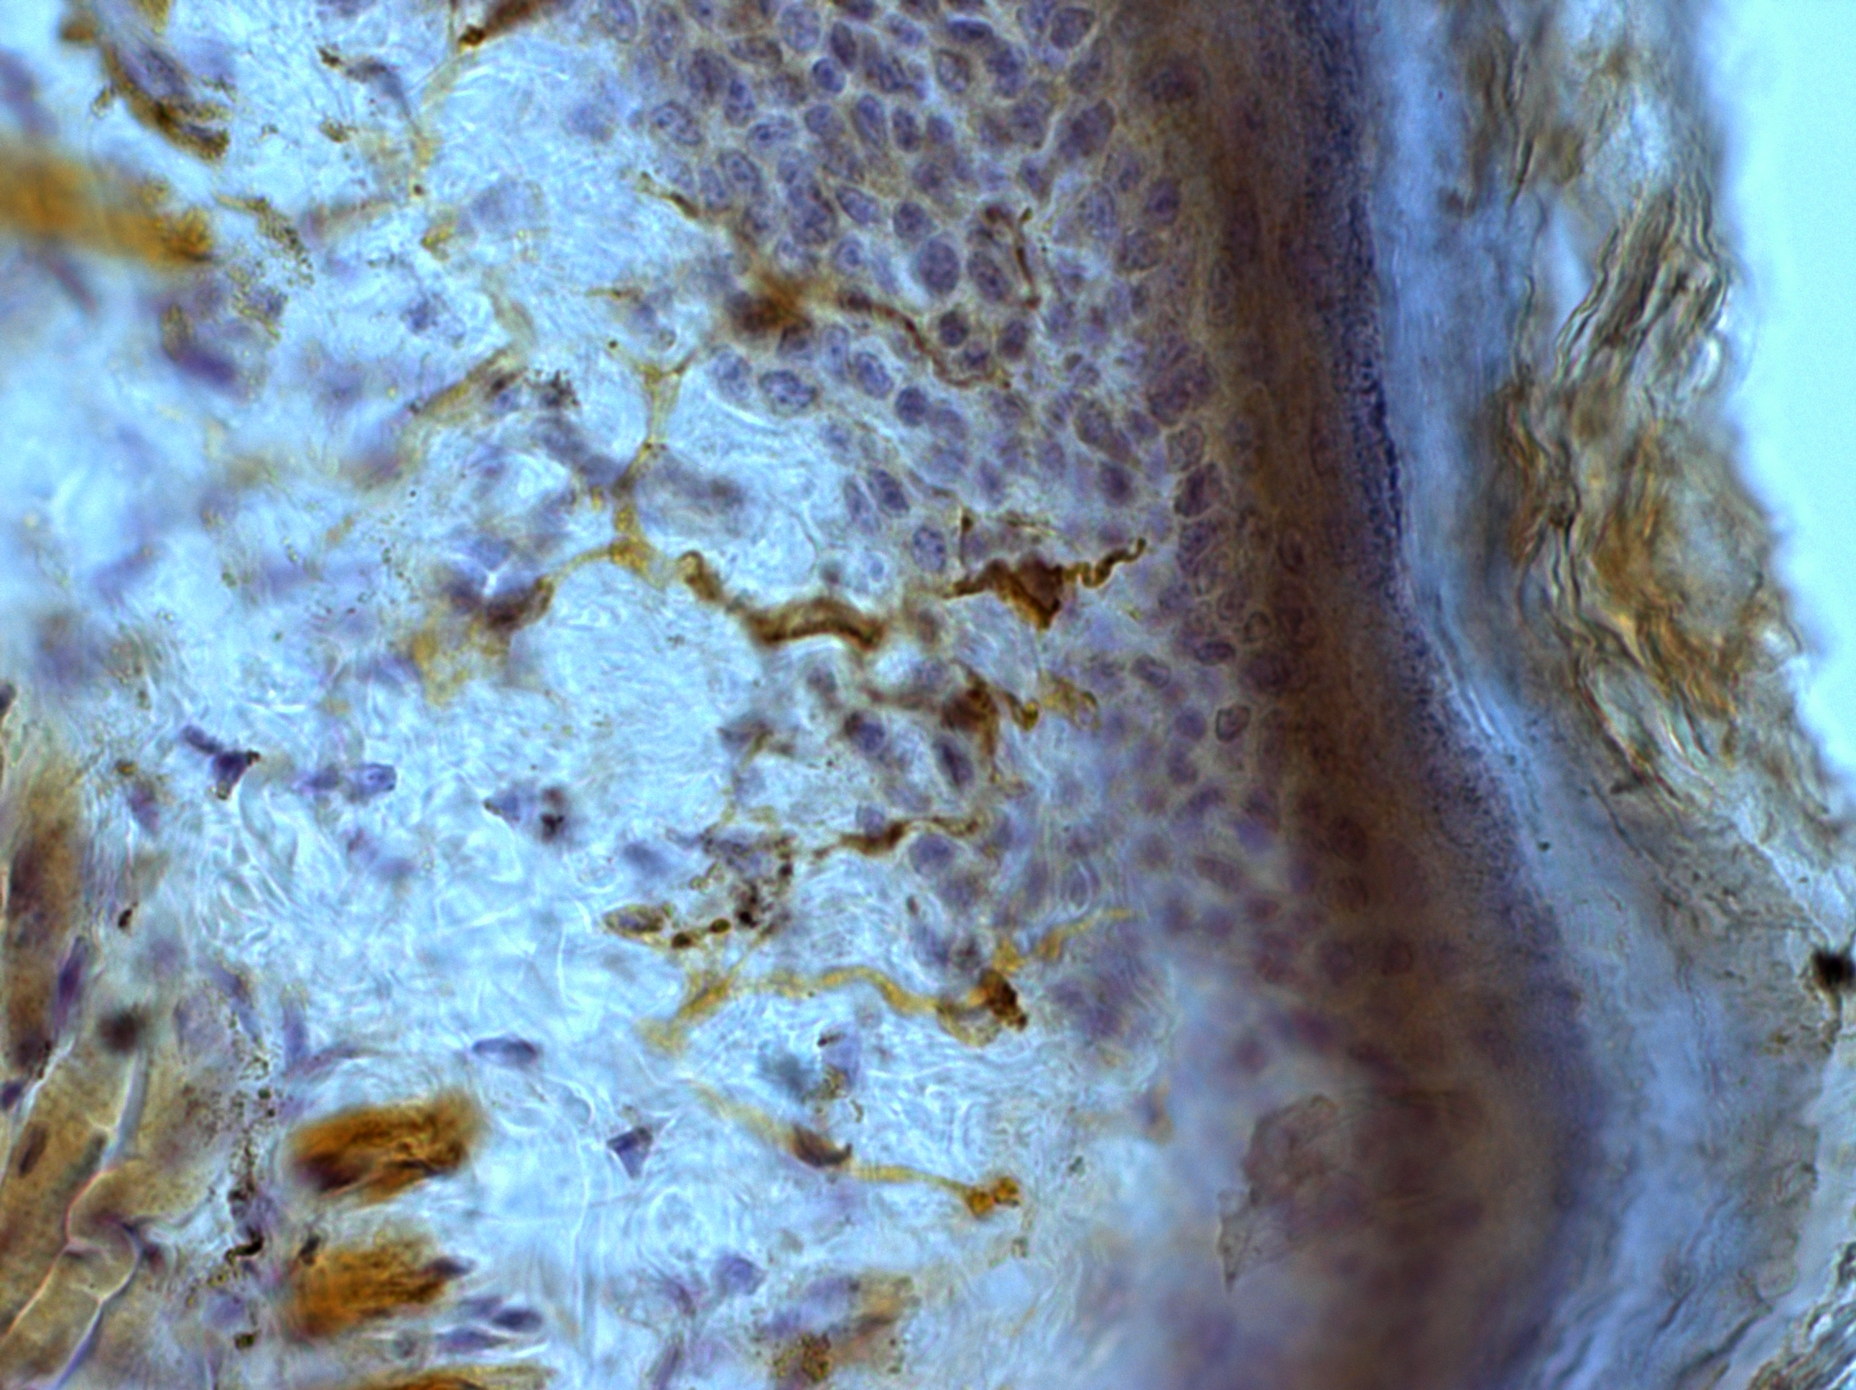
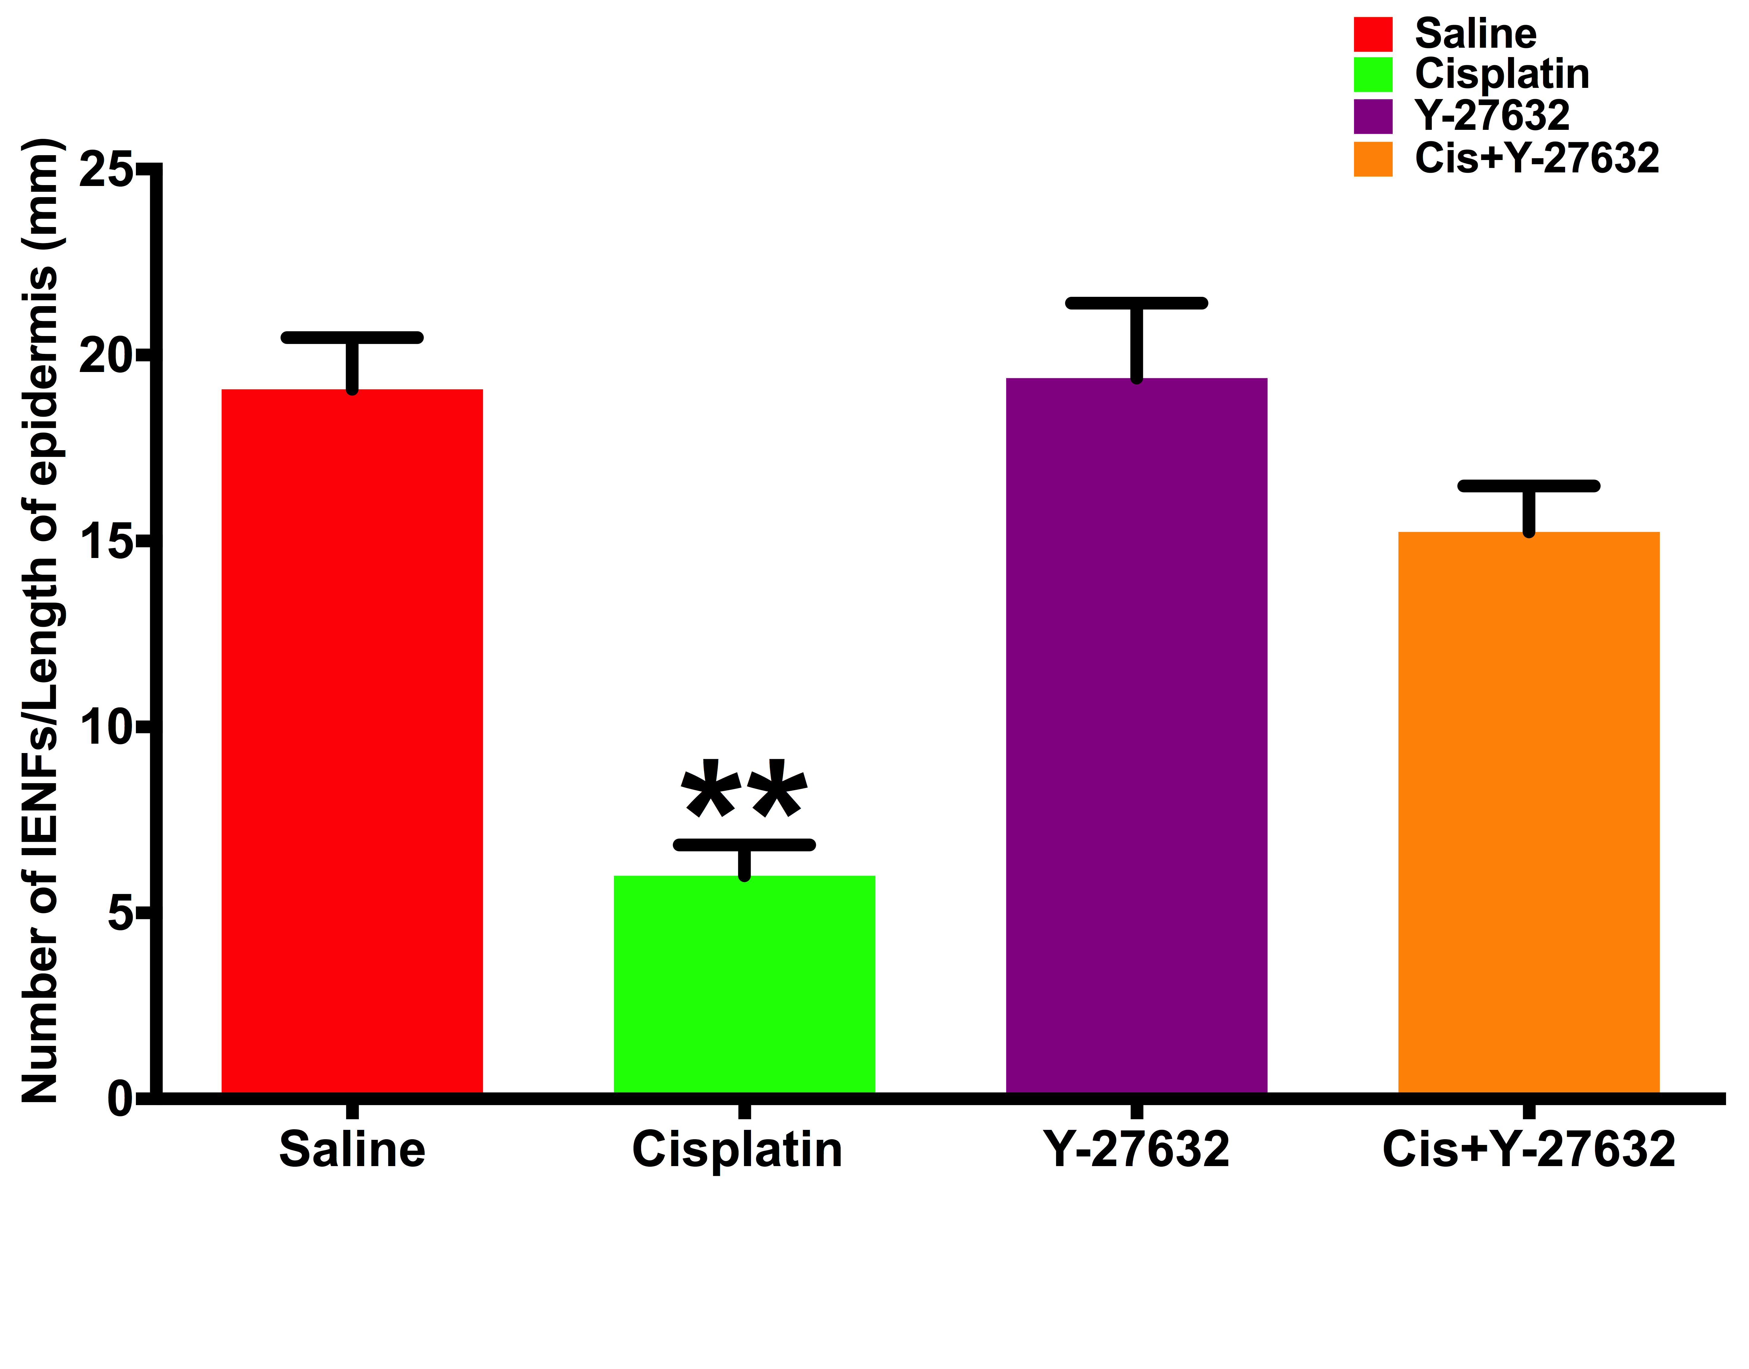
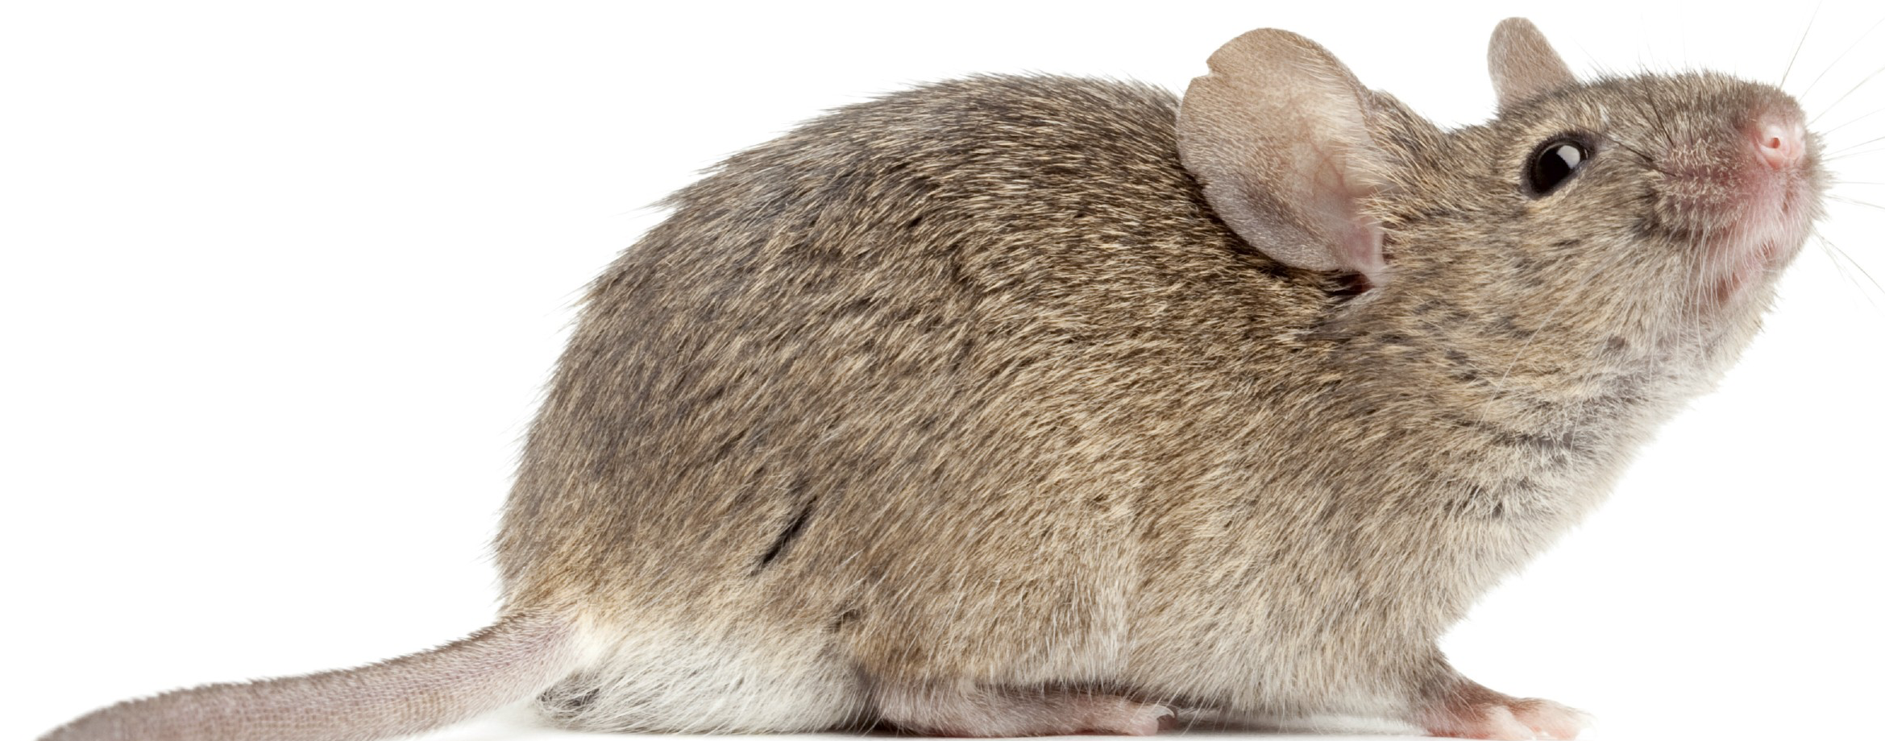
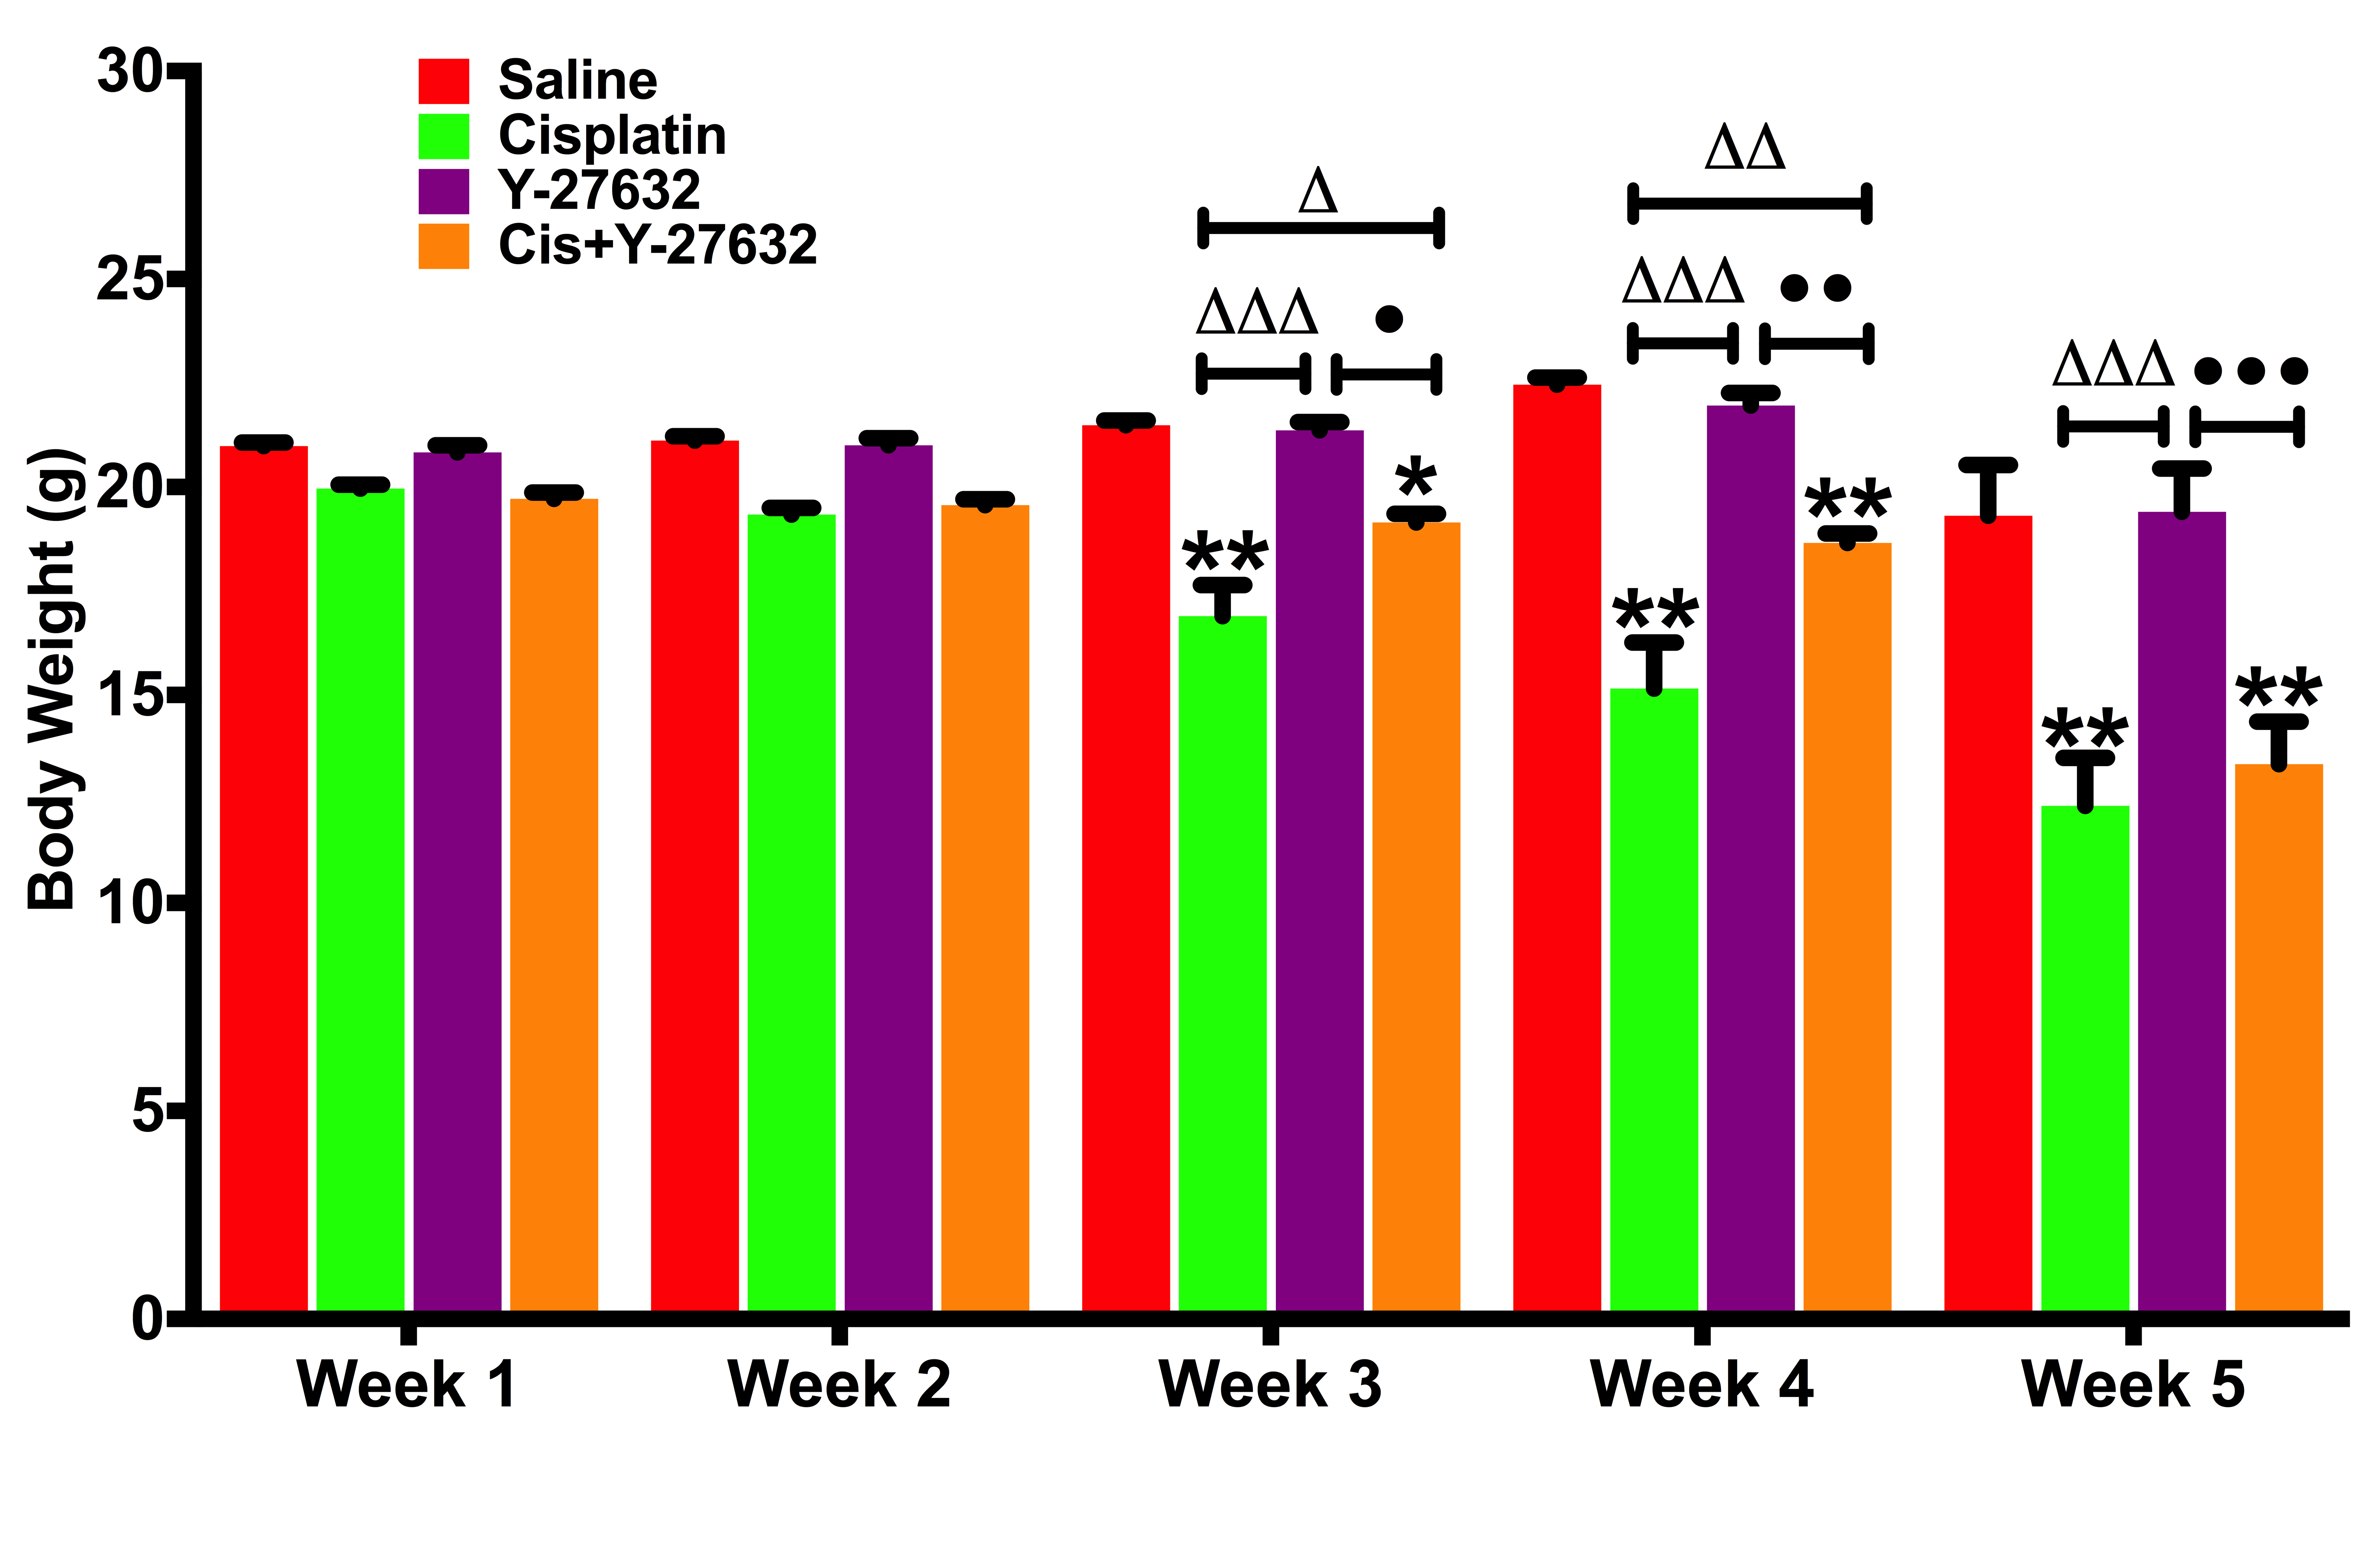

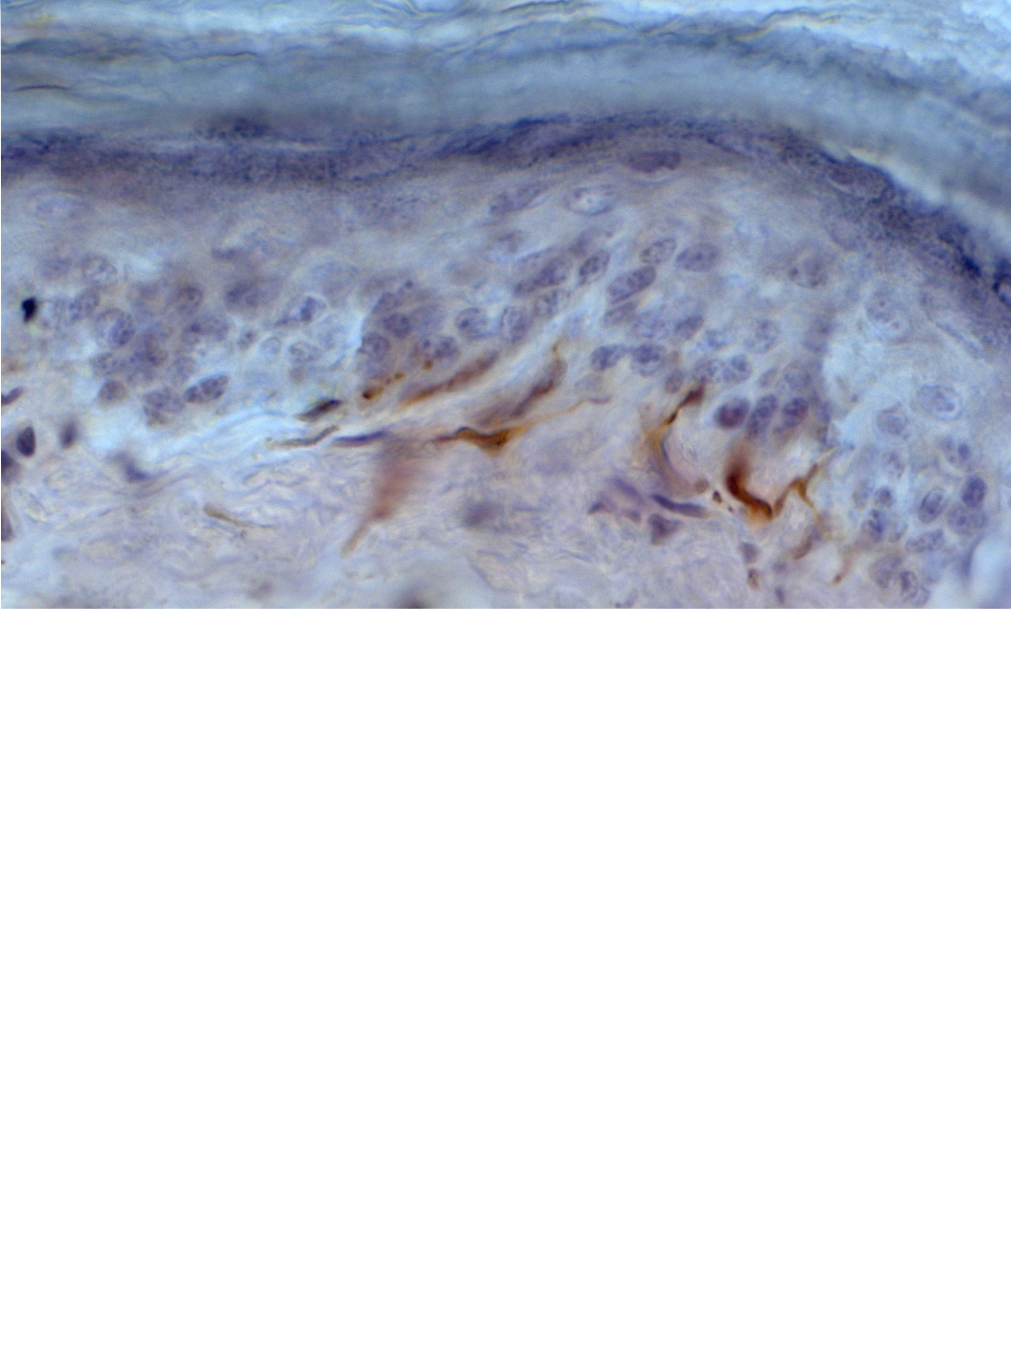
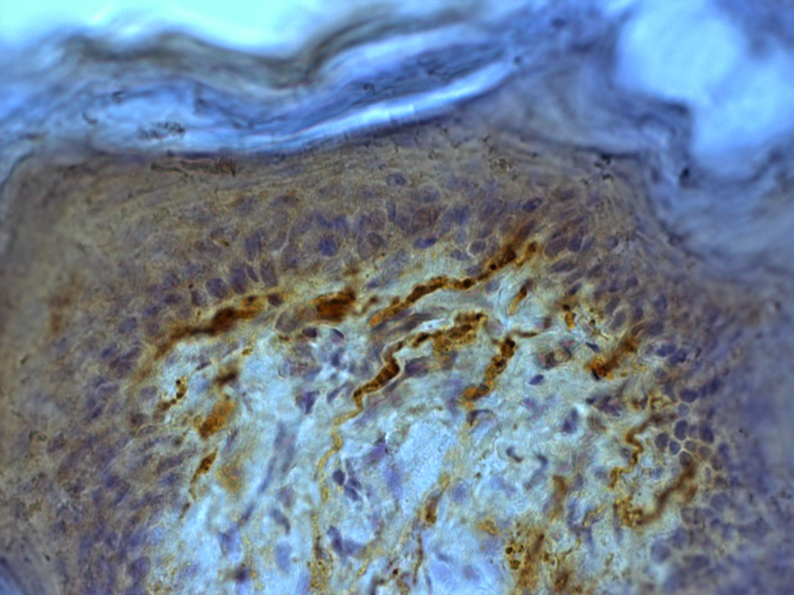
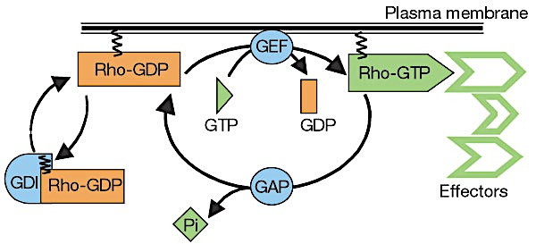

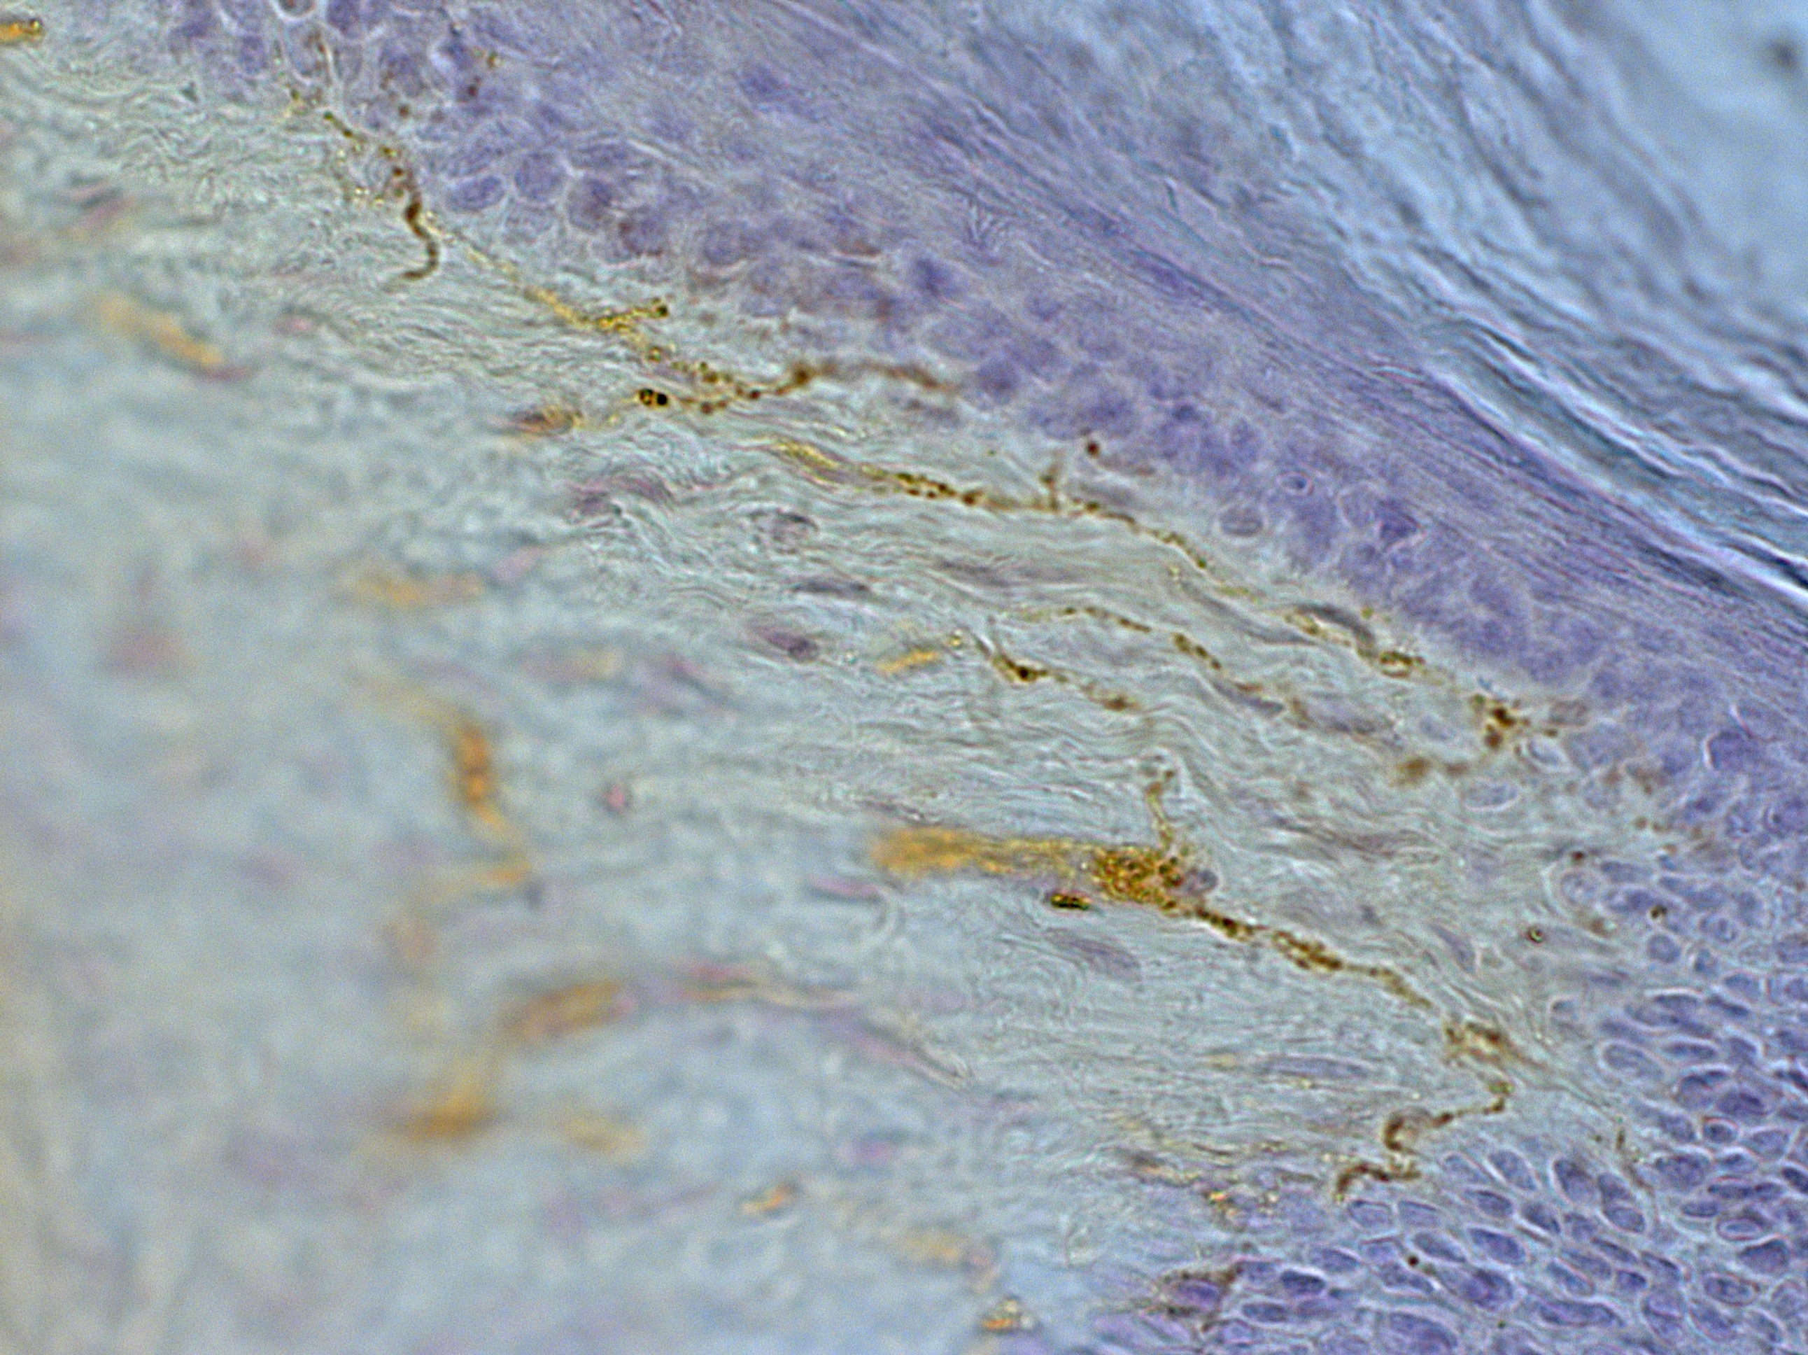
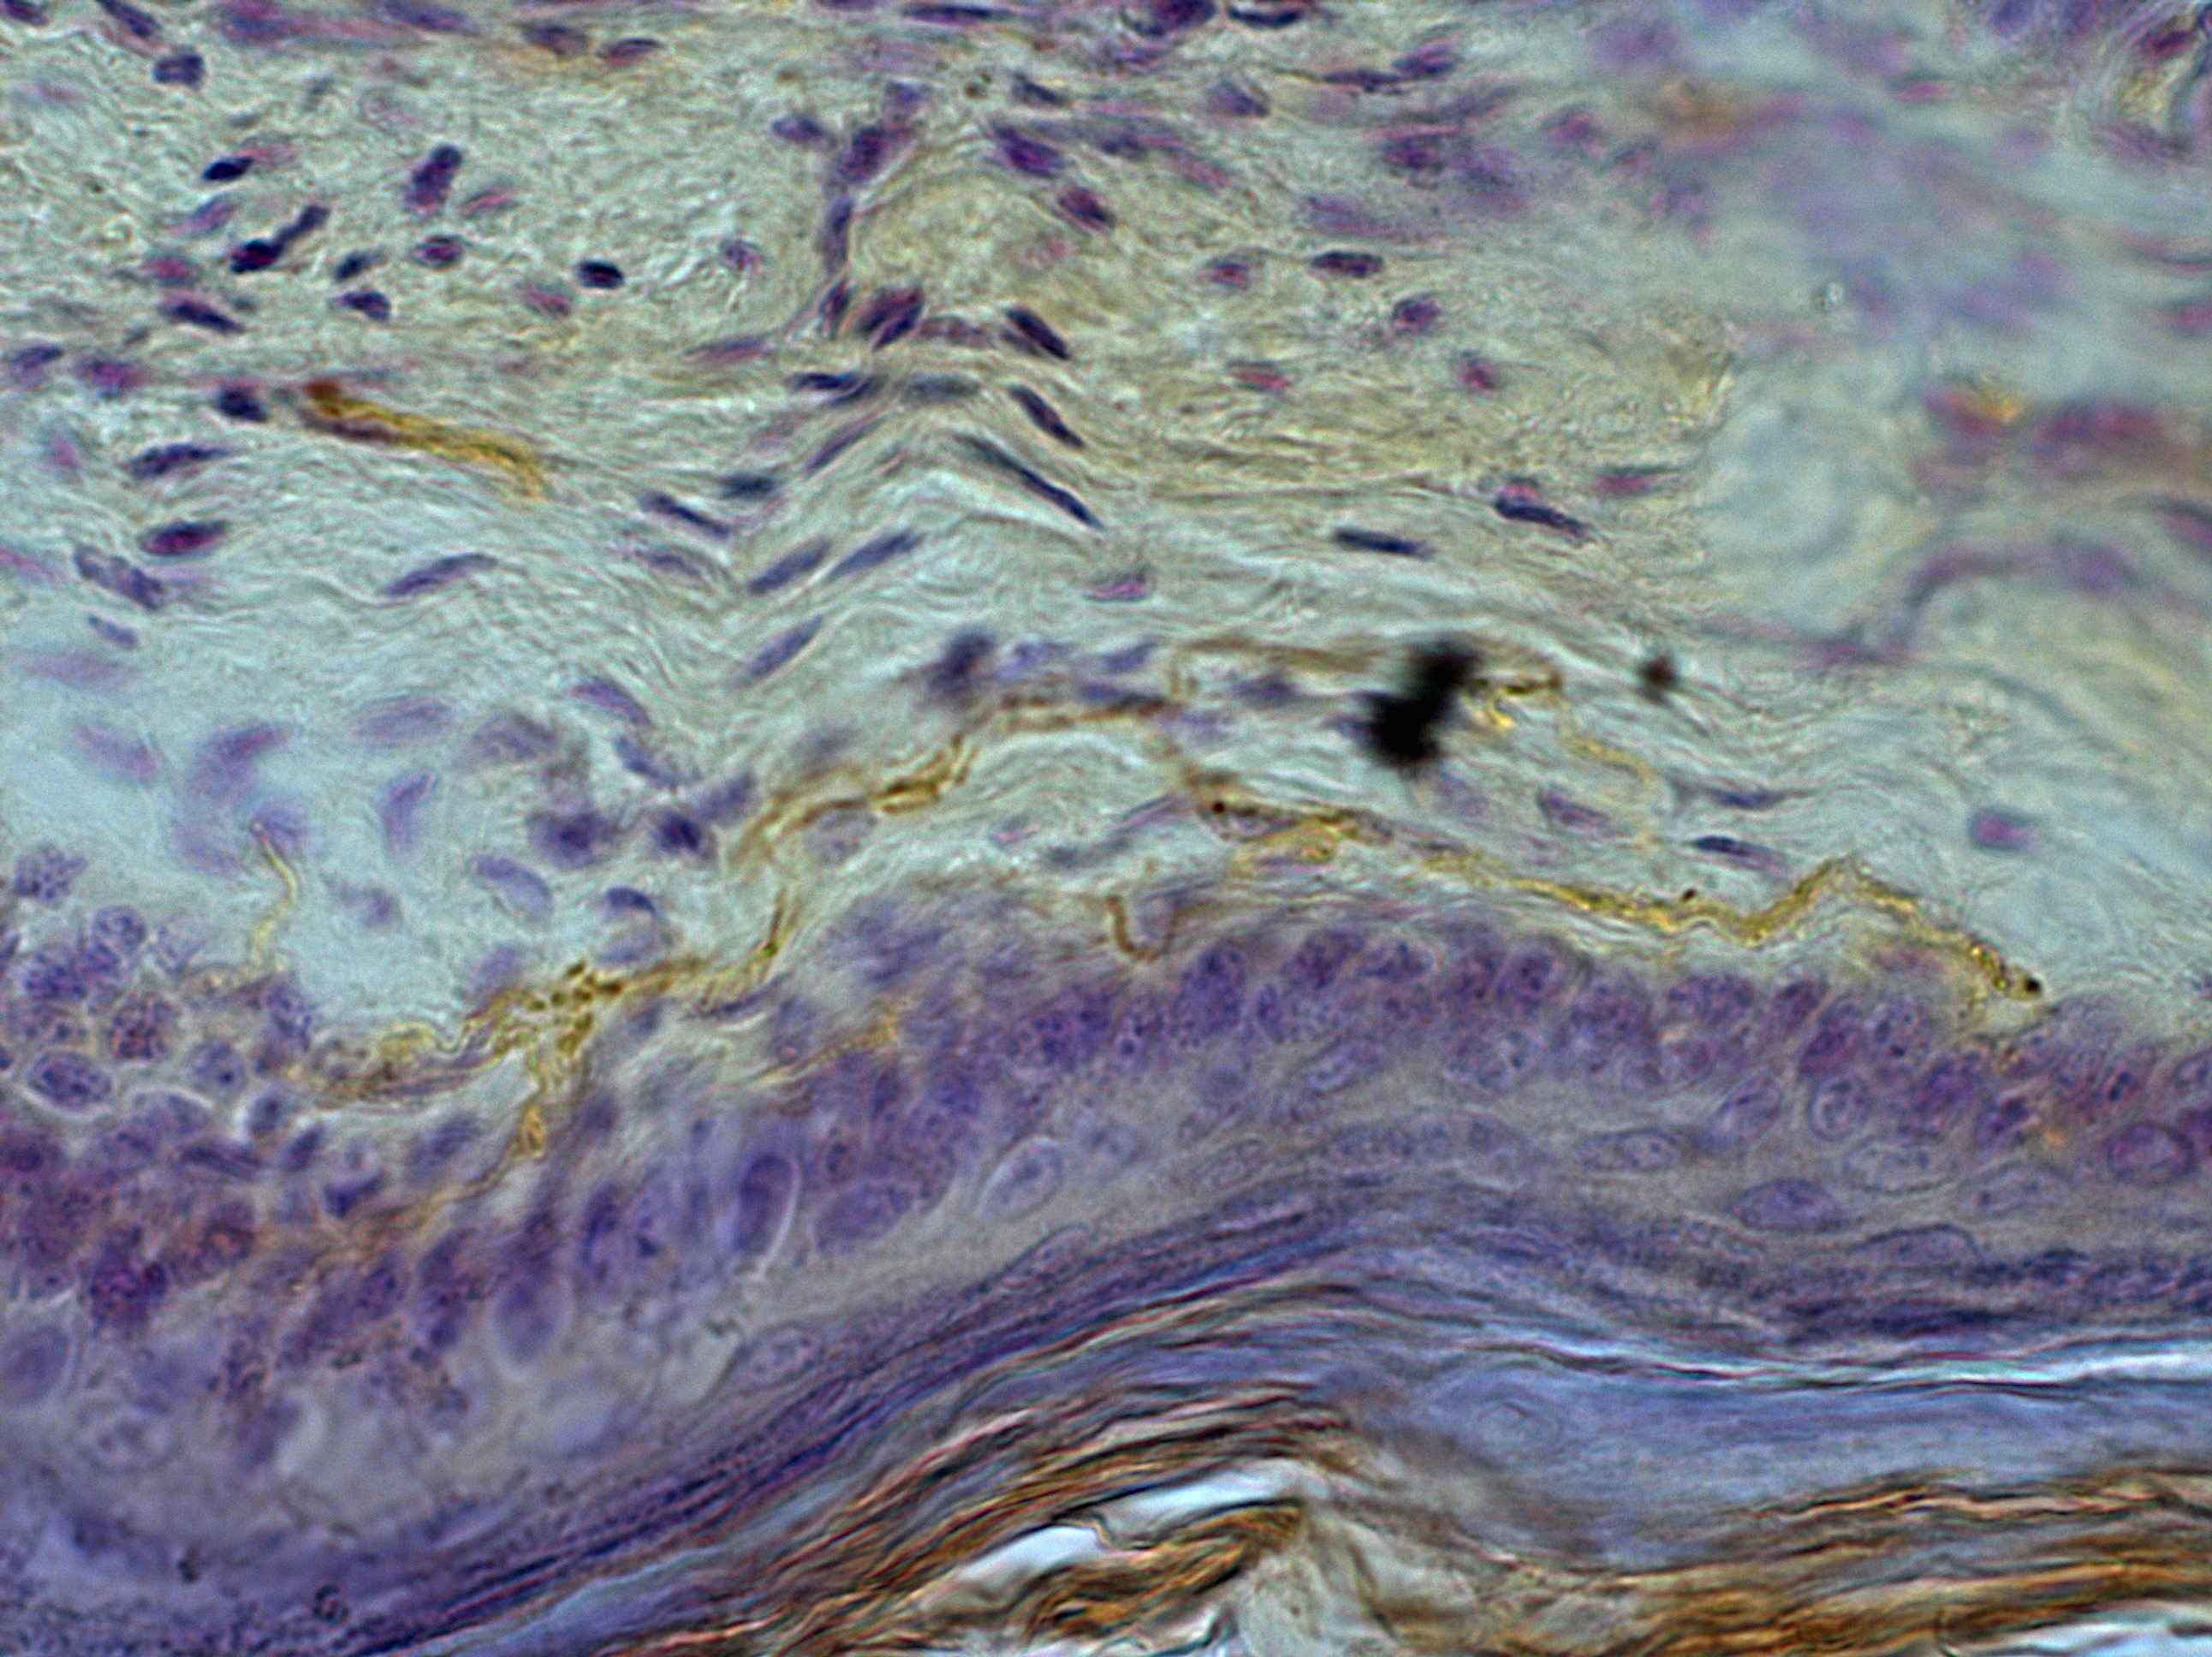
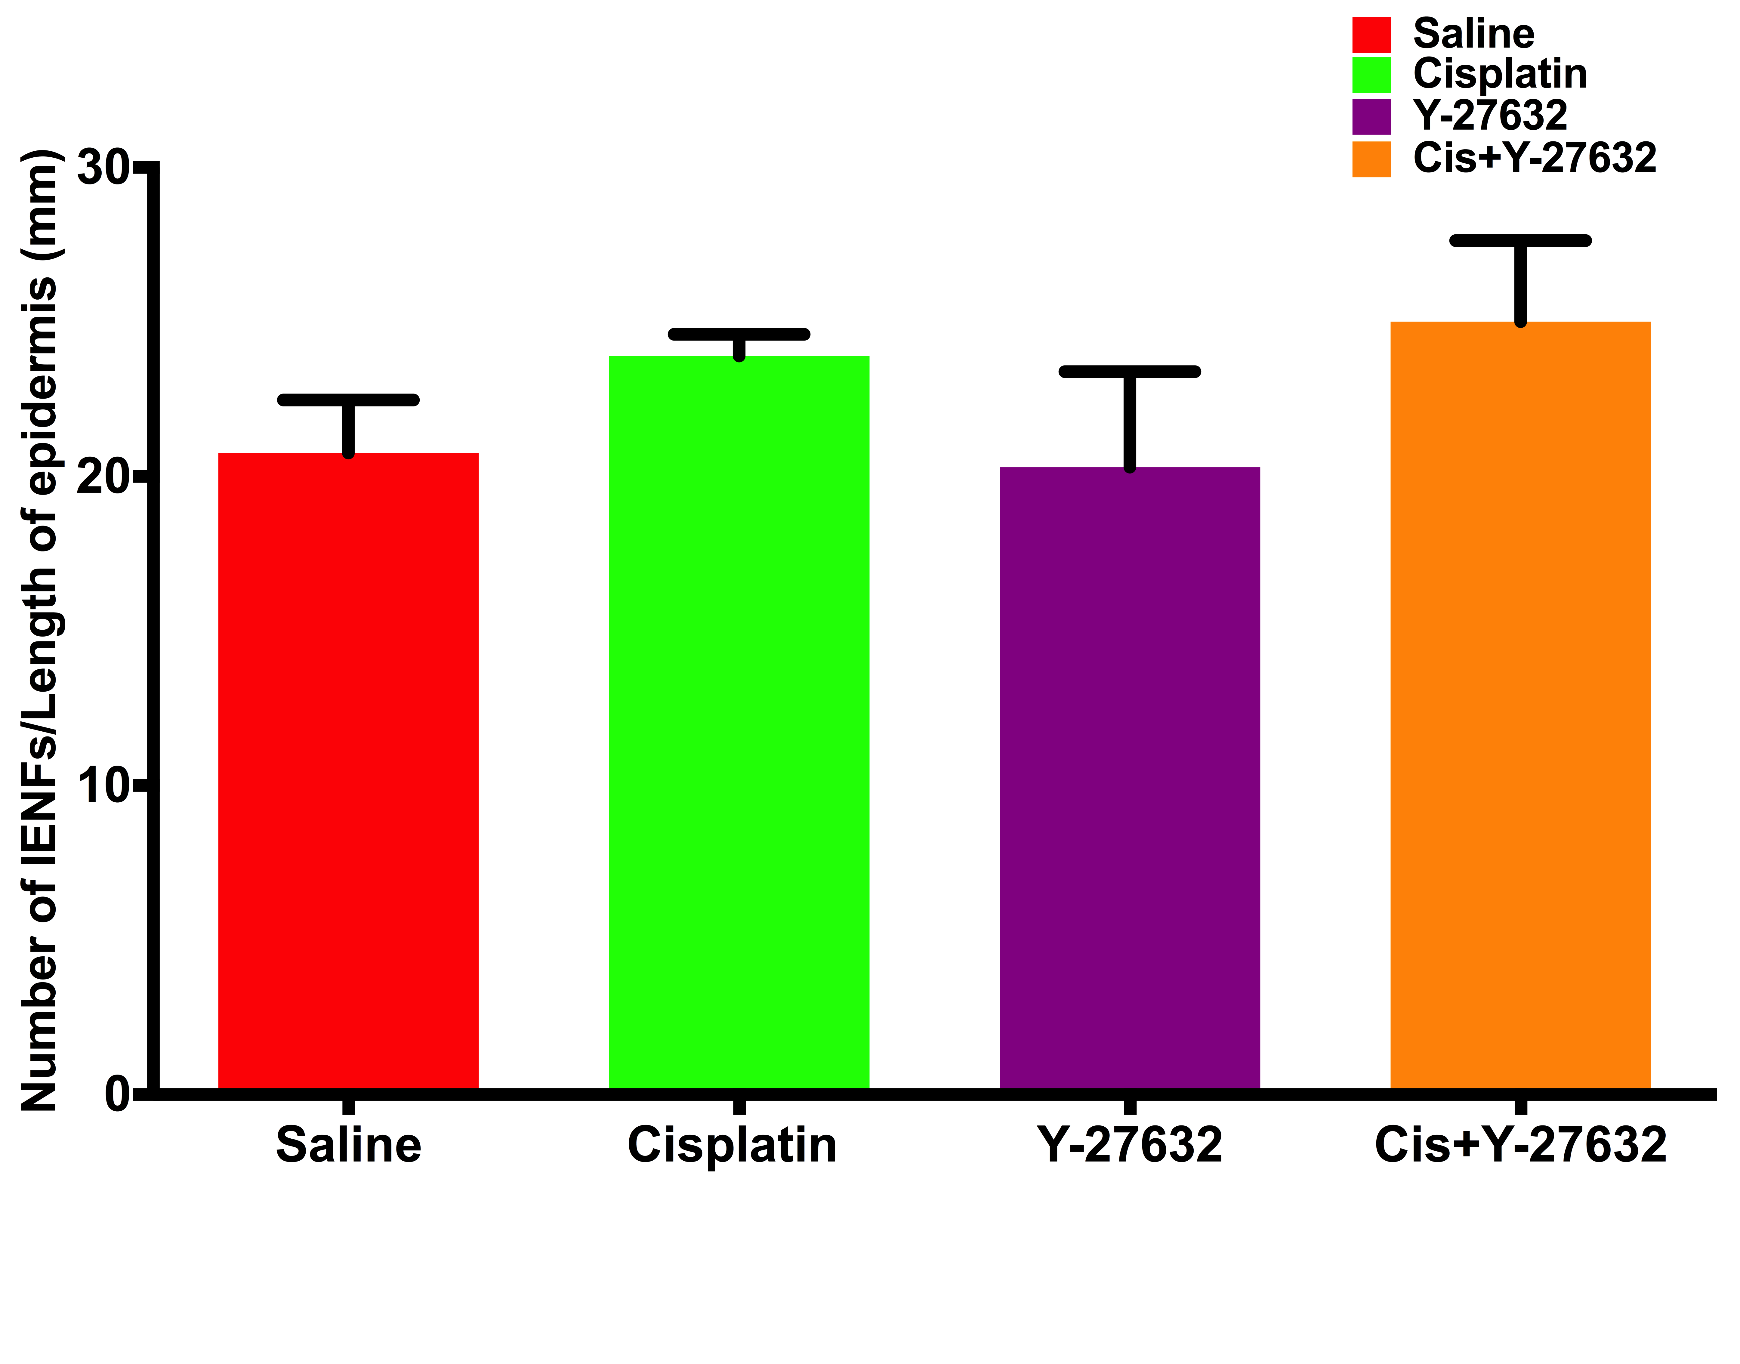
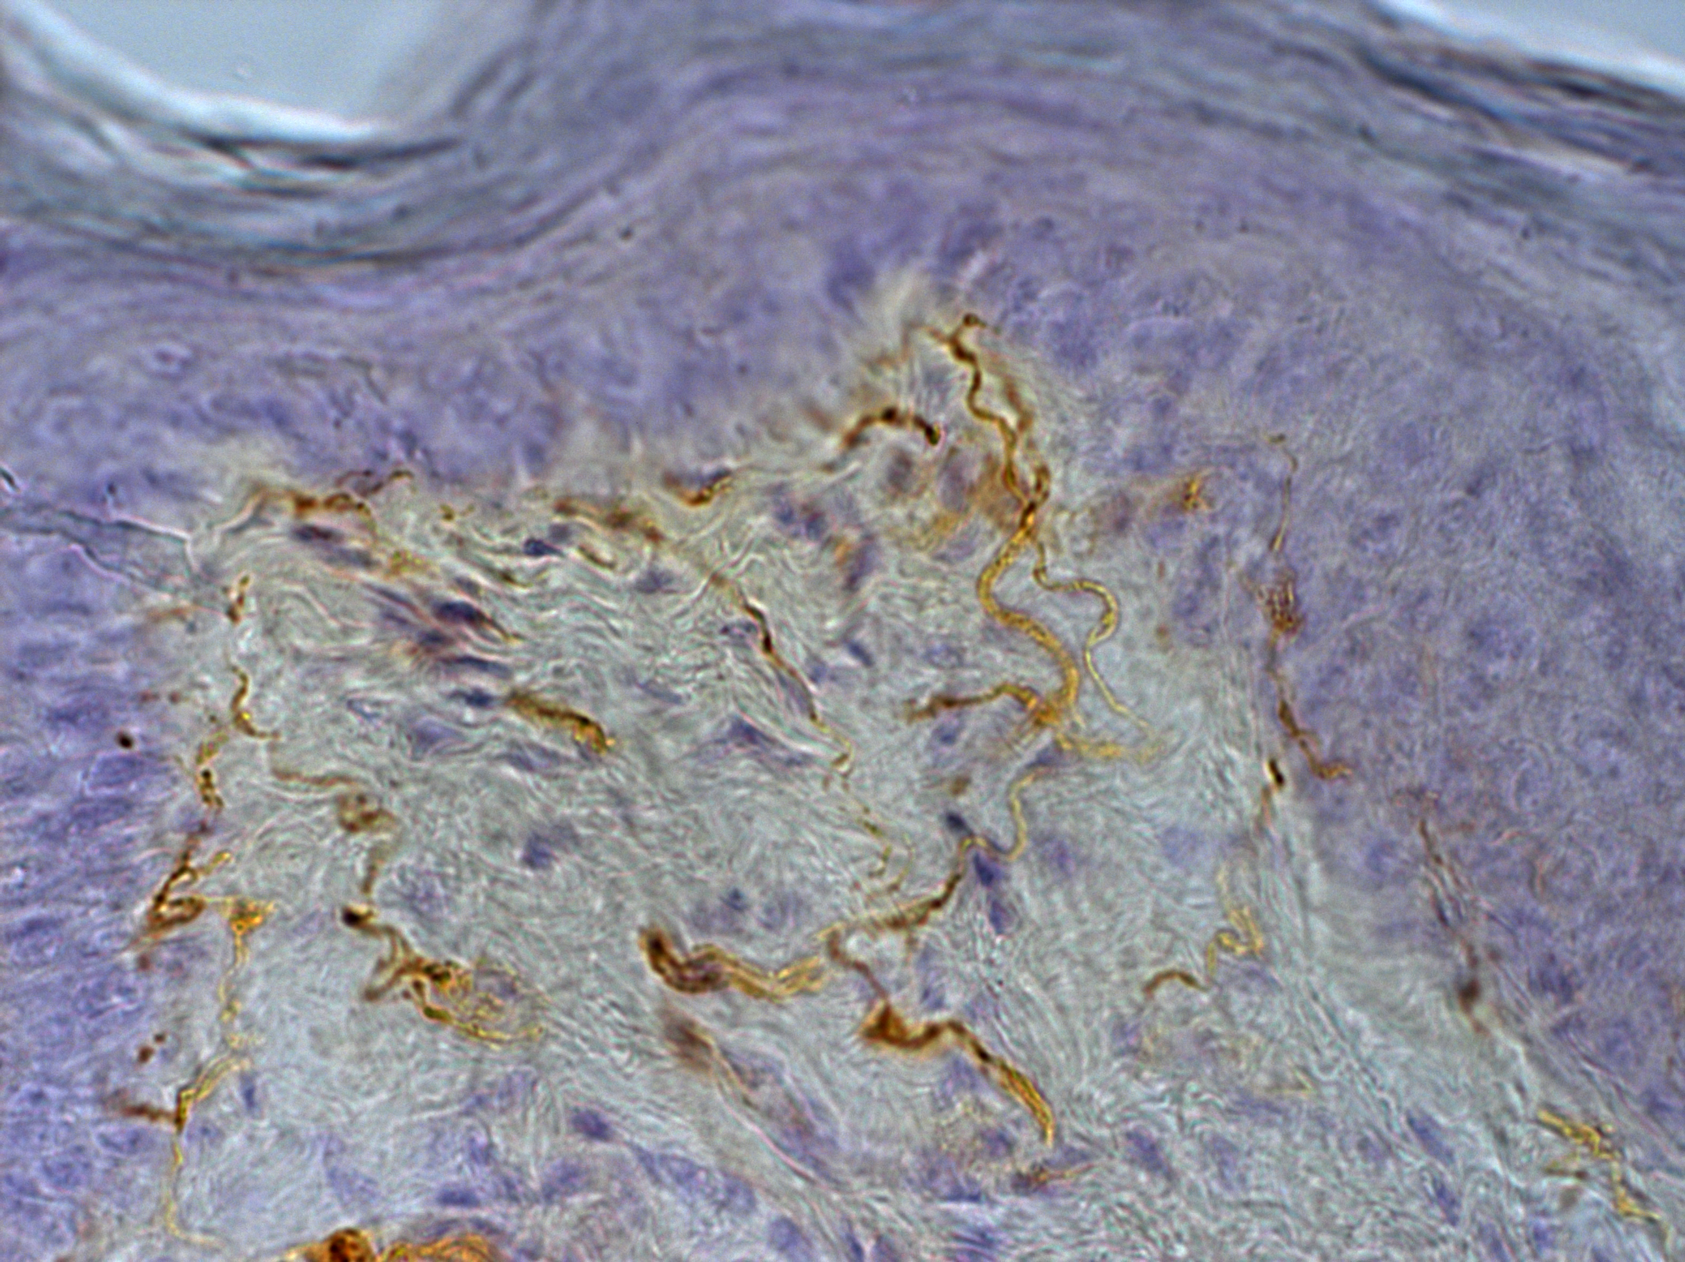
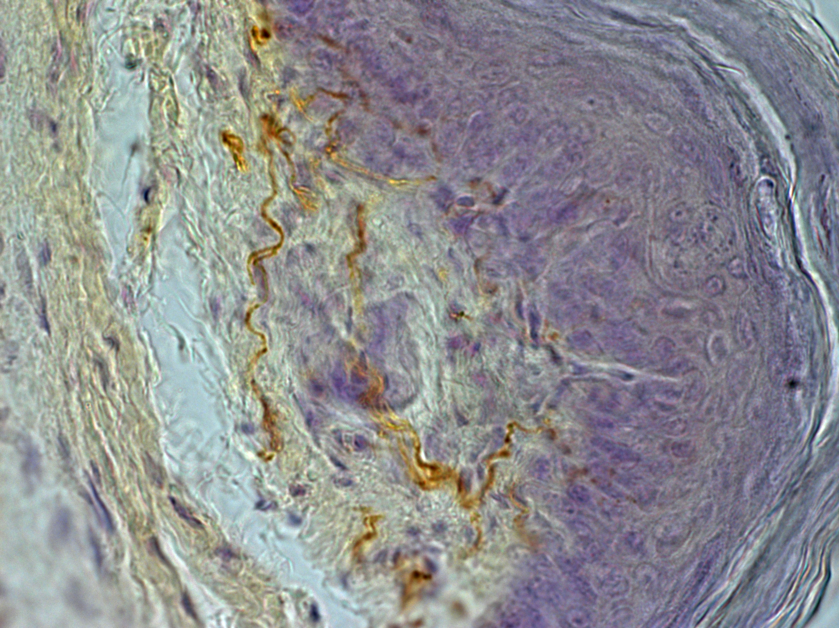
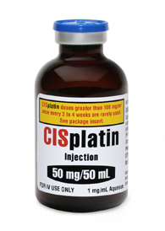
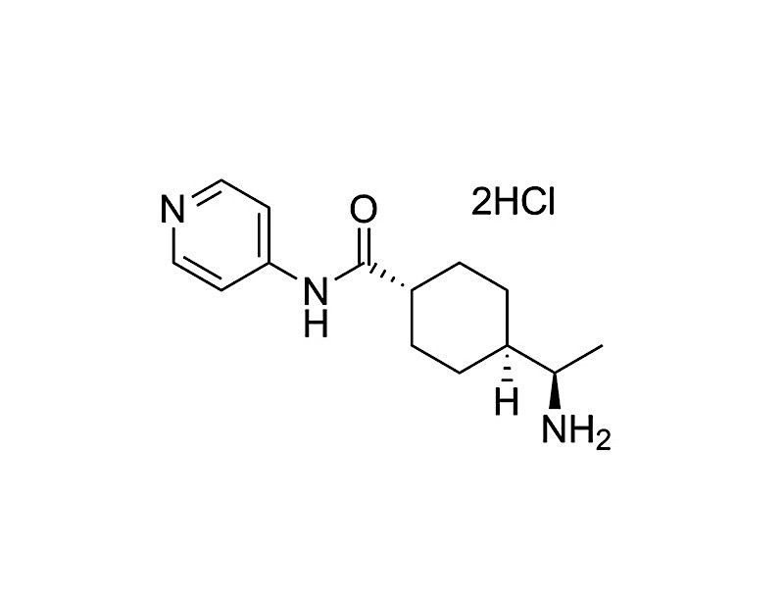
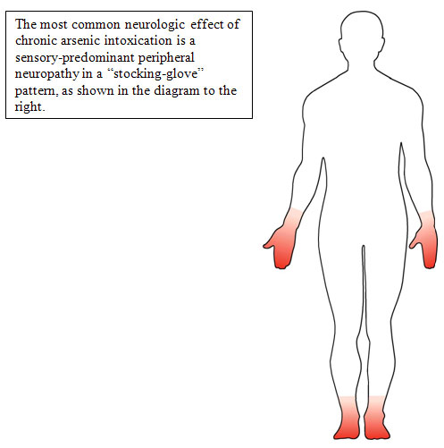
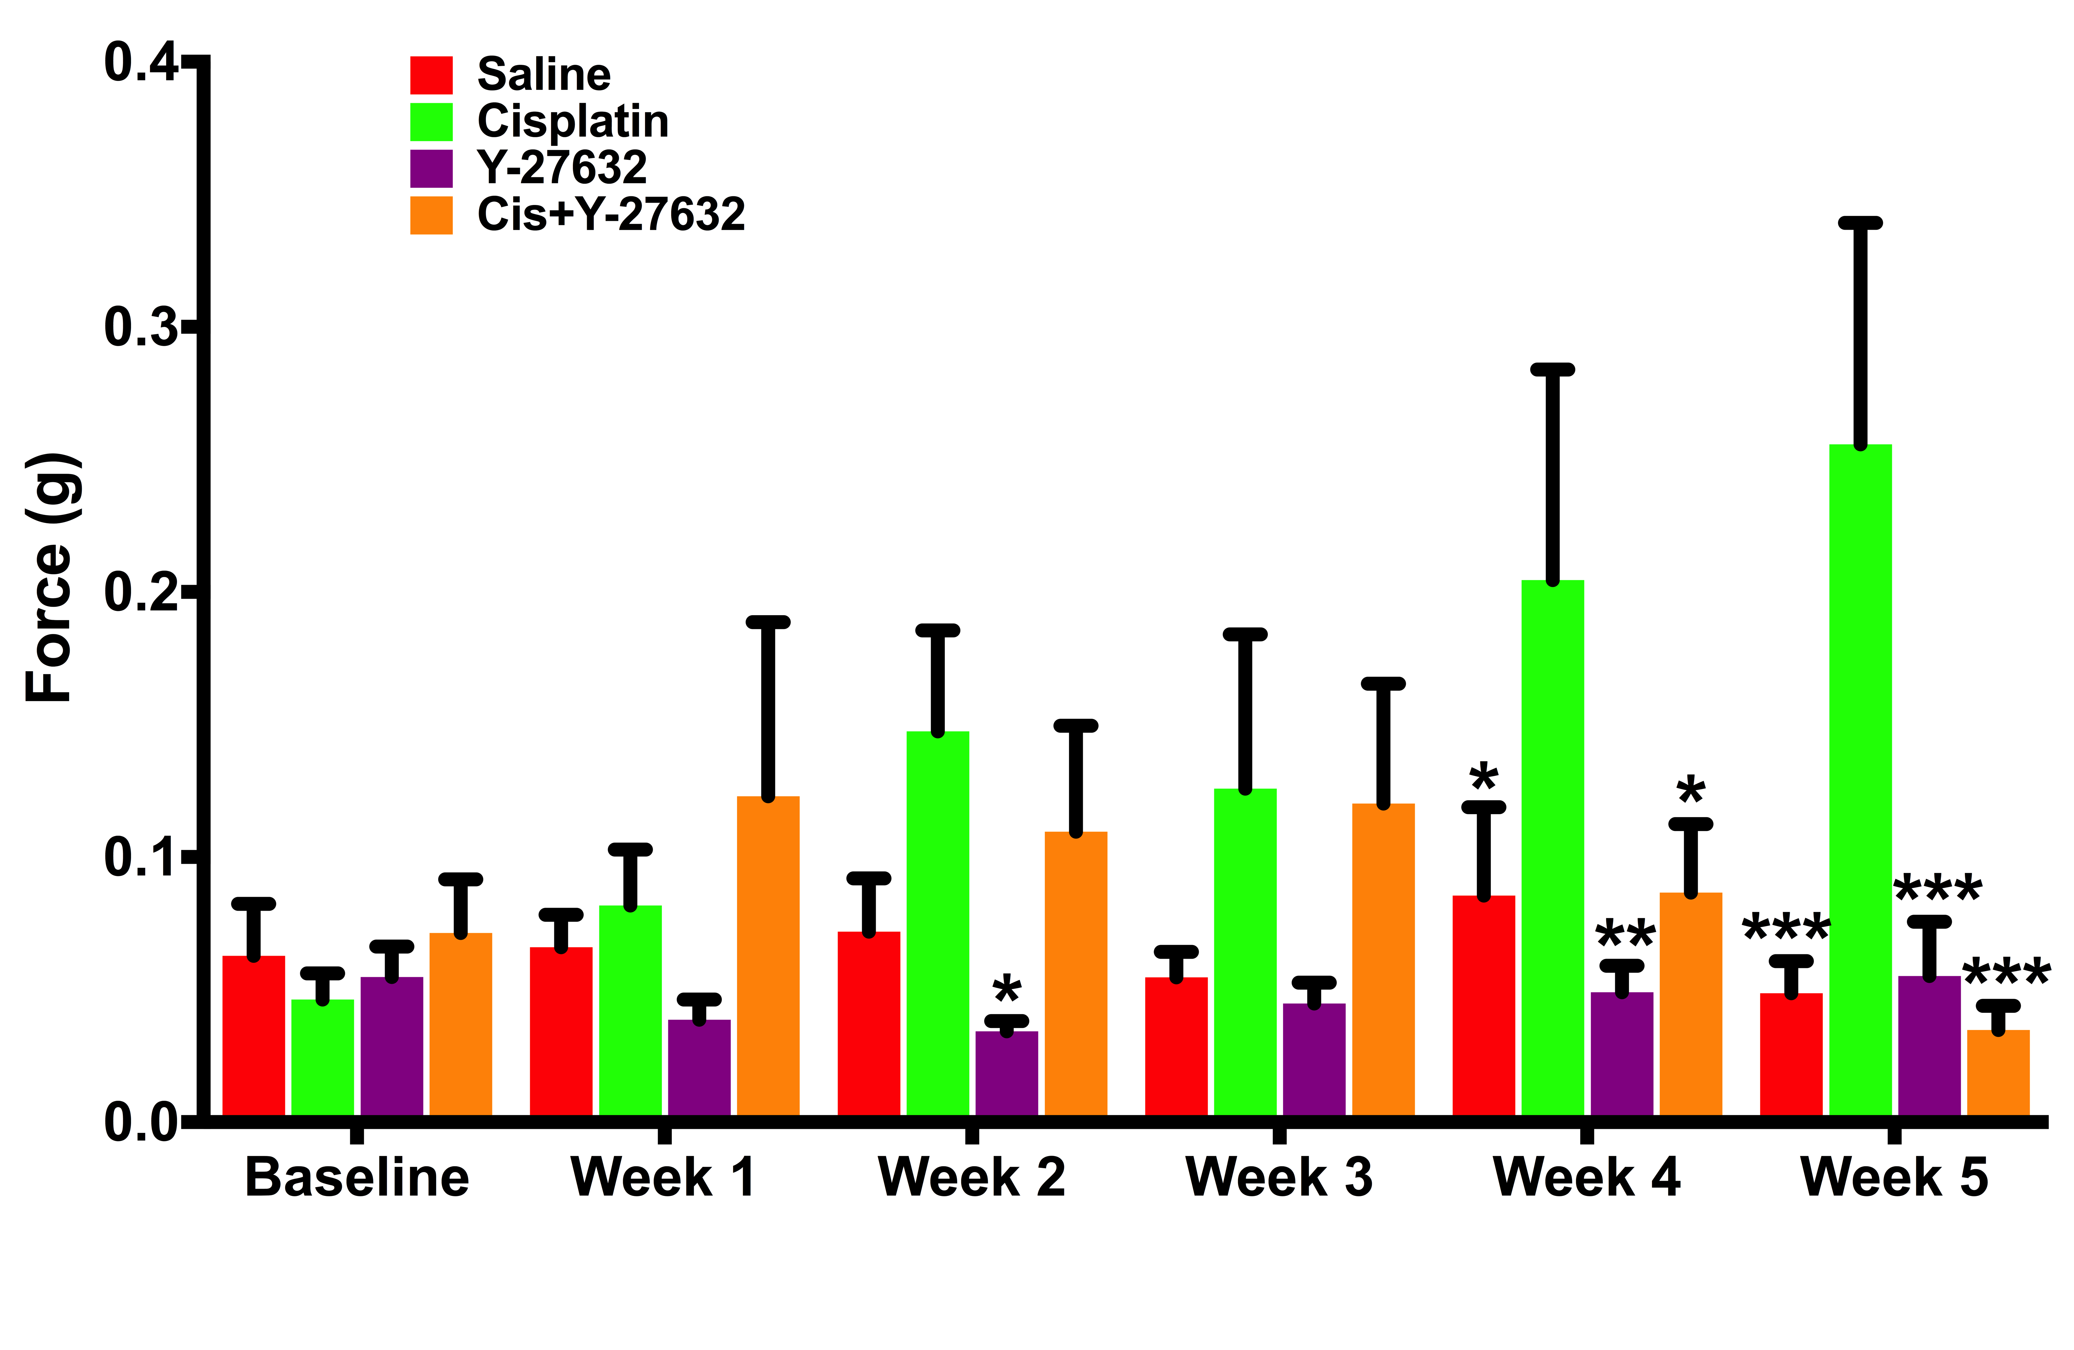
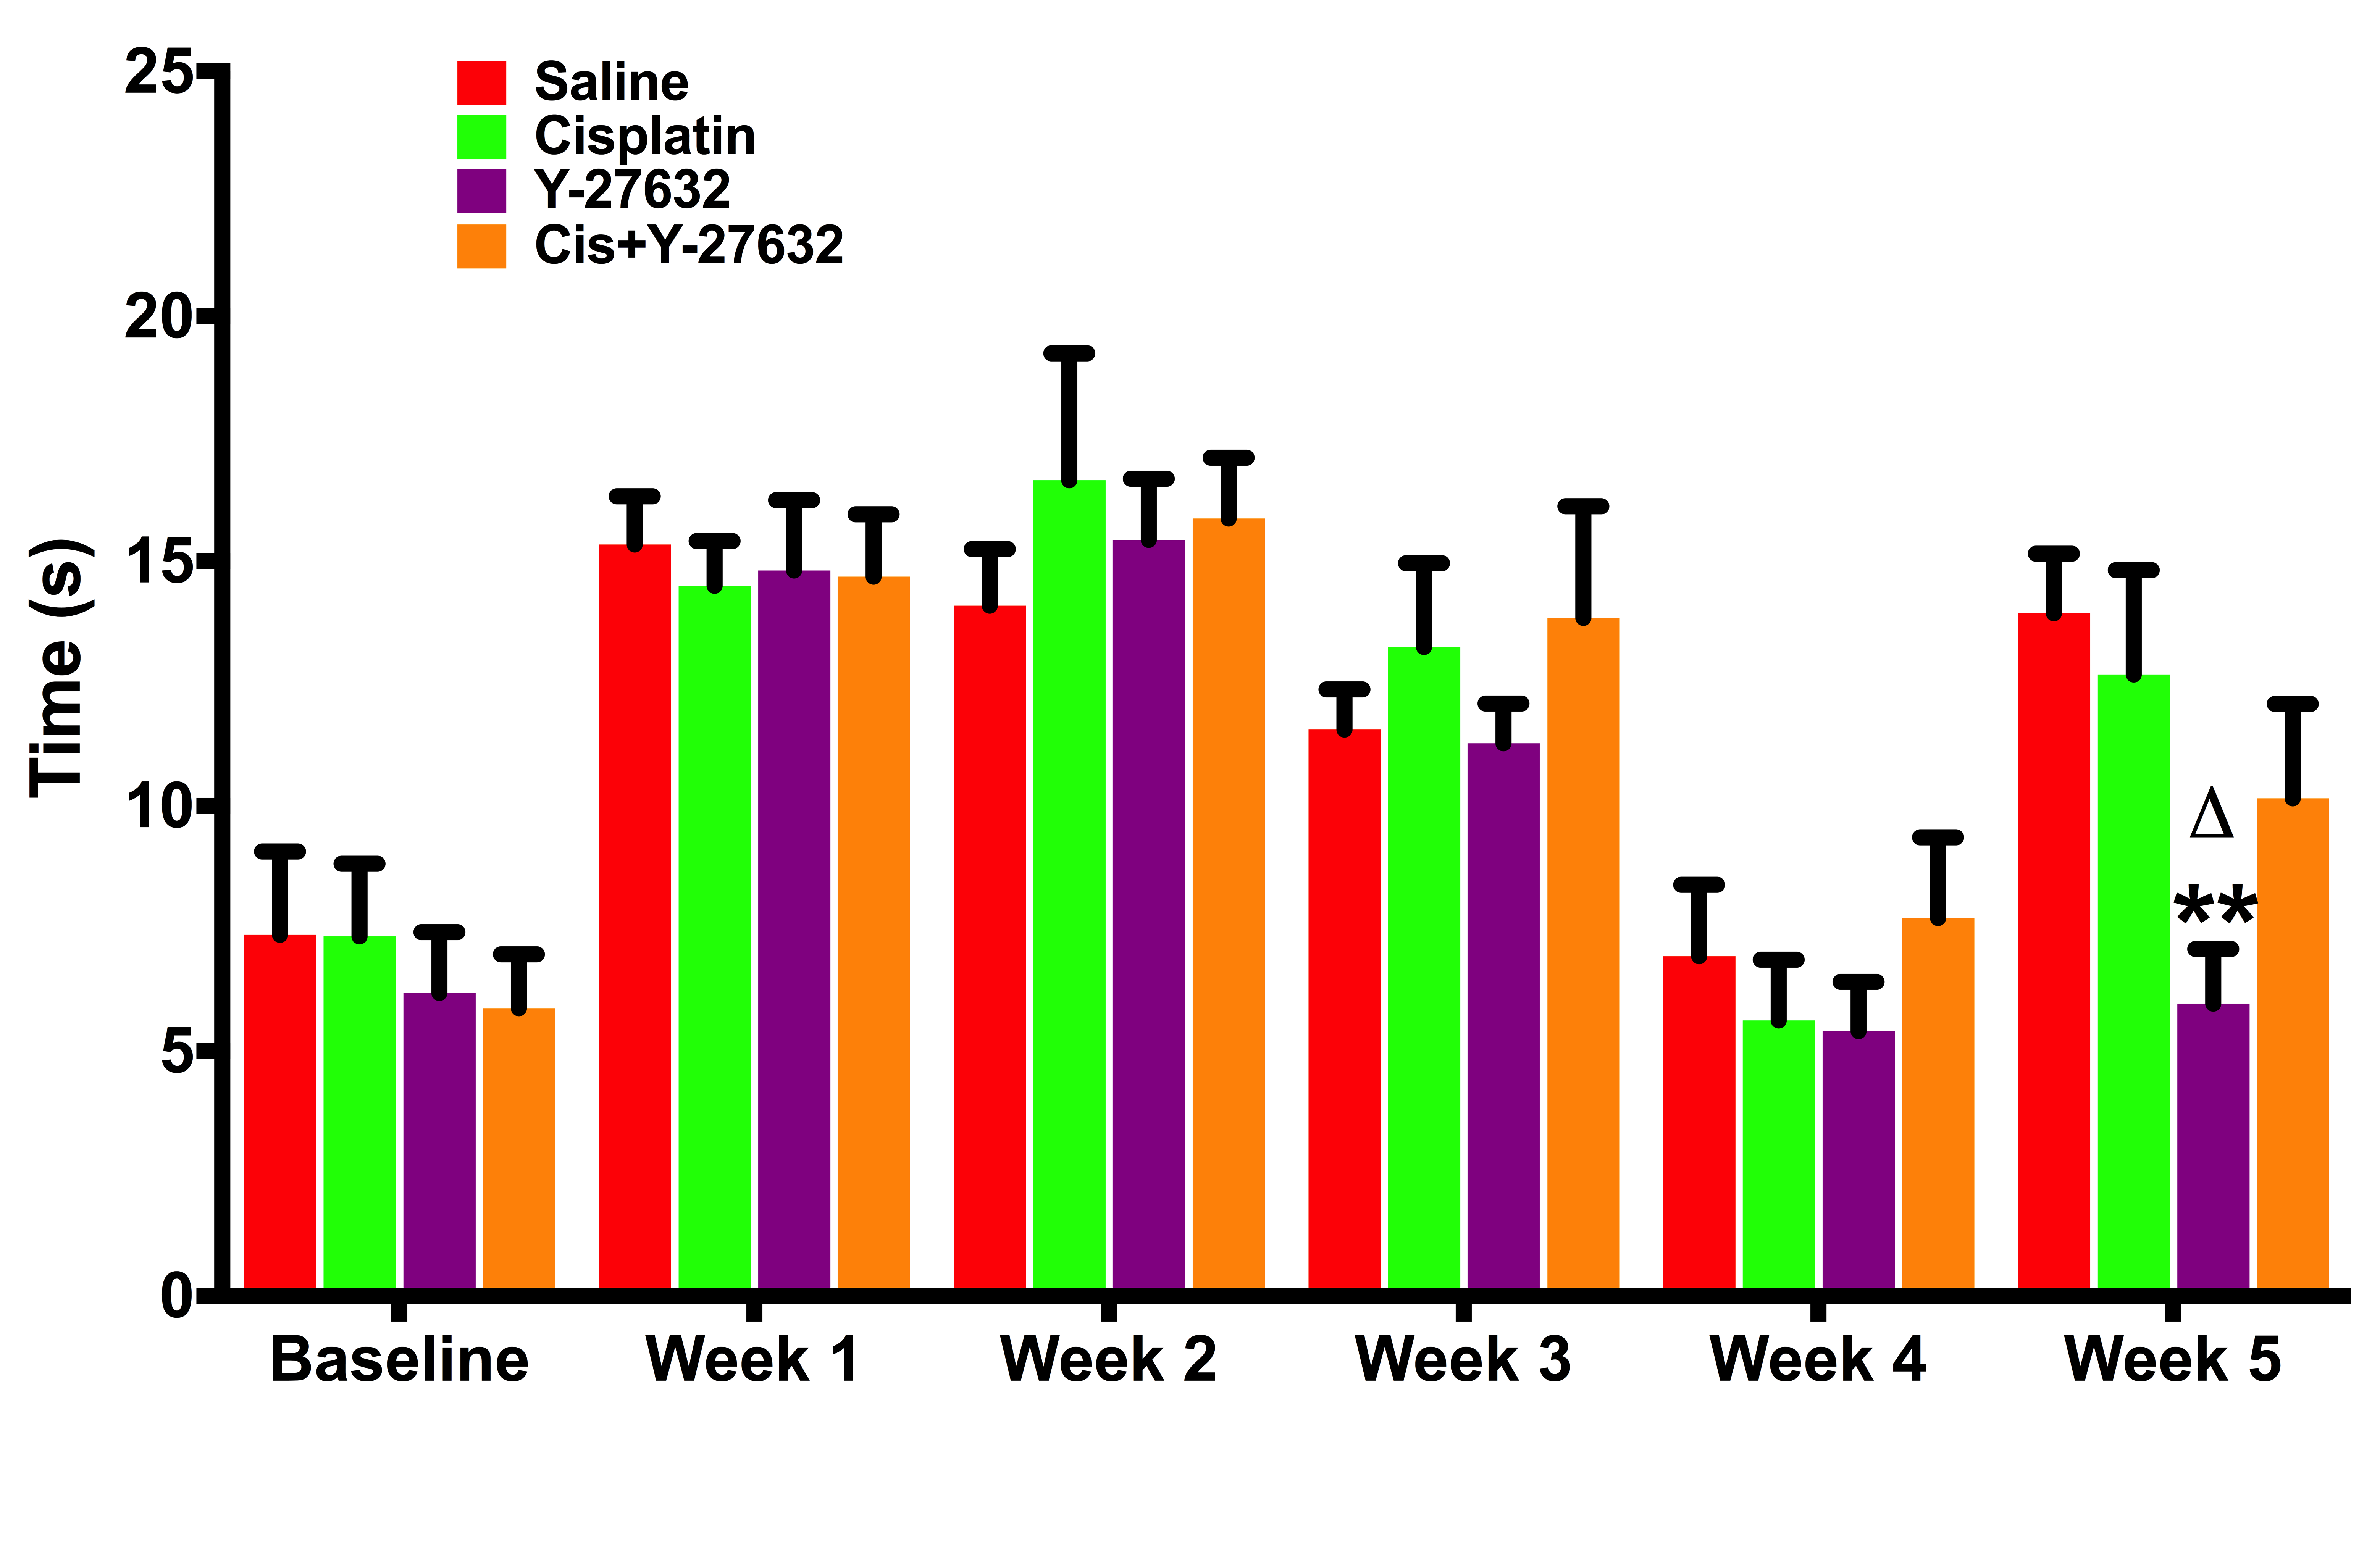
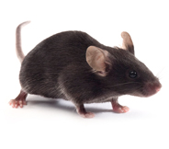


The therapeutic effect of Rho kinase inhibitor Y-27632 on protection from chemotherapy-induced peripheral neuropathy in a mouse model
Zachary Elliott, Taylor Leposa, Yi Zhu^{1,3}, Christi Boykin¹, Qun Lu^{1, 3}
¹Department of Anatomy and Cell Biology; ²Department of Surgery, ³The Harriet and John Wooten laboratory for Alzheimer’s and Neurodegenerative Diseases Research, The Brody School of Medicine at East Carolina University, Greenville, North Carolina 27834
ABSTRACT
RESULTS
Saline
Y-27632
Cisplatin often causes loss of touch sensitivity in the hands and feet of cancer patients as well as tingling, numbness, and a shooting or burning pain; these clinical symptoms are referred to as chemotherapy-induced peripheral neuropathy (CIPN). CIPN frequently results in a reduction or cessation of chemotherapy, and there is currently no effective intervention or prevention for CIPN. Therefore, it is important to understand the mechanism of CIPN pathogenesis and determine associated signaling pathways to identify potential therapeutic targets. Previous in vitro studies generated by other labs indicated that aberrant activity of RhoA signaling pathway was involved in the onset of CIPN. In order to fully capture the clinical situation, in this study, we created a CIPN mouse model in 4 month old C57/BL6 mice by intraperitoneal injections of 6 mg/g cisplatin and 30 mg/g Y-27632 weekly for 4 weeks for each respective group. To investigate the potential therapeutic effect of RhoA signaling pathway inhibition in CIPN, Y-27632, which selectively inhibit Rho kinase/p160^{ROCK} (a downstream effector of the RhoA signaling pathway), was applied to selective group of mice. The peripheral nerve function of mouse hind paw was evaluated by Von Frey monofilaments and acetone evaporation assay. Our data indicated that Y-27632 treatment could potentially protect mice from cisplatin-induced peripheral nerve damage. Additionally, immunohistochemical analysis of intraepidermal nerve fibers (IENFs) in the footpad tissue demonstrated that concurrent treatment of cisplatin with Y-27632 could alleviate the loss of touch sensory-associated IENFs caused by cisplatin. Therefore, Y-27632 can protect peripheral nerve function in a CIPN mouse model.
S-100
Cisplatin
Cis+Y-27632
INTRODUCTION
Fig 3. Y-27632 protected the density of touch sensory associated-IENFs under the epidermis from being injured by cisplatin
Quantification analysis of anti-S-100 immunohistochemical staining results confirmed a significant reduction in the density of touch sensory-associated IENFs in Cisplatin treatment group, which was prevented by concurrent treatment with Y-27632. (Values represent mean±sem. **p<0.01, relative to Saline, Y-27632 and Cis+Y-27632 treatments).
1.
RhoA belongs to the Rho family of small GTPases. This family functions primarily as molecular switches (1.), through exchange between a GTP-bound active state and a GDP-bound inactive state. Regulation of the states of these molecular switches is exerted by GEF’s (guanine nucleotide exchange factors) and GAPs (GTPase-activating proteins) which facilitate activation of the GTPase through GDP release and inactivation, through GTP hydrolysis, respectively. Importantly, GDI’s (guanine nucleotide dissociation inhibitors) play an additional role in regulation of the Rho family of small GTPases by blocking spontaneous activation through their interaction with the GDP-bound or inactive GTPases. Rho kinase or ROCK (2.) is one of the major downstream effectors of RhoA signaling pathway. The activation of Rho kinase can subsequently trigger actin cytoskeleton organization. Based on previous research investigations, aberrant activation of RhoA pathway is involved in a wide range of clinical implications, such as cardiovascular diseases, neurological disorders, and cancer.
2.
p75 Neurotrophin
Receptor
Extracellular
Intracellular
GEF
Saline
Y-27632
GDI
RhoA
Rho kinase/ROCK
Fig 1. Cisplatin treatment induced a significant body weight loss.
Quantification analysis of body weight in all treatment groups of mice. The average body weight of mice in the Y-27632 treatment group was maintained over the course of experiment. Furthermore, Cis+Y-27632 treatment could slow down the decrease of body weight caused by cisplatin on week 3 and week 4. Therefore, Y-27632 treatment prevented cisplatin-induced excessive body weight loss, which was commonly observed in chemotherapy patients. Values represent mean±sem. *p<0.05, **p<0.0001, relative to Saline. •p<0.05, ••p<0.0005, •••p<0.0001, relative to Y-27632. Δp<0.05, ΔΔp<0.0005, ΔΔΔp<0.0001, relative to Cisplatin.
CGRP
Etienne-Manneville, S., & Hall, A. (2002). Rho GTPases in cell biology. Nature, 420, 629-635
Actin cytoskeleton organization
Cisplatin
Cis+Y-27632
RESEARCH HYPOTHESIS
Von Frey Monofilament Assay
Acetone Evaporation Assay
Fig 4. Nociceptive IENFs were not affected by pharmacological treatments
Quantification analysis of anti-CGRP immunohistochemical staining results suggested that the density of nociceptive IENFs was not significantly different between each treatment group.
Y-27632
CIPN
RhoA
Rho kinase/ROCK
CONCLUSIONS
APPROACH
Employment of Y-27632 in the treatment regimen reduce the risks of peripheral neuropathy in cisplatin-treated mice, which also promoted Y-27632 as a potential adjuvant for cisplatin treatment.
By creating a tumor-bearing CIPN mouse model, we showed the potential clinical benefit for suppression of RhoA pathway in preventing CIPN.
Future experiments may study effects of Von Frey on larger mammals over a longer trial.
Female mice
(C57BL6/J strain)
n=40
Fig 2. Cisplatin-caused reduction of touch sensitivity was ameliorated by Y-27632 while the pain sensation was not affected by all treatments
Von Frey monofilament assay showed a significant increase of force to trigger a positive response in the cisplatin-treated mice after four weeks of treatment, which indicated a decline of touch sensitivity in the peripheral nerve. However, the loss of touch sensitivity caused by cisplatin was prevented by the additional treatment of Y-27632 since no significant difference in the intensity of force applied to the hind paw was observed between Saline treatment group and Cis+Y-27632 treatment group. Acetone Evaporation assay indicated that there was no significant difference in the duration of pain sensation response between different treatment groups after four weeks of experiment. (Values represent mean±sem. *p<0.05, **p<0.005, ***p<0.001, relative to Cisplatin)
References
Tumor bearing mouse model
Pharmacological treatments
Von Frey monofilament assay
Peripheral nerve function analysis
Acetone evaporation assay
Immuno-histological analysis
Footpad tissues
Body Weight measurements
Touch sensitivity evaluation
Pain sensation evaluation
Interepidermal nerve fibers (IENFs) density
Saline
n=10
Cisplatin
n=10
Y-27632
n=10
Cis+Y-27632
n=10
Boyette-Davis, J., & Dougherty, P. (2011). Protection against oxaliplatin-induced mechanical hyperalgesia and intraepidermal nerve fiber loss by minocycline. Experimental Neurology, 229(2), 353-357. doi:10.1016/j.expneurol.2011.02.019
Friesland, A., Weng, Z., Duenas, M., Massa, S. M., Longo, F. M., & Lu, Q. (2014). Amelioration of cisplatin-induced experimental peripheral neuropathy by a small molecule targeting p75NTR. NeuroToxicology, 45, 81-90. doi:10.1016/j.neuro.2014.09.005
James, S. E., Dunham, M., Carrion-Jones, M., Murashov, A., & Lu, Q. (2010). Rho kinase inhibitor Y-27632 facilitates recovery from experimental peripheral neuropathy induced by anti-cancer drug cisplatin. NeuroToxicology, 31(2), 188-194. doi:10.1016/j.neuro.2009.12.010
Ta, L. E., Low, P. A., & Windebank, A. J. (2009). Mice with Cisplatin and Oxaliplatin-Induced Painful Neuropathy Develop Distinct Early Responses to Thermal Stimuli. Molecular Pain, 5. doi:10.1186/1744-8069-5-9
ACKNOWLEDGEMENTS
We wish to acknowledge the technical assistance from Joani Zary Oswald and the members of Dr. Lu and Dr. Verbanac Labs. This study is supported in part by grants from National Cancer institute CA111891 and CA165202 and the Harriet and John Wooten Foundation for Alzheimer’s Diseases Research

