Slide 1
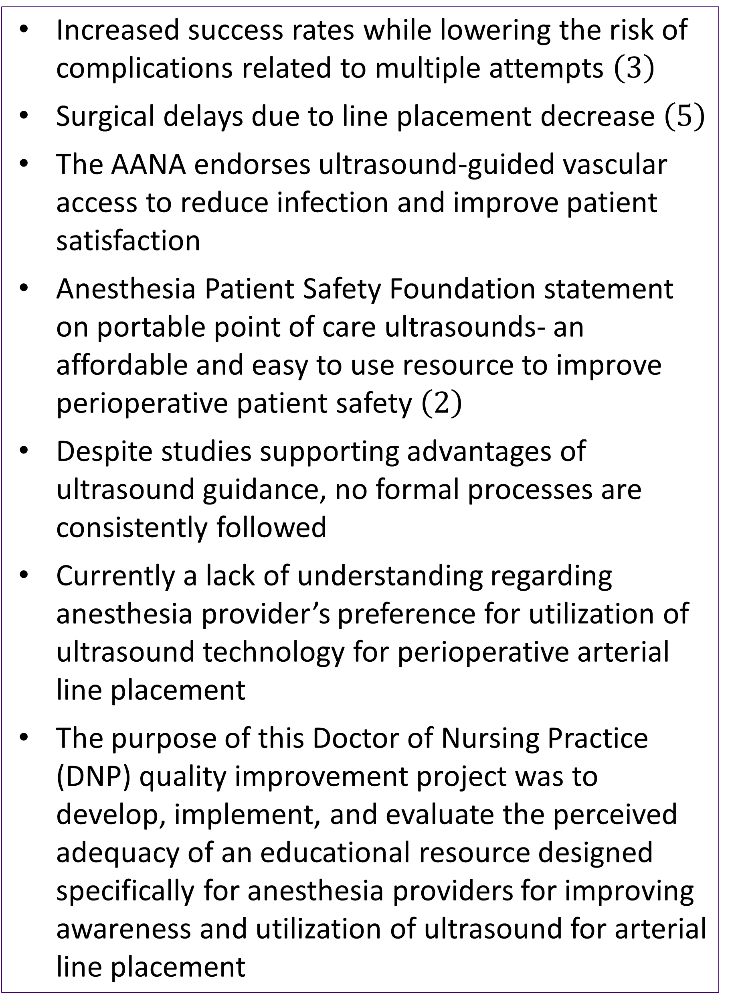
Assessing Anesthesia Providers’ Perceptions of Ultrasound Use with Arterial Line Placement and the Impact of an Educational Resource: A DNP Project
Breanna Love, BSN, SRNA
Travis Chabo, PhD, CRNA, Project Chair
Nurse Anesthesia Program
College of Nursing, East Carolina University
Greenville, North Carolina 27858
Loveb22@students.ecu.edu
INTRODUCTION
RESULTS
DISCUSSION
Increased success rates while lowering the risk of complications related to multiple attempts $\left(3\right)$
Surgical delays due to line placement decrease $\left(5\right)$
The AANA endorses ultrasound-guided vascular access to reduce infection and improve patient satisfaction
Anesthesia Patient Safety Foundation statement on portable point of care ultrasounds- an affordable and easy to use resource to improve perioperative patient safety $\left(2\right)$
Despite studies supporting advantages of ultrasound guidance, no formal processes are consistently followed
Currently a lack of understanding regarding anesthesia provider’s preference for utilization of ultrasound technology for perioperative arterial line placement
The purpose of this Doctor of Nursing Practice (DNP) quality improvement project was to develop, implement, and evaluate the perceived adequacy of an educational resource designed specifically for anesthesia providers for improving awareness and utilization of ultrasound for arterial line placement
Eight participants completed pre-survey, nine completed post-survey
Increase in awareness of advantages of ultrasound-guided arterial line placement
Increase in participants' perceptions that ultrasound use with arterial line placement is superior to traditional palpation techniques
Confidence levels unchanged
All participants following project implementation are unlikely to use ultrasound-guidance for arterial line placement
Suggested that barriers participants faced may be why they are unlikely to use ultrasound-guidance despite positive perceptions of technique
CONCLUSIONS
No participants stated they would likely use ultrasound guidance for arterial line placement
In the future: Evaluating perceived barriers of anesthesia providers related to ultrasound use with arterial line placement can allow implementation of ways to decrease barriers and improve utilization of ultrasound with arterial line placement
Limitations: small sample size, short implementation time, no accurate way to tell if participants utilized educational resources
Overall, QI project "increased anesthesia providers' perception that u/s is superior to traditional palpation technique and advantages of using u/s plus raised awareness of barriers to u/s use with arterial line placement"
METHODS
Literature search and synthesis performed
Single Plan-Do-Study-Act cycle implemented
Educational handout and PowerPoint Voiceover
Pre- and post-surveys created using Qualtrics
Convenience sample
Participation voluntary
Nine participants emailed instructions, educational resources, and individualized links to pre-survey
Participants asked to utilize educational resources during two-week implementation period
Participants emailed post-survey links
Data analyzed and visuals made using Microsoft Excel
REFERENCES
(1) Institute for Healthcare Improvement. (2023). How to improve. http://www.ihi.org/resources/Pages/HowtoImprove/default.aspx
(2) Lindsay, P., Gibson, L., Bittner, E. A., & Chang, M. G. (2020). Portable point of care ultrasound (PPOCUS): An emerging technology for improving patient safety. Anesthesia Patient Safety Foundation. https://www.apsf.org/article/portable-point-of-care-ultrasound-ppocus-an-emerging-technology-for-improving-patient-safety/
(3) Pierre, L., Pasrija, D., & Keenaghan, M. (2023). Arterial lines. National Library of Medicine. https://www.ncbi.nlm.nih.gov/books/NBK499989/
(4) Wang, A., Hendin, A., Millington, S. J., Koenig, S., Eisen, L. A., & Shiloh, A. L. (2020). Better with ultrasound: Arterial line placement. Chest, 157(3), 574–579. https://doi.org/10.1016/j.chest.2019.08.2209
(5) Wilson, C., Rose, D., Kelen, G. D., Billioux, V., & Bright, L. (2020). Comparison of ultrasound-guided vs traditional arterial cannulation by emergency medicine residents. The Western Journal of Emergency Medicine, 21(2), 353-358. https://doi.org/10.5811/westjem.2019.12.44583

