Slide 1


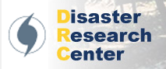

A new approach to regional hurricane evacuation and sheltering
NCEM, NWS and ECU Hurricane Workshop
May 18, 2011
Professor Rachel Davidson (University of Delaware)

Slide 2
PROJECT TEAM
Introduction
Hazard models
Shelter model
Evacuation model
Conclusions

Slide 3
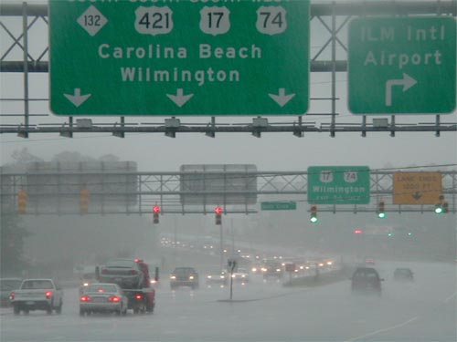
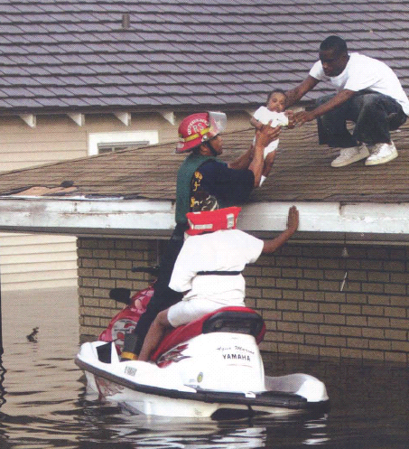
MOTIVATION
Introduction
Hazard models
Shelter model
Evacuation model
Conclusions
Too many people
+
Too little road capacity
Traditional, conservative approach not feasible in some regions
Too soon
Unnecessary, expensive,
dangerous
Too late
Dangerous

Slide 4
A NEW APPROACH
Introduction
Hazard models
Shelter model
Evacuation model
Conclusions
Broader decision frame →
New objectives (e.g., safety, cost)
New alternatives (shelter-in-place, phased evacuation) Direct integration & comparison of alternatives
Consider uncertainty in hurricane scenarios explicitly
Consider evacuation and sheltering together

Slide 5
OVERVIEW OF MODELS
Introduction
Hazard models
Shelter model
Evacuation model
Conclusions
Shelter model
Which shelters should be maintained over long-term?
Which should be opened in specific hurricane?
Evacuation model
For approaching hurricane:
Who should stay home?
Who should evacuate and when?
Hurricane scenarios
Dynamic traffic modeling
Behavioral assumptions
North Carolina case study

Slide 6
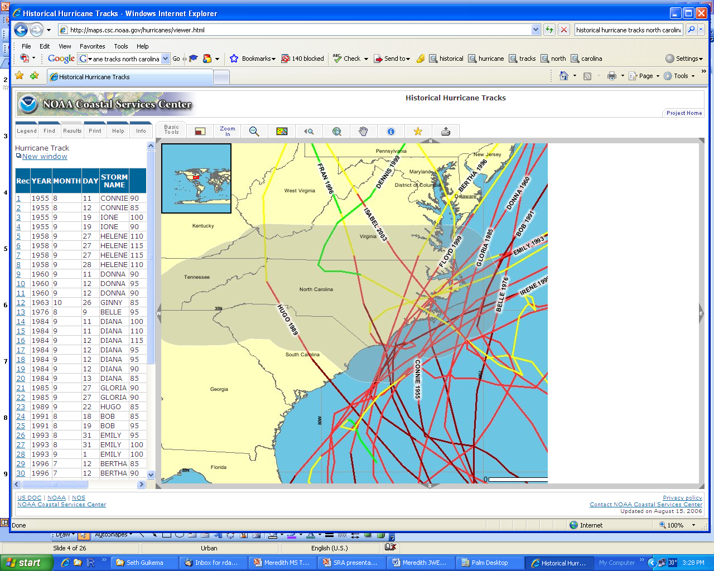
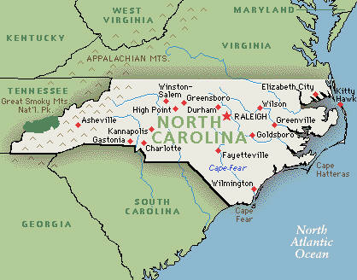
HAZARD MODELING
Introduction
Hazard models
Shelter model
Evacuation model
Conclusions
For shelter model
Long-term
Goal
Set of scenarios with adjusted occurrence probabilities
Represent all that could happen over long term
Are few in number
For evacuation model
Short-term
Goal
Set of scenarios with adjusted occurrence probabilities
Represent all that could happen that are consistent with track to date
Are few in number
B
C
A

Slide 7
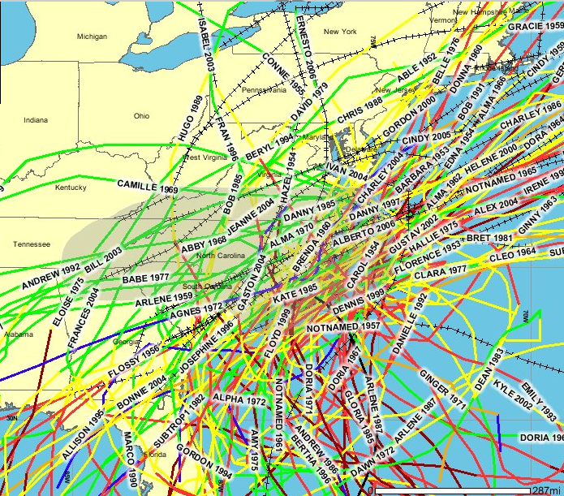
LONG-TERM HAZARD MODELING
Introduction
Hazard models
Shelter model
Evacuation model
Conclusions
Develop large candidate set of hurricanes
For each, calc. wind speeds & coarse grid coastline surge levels
Find reduced set to minimize sum of errors w_{i,r} and s_{i,r}
Calculate all find grid surge levels for reduced set
Match hazard curves for each census tract
All historical or
synthetic events
Reduced set of events with adjusted annual frequencies
NOAA Coastal Services Center

Slide 8
LONG-TERM HAZARD MODELING:
RESULTS
Introduction
Hazard models
Shelter model
Evacuation model
Conclusions
Optimization-based Probabilistic Scenario (OPS) method
Huge computational savings
Can explicitly tradeoff num. hurricanes and error
Retains spatial coherence of individual hurricanes
Spatial correlation is largely captured
Can prioritize specific tracts, return periods
Only do computationally-intensive surge estimates for reduced set of events
Hazard curve errors for worst census tract

Slide 9
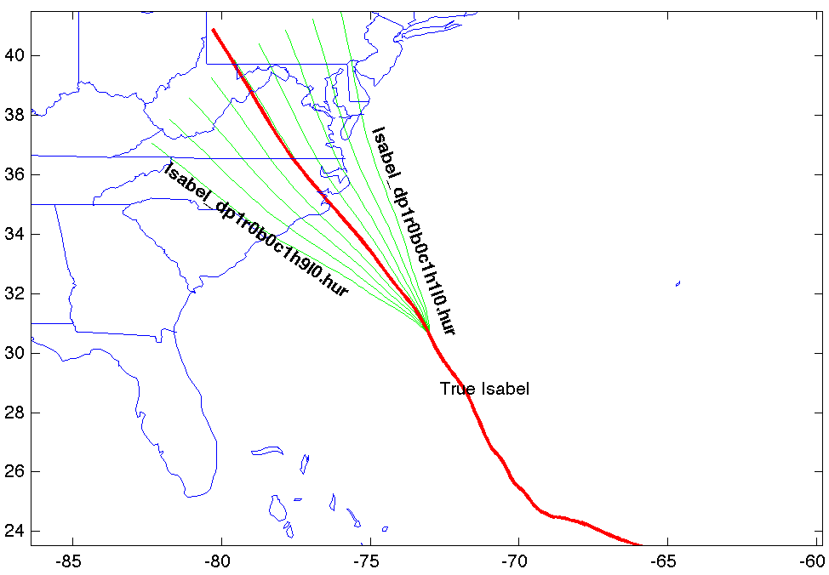
SHORT-TERM HAZARD MODELING
Introduction
Hazard models
Shelter model
Evacuation model
Conclusions
Estimated 135 possible scenarios based on Isabel (2003) with modifications
Central pressure deficit change (mb)
value=[-20 -10 0 10 20]
prob.=[.1 .2 .4 .2 1]
Along-track speed change (%)
value=[-10 0 10]
prob.=[.25 .5 .25]
Heading change (degrees)
value=[-20 -15 -10 -5 0 5 10 15 20]
prob.=[.025 .075 .1 .15 .30 .15 .1 .075 .025]
Scenario duration (3 days)
Same for 1 day
Landfall
Sept. 16
17
18
19
20

Slide 10
HURRICANE SCENARIO-BASED
ANALYSIS: KEY FEATURES
Introduction
Hazard models
Shelter model
Evacuation model
Conclusions
Each scenario is explicit
Capture probability distributions of wind/water/travel times
  → Find strategies that are robust given uncertainty in hurricane tracks, intensities, speeds
Model wind and surge together
Can use state-of-the-art surge modeling
Could capture hurricane-specific features (e.g., track leading to earlier evacuation vs. directly onshore)

Slide 11
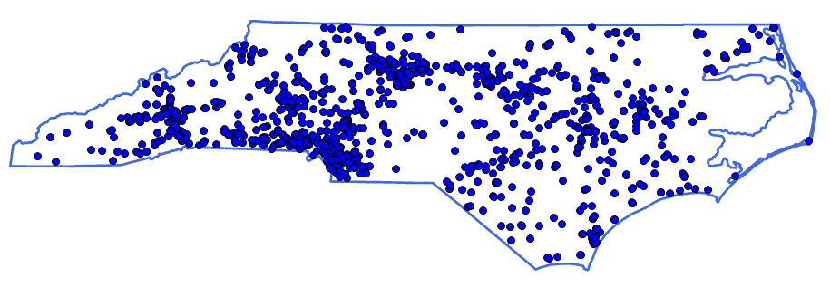
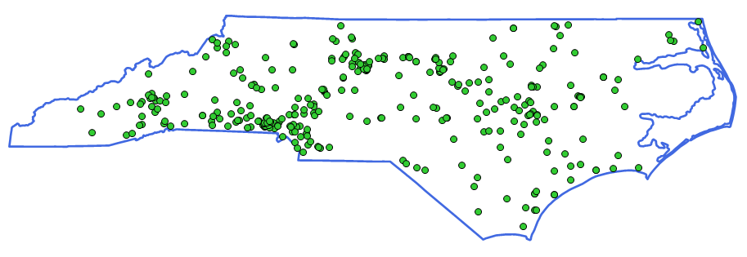
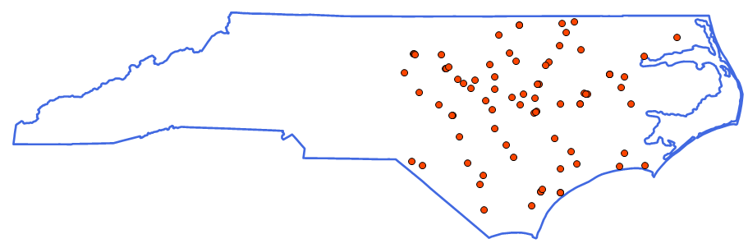
SHELTER PLANNING:
MOTIVATION & OBJECTIVES
Introduction
Hazard models
Shelter model
Evacuation model
Conclusions
Motivation
Deliberate, focused planning for selected shelters
  Upgrade, prepare, plan for them
Shelter locations affect traffic
  → Locate them to alleviate traffic
Objectives
Determine which shelters to maintain over the long-term
For each particular hurricane scenario, determine which shelters to open and how to allocate people to these shelters

Slide 12
SHELTER MODEL STRUCTURE
Introduction
Hazard models
Shelter model
Evacuation model
Conclusions
Inputs
Evacuation demand; hurricane scenarios and probabilities; destinations
Upper-level
Which shelters to maintain over the long-term?
For a certain hurricane scenario, which shelters to open and how to allocate people to these shelters by origin?
Upper-level:
Shelter Location-Allocation
Shelter plan
Travel times
Lower-level:
Traffic Assignment Model
Lower-level
For each scenario:
What route does each driver take given shelter locations?
What are expected travel times?
Outputs
Shelter plan and performance by scenario (shelter use, travel times)

Slide 13
SHELTER UPPER-LEVEL MODEL
Introduction
Hazard models
Shelter model
Evacuation model
Conclusions
Minimize weighted sum of expected (over all hurricane scenarios):
  Total evacuee travel time
  Unmet shelter demand
OBJECTIVE
CONSTRAINTS
Shelters
  Can not maintain more than max. allowable number of shelters
  In each scenario, can only open shelter if one is located there and is safe for that scenario
  In each scenario, num. evacuees going to a shelter cannot exceed shelter capacity
Staffing
  For each scenario, cannot exceed available number of staff

Slide 14
SHELTER LOWER-LEVEL MODEL
Introduction
Hazard models
Shelter model
Evacuation model
Conclusions
OBJECTIVE
Minimize
  Each driver’s own perceived travel time
  (stochastic user equilibrium)
Assumptions
  For each scenario, given open shelters as determined in upper-level
  Describes individual drivers’ route choice behavior
  Independent decision makers
  Only passenger cars
  2 types of evacuees, headed to:
    Public shelter
    Destination other than a public shelter
      Assumption 1: Leave threatened area quickly as possible
      Assumption 2: Fixed destinations
  Peak flow analysis for traffic

Slide 15
SHELTER MODEL SOLUTION
Introduction
Hazard models
Shelter model
Evacuation model
Conclusions
Initialization:
Free-flow travel times
Upper-level
Find candidate shelter locations and O-D matrices by solving upper-level with travel times fixed
Lower-level
For each scenario, solve SUE problem to find flow pattern, link travel times, and average travel times for each O-D
Test for optimality?
No
Yes
End

Slide 16
SHELTER MODEL CASE STUDY INPUTS
Introduction
Hazard models
Shelter model
Evacuation model
Conclusions
Highway network
7691 bi-directional links
5055 nodes at origins,
destinations, link intersections
Origins and destinations
Origins: 529 eastern census tracts
Destinations: 187 potential shelter locations from ARC (capacity 700-4000)
  Exits from evacuation area (vary by scenario; about 3 to 5)
Evacuation and shelter demand
Estimated using HAZUS-MH
Hurricane scenarios
33 hurricane scenarios with annual occurrence probabilities estimated using OPS method based on wind speeds
Shelters
3000 staff available
Can maintain at most 50 shelters
Free flow speed=55 mph
Capacity per lane: 1500 vph
2 people/vehicle

Slide 17
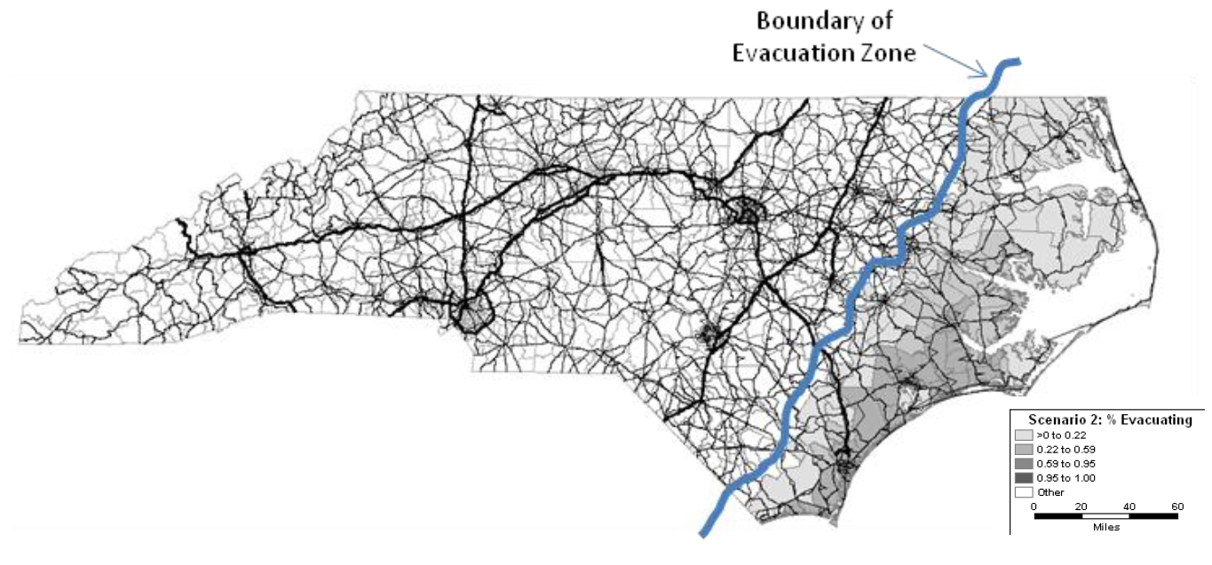
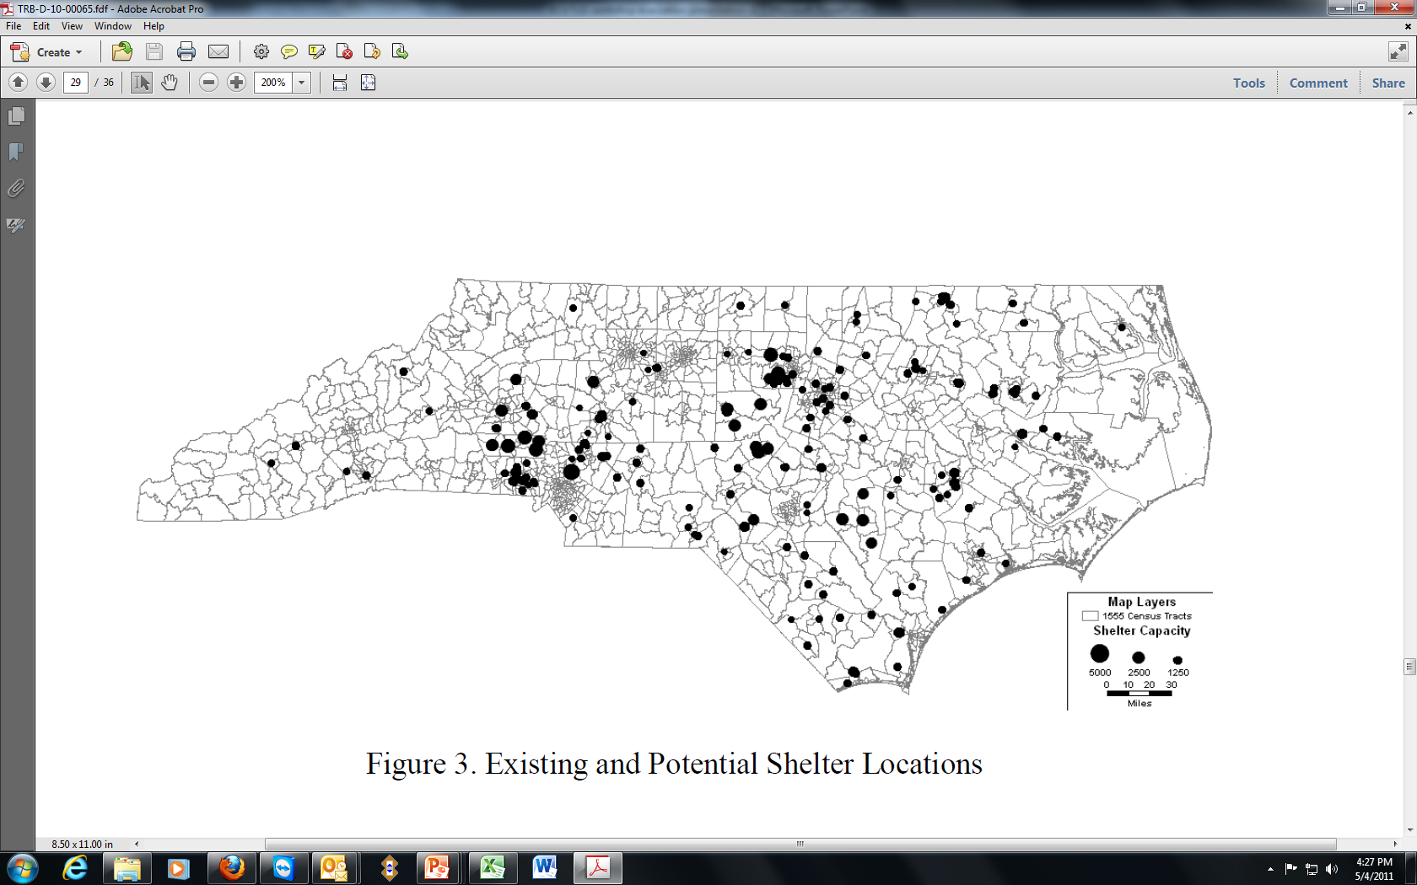
SHELTER MODEL CASE STUDY INPUTS
Introduction
Hazard models
Shelter model
Evacuation model
Conclusions
Highway network
Possible shelters

Slide 18
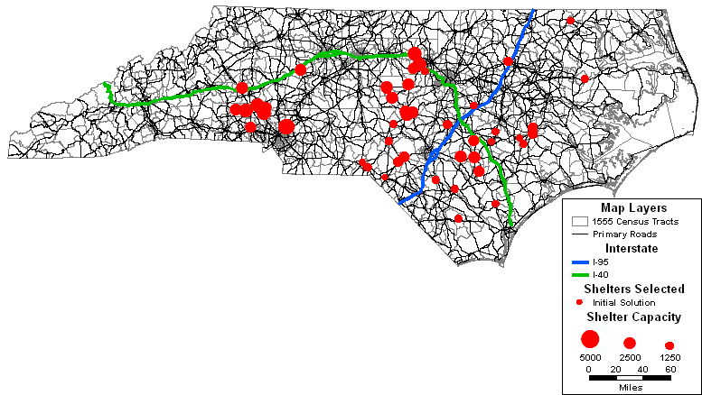
SHELTER MODEL CASE STUDY RESULTS
Introduction
Hazard models
Shelter model
Evacuation model
Conclusions
Recommendation of shelters to maintain
50
103
30
107
59
Initial solution
(not considering effect shelter location has on travel times)

Slide 19

SHELTER MODEL CASE STUDY RESULTS
Introduction
Hazard models
Shelter model
Evacuation model
Conclusions
Recommendation of shelters to maintain
48
131
Optimized solution
(considering effect shelter location has on travel times)
39
14
13
50 shelters selected
Most to the west of I-95, I-40
Considering traffic suggests moving some shelters.

Slide 20
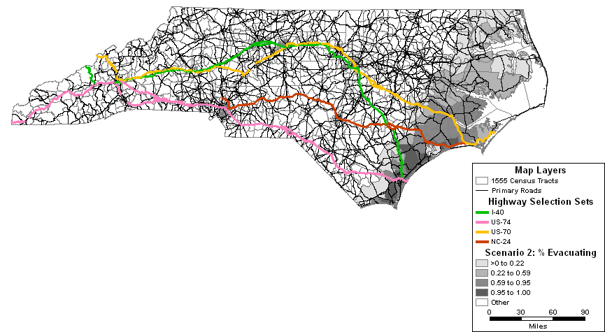
SHELTER MODEL CASE STUDY RESULTS
Introduction
Hazard models
Shelter model
Evacuation model
Conclusions
Illustrative hurricane scenario
Evacuation demand: 410,000
Shelter demand: 44,260
Peak wind: 175 mph (Category 5)
Landfall near Wilmington, then travels north along coast
20

Slide 21
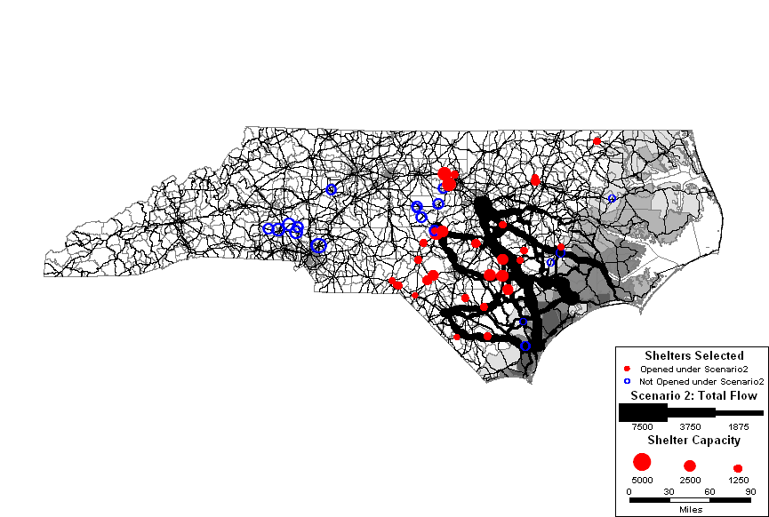
SHELTER MODEL CASE STUDY RESULTS
Introduction
Hazard models
Shelter model
Evacuation model
Conclusions
Illustrative hurricane scenario
(Assuming nonshelter evacuees exit quickly as possible)
Shelter use and total traffic flows
To Greensboro
To Raleigh-Durham
US-70
NC-24
To Charlotte and S. Carolina
Morehead
Jacksonville
Wilmington
Northbound I-40 and Rte 74 heavy
Some shelters in west not needed
Some shelters in east cannot be used
Congestion b/c many to Raleigh/Durham
US-74
I-40
Thickest line = 7500 vph

Slide 22
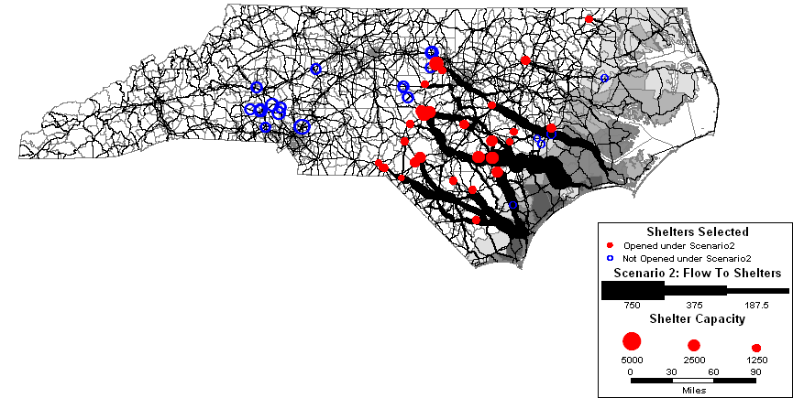
SHELTER MODEL CASE STUDY RESULTS
Introduction
Hazard models
Shelter model
Evacuation model
Conclusions
Illustrative hurricane scenario
(Assuming nonshelter evacuees exit quickly as possible)
Shelter use and traffic flows to shelters only
NC-24
Initial solution
(not considering effect shelter location has on travel times)
NC-24 heavily used
Thickest line = 750 vph

Slide 23
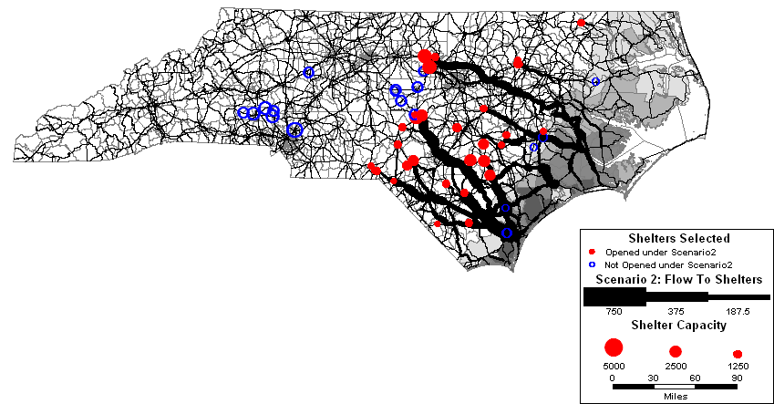
SHELTER MODEL CASE STUDY RESULTS
Introduction
Hazard models
Shelter model
Evacuation model
Conclusions
Illustrative hurricane scenario
(Assuming nonshelter evacuees exit quickly as possible)
Shelter use and traffic flows to shelters only
Optimized solution
(considering effect shelter location has on travel times)
Little traffic on congested roads
23
Thickest line = 750 vph

Slide 24
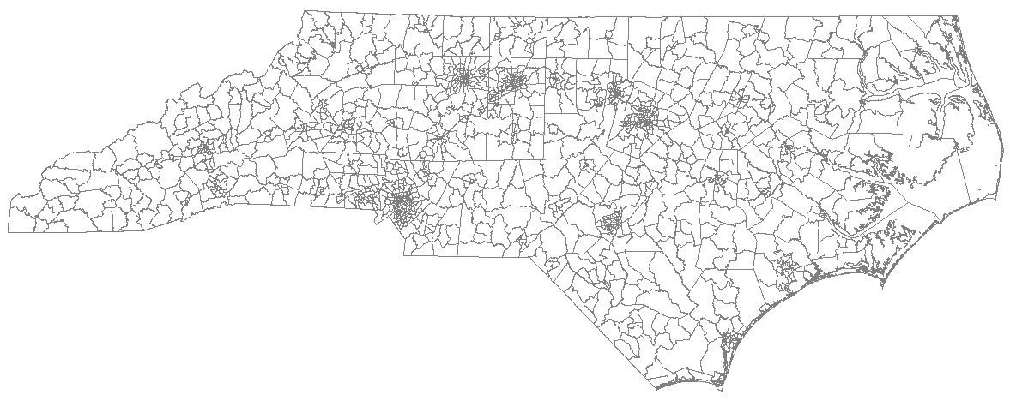
SHELTER MODEL CASE STUDY RESULTS
Introduction
Hazard models
Shelter model
Evacuation model
Conclusions
Different assumption for non-shelter evacuees
Two types of evacuees: To shelter or not
For evacuees not going to a public shelter
  Leave evacuation area as quickly as possible
  Fixed destinations
  (Outer Banks to VA; others evenly distributed between 5 cities)
Durham
Virginia
Greensboro
Raleigh
Charlotte
Fayetteville

Slide 25
SHELTER MODEL CASE STUDY RESULTS
Introduction
Hazard models
Shelter model
Evacuation model
Conclusions
Scenario | Number evacuating | Number who use shelters | Average travel time to a shelter
 |  |  | Leave area quickly as poss. |  |  | Fixed destinations
 |  |  | Initial iteration | Optimal iteration | % reduction | Initial iteration | Optimal iteration | % reduction
1 | 566,530 | 62,550 | 4.11 | 3.41 | 21% | 10.2 | 3.16 | 222%
2 | 411,860 | 44,260 | 2.85 | 2.49 | 14% | 3.28 | 2.46 | 33%
3 | 323,110 | 35,537 | 2.69 | 2.57 | 5% | 3.33 | 2.7 | 24%
4 | 325,360 | 34,154 | 2.18 | 2.06 | 6% | 4.9 | 2.3 | 113%
… | … | … | … | … | … | … | … | …
Reduction in travel time for shelterees depends on scenario
Reduced 6.7% on average across all trips; 20+% for many scenarios
Benefit more pronounced with fixed destinations
Choosing shelter locations carefully can reduce travel times

Slide 26
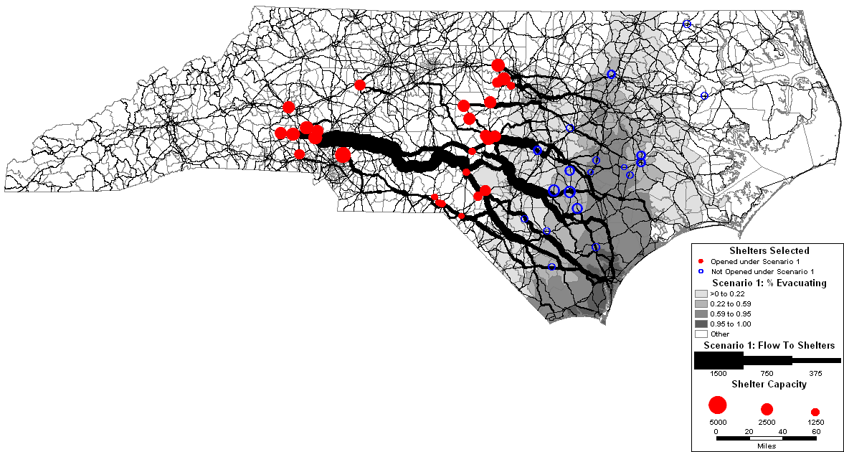
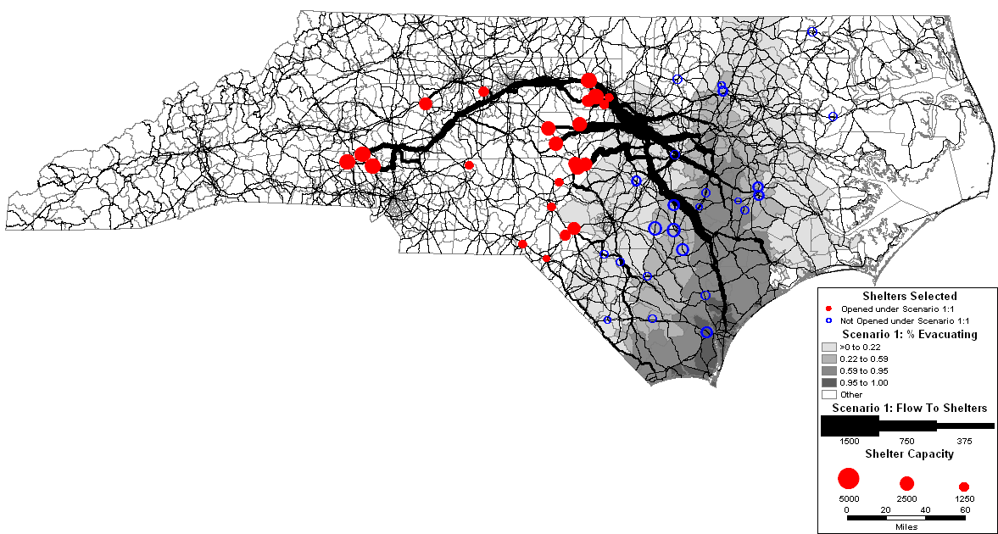
SHELTER MODEL CASE STUDY RESULTS
Introduction
Hazard models
Shelter model
Evacuation model
Conclusions
Fixed destination assumption for non-shelter evacuees
Scenario #1
Shelter use and traffic flows to shelters only
Durham
Raleigh
Charlotte
Initial solution
Optimized solution
In initial solution many housed in Charlotte → traffic
In optimal solution, evacuees shifted to Raleigh/Durham → alleviates traffic

Slide 27
SHELTER PLANNING:
CONCLUSIONS
Introduction
Hazard models
Shelter model
Evacuation model
Conclusions
Choice of shelters to maintain over long-term
  Carefully choose subset
  Easier to upgrade, prepare, plan for smaller set
  Can select so that they are robust in range of hurricane scenarios
Choice of shelters to open in specific hurricane
  Can choose so as to alleviate traffic
  Direct shelter evacuees away from non-shelter evacuees’ routes

Slide 28
EVACUATION PLANNING:
MOTIVATION & OBJECTIVES
Introduction
Hazard models
Shelter model
Evacuation model
Conclusions
Motivation
Want a strategy that is good on average and robust across all possible scenarios
Consider phased evacuation and sheltering-in-place
Minimize risk
Minimize travel times/cost
Objectives
For approaching hurricane:
Who should stay home?
Who should evacuate and when?
Normative

Slide 29
EVACUATION MODEL STRUCTURE
Introduction
Hazard models
Shelter model
Evacuation model
Conclusions
Inputs
Population at origins; hurricane scenarios and probabilities; shelter capacity; risk
Upper-level
(aggregated areas & time steps)
Who should stay home?
Who should go to shelters and when?
Who should go non-shelters and when?
Upper-level:
Evacuation Model
Evac.
plan
Travel times
Lower-level
(disaggregated areas & time steps)
For each scenario:
What route does each driver take given evacuation plan?
What are expected travel times?
What is the expected risk?
Lower-level:
Traffic Assignment Model
Outputs
Evacuation plan and performance by scenario (risk, travel times)

Slide 30
EVACUATION UPPER-LEVEL MODEL
Introduction
Hazard models
Shelter model
Evacuation model
Conclusions
Minimize weighted sum of expected (over all hurricane scenarios):
  Risk at home
  Risk while traveling
  Risk at destination
  Risk beyond threshold (k₂)
  Total travel time to shelters (k₁)
  Total travel time to non-shelters (k₁)
  Penalty for leaving early (k₃)
OBJECTIVE
CONSTRAINTS
Shelters
  In each scenario, num. evacuees going to a shelter cannot exceed shelter capacity
Conservation of people
  People must stay, go to a shelter, or go to a non-shelter
Definitions
  Define critical risk as num. people in danger above a threshold
  Define risk at home, while traveling, at destination
  Define total travel times

Slide 31


EVACUATION UPPER-LEVEL MODEL
Introduction
Hazard models
Shelter model
Evacuation model
Conclusions
Definition of risk
Probability of being in danger (killed, injured, having a traumatic experience)
Would rather evacuate than experience this
Risk for each person in hurricane h in location l
= max{P(being in danger from surge or wind at any t in location l)}
Home
Destination
Home
Destination

Slide 32
EVACUATION LOWER-LEVEL MODEL
Introduction
Hazard models
Shelter model
Evacuation model
Conclusions
OBJECTIVE
Minimize
  Total travel time over network and planning horizon
  (dynamic traffic assignment)
Key features
  Dynamic traffic assignment (vs. equilibrium) necessary to know who is where and when.
  Intersection of people and flood/wind in space and time creates risk.
  Very fast model to run!

Slide 33
EVACUATION MODEL
CASE STUDY INPUTS
Introduction
Hazard models
Shelter model
Evacuation model
Conclusions
Highway network
7691 bi-directional links
5055 nodes at origins,
destinations, link intersections
Origins and destinations
Origins: 66 zip-code-based evacuation zones
Destinations: 100 potential shelter locations (≈ those used in Isabel) 6 exits from evacuation area
Population: Only residents from census
Hurricane scenarios
Only actual Isabel track
7 hurricane scenarios w/estimated occurrence probabilities
Risk functions: As shown
User-specified parameters: Δt=6 hours; T=72 hours
k₁ (travel)=0.001; k₂ (critical risk)=0; k₃ (early penalty)= 0.0004;
Free flow speed=55 mph
Capacity per lane: 1500 vph
2 people/vehicle
2 runs

Slide 34
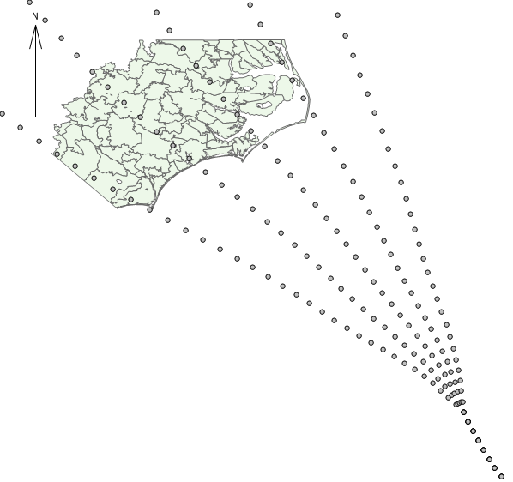
EVACUATION MODEL
CASE STUDY INPUTS
Introduction
Hazard models
Shelter model
Evacuation model
Conclusions
7 scenarios | Occurrence probability
Isabel | 0.54
Divert north | 0.18
Divert south | 0.18
Divert far north | 0.04
Divert far south | 0.04
Best case northernmost highest cen. pressure deficit slowest forward speed | 0.01
Worst case southernmost lowest cen. pressure deficit fastest forward speed | 0.01
Isabel

Slide 35
EVACUATION MODEL
CASE STUDY RESULTS
Introduction
Hazard models
Shelter model
Evacuation model
Conclusions
Evacuation plan. Plan based on actual Isabel track only.
(k_{travel}=0.001, k_{critical_risk}=0, k_{earlypenalty}=0.0004)
Total number of people | Plan based on Isabel only
Leaving to shelters | 32,700
Leaving not to shelters | 141,200
Staying home | 2,977,500
Landfall

Slide 36
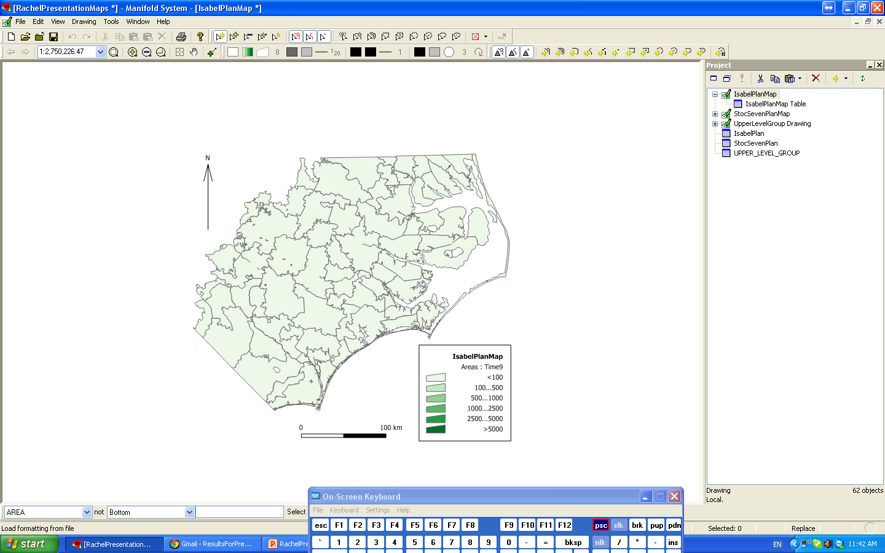
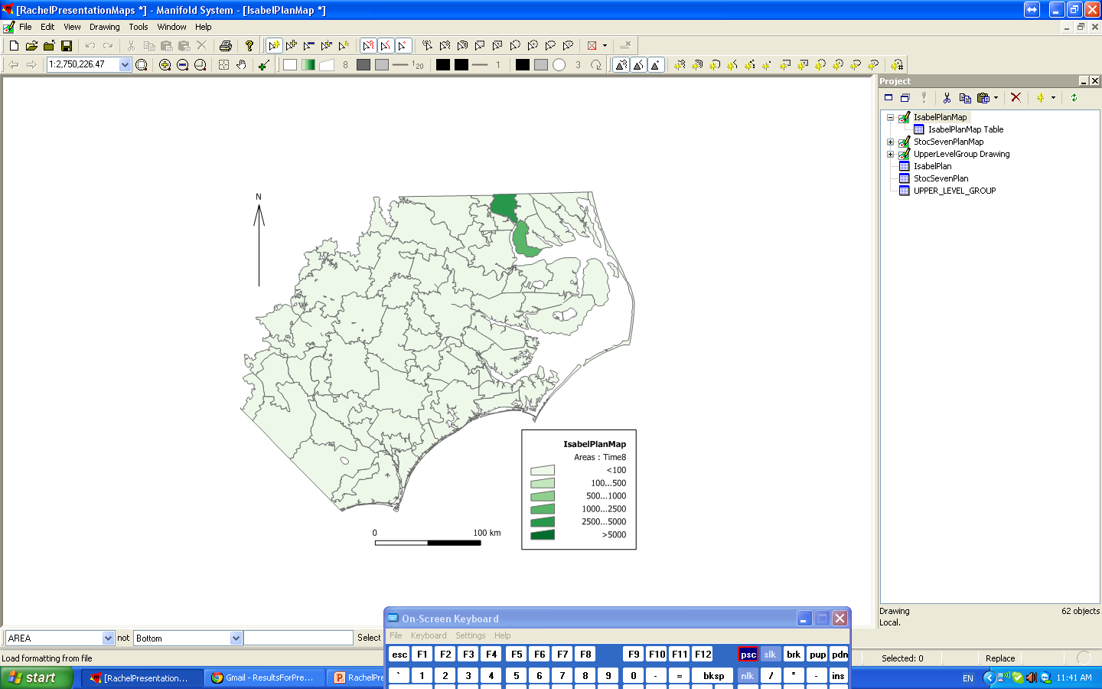
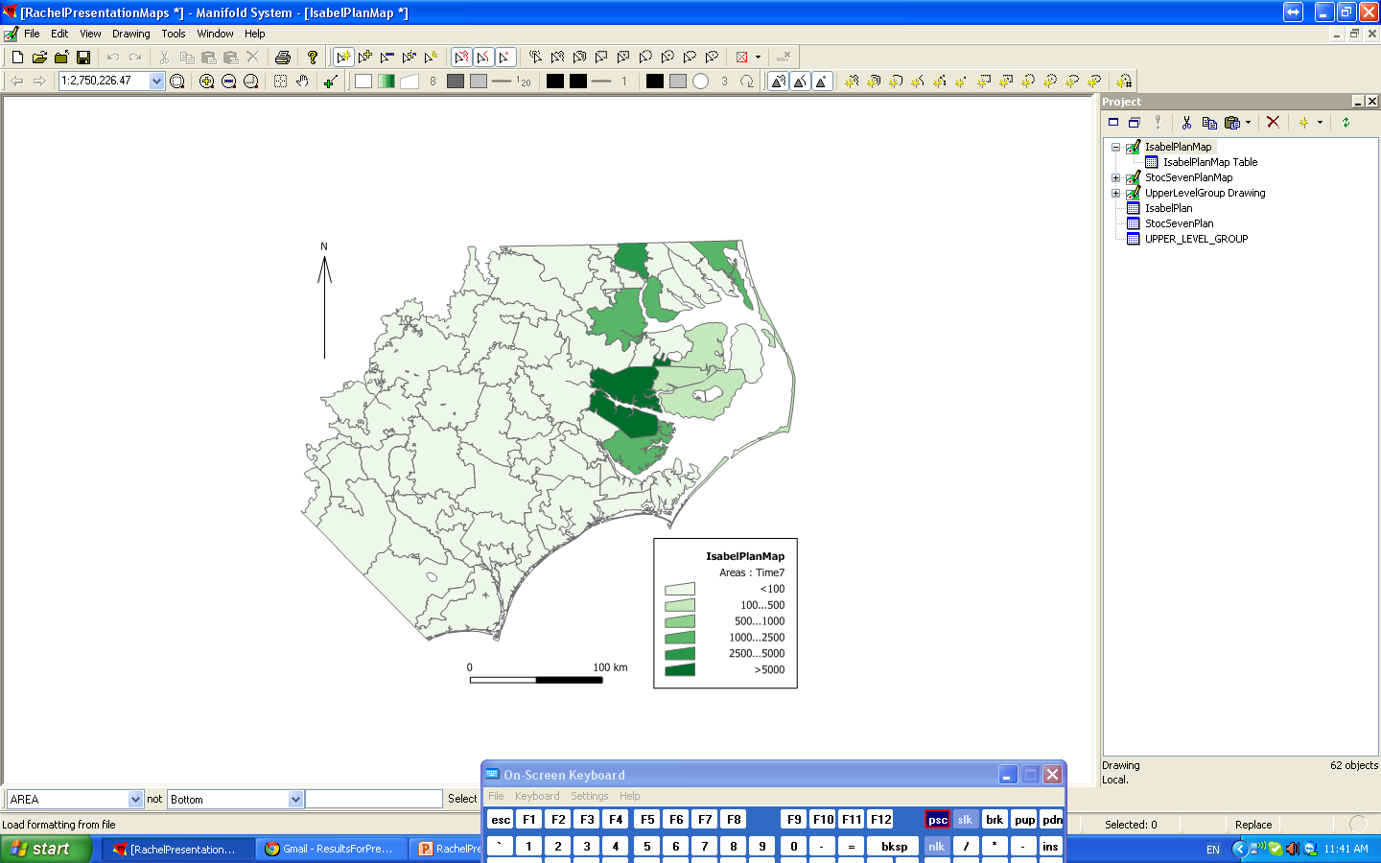
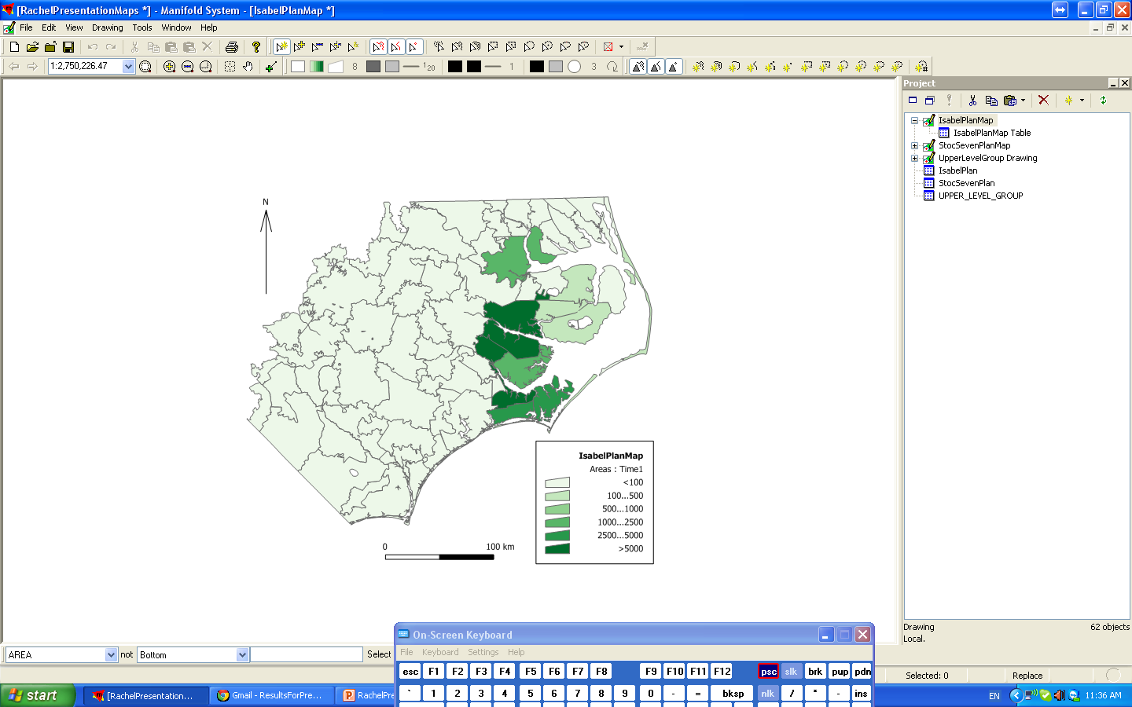
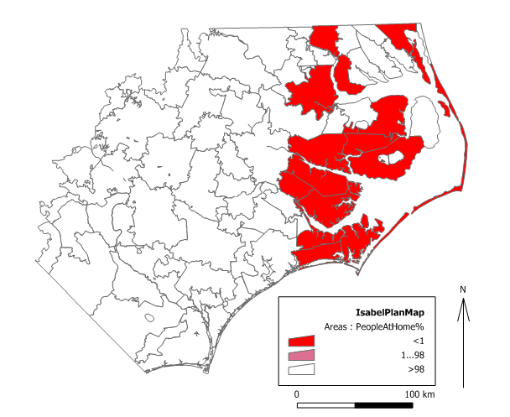
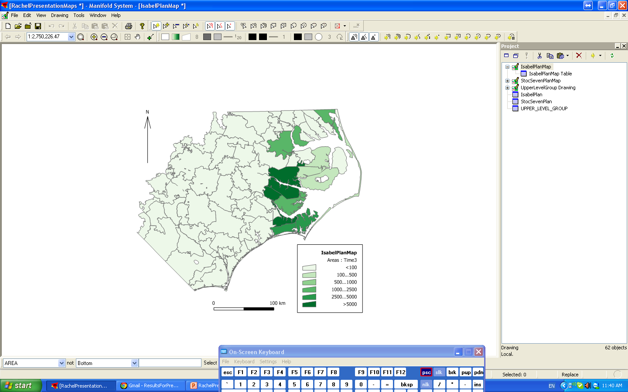

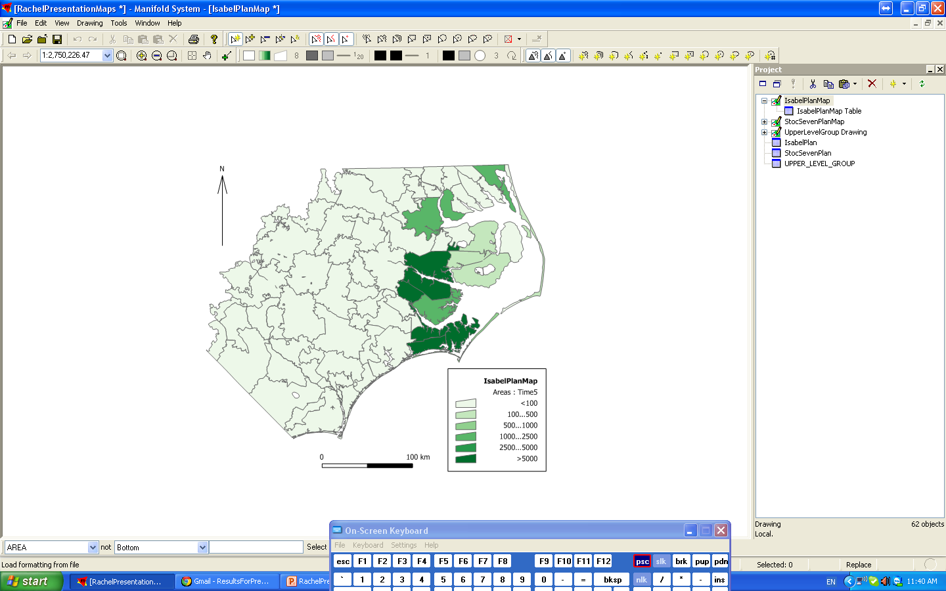


EVACUATION MODEL
CASE STUDY RESULTS
Introduction
Hazard models
Shelter model
Evacuation model
Conclusions
Evacuation plan. Plan based on actual Isabel track only.
(k_{travel}=0.001, k_{critical_risk}=0, k_{earlypenalty}=0.0004)
% of population that stays home
Num. leaving hours before landfall
48
36
30
24
18
12
42
6
0
Some start later or end earlier. Spread out evacuation as possible.

Slide 37
EVACUATION MODEL
CASE STUDY RESULTS
Introduction
Hazard models
Shelter model
Evacuation model
Conclusions
Performance. Plan based on actual Isabel track only.
(k_{travel}=0.001, k_{critical_risk}=0, k_{earlypenalty}=0.0004)
 | Scenario that actually occurs | Occ. Prob. | All risk | Home risk | Travel risk | Shelter risk
1 | Isabel | 0.54 | 7,202 | 7,180 | - | 22
2 | Divert north | 0.18 | 167 | 160 | 4 | 3
3 | Divert south | 0.18 | 183,174 | 182,880 | 81 | 213
4 | Divert far north | 0.04 | 6 | - | 6 | -
5 | Divert far south | 0.04 | 335,195 | 334,750 | 318 | 127
6 | Best | 0.01 | 604 | - | 604 | -
7 | Worst | 0.01 | 336,903 | 335,580 | 1,065 | 258
 | Expected value |  | 53,806 | 53,709 | 39 | 58
 | Total travel time (million person-minutes)
To shelters | 2.2
To non-shelters | 18.7

Slide 38
EVACUATION MODEL
CASE STUDY RESULTS
Introduction
Hazard models
Shelter model
Evacuation model
Conclusions
Evacuation plan comparison.
(k_{travel}=0.001, k_{critical_risk}=0, k_{earlypenalty}=0.0004)
Total number of people | Plan based on
 | Isabel only | 7 hurricanes
Leaving to shelters | 32,700 | 33,000
Leaving not to shelters | 141,200 | 434,100
Staying home | 2,977,500 | 2,684,700
Landfall

Slide 39
EVACUATION MODEL
CASE STUDY RESULTS
Introduction
Hazard models
Shelter model
Evacuation model
Conclusions
Evacuation plan comparison.
(k_{travel}=0.001, k_{critical_risk}=0, k_{earlypenalty}=0.0004)
Total number of people | Plan based on
 | Isabel only | 7 hurricanes
Leaving to shelters | 32,700 | 33,000
Leaving not to shelters | 141,200 | 434,100
Staying home | 2,977,500 | 2,684,700

Slide 40
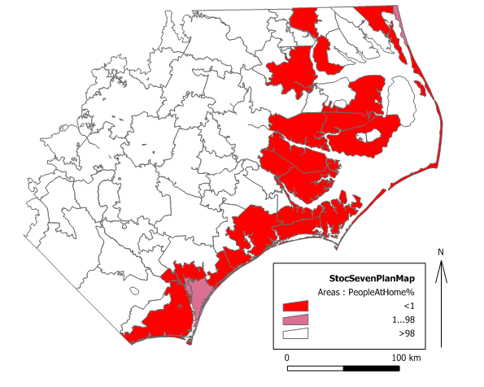
EVACUATION MODEL
CASE STUDY RESULTS
Introduction
Hazard models
Shelter model
Evacuation model
Conclusions
Evacuation plan comparison.
(k_{travel}=0.001, k_{critical_risk}=0, k_{earlypenalty}=0.0004)
Isabel only plan
% of population that stays home
7 hurricane plan
% of population that stays home

Slide 41
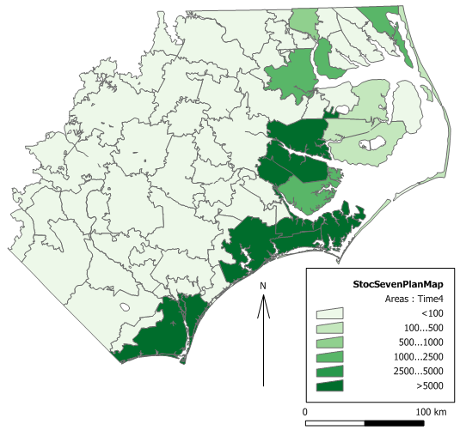

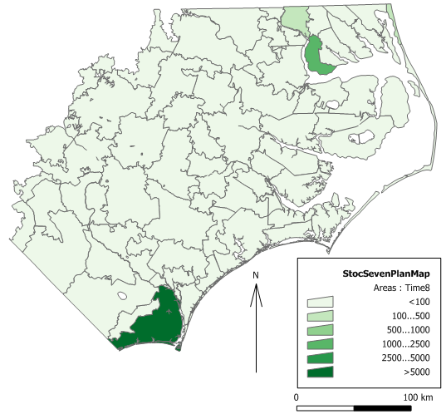
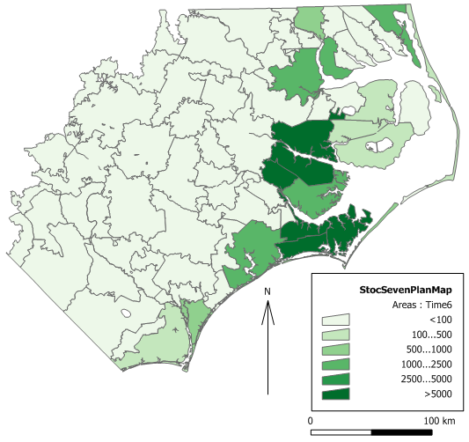
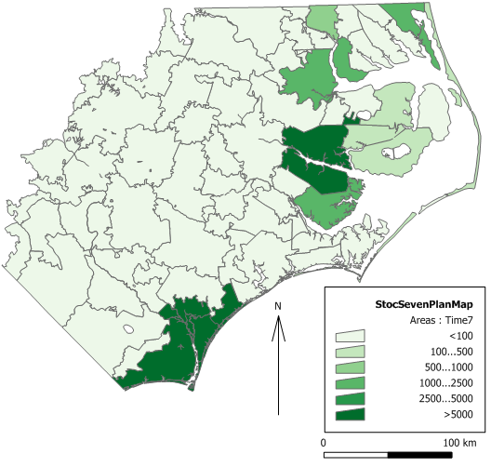
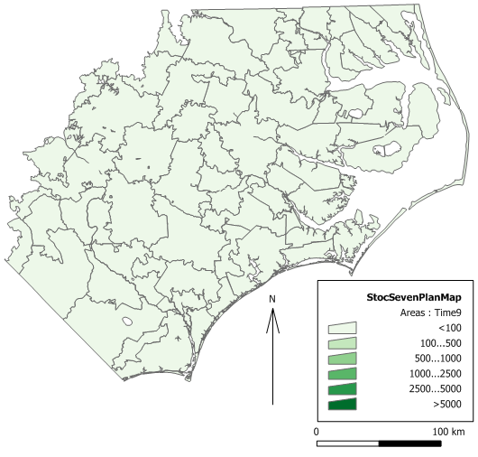

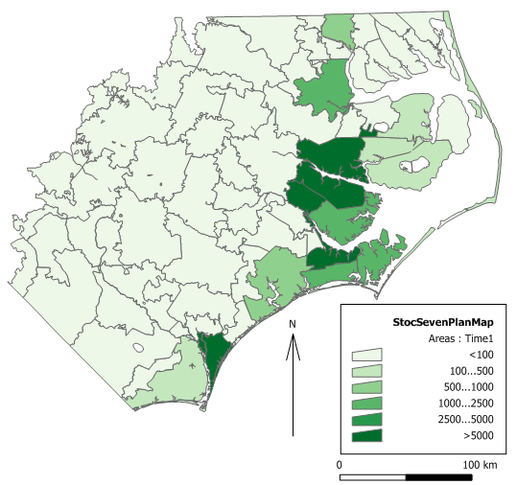

EVACUATION MODEL
CASE STUDY RESULTS
Introduction
Hazard models
Shelter model
Evacuation model
Conclusions
Evacuation plan comparison.
(k_{travel}=0.001, k_{critical_risk}=0, k_{earlypenalty}=0.0004)
Isabel only plan
7 hurricane plan
Num. leaving hours before landfall
Num. leaving hours before landfall
48
48
36
30
24
18
12
42
6
36
30
24
18
12
42
0
6
0

Slide 42
EVACUATION MODEL
CASE STUDY RESULTS
Introduction
Hazard models
Shelter model
Evacuation model
Conclusions
Performance comparison.
(k_{travel}=0.001, k_{critical_risk}=0, k_{earlypenalty}=0.0004)
 | Scenario that actually occurs | Home risk |  | Travel risk |  | Shelter risk
 |  | Isabel | 7 hurr. | Isabel | 7 hurr. | Isabel | 7 hurr.
1 | Isabel | 7,180 | 146 | - | - | 22 | -
2 | Divert north | 160 | 27 | 4 | 2 | 3 | -
3 | Divert south | 182,880 | 8,713 | 81 | 13 | 213 | 39
4 | Far north | - | - | 6 | 3 | - | -
5 | Far south | 334,750 | 43,810 | 318 | 420 | 127 | -
6 | Best | - | - | 604 | 882 | - | -
7 | Worst | 335,580 | 43,810 | 1,065 | 3,155 | 258 | 15
 | Expected value | 53,709 | 3,865 | 39 | 44 | 58 | 7

Slide 43
EVACUATION MODEL
CASE STUDY RESULTS
Introduction
Hazard models
Shelter model
Evacuation model
Conclusions
Performance comparison.
(k_{travel}=0.001, k_{critical_risk}=0, k_{earlypenalty}=0.0004)
 | Total travel time (million person-minutes)
 | Isabel only plan | 7 hurricane plan
To shelters | 2.2 | 2.2
To non-shelters | 18.7 | 57.4
In 7-hurricane plan, more people evacuated due to uncertainty in scenario
lower risk for all scenarios (although still some risk)
higher travel times

Slide 44
EVACUATION MODEL
CASE STUDY RESULTS
Introduction
Hazard models
Shelter model
Evacuation model
Conclusions
Performance. Plan based on actual Isabel track only.
(k_{travel}=varying, k_{critical_risk}=0, k_{earlypenalty}=0.0004)
Tradeoff between minimizing risk and minimizing travel time

Slide 45
CONCLUSIONS
Introduction
Hazard models
Shelter model
Evacuation model
Conclusions
Broader decision frame →
New objectives (e.g., safety, cost)
New alternatives (shelter-in-place, phased evacuation) Direct integration & comparison of alternatives
Consider uncertainty in hurricane scenarios
Considering evacuation and sheltering together

Slide 46
ON-GOING/POSSIBLE FUTURE WORK
Introduction
Hazard models
Shelter model
Evacuation model
Conclusions
Hazard modeling
Develop more systematic approach to real-time generation of short-term scenarios
Shelter modeling
Run with dynamic traffic assignment model, better input
Address people with various functional and developmental impairments
Incorporate results from behavioral survey
Consider shelter investments and budget constraint
Evacuation modeling
Examine results in more depth, incl. effect of varying k_{i} weights
Address different groups of people (e.g., mobile homes, tourists)
Consider contraflow plan, road closures
Incorporate results from behavioral survey/Make more descriptive
Two-stage analysis
Your ideas?

Slide 47
ACKNOWLEDGEMENTS
Partners
NC Division of Emergency Management
American Red Cross-North Carolina
Undergraduate students
Paige Mikstas
Sophia Elliot
Samantha Penta
Kristin Dukes
Andrea Fendt
Vincent Jacono
Michael Sherman
Madison Helmick
Gab Perrotti
Inna Tsys

