Slide 1
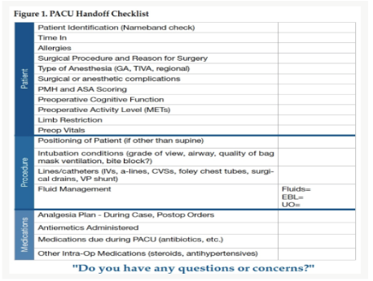
Assessing Anesthesia and Post Anesthesia Care Unit Perceptions of Adequacy of a Patient Care Handoff Tool: A Doctor of Nursing Practice Project
Reagan V. Atkins, BSN, SRNA
Dr. Maura McAuliffe, PhD, CRNA, FAAN, Project Chair
Nurse Anesthesia Program
College of Nursing, East Carolina University
Greenville, North Carolina 27858
Atkinsr19@students.ecu.edu
ABSTRACT
RESULTS
DISCUSSION
This DNP Project aimed to assess the perceptions of CRNAs and PACU RNs regarding a standardized handoff checklist utilized during transfer of care from the operating room to the PACU in a level one trauma center in the southeastern United States. CRNAs were provided the American Patient Safety PACU Handoff Checklist and utilized the checklist for a two-week period. Qualtrics surveys before and after the pilot project assessed their opinions. PACU RNs were given a survey upon transfer of care to assess their perceptions completeness and efficiency of handoff when the checklist was used. All CRNAs agreed the checklist was a comprehensive and efficient way to organize information and the majority of PACU RNs (n=28) believed the checklist contributed to an efficient and comprehensive handoff report.
Figure 1
Post-Intervention CRNA Perceptions of the APSF PACU Handoff Checklist (n=5)
Table 1
Post-Intervention PACU RN Survey Results Assessing Completeness of APSF PACU Handoff Checklist
5 CRNAs completed both pre- and post-surveys assessing their perception of the APSF PACU Handoff Checklist.
All “agreed” or “strongly agreed” the APSF PACU Handoff Checklist was an efficient and comprehensive way to organize handoff and that the tool did not lend itself to communication errors.
31 PACU RN surveys were submitted
Nearly 70% of PACU RNs “agreed” or “strongly agreed” the tool contributed to both efficiency and comprehensiveness of OR handoff.
CONCLUSIONS
INTRODUCTION
The majority of CRNAs and PACU RNs found the tool efficient and complete. This project can serve as a pilot study should the department decide to perform a quality improvement project regarding the efficacy of handoff tools. Standardized handoff may increase patient safety in the peri-operative period as relaying key information accurately can contribute to seamless patient care. Improved communication of previous anesthetic treatments could lead to improved pain and nausea control in the peri-operative period as well as improved patient satisfaction.
The Joint Commission reported 1,744 deaths and $1.7 billion in hospital malpractice costs in the United States between 2010 and 2015 were associated in some way with inadequate communication (2017).
Inadequacies and inconsistencies identified during handoffs between anesthesia providers and PACU RNs (Lambert & Adams, 2018) support a potential for incomplete or inefficient handoff reports.
The purpose of this quality improvement project was to assess anesthesia providers’ and PACU nurses’ perceptions of adequacy of a standardized tool: the APSF PACU Handoff Checklist.
THE TOOL
METHODS
Pre-and post-survey design
Single Plan, Do, Study, Act (PDSA) cycle (IHI, 2020).
CRNAs answered a Qualtrics survey assessing their current handoff practice
CRNAs gave handoff report to PACU RNs using the APSF PACU Handoff checklist for a two-week implementation period
The PACU RNs completed an assessment after each handoff which asked about their perceptions of completeness and efficiency of the tool
After the two-week intervention period the CRNAs completed a Qualtrics post-intervention survey addressing their perceptions of the tool.
Were the following areas addressed in handoff? | n | Yes | No | N/A
Was the patient identified | 31 | 97% | 3%
Allergies | 31 | 94% | 6%
Antibiotics | 30 | 80% | 13% | 7%
Intake/ Output | 30 | 100%
EBL | 30 | 97% | 3%
Pain management | 30 | 100%
Nausea management | 28 | 100%
Any major concerns that might affect PACU care addressed | 24 | 67% | 3% | 30%
REFERENCES
Institute for Healthcare Improvement. (2020). Initiatives: The IHI triple aim. http://www.ihi.org/Engage/Initiatives/TripleAim/Pages/default.aspx
The Joint Commission. (2017, September 12). Inadequate hand-off communication. Sentinel Event Alert, (58), 1-6. https://tinyurl.com/43jz2v8y
Lambert, L. H., & Adams, J. A. (2018). Improved anesthesia handoff after implementation
of the written handoff anesthesia tool (WHAT). AANA Journal, 86(5), 361-370.
APSF PACU Handoff Checklist. Copied from “Improving post anesthesia care unit (PACU) handoff by implementing a succinct checklist,” by Potestio, Mottla, Kelley, and DeGroot, APSF Newsletter, 20(1), 13-14.

