Slide 1
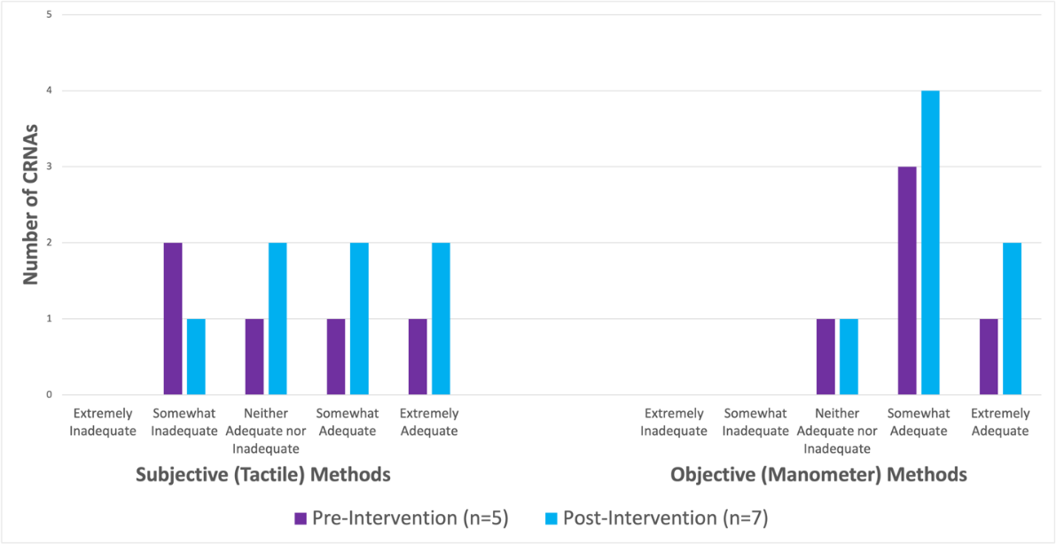
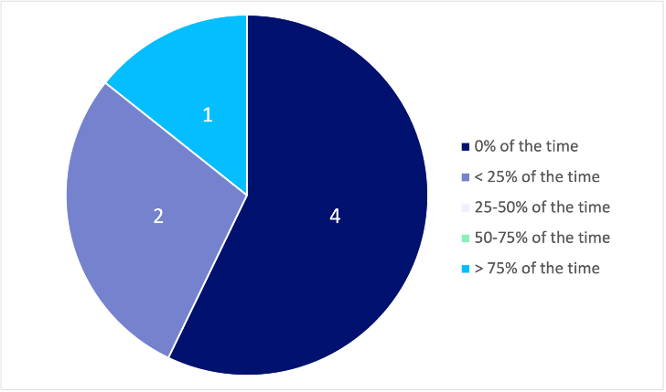
Assessing Anesthesia Providers’ Preferences and Perceptions of Adequacy of Endotracheal Tube Cuff Pressure Assessment Techniques: A Quality Improvement Study
Hannah Travlos, BSN, SRNA
Travis Chabo, PhD, CRNA, Project Chair
Nurse Anesthesia Program
College of Nursing, East Carolina University
Greenville, North Carolina 27858
travlosh10@students.ecu.edu
ABSTRACT
RESULTS
DISCUSSION
Certified Registered Nurse Anesthetists (CRNAs) at an outpatient surgical center were given pre- and post-intervention surveys to assess their preferences and perceptions of adequacy regarding subjective versus objective methods of assessing endotracheal tube (ETT) cuff pressure. The intervention consisted of an informational video and the provision of a manometer. Post-intervention, six out of seven CRNAs found manometers to be adequate and three out of seven intended to use manometers in their future practice.
Medical complication costs from inappropriate ETT cuff pressure can be high
    Financial
    Morbidity and mortality
CRNA practices and opinions regarding subjective and objective assessment methods vary
    Practice preferences
    Perceptions of adequacy
Manometers
    Objectively measure ETT cuff pressure
    Cost effective
Previous studies
    Interventions may lead to increased frequency of appropriate ETT cuff pressures
        Education
        Encouraged use of readily available manometers
CRNA Opinions on Adequacy of Methods for Obtaining Appropriate ETT Cuff Pressure
INTRODUCTION
Inappropriate ETT cuff pressure may lead to medical complications¹
      Aspiration, tracheal mucosal ischemia, tracheal stenosis, recurrent laryngeal nerve palsy, etc.
Optimal ETT cuff pressure = 20-30 cmH₂O²
ETT cuff pressure assessment methods
      Subjective
            E.g., pilot balloon palpation, set volume, minimal leak test
            Often result in inappropriate cuff pressures (>30 cmH₂O)¹
      Objective
            I.e., manometer
            Most accurate, gold standard²
CONCLUSIONS
Practice preferences and opinions may or may not have been affected by the intervention
Some participants saw a potential benefit to using manometers and may incorporate them into future practice
Further research needed
    Larger sample size
    Comparison between subjective and objective methods
        Cuff pressure measurements
        Rates of medical complications
    Insight into CRNA preferences and perceptions
Post-Intervention Frequency that CRNAs Intend to Utilize a Manometer in their Practice
Pre-intervention
    Participants only reported using subjective methods
Post-intervention
    Would a manometer be beneficial in certain types of cases?
        3 responded “no”
        3 responded ”yes” (peds, tracheal stenosis, prolonged intubation)
    3 participants intended to incorporate a manometer in future practice
METHODS
Project design guided by the Plan-Do-Study-Act method³
Pre- and post-intervention surveys
    Preferences and utilization of subjective versus objective methods
    Perceptions of adequacy
Intervention
    Informational video
        Optimal ETT cuff pressure range and possible complications from inappropriate cuff pressure
        How to use a manometer
    Provision of manometer
Voluntary participation by CRNAs at outpatient surgical center
REFERENCES
Hockey, C. A., van Zundert, A. A. J., & Paratz, J. D. (2016). Does objective measurement of tracheal tube cuff pressures minimise adverse effects and maintain accurate cuff pressures? A systematic review and meta-analysis. Anaesthesia and Intensive Care, 44(5), 560-570.
Kumar, C. M., Seet, E. & Van Zundert, T. C. R. V. (2020). Measuring endotracheal tube intracuff pressure: No room for complacency. Journal of Clinical Monitoring and Computing. Advance online publication. https://doi.org/10.1007/s10877-020-00501-2
Institute for Healthcare Improvement. (2017). Plan-Do-Study-Act (PDSA) worksheet. http://www.ihi.org/resources/Pages/Tools/PlanDoStudyActWorksheet.aspx

