Slide 1
Open Access to Electronic Theses and Dissertations: What's Right for Me
Dr. Belinda Patterson, Assistant Dean, ECU Graduate School
Jan Lewis, Associate Director, Academic Library Services
October 19, 2009

Slide 2
Open Access to ETDs: What’s Right for Me: What We’ll Cover
History of electronic theses and dissertations (national & at ECU)
UMI & ECU Publishing Agreements/Licenses
What is Open Access
Advantages/Concerns with Open Access
How to Choose Between OA and Traditional
ECU’s Submission Process
How to find open access ETDs

Slide 3
History of ETDs in the U.S.
1987: ETDs were first discussed publicly at a workshop hosted by UMI, held at Virginia Tech.
Early 1990’s: Adobe Acrobat software was developed, supporting the creation of PDF files.
Mid to late 1990’s: Universities begin to offer voluntary electronic submission. Va. Tech: 1995; NCSU: 1997.
Late 1990’s: First schools began requiring electronic submission. Va. Tech: 1997; WVU: 1998
2000-09: More schools required electronic submission: NCSU: 2002; UNCG: 2006, UNC-CH: 2008

Slide 4
History of Electronic Submission at ECU
ETD Task Force Organized Spring 2007
Group’s Recommendations Approved by Graduate School Administrative Board
Test of Submission Site - Spring 2008
Pilot Study Fall 2008
Voluntary Electronic Submission Spring and Fall 2009
Mandatory Electronic Submission Spring 2010

Slide 5
Background of UMI/ProQuest
ECU, like over 700 other institutions worldwide, publishes its theses and dissertations through the UMI/Proquest Dissertation Publishing Program
Graduate work archived both in microform and digitally
Dissertations and theses are listed in the ProQuest Dissertations and Theses database
UMI/Proquest serves as Library of Congress’ official offsite repository for dissertations and theses in digital format

Slide 6
Proquest/UMI Publishing Agreements
Traditional Publishing
Sales and Royalties
Open Access
Embargoes & Restrictions
Delayed Release of Full Text
-Six months
-One year
-Two years

Slide 7
What is Open Access?
Freely available
Immediate (can be subject to an embargo)
Permanent
Full-text
Online
Access
*Credit: Steven Harnad, Integrating Universities' Thesis and Research Deposit Mandates, ETD 2009

Slide 8
ECU Institutional Repository License
Grants ECU a non-exclusive license to reproduce and distribute thesis or dissertation
Verifies publishing option selected with ProQuest
Informs institutional repository administrator of any embargo and its length

Slide 9
Why Open Access?
Underlying principle: Publication of the thesis or dissertation is a requirement for graduation.
Open access ensures that the knowledge created by the student while at the university is added to the body of scholarly knowledge.
Open access removes artificial barriers of time and place associated with paper T/Ds housed in the library or academic department.

Slide 10
Advantages of Open Access ETDs
Help students promote their scholarly work and build their reputation
  Better visibility and “findability” through searches in Google, Scirus and other search engines
  Ability to provide colleagues or prospective employers with a stable URL for the T/D
  Permanent free archiving in the university’s institutional repository

Slide 11
Advantages of Open Access ETDs
Supports ECU’s leadership in distance education.
Helps with faculty and student recruitment – ability to show the quality research being done at ECU and our commitment to dissemination
Students become familiar with electronic publishing and scholarly communication issues, including copyright management

Slide 12
Increased Sharing of Knowledge
University of Nebraska found a 60-fold increase in use of open access dissertations, compared to ones that were not open access.
West Virginia University’s ETDs are accessed 145% more than their printed counterparts
Open access ETDs will help meet the UNC Tomorrow recommendation that “UNC should apply, translate, and communicate research and scholarship to broader audiences.”

Slide 13
Concerns Associated with ETDs
Prior publication / Patent Concerns
  Students should investigate specific publishers’ policies before submitting the ETD (Sherpa/RoMEO database collects publishers’ copyright policies). Also check “Instructions for Authors” or “Copyright Information” on the specific journal’s web site.
  Publisher surveys and alumni experiences find few problems with ETDs
  Usually, concerns can be addressed through the use of embargos – periods of time before the full-text of the ETD is made available to the public. Students have the ability to select from a range of embargo periods.
Notes:
Publisher survey: no specific policies against ETDs, consider submissions individually, chapter greatly rewritten for a different audience, peer review. ACS appears to be the exception.
Va Tech – alumni survey – no problems

Slide 14
Open Access ETDs: Concerns
Copyright management
  Students who will use in their ETDs materials that have previously been published as journal articles and book chapters may need to make arrangements with their editors or publishers to reuse this material. (This is true also for traditional publishing, but it was harder to track usage of copyrighted materials.)
  The SPARC Author Addendum is one example of a legal instrument that modifies the publisher’s standard agreement and allows authors to keep key rights to their articles.

Slide 15
Open Access ETDs: Concerns
Copyright management
  Students need to get permission to include images, diagrams, test instruments and surveys that came from other sources, if not covered by the fair use exception.
Royalties
  Proquest distributes royalties based on sales of theses/dissertations. Open access may undercut the sale of the dissertation; on the other hand, it may show a demand for the material that can lead to a book contract.

Slide 16
Open Access vs. Traditional Publishing—How do I choose?
Seek the advice of your advisor, committee chair, mentors in your field to determine the sentiments of your discipline either for or against open access publishing
Check restrictions of funding source
Patent pending or patentable rights in the work?
Content likely to be submitted to peer-reviewed journal?
Interest or potential interest by an academic or commercial press in publishing your work as a book ?
Ethical need to prevent disclosure of sensitive information?

Slide 17
ETD Submission Process at ECU
Process begins after successful defense
Select Publishing Agreement in consultation with committee
Submission site: http://www.etdadmin.com/ecu
Submit ECU Non-Exclusive Distribution License to Graduate School
Format & Content Review and Approval by Graduate School
Once approved by Dean and graduation is verified, document submitted to Proquest/UMI and Joyner Library with publishing selections

Slide 18
How are OA ETDs Accessed?
Google / Google Scholar / Other Search Engines
Institutional Repositories (The ScholarShip @ ECU)
PQDT Open ($95 charge to the graduate student for the cost of Proquest hosting the student’s work for online public access)

Slide 19
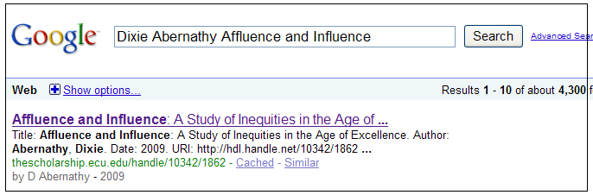
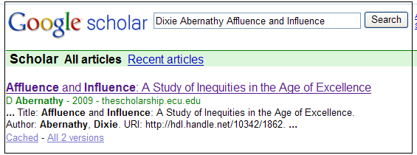

Google & Google Scholar

Slide 20
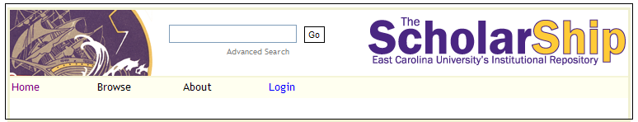
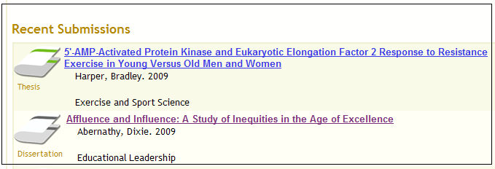
ECU’s Institutional Repository

Slide 21
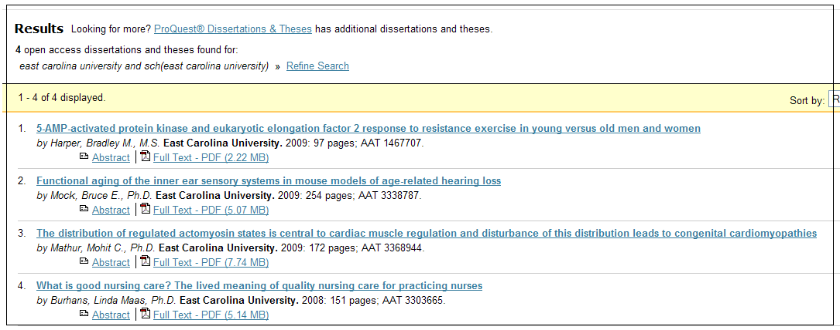
PQDT Open

Slide 22
Questions?
Contact us:
Belinda Patterson: pattersonb@ecu.edu / 328-5792
Jan Lewis: lewisja@ecu.edu: 328-2267

