Slide 1
A Fund Allocation Process: Employing a Use Factor
Lisa Barricella and Cindy Shirkey
November 7, 2014

Slide 2
Will we BORE you?
We’ll try to make this interesting
It’s a tough subject but a little understanding goes a long way

Slide 3
Fund Allocation Formulas: Types
Percentage-Based Allocation
Historical Allocation
Weighted Multiple Variable Allocation
Circulation-Based Allocation

Slide 4
Percentage-Based Allocations
Each fund is assigned a percentage of the whole budget
Usually tied to the college or university’s overall budget: if the Anthropology department gets 3.2% of the university’s budget, then it gets 3.2% of the library’s budget, as well
Is anyone here using this type of allocation process?

Slide 5
Historical Allocation
Just what it sounds like
  X has always gotten 20% of the budget
  Y always gets $1500
  Reasons for the allocations may have evaporated years ago
How many of you use historical allocations?

Slide 6
Weighted Multiple Variable
Library selects own variables and then assigns weight to them
ECU’s previous fund formula is an example of this
According to Kitti Canepi in her meta-analysis article “Fund Allocation Formula Analysis: Determining Elements for Best Practices in Libraries” the four most important variables are:
  Enrollment
  Cost
  Use/Circ
  Number of faculty
Is anyone using this type of fund formula?

Slide 7
Fund Allocation Formulas: Variables
Price per book
FTE faculty
Number of majors
Number of courses
Really, each of these is a proxy for actual use
What variables do your fund allocation formulas use?

Slide 8
Circulation-Based Allocation
Quantitative method based on circulation
Can take into account librarians’ experience & knowledge
Data-driven
ECU’s new fund formula is a variation on this

Slide 9
ECU’s Old MAP Formula
Lots of variables at different weights
Most variables were proxies for use
Student credit hours
Number of course sections (grad weighted 2)
Average cost of books (weighted 10)
Declared majors (grad weighted 2)
Faculty FTE (weighted 6)
Everything was expressed as a percentage
It was beastly, ghastly and unwieldy

Slide 10
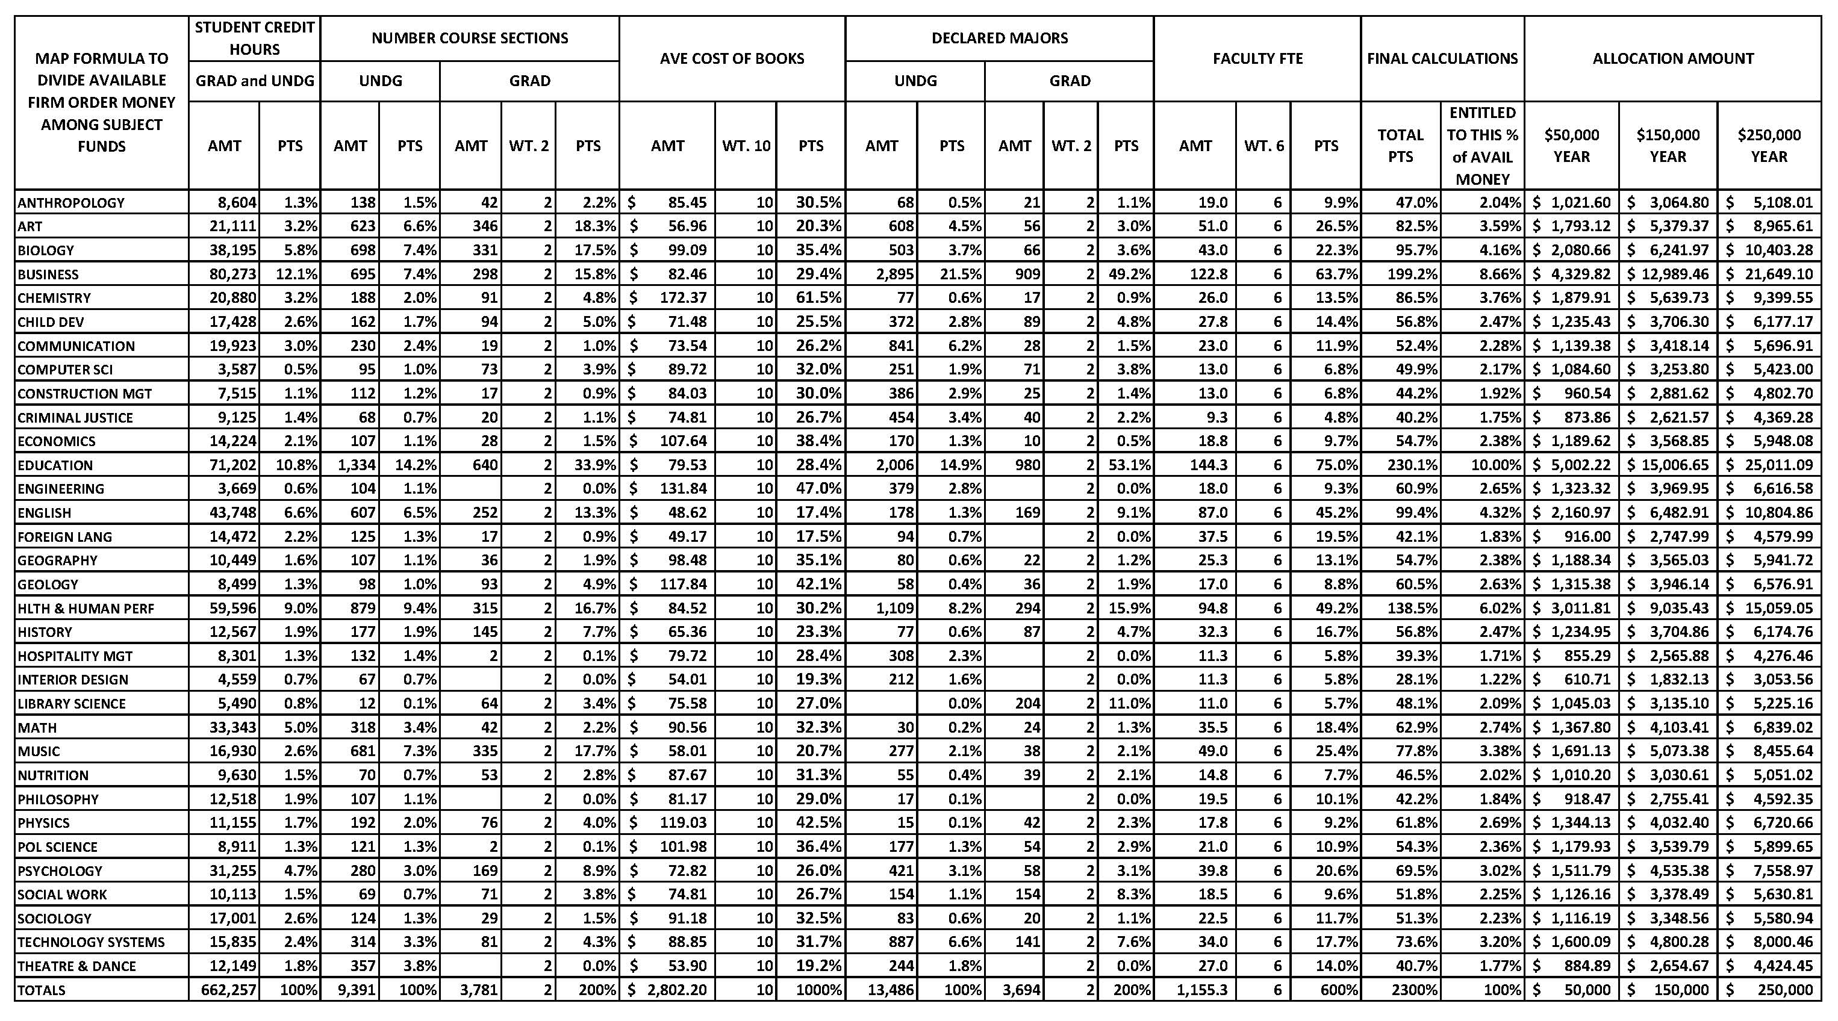
Old MAP Formula

Slide 11
ECU’s New Formula
Two variables:
  Bonn’s Use Factor (Print and E)
  Average price paid (per piece)

Slide 12
Bonn’s Use Factor
Percentage of circulations divided by the percentage of holdings
Because you’re working with percentages, it eliminates the problem you run into with small collections, i.e. that a small collection is always going to have fewer circs than a large collection

Slide 13
Average Price Paid
We chose to use an ILS generated number that takes into account books, firm order e-books and media
We chose our own data because it’s a better reflection of what we actually pay per piece for each separate fund, plus we needed the information broken down by fund anyway
Could use YBP’s or Bowker’s figures, too

Slide 14
What We Counted: Print
For 2013-14, we looked at print monographs added to the collection with a date cataloged 08-09, 09-10, 10-11 and 11-12
For 2014-15, we looked at print monographs added to the collection with a date cataloged 09-10, 10-11, 11-12 and 12-13
Titles NOT items
In-house check outs and regular check outs

Slide 15
Gathering the Data: Print
We asked our ILS administrator to help us because we were not able to pull Symphony reports that got the data we needed ourselves
She gave us back lists of hundreds (thousands) of items organized roughly by LC
We had to fix the LC organization in some files
Then we had to pull out titles and count them
We put all the titles with their respective check out data into one of 39 different fund codes
It took a lot of time!

Slide 16
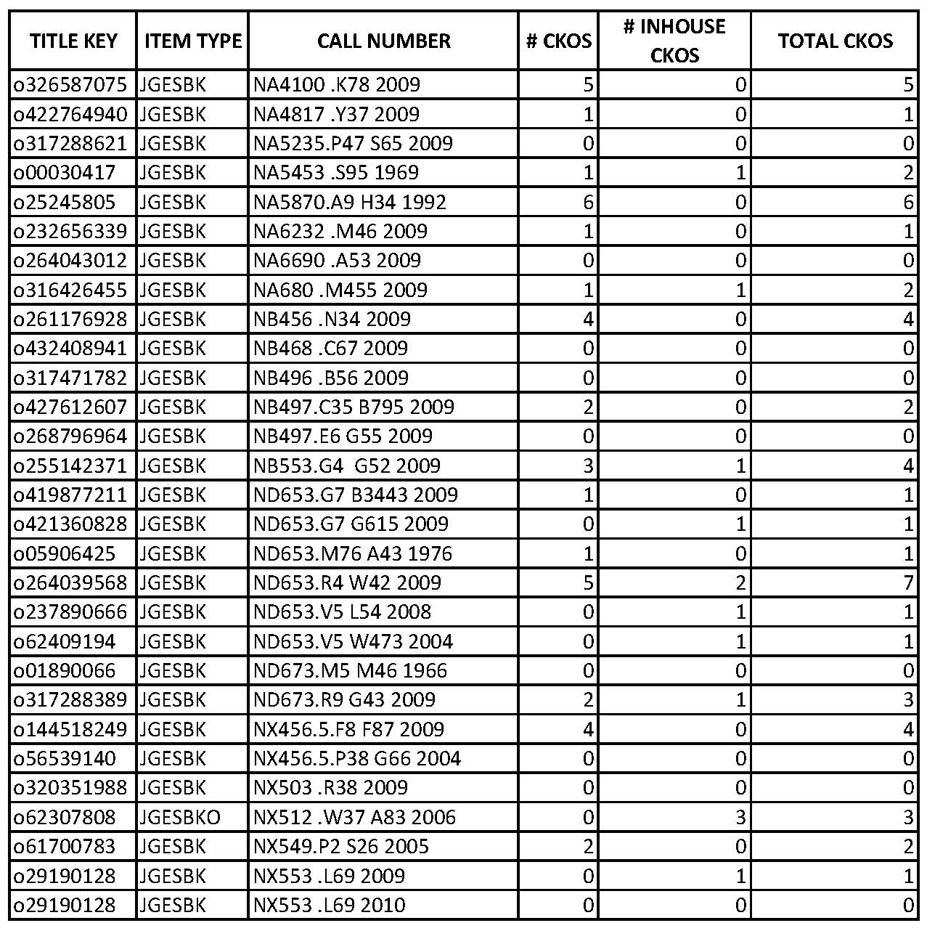
Print Data from ILS

Slide 17
What We Counted: E-books
For 2014-15, we counted firm order e-books acquired from ebrary with a date purchased of 09-10, 10-11, 11-12 and12-13
We also counted e-books from our DDA program with date triggered of 11-12 and 12-13
Counted the number of user sessions for any title with a user session of two or more
1 user session or less = cataloging
2nd and higher sessions = 1 circulation or more

Slide 18
Gathering the Data: E-books
From the admin module of ebrary we ran a title report that listed all titles on the ECU SUPO or MUPO channel which had usage during our specified time period
We divided the titles into groups by purchase date or DDA trigger date
Using the LC call number from the ebrary report we grouped the titles with their respective usage into one of 39 different fund codes
Didn’t take as much time as gathering the print data but there were other challenges

Slide 19
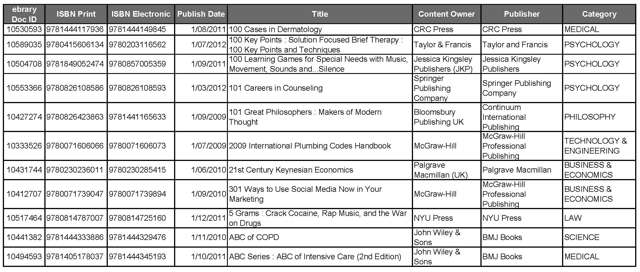
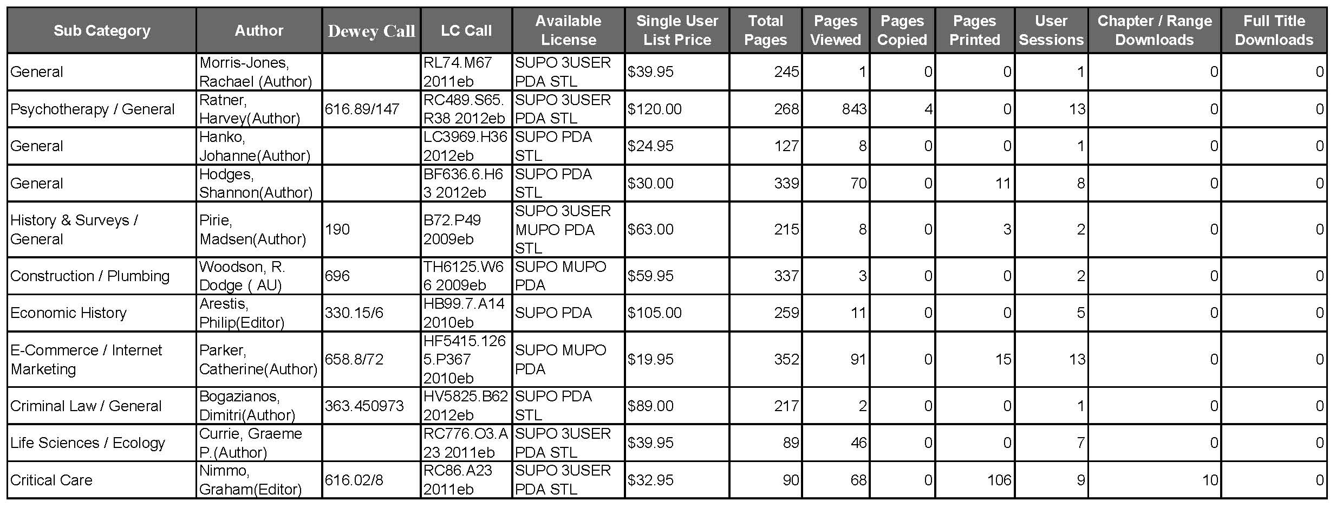
E-book Data from ebrary

Slide 20
How We Used Those Figures
Added print and e-book statistics and got a combined “circulation” figure
Divided the percentage of circulations by the percentage of holdings and got each year’s use factor
Averaged them over 4 years to get an overall use factor
Added the use factor to the average price paid and expressed it as a percentage
That percentage is the amount of the available money to which each fund is entitled

Slide 21
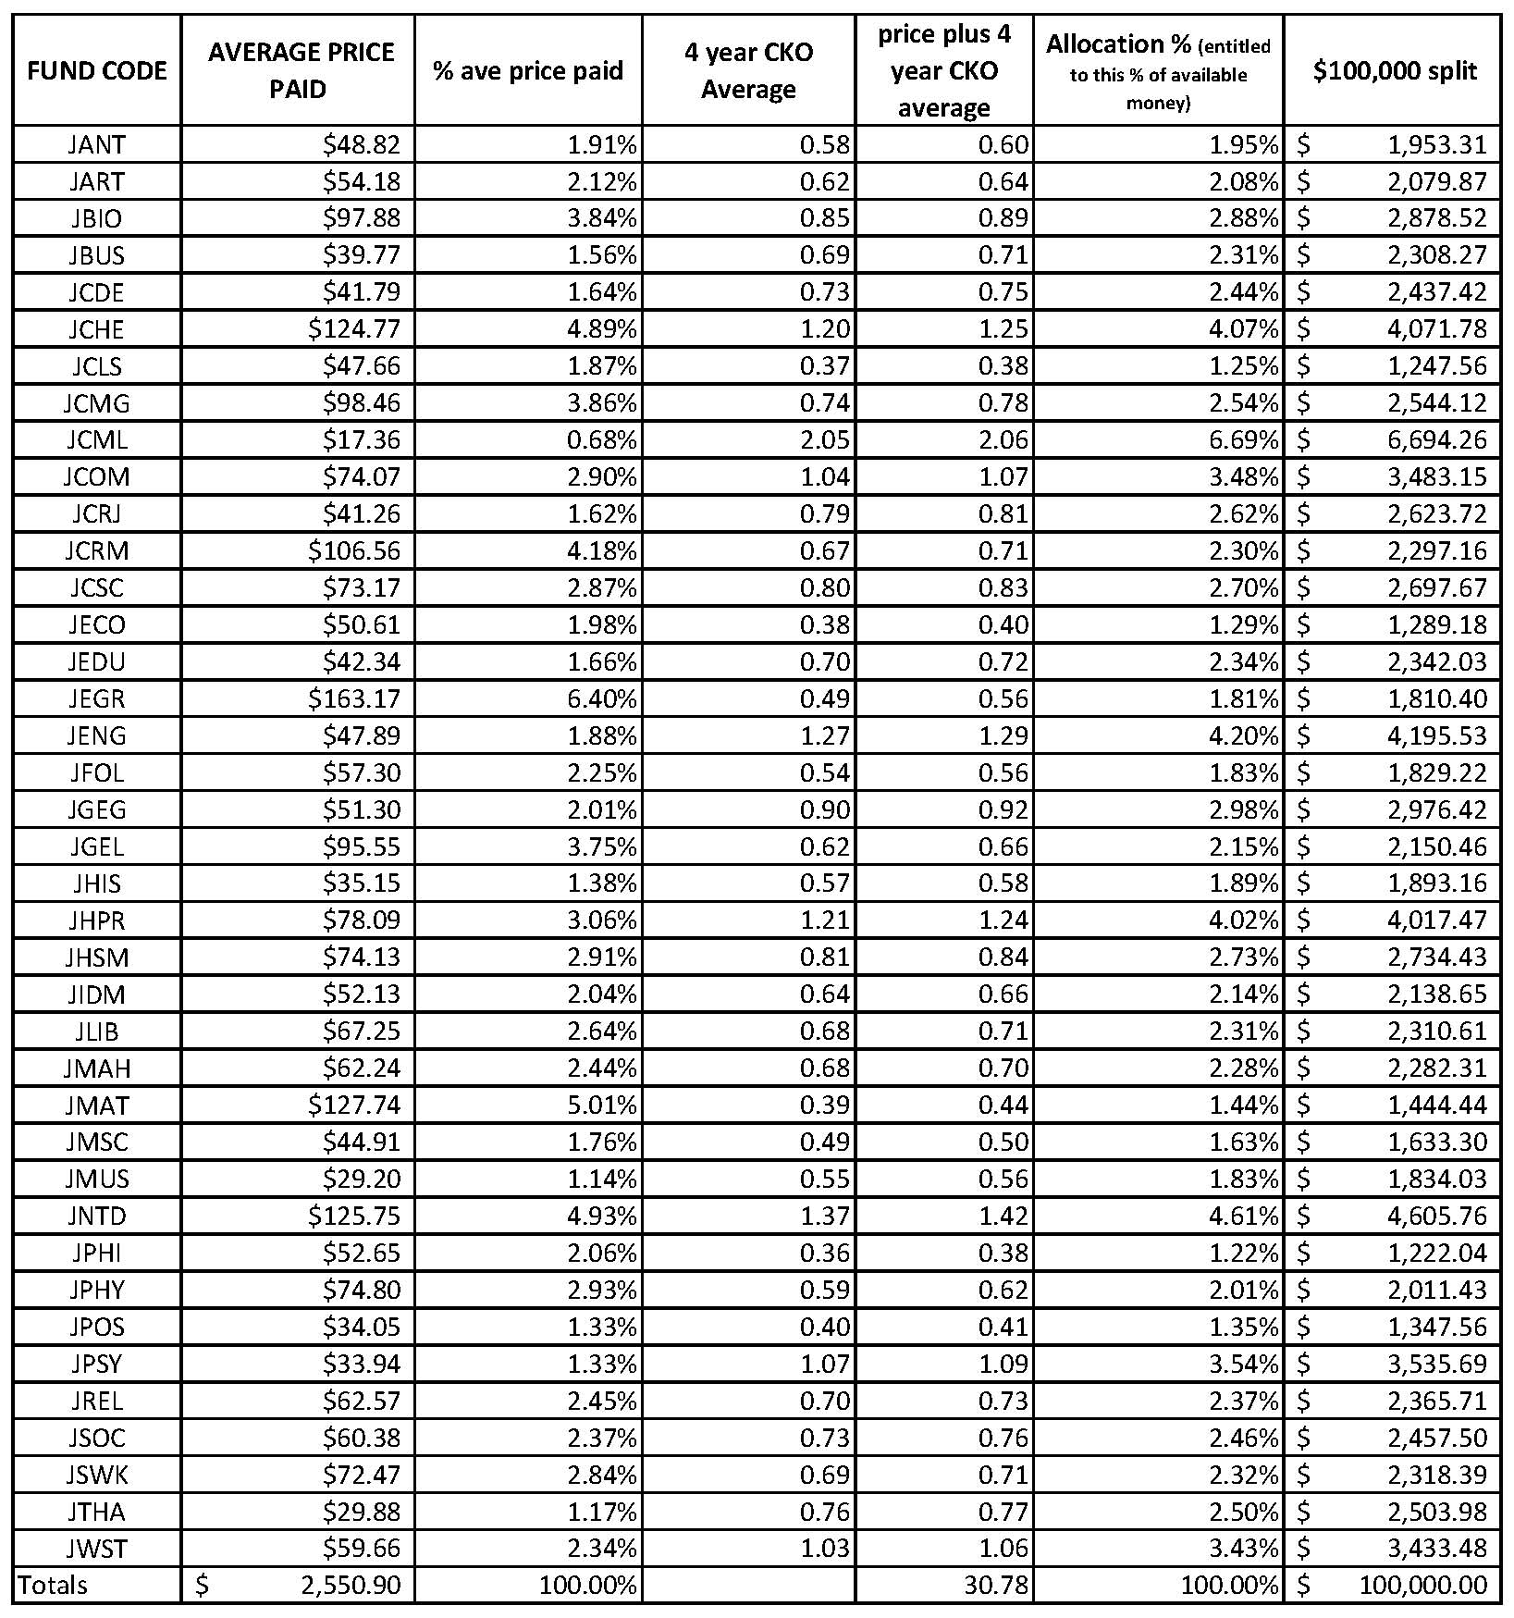
New Use Factor Formula

Slide 22
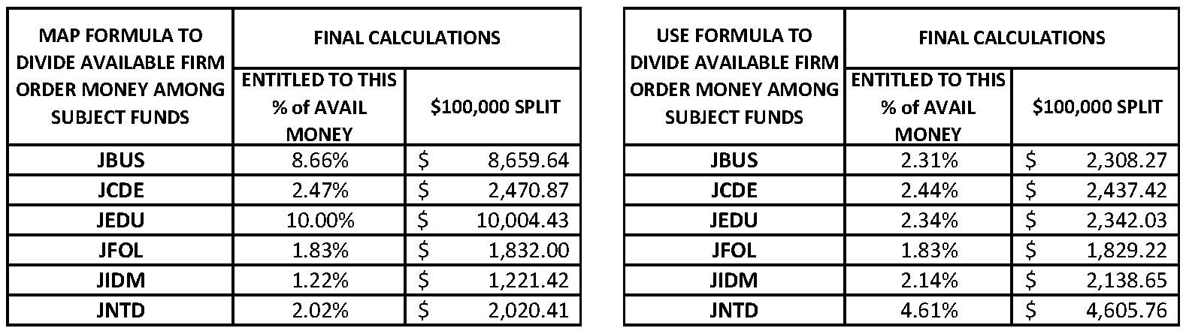
How Allocations Changed Between Old MAP Formula and New Use Factor Formula

Slide 23
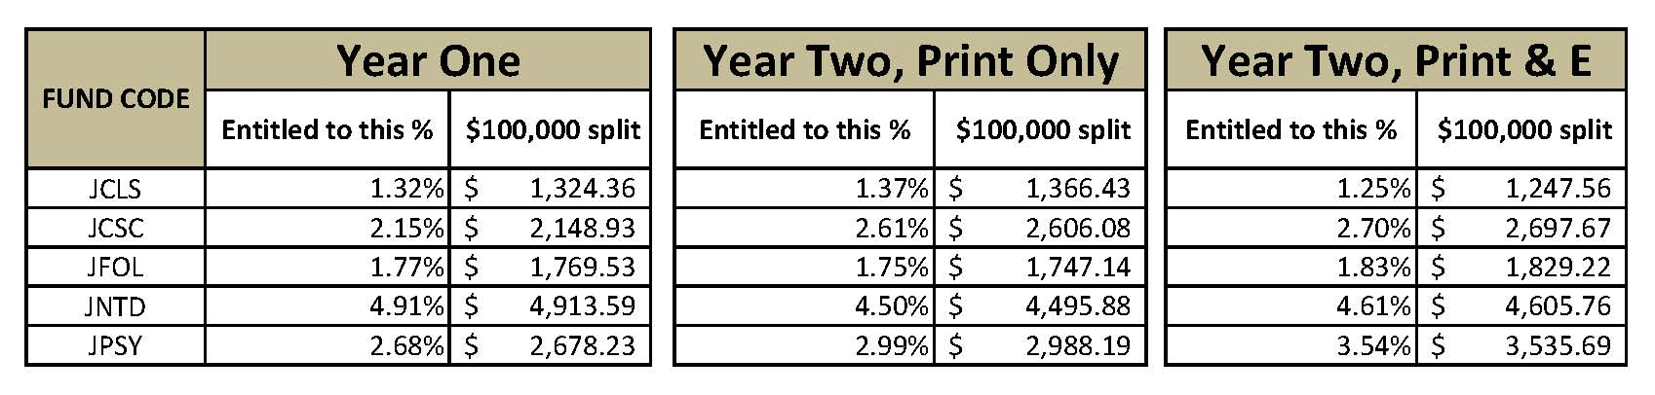
Differences Between Year One and Year Two

Slide 24
Political implications
In our case, we had to be careful of how much any one fund was changed, so we made the 2K rule
Even so, English and History changed that full 2K so we had to work with those departments to help them understand
It was necessary for us to get approval from our Faculty Senate Libraries Committee to use this allocation formula on a permanent basis; different schools will have different authorities to consider

Slide 25
Things to think about
Still 2nd year and we may do it differently next year
Which 4 year range?
ILL problem: should borrowings be counted somehow? (Percentage of borrowings to holdings ratio)
1 user multiple page e-book issue
Additional e-book vendors
Un-triggered DDA use: how to account for it?
Ingestion of large gifts can have an effect
Average cost per title really has an impact

Slide 26
References
Aguilar, W. (1986). The application of relative use and interlibrary demand in collection development. Collection Management, 8, 15-24. doi:10.1300/J105v08n01_02
Bonn, G. S. (1974). Evaluation of the collection. Library Trends, 22, 265-304. Retrieved from http://search.ebscohost.com/login.aspx?direct=true&db=llr&AN=521800407&site=ehost-live
Canepi, K. (2007). Fund allocation formula analysis: Determining elements for best practices in libraries. Library Collections, Acquisitions, & Technical Services, 31(1), 12-24. doi:10.1016/j.lcats.2007.03.002
Catalano, A. J., & Caniano, W. T. (2013). Book allocations in a university library: An evaluation of multiple formulas. Collection Management, 38(3), 192-212. doi:10.1080/01462679.2013.792306

