Slide 1

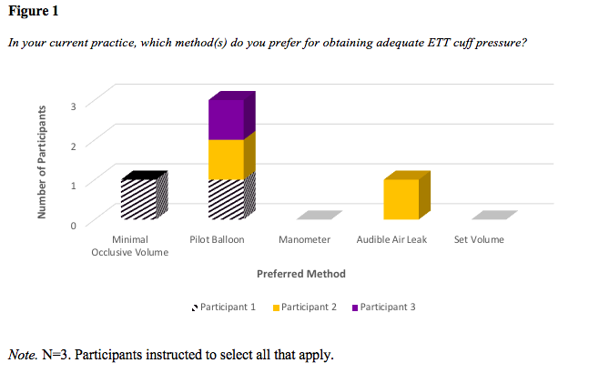
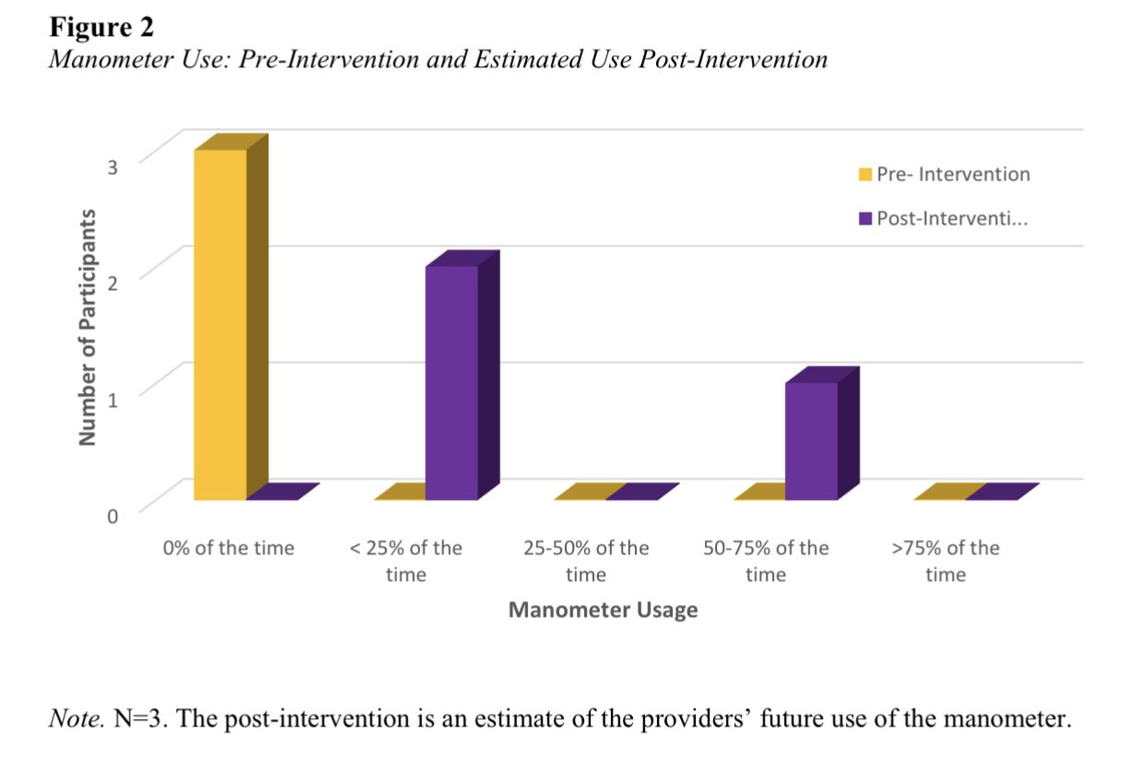
Subjective Versus Objective Measurement of ETT Cuff Pressures in the Operating Room: A Quality Improvement Project
Jordan Jackson, BSN, SRNA
Travis Chabo, PhD, CRNA, Project Chair
Nurse Anesthesia Program
College of Nursing, East Carolina University
Greenville, North Carolina 27858
jacksonjo12@students.ecu.edu
ABSTRACT
RESULTS
DISCUSSION
This quality improvement project assessed anesthesia providers’ perceptions of perioperative usefulness of subjective assessment (tactile) and objective assessment (manometer) of occlusive volume for ETT cuffs before and after viewing an educational video and two weeks of using the methods of their choice. Findings showed most felt their current technique of subjective measurement was sufficient and accurate in obtaining ETT cuff pressures.
Pre-intervention questionnaire - participants’ preferred method of obtaining ETT cuff pressures and their current views of objective measurement.
  participants preferred subjective methods of measurement including pilot balloon palpation, minimal occlusive volume, and audible air leak, no manometer use.
Post-intervention questionnaire - participants’ post implementation perceptions of objective and subjective measurement and their method of choice
  even after exposure to objective measurement education and use, they preferred to use subjective over objective measurement, and only planned to use objective measurement in less than 25-75% of their future cases
INTRODUCTION
No single standard practice established for measuring ETT cuff pressures.
By measuring cuff pressures there will be a greater consistency of in-range cuff pressures improving patient safety (Letvin et. al., 2018,).
Ideal pressure range for ETT cuff inflation, is 20-30 cmH₂O (Seegobin & van Hasselt, 1984).
Multiple ways to inflate the ETT cuff, with both subjective and objective assessments
There is a lack of understanding of provider’s preferences for selection of measurement technique for monitoring ETT cuff pressures during surgical procedures requiring an ETT.
The purpose of this quality improvement project was to assess anesthesia providers’ perceptions of perioperative usefulness of subjective assessment (tactile) and objective assessment (manometer) of occlusive volume for ETT cuffs.
CONCLUSIONS
Participants of this study reported that the use of a manometer (objective measurement) was somewhat adequate, which is the same adequacy they reported for subjective measurement.
This does not align with the findings in the literature, perhaps due to the small scale of the project.
Having providers current in their practice and knowledgeable of a variety of techniques can help the healthcare system provide best practice, facilitating prevention of adverse events
For further study, a project involving direct comparison of subjective and objective methods of ETT cuff pressures in a large operative setting with multiple CRNAs is suggested.
REFERENCES
METHODS
Letvin, A., Kremer, P., Silver, P., Samih, N., Reed-Watts, P., & Kollef, M. (2018). Frequent versus infrequent monitoring of ETT cuff pressures. The Respiratory Care Journal, 63(5), 495-501.
Seegobin, R. & van Hasselt, G. (1984). Endotracheal cuff pressure and tracheal mucosal blood flow: Endoscopic study of effects of four large volume cuffs. British Medical Journal, 288(6422), 965-968. https://doi.10.1136/bmj.288.6422.965
Institute for Healthcare Improvement. (2021). QI essentials toolkit: PDSA worksheet. [PDF file]. Retrieved from http://www.ihi.org/education/IHIOpenSchool/resources/Assets/PDSA_Worksheet(short).pdf
A single Plan, Do, Study, Act cycle (2021) was completed using a pre-test/post-test design. CRNA participants
received an email with a link to a pre-intervention questionnaire in Qualtrics as well as an educational video
filled out this questionnaire and watched the video
were given a manometer and asked to keep track of the techniques they used to measure their ETT cuff pressures for two weeks
Received and completed a post-intervention questionnaire via Qualtrics

