Slide 1
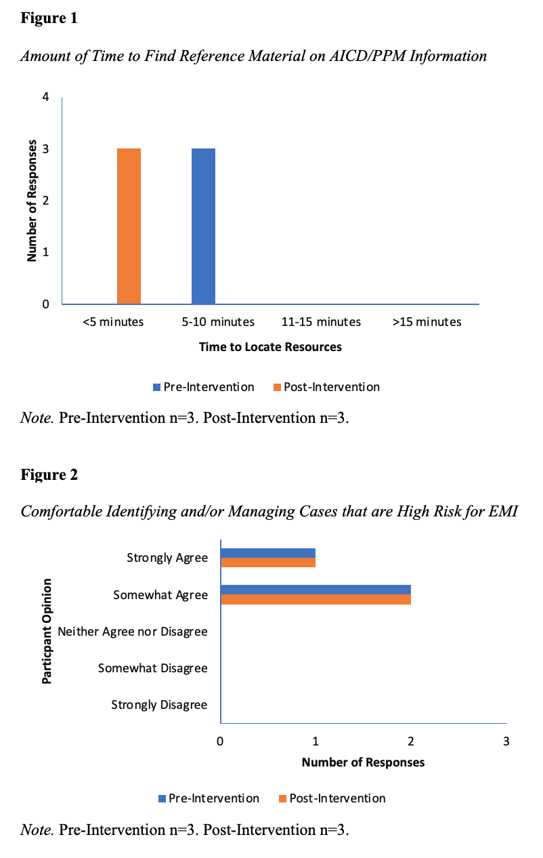
Perioperative Care for Patients with Cardiac Implantable Electronic Devices: A DNP Project
Leanne Burton, BSN, SRNA
Travis Chabo, PhD, CRNA, Project Chair
Nurse Anesthesia Program
College of Nursing, East Carolina University
Greenville, North Carolina 27858
burtonl11@students.ecu.edu
INTRODUCTION
RESULTS
DISCUSSION
Pacemakers and automatic implantable cardioverter/defibrillators, collectively known as cardiac implanted electronic devices (CIEDs), represent 2% of all surgical cases (Neubauer et al., 2018). Patients with CIEDs are at increased risk of complications in the perioperative setting. Electromagnetic interference (EMI), which occurs when electrosurgery is used during surgical procedures, places patients at risk of CIED error, misinterpretations, and misfiring. An educational resource about the perioperative care of patients with CIEDs was created to support more consistent management by anesthesia providers and decrease the risk of adverse events for this patient population. This quality improvement project assessed CRNAs’ perceptions of the newly created AICD/PPM Handout as a resource to support perioperative care for patients with CIEDs.
All CRNA participants reported not currently using a standardized approach or an AICD/PPM policy for providing perioperative care for patients with CIEDs.
All CRNA participants selected that additional AICD/PPM education would help prevent negative outcomes.
All CRNA participants reported that the AICD/PPM Handout was very useful to their current practice.
All CRNA participants reported a decreased amount of time to find AICD/PPM reference material.
CRNA participants reported comfortability identifying/managing cases that are high-risk for EMI did not change.
CONCLUSIONS
This DNP project was designed to help standardize CIED management with an easily accessible resource and provide education on current ASA and HRS recommendations.
The AICD/PPM Handout improved the CRNAs’ perceived efficiency in perioperative assessments of patients with CIEDs and reduced the amount of time to find necessary CIED information.
Based on the results of this DNP project, CRNAs found the AICD/PPM Handout to be very useful and would be extremely likely to use it in the future.
Future studies should include larger sample sizes and longer implementation periods.
METHODS
A single plan-do-study-act cycle was completed using a pre- and post-intervention survey study design (Agency for Healthcare Research and Quality, 2022).
• “Plan” phase: Included the synthesis of literature surrounding perioperative care of patients with a CIED, and the creation of an educational handout, PowerPoint presentation, and pre- and post-educational intervention surveys.
• “Do” phase: Involved implementation of this quality improvement project by providing education and tangible resources to the anesthesia providers participating in the project. Pre- and post-surveys were distributed by email to participants.
• “Study” phase: Consisted of pre- and post-survey data collection through Qualtrics. Data was exported to Excel for data analysis.
• “Act” phase: Included developing and sharing recommendations for future quality improvements.
REFERENCES
Agency for Healthcare Research and Quality. (2022). Health literacy universal precautions toolkit (2nd ed.) https://www.ahrq.gov/healthliteracy/improve/precautions/tool2b.html
Neubauer, H., Wellmann, M., Herzog‐Niescery, J., Wutzler, A., Weber, T. P., Mügge, A., & Vogelsang, H. (2018). Comparison of perioperative strategies in ICD patients: The perioperative ICD management study (PIM study). Pacing and Clinical Electrophysiology, 41(11), 1536-1542. https://doi.org/10.1111/pace.13514

