Slide 1
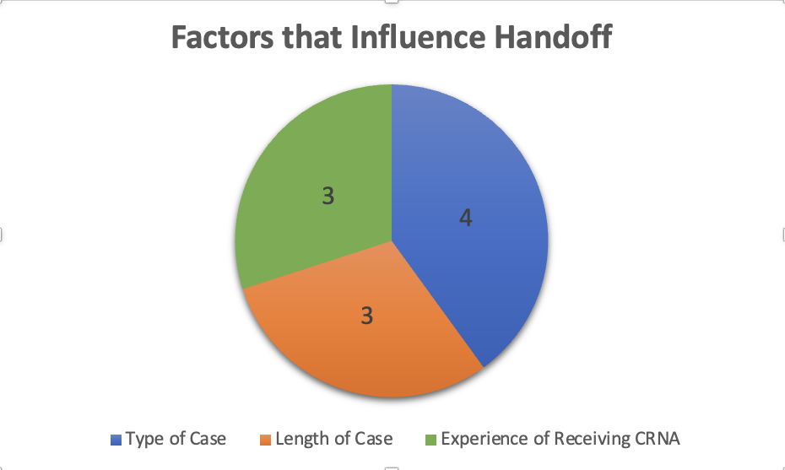
Implementation of a Standardized Handoff Report for Nurse Anesthetists in the
Intraoperative Setting: A Quality Improvement Project
Courtney Warner, BSN, SRNA
Maura McAuliffe, PhD, CRNA, FAAN, Project Chair
Nurse Anesthesia Program
College of Nursing, East Carolina University
Greenville, North Carolina 27858
warnerc15@students.ecu.edu
INTRODUCTION
RESULTS
DISCUSSION
70% of reported sentinel events are caused by communication problems, with half of those breakdowns occurring during patient handoff reports (Canale, 2018).
Standardized processes recommended by The Joint Commission.
No standardized patient handoff tool has been endorsed by any national anesthesia professional associations.
Doctor of Nursing Practice (DNP) Project Purpose: assess anesthesia providers' perceptions of adequacy of the PATIENT mnemonic to facilitate standardized handoffs of anesthetized patients.
Pre-Implementation: What factors influence your current handoff practices? (n=4)
Post-Implementation: Perceptions of the PATIENT mnemonic (n=2)
Eight participants selected for this project (n=8)
Most participants had their own methods for providing reports, with no common standardized tool in use across the department.
Pre-Implementation survey data: identified that the type of case, the experience of the receiving CRNA, and the length of the case were key factors influencing current handoff practices.
Post-implementation survey data: revealed a mixed picture of its effectiveness and acceptance among the two participants. One participant used the mnemonic five times, while the other did not use it at all, indicating varying levels of engagement.
Limitations to the project include a small sample size
METHODS
CONCLUSIONS
Pre- and post-implementation survey design
Surveys created using Qualtrics software and distributed via email to participating CRNAs
Educational resource created with voice recorded PowerPoint presentation reviewing the PATIENT mnemonic sent via email and a hard copy provided to participants
Post-Implementation surveys sent two-weeks after the initial survey
Responses analyzed using Microsoft Excel
Departmental support could lead to more engagement.
Policy and procedure development could also lead to more engagement.
Further studies can also be done to look into the factors that influence the CRNAs’ current handoff practices and how they vary.
Future research on this topic should utilize a larger sample size to facilitate more robust analysis.
REFERENCES
Burden, A., Potestio, C., & Pukenas, E. (2021). Influence of perioperative handoffs on complications and outcomes. Advances in Anesthesia, 39, 133-148. https://doi.org/10.1016/j.aan.2021.07.008
Canale, M. L. (2018). Implementation of a standardized handoff of anesthetized patients. AANA Journal, 86(2), 137-145.
Wright, S. M. (2013). Examining transfer of care processes in nurse anesthesia practice: introducing the PATIENT protocol. AANA Journal, 81(3), 225-32.

