Slide 1
A Mixed Methods Critical Review of the A+ Schools in North Carolina: An Argument for High Standards in Implementation
Arts integration:
Learning through and with the arts: visual art, music, theater, and dance
-Crosscurricular connections
-Collaboratively created

Slide 2
Four Approaches
Subservient
Affective
Social
Co-equal
Extensive evidence of arts integration leading to success
Which approach did they take?

Slide 3
Success of Arts Integration
Affective:
Multisensory
SEL
Positive Climate
Effective:
A+ program
Bugg elementary 83.8% student proficiency
R.N. Harris 80.9% student overall proficiency
Saluda elementary 91.4% overall proficiency (A+ Schools Program of the NC Arts Council, 2014)
United States
Turnaround Arts Program: All 8 schools showed growth in either math or reading, and the average of all 8 schools after only two years of implementation showed reading proficiency scores increase of 23%, and math proficiency scores of 13% (Stoelinga et al., 2015).

Slide 4
To answer these research questions:
Research Design
What are the methods used to implement arts integration? What challenges do schools face in implementation?
How effective has NC’s A+ program been at increasing standardized test scores?
Quantitative
37 A+, 37 districts
Proficiency scores from beginning of implementation, 5 years later, and 2019
Absenteeism, Economically disadvantaged status, and number of arts
Qualitative
3 interviews
1 A+ administrator
2 A+ school leaders
Frameworks, school climate, evidence of success

Slide 5
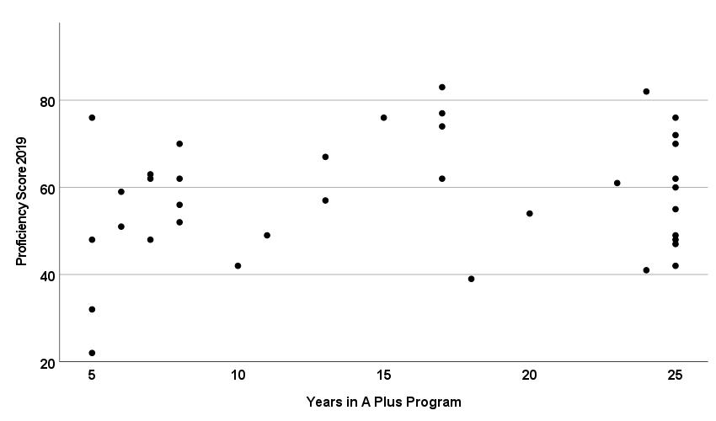
Quantitative Results:
Lowest-Proficiency
Scores decreased progressively
Lowest five: 22-42%
70% lower than 65%
ED rates 61-83%
Highest-Proficiency
Highest score outperforms all corresponding districts
Top five: 76-83%
30% higher than 65%
ED rates 10-56%
2019 Scores at A+ Schools and Time in A+

Slide 6
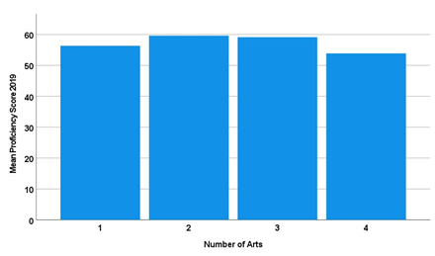
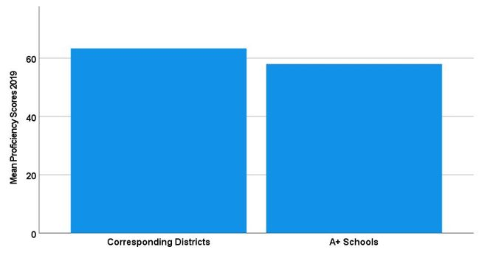
Districts Compared to A+ Schools:
2019 Average Scores and Number of Arts
Number of Arts and 2019 A+ School Scores
Average 2019 Scores Districts and A+ Schools

Slide 7
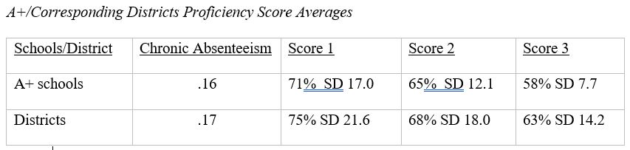
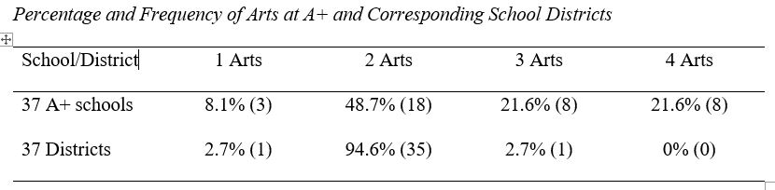
Districts Compared to A+ Schools:
Economically Disadvantaged
A+: 57% Districts: 58%

Slide 8
Qualitative Results: 3 Interviews
Frameworks:
PD: 11 codes
Budgeting: 5
Curriculum: 7
Leadership: 6
Multiculturalism: 6
Collaboration: 8
School Climate:
SEL: 8 codes
School as a Team: 6
Evidence of Success:
Arts Integration: 11 codes
Community Engagement: 4
Student engagement: 9
Higher scores: 1

Slide 9
School Frameworks Discussion
“Some schools are in an inactive status, so we've had schools that have been inactive for six or seven years because there was a principle that just wasn't engaged” (A+ administrator, personal communication, September 29, 2020).
“We use the arts because they give us a doorway to cultural exploration...(A+ school leader 1, personal communication, October 20, 2020).
“It [arts integration] requires cooperation and collaboration.” (A+ school leader 1, personal communication, October 20, 2020).
“Teachers all have A+ training and professional development at the beginning of the school year. New hires must go to training” (A+ school leader 1, personal communication, October 20, 2020).
“Of course, you know, like put on a musical? You have to have money” (A+ school leader 2, personal communication, October 2, 2020).
“We try to do two-way integration- teachers in the classroom are also reinforcing the arts” (A+ school leader 1, personal communication, October 20, 2020).

Slide 10

Discussion
Success: Challenges:
Student Engagement, .16 vs .17 chronic absenteeism
SEL
Positive Climate
30% High Scores
Higher number of arts
High Economically Disadvantaged rate
Outside factors
PD
Leadership
Budgeting
Curriculum
Multiculturalism
Collaboration
70% Low Scores
High deviation of scores

Slide 11
Suggestions for Further Research
Achieving successful arts integration is challenging. Schools with cohesive frameworks also demonstrated higher achievement. Therefore frameworks may need to be implemented with fidelity for arts integrated schools to reach higher achievement.

