Slide 1
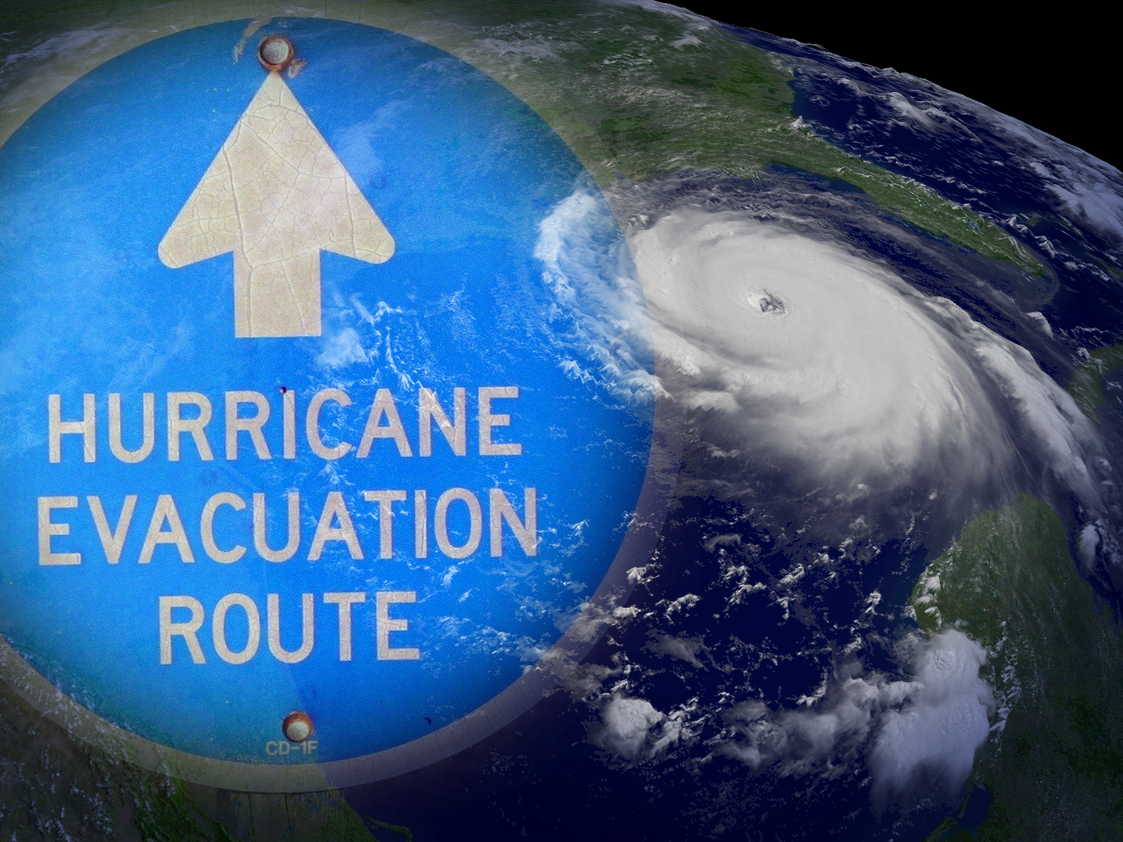

NWS WFO
Storm Surge Products
An Evolution Over Time
Richard Bandy
Meteorologist-in-Charge
NWS WFO Newport/Morehead City, NC

Slide 2
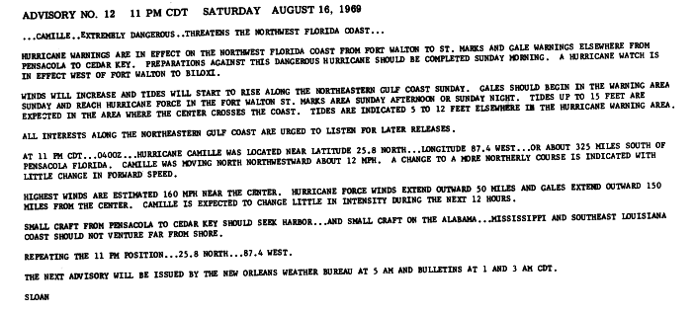
State of the Art Storm Surge Forecast Hurricane Camille, 1969

Slide 3
State of the Art Storm Surge Forecast Hurricane Isabel, 2003
HURRICANE ISABEL LOCAL STATEMENT
NATIONAL WEATHER SERVICE NEWPORT/MOREHEAD CITY NC
900 PM EDT TUE SEP 16 2003
...HURRICANE ISABEL CONTINUES MOVING TOWARD THE NORTH CAROLINA
COAST...
THIS STATEMENT RECOMMENDS ACTIONS TO BE TAKEN BY RESIDENTS OF THE
FOLLOWING COUNTIES: DARE...CARTERET...HYDE...PAMLICO...CRAVEN...
BEAUFORT...TYRRELL...WASHINGTON...ONSLOW...GREENE...LENOIR...DUPLIN..
.JONES...MARTIN...AND PITT COUNTIES.
...WATCHES...
A HURRICANE WATCH IS IN EFFECT FOR THE ENTIRE NORTH CAROLINA COAST
INCLUDING THE ALBEMARLE AND PAMLICO SOUNDS. A HURRICANE WATCH MEANS
THAT HURRICANE CONDITIONS ARE POSSIBLE WITHIN THE NEXT 36 HOURS.
...STORM INFORMATION...
AT 8 PM THE CENTER OF HURRICANE ISABEL WAS LOCATED ABOUT 545 MILES
SOUTH SOUTHEAST OF CAPE HATTERAS. ISABEL WAS MOVING NORTH NORTHWEST
AT 8 MPH. MAXIMUM SUSTAINED WINDS WERE NEAR 105 MPH WITH HIGHER
GUSTS...MAKING ISABEL A CATEGORY TWO HURRICANE.
THE CENTER OF ISABEL IS FORECAST TO MOVE TO NEAR CAPE LOOKOUT ON
THURSDAY MORNING...THEN INLAND JUST WEST OF ALBEMARLE SOUND AND INTO
EASTERN VIRGINIA THURSDAY NIGHT.
WINDS OVER EASTERN NORTH CAROLINA ARE EXPECTED TO BEGIN INCREASING
WEDNESDAY NIGHT AROUND MIDNIGHT TO TROPICAL STORM FORCE...GREATER
THAN 39 MPH...ALONG THE COAST. BY MID MORNING THURSDAY...WINDS COULD
BE AS HIGH AS HURRICANE FORCE...GREATER THAN 74 MPH...ALONG THE
IMMEDIATE COAST.
MINOR BEACH EROSION WILL OCCUR TONIGHT ALONG THE OUTER BANKS. SOME
OCEAN OVERWASH IS LIKELY ON HIGHWAY 12 ON THE OUTER BANKS...
ESPECIALLY AROUND HIGH TIDE WHICH WILL OCCUR AROUND MIDNIGHT.
...PREPAREDNESS ACTIONS...
FOR HYDE COUNTY...THERE IS A MANDATORY EVACUATION FOR OCRACOKE.
FOR DARE COUNTY...THERE IS A MANDATORY EVACUATION IN EFFECT. THERE
ARE NO RED CROSS SHELTERS OPENED IN DARE COUNTY. SHELTERS ARE OPENED
IN BIENVENUE ELEMENTARY IN ROCKY MOUNT. ALSO...FIKE HIGH SCHOOL IN
WILSON. DARE COUNTY SCHOOLS ARE CLOSED UNTIL FURTHER NOTICE. FERRIES
ARE CURRENTLY OPERATING.
FOR CARTERET COUNTY...A VOLUNTARY EVACUATION IS IN EFFECT FOR
CARTERET COUNTY. A MANDATORY EVACUATION IS CURRENTLY PLANNED FOR 7
AM WEDNESDAY MORNING FOR PEOPLE RESIDING ON BOGUE BANKS...PEOPLE IN
LOW LYING AREAS...AND PEOPLE IN MOBILE HOMES. SCHOOLS WILL BE CLOSED
IN CARTERET COUNTY FROM WEDNESDAY THROUGH FRIDAY. WEST CARTERET HIGH
SCHOOL AND NEWPORT MIDDLE SCHOOL WILL BE OPENED AS SHELTERS IN
CARTERET COUNTY AT NOON ON WEDNESDAY.
FOR CRAVEN COUNTY...SCHOOLS WILL BE CLOSED AT NOON WEDNESDAY...ALL
DAY THURSDAY...AND A TWO HOUR DELAY ON FRIDAY.
IN JONES COUNTY...THREE SHELTERS WILL OPEN AT 6 PM ON WEDNESDAY...AT
THE COMFORT ELEMENTARY SCHOOL...JONE COUNTY CIVIC CENTER...AND THE
MAYSVILLE ELEMENTARY SCHOOL.
FOR ONSLOW COUNTY...SCHOOLS WILL CLOSE AT 1230 PM ON WEDNESDAY...AND
WILL REMAIN CLOSED ALL DAY ON THURSDAY AND FRIDAY. A VOLUNTARY
EVACUATION IS IN EFFECT. SIX RED CROSS MANAGED SHELTERS WILL BE
OPENED ACROSS THE COUNTY AT 7 PM ON WEDNESDAY. CONSULT LOCAL MEDIA
FOR LOCATIONS.
WEDNESDAY WILL BE THE LAST DAY TO MAKE PREPARATIONS BEFORE ISABEL
ARRIVES. PEOPLE ARE URGED TO COMPLETE NECESSARY PREPAREDNESS ACTIONS
WEDNESDAY.
...STORM SURGE...
AS NORTHEAST WINDS INCREASE ON WEDNESDAY NIGHT AND THURSDAY...WATER
LEVELS ALONG THE NEUSE AND PAMLICO RIVERS WILL BEGIN TO RISE. WATER
LEVELS COULD RISE TO 8 TO 10 FEET ABOVE NORMAL...ESPECIALLY NEAR NEW
BERN...WASHINGTON...EASTERN PAMLICO COUNTY...AND DOWNEAST CARTERET
COUNTY ALONG THE NEUSE. STORM SURGES ON THE OUTER BANKS ARE EXPECTED
TO BE AROUND 6 TO 8 FEET ON THURSDAY. STORM SURGE IS EXPECTED IN THE
2 TO 4 FEET FOR ONSLOW COUNTY.
...RAINFALL AND RIVERS...
RAINFALL AMOUNTS COULD BE AS HIGH AS 5 TO 8 INCHES THROUGH THURSDAY.
INITIALLY THE RAIN WILL SOAK INTO THE GROUND. HOWEVER MINOR FLOODING
IS POSSIBLE.
...MARINE INFORMATION...
VERY ROUGH SURF CONDITIONS ARE ALREADY OCCURRING. SEAS WERE RUNNING
10 TO 15 FEET AT DIAMOND SHOALS. ON WEDNESDAY...SEAS WILL INCREASE
TO NEAR 30 FEET BY SUNSET. OCEAN SWELLS STRIKING THE BEACH WILL
RESULT IN DANGEROUS RIP CURRENTS. PEOPLE ARE URGED TO STAY OUT OF
THE WATER.
...ADDITIONAL INFORMATION...
CHECK ADVISORIES FROM THE NATIONAL HURRICANE CENTER AND STATEMENTS
FROM THE NATIONAL WEATHER SERVICE IN NEWPORT FOR MORE INFORMATION.
ADDITIONAL INFORMATION CAN BE FOUND ON OUR WEBPAGE AT
HTTP://WWW.ERH.NOAA.GOV/MHX
THE NEXT HURRICANE LOCAL STATEMENT WILL BE ISSUED AROUND MIDNIGHT

Slide 4
State of the Art Storm Surge Forecast Hurricane Katrina, 2005
HURRICANE LOCAL STATEMENT
NATIONAL WEATHER SERVICE MOBILE AL
1148 AM CDT SUN AUG 282005
...STORM SURGE FLOOD AND STORM TIDE IMPACTS...
KATRINA IS EXPECTED TO MAKE LANDFALL SOMEWHERE NEAR SOUTHEAST LOUISIANA AS A MAJOR HURRICANE...LIKELY AS AT LEAST A CATEGORY FOUR AND POSSIBLY A CATEGORY FIVE. A SIGNIFICANT AND LIFE THREATENING STORM SURGE IS EXPECTED TO BE FELT WELL EAST OF THE STORMS CENTER...OVER THE MISSISSIPPI AND ALABAMA COASTLINES.
BASED ON THE LATEST FORECAST TRACK AND SPEED...A CATEGORY FIVE LAND-FALLING HURRICANE WOULD BRING TIDE LEVELS AS HIGH AS 10 TO 15 FEET ALONG COASTAL MOBILE COUNTY AND THE WESTERN PORTIONS OF MOBILE BAY...WITH A SURGE AROUND 20 FEET POSSIBLE IN THE NORTHERN PART OF MOBILE BAY...WHICH WOULD SEVERELY AFFECT DOWNTOWN MOBILE WITH WATER SPILLING INTO THE DOWNTOWN AREA AND EXTENDING AS FAR WEST AS BROAD STREET. THIS WOULD BE THE HIGHEST SURGE LEVEL EVER EXPERIENCED IN MOBILE. FOR COMPARISON...THE HIGHEST SURGE LEVELS PREVIOUSLY EXPERIENCED IN THE DOWNTOWN AREA WERE NEAR 9 FEET WITH HURRICANES FREDERIC AND GEORGES. IN ADDITION...DAUPHIN ISLAND WOULD LIKELY BE INUNDATED...EXCEPT FOR HIGHER GROUND ON THE EAST END.
A STORM TIDE OF 10 TO 12 FEET IS EXPECTED ALONG COASTAL BALDWIN COUNTY...COMPARABLE TO HURRICANE IVAN OF LAST YEAR. SIGNIFICANT INUNDATION IS LIKELY ALONG THE BEACHES OF GULF SHORES AND ORANGE BEACH. PARTS OF THE FORT MORGAN PENINSULA WILL LIKELY BE INUNDATED AS WELL.
TIDE LEVELS ALONG THE NORTHWEST FLORIDA COAST WILL RANGE FROM NEAR 8 FEET IN THE PENSACOLA AREA TO AROUND 5 FEET IN THE DESTIN AREA.

Slide 5

Hurricane Earl, 2010
Advisory Time: 500 AM EDT 01 Sep
Position:
25.1N 72.1W
Intensity:
125 mph (Category 3)
Movement:
NW at 17 mph
Minimum Pressure:
27.85 inches/943 mb
Watches:
Tropical Storm Warning from Cape Fear to west of Bogue Inlet.
Hurricane Warning from Bogue Inlet to the NC/VA border, including the Albemarle and Pamlico Sounds and adjacent counties.

Slide 6
State of the Art Storm Surge Forecast Hurricane Earl, 2010
NCZ045>047-080-081-093-094-031115-
/O.CON.KMHX.HU.W.1007.000000T0000Z-000000T0000Z/
WASHINGTON-TYRRELL-MAINLAND DARE-BEAUFORT-MAINLAND HYDE-CRAVEN-
PAMLICO-
703 AM EDT THU SEP 2 2010
...HURRICANE WARNING REMAINS IN EFFECT...
...STORM SURGE AND STORM TIDE...
SOUNDSIDE STORM SURGES OF 3 TO 5 FEET ARE POSSIBLE ALONG THE
NEUSE RIVER IN CRAVEN COUNTY AND EASTERN PAMLICO COUNTY STARTING
THIS EVENING. THIS WOULD RESULT IN MODERATE COASTAL FLOODING.
ALONG THE PAMLICO RIVER INCLUDING THE WASHINGTON AND AREAS IN EASTERN
AND NORTHEASTERN PAMLICO COUNTY 1 TO 2 FEET OF INUNDATION IS
POSSIBLE. ALONG THE WESTERN ALBEMARLE INCLUDING WASHINGTON AND
WESTERN TYRRELL COUNTIES AND IN THE PAMLICO SOUND FROM STUMPY
POINT SOUTH THROUGH ENGELHARD AND WEST TOWARDS SWANQUARTER 1 TO 2
FEET OF INUNDATION IS POSSIBLE RESULTING IN MINOR FLOODING.
/O.CON.KMHX.HU.W.1007.000000T0000Z-000000T0000Z/
OUTER BANKS DARE-OUTER BANKS HYDE-
703 AM EDT THU SEP 2 2010
...HURRICANE WARNING REMAINS IN EFFECT...
...STORM SURGE AND STORM TIDE...
BREAKING WAVES WILL PEAK LATER TONIGHT INTO EARLY FRIDAY AT 12 TO
18 FEET. STORM SURGE VALUES WILL ALSO PEAK AT THAT TIME AROUND 2
TO 4 FEET. THE SURGE COUPLED WITH HIGH WAVE RUN UP WILL CAUSE
SIGNIFICANT BEACH EROSION AND OVERWASH. SECTIONS OF HIGHWAY 12
ALONG THE OUTER BANKS WILL BE AFFECTED STARTING TONIGHT. IT IS
POSSIBLE HATTERAS ISLAND COULD BE BREACHED IN NARROW LOCATIONS
NORTH OF BUXTON. HIGH TIDE AROUND 3 AM FRIDAY MORNING WILL BE
PARTICULARLY DANGEROUS.
SOUNDSIDE STORM SURGES OF 3 TO 5 FEET ARE POSSIBLE EARLY FRIDAY
MORNING THROUGH FRIDAY AFTERNOON WITH 3 TO 5 FEET EXPECTED SOUTH
OF OREGON INLET TO OCRACOKE AND 1 TO 3 FEET OF INUNDATION
EXPECTED NORTH OF OREGON INLET. PORTIONS OF HIGHWAY 12 WILL
LIKELY BE INUNDATED.
THERE IS A SIGNIFICANT THREAT TO LIFE AND PROPERTY FROM COASTAL
FLOODING...POTENTIALLY HAVING A MAJOR IMPACT. THE CONCERN IS
FOR THE CHANCE OF MAJOR COASTAL FLOODING TO OCCUR IN AREAS
WITHIN THE SURGE ZONE...RESULTING IN DAMAGING AND LIFE
THREATENING INUNDATION.
NCZ095-031115-
/O.CON.KMHX.HU.W.1007.000000T0000Z-000000T0000Z/
CARTERET-
703 AM EDT THU SEP 2 2010
...HURRICANE WARNING REMAINS IN EFFECT...
...STORM SURGE AND STORM TIDE...
THE PEAK IN BREAKING WAVES WILL COME LATE TONIGHT INTO EARLY
FRIDAY AT 10 TO 15 FEET. STORM SURGE VALUES WILL ALSO PEAK AT THAT
TIME AROUND 2 TO 4 FEET. THE SURGE COUPLED WITH HIGH WAVE RUN UP
WILL CAUSE SIGNIFICANT BEACH EROSION AND OVERWASH.
SOUNDSIDE STORM SURGES PRODUCING 3 TO 5 FEET OF INUNDATION ARE POSSIBLE ALONG THE SOUTHERN PAMLICO SOUND IN DOWNEAST CARTERET COUNTY INTO CORE SOUND.
THERE IS A SIGNIFICANT THREAT TO LIFE AND PROPERTY FROM COASTAL
FLOODING.

Slide 7
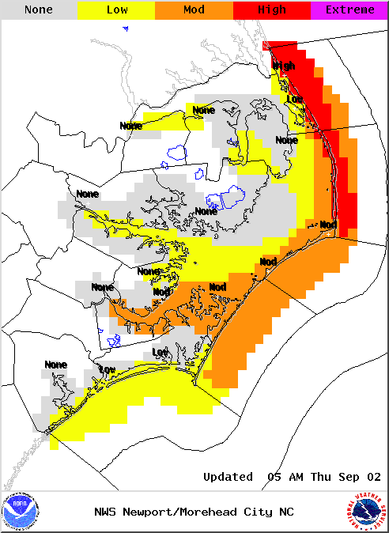
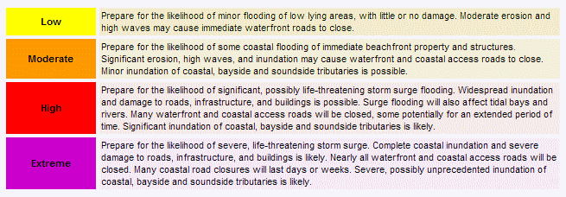
Storm Surge Graphical HLS Web Page
http://www.weather.gov/ghls/php/ghls_index.php?sid=MHX

Slide 8
PowerPoint Threat Assessment Briefings
Hurricane Earl Briefing
September 2–3, 2010
Eastern North Carolina
Threat Assessment
Hurricane Earl
National Weather Service
Newport/Morehead City, NC
Date/Time Created: 9/2/2010 5:00 PM

Slide 9
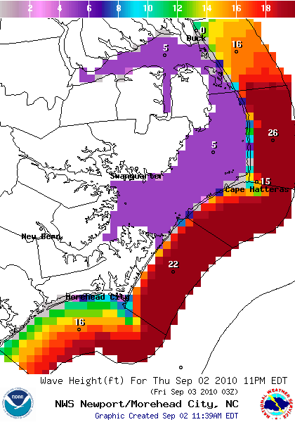
High Seas/Waves Threat
Seas will continue to build to 15 to 20 feet in our central and northern coastal waters and by this evening.
Tonight seas will peak at 20 to 30 feet in the central coastal waters and 15 to 20 feet to the south.
Even on the Pamlico and Albemarle Sounds 4 to 6 foot waves are possible Thursday Night.
All small craft are urged to remain in port.

Slide 10
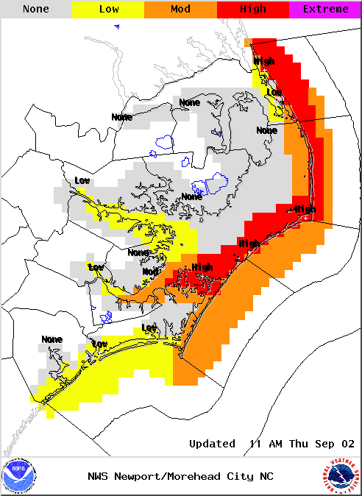
Storm Surge/Coastal Flooding Threat
Breaking waves along all coastal areas will peak tonight into early Friday at 15 feet or higher. Storm surge values will also peak Tonight into Early Friday at 2 to 4 feet of inundation along the ocean highest along Core Banks and the Outer Banks. The surge will couple with the high wave run up to produce significant beach erosion and over wash. Sections of Highway 12 along the Outer banks will likely be affected starting tonight. It is not out of the realm of possibility that a breach could occur over narrow sections of Hatteras Island just north of Buxton even if the center of the storm remains offshore. High tide around 3 AM Friday morning will be a particularly dangerous time.
Soundside flooding will be a concern as well. Inundation of 2 to 3 feet is possible in the Upper Neuse River near New Bern, increasing to 4 to 6 feet from near Adams Creek through South River and Cedar Island, wrapping around into Core Sound, Downeast Carteret, into Core Sound and Eastern Pamlico Counties Tonight. Soundside flooding is also possible on the Outer Banks early Friday Morning into early Friday Afternoon. North of Oregon Inlet, 1 to 3 feet of inundation is possible with 3 to 5 feet possible from Oregon inlet to Buxton and 4 to 6 feet possible from Buxton south through Ocracoke. Portions of Highway 12 will likely be inundated. Inundation of 1 to 2 feet is possible along the Pamlico River into Washington and Eastern and Northeast Pamlico County.

Slide 11
MOM
Category 2
Category 3

Slide 12
MEOW
(Moving North at 15 MPH)
Category 2
Category 3

Slide 13
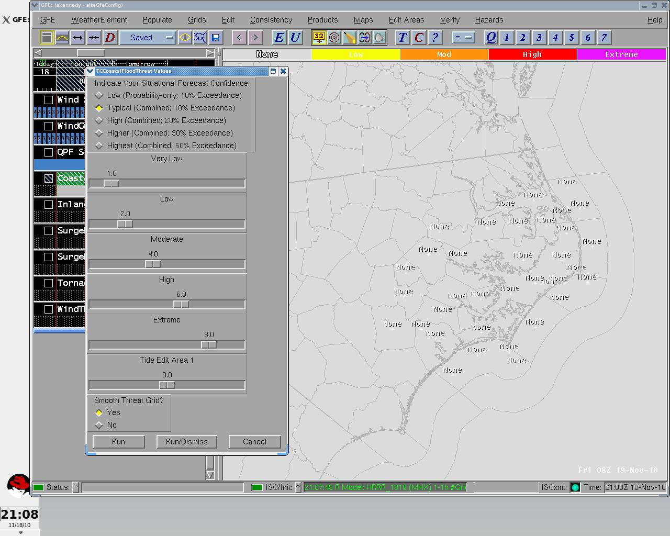

Slide 14
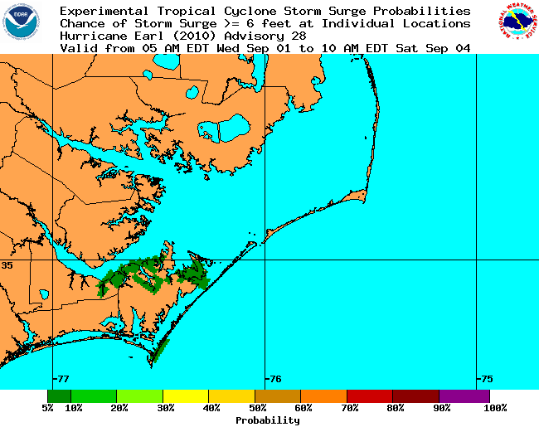
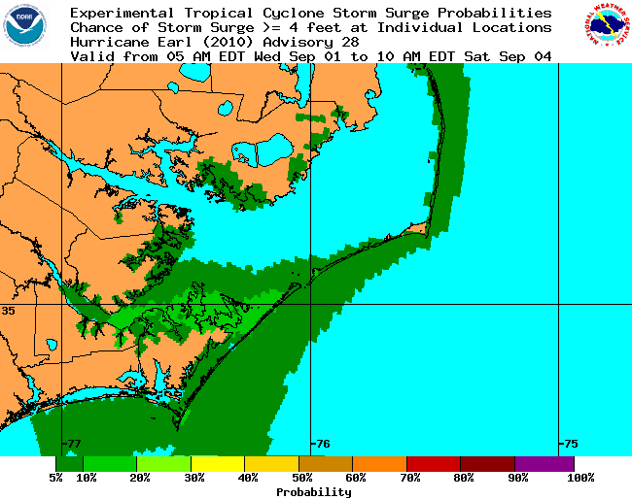
P-Surge and Graphical HLS

Slide 15
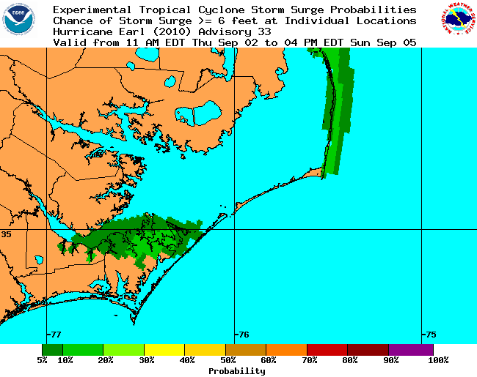
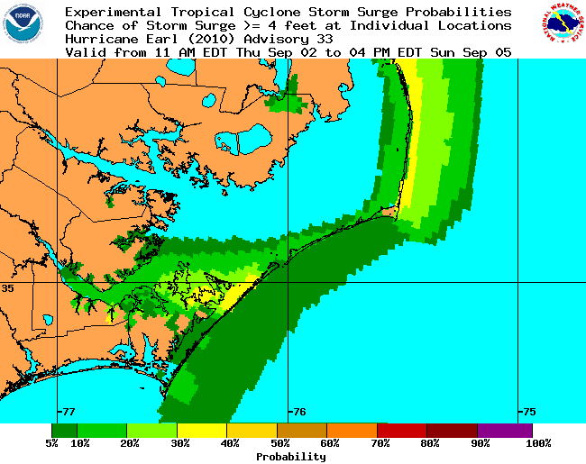
P-Surge and Graphical HLS

Slide 16
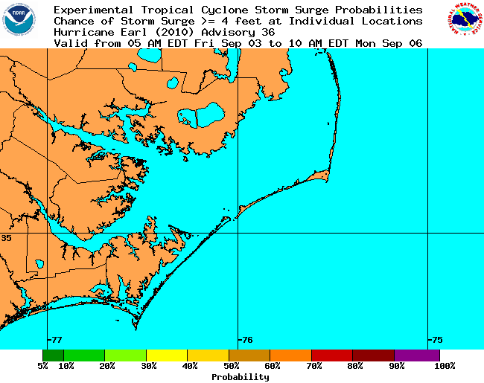
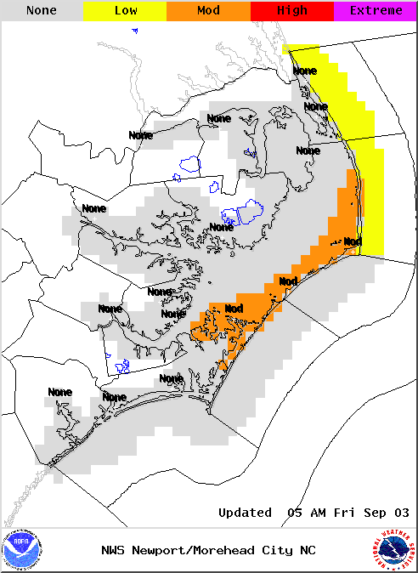
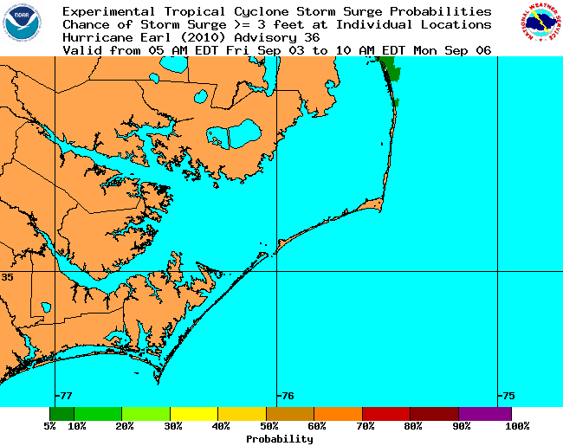
P-Surge and Graphical HLS

Slide 17
Storm Surge Graphical HLS
(Evolution over Time)

Slide 18
Deterministic SLOSH Run

Slide 19
Mini-MEOW

Slide 20
How We Used Mini-MEOW and P-Surge Operationally
We were able to use both tools operationally to evaluate an EM request for DSS with regards to evacuating a hospital in the surge zone.
  “Good afternoon. One of our regional hospitals (Pungo District
  Hospital) is in Belhaven. They are a very small facility with mostly
  ventilator patients and are right on the waterfront in Belhaven.
  Can you tell me if they may be affected by storm surge
  prior to, during or after Hurricane Earl. They will need to make
  a decision by noon tomorrow (Wed Sep 1st) if they will need to evacuate. ”
Just using the MEOW would have shown potential for significant surge. Both P-Surge and the Mini-MEOW made it clear that Belhaven had little risk. Using the mini-MEOW, P-surge, and our knowledge of likely track deviations, we were able to confidently inform the EM that there was little to no risk for the hospital from surge and they decided not to evacuate. Without these new tools we may not have been able to provide such a confident response and if evacuated there was a certain risk of a loss of life.

Slide 21
MEOW Compared to P Surge and Mini-MEOW
P-Surge
MEOW
Mini-MEOW

Slide 22
THE END

