Slide 1
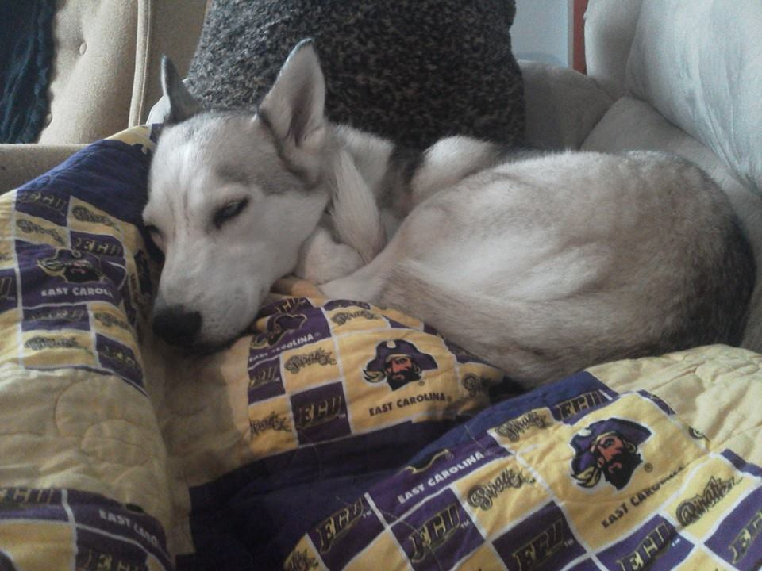
Destiny DeHart
ECU Honors College
Senior Honors College Psychology, Undergraduate Major
Mentor: Dr. Karl Wuensch
Canine aggression: understanding owner beliefs about the biological locus of origin for rehabilitation of aggressive behaviors
“[T]here are almost as many cats and dogs in households as televisions.” – McKenna 2013
“…right to protect their persons and property from aggressive roaming dogs…” – Canine Control Ordinance
Introduction
Twentieth century research focused on identifying, classifying, and understanding aggressive canine behaviors
(Uchida, Dodman, DeNapoli, & Aronson, 1997; Dodman, Donnelly, Shuster, Mertens, Rand, &
Miczek, 1996; Tortora, 1983).
In the early twenty-first century, research focused on comparisons and manipulations of treatment methods while attempting to address treatments that could be administered by the owner at home
(Reisner, 2003; Ibanez & Anzola, 2009).
Research has yet to address the influence of human beliefs about canine aggression which could have important implications regarding the successful applications of treatment methods by owners.
Hypothesis 1. Owners’ beliefs that causes of canine aggression are biological will have a positive correlation to beliefs that aggressive dogs should be disposed of rather than attempting rehabilitation.
Hypothesis 2. Owners’ beliefs that canine behavior is malleable will have a negative correlation to beliefs that aggressive dogs should be disposed of rather than attempting rehabilitation.
Results
Cronbach’s Alpha: Each scale was tested separately
  CALO 5/10 items retained
  C-IPT 2/4 items retained
  Canine Disposal 8/8 items retained
A multiple regression predicting Canine Rehabilitation from Canine Locus of Origin and Canine IPT was statistically significant (see Table 1),
  F(2, 224) = 7.735, p = .001, R = .254
H¹ = Positive correlation (r = 0.212 significant at the 0.01 level)
  between biological and no-rehab variables
H² = Negative correlation (r = -0.216 significant at the 0.01 level)
  between can-change and no-rehab variables
Methods
CALO: The MHLO was used as a template for the format of this research and item development for the CALO survey (Hill & Bale, 2010). CALO items were reviewed by a panel of faculty members and rated on the polarity of the items: internal vs. external locus of origin. Ten out of thirty items were retained for the survey. Figure 1.
Canine IPT: Items were rated one to five on the polarity of each item: behavior is fixed vs. malleable. Four items were retained. Figure 2.
Canine Disposal Scale: Eight original items were generated to measure owners’ beliefs about how to deal with an aggressive canine. Canine Disposal includes euthanasia, shelter surrender, or non-rehabilitation avenues. Figure 3.
Survey: The survey was conducted using the Qualtrics surveying program approved by ECU. Requests for individuals to complete this survey were sent via email using a list of past Pitt County Animal Shelter adopters. A five point Likert scale format was applied.
Conclusions
Hypothesis 1: Participants that hold a particular belief about canine aggression – that it is biological – also show a preference for resolving problems with aggressive behaviors a certain way – canine disposal (no-rehab).
Hypothesis 2: Owners that think aggressive behavior is malleable (can-change) also are less like to pursue euthanasia or canine disposal (no-rehab) when faced with a canine exhibiting aggressive behaviors.
Discussion/ Limitations:
The inverse: owners’ beliefs that causes of canine aggression are environmental will have a positive correlation to beliefs that aggressive dogs should be rehabilitated – cannot be assumed based on this data.
Still, the evidence for owners having a particular belief and correspondingly holding particular attitudes about rehabilitation suggests that changing a person's belief about the locus of canine aggression could change his/her likelihood to pursue or not pursue rehabilitation.
 | Rating | Item
Fixed | 5 | As much as I hate to admit it, you cannot teach an old dog new tricks.
Maleable | 5 | An owner can change a dog’s behavioral characteristicts, no matter the breed.
Fixed | 5 | An owner can change a dog’s behavioral characteristics, no matter the dog’s behavioral history .
Malleable | 4 | An owner can substantially change a dog’s characteristicts.
Malleable | 4 | No matter what kind of dog an owner has, an owner can significantly change it’s behavior.
Fixed | 5 | Owners cannot much change even the most basic behavioral qualities in their dogs.
Item | Dr. Wuensch | Dr. Curtindale | Mean | Type
1 | 5 | 5 | 5 | Bio
3 | 5 | 5 | 5 | Envir
5 | 5 | 5 | 5 | Bio
6 | 5 | 5 | 5 | Envir
7 | 5 | 5 | 5 | Bio
10 | 5 | 5 | 5 | Envir
13 | 5 | 5 | 5 | Bio
18 | 5 | 5 | 5 | Bio
23 | 5 | 5 | 5 | Bio
29 | 5 | 5 | 5 | Bio
30 | 5 | 5 | 5 | Bio
2 | 5 | 4 | 4.5 | Bio
8 | 5 | 4 | 4.5 | Bio
12 | 4 | 5 | 4.5 | Envir
20 | 4 | 5 | 4.5 | Bio
22 | 4 | 5 | 4.5 | Bio
4 | 5 | 4 | 4 | Envir
21 | 3 | 5 | 4 | Envie
26 | 4 | 4 | 4 | Bio
27 | 4 | 4 | 4 | Envir
19 | 3 | 4 | 3.5
24 | 3 | 4 | 3.5
25 | 4 | 3 | 3.5
28 | 4 | 3 | 3.5
16 | 2 | 4 | 3
17 | 2 | 4 | 3
9 | 1 | 4 | 2.5
15 | 4 | 1 | 2.5
11 | 1 | 3 | 2
14 | 1 | 3 | 2
Figure1: left - CALO psychologist rated items with scores
Figure 2: above – Canine IPT psychologist rated items with scores
Figure 3: below – Canine Disposal scale psychologist rated items with scores
Mean | Dr. Wuensch | Dr. Curtindale | Number | Item
4 | 4 | 4 | 6 | If a dog bites a human, Animal Control should collect it and have it put down.
4 | 4 | 4 | 22 | Euthanasia (putting a dog down) would be my last choice if I owned an aggressive dog.
4 | 4 | 4 | 23 | Euthanasia is the responsible solution for a dog that displays aggression.
3.5 | 3 | 4 | 18 | If I felt threatened by my dog in any way, I would take it to the shelter.
3.5 | 3 | 4 | 15 | If I was the owner of an aggressive canine, I wouldn’t try training classes or medical treatments because they are too expensive and don’t work.
3.5 | 3 | 4 | 7 | IF a dog bites a human or another dog, it should be given a second chance before it is put down.
3 | 3 | 3 | 4 | Owners of dogs who show inappropriate aggressive behaviors should learn how to use behavioral therapy to train their dogs to behave better.
Resources
Canine Control Ordinance, Animal Control, Ordinance No. 4. Retrieved From: http:// www.pittcountync.gov/bcc/ordinance/amcontrol/4.pdf
Dodman, N., Donnelly, R., Shuster, L., Mertens, P., Rand, W., Miczek, K. (1996). Use of fluoxetine to treat dominance aggression in dogs. J Am Vet Med Assoc, 209(9). 1585–1587.
Hill, D. J., Bale, R. M. (2010). Development of the mental health locus of control and mental health locus of origin scales. Journal of Personality Assessment, 44(2). 148-156
Ibanez, M., Anzola, B., (2009). Use of fluoxetine, diazepam, and behavior modification as therapy for treatment of anxiety-related disorders in dogs. Journal of Veterinary Behavior: Clinical Applications and Research. 4(6). 223-229.
Reisner, I. R., (2003). Differential diagnosis and management of human-directed aggression in dogs. The Veterinary Clinics. 33(2). 303-320.
Mckenna, E. (2013). Pets, people, and pragmatism. New York: Fordham University Press
Tortora, D. F. (1983). Safety training: The elimination of avoidance-motivated aggression in dogs. Journal of Experimental Psychology: General. 112(2). 176-214.
Uchida, Y., Dodman, N., DeNapoli, J., Aronson, L. (1997). Characterization and treatment of 20 canine dominance aggression cases. Journal of Veterinary Medical Science. 59(5). 397-399.

