Slide 1



PENNY PINCHERS
HEALTHY GROCERY STORE TOUR
DEVELOPED FOR USE AT FOOD LION STORES
IN PARTNERSHIP WITH:
PITT PARTNERS FOR HEALTH
Updated February, 2024
1.

Slide 2
HOW DOES THIS WORK?
  The lead volunteers for the grocery store project are De'Vette Thomas (252-847-6497 and dmthomas@ecuhealth.org) and Gerri Ashe (252-816-2235 and gerri.ashe@ecuhealth.org)
  They will accept requests for tours from church groups, clubs, community organizations, and educational classes
  They will identify a time and store for the tour and ask for volunteer leaders and assistants
  They will contact the store manager to confirm arrangements
  They will make sure the tour leader has the needed materials to conduct the tour
    Registration form, booklets, Food Lion gift cards for the challenge, name tags, pens, marker for name tag, clip boards, evaluations
  A tour assistant will be responsible for
    Noting any questions that were asked and not answered and participant who asked so they can get an answer to them
  At the end of the tour, the participants may keep:
    Booklet
    Gift card if any money remains
Updated February, 2024

Slide 3
INTRO
  While participants are gathering, if possible, speak to each person individually saying you are glad they are here.
  Start ON TIME, even if others continue to join.
  Begin with introductions. Start with yourself, then ask participants to introduce themselves, introduce assistants, and if any participants joined late, ask them to introduce themselves.
    Share your name, your job/background, place of employment (if applicable), and note that you are a volunteer. Share why you agreed to lead a tour.
    Ask one or two participants to share why they came and what they hope to learn.
WHY FOOD LION?
  Guiding Stars
  Food Lion Feeds - addressing food insecurity in local communities
  Commitment to providing consistent affordable, fresh produce
Remind the group that they can still apply a lot of what they learn to most grocery stores in town.
Updated February, 2024

Slide 4
INTRO
A note on how to handle participants who may disagree with the information presented:
  You may have participants who hold beliefs that are different from what we present as facts.
    Do not argue with them.
    Repeat that the information and training you have received is from credentialed nutrition professionals, and the information in the guides have all been fact-checked with evidence-based resources.
  You may offer to have a Pitt Partners licensed dietitian call them to discuss their questions. If they say yes, get a phone number and send to Dr. Kathy Kolasa, Professor Emeritus at ECU Brody School of Medicine at kolasaka@ecu.edu along with their question or concern.
Updated February, 2024

Slide 5
INTRO
TELL YOUR GROUP:
The tour was designed by two Registered Dietitian Nutritionists (RDNs), Dr. Kathy Kolasa and Ms. Brittany Smith from the Brody School of Medicine. If questions come up during the tour that I (the tour guide) cannot answer, we will get them or one of the other volunteer RDNs from Pitt Partners to answer.
Remind them:
  We can’t do the whole store, so we have picked stations most people want to know about. The tour should take about 60 minutes.
  We won’t have a lot of time at each station to answer questions.
  Please be respectful of the shoppers who may be trying to buy their groceries while we are touring. Please let them and the staff through the aisles.
  At the end, you will have a chance to shop for a healthy meal for your family. Pitt Partners is providing a gift card. We will give you instructions right before that part of this tour. During the time you shop, if you have questions about what you have seen or other questions, I (tour leader), will be happy to answer them one-on-one.
Updated February, 2024

Slide 6
ESTIMATED COST OF FOOD FOR JAN 2024
USDA Food Plans-weekly cost
What are your phone/internet bills?
 | Male (19-50yo) | Female (19-50yo) | 4 in Family (with a 6-8yo and 9-11yo)
THRIFTY | $69.50 | $56.00 | $223.70
LOW COST | $69.50 | $60.20 | $247.80
MODERATE COST | $87.00 | $92.50 | $233.77
LIBERAL COST | $97.80 | $93.60 | $336.40
Google: USDA Food costs to update chart
Updated February, 2024
Notes:
NOTE TO INSTRUCTOR. This is an optional slide. Update it with current data from the USDA website www.cnpp.usda.gov. It is helpful for medical students to understand the cost of meeting the Dietary Guidelines. These figures are based on eating most meals at home. The Thrifty food plan is used to help determine the amount of food assistance provided to individuals who qualify.

Slide 7
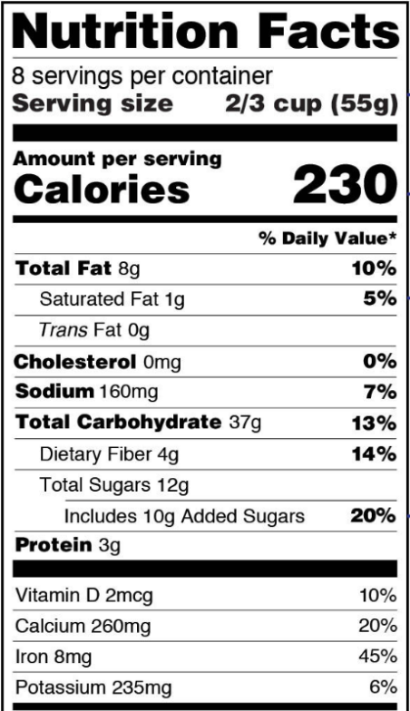
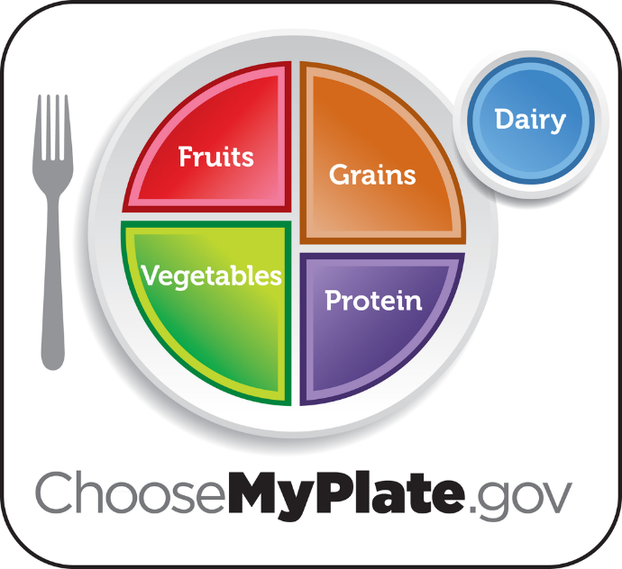
Shopping for healthy, affordable food that meets your preferences
Updated February, 2024
Notes:
Before we start, just a reminder that My Plate is a healthy way of eating. If you or a family member has a chronic condition that diet impacts, you still start with MyPlate and then make some changes to meet their needs.
Also, the best tool for picking healthy foods is the Nutrition Facts label. We will use that throughout the tour as well. Make sure you know where to find nutrition information about a food product using the Nutrition Facts label.

Slide 8
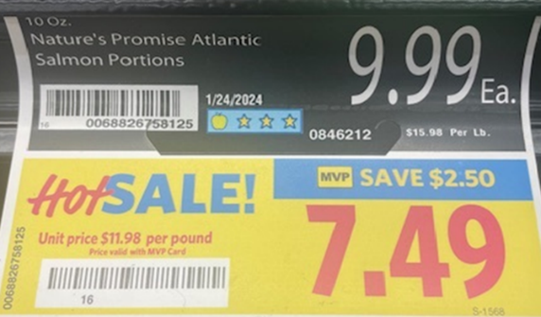
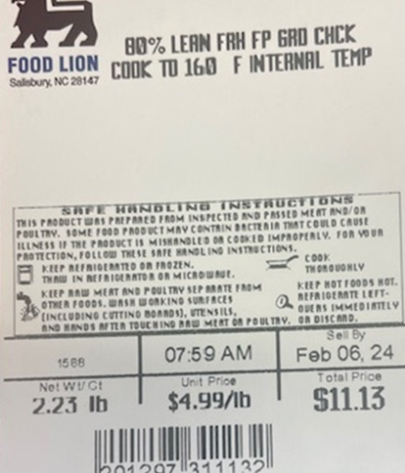
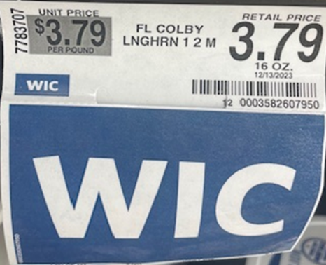
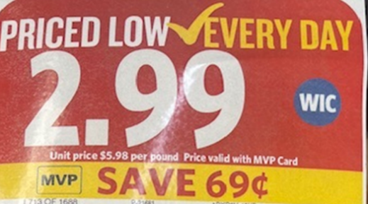
HELPFUL SHELF TAGS
  Guiding Stars
  WIC eligible
  Unit pricing (on the shelf, or on meat packages)
  Alert to sales
  For those with celiac, note gluten-free tags
Updated February, 2024
Notes:
There are other helpful shelf tags that can make it easier to identify healthy food choices.
We mentioned Food Lion participates in the Guiding Stars program. This does not replace the information on the Nutrition Facts label, but helps you find the healthier products in sections of the store.
If you are a FL shopper, have you noticed them? The stars, 1,2, or 3 help identify the healthier choice among like product. For example a cereal with 3 stars would be a better choice than a cereal with 1 or no stars. It does not compare unlike foods. A cereal with 3 stars may or might not be a better choice than a fruit with 3 stars. The stars are assigned based on scientific research to identify foods with more vitamins, minerals, fiber, whole grains, omega 3s. and less Saturated Fat,Trans Fat, Added Sodium, Added Sugars, Additives to Limit. ,Specific nutrients and ingredients contribute to foods earning or losing points. Nutrients that are best to limit in our diets cause a food to lose points. Nutrients we should generally be eating more of cause a food to earn points.
You can learn more at https://guidingstars.com. If you shop foodlion on line you will see Guiding Stars in th Quick Facts section of the food product
Many of you know WIC stands for the Women Infants and Children’s program. These are healthy foods and beverages that low resource families with pregnant women and children under 5 years old may participate in. They can only purchase items deemed as healthy and important for pregnancy, and children’s growth and development.
Unit pricing: This is often found on a shelf tag, or directly on a package of meat. It is the price per unit (lb, oz, piece) of a food (different than the retail price which is the total cost for a food item). You will demonstrate how to use unit price to compare foods of different brands or size packages to find the best buy.
Gluten Free: In the past Food Lion and other stores put gluten free in one area. Here they are throughout the store and marked with tags. I am only pointing them out to say that it does not mean a food or drink is healthier. It is critical for those who have been diagnosed with celiac disease to know what foods have gluten in them. They are often more expensive than non-gluten free products. Gluten free is not necessarily healthier for everyone.

Slide 9
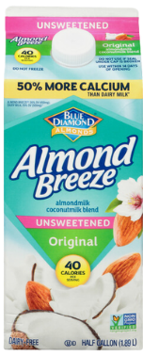
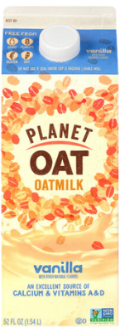
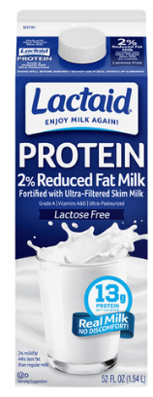
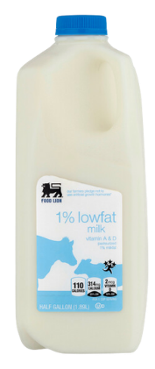


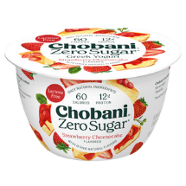


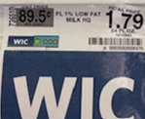


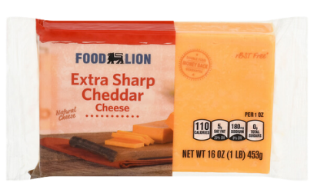
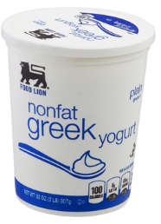
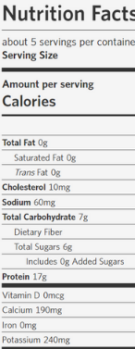


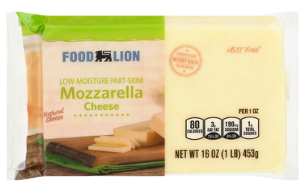


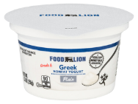
DAIRY
You will start with:
YOGURT
  Discuss and demonstrate where to find protein and added sugars using the Nutrition Facts label
CHEESE
  Look for less saturated fat
DAIRY MILK
  Low fat is best
  Usually fortified with vitamins A & D and is a significant source of protein and calcium
  Can use unit price to demonstrate the difference between different brands/sized packages
  Lactose-free options are great alternatives for those with lactose-intolerance, but cost more
NON-DAIRY MILK BEVERAGES
  On their own, most plant-milks are not a significant source of protein, calcium, vitamins A & D
  Discuss and demonstrate how to look for fortified beverages and those without added sugars
Updated February, 2024
Notes:
Starting with Yogurt: Greek yogurt is higher in protein. Not everyone needs more protein so regular yogurt may be a cost effective choice. Watch for added sugar. Use the Nutrition Facts label to demonstrate where added sugar is.Engage your participants by asking them to show the group where added sugar is on the label. And to find in the case a yogur with at least one star and tell the group how much added sugar is in it.
Then cheese. We know that many people eat more cheese than is good for their heart. So both eating less and picking lower saturated fat cheese is important.
Dairy and non-dairy beverages. Yogurt and cheese are great sources of protein and many other nutrients. Milk especially is an excellent source of calcium, vitamins A and D. We are looking for affordable products that are lower in saturated fat and added sugar.
Plant milks do NOT have a standard of identify so the manufacturers can change the ingredients all the time. If you choose a plant-based milk, make sure you are getting the nutrients milk usually provides - protein, calcium, vitamin D, Vitamin A
You will need to demonstrate where on the Nutrition Facts you will find saturated fat.Again engage a participant to look at the label.
In the milk or yogurt section, ask a participant to select a product with 3 Guiding Stars or no Guiding Star and compare the differences using the Nutrition Facts label - with special attention to differences in saturated fat, added sugars, vitamins, and minerals.

Slide 10
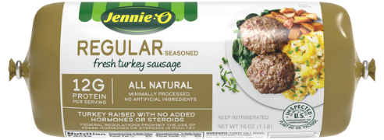
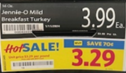
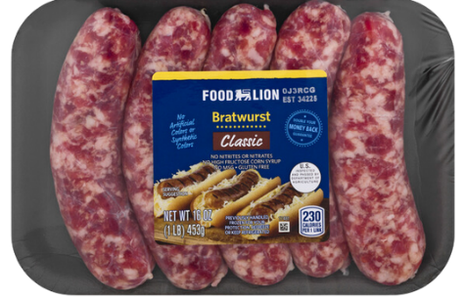
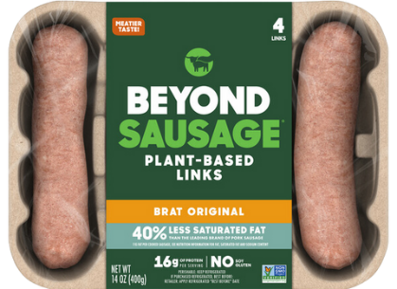
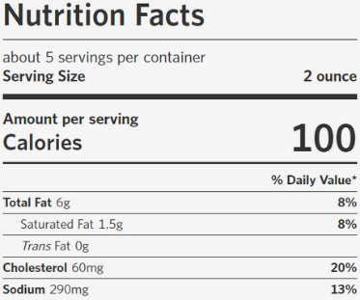
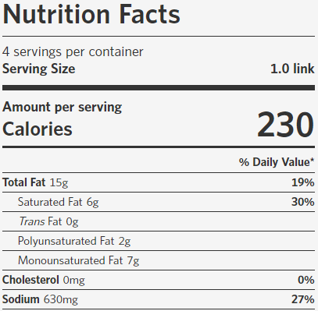
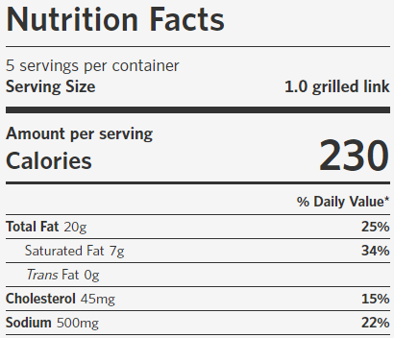

PROCESSED MEATS
BACON, SAUSAGE, HOT DOGS, LUNCHMEAT
JUST HIT THE HIGHLIGHTS:
  NO Guiding Stars because they are often higher in less desirable nutrients like saturated fat and sodium
  Should be “sometimes” foods, not “everyday” foods
  Plant-based meats are also “ultra-processed” and may not be healthier than regular meat products
  Be able to show the group where to find saturated fat and sodium on the Nutrition Facts label
Updated February, 2024
Notes:
We really don’t have time on this tour to say much here, but here are a few comments.
There probably are no products with Guiding Stars in this section. These products are usually high in saturated and total fat, sodium and calories. Many people in our community eat these products every day but they really aren't “everyday foods” for people eating healthfully. A poultry-based product like turkey sausage/bacon will generally have less saturated fat but is still a high in sodium and is best to limit a 'sometimes.’ not everyday food.
The new plant based “meats” are made to look and mimic the flavors of meat. These items may not be any healthier than the regular meat products. Read the labels. The plant-based products can be considered “ultra-processed”. “Ultra processed is a buzz word that does not have an accepted definition but does imply it is a not a health promoting food. This is a good place to make sure your participants know where and how to look at the ingredient list. The ingredients are listed by weight. The ingredient that is the heaviest is listed first, and it might be water. These plant based food can also be more expensive. A better way to eat plant based and save money would be to incorporate more beans in your diet. We will stop by the bean counter later
Though you won't spend much time in this section, this is a good place to point out where saturated fat and sodium can be found on the Nutrition Facts label.

Slide 11
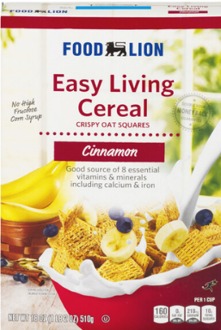

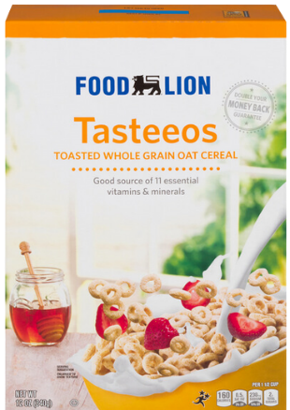
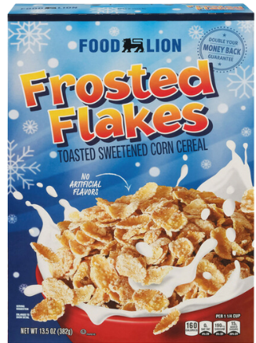


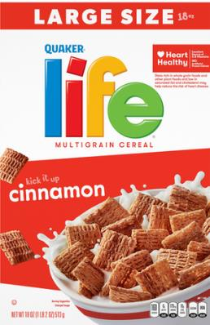
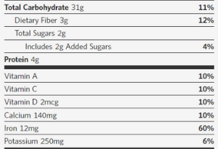
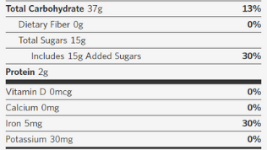

CEREAL
Can be a good source of vitamins and dietary fiber But can also be a big source of ADDED SUGARS
USE THE GUIDING STARS AND WIC-TAG
DIETARY FIBER:
  Desirable for most people to get more of (28-38 grams per day)
  You will demonstrate where to find dietary fiber on the Nutrition Facts label
ADDED SUGARS:
  Desirable for most people to get less of
    Children under 2 years old should avoid foods with added sugars
    Children <25 grams per day
    Women <25 grams per day
    Men <36 grams per day
  You will demonstrate where to find added sugars on the Nutrition Facts label
An opportunity to save money by shopping generic/store brand
Updated February, 2024
Notes:
Many people in our area get only about 15 grams of dietary fiber a day and would be better off if they had closer to 30 grams. They would be constipated less and have better control of their blood sugar and weight.
Cereals are also places where children especially, get too much added sugar. The American Heart Association recommends that children and women limit their intake of added sugar to 25 grams a day. One serving of a sweetened cereal can provide a substantial part of that.
You will ask a participant to select a cereal with 2-3 Guiding Stars and compare it to a cereal with no Guiding Stars. Look at differences in dietary fiber and added sugar.
This is also a good place to look at the price differences between Store Brands and Brand Names cereals…. Like the Food Lion tasteeos and brand name cheerios. Also look at unit pricing between a big box and a smaller box of cereal

Slide 12
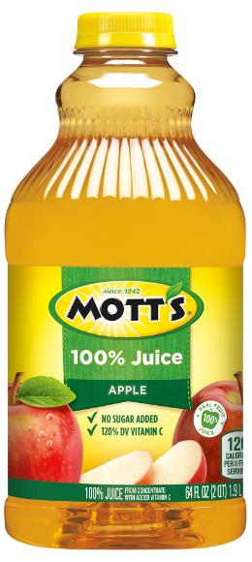
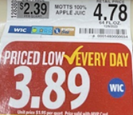
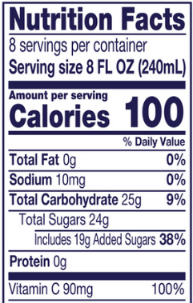
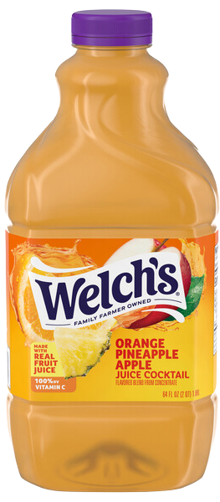

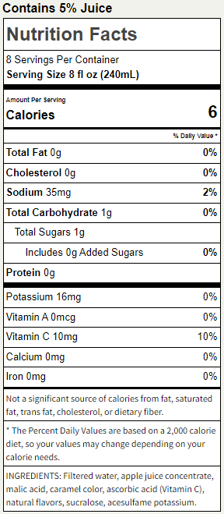
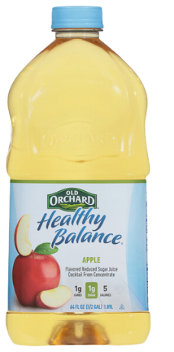
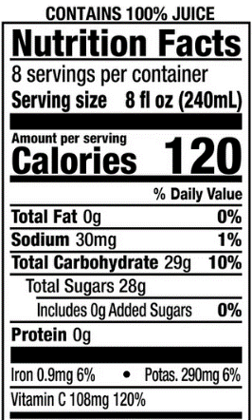
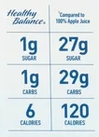

JUICE
The best choice
100% FRUIT JUICE
  BUT these products are still a concentrated source ofnatural sugars that should be limited
    Children less than 1 year old: avoid
    Young children: 4 oz (1/2 cup) per day
    Teens and Adults: 8 oz (1 cup) per day
Updated February, 2024
Notes:
You probably have heard that 100% juice is the healthiest. Even so, the recommendation is that children get no more than 4 ounces (1/2 cup) per day and teens and adults get no more than 8 ounces (1 cup) per day. They have a lot of calories and not so much other nutrition.
If you or a family member has diabetes, it may be best to avoid even 100% fruit juices or limit intake to <4oz per day. A diet juice contains less juice and is sweetened with nonnutritive sweeteners. It does not provide much nutrition, but contains no added sugars.
Some 100% juices are blended with less expensive juices like apple juice that have been stripped of flavor and nutrients and are in essence sugar water.
Save money by drinking tap water.

Slide 13
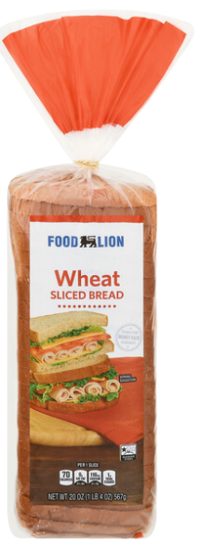
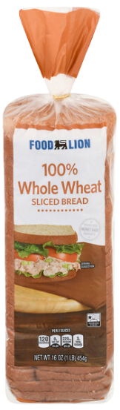
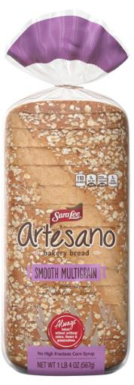



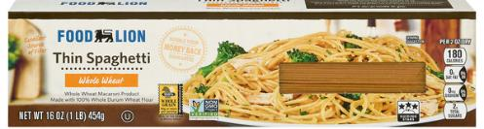
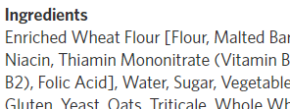
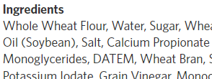
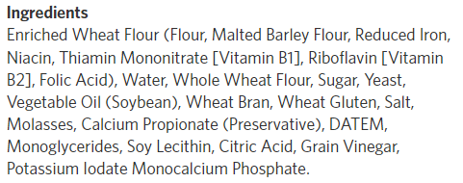


BREADS & CRACKERS
An opportunity to discuss
WHOLE GRAINS
  A better source of dietary fiber, a desirable nutrient for most to get more of
  You will demonstrate how to identify better fiber sources using the Nutrition Facts label
    GOOD sources = > 2.5 grams per serving (10% DV)
    EXCELLENT sources = >5 grams per serving (20% DV)
  and how to identify whole grains using the ingredient list
    You CANNOT tell by color, name, or front-of-package claims
    You CAN tell by seeing if “whole” is the first word listed in the ingredient list
Updated February, 2024
Notes:
We have already said that most Americans do not get enough fiber. This is a good section to talk about whole grains and how we can identify them using the ingredient list. It may be good to point out that front-of-package claims, color, and names of products can be misleading.
Whole grains are good sources of dietary fiber. You can also use the Nutrition Facts label to identify high-fiber sources. A simple way to tell if a serving of a food is a good source of fiber is to look at the %DV - 10% or more is considered a good source and 20% or more is considered an excellent source.
Ask your group to practice identifying whole grains and determining if a food is a good source of dietary fiber. For your own benefit to learn more about whole grains there are great materials on the website: https://wholegrainscouncil.org. During this tour we don’t have time to stop and look at all the grains you might find near the rice section of the store. If this is important to your audience or if you have a vegetarian group you might skip the meat section and spend more time on aisle 3.

Slide 14
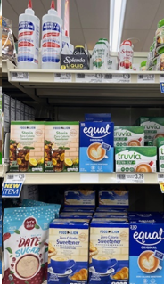
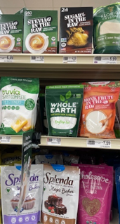
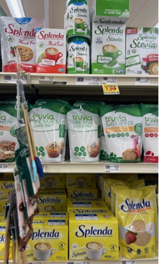
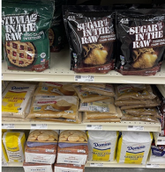
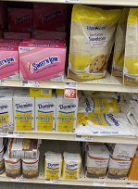



















CANNED FRUIT, SWEETENERS, SALT, OILS
CANNED FRUIT
  Generally, less expensive
  Use Guiding Stars and WIC-tags to identify the healthiest options
SWEETENERS
  If the group is interested, discuss the difference between caloric and non-caloric sweeteners
    Caloric - all sugars (white, brown, raw, powdered, date), honey, agave, maple syrup, sugar-blends
      ALL are sugar (~4 grams of carbohydrate per teaspoon)
    Non-Caloric - sucralose (Splenda), aspartame (equal), saccharin (sweet-n-low), stevia, monk-fruit, FL zero-calorie sweetener
SALT
  A source of sodium, ideal to limit
  Point out other herbs, spices, and salt-free blends
  Variety of “salts” available have little nutrition difference (all contain sodium) but can vary widely in cost
  Coarser (larger grain) salts may help you use less
OLIVE OIL
  Plant oils like olive and canola oil are healthy options
  Range of products and prices
    Store brand is usually lower in price
    A more refined oil can be used for all-purpose cooking
PER 1/4 TSP
PER 1/4 TSP
PER 1/4 TSP
Updated February, 2024
Notes:
You wont have much time to point out the canned fruit section as you walk down the aisle. Just remind them about it generally being a less expensive option than fresh and usually with less waste. Use the Guiding Stars to help them make the best choice.
Stop at the sweeteners, especially if you have anyone with diabetes in the group. Point out that there are a lot of options, but we can generally sort them into 2 groups - those that have calories and behave like sugar, and those that do not. Familiarize yourself with the products available so that you are able to answer questions about which sweeteners fall into which group. In general, caloric sweeteners include all sugars (white, brown, raw, powdered, date, coconut), and sugar-blends, honey, agave, and maple syrup. In the non-caloric sweeteners you may ask someone to compare the unit price for a Splenda brand name product and a store brand sucralose. There are savings to be had here. For your own reading about the safety of sweeteners (they are) see: https://foodinsight.org/facts-about-low-calorie-sweeteners/
Next move to salt and spices. Briefly note that salt is a source of sodium, which most Americans consume too much of. Spices, herbs, and salt-free blends can be a good way to add flavor to foods while using less salt.
You will notice a variety of salt products, which can range in price. Remind the group that the nutritional difference between these are very minimal, and all of them are still a source of sodium. You might point out that for people following the Mediterraean Diet, they do NOT need to buy a salt labeled as Mediterranean. Some people may be able to detect a slight flavor difference. It is not necessarily healthier and usually costs more.
Plant oils like olive oil (and usually at a lower price, canola oil), are healthier alternatives to cook with than butter. Olive oil prices vary by brand and degree of processing. A more refined olive oil like 'light' or 'classic' are better for all-purpose cooking. Need to learn more about oils? Read https://foodinsight.org/?s=olive+oil

Slide 15














BEANS & FISH
BEANS
  Highlight that beans are excellent sources of fiber, plan-protein, and other healthy nutrients, while being low in saturated fat
  Demonstrate difference in cost between dried and canned beans
  Demonstrate ways to limit sodium from canned beans
    Look for Guiding Stars
    “No salt added;” “Low sodium”
    Drain and rinse
FISH
  Highlight that fish is a healthy choice recommended to enjoy 2 times per week
  Discuss difference in cost between a variety of canned, frozen, and fresh options and offer tips to save money
Updated February, 2024
Notes:
The American Heart Association (AHA) recommends beans and legumes as part of a healthy eating pattern. They are good sources of plant protein, high in dietary fiber, good sources of heart-healthy nutrients like potassium, and contain no saturated fat or cholesterol. Beans and legumes like lentils also happen to be the most affordable protein source in the grocery store! You can demonstrate the difference in cost between dried and canned beans, but also note that because canned beans are ready to eat, they can make adding them to our diets easier. Be able to demonstrate how to find lower-sodium canned items. Need to learn more about beans? See https://www.ndsu.edu/agriculture/extension/publications/all-about-beans-nutrition-health-benefits-preparation-and-use-menus
The AHA also encourages fish at least 2 times per week . Frozen, fresh, and canned fish are low in saturated fat and can be a good source of heart-healthy omega-3s. Look for sales on fresh fish and stock up when you can get a good price. Frozen and canned options are often less expensive and do well in salads, casseroles, fish cakes and chowders.

Slide 16














FRESH MEAT
ENCOURAGE LEAN MEATS
  Like skinless poultry, 90% lean ground meats, and red meats with less marbling and visible fat
    Be able to demonstrate how to identify these
REVIEW RIGHT SIZE PORTIONS
  For most men, about 4 oz
  For most women, about 3 oz
  How can you determine the number of servings in a package of meat?
WAYS TO SAVE MONEY
  Use unit price to compare different size packages
PLANT-BASED MEATS
  May not be healthier than their fresh meat counterparts
  The Nutrition Facts label is the best way to compare products
Updated February, 2024
Notes:
You will make a few points in this section.
1) Encourage lean meats which are good sources of protein and other nutrients, but lower in saturated fat. (like skinless poultry, 90% lean ground meats, and meats with less marbling and less visible fat)
2) Review that a portion size for most is about 3-4 ounces, so a lb of meat may contain about 4-5 servings. Often bulk packages are less expensive, but can be down-sized at home to right-size portioned packages and then frozen.
3) Unit prices can help compare the cost of different size packages and types of meat. You will have participants compare the unit price of an 80% ground meat to a 90% ground meat. Remind them to be on the lookout for sales on leaner packages of ground beef, which tend to be more expensive, and save these in the freezer if you have room.
4) Remember that we have said that 'plant-based' processed meats may not be healthier than fresh meat, and are often more expensive.
A good discussion of ground turkey versus ground beef is at https://extension.illinois.edu/blogs/simply-nutritious-quick-and-delicious/2023-04-06-nutritional-comparison-ground-turkey-and.

Slide 17


















CANNED, FROZEN, FRESH VEGETABLES
CANNED & FROZEN
  Highlight the PROS:
    Affordable
    Shelf-stable
    Convenient to prepare
    Less food waste
    Excellent source of healthful nutrients
  No less nutritious than fresh vegetables
  Review how to identify low sodium choices (Guiding Stars and Nutrition Facts)
  Review how to compare unit prices to find the best buy
Updated February, 2024
Notes:
All vegetables are nutritious options - and frozen and canned veggies are no less nutritious than fresh.
There is a benefit to purchasing a variety of types of vegetables, including canned and frozen. For example, canned and frozen veggies may be less expensive (especially during certain times of the year), are more shelf-stable, can be easy and convenient to prepare, and often have less food waste.
Using unit prices can help you find the lowest price. But it is also helpful to consider what form of the veggie will make you more likely to add it to your diet (do you prefer the texture of fresh? like the convenience of frozen? need the cost of canned?)
You will also demonstrate better options when shopping for frozen and canned by comparing items that are seasoned/salted and unseasoned/have no-salt-added.

Slide 18



















PRODUCE
SAVING MONEY
  Shop in season
  Buy unprocessed
  Buy in bulk (but only what you can use or freeze)
  Buy conventional (unless organic is less expensive)
    Remind the group that organically grown produce has not been shown to be safer nor significantly healthier for humans than their conventionally grown counterparts
  Compare unit price
  Pay attention to produce priced per lb or per each
  Shop frozen and canned items
=$0.80/lb
Updated February, 2024
Notes:
We all know that fruits and vegetables are foods that are desirable to add more of to our diets. One perceived barrier that I often hear is that fruits and vegetables are too expensive. You will spend time in this section demonstrating ways to save money - looking for sales (often on seasonal produce); buying less-processed (whole collards vs pre-washed cut collards); buying in bulk (but only what will keep or you plan to use); buying conventional (unless organic costs less); using unit price; paying attention to produce that is priced by weight or by each.
You can also remind the group in this section that frozen and canned produce are also great options to save money.
A word on organic versus conventional fruits and vegetables. If shopping on a budget organic is usually more expensive per ounce than conventional. On those days it is less expensive, you might consider buying the organic---unless it is overripe. There continues to be a controversy about the safety of conventional produce. Some advocacy organizations publish lists of “ dirty” and “clean “produce. Please note that the methods used to create these lists have been criticized by major health organizations as lacking in scientific credibility. The amount of pesticides in growing crops is closely regulated by USDA and the Environmental Protection Agency. An and FDA and they maintain that the level of residue that may be found on both organic and conventionally grown crops is safe.
Even so, some people will choose organic over conventional. Remind your participants to wash ALL produce before eating.
The advice from the American Academy of Pediatrics is important here. “Consuming fresh or frozen produce is of paramount importance. Families should not avoid consuming produce just because organics are not available or possible for the family to purchase.” Read the American Academy of Pediatrics’ whole statement on food safety for children at: https://www.aap.org/en/patient-care/environmental-health/promoting-healthy-environments-for-children/food-safety
You may have participants who hold beliefs that are different from what we present as facts. Do not argue with them, repeat that the information and training you have received is from credentialed nutrition professionals.

Slide 19


$15 CHALLENGE
20 - 30 minutes
AND CHECKOUT
YOUR ROLE IS TO:
  Can only spend $15 (including tax)
  THE CHALLENGE is to purchase ingredients to build a balanced meal which includes at least:
    3 items from any of the following four MyPlate food groups (grains, fruits, vegetables, dairy)
    1 item from the protein food group
      CANNOT be processed meats like bacon, sausage, lunchmeat, or jerky, plant-based burgers, or canned beans and tofu with added seasonings
    Leftover money can be used to purchase additional healthy items, healthy oils, or herbs/spices
Provide instructions.
Answer questions as needed during the activity.
Collect questions you don’t know the answer to and take back to RDNs with Pitt Partners to answer.
Assist with check-out. Participants cannot go over $15, including tax. If they do, check with Quatavia or DeVette to see if need to take something out of their basket, or if Pitt Partners an cover the excess
Please Be kind, we don’t want to embarrass any of our participants.
Ask the participant to point out what is in their basket from each of the foo groups
  Purchased foods must have a WIC label or guiding stars
Answer questions as needed during the activity
Updated February, 2024

