Slide 1
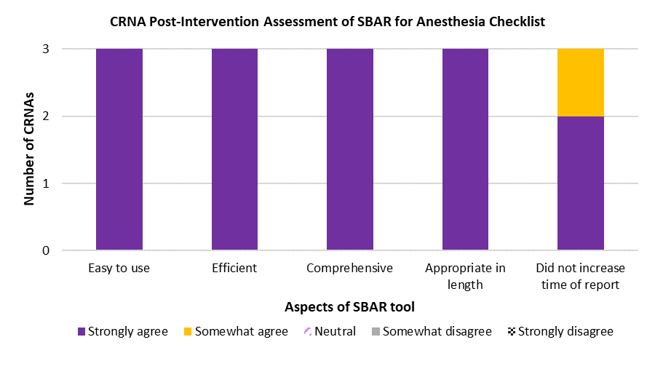
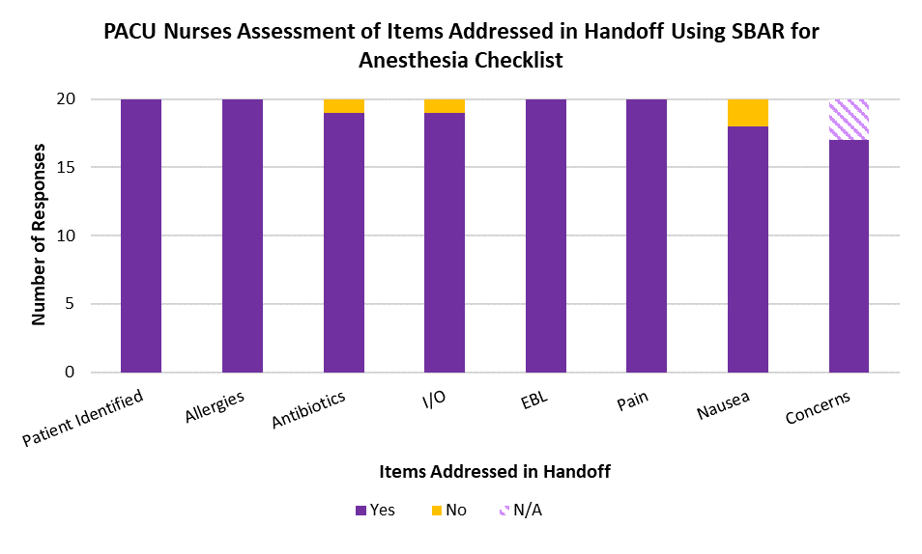
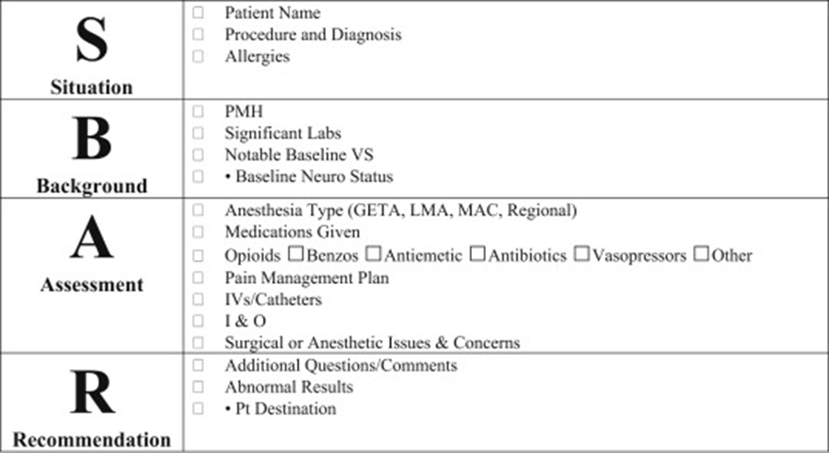
Standardizing OR to PACU Patient Handover with SBAR:
A Quality Improvement Project
Mary-Belle Mikesell, BSN, SRNA
Dr. Maura McAuliffe, PhD, CRNA, FAAN, Project Chair
Nurse Anesthesia Program
College of Nursing, East Carolina University
Greenville, North Carolina 27858
mikesellm11@students.ecu.edu
ABSTRACT
METHODS
DISCUSSION
Miscommunication between health care providers has been linked to adverse patient outcomes. The purpose of this quality improvement project was to assess anesthesia providers’ and post-anesthesia care unit nurses’ perceptions of adequacy of a standardized anesthesia SBAR tool during patient handover from the operating room to post-anesthesia care unit at a partnering facility using confidential pre- and post-intervention surveys. The results demonstrated that the SBAR for anesthesia checklist was found to be both efficient and comprehensive.
A pre-/post-survey methodology was used to assess staff perceptions of the SBAR for anesthesia checklist for OR to PACU patient handover compared to staff perceptions of their current handover process
PACU nurse post-intervention surveys asked whether or not the anesthesia provider addressed important aspects of the patient’s information and assessed the PACU nurses’ perception of efficiency and comprehensiveness of the SBAR for anesthesia checklist
CRNA participants responded that they were “very satisfied” or “somewhat satisfied” in regards to the SBAR for anesthesia checklist
CRNAs in the study reported finding the tool easy to use, efficient, comprehensive, appropriate in length, and did not appreciably increase the time needed to give PACU report
While using the SBAR for anesthesia checklist the patient was identified every time and that allergies, antibiotics, intake and output, estimated blood loss, pain management, nausea management, and concerns were addressed majority of the time
All PACU surveys reported no essential information was missing
Additionally, all PACU nurse responses were “yes” they would like to see the SBAR for anesthesia checklist used in the future
Responses were mixed regarding whether or not PACU RN participants felt the SBAR tool increased time needed to receive report
RESULTS
INTRODUCTION
N = 3
The Joint Commission’s National Patient Safety Goals recommended that all healthcare systems utilize standardized handover procedures to improve communication between providers to increase patient safety (The Joint Commission, 2017)
Standardizing the patient handover process promotes a culture of safety and helps set clear roles and responsibilities during patient transfers, which allows for clearer, more effective communication (Padgett, 2018)
By implementing a standardized tool for OR to PACU patient handover, the communication between the anesthesia providers and PACU staff may be enhanced and lead to an improvement in the quality of patient information exchange as well as higher staff satisfaction regarding patient handover
The purpose of this project was to assess anesthesia providers’ and PACU nurses’ perceptions of adequacy of the SBAR for anesthesia checklist developed by Halterman et al. (2019) during patient handover from the operating room to PACU
CONCLUSIONS
Not a significant change between the satisfaction levels prior to and during implementation of the SBAR for anesthesia checklist
Survey responses demonstrated that the CRNAs and PACU nurses were satisfied overall with the SBAR for anesthesia checklist
Majority of responses had the opinion that the SBAR for anesthesia checklist was efficient and comprehensive
There may be potential for future use of the SBAR for anesthesia checklist based on the level of enthusiasm from the CRNAs and PACU nurses
N = 20
REFERENCES
Halterman, R. S., Gaber, M., Janjua, M.S., Hogan, G. T., & Cartwright, S. (2019). Use of a checklist for the postanesthesia care unit patient handoff. Journal of Perianesthesia Nursing, 34(4), 834-841. https://doi.org/10.1016/j.jopan.2018.10.007
The Joint Commission. (2017). Inadequate hand-off communication. Sentinel Event Alert, (58), 1-6. https://www.jointcommission.org/-/media/tjc/documents/resources/patient-safety-topics/sentinel-event/sea_58_hand_off_comms_9_6_17_final_(1).pdf
Padgett, T. M. (2018). Improving nurses’ communication during patient transfer: A pilot study. Journal of Continuing Education in Nursing, 49(8), 378-384. https://doi.org/10.3928/00220124-20180718-09

