Slide 1

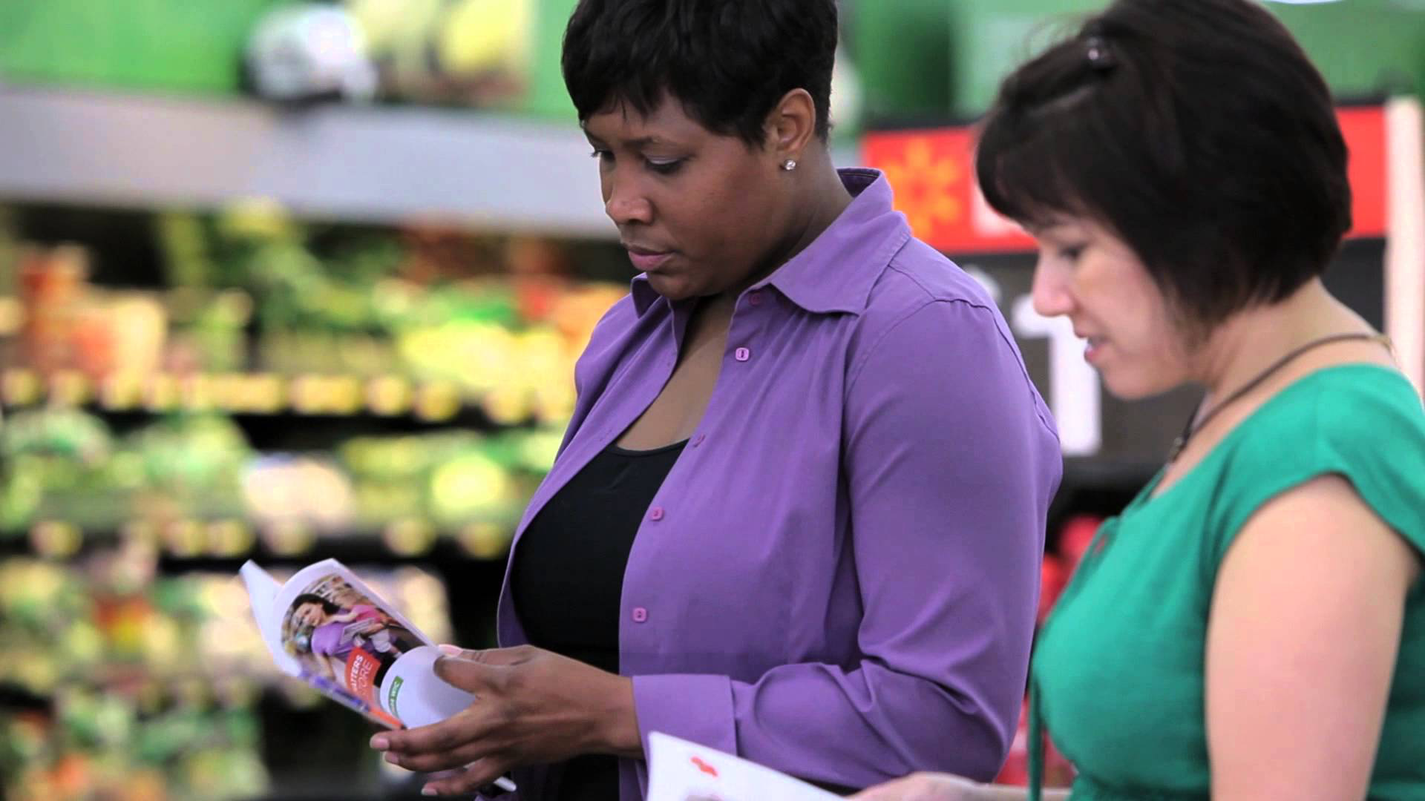
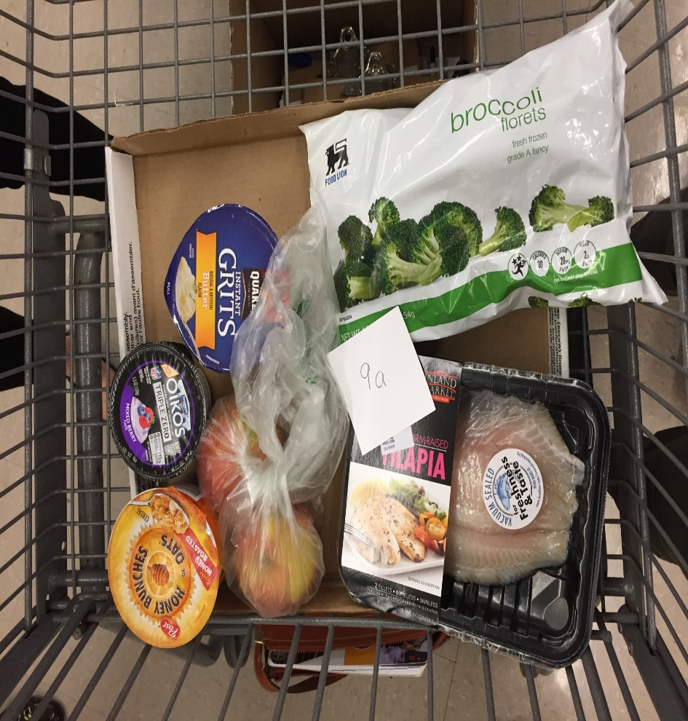
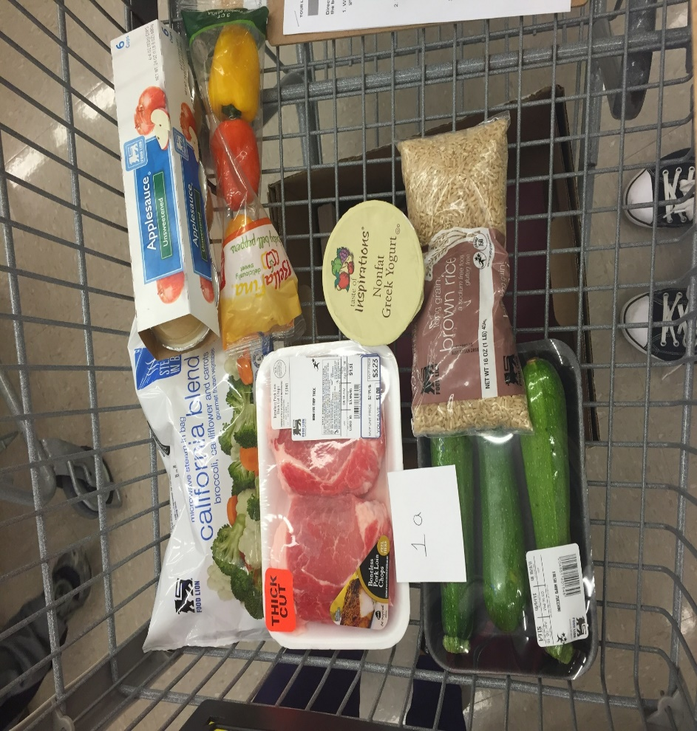
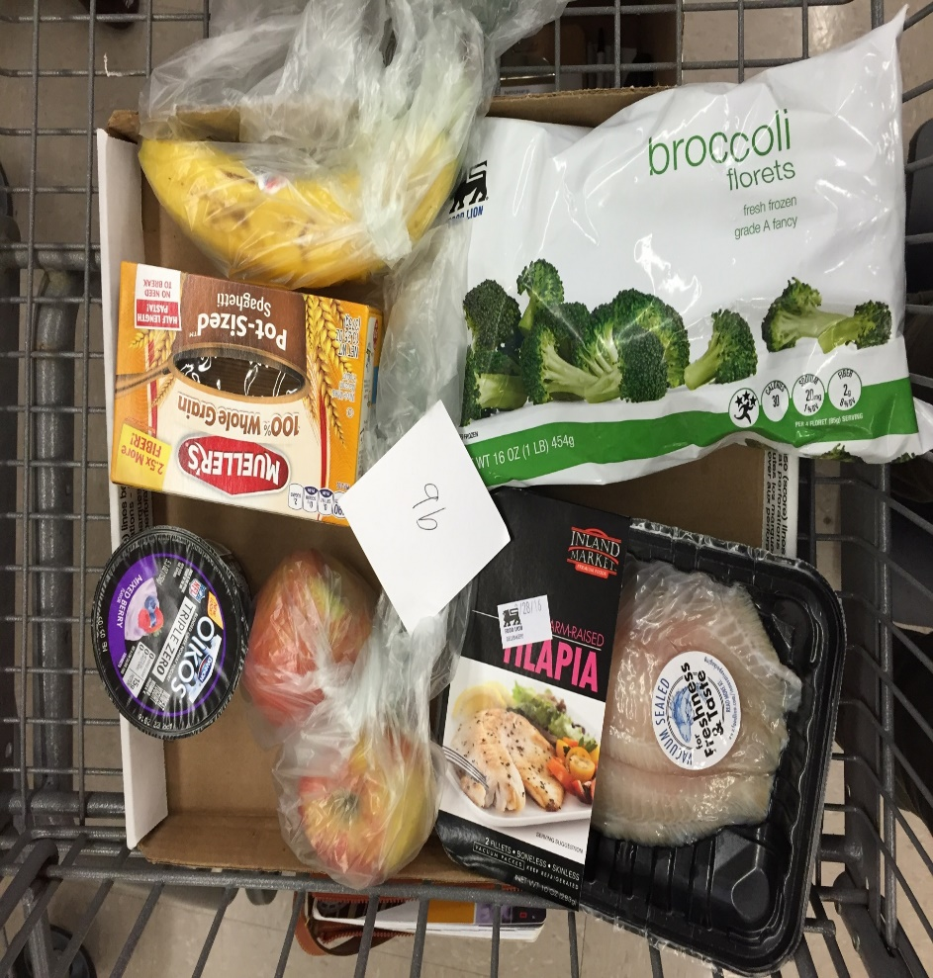
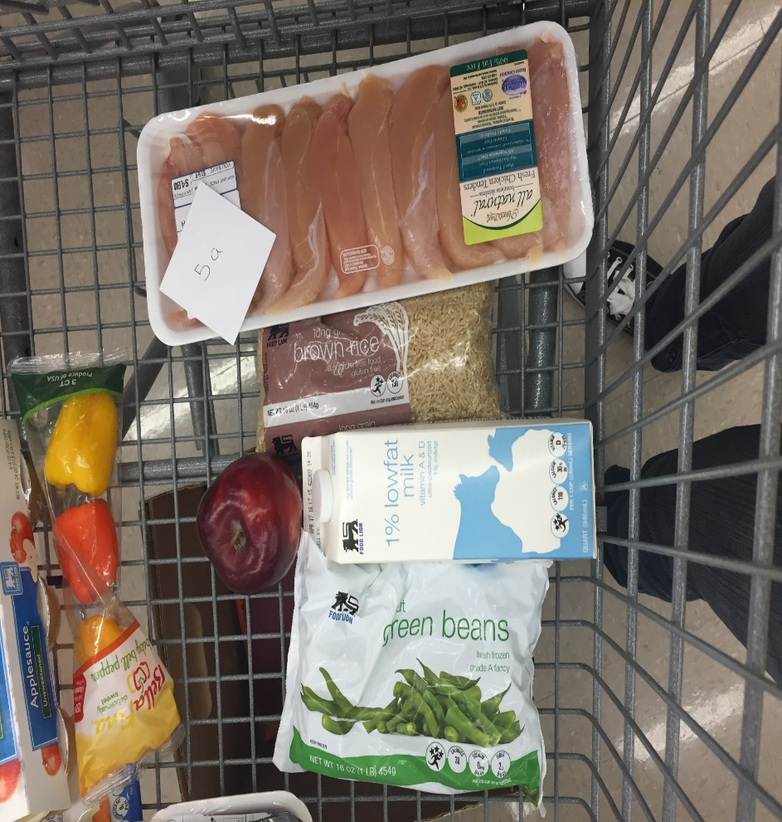


Evaluation of Guided Grocery Store Tour Impact on Participant Nutrition Knowledge and Food Choices: A Pilot Study
Rachel Winn¹, Virginia C. Stage PhD, RD, LDN¹ & Jackie Sugg RD²
¹Department of Nutrition Science, College of Allied Health Sciences, East Carolina University, Greenville, NC; ²Pitt County Health Department, Greenville, NC
RESULTS
A total of 74 participants were involved in 10 tours. The majority of participants were female (98.6%), 50% had a four-year degree, and were Black or African American.
Because individual demographic information was collected separate from the Nutrition Knowledge and $10 Grocery Basket Challenge assessments, only demographic information on all participants (versus only those who participated in the evaluation of the tours) at this time.
A total of 28 participants completed the nutrition knowledge baseline and post-assessment Average score on the baseline (before tour) nutrition knowledge assessment was 82.81% (SD±.16); post-assessment (after tour) was 89.06% (SD±.11) (Table 1).
While all participants competed the $10 Grocery Basket Challenge, only a total of 13 participants were included in the pictorial evaluation (Table 2).
Figure 1 shows examples of $10 challenge baskets.
INTRODUCTION
Healthful dietary patterns have been clearly linked to long-term risk of chronic disease, however many adults still fall short of dietary recommendations for health promotion.¹
Additionally, 53% to 62% of consumers in the US report using nutrition facts labels sometimes, but many are confused by nutrition labels and lack comprehension for use and product comparison.²
Grocery Store Tours are one method used to address consumers’ grocery shopping practices and increase nutrition label comprehension.³
These structured tours are led by a dietitian and take small groups through a grocery store to teach participants skills and strategies to enable healthful food purchasing choices.^{4,5}
Unfortunately, the effectiveness of these tours on participant knowledge and behavior is rarely evaluated due to limited time and financial resources.³
Table 1. Nutrition Knowledge Survey Questions and Baseline/Post-Assessment Scores
Survey Question | Baseline % Correct | Post % Correct | p-value
1. What food belongs in the grain group? | 89.3 | 92.9 | .33
2. What food belongs in the fruit group? | 100 | 96.4 | .33
3. What type of green bean will have the most sodium? | 92.9 | 96.4 | .33
4. What should you try to do when you buy dairy? | 92.9 | 96.4 | .57
5. A healthy meal has half a plate full of: | 78.6 | 89.3 | .36
6. When are most fresh fruits and vegetables priced lower? | 60.7 | 85.7 | .03*
7. Which food is a whole grain? | 67.9 | 71.4 | .75
8. Why is whole wheat pasta healthier than regular pasta? | 100 | 89.3 | .08
9. What is the serving size of Fiber Flakes cereal?ª | 92.9 | 92.9 | 1.00
10. How can you tell if Fiber Flakes is a whole grain food?ª | 71.4 | 92.9 | .03*
11. How many grams of sugar are in 1 serving of Fiber Flakes?ª | 82.1 | 96.4 | .04*
12. How much sodium is in one serving of Fiber Flakes cereal?ª | 82.1 | 92.9 | .08
13. What is the retail price for the 6oz low-fat yogurt?^{b} | 75.0 | 71.4 | .77
14. Which is the better buy when comparing unit prices?^{b} | 78.6 | 82.1 | .71
15. What is the unit price for the 32oz low-fat yogurt?^{b} | 85.7 | 85.7 | 1.00
16. If you were trying to save the most money, which of these would you buy?^{b} | 75.0 | 92.9 | .06
ªIn addition to response options, participants are also provided a Nutrition Facts label. ^{b}In addition to response options, participants are also provided with a unit price label. *p</=.05 indicates significant change in scores from baseline to post-assessment.
DISCUSSION
Overall, participants showed improvements in nutrition knowledge and ability to create a healthy grocery basket at the end of the tours.
Findings are difficult to compare with existing literature, as study design and survey content differ drastically. However, multiple other studies on grocery store tours showed marked improvement in nutrition knowledge. ³
With the exception of five questions, all questions demonstrated improvement in knowledge, however only three questions demonstrated statistically significant improvements in knowledge (Questions 6, 10, and 11).
While not significant, questions 3, 8, and 13 showed declines in knowledge. Questions 9 and 15 showed no improvement.
The sample size for this study was small, and not all participants who completed demographic forms were able to complete pre/post surveys and pictorial evaluation.
PURPOSE
The purpose of this evaluation was to evaluate the effectiveness of a guided grocery store tour to improve the nutrition knowledge food selection behaviors of low-income, low-resource adults in Pitt County, North Carolina.
INTERVENTION
FUTURE RESEARCH
Created by the Share Our Strength organization in 2010, The Cooking Matters at The Store (CMATS) program is based on over 20 years of outreach to low-income families across the United States. ⁵
Each tour is structured around four primary teaching components: (1) reading food labels (2) comparing unit prices; (3) finding whole grains; and (4) identifying three ways to purchase produce (fresh, frozen, and canned).⁵
Each CMATS tour ends with a “$10 Challenge”, an activity in which tour participants use their new knowledge to by a healthy meal for under $10.⁵
Participants take home a booklet with recipes and shopping tips, a reusable grocery bag, and $10 worth of healthy groceries.⁵
Current research on CMATS tours persists through the 2017 year with assistance from Pitt County dietitians.
An URCA grant was awarded for the 2016 – 2017 year to further this research, funding various data collection materials, allowing for more thorough data collection, including funding research incentives.
A team of 17 nutrition science students were thoroughly trained to assist in collection of further data in March, 2017.
Pilot testing of new materials and additional on-site training of student volunteers was conducted on two separate dates in February, 2017.
Data has been collected throughout National Nutrition Month (March, 2017) over 10 separate tours led by Pitt County dietitians.
In addition to revision of the pre/post survey, dietitian questionnaires and extra data on challenge basket participants was collected.
Ongoing analysis of 2017 data will continue throughout the year to assist the Pitt County Health Department in applying for future grants to further this project.
Table 2.
$10 Grocery Basket Challenge Nutrition Analysis
METHODS
Nutritional Component | Basket 1 mean±SD (n=13) | Basket 2 mean±SD (n=4) | Basket 3 mean±SD (n=1) | p-valueª
Calories kilocalories | 492.31 (146.86) | 600.00 (296.76) | 490 | .39
Protein grams | 33.46 (12.11) | 38.25 (16.15) | 38.00 | .20
Carbohydrate grams | 62.08 (22.46) | 78.00 (39.34) | 46.00 | .25
Fiber grams | 8.00 (3.49) | 8.75 (4.65) | 3.00 | .12
Sugar grams | 26.15 (12.62) | 31.25 (18.28) | 19.00 | .13
Total Fat grams | 13.15 (5.24) | 16.75 (14.86) | 17.00 | .69
Saturated Fat grams | 4.54 (2.03) | 4.63 (2.56) | 6.00 | .92
First Attempt
Data collection was conducted in collaboration with the Pitt County Health Department (PCHD) using the CMATS program.
Participants of the evaluative research completed a nutrition knowledge survey before and after the tour, with questions based on each of the four components of the CMATS tours.
Data collectors administered the surveys to tour participants at ten separate tours in March, 2016.
Each consecutive $10 challenge basket was photographed for later nutrient analysis of healthy foods taken home by participants.
Separate demographic forms from the CMATS program were collected to assess participant socioeconomic status.
Analyses were conducted using SPSS 22.0 (version 20.0, IBM Corp., 2011).
Descriptive statistics on demographics were conduced. Each consecutive $10 challenge basket was photographed and analyzed using a food processor nutrition analysis software for nutrient content (Food Processor, 2016).
This study was approved by the ECU IRB​ (UMCIRB 16-000287).
REFERENCES
Division of Nutritional Sciences at the University of Illinois at Urbana-Champaign, Urbana, IL
Blitstein JL, Evans WD. Use of nutrition facts panels among adults who make household food purchasing decisions. J Nutr Educ Behav. 2006;38:360-364.
Nikolaus, C. J., Muzaffar, H., & Nickols-Richardson, S. M. (2016). Grocery Store (or Supermarket) Tours as an Effective Nutrition Education Medium: A Systematic Review. Journal of Nutrition Education and Behavior, 48(8).
Burros M. Eating well. Living Desk. http://www.nytimes.com/1990/08/01/ garden/eating-well.html. Accessed March 23, 2017.
About Cooking Matters At The Store. (n.d.). Retrieved March 17, 2017, from https://cookingmatters.org/at-the-store
*Full reference list available in handout form.
Second Attempt
ACKNOWLEDGEMENTS
Figure 1.
Example $10 Challenge Basket Photos
Notes:
RGB Sliders
Orange: 255 102 0
Navy blue: 0 45 89
Lighter blue: 0 106 158
Green: 102 153 0
Yellow: 255 221 0
Red 181 9 55

