Slide 1
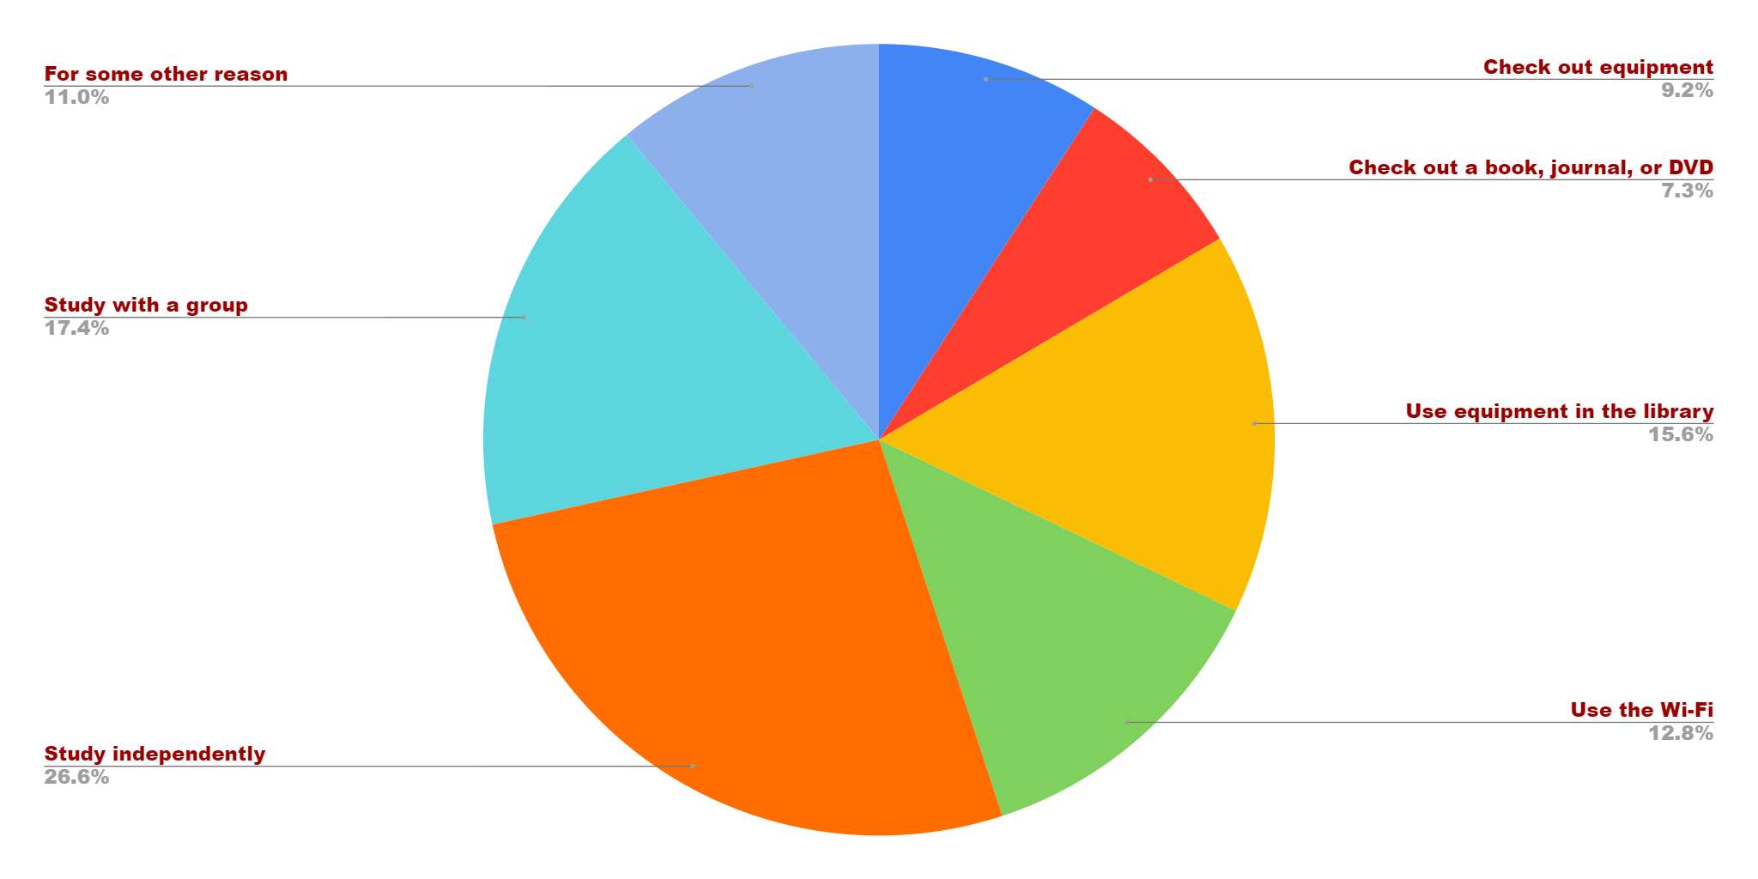

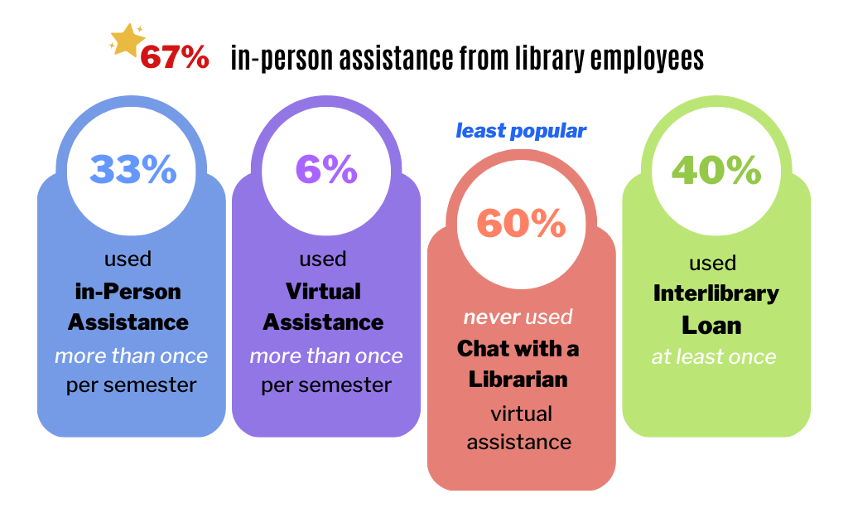
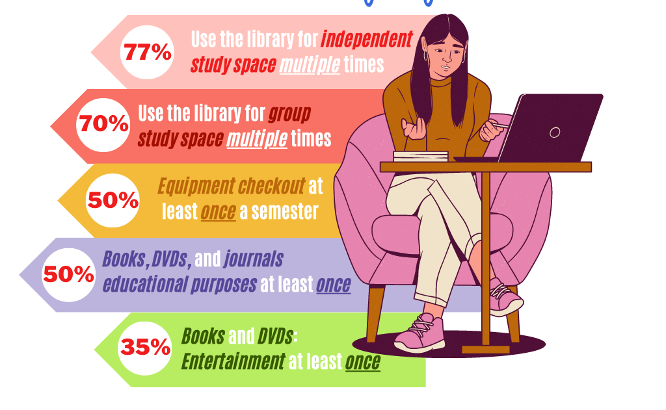
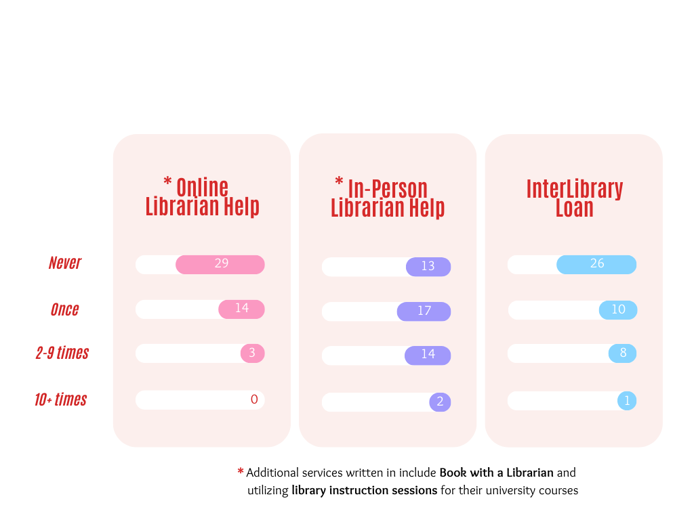

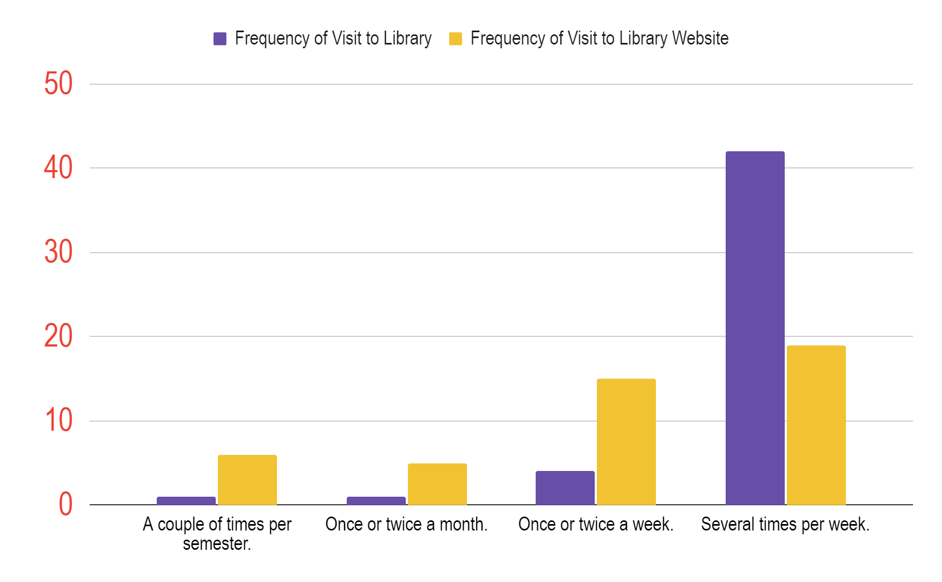
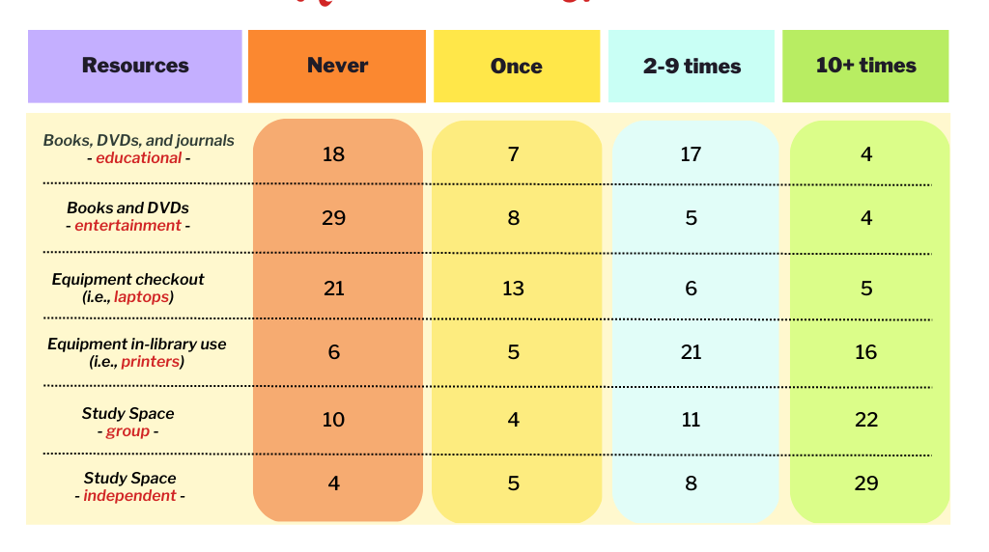
Students’ Motivations to Use
Academic Library Resources and Services
Laura K. Bright and Ammini Thompson
East Carolina University
Greenville, North Carolina 27858
Introduction
Reason for Current Visit
Conclusion
As workers dedicated to patron satisfaction and library efficiency, we conducted an anonymous survey for students using our library. The survey questions allowed students in the building to communicate their visitation frequency, material and space usage, and to provide other feedback about their motivation to use the library, satisfaction with services, and suggestions.
Using data from the survey responses, which we collected over three days we organized the results into 5 sections: Reason for Visiting, Frequency of Visits, Services Used, Resources Used, and Comments and Suggestions. Of these, there are several graphs that effectively illustrate the data collected and communicate any important connections discovered.
Throughout the creation, conduction, and conclusion of this project, the results allowed us to become better acquainted with what students value about the library and how they perceive it benefits them. Considering our students’ responses will allow our library to continue to evolve and thrive with its community.
We received 48 survey responses from students and eliminated 5 other responses that were either not from students or that were blank. Of the 48 responses, 13 were from graduate students, 34 were from undergraduate students, and 1 was from a non-degree seeking student.
Graduate students were more likely than undergraduate students to write in their own responses to questions, to check out materials for either education or entertainment, and to have used the library for independent study very frequently (10 times or more per semester) than undergraduate students. Otherwise, there was no remarkable difference in graduate students’ responses when compared to undergraduate students’ responses.
Independent study, group study, and use of equipment in the library were the most cited reasons for students’ current library visits. Many students cited more than one reason for their visit.
60% of students who responded to the survey were at the library to study independently.
Only 17% of students were at the library to check out a book, journal, or DVD. This was the least-cited reason for a current visit.
Aside from the given response options, students who responded to the survey also cited the use of a child-friendly space in the TRC, student employment, Starbucks, the sensory room, and library programs as reasons for their current visits.
Reason for Current Visit
Based on responses from students who participated in the survey, study space is the primary motivation for visiting the physical building. Students are also highly motivated to use equipment in the building, to check out materials for educational purposes, and to access Wi-Fi. More than a third of student respondents reported visiting the library at least once to receive in-person help from library staff, so this support is another important factor which motivates students to visit.
Based on students’ responses, recommendations for East Carolina University’s main campus library include increasing cleanliness of study rooms and improving the selection of specific electronics such as headphones, cameras, and scanners with higher resolutions. Students also report enjoying that the library is accessible for 24-hour periods, so it is recommended that the library continue to provide access to the building at night.
Other student suggestions included the addition of a podcast room and a food hub with free snacks and drinks. The student participant who mentioned the food hub compared the idea to the Pirate Pantry, which provides free food to students, and the inclusion of a food hub would especially benefit students from low-income backgrounds.
The survey responses were gathered from students who physically visited East Carolina University’s main library and therefore may not be representative of all students, such as distance learning students or students who are currently studying abroad. Participants in the study revealed that they use the library much more frequently than the library website, and a virtual survey that includes more questions about electronic resources could help the library better assess the motivations and satisfaction levels of all students.
Services Used
In-person assistance from librarians seemed more popular among student participants than virtual assistance.
6% of students use Chat with a Librarian more than once per semester, and 33% of students use in-person assistance from library employees more than once per semester.
Furthermore, Chat with a Librarian seemed to be the least popular service; 60% of students responded that they had never used the service, and 0% of students reported using the service 10 times or more.
How Students are Using Library Services
Most Students Have Received Help from Library Staff
Services Used Each Semester
Frequency of Visits
Overall, students reported using interlibrary loan infrequently, but 40% report using the service at least once per semester.
One graduate student mentioned taking advantage of library instruction sessions for classes and another student reported using library consultation services (Book a Librarian), otherwise, the response options seemed to accurately describe services used.
Comments and Suggestions
88% of students who responded to the survey indicated they visit the library several times per week.
Very few (4%) of students surveyed indicated that they visit the library about once a month or less.
71% of students who responded to the survey indicated they visit the library website site at least once or twice a week and 13% of students indicated visiting the library website only a couple of times per semester.
We asked students,
“Are there any additions or changes to services or resources that would motivate you to use the library more frequently?”
Read some of their responses below.
Resources Used
Frequency of Visits to Library and Website
Study space, particularly for individual study, was the most frequently used resource by students who responded to the survey.
77% of students surveyed use the library for independent study space multiple times per semester, and 70% of students survey used the library for group study space multiple times per semester.
“Books and DVDs for entertainment” was the least popular resource option among the students surveyed, but 35% reported using these resources at least once per semester.
58% of students reported using “Books, DVDs, and journals for educational purposes” at least once per semester and 50% of students reported using “Equipment checkout” at least once per semester.
Apart from the resource options given, students also reported frequently using the sensory room, databases, and the One Button audiovisual studio.
Resources Used Each Semester
Disinfectant wipes, particularly in the Graduate Study Lounge.
More study rooms.
I wish the study rooms were cleaned more often.
Allow Hotspots to be checked-out for longer than a week.
Have an area like Pirate Pantry except it's like an area for students to rehydrate and snack after a study session.
Quick (like CZUR), easy (like KIC) scanners that scan at 600dpi or greater resolutions.
Podcast room.

