Slide 1
That's Mine!
How to Cite, Modify, and Create OERs using Creative Commons
Heather Seibert – Scholarly Communications seiberth17@ecu.edu
Delores Reeves – Special Cataloging reevesd@ecu.edu CC BY SA

Slide 2
Plan for the Day
Talk briefly about Open Educational Resources
Create our own work
What is Creative Commons
Look at different types of CC License
Look for items with CC Licenses
How to identify a CC License
How to give attribution
Obtaining a CC License
Practice identifying/ modifying and attributing CC items

Slide 3
Let’s talk a little about OERs

Slide 4
Open Educational Resources are educational materials found in the public Domain or have an open license (i.e. Creative Commons) that legally allows anyone to freely use, copy, adapt and re-share those resources with others.

Slide 5
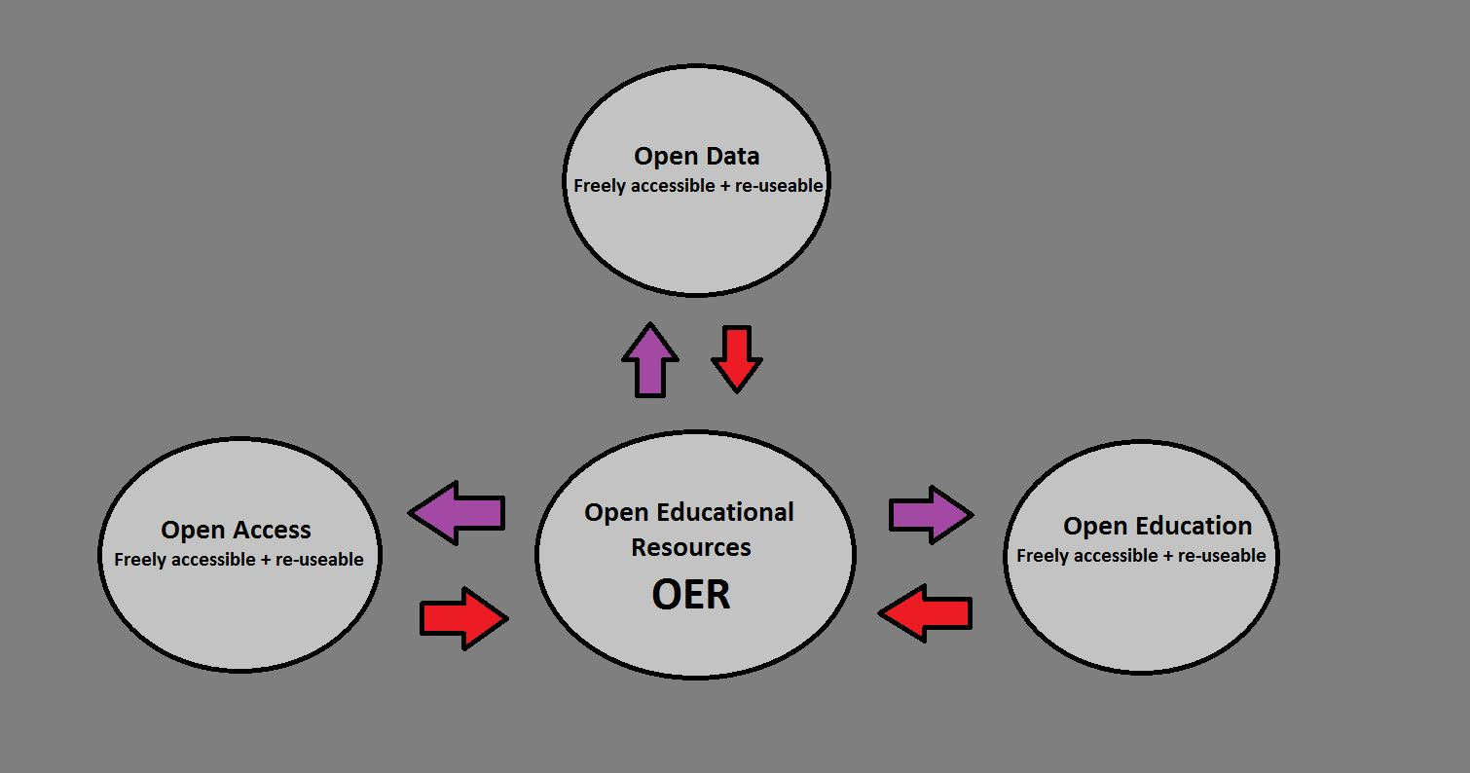

Slide 6
You are a blogger and a poet and want to create a work of art to add to your blog page
You decide to write a short (4-5 Lines) poem on the perils of Legos
You want to protect your work with a Creative Commons License
Create you work
Create!

Slide 7

But THAT’s MINE!!
How to get credit for your work when creating Open Educational Resources.

Slide 8
What is Creative Commons ?

Slide 9
Freely accessible = free to read
Re-usable = Openly licensed (CC)
Retain, reuse, revise, remix, and redistribute
This slide, is a derivative of “OpenCon2017” bit.ly/ocswflt by Southwest Florida , used by CC BY SA. This attributed slide licensed under CC BY SA by Heather Seibert.

Slide 10

CREATIVE COMMONS
Creative Commons is an American non-profit organization devoted to expanding the range of creative works available for others to build upon legally and to share.

Slide 11
“Meet Creative Commons” By cc Qatar

Slide 12
License Overview

Slide 13

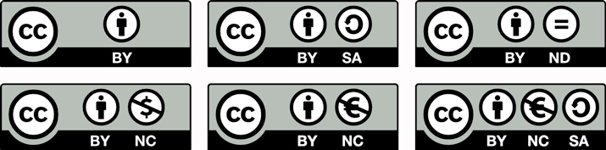
Open licenses for re-use
“some rights reserved” creativecommons.org
This slide, is a derivative of “OpenCon2017” bit.ly/ocswflt by Southwest Florida , used by CC BY SA. This attributed slide licensed under CC BY SA by Heather Seibert.

Slide 14
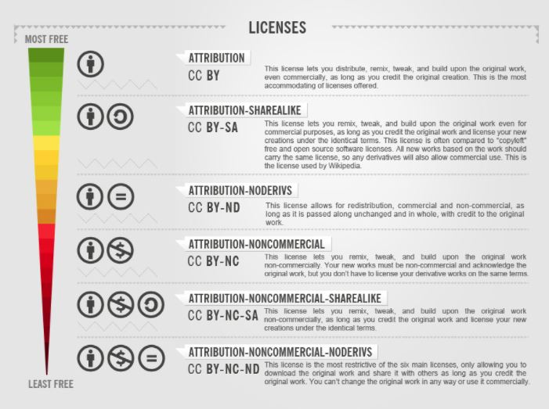

Slide 15
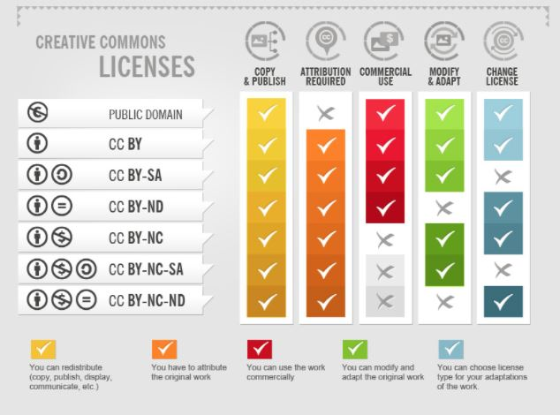

Slide 16
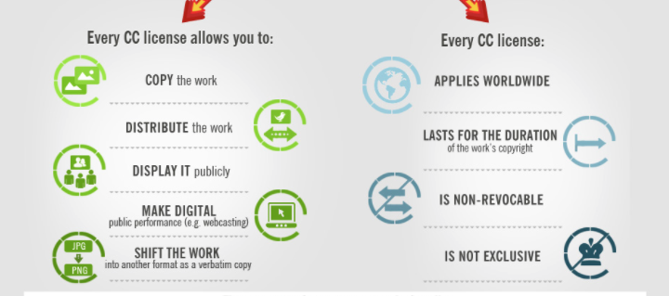
FREEDOM TO SHARE AND CREATE
How to Attribute Creative Commons Photos by Foter
CC BY SA

Slide 17
Where to look

Slide 18
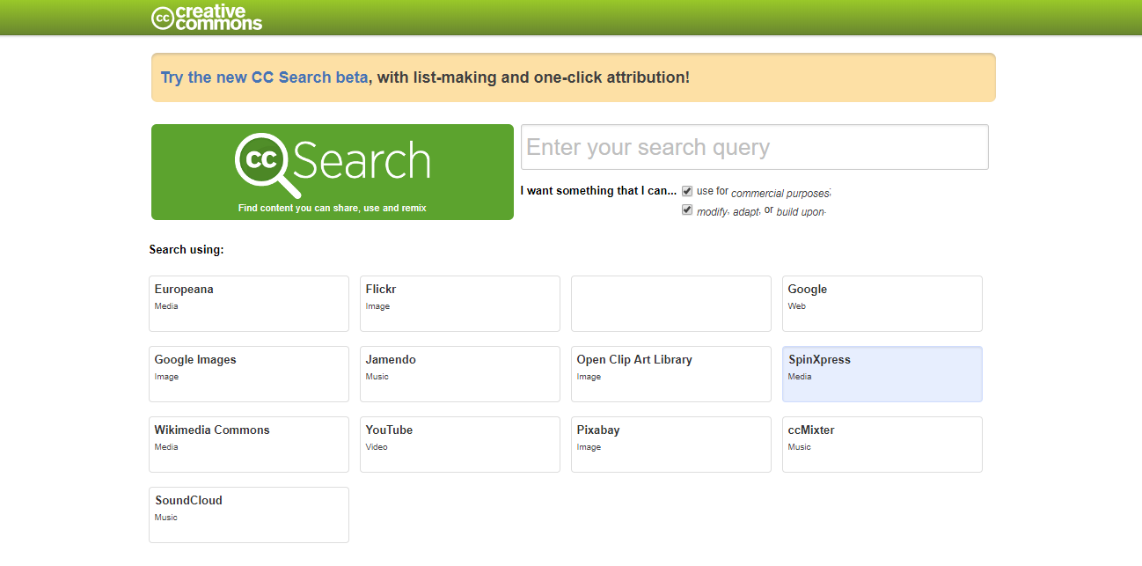
Creative Commons Search

Slide 19
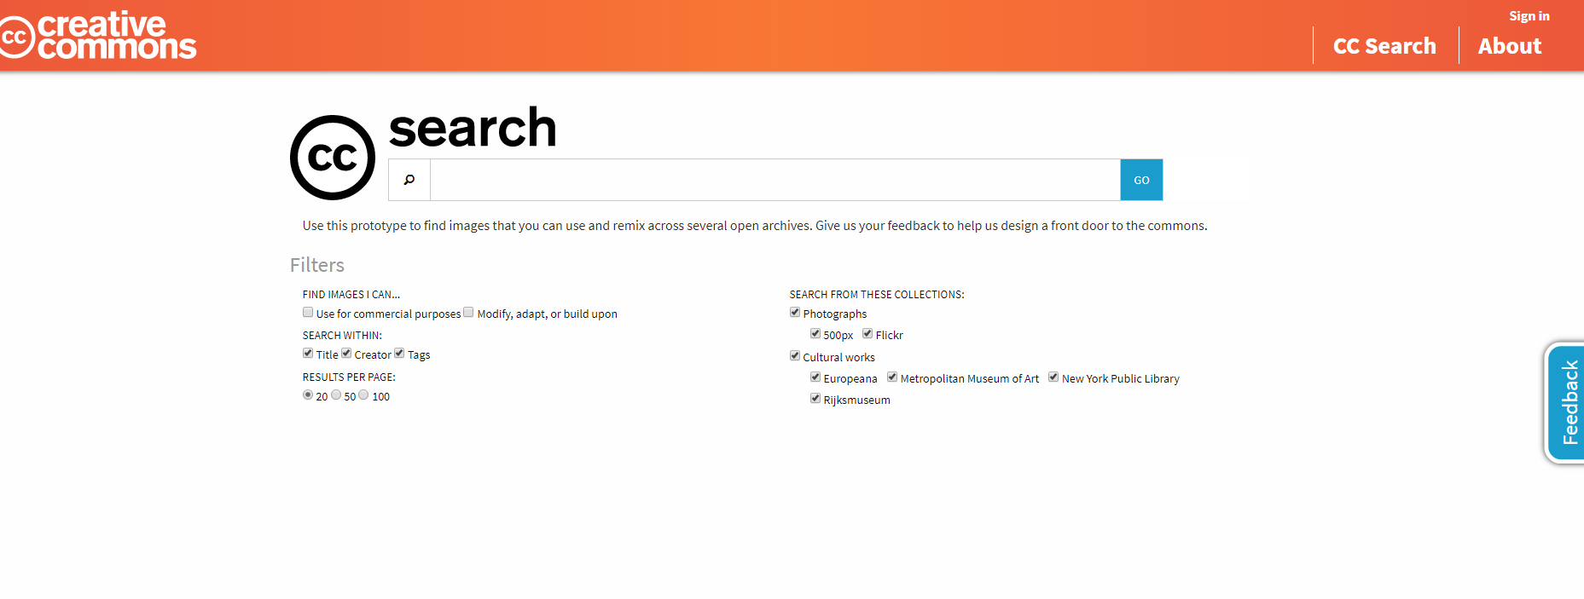
Creative Commons Search Beta Site

Slide 20


“Daisy” by Thomas Hawk

Slide 21
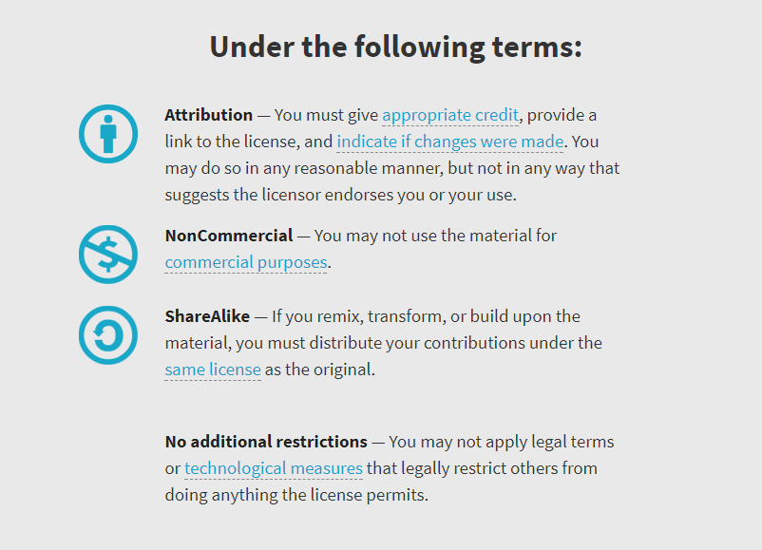
DR

Slide 22
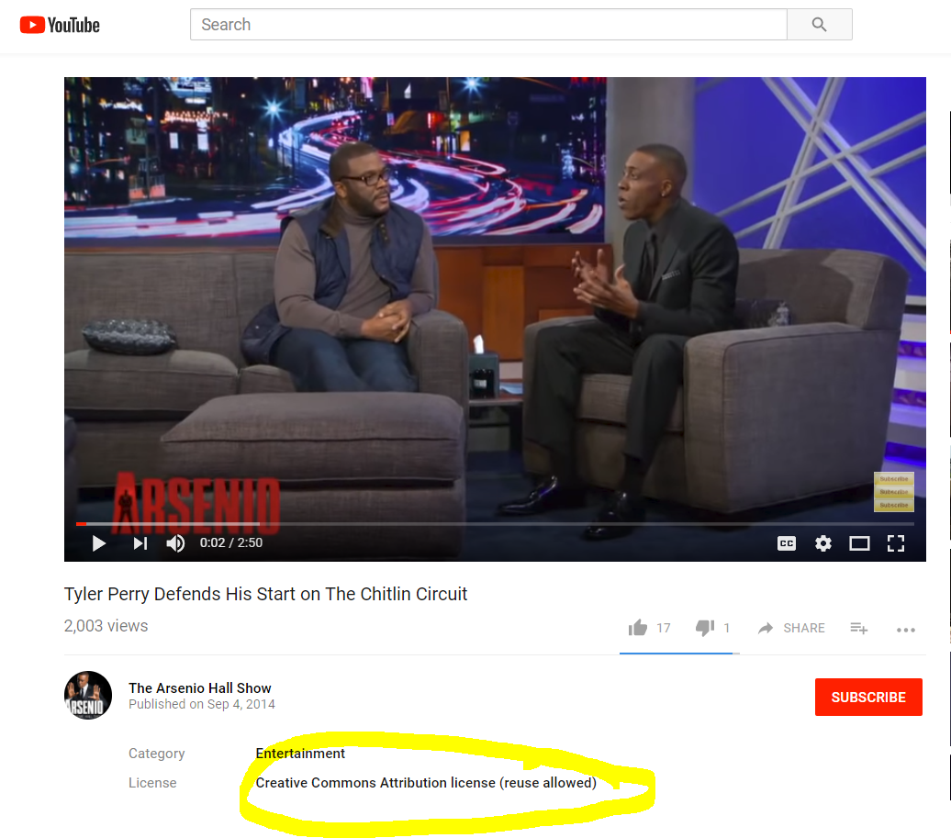

“Tyler Perry Defends His Start on The Chitlin Circuit” by The Arsenio Hall Show
CC for YouTube
DR

Slide 23
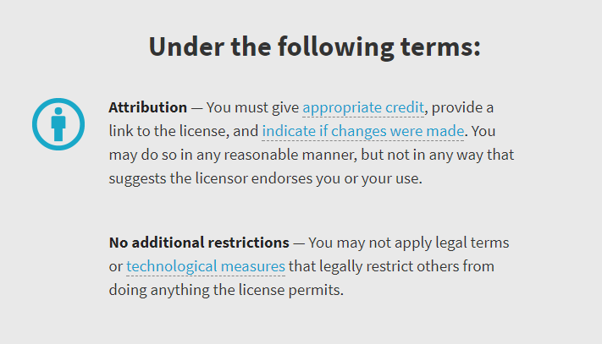
DR

Slide 24
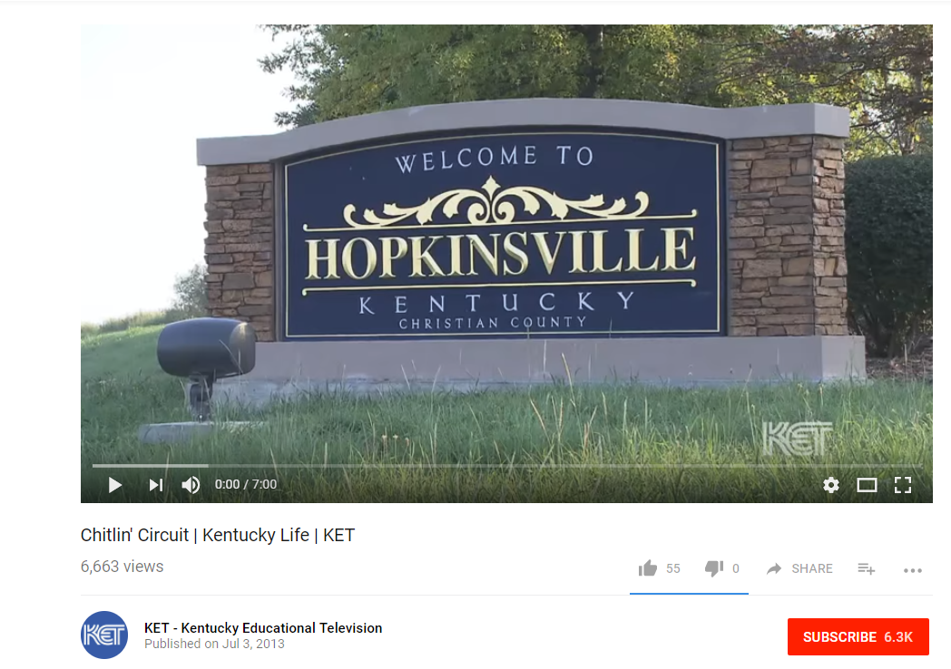
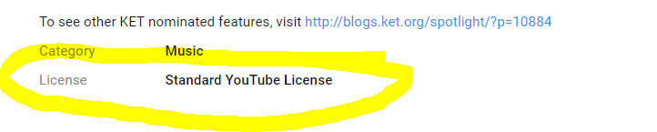
[KET-Kentucky Educational Television]. (2013, July 3). Chilitn’ Circuit /Kentucky Life/KNET [Video File]. Retrieved from https://www.youtube.com/watch?v=huQQksGrSDw
More on the Standard YouTube License
A Standard YouTube License is not a Creative Commons license
DR

Slide 25
The difference between the default copyright status of a video posted on YouTube and a video that is published under a Creative Commons license: by default videos are the exclusive copyright of the creator/rightsholder and a video that has a Creative Commons license may be copied, republished or otherwise used by others without a fee as long as the license conditions are followed. Creative Commons licenses can have various restrictions like only non-commercial use allowed, or providing credit to the creator. To use a video that is simply the copyright-protected work of another one must either negotiate a license to use it or (under US law) use it without permission in a manner that is permitted by law as a "fair use." - Ted Hasse
US Copyright and Fair Use Center

Slide 26
QUIZ TIME!

Slide 27
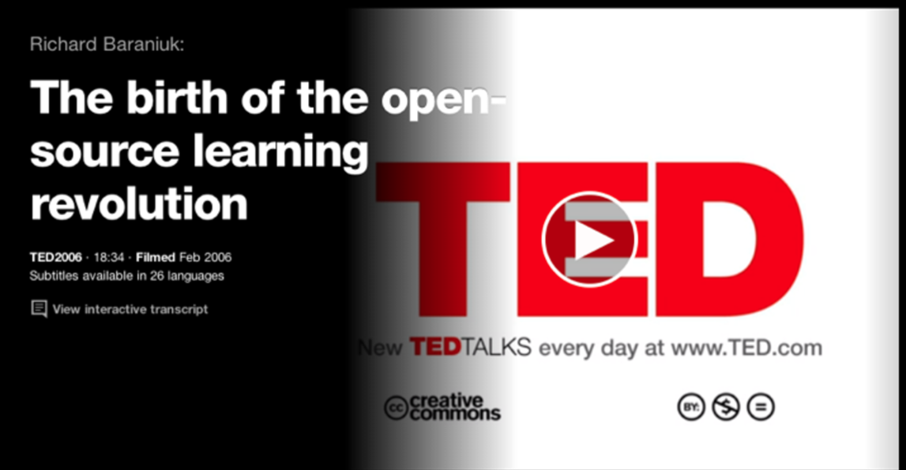

Slide 28
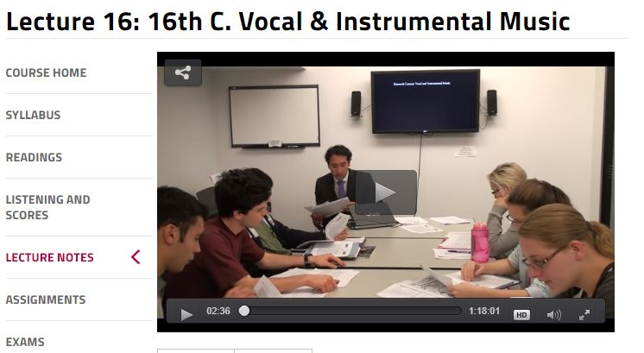
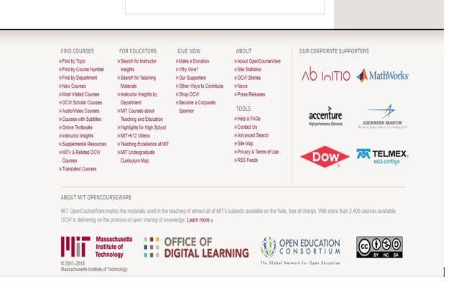
Lecture 16: 16th C. Vocal & Instrumental Music

Slide 29
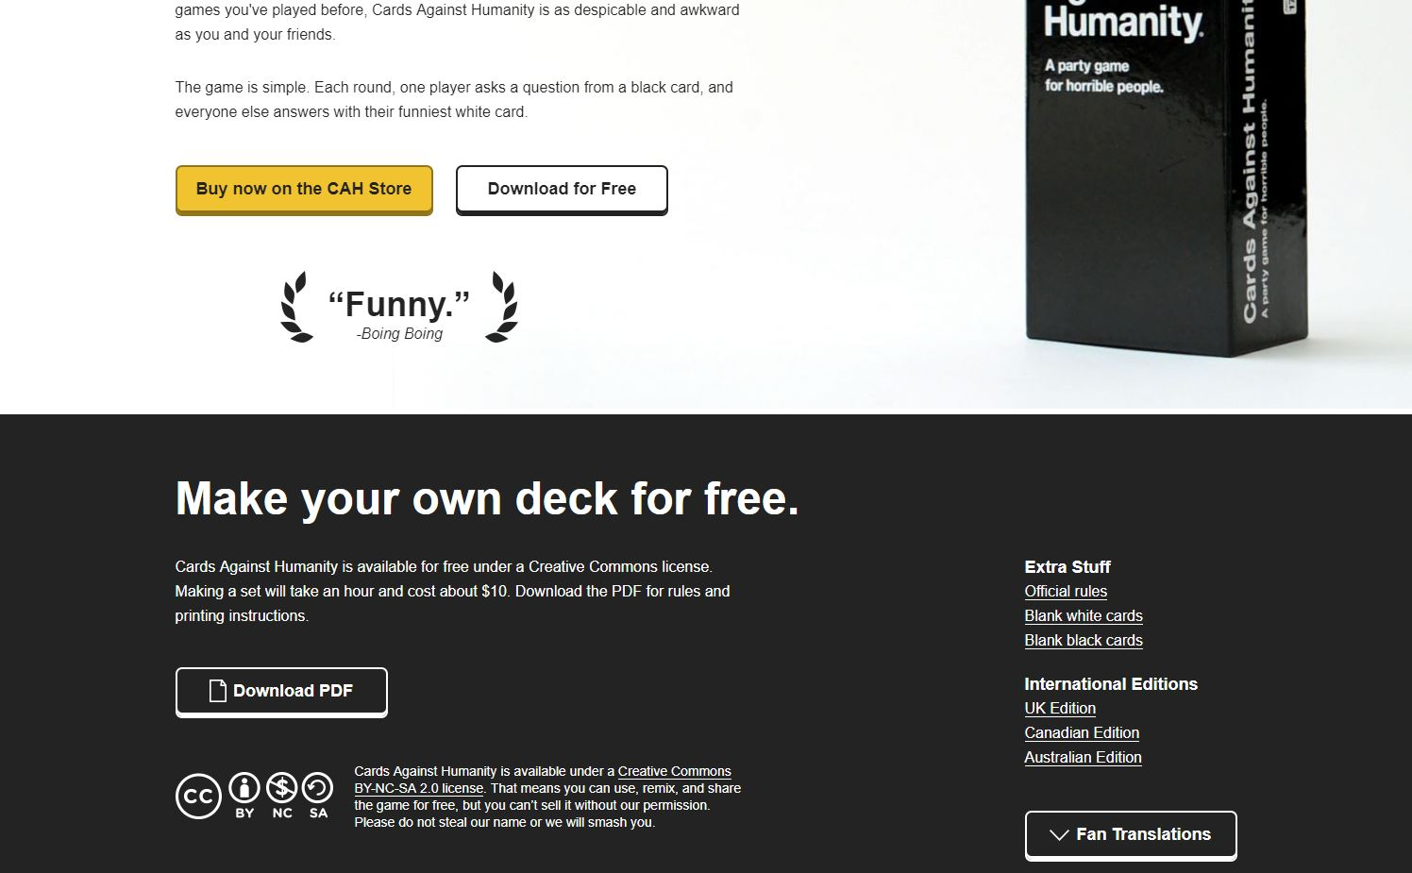

Slide 30
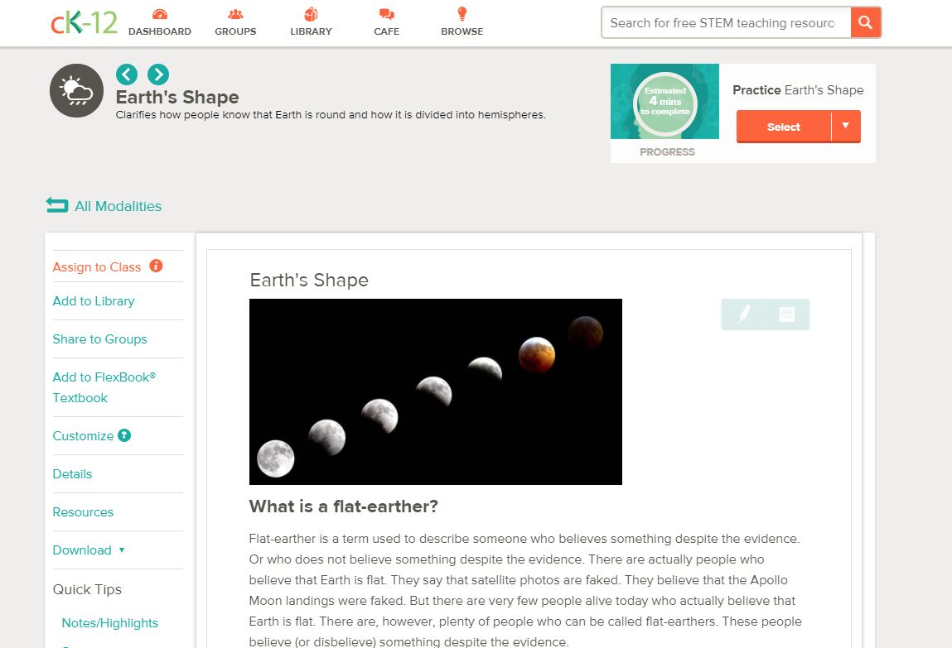
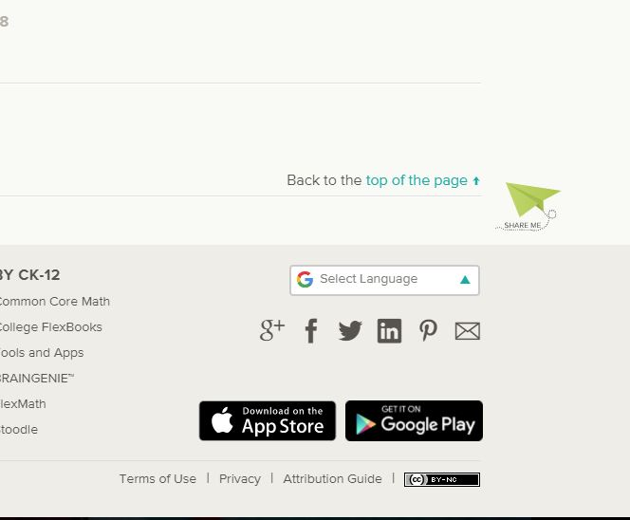

Slide 31
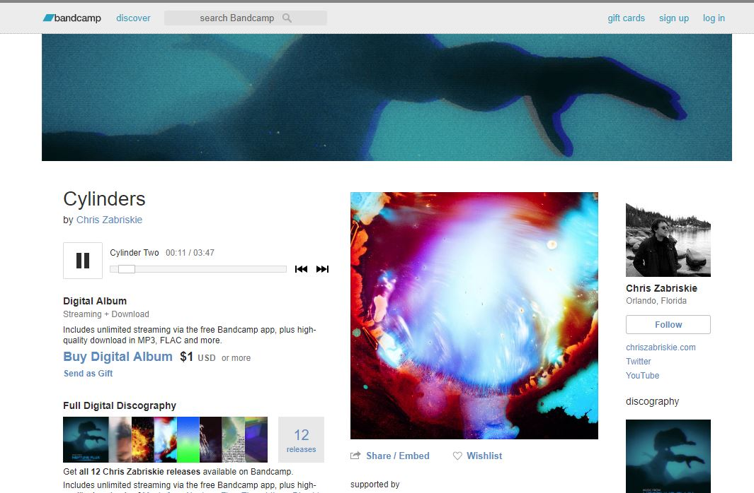

Cylinders
by Chris Zabriskie

Slide 32
ATTRIBUTION in Creative Commons

Slide 33
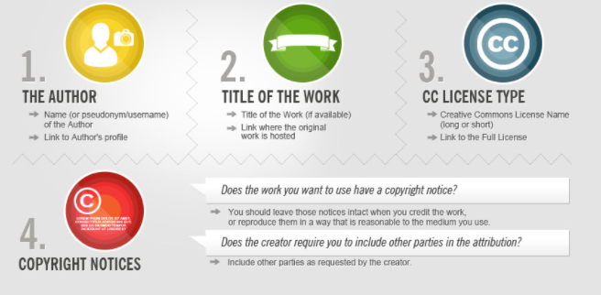
All Creative Commons license require attribution to the original authors. There is no only one way to provide attribution but it must be given to the best of the use’s ability with the information given.
Author
Title
CC License (short or long) linked
Copyright notices
included

Slide 34
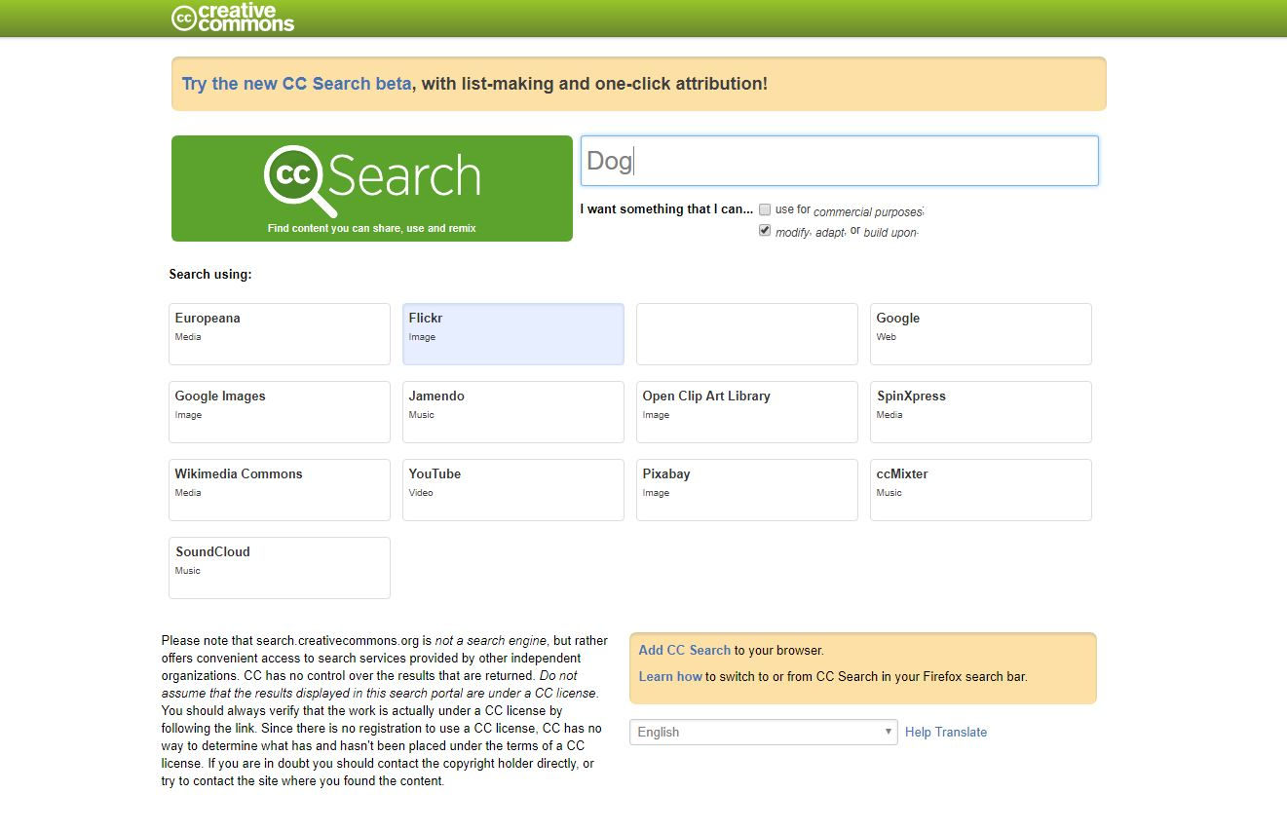
CC Search - Creative Commons Search: DOG – Flickr
New beta search CC

Slide 35
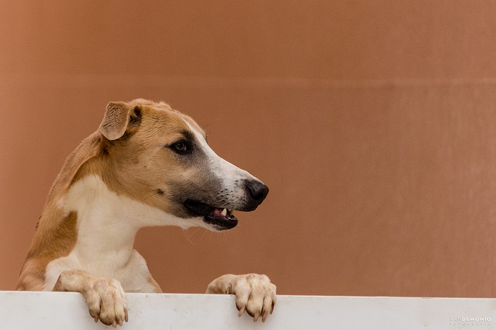
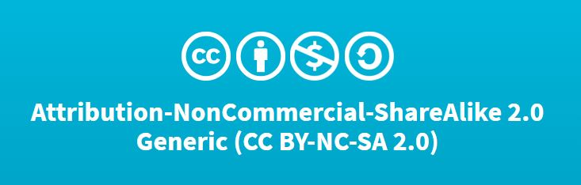
“Dog”
By Rodrigo Yassuda

Slide 36
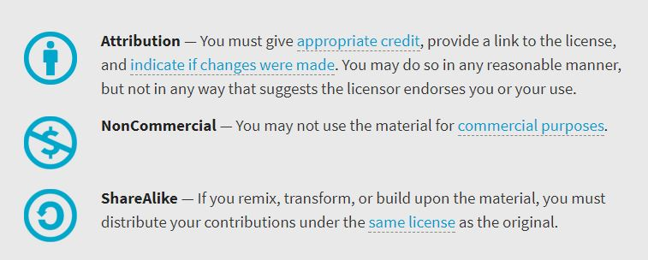
You are free to:
Share — copy and redistribute the material in any medium or format
Adapt — remix, transform, and build upon the material
The licensor cannot revoke these freedoms as long as you follow the license terms.

Slide 37
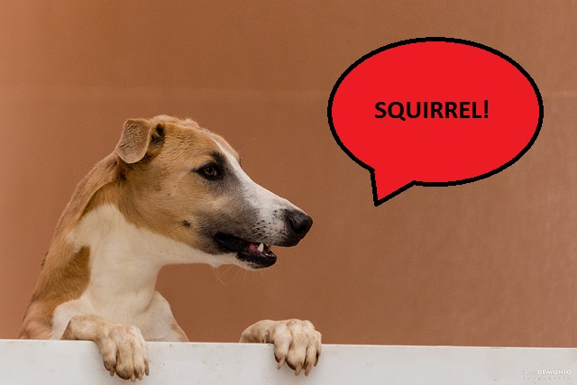
This work, “Squirrel Dog”, is a derivative of “Dog” by Rodrigo Yassuda , used by CC BY NC SA. “Squirrel Dog is licensed under CC BY NC SA by Heather Seibert.
CC license must be under the same as the original.

Slide 38
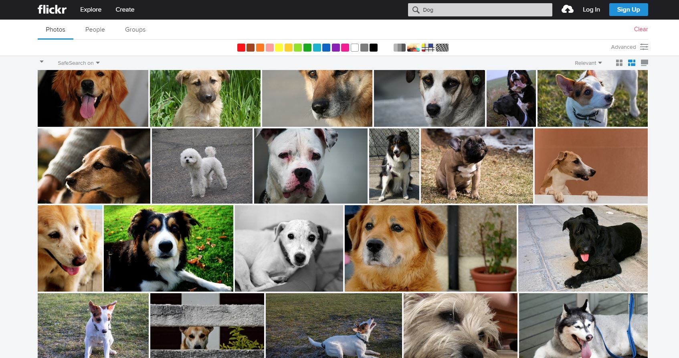
This work, “Squirrel Dog”, is a derivative of “Dog” by Rodrigo Yassuda , used by CC BY NC SA. “Squirrel Dog is licensed under CC BY NC SA by Heather Seibert.
CC license must be under the same as the original.

Slide 39

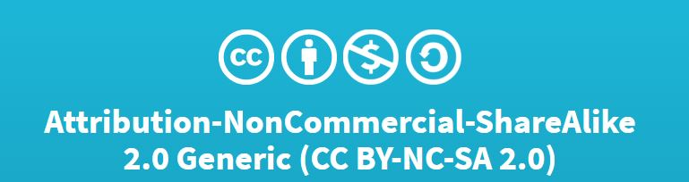
The Edges of Dubai by Trey Ratcliff
CC BY NC SA 2.0

Slide 40
1. Creative Commons (creativecommons.org)
2. (Click)Share your Work
3. (Click) Get Started
4. Take a moment to read the licensing considerations (linked on the page)
5. Choose your license features
6. Creative Commons will generate your license and provide information on what is a Free Cultural License
7. Choose to create attribution information
8. Copy link code or graphic to add to your work
Getting a CC License

Slide 41
You are a blogger and a poet and want to create a work of art to add to your blog page
You decide to write a short (4-5 Lines) poem on the perils of Legos
You want to protect your work with a Creative Commons License
Create you work
Create a CC license and add it to your poem and art
Now you try!

Slide 42
1. Creative Commons (creativecommons.org)
2. (Click)Share your Work
3. (Click) Get Started
4. Take a moment to read the licensing considerations (linked on the page)
5. Choose your license features
6. Creative Commons will generate your license and provide information on what is a Free Cultural License
7. Choose to create attribution information
8. Copy link code or graphic to add to your work
Getting a CC License

Slide 43
You are a world famous author and have written a book on Legos
1
You come across a bloggers page with the perfect poem on Legos and art as well!
2
You are very excited and want to use this persons work in your upcoming book
3
However, you decide to add a little of your own “flavor” into the work
4
SO!
5
What can you do? What does the license allow?
Create the change
Give attribution to the work.
Switch!

Slide 44
1. Creative Commons (creativecommons.org)
2. (Click)Share your Work
3. (Click) Get Started
4. Take a moment to read the licensing considerations (linked on the page)
5. Choose your license features
6. Creative Commons will generate your license and provide information on what is a Free Cultural License
7. Choose to create attribution information
8. Copy link code or graphic to add to your work
Getting a CC License

Slide 45
Talk briefly about Open Educational Resources
Create our own work
What is Creative Commons
Look at different types of CC License
Look for items with CC Licenses
How to identify a CC License
How to give attribution
Obtaining a CC License
Practice identifying/ modifying and attributing CC items
Recap!

Slide 46
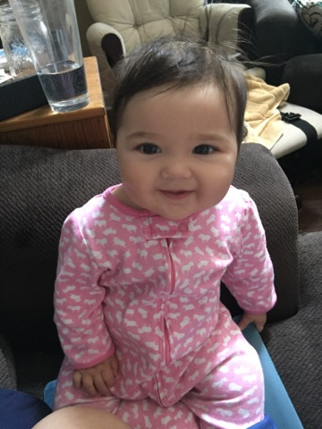


Slide 47
A Cover to Cover Solution | Student PIRGs. (n.d.-b). Retrieved July 26, 2017, from http://www.studentpirgs.org/reports/cover-cover-solution
Creative Commons & Copyright-Free Resources. (2012, August 14). Retrieved September 25, 2017, from https://www.spnn.org/node/6974
cc Qatar. (n.d.). Meet Creative Commons. Retrieved from https://www.youtube.com/watch?time_continue=1&v=P1j0OA9N4hs
CC Search. (n.d.-a). Retrieved October 11, 2017, from https://search.creativecommons.org/
CC Search. (n.d.-b). Retrieved September 26, 2017, from https://search.creativecommons.org/?query=Powerpoint
Clipart - High Quality, Easy to Use, Free Support. (n.d.). Retrieved October 11, 2017, from https://openclipart.org/
Creative Commons! (n.d.). Retrieved September 25, 2017, from https://www.emaze.com/@AIZOWOCR
Harley, D., Lawrence, S., Acord, S. K., & Dixson, J. (2009). Affordable and Open Textbooks: An Exploratory Study of Faculty Attitudes. Research Occasional Paper Series. CSHE.9.09. Center for Studies in Higher Education. Retrieved from https://eric.ed.gov/?id=ED507058
Minneapolis, C. for O. E. | 178 P. D. S. |, Education, M. 55455 U. C. of, & Minnesota, H. D. | U. of. (n.d.). Network Members | Open Textbook Network. Retrieved October 11, 2017, from http://research.cehd.umn.edu/otn/membership/network-members/
New government projections forecast dramatic growth in college students 25 and older. (2011, October 11). Retrieved September 12, 2017, from http://blogem.ruffalonl.com/2011/10/11/government-projections-forecast-dramatic-growth-college-students-25-older/
New study finds veterans are graduating at rates comparable to their peers. (n.d.). Retrieved September 12, 2017, from http://america.aljazeera.com/articles/2014/3/27/new-study-finds- veteransaregraduatingatratescomparabletotheirpee.html
Nontraditional Undergraduates / Trends in Nontraditional Student Enrollment. (n.d.). Retrieved September 12, 2017, from https://nces.ed.gov/pubs/web/97578f.asp
Open Educational Resources infoKit / Finding OERs. (n.d.). Retrieved September 15, 2017, from https://openeducationalresources.pbworks.com/w/page/27045418/Finding%20OERs
OpenCon Southwest Florida Toolkit - Google Drive. (n.d.). Retrieved September 25, 2017, from https://drive.google.com/drive/folders/0B3zC2zJzpxoIV1hiQzFKbVIxZDg
Minneapolis, C. for O. E. | 178 P. D. S. |, Education, M. 55455 U. C. of, & Minnesota, H. D. | U. of. (n.d.). Network Members | Open Textbook Network. Retrieved October 11, 2017, from http://research.cehd.umn.edu/otn/membership/network-members/
Rising Textbook Expenses and a Search for Solutions: Survey and Interview Results from Michigan Faculty. (n.d.). Retrieved July 26, 2017, from https://deepblue.lib.umich.edu/handle/2027.42/78552?show=full
Seibert-Racine, H. (n.d.). Research Guides: Open Educational Resources: Home. Retrieved September 12, 2017, from http://libguides.ecu.edu/c.php?g=168838&p=1107859
Veterans and College. (n.d.). Retrieved September 12, 2017, from http://www.ncsl.org/research/education/veterans-and-college.aspx
Wang, G. C., & Buckeridge, J. S. (2015). Ethics for Construction Engineers and Managers in a Globalized Market. In Engineering Ethics for a Globalized World (pp. 143–164). Springer, Cham. Retrieved from https://link.springer.com/chapter/10.1007/978-3-319-18260-5_10

Slide 48
Default Virtual Lab Stockroom. (n.d.). Retrieved September 25, 2017, from http://www.chemcollective.org/vlab/vlab.php
Home schooling accelerates in North Carolina | Charlotte Observer. (n.d.). Retrieved September 25, 2017, from http://www.charlotteobserver.com/news/local/education/article9150560.html
Homeschool Statistics. (n.d.). Retrieved September 25, 2017, from /stats
HSLDA | Homeschooling Through the Early Years: The Cost. (n.d.). Retrieved September 25, 2017, from https://www.hslda.org/earlyyears/Costs.asp
Home schooling accelerates in North Carolina | Charlotte Observer. (n.d.). Retrieved September 25, 2017, from http://www.charlotteobserver.com/news/local/education/article9150560.html
Introduction to Sociology - OpenStax CNX. (n.d.). Retrieved September 25, 2017, from http://cnx.org/contents/afe4332a-c97f- 4fc4-be27-4e4d384a32d8
Khan Academy. (n.d.). Retrieved September 25, 2017, from http://www.khanacademy.org
List of Creative Commons Image Directories and Sites. (n.d.). Retrieved September 25, 2017, from http://budgetstockphoto.com/creative_commons_images.html
More parents turn to homeschooling: 62% increase in the last decade. (2015, July 31). Retrieved September 25, 2017, from http://eagnews.org/more- parents-turn-to-homeschooling-62-increase-in-the-last-decade/
NC DOA : Home School FAQs. (n.d.). Retrieved September 25, 2017, from https://ncadmin.nc.gov/citizens/home-school/home- school-faqs
New study finds veterans are graduating at rates comparable to their peers. (n.d.). Retrieved September 12, 2017, from http://america.aljazeera.com/articles/2014/3/27/new-study-finds-veteransaregraduatingatratescomparabletotheirpee.html
News & Announcements | North Carolinians for Home Education. (n.d.). Retrieved September 25, 2017, from http://www.nche.com/news
OER Commons. (n.d.). Retrieved September 25, 2017, from https://www.oercommons.org/
Open Educational Resources infoKit / Finding OERs. (n.d.-a). Retrieved September 25, 2017, from https://openeducationalresources.pbworks.com/w/page/27045418/Finding%20OERs
Open Educational Resources infoKit / Finding OERs. (n.d.-b). Retrieved September 15, 2017, from https://openeducationalresources.pbworks.com/w/page/27045418/Finding%20OERs
Trends in Higher Education - The College Board. (n.d.). Retrieved September 25, 2017, from https://trends.collegeboard.org/
Veterans and College. (n.d.). Retrieved September 12, 2017, from http://www.ncsl.org/research/education/veterans-and- college.aspx
Public Libraries: Transforming the Lives of Job Seekers. (n.d.). Retrieved October 11, 2017, from https://www.ebsco.com/blog-archives/article/public-libraries- transforming-the-lives-of-job-seekers
When we share, everyone wins. (n.d.). Retrieved September 25, 2017, from https://creativecommons.org/
2017 Top Military-Friendly Online Colleges. (n.d.). Retrieved October 17, 2017, from https://www.guidetoonlineschools.com/online-schools/military-friendly
Clipart - High Quality, Easy to Use, Free Support. (n.d.). Retrieved October 11, 2017, from https://openclipart.org/

