Slide 1
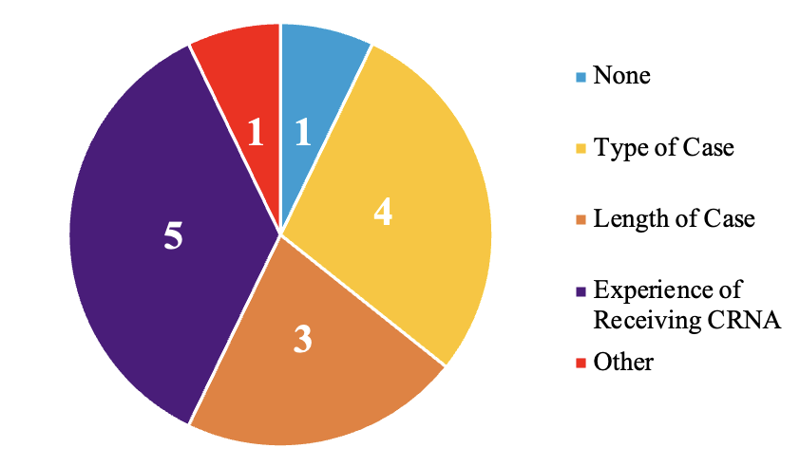
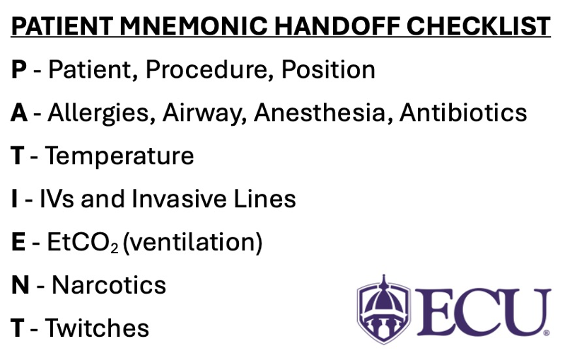
Implementation of a Standardized Handoff Report for Nurse Anesthetists in the
Intra-Operative Setting: A Quality Improvement Project
Grace Mook, BSN, SRNA
Maura McAuliffe, PhD, CRNA, FAAN, Project Chair
Nurse Anesthesia Program
College of Nursing, East Carolina University
Greenville, North Carolina 27858
mookg22@students.ecu.edu
INTRODUCTION
RESULTS
DISCUSSION
• 70% of sentinel events are caused by incomplete communication. Half of those breakdowns occur during handoff report (Canale, 2018).
• Potential adverse outcomes of inadequate handovers include:
Increased length of hospital stay
Increased morbidity
Potential mortality (Hu et al., 2020)
• Standardized handoff tools may improve the quality and continuity of information, perception of patient safety, and healthcare worker satisfaction (Canale, 2018).
• This Doctor of Nursing Practice (DNP) project assessed CRNAs’ perceptions of adequacy of the PATIENT mnemonic to facilitate standardized handoffs of anesthetized patients.
Figure 1
Factors influencing current CRNA handoff practices (n=6)
Figure 2
CRNA Post-Implementation Likert-type Responses (n=5)
I found the PATIENT mnemonic handoff tool:
• Pre-implementation survey (n=6):
- 5/6 CRNAS had ≥ 16 years of experience
4/6 CRNAs had a systematic method for handoff
Current handoff methods were efficient, comprehensive, and did not lend to communication errors.
Type/length of case and experience of the receiving CRNA influenced current handoff practices (Figure 1).
• Post-implementation survey (n=5):
4/5 reported PATIENT tool use: 2 CRNAs used the tool 1-5 times, and 2 CRNAs used the tool 0 times
The PATIENT mnemonic was easy to use but not more efficient, comprehensive, or appropriate in length when compared to previous handoff methods (Figure 2).
Net neutral response regarding whether the tool was more time consuming, lent itself to errors, and overall satisfaction.
CONCLUSIONS
• Limitations:
- Small sample size.
- Varying responses to surveys
• Recommendations:
Creation of a facility specific handoff tool in collaboration with anesthesia department to address specific concerns
Larger sample size
Include qualitative data
Project champions
METHODS
• Pre- and post-implementation survey design
• Framework: plan-do-study-act (PDSA) and the theory of planned behavior/reasoned action
• PATIENT mnemonic printed on laminated badge-buddy to attach to employee identification badge
REFERENCES
Canale, M. L. (2018). Implementation of a standardized handoff of anesthetized patients. American Association of Nurse Anesthesiology Journal, 86(2), 137-145.
Hu, J., Yang, Y., Li, X., Yu, L., Zhou, Y., Fallacaro, M. D., & Wright, S. (2020). Adverse outcomes associated with intraoperative anesthesia handovers: A systematic review and meta-analysis. Journal of PeriAnesthesia Nursing, 35(5), 525-535. https://doi.org/10.1016/j.jopan.2020.01.016
Wright, S. (2013). Examining transfer of care processes in nurse anesthesia practice: Introducing the PATIENT protocol. American Association of Nurse Anesthesiology, 81(3), 225-232.

