Slide 1

Are We Burned Out Yet?
Librarians Experiencing Burnout in their Careers
Mónica Colón-Aguirre, Assistant Professor, Library Science
Katy Webb, Head of Research and Instructional Services

Slide 2

What is Burnout?
A syndrome expressed in three types of feelings or dimensions
    Exhaustion
    Cynicism
    Lack of Effectiveness (Ineffectiveness)
A psychological response to aspects of one’s daily experiences
Can happen on a wide range of activities beyond paid employment

Slide 3
What is Burnout?
Change in attitude and behavior in response to a demanding, frustrating, unrewarding work experience
Burnout is characterized by an imbalance of the social environment in which people work (Maslach & Leiter, 1997)
  Main source lies in the mismatch between the nature of the job and the nature of the person performing that job
Should not be confused with work stress or fatigue

Slide 4

Burnout Among Librarians and Academics
Library profession has historically been perceived by people on the outside as one that carries low levels of stress (Sheesley, 2001)
  Despite this, studies indicate academic librarians experience burnout (Affleck, 1996; Shupe, Wambaugh & Bramble, 2015; Nardine, 2019)

Slide 5
Research Questions
Do academic librarians experience burnout?
Is there a relationship between the level of burnout and the type work performed in the library?
Is there a relationship between burnout and independent variables including: gender, race, sexual orientation or family situation?

Slide 6
Research Study: Method
Survey based on Maslach Burnout Inventory
Additional demographic questions added
Sent to ASERL schools (academic libraries in the Southeast US). Sent to 1769 librarians; completed by 614 librarians, 526 fully completed surveys

Slide 7
Other Questions Asked
Do you teach any credit-bearing, semester long courses?
Number of professional committees
Sex
LGBTQIA+ status
Marital status
Number of children
Race or ethnic group affiliation

Slide 8
Research Study: Method
Maslach Burnout Inventory (MBI)
Version Used: MBI General Survey
Inventory treats burnout as a continuous variable
  Expressed feeling goes from low to moderate to high degrees
  As opposed to either present or absent (i.e. dichotomous variable)

Slide 9
MBI - Exhaustion
  Feel drained, used up and unable to unwind and recover
  Lack of energy to face another project or person
  Questions focus on how often people feel tired at various points of the day and ability to deal with new problems at work

Slide 10
MBI - Cynicism
Those who feel cynicism take a cold, distant attitude towards work and people on the job
Minimize involvement at work
Give up their ideals
Questions focus on level of interest held for work, enthusiasm, perceived contributions of the work and significance of it

Slide 11
MBI - Ineffectiveness
Decreased feelings of effectiveness at work leave people with a sense of inadequacy
People lose confidence in their ability to make a difference
Lose confidence in themselves
Questions focus on contributions they make at work, interest level and perceived accomplishments at their job

Slide 12
Scale
Never
A few times a year or less
Once a month or less
A few times a month
Once a week
A few times a week
Every day

Slide 13
Survey Respondents
Library Department | Count | Percentage
Reference/User Services | 206 | 33.99%
Archives | 72 | 11.88%
Technical Services | 110 | 18.5%
Circulation/Access Services | 25 | 4.13%
Information Technology Support | 20 | 3.30%
Administration | 53 | 8.75%
Other | 120 | 19.80%

Slide 14
Survey Respondents
Do you have a MLS degree?
Yes | 538 | 88.63%
No | 63 | 10.38%
In Progress | 6 | 0.99%
Are you on the Tenure Track?
Yes | 182 | 30.08%
No | 423 | 69.92%

Slide 15
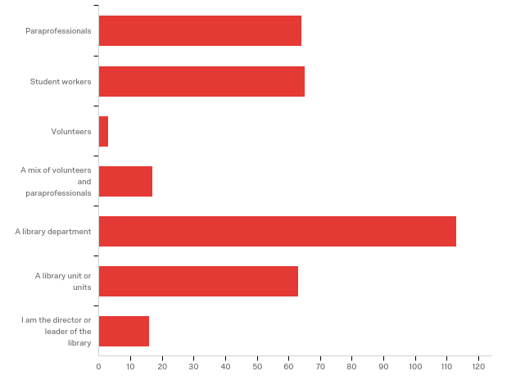
Survey Respondents
Do you have supervisory
duties?
Yes | 351 | 57.83%
No | 256 | 42.17%

Slide 16
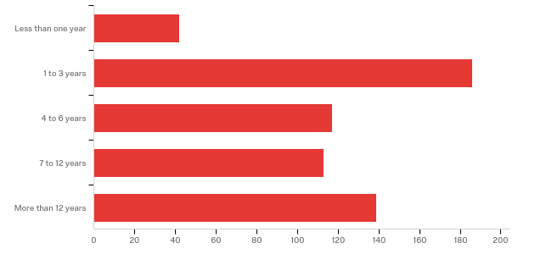
Survey Respondents
How long have you been employed in your current position?

Slide 17
Preliminary Results
We’re not burned out. We’re stressed.
MBI Results
 |  | Exhaustion | Effectiveness | Cynicism
N | Valid | 530 | 530 | 527
 | Missing | 84 | 84 | 87
Mean |  | 3.75 | 2.41 | 3.45
Median |  | 3.60 | 2.25 | 3.20

Slide 18
Burnout vs. Stress
Cherniss’ (1995) “Crisis of Competence”
Training which focuses on ideal situations
Lack of appreciation by clients
The boredom of day to day work (especially routine work)
Lack of collegiality

Slide 19
Managing Stress
Find time to play
Physical exercise
Set realistic goals
Use a support network
Keep an open mind
Know when it is time to leave

Slide 20
Think/Pair/Share
Have you experienced burnout in your current or past work?
What are some ways that you have sought to find a work life balance?

Slide 21
Questions?
Contact Us!
Mónica Colón-Aguirre
colonaguirrem17@ecu.edu
Katy Webb
kavanaghk@ecu.edu

Slide 22
References
Cherniss, C. (1980). Professional burnout in human service organizations. New York, NY: Praeger Publishers.
Cherniss, C. (1995). Beyond burnout: Helping teachers, nurses, therapists, and Lawyers recover from stress and disillusionment. New York, NY: Routledge.
Maslach, C., & Leiter, M. P. (1997). The truth about burnout: How organizations cause personal stress and what to do about it. San Francisco, CA: Jossey-Bass.
Philipp, A., & Schüpbach, H. (2009). Influence of emotional labor in demanding classroom situations on health and well-being of teachers. In Schwartzhoffer, R. V. (Ed.). Psychology of burnout: Predictors and coping mechanisms. New York, Y: Nova Science Publishers.
Sheesley, D. F. (2001). Burnout and the academic teaching librarian: An examination of the problem and suggested solutions. The Journal of Academic Librarianship, 27(6), 447-451.

