Slide 1
Module 10: Wireless Networks and Mobile Computing
Lesson 1: Wireless Networks and Protocols
Notes:
Hi everyone! My name is Alex Hodges, and welcome to the first of five lessons designed to introduce you to the field of wireless networks and mobile computing. In this first lesson, we will explore wireless networks and common protocols used with them.
The importance of wireless networks has never been greater than it has in modern history. In fact, according to market research conducted by PR Newswire, the revenue in the global wireless market is expected to expand from $1,431.3 billion in 2019 to $5,519.4 billion by 2024. With the recent pandemic, the position of wireless networks and wireless internet access as an important staple in homes and the workplace has never been more proven and solidified. As more and more wireless devices become available, wireless networks are becoming more prevalent and, in some cases, even preferred. Imagine, for example, if all the computing devices you have around you had to be connected to share data. That means anything that communicates to other devices. How inconvenient would it be if your phone had to be connected to your smart watch, headphones, laptop, and another person’s phone to send data to all those devices. You would have to constantly move cables and reconfigure devices just to send that meme to your friends. And you still wouldn’t even have Internet access until you plugged into wired IT infrastructure!
With the importance of wireless networks growing, it’s even more important that we have a workforce that has at least a basic understanding of these networks, their offerings, and their drawbacks. So, without further ado, welcome to the wonderful world of wireless.

Slide 2
Learning Objectives
Define a wireless network and its benefits
Compare and contrast wireless and wired networks to identify advantages and disadvantages of each and determine when each should be used
Identify types of wireless networks, their benefits/differences and when they are used
Choose a model that is most appropriate for a given, straightforward scenario
Match common wireless protocols/standards with their uses
Notes:
In this first lesson, we will explore wireless networks and their common uses, types, and protocols. By the end of this lesson, you should be able to:
Define a wireless network
Compare and contrast a wireless and wired network to identify advantages and disadvantages of each, as well as determine when each should be used
Identify types of wireless networks, their benefits, drawbacks, and differences, and identify when they are used
Choose a simple model that is most appropriate for a given, straightforward scenario
And finally, be able to match simple, common wireless protocols and standards to their uses

Slide 3
What is a Wireless Network?
Notes:
In this section of the lesson, we will explore the basics of what defines and comprises a wireless network, as well as a brief history of wireless.

Slide 4
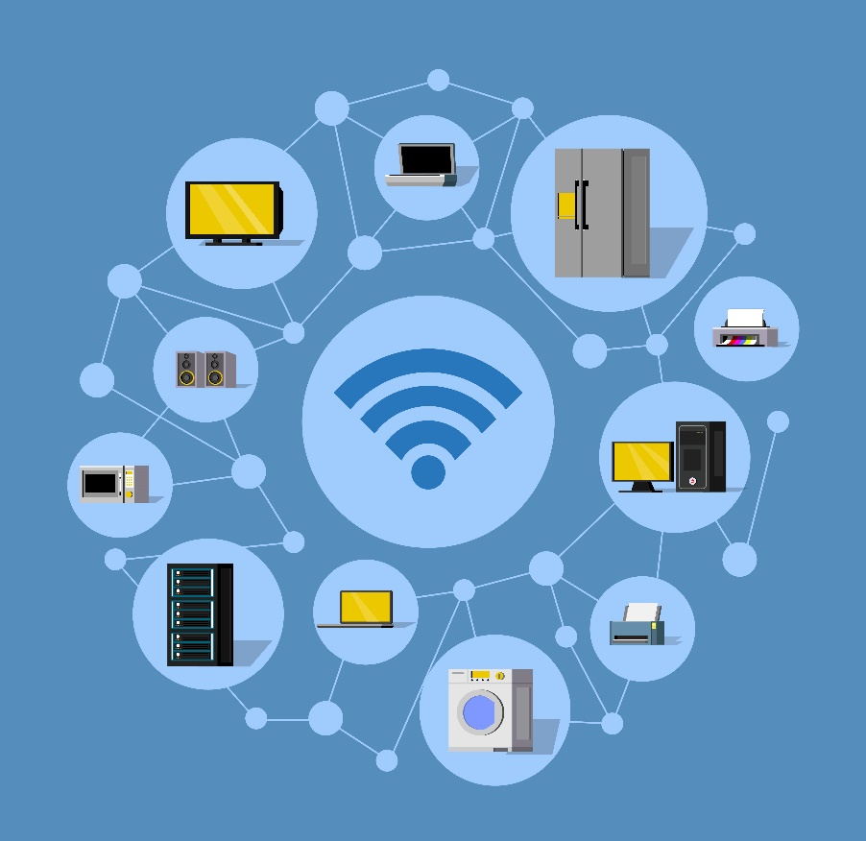
What is a Wireless Network?
Network where connections are made without cables – no cables are required
Devices communicate using radio waves
Wireless Network
Designed by macrovector / Freepik
Notes:
So, to understand wireless networks and protocols, we first must establish what a wireless network is. Put simply, a wireless network is a communications network where data can be transmitted, and connections made without cables. In a wireless network, communication takes place using radio waves, much like how walkie-talkies or your car radio would work.

Slide 5
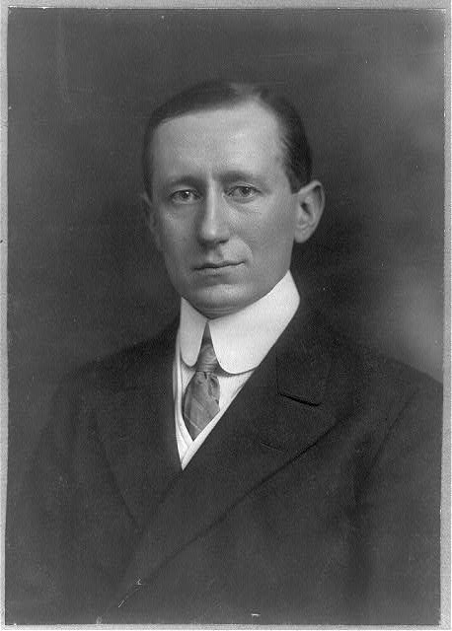
History of Wireless Networks
1896: Invention of the wireless telegraph
1946: First commercial telephone service
1947: Invention of the transistor
1962: First communications satellite
1968: Development of ARPANET
1971: Development of ALOHAnet
1979: First commercial automated cellular network (1G)
Guglielmo Marconi (retrieved from Library of Congress)
Notes:
The history of wireless networks is a long, somewhat complicated one. However, most agree that one of the most important developments on the road to wireless networks was the invention of the wireless telegraph in 1896. This telegraph, developed in the UK by Guglielmo Marconi, operated in a similar fashion to regular telegram “Morse code” in that the information was transferred by pulses of radio waves of two different lengths, called “dots” and “dashes”. The transmission is then received as audio which is then translated.
For the first half of the 20th century, telegraph remained the most prominent wireless communication technology. This was until the first generation of mobile phones hit the market. The Mobile Telephone service by AT&T became the first generation of mobile telephones in 1946, often referred to as the start of the 0G generation. The system used radio waves to link the mobile phones to the public switched telephone network. In this service, the caller wasn’t calling an end user directly but rather wirelessly calling the operator who connected them with the receiver via the PSTN, which required a hard connection. In this service, the caller had to search for an open channel before calling, and the call would be a simplex connection, meaning only one person could talk at a time. AT&T would later improve on this system in a number of ways, most notably by making the service duplex in 1964. These phones were large and typically only installed in cars or other locations that were unable to have a wired connection. However, the next event would lead to an era of shrinkage in technology.
The invention of the transistor in 1947 by three American physicists, John Bardeen, Walter H. Brattain, and William B. Shockley, at AT&T Bell was revolutionary as a viable alternative, and eventual replacement, to the electron tube. Due to the transistor’s small size, low heat, low power consumption, and high reliability, circuitry began the process of miniaturization, a process which continues to this day. It serves as an amplifier, controller, and/or generator of electrical signals in circuits.
In 1962, AT&T Bell, which later became Nokia Bell, launched Telstar 1, making it the first orbital communications satellite. This satellite facilitated the transmission of live TV and phone signals across the globe, with its primary task being to receive signals from the USA, amplify them 10 billion times, and return them to Europe, and vice versa.
In 1968, the development of ARPANET was in full swing, which became the precursor to today’s modern Internet. This network was a military research project ton connect computers over long distances without the need for cables. The system used existing phone lines to connect to other computers around the world and was one of the first to use the TCP/IP model while also standardizing several other protocols, like FTP, Telnet, email, and more.
ALOHAnet was a network system developed in 1971 at the University of Hawaii to connect computer systems across islands. It was the first to demonstrate wireless data packet transfers utilizing an experimental UHF (ultra-high frequency). It was one of, if not the first, network to utilize packets in the ALOHA protocol (still used today to establish an initial link), a random-access protocol, a share medium access, and more. It also helped lead, directly, to the development of Ethernet and personal wireless communication technologies.
In Japan in 1979, the beginning of cellular networks occurred, often referred to as 1G. Unlike the MTS and IMTS, the call was switched automatically, and could be transferred using various cellular sites rather than just one radio mast.

Slide 6
History of Wireless Networks
1986: First commercial wireless network, WaveLAN, by NCR
1991: 2G cellular network
1997: 802.11 Wi-Fi protocol first released
2001: 3G cellular network
2007: 4G/LTE cellular network
2018: 5G network at Olympics
Notes:
In 1986, wireless networks were brought to the masses with the WaveLAN products developed by NCR. Its proprietary protocols laid the basis for Wi-Fi and other wireless standards. From these points, Wi-Fi and wireless networks have continued to evolve. We are now on 5G cellular networks and Wi-Fi 6, and other Wireless technologies like Bluetooth and ZigBee have grown in popularity quickly.

Slide 7

Uses of Wireless Networks
  Libraries
  Any hotspots
In theory, can be used anywhere wired networks are used
Used often in public locations/open spaces:
  Cafes
  Hotels
  Offices
  Homes
Using Wireless Network in Library
Designed by pikisuperstar / Freepik
Notes:
In theory, wireless networks can be used anywhere that wired networks are used. In modern technologies, they often have similar, if not identical, speeds and security. However, wireless networks are best used in places where mobility is preferred or even required, or where running cable may be dangerous, costly, or just plain impossible. Wireless is used in nearly every location we visit today, but a few common examples of where they can be seen are cafes, hotels, offices, homes, libraries…basically anywhere that is a “hotspot” utilizes wireless.

Slide 8
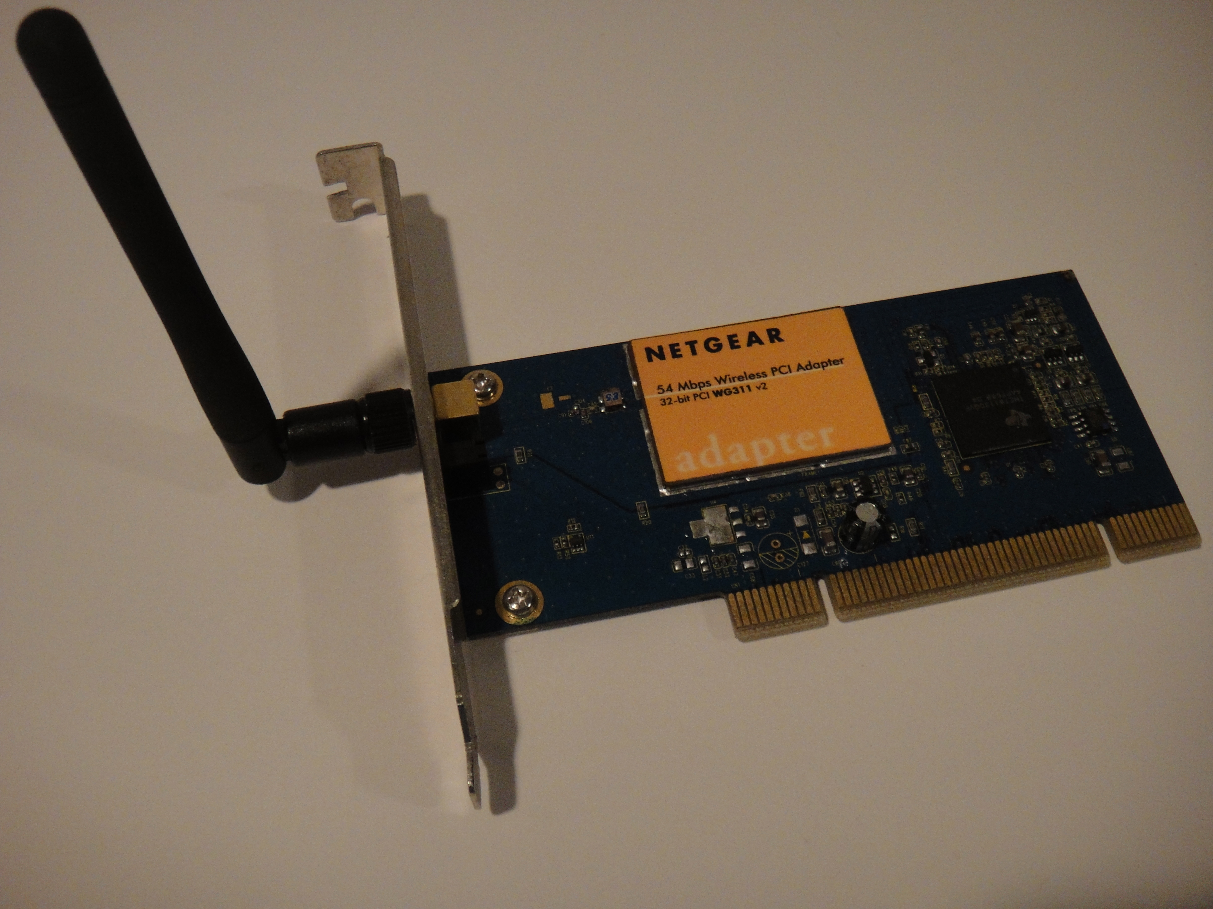
Hardware Used
Wireless-capable router
Wireless adapters
Wireless NIC
Wire-based connections for the backbone
Access points
Wireless extenders
Switch
Firewall
Wireless-Enabled devices
WLAN Controllers
Wireless NIC Adapter
CyberXRef, CC BY-SA 3.0 <https://creativecommons.org/licenses/by-sa/3.0>, via Wikimedia Commons
8
Notes:
Much of the hardware used in wired networks are also used in wireless networks. Obviously, you need routers, switches, and devices. However, these devices are slightly different for wireless networks. Wireless networks require a wireless-capable router that broadcasts the radio signals for devices to connect to. For a device to connect to these routers, they need a wireless adapter of some kind, which often is a wireless network interface card (NIC). With just these two pieces of hardware, a simple wireless network can be made. However, it is highly likely that more will be needed. In order to access the internet, for example, there must be at least one wired connection from the wireless router to the modem or Internet access medium. If there is a LAN backbone or system that a client would like to connect to wirelessly, then a connection is required to this as well. It is highly likely that your wireless router will not give you the range required to reach all your wireless devices. In this case, using access points, extender, or switches to extend the range and amplify the signal may be necessary. As with any network, security is also needed; therefore, many networks, both wired and wireless, include a hardware-based firewall as well.

Slide 9
How They Work
Wireless adapters in devices send/receive radio waves
Send data via radio waves to wireless router, which has a wired connection to the LAN and/or out to the Internet
Radio waves are converted into machine-readable binary
Wireless access points amplify the signal by connecting directly (via cable) to the router, extending the range
Extenders/antennas work to amplify the signal wirelessly by rebroadcasting the signal from a router/AP
9
Notes:
Wireless networks may seem complicated, but, at the surface level, they communicate in a relatively simple way. Say a client wants to connect to the internet wirelessly. In this case, the wireless adapter, like a wireless NIC, will send radio waves out into the air. From here, the waves are received on the wireless router, which passes the data via a wired connection to the LAN or out to the internet. The requested data or connection is then sent back the same way. At each machine, the radio waves are converted to machine-readable binary.
Along the way, the signal may come into contact with other devices. A wireless access point is a common type of device that is used in creating a wireless network. They amplify/extend the signal from a wireless router by being directly connected, via a cable, to the router. On the other hand, wireless extenders amplify the signal by intercepting the signal wirelessly from the router or AP and then rebroadcasting the signal to cover a larger area.

Slide 10
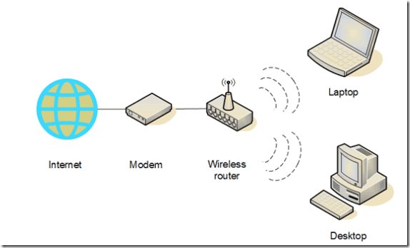
How They Work
Wireless Network
10
Notes:
Wireless networks may seem complicated, but, at the surface level, they communicate in a relatively simple way. Say a client wants to connect to the internet wirelessly. In this case, the wireless adapter, like a wireless NIC, will send radio waves out into the air. From here, the waves are received on the wireless router, which passes the data via a wired connection to the LAN or out to the internet. The requested data or connection is then sent back the same way. At each machine, the radio waves are converted to machine-readable binary.
Along the way, the signal may come into contact with other devices. A wireless access point is a common type of device that is used in creating a wireless network. They amplify/extend the signal from a wireless router by being directly connected, via a cable, to the router. On the other hand, wireless extenders amplify the signal by intercepting the signal wirelessly from the router or AP and then rebroadcasting the signal to cover a larger area.

Slide 11

How Do I Connect?
Only need a wireless connection (AKA hotspot) and an adapter to pick up the signal
Cell Phone Connecting to Wi-Fi Hotspot
11
Notes:
Connecting to a wireless network is simple. All that is needed is an area with a wireless connection/signal, also known as a hotspot, and an adapter of some sort that can pick up and translate the signal into a usable format for the machine. Once connected, some further steps may be required, such as inputting a password, authentication, and more.

Slide 12
Quick Check
1. How do wireless networks communicate?
A. Light
B. Radio Waves
C. Electrical Signals
D. Microwaves
12

Slide 13
Quick Check
1. How do wireless networks communicate?
A. Light
B. Radio Waves
C. Electrical Signals
D. Microwaves
Answer: B
Though the data is converted to an electrical signal, it transmits as radio waves
13

Slide 14
Quick Check
2. Name one place where a wireless network may be used and why it may be used there.
(Answers will vary)
14

Slide 15
Quick Check
2. Name one place where a wireless network may be used and why it may be used there.
(Answers will vary)
Wireless networks are commonly used in public places where quick, easy access is needed without having to run loose cables
15

Slide 16
Quick Check
3. A device or computer must have some form of wireless adapter to connect to wireless networks.
A. True
B. False
16

Slide 17
Quick Check
3. A device or computer must have some form of wireless adapter to connect to wireless networks.
A. True
B. False
Answer: A
All wireless devices have some form of wireless adapter aboard
17

Slide 18
Section 1 Quick Check Answers
How do wireless networks communicate? B. Radio Waves
Name one place where a wireless network may be used and why it may be used there. Answers will vary, but could include libraries, offices, homes, and so on. Reasons could include cost, ease of use, mobility, and so on.
A device or computer must have some form of wireless adapter to connect to wireless networks. A. True
18

Slide 19
Wireless vs. Wired Networks
Notes:
Now that we know a little bit about wireless networks, let’s compare them to wired networks.

Slide 20
Advantages of Wireless
Wireless:
  Installation speed/simplicity
  Cost
  Increased mobility/flexibility
  Wider access
  Many connections
  No wires
  Scalability
  BYOD
  Convenience
  Ease of use
20
Notes:
When comparing wireless and wired networks, there are several advantages that each may provide in each scenario. These advantages play an important role in determining what network type is chosen in each location.
The biggest advantage in a wireless network is increased mobility. Users can move around without having to worry about carrying around a cable and reconnecting every time they need to access the network or internet. Within the area covered by the network, users can move to any location and work from any device, allowing for flexibility and increased productivity. One of the other huge benefits of wireless networks is the ability to increase the range of access. Wireless allows for connectivity in locations that may be difficult or even impossible to run cables through. Obviously, wireless networks also end up being neater and more organized; this is largely due to the fact that there are no cables to deal with or organize. This also makes the infrastructure safer to traverse; there is less of a chance of tripping over a cable or accidentally pulling one out, and having less cables makes the infrastructure more easily traceable when physical work on the systems is needed. The fact of having no cables also makes the setup easier and quicker, and sometimes even cheaper, when compared to a wired network. Running cables can quickly add up; a foot of CAT-5e will set you back about $0.25 while the same distance of CAT-8 ethernet will be nearly three times that amount at $0.70 per foot. Likewise, the scalability of wireless networks also benefits from this lack of cables; to add a new device, no new cables have to be run. Instead, it just needs to be in range of the wireless network. This is also possible because of the number of users that wireless networks can handle. While too many users will make the network performance suffer, a wireless network is not limited to the number of ports available on a switch or router. Wireless technologies also increase the use and success of BYOD policies, which can further cut down on costs. Finally, wireless is simply convenient and easy to use for both employees and customers. Being able to transport a device wherever you may go and connect to get some work done benefits both the individual and the organization from both directions. Customers often appreciate a guest network that they can connect to easily, which allows them to utilize their devices on the go, while employees are free to work from any location, at any time. Wireless also makes some processes much easier, such as file transfers from devices to other devices, especially from a device like a phone or tablet.
While wireless has numerous benefits, wired networks have their advantages and place as well. Wired networks provide more control over the connected devices and their security. In the same light, it is typically more difficult for an attacker to gain access to a wired network. Though wireless can be nearly equivalent to wired speeds today, wired networks tend to be a little faster and perform better overall. This is because, since they do not use radio waves, they tend to have less interference, instability, and complications.

Slide 21
Advantages of Wired
Wired:
  More control
  More secure
  More reliable
  Better speed
21
Notes:
When comparing wireless and wired networks, there are several advantages that each may provide in each scenario. These advantages play an important role in determining what network type is chosen in each location.
The biggest advantage in a wireless network is increased mobility. Users can move around without having to worry about carrying around a cable and reconnecting every time they need to access the network or internet. Within the area covered by the network, users can move to any location and work from any device, allowing for flexibility and increased productivity. One of the other huge benefits of wireless networks is the ability to increase the range of access. Wireless allows for connectivity in locations that may be difficult or even impossible to run cables through. Obviously, wireless networks also end up being neater and more organized; this is largely due to the fact that there are no cables to deal with or organize. This also makes the infrastructure safer to traverse; there is less of a chance of tripping over a cable or accidentally pulling one out, and having less cables makes the infrastructure more easily traceable when physical work on the systems is needed. The fact of having no cables also makes the setup easier and quicker, and sometimes even cheaper, when compared to a wired network. Running cables can quickly add up; a foot of CAT-5e will set you back about $0.25 while the same distance of CAT-8 ethernet will be nearly three times that amount at $0.70 per foot. Likewise, the scalability of wireless networks also benefits from this lack of cables; to add a new device, no new cables have to be run. Instead, it just needs to be in range of the wireless network. This is also possible because of the number of users that wireless networks can handle. While too many users will make the network performance suffer, a wireless network is not limited to the number of ports available on a switch or router. Wireless technologies also increase the use and success of BYOD policies, which can further cut down on costs. Finally, wireless is simply convenient and easy to use for both employees and customers. Being able to transport a device wherever you may go and connect to get some work done benefits both the individual and the organization from both directions. Customers often appreciate a guest network that they can connect to easily, which allows them to utilize their devices on the go, while employees are free to work from any location, at any time. Wireless also makes some processes much easier, such as file transfers from devices to other devices, especially from a device like a phone or tablet.
While wireless has numerous benefits, wired networks have their advantages and place as well. Wired networks provide more control over the connected devices and their security. In the same light, it is typically more difficult for an attacker to gain access to a wired network. Though wireless can be nearly equivalent to wired speeds today, wired networks tend to be a little faster and perform better overall. This is because, since they do not use radio waves, they tend to have less interference, instability, and complications.

Slide 22
Disadvantages
Wireless:
  Interference/signal strength & quality
  Security
  Speed
  Dependability/reliability
Wired:
  Expensive
  Maintenance overhead
  Messy/hazardous cables
  Limited number of connections to router
  Limited mobility
22
Notes:
With all the advantages these network categories bring, they also carry a significant number of disadvantages when compared with each other, depending on the use case. Disadvantages play just as big of a role as advantages when choosing a type of network, so understanding both is crucial to making a well-informed decision.
Though there are many benefits to wireless networks, they tend to suffer more severely from interference, instability, and degraded signal strength and quality. This is largely due to the distance the signal has to travel, the number of devices connected, and what the signal has to pass through. Wireless networks tend to have an increased security risk as well, as it is typically easier to get into a wireless network. Once in, a wireless network has less control over its connected devices, so a device could be carrying malicious packets or using outdated protocols or security measures. Speeds on wireless, though relatively similar to wired speeds, do tend to be slower, overall. Additionally, while a wireless network tends to be cheaper in most cases, it can end up being expensive or extremely difficult.
Wired networks also have several disadvantages. First, most obviously, the cables they require can be expensive, messy, and hazardous. Wired networks also tend to be more complicated to troubleshoot, as a particular cable or device likely needs to be physically located before it can be fixed or, certainly, replaced, and is less likely to be resolved remotely or via software. Expanding a wired network is also usually much more time-consuming and expensive than expanding a wireless network; a new device must be ordered, shipped, installed, configured, cabled, and so on. They are also much less convenient and mobile, requiring a cabled connection to a station at all times. Additionally, the number of users a wired network can support is limited to the number of ports a device, be it a router, switch, or otherwise, has.

Slide 23
Quick Check
1. Name 2 advantages and disadvantages of a wireless network.
(Answers will vary)
23
Notes:
Connecting to a wireless network is simple. All that is needed is an area with a wireless connection/signal, also known as a hotspot, and an adapter of some sort that can pick up and translate the signal into a usable format for the machine. Once connected, some further steps may be required, such as inputting a password, authentication, and more.

Slide 24
Quick Check
1. Name 2 advantages and disadvantages of a wireless network.
(Answers will vary)
Advantages may include mobility, convenience, BYOD, cost, etc.
Disadvantages may include interference, speed, security, etc.
24
Notes:
Connecting to a wireless network is simple. All that is needed is an area with a wireless connection/signal, also known as a hotspot, and an adapter of some sort that can pick up and translate the signal into a usable format for the machine. Once connected, some further steps may be required, such as inputting a password, authentication, and more.

Slide 25
Quick Check
2. Name 2 advantages and disadvantages of a wired network.
(Answers will vary)
25
Notes:
Connecting to a wireless network is simple. All that is needed is an area with a wireless connection/signal, also known as a hotspot, and an adapter of some sort that can pick up and translate the signal into a usable format for the machine. Once connected, some further steps may be required, such as inputting a password, authentication, and more.

Slide 26
Quick Check
2. Name 2 advantages and disadvantages of a wired network.
(Answers will vary)
Advantages may include better speed and security, etc.
Disadvantages may include messy/hazardous cables, inconvenience, cost, etc.
26
Notes:
Connecting to a wireless network is simple. All that is needed is an area with a wireless connection/signal, also known as a hotspot, and an adapter of some sort that can pick up and translate the signal into a usable format for the machine. Once connected, some further steps may be required, such as inputting a password, authentication, and more.

Slide 27
Section 2 Quick Check Answers
Name 2 advantages and disadvantages of a wireless network. Answers may vary. Advantages may include mobility, convenience, BYOD, cost, etc. Disadvantages may include interference, speed, security, etc.
Name 2 advantages and disadvantages of a wired network. Advantages may include better speed and security, etc. Disadvantages may include messy/hazardous cables, inconvenience, cost, etc.
27

Slide 28
Common Wireless Types & Security Protocols/Encryptions
Notes:
Now that we have learned about the advantages a wireless network can brings, how do we know what kind of wireless networks an organization, home, or individuals may need to suit their needs? Well, first, it is important that we familiarize ourselves with some of the most common types of wireless networks. Today, we will explore five of the most common.

Slide 29
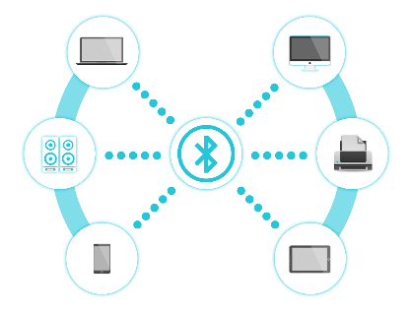
Common Wireless Network Types
Wireless Personal Area Network (WPAN)
  Short-range network of about 30 feet
  Used to connect smaller items based in a central location
  Usually use Bluetooth or similar (IEEE 802.15)
Bluetooth-Connected WPAN
29
Notes:
Wireless Personal Area Networks, WPANs, on the other hand, are networks with a very small range of about thirty feet. They are used to connect small, personal devices around a central location, and typically use Bluetooth or other such protocols. These networks typically connect things like smart watches, headphones, and speakers to mobile phones, for example. These networks typically have moderate performance and use standards such as Bluetooth, IEEE 802.15, and IrDa (Infrared Data Association).

Slide 30
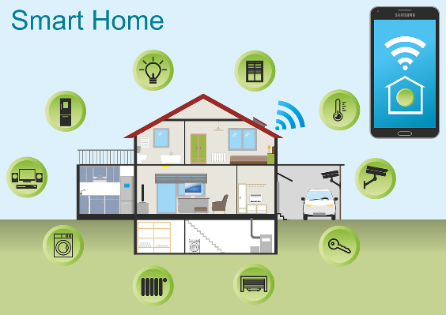
Common Wireless Network Types
Wireless Local Area Network (WLAN)
  Limited exposure area
    Usually, one building or small group of buildings
WLAN
30
Notes:
One of the most common wireless networks we see are wireless local area networks, or WLANs. Much like wired LANs, these networks cover a limited, local exposure area and are commonly used in areas such a university campus or library. They are also commonly used as an expansion of a wired network or another wireless network. WLANs typically have high performance, and use the IEEE 802.11, Wi-Fi, and HiperLAN standards.

Slide 31

Common Wireless Network Types
Wireless Metropolitan Area Network (WMAN)
  Within a city or related region
  Spans up to 30 miles
  Commonly used in schools/colleges and public services
WMAN
Designed by macrovector / Freepik
31
Notes:
Wireless Metropolitan Area Networks, WMANs, are networks located within a city and usually span roughly 30 miles and are usually seen in urban settings. They typically connect multiple networks from several buildings in the area, including offices, schools, and public services, and serve as both an alternative and a back-up to copper and fiber networks. WMANs typically have high performance and utilize either the Wi-Fi or the IEEE 802.16 and WIMAX standards, though proprietary protocols and standards may be used.

Slide 32

Common Wireless Network Types
Wireless Wide Area Network (WWAN)
  Large distance wireless network
    Connect several smaller networks
    Used to connect a company’s HQ, branch offices, cloud, and other facilities
WWAN
32
Notes:
Wireless Wide Area Networks, or WWANs, are large distance networks that can spread over cities or countries, and typically rely on satellites and/or antennas and work closely with ISPs to ensure connectivity. They typically work to connect smaller networks, like WLANs and WMANs together. These networks usually have low performance, and may utilize several standards, which used to include Cellular Digital Packet Data (CDPD) but is now predominantly cellular networks from 2G to 5G.

Slide 33
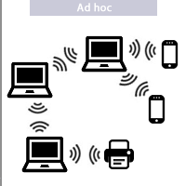
Common Wireless Network Types
Ad-Hoc network
  LAN network created “as needed” when devices connect to each other
  Forward packets to and from each other without a central base station
    Used when Internet connectivity and/or Wi-Fi is not needed or available
      Common in disaster-relief scenarios
Ad-Hoc Network
Lynxman03, CC BY-SA 4.0 <https://creativecommons.org/licenses/by-sa/4.0>, via Wikimedia Commons
33
Notes:
Ad-Hoc Networks are a form of WLANs, but they have some unique characteristics. Specifically, ad-hoc networks are formed primarily on an as-needed basis, especially when other connections and/or Wi-Fi are not available. Instead of utilizing a central base, like a router or switch, the devices are free to forward traffic amongst themselves. These networks are commonly seen in disaster relief efforts as quick, simple solutions to get connections and communications running.

Slide 34
Common Wireless Network Types
Hybrid network
  Combines elements of multiple networks/technologies
    Uses both Ethernet 802.3 and Wi-Fi 802.11 standards
34
Notes:
A hybrid network is a network that incorporates components of several network types and technologies. For example, it may include both wired and wireless components.

Slide 35
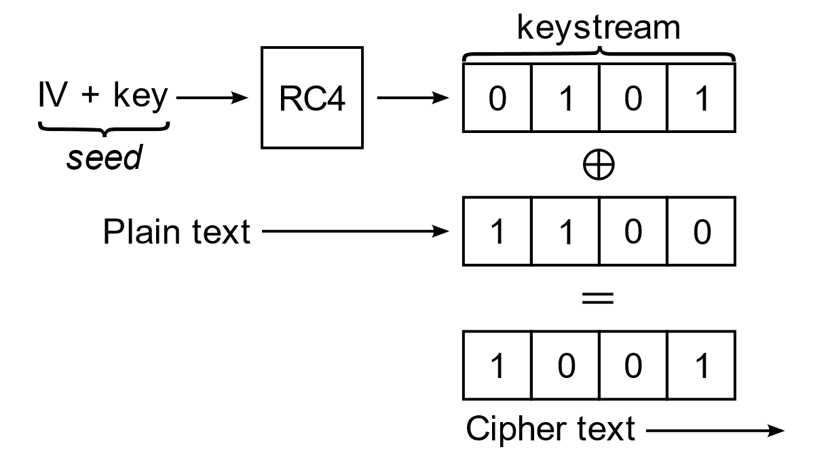
Common Security & Encryption
Wired Equivalent Privacy (WEP)
  First security solution for wireless
  Employed 40-bit key encryption using the Rivest Cipher 4 algorithm and a 20-bit Initialization Vector (IV)
  Designed to bring wired security to wireless networks
Example of WEP Encryption
Traced by User:Stannered, original by en:User:Mhandley, CC BY-SA 3.0 <http://creativecommons.org/licenses/by-sa/3.0/>, via Wikimedia Commons
35
Notes:
Since their inception, wireless networks have proven to be severe security threats, and this is only truer today as the occurrence of attacks increases and their tools become more and more available. Therefore, it is important to know of the most common security solutions for wireless networks and their strength.
The first security solution for wireless networks that was widely implemented and standardized was the Wireless Equivalent Privacy (WEP) solution. In the early days of wireless, the providers wanted to make its set-up and use as easy as possible, so the security was left to a minimum, of any. When WEP came around, it proved not to be much better. WEP was released in 1999 and was designed to provide the same security level as a wired network. Though it was the first to use encryption, it was a very weak encryption. It used a static key consisting of a 40-bit key with a 24-bit initialization vector (IV). This IV is an arbitrary number that, when used with the key, encrypts and decrypts data. However, the IV was sent in clear text. Additionally, WEP used the Rivest Cipher 4 algorithm for encryption, which is a stream cipher dependent on a stream of data and is one of the most widely used stream ciphers because of its speed and simplicity. Since WEP could be broken so easily, due in large part to the clear text IV, the key was extended to 104 bits, thought this did little to fix the issue. This solution is now considered obsolete and highly vulnerable, as well as difficult to configure.

Slide 36
Common Security & Encryption
Wi-Fi Protected Access (WPA)
  Temporary replacement for WEP that allowed for use of 802.1x standards and other enhancements
    802.1x Extensible Authentication Protocol (EAP) – Layer 2 process which enabled a wireless client to authenticate to a network
  Allows personal and enterprise mode
    Personal required no authentication server
      Uses a pre-shared key (PSK) configured on clients and APs to authenticate
      Uses the Temporal Key Integrity Protocol (TKIP) for encryption
    Enterprise uses an authentication server to generate keys or certificates
36
Notes:
WPA was designed as a temporary replacement for WEP that allowed the 802.1x standard to be used, along with other enhancements until the next standard could be established. 802.1x EAP was the Layer 2 protocol that enabled a wireless client to authenticate to a wireless network and was used heavily in WPA and beyond. The solution operates in two modes: personal and enterprise. Personal mode was designed for SOHO uses and works by creating a pre-shared key for authentication. This key must be configured on each client and access point, but no authentication server is needed. It also used TKIP for encryption; TKIP was very similar to RC4 but was much longer. However, it also generated different keys and base keys each time. Enterprise mode was designed for large companies using an authentication server to centralize authentication keys or certificates. While WPA was far better than WEP, it was still very vulnerable, and somewhat difficult to implement.

Slide 37
Common Security & Encryption
Wi-Fi Protected Access Version 2 (WPA2)
  802.11i security solution
  Uses the Advanced Encryption Standard (AES) algorithm and the CBC-MAC Protocol (CCMP)
37
Notes:
WPA2, the most common solution today, is a vast improvement over the other two. This solution, also known as 802.11i, uses the Advanced Encryption Standard algorithm, which is approved for top-secret information by the US government! It features a symmetric key, symmetric block cipher and keys from 128 to 256 bits. Though not perfect, especially if using the Wi-Fi Protected Setup (WPS) it is very highly secure and is considered the best standard as of now, as well as the easiest to configure.

Slide 38
Quick Check
1. WEP is more secure than WPA.
A. True
B. False
38
Notes:
Connecting to a wireless network is simple. All that is needed is an area with a wireless connection/signal, also known as a hotspot, and an adapter of some sort that can pick up and translate the signal into a usable format for the machine. Once connected, some further steps may be required, such as inputting a password, authentication, and more.

Slide 39
Quick Check
1. WEP is more secure than WPA.
A. True
B. False
Answer: B
WEP is far less secure than WPA, and should not be used
39
Notes:
Connecting to a wireless network is simple. All that is needed is an area with a wireless connection/signal, also known as a hotspot, and an adapter of some sort that can pick up and translate the signal into a usable format for the machine. Once connected, some further steps may be required, such as inputting a password, authentication, and more.

Slide 40
Quick Check
2. Match the wireless network type to its description.
A. WLAN a. Range of a city or region; uses WiMax
B. WMAN b. Range across cities and beyond; uses cellular
C. WWAN c. Range of about 30 feet; uses Bluetooth
D. WPAN d. Range of one building; uses Wi-Fi
40
Notes:
Connecting to a wireless network is simple. All that is needed is an area with a wireless connection/signal, also known as a hotspot, and an adapter of some sort that can pick up and translate the signal into a usable format for the machine. Once connected, some further steps may be required, such as inputting a password, authentication, and more.

Slide 41
Quick Check
2. Match the wireless network type to its description.
A. WLAN a. Range of a city or region; uses WiMax
B. WMAN b. Range across cities and beyond; uses cellular
C. WWAN c. Range of about 30 feet; uses Bluetooth
D. WPAN d. Range of one building; uses Wi-Fi
41
Notes:
Connecting to a wireless network is simple. All that is needed is an area with a wireless connection/signal, also known as a hotspot, and an adapter of some sort that can pick up and translate the signal into a usable format for the machine. Once connected, some further steps may be required, such as inputting a password, authentication, and more.

Slide 42
Section 3 Quick Check Answers
WEP is more secure than WPA. B, False
Match the wireless network type to its description.
A. WLAN → d. Range of one building; uses Wi-Fi
B. WMAN→ a. Range of a city or region; uses WiMax
C. WWAN→ b. Range across cities and beyond; uses cellular
D. WPAN → c. Range of about 30 feet; uses Bluetooth
42

Slide 43
Common Wireless Network Protocols
Notes:
Finally, as you move into the IT field, it will be important to know what network protocols are out there, and what standards should be met. However, this gets very complicated very quickly, so we will just be going over the surface level of some of the most common.

Slide 44
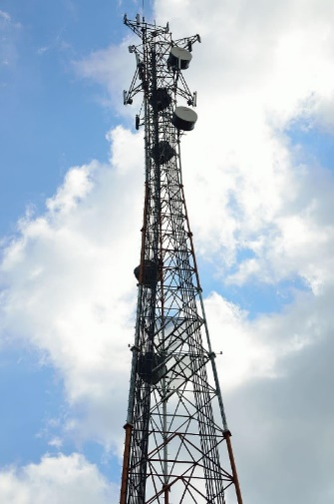
Common Wireless Network Protocols
Wi-Fi
  WLAN protocol that uses the 802.11 family of specifications
WiMAX
  WMAN Protocol that uses IEEE 802.16 specifications
Cellular Networks (2G-5G)
Bluetooth & other WPAN protocols (ZigBee, IrDA, IEEE 802.15, etc.)
Cellular Network Tower
44
Notes:
The most common wireless protocols, regardless of wireless network type, is Wi-Fi. Wi-Fi is typically used in WLANs but can be used in most of the other types as well. Wi-Fi is a category of protocols and covers any protocol that uses the 802.11 family of IEEE specifications.
Similarly, WiMAX is used primarily in WMANs, and is a category of protocols that use the 802.16 family of IEEE specifications.
Another very common wireless connection type is cellular networks. These networks are used most frequently on cell phones but can also be used on tablets and other mobile devices. They are also the primary method of data transmission for WWANs.
WPAN protocols are abundant, but the most common is Bluetooth. However, plenty of others exist, such as ZigBee, IrDA, RFID, IEEE 802.15, and many more. The use of these protocols can likely be recognized when connecting wireless devices, like headphones, to your smartphone.
Cellular networks and WPAN protocols will be discussed in more detail in later lessons centered on mobile devices and computing.

Slide 45
Common IEEE Wi-Fi Standards
802.11
  Now-obsolete, original Wi-Fi standard
    Up to 2 Mbps
    2.4 GHz frequency range
  Typically, later letters are newer
    Also provide increased throughput, speed, etc.
45
Notes:
There are many, many IEEE specifications. The 802.11 family is huge. Therefore, we will only cover some of the more common standards.
First, the IEEE 802.11 standards are a family of specifications developed for WLANs and other wireless networks. They are considered industry standards and are widely used across the world.

Slide 46
Common IEEE Wi-Fi Standards
802.11b
  One of the most prevalent
  Operate in the unregulated 2.4 GHz frequency range
  Maximum speed is 11Mbps
46
Notes:
The most common of these standards is 802.11b. This standard applies to any protocol that operates within the 2.4 GHz range, which in unregulated and very overpopulated with devices of all sorts, which can create significant interference in a network. However, devices using this protocol are generally inexpensive. It has a maximum speed of 11 Mbps.
The 802.11g protocol improves on 802.11b by increasing the maximum speeds to 54 Mbps, though it still uses the 2.4 GHz channel. The two protocols are compatible but mixing the two is not recommended.
802.11a is a protocol which introduces a new frequency range, the 5 GHz range. This leads to much less interference and competition, though the maximum speeds are still at 54 Mbps. Hardware using this protocol is generally more expensive.
IEEE also has a category that houses standards that are in development but are not yet approved by IEEE. These protocols are typically labeled with the 802.1x label.

Slide 47
Common IEEE Wi-Fi Standards
802.11g
  Uses the same frequency as 802.11b
  Capable of speeds up to 54 Mbps
802.11a
  Uses both 5 GHz frequency range
  Capable of speeds up to 54 Mbps
47
Notes:
The 802.11g protocol improves on 802.11b by increasing the maximum speeds to 54 Mbps, though it still uses the 2.4 GHz channel. The two protocols are compatible but mixing the two is not recommended.
802.11a is a protocol which introduces a new frequency range, the 5 GHz range. This leads to much less interference and competition, though the maximum speeds are still at 54 Mbps. Hardware using this protocol is generally more expensive.

Slide 48
Common IEEE Wi-Fi Standards
802.1x
  Holding category for standards in development but not yet approved by IEEE
48
Notes:
There are many, many IEEE specifications. The 802.11 family is huge. Therefore, we will only cover some of the more common standards.
First, the IEEE 802.11 standards are a family of specifications developed for WLANs and other wireless networks. They are considered industry standards and are widely used across the world.
The most common of these standards is 802.11b. This standard applies to any protocol that operates within the 2.4 GHz range, which in unregulated and very overpopulated with devices of all sorts, which can create significant interference in a network. However, devices using this protocol are generally inexpensive. It has a maximum speed of 11 Mbps.
The 802.11g protocol improves on 802.11b by increasing the maximum speeds to 54 Mbps, though it still uses the 2.4 GHz channel. The two protocols are compatible but mixing the two is not recommended.
802.11a is a protocol which introduces a new frequency range, the 5 GHz range. This leads to much less interference and competition, though the maximum speeds are still at 54 Mbps. Hardware using this protocol is generally more expensive.
IEEE also has a category that houses standards that are in development but are not yet approved by IEEE. These protocols are typically labeled with the 802.1x label.

Slide 49
Wi-Fi Numbers
Wi-Fi 1 – 1997
  Assigned to 802.11
    Up to 2 Mbps
    Use 2.4 GHz frequency range
  Specified 3 physical layer technologies to reduce interference:
    Direct-Sequence Spread Spectrum (DSSS)
    Frequency-Hopping Spread Spectrum (FHSS)
    Diffuse infrared
49
Notes:
Apart from the IEEE standards and their evolution, the actual Wi-Fi protocol and label has been applied to specific standards and evolved along with the IEEE standards, often selecting the best current option to receive the next “version” label. This numbering was standardized in 2018 and was retroactive. Thus, instead of having to identify a specific IEEE standard, administrators or devices could simply refer to the Wi-Fi number.
Wi-Fi 1 was assigned to the first released standard, 802.11. This standard supported speeds up to 2 Mbps and used the 2.4 GHz frequency range. This standard introduced three physical layer technologies to reduce interference: direct-sequence spread spectrum, frequency-hopping spread spectrum, and diffuse infrared. These technologies were crucial to the success of Wi-Fi; however, exploring these concepts in detail is beyond the scope of this lesson. For more information and resources regarding these technologies, and others discussed, please see the instructor. This standard is the backbone of Wi-Fi which all other later versions are built from.

Slide 50
Wi-Fi Numbers
Wi-Fi 2 – 1999
  Assigned to 802.11b
    Up to 11 Mbps
    Use 2.4 GHz
Wi-Fi 3 – 1999
  Assigned to 802.11a
    Up to 54 Mbps
    Use 5 GHz – new band reduces interference & range
  Introduced Orthogonal Frequency-Division Multiplexing (OFDM)
    Allowed many signals over one medium simultaneously
50
Notes:
Wi-Fi 2, established in 1999, was assigned to IEEE standard 802.11b. This version was nearly identical to Wi-Fi 1 in all ways except speed; for this Wi-Fi version, the speed reached rates up to 11 Mbps.
Wi-Fi 3, also established in 1999, was assigned to 802.11a and increased speed up to 54 Mbps. It also introduced a new 5 GHz frequency range that reduces interference, as there are far less devices on this band. However, the 5 GHz band also, in theory, reduces range; this is because the 5 GHz band tends to be absorbed by building materials more than the 2.4 GHz bands, likely due to the difference in wavelength. This is one place that physics can be applied to the IT field; more information and resources on radio waves and the physics of IT can be received from the instructor. Wi-Fi 3 also introduced orthogonal frequency-division multiplexing, which allows many signals to be transported over one medium simultaneously.

Slide 51
Wi-Fi Numbers
Wi-Fi 3E – 2003
  Assigned to 802.11g
    Up to 54 Mbps
    Use 2.4 GHz
  Backwards compatibility
Wi-Fi 4 – 2008
  Assigned to 802.11n
    Up to 600 Mbps
    Use 2.4/5 GHz
  Added support for Multiple-Input Multiple-Output (MIMO) antennas
    Allows multiple antennas to communicate with multiple devices
      Utilizes multipath propagation to increase capacity
51
Notes:
Wi-Fi 3E is often described as an expansion of Wi-Fi 2, and was assigned to 802.11g. This Wi-Fi version increased speed in the 2.4 GHz band to 54 Mbps. It also encouraged and sped up the development of backwards compatibility between the Wi-Fi versions. Since many devices were (and still do) use 802.11b, there was immense concern that devices running on Wi-Fi 2 would not work with the new Wi-Fi 3E. This encouraged the development of backwards compatibility between the two and explains why Wi-Fi devices commonly advertise their supported versions as 802.11b/g.
Wi-Fi 4, established in 2008, was assigned to 802.11n, which builds on to the 802.11a standard. Wi-Fi 4 allows for speeds up to 600 Mbps, and uses both 2.4 GHz and 5 GHz frequencies, allowing for more connected devices with less interferences, as well as provides more options dependent on the needs of a user, be it speed or range. This Wi-Fi version also introduced support for multiple-input multiple-output antennas, which allow multiple antennas to be used in communication with multiple devices; put simply, it allows for multiple paths to increase the network capacity. More information on MIMO antennas can be found in the resources provided to the instructor.

Slide 52
Wi-Fi Numbers
Wi-Fi 5 – 2014
  Assigned to 802.11ac (builds on 802.11n)
    Up to 6933 Mbps
    Use 5 GHz
Wi-Fi 6 – 2019
  Assigned to 802.11ax (builds on 802.11ac)
    Up to 9608 Mbps
    Use 2.4/5 GHz
Wi-Fi 6E – 2019
  Assigned to 802.11ax
    Up to 9608 Mbps
    Use 6 GHz
52
Notes:
Wi-Fi 5, established in 2014, was assigned to 802.11ac and builds on the 802.11n standard. This standard increases speed to a maximum of 6933 Mbps and operates on the 5 GHz frequency band. When used in conjunction with Wi-Fi 4, it allows for 802.11n standards on the 2.4 GHz range and 802.11ac standards on the 5 GHz, as they are very similar.
The most recent Wi-Fi versions, Wi-Fi 6 and 6E, are not yet widely available. These versions, which build on the 802.11ac standard, provide speeds up to 9608 Mbps, and use 2.4, 5, and 6 GHz frequency ranges. It is predicted that these Wi-Fi versions will have about quadruple the throughput and 37% faster rates in some cases than those provided with Wi-Fi version 5.

Slide 53
Quick Check
1. Which of the following is a wireless network standard?
A. Wi-Fi
B. WiMAX
C. 802.11
D. All the above are standards
E. None of the above are standards
53
Notes:
Connecting to a wireless network is simple. All that is needed is an area with a wireless connection/signal, also known as a hotspot, and an adapter of some sort that can pick up and translate the signal into a usable format for the machine. Once connected, some further steps may be required, such as inputting a password, authentication, and more.

Slide 54
Quick Check
1. Which of the following is a wireless network standard?
A. Wi-Fi
B. WiMAX
C. 802.11
D. All the above are standards
E. None of the above are standards
Answer: D
All of these are wireless standards, though some may be outdated or obsolete
54
Notes:
Connecting to a wireless network is simple. All that is needed is an area with a wireless connection/signal, also known as a hotspot, and an adapter of some sort that can pick up and translate the signal into a usable format for the machine. Once connected, some further steps may be required, such as inputting a password, authentication, and more.

Slide 55
Lesson Summary
Notes:
So now, let’s review a few key points from each section.

Slide 56
Section 1 Summary
Wireless networks have no cables and use radio waves to communicate
A wireless network must have a wireless-capable router and devices must have a wireless adapter
Notes:
So now, let’s review a few key points from each section. As you can recall, wireless networks have no cables and use radio waves to communicate. Additionally, a wireless network must have a wireless-capable router and devices must have a wireless adapter to connect.

Slide 57
Section 2 Summary
Wireless networks are more mobile than wired networks, have greater scalability, and likely less costs
However, they are more susceptible to security threats and interference
Notes:
In section two, we learned of several advantages and disadvantages for both wireless and wired networks. Here we learned that while wireless networks are more flexible, mobile, and scalable than wired networks, and are typically cheaper, they are also harder to control and more susceptible to threats, interference, and degraded performance.

Slide 58
Section 3 Summary
There are many wireless network types, and each serves a different purpose, with WLAN being the most common:
  WPAN
  WLAN
  WMAN
  WWAN
  Ad-Hoc
  Hybrid
There are also several encryption and security methods, of which WPA2 is the most secure
Notes:
In section three, we explored the wireless network types and their purposes. Clearly, WLAN is the most common, but the rest are also heavily prevalent. We also learned about the various encryption and security methods and established that WPA2 was the most secure and should be used.

Slide 59
Section 4 Summary
Wi-Fi is a set of IEEE protocols that are most used in wireless networks (especially WLANs)
  Wi-Fi 5 is the most recent for widely available use
  Wi-Fi 6 is in development
The 802.11 family houses all the IEEE wireless protocols
Notes:
Finally, in section four, we learned briefly about various wireless protocols. The most common ones, Wi-Fi and 802.11, are the key takeaways here. Wi-Fi is a set of IEEE WLAN protocols that follow the 802.11 specifications, and the 802.11 specifications set forth in IEEE are home to numerous wireless protocols.

Slide 60
Final Assessment
Notes:
Let’s check your knowledge! This brief assessment will reinforce what you learned from this lesson and identify areas that may be worth looking back over.

Slide 61
Review Questions
1. A wireless network is a network that communicates using satellites.
A. True
B. False
61
Notes:
Connecting to a wireless network is simple. All that is needed is an area with a wireless connection/signal, also known as a hotspot, and an adapter of some sort that can pick up and translate the signal into a usable format for the machine. Once connected, some further steps may be required, such as inputting a password, authentication, and more.

Slide 62
Review Questions
1. A wireless network is a network that communicates using satellites.
A. True
B. False
Answer: B
While a wireless network can use satellites, it does not have to.
62
Notes:
Connecting to a wireless network is simple. All that is needed is an area with a wireless connection/signal, also known as a hotspot, and an adapter of some sort that can pick up and translate the signal into a usable format for the machine. Once connected, some further steps may be required, such as inputting a password, authentication, and more.

Slide 63
Review Questions
2. Based on the following scenario, should this organization use a wired or wireless network?
A group wants to have easy, convenient access with fast speeds and reliable internet but demands that employees be mobile. They also have numerous areas where cables cannot be run.
63
Notes:
Connecting to a wireless network is simple. All that is needed is an area with a wireless connection/signal, also known as a hotspot, and an adapter of some sort that can pick up and translate the signal into a usable format for the machine. Once connected, some further steps may be required, such as inputting a password, authentication, and more.

Slide 64
Review Questions
2. Based on the following scenario, should this organization use a wired or wireless network?
A group wants to have easy, convenient access with fast speeds and reliable internet but demands that employees be mobile. They also have numerous areas where cables cannot be run.
Answer: Because they need mobile access and have some places where cable cannot be run, wireless is ideal.
64
Notes:
Connecting to a wireless network is simple. All that is needed is an area with a wireless connection/signal, also known as a hotspot, and an adapter of some sort that can pick up and translate the signal into a usable format for the machine. Once connected, some further steps may be required, such as inputting a password, authentication, and more.

Slide 65
Review Questions
3. Which wireless network type would you recommend for connecting offices on opposite sides of the country?
A. WPAN
B. WLAN
C. WMAN
D. WWAN
65
Notes:
Connecting to a wireless network is simple. All that is needed is an area with a wireless connection/signal, also known as a hotspot, and an adapter of some sort that can pick up and translate the signal into a usable format for the machine. Once connected, some further steps may be required, such as inputting a password, authentication, and more.

Slide 66
Review Questions
3. Which wireless network type would you recommend for connecting offices on opposite sides of the country?
A. WPAN
B. WLAN
C. WMAN
D. WWAN
Answer: D
Since the network is connecting offices across the country, far beyond city limits, a WWAN is the best of these choices
66
Notes:
Connecting to a wireless network is simple. All that is needed is an area with a wireless connection/signal, also known as a hotspot, and an adapter of some sort that can pick up and translate the signal into a usable format for the machine. Once connected, some further steps may be required, such as inputting a password, authentication, and more.

Slide 67
Review Questions
4. Which protocol introduced the 5 GHz frequency range and operates at a maximum of 54 Mbps?
A. 802.11a
B. 802.11b
C. 802.11g
D. 802.1x
67
Notes:
Connecting to a wireless network is simple. All that is needed is an area with a wireless connection/signal, also known as a hotspot, and an adapter of some sort that can pick up and translate the signal into a usable format for the machine. Once connected, some further steps may be required, such as inputting a password, authentication, and more.

Slide 68
Review Questions
4. Which protocol introduced the 5 GHz frequency range and operates at a maximum of 54 Mbps?
A. 802.11a
B. 802.11b
C. 802.11g
D. 802.1x
Answer: A
While 802.11g also operated at 54 Mbps, the 5 GHz frequency was introduced with 802.11a
68
Notes:
Connecting to a wireless network is simple. All that is needed is an area with a wireless connection/signal, also known as a hotspot, and an adapter of some sort that can pick up and translate the signal into a usable format for the machine. Once connected, some further steps may be required, such as inputting a password, authentication, and more.

Slide 69
Final Assessment Answers
A wireless network is a network that communicates using satellites. B, False
Should this organization use a wired or wireless network? A group wants to have easy, convenient access with fast speeds and reliable internet but demands that employees be mobile. They also have numerous areas where cables cannot be run. Because they need mobile access and have some places where cable cannot be run, wireless is ideal.
Which wireless network type would you recommend for connecting offices on opposite sides of the country? D, WWAN
Which protocol introduced the 5 GHz frequency range and operates at a maximum of 54 Mbps? A, 802.11a
69

Slide 70
End of Lesson 1
This concludes Lesson 1! For more information on this and other related topics, check the references at the end of this presentation or discuss with the instructor.

Slide 71
References
AccessAgility Blog Team. (2017, December 15). Basic hardware required for a wireless network. Retrieved from AccessAgility: https://www.accessagility.com/blog/basic-hardware-required-for-a-wireless-network
Bradley, T. (2020, February 2). Wireless Networking Protocols Explained. Retrieved from Lifewire: https://www.lifewire.com/wireless-networking-protocols-explained-2486947
BT & Cyber Security Challenge UK. (2019, August). Wired and Wireless Networks. Retrieved from Cyber Security Challenge UK: https://www.cybersecuritychallenge.org.uk/app/uploads/2019/08/Lesson-Plan-Wired-and-Wireless-Networks.pdf
ComputerNetworkingNotes. (2018, August 6). Types of wireless network explained with standards. Retrieved from Computer Networking Notes: https://www.computernetworkingnotes.com/ccna-study-guide/types-of-wireless-network-explained-with-standards.html
Goodman, P. (2020, April 27). Wireless network vs wired network: Advantages and disadvantages. Retrieved from TurboFuture: https://turbofuture.com/computers/Wireless-Network-vs-Wired-Network-Advantages-and-Disadvantages
Gookin, D. (n.d.). Hardware needed for a wireless network. Retrieved from Dummies: https://www.dummies.com/computers/pcs/hardware-needed-for-a-wireless-network/
Mckinney, E. (n.d.). Disadvantages of wireless networks. Retrieved from Techwalla: https://www.techwalla.com/articles/disadvantages-of-wireless-networks
Miller, L. C. (n.d.). Wireless Security Protocols: WEP, WPA, and WPA2. Retrieved from Dummies: https://www.dummies.com/computers/computer-networking/wireless/wireless-security-protocols-wep-wpa-and-wpa2/
Net Spot. (2020). Wireless Security Protocols. Retrieved from Net Spot: https://www.netspotapp.com/wifi-encryption-and-security.html
The history of wireless technology- StoryMap. (n.d.). Retrieved from Exigent Networks: http://www.exigentnetworks.ie/the-history-of-wireless-technology-storymap/

