Slide 1
Demystifying Fund Allocation Formulas in an Academic
Library Setting
Lisa Barricella and Cindy Shirkey
October 16th, 2013

Slide 2

Boring at first…
Image from FanPop!

Slide 3

It gets better!
Image from Cape Escape Vacation Rentals

Slide 4
Types of Fund Formulas
Percentage-Based Allocations
Weighted Multiple-Variable
Factor Analysis
Circulation-Based Allocation

Slide 5
Percentage-Based Allocation
Each fund is assigned a percentage of the whole budget
Usually tied to the university’s overall budget

Slide 6
Weighted Multiple Variable
Library selects own variables and then assigns weight to them
According to Kitti Canepi in her meta-analysis article “Fund Allocation Formula Analysis: Determining Elements for Best Practices in Libraries” the four most important variables are:
  Enrollment
  Cost
  Use/Circ
  Number of faculty
Joyner’s old fund formula is an example of this

Slide 7
Factor Analysis
Way of statistically determining which variables are most important
Walters (2008) found the most frequently used variables are:
  Course enrollment
  Cost of books
  Number of faculty
  Number of majors
  Circulation data

Slide 8
Circulation-Based Allocation
Qualitative method based on circulation
Takes into account librarians experiences & knowledge
Data-driven
Joyner’s new fund formula is a variation on this

Slide 9
Variations
Lots of variations
Find one that works for your situation by looking at what you value most
It shouldn’t be something you dread working on

Slide 10
Reality Check
Fund allocation formulas – all of them – are just approximations of what really goes on and none are perfect
Jasper Shad in an article from the Journal of Academic Librarianship says “a formula or model is only useful to the degree that it reflects accurately the realities of any situation.” (p. 330)
He goes on to say that a perfect formula doesn’t exist

Slide 11
How big is your pot?
Remember that a lot of expenses have to come off-the-top:
  Approval plans
  Standing orders
  Special collections
  Electronic resources
  Serials

Slide 12
Proxies
Proxies are place holders for measures of supply and demand
  Credit hours
  Enrollment
  Faculty FTE
  Average price per book

Slide 13
Considerations
Problems with gathering data
  Not all available in same format
  Not all available online
  Not all available at same time
  Not all in the same place
  Relying on others to supply it

Slide 14
The Math Behind the Formula
Real world example of what you learned in high school
  Averages
  Percentages of wholes
  Stuff from Algebra

Slide 15
Old Map Formula
Developed in early 80’s
Created by Senate Libraries Committee which included ex officio membership from Joyner Library
Rocky road to adoption, first year in use was supposed to be on a temporary basis
Faculty wanted to include a research factor, but never figured out how after trying twice
Included factors based on supply and perceived demand
Created in response to economic circumstances and need to manage significant materials budget cuts

Slide 16
Problems with Old Formula
Demand: student credit hours (grad & undergrad), number of course sections (grad & undergrad), declared majors (grad & undergrad) and faculty FTE
Supply: average cost of books
Practical problems:
  Had to go to multiple places to get data and hand enter
  Hard to get some of this data, especially number of course sections which was only available by asking the registrar
  Data collection was hampered by time lags in available data
Theoretical problems:
  Heavy on proxies for demand, but no real measure of use

Slide 17
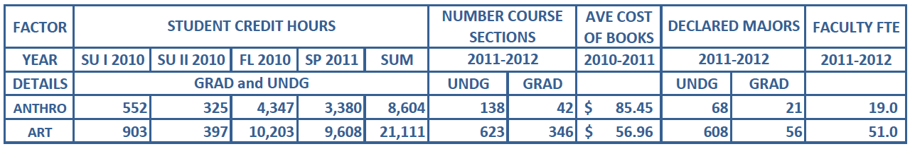
Historic MAP Formula – Data Gathered

Slide 18
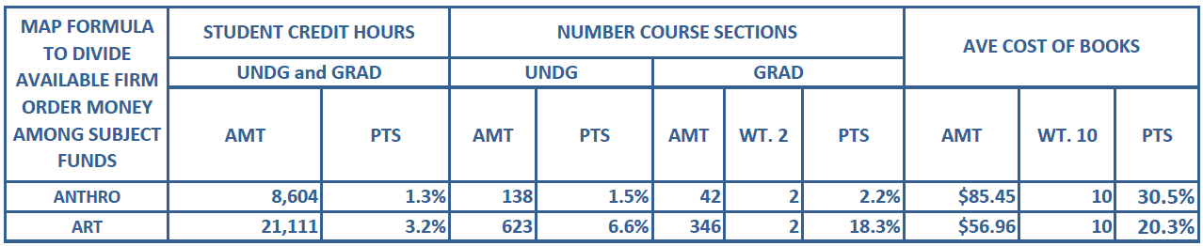
Historic MAP Formula – In Use

Slide 19
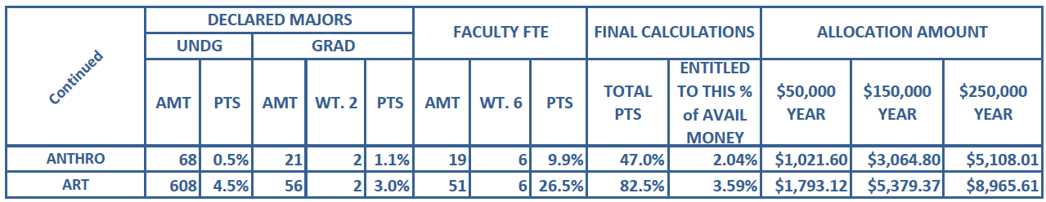
Historic MAP Formula continued…

Slide 20
Our Idea
Why not get rid of the proxies for demand and employ actual usage?
  Bonn’s Use Factor
  Ratio of ILL Requests to Holdings

Slide 21
Bonn’s Use Factor
Percentage of circulations divided by percentage of holdings
Subject A provides 30% of all circulations but accounts for only 15% of holdings
Therefore: Bonn’s Use Factor is 2 and Subject A is overused
Ideal is close to 1

Slide 22
Ratio of ILL Requests to Holdings
ILL Requests : Holdings
Borrowings % divided by holdings %
Way to check Bonn’s Use Factor when evaluating the collection

Slide 23
Dividing Up LC
Remember yellow slips? We used a spreadsheet that had originally been designed to divvy up the call numbers amongst selectors and which showed the subject assigned to an LC range and which matched the fund codes in our ILS

Slide 24
Internal Data Sources
We needed three types of data for our formula
  Circulation: from our ILS system administrator and Symphony ILS reports
  ILL: from our ILL librarian and Illiad reports
  Average Price Paid Per Item: from ILS data

Slide 25
Symphony Data
Needed the number of titles added in each of 4 fiscal years: 08-09, 09-10, 10-11, 11-12 sorted by LC call number
Needed the circ statistics for those titles from acquisition to present
From there we mapped the call numbers and check-outs to the corresponding subject on the LC divvy up sheet
Took one person 3-4 hours a day for 3 weeks
In the future this data could be pulled by the ILS system administrator and then cleaned up by grad students

Slide 26
ILL Data
Needed items borrowed during each of 4 fiscal years: 08-09, 09-10, 10-11 and 11-12 sorted by LC call number
Took ILL librarian about 12 hours to pull data
But there was a problem: the ILLiad reports were only pulling between 30% and 50% of actual requests and we needed everything, not just a sample
Plus, LC call numbers were not sorted by call number, they were sorted numerically
  Given time this could be corrected, but we did not have the time and besides, we didn’t have all the data
Gave up on using ILL data at this time

Slide 27
Average Cost Per Item
Used Symphony’s average price paid for item per fund
Includes videos, scores and firm orders bought from YBP and sources other than YBP – better representation
Thought about using YBP’s table, but would have had to map subject areas to funds
Also, YBP’s table is based on hardcover prices and we prefer paper so that would make a big difference

Slide 28
What We Did with the Data
We checked it, found a couple of errors and corrected them
We found and grouped all the LC areas into their subject funds (Ns and TRs combined under Art)
Did this for all four years
Found total number of circulations and total number of holdings

Slide 29
Data Manipulation Continued
Figured our percentage of total holdings for each fund and percentage of total circulations for each fund
Divided the percentage of circs by the percentage of holdings for each fund
That gave us Bonn’s Use Factor
Took a four-year average of Bonn’s Use Factor
Found the percentage of price per item
Added the average of Bonn’s Use Factor and the percentage of price per item
Expressed it as a percentage of overall budget

Slide 30
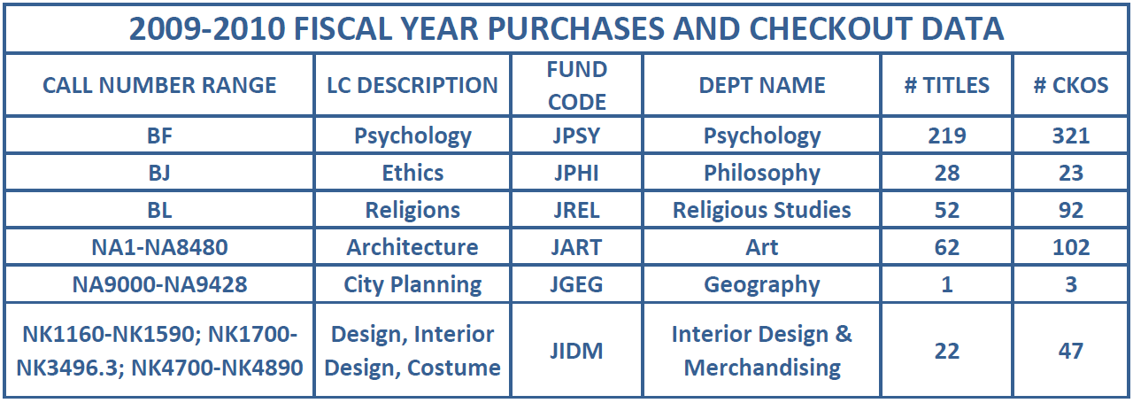
LC Sorted Checkout Data

Slide 31
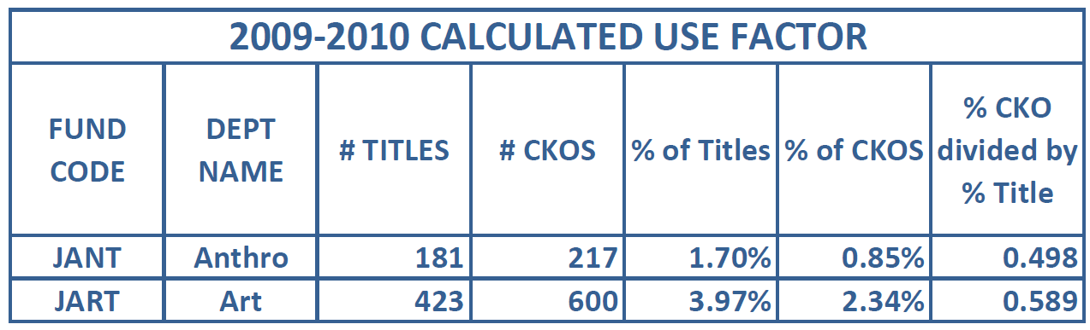
Calculating Use Factor by Year

Slide 32
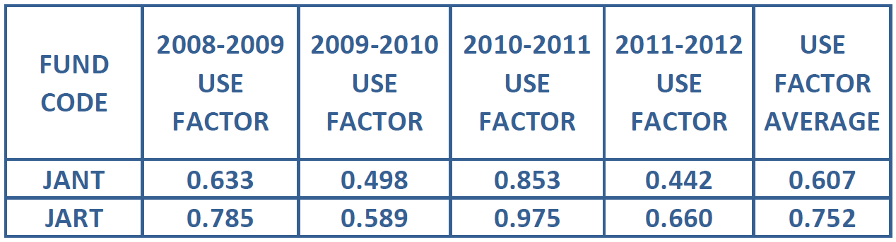
Use Factor Averaged over Four Years

Slide 33
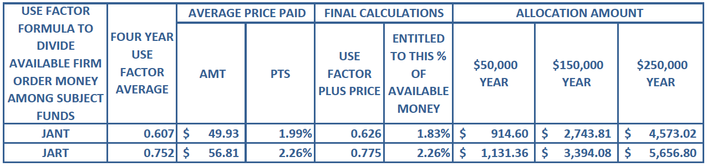
Use Factor Formula In Use

Slide 34
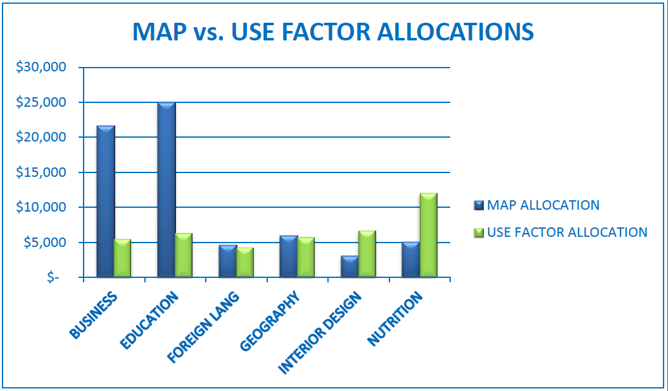
Allocation Comparison

Slide 35
Caveats
What constitutes a circulation? Both reserves use and renewals counted for us. Data was checked for current reserves, but we don’t keep historical reserve lists
In-House circulation data: We do not have any for anything housed in Joyner Library. Music Library keeps this data, but we did not use it in this first iteration of the process
Music’s funds will need to be increased accordingly
Does not work for some interdisciplinary areas
$2,000 limit in how much a fund could change

Slide 36

Success!
Image from goldenretrieverforum.com

Slide 37
Next Steps
Factor in Music in-house data
Figure out why ILLiad reports didn’t pull all of the ILL data
Test formula this year
Take to Senate Libraries Committee this fall

Slide 38

Questions?
Image from journeythrul.com
Cindy Shirkey Lisa Barricella
Head, Collection Development Head, Monographic Acquisitions
Joyner Library, ECU Joyner Library, ECU
252-737-2724 252-328-0838
shirkeyc@ecu.edu barricellal@ecu.edu

