Slide 1
Vivo: Discovery, Management and Connecting Researchers
Heather Seibert-Racine : Research and Scholarly Communications
12th Annual Joyner Library Paraprofessional Conference:
Digital Humanities and the Library Community
May 13, 2016

Slide 2
Vivo
VIVO is member-supported, open source software and an ontology for representing scholarship. VIVO supports recording, editing, searching, browsing and visualizing scholarly activity. VIVO encourages research discovery, expert finding, network analysis and assessment of research impact. VIVO is easily extended to support additional domains of scholarly activity.
https://wiki.duraspace.org/display/VIVO/VIVO

Slide 3
Open Source
Open Community
Open Data

Slide 4
VIVO is an open source semantic web application developed and implemented at Cornell. Circa 2005
Applications to gather information data include, VIVO Search, VIVO Searchlight, and Inter-Institutional Collaboration Explorer (an application that allows visualization of other institutional partners)
Content is installed and maintained manually
Information can be migrated and brought into VIVO from local records, HR, grants, Faculty databases and publication and funding agencies.
  Scopus
  ORCID

Slide 5
ORCID
academia.edu
ReachNC
Researchgate
Linkedin

Slide 6
Populated with Researchers Interests, activities, accomplishments
  Education
  Organizations
  Affiliations
  Contact Information
  Identifiers
  Controlled headings
  Research Mapping

Slide 7
Provides the opportunity to
Cross reference
Browse and search by terms
Discover
Collaborate

Slide 8
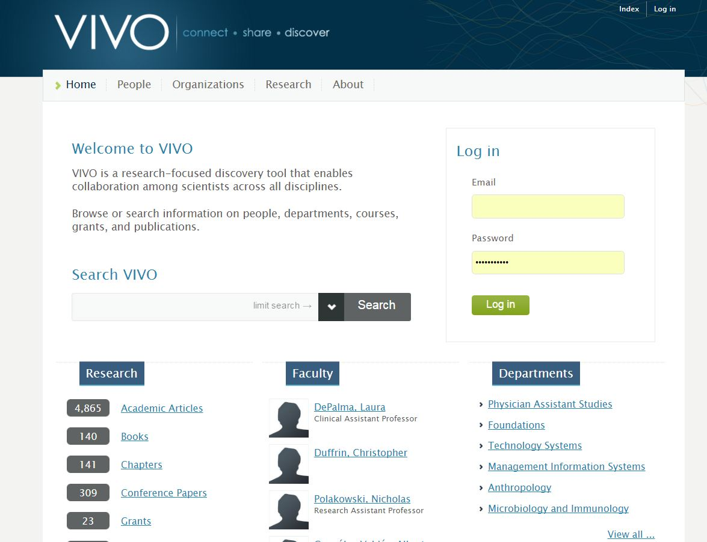

Slide 9
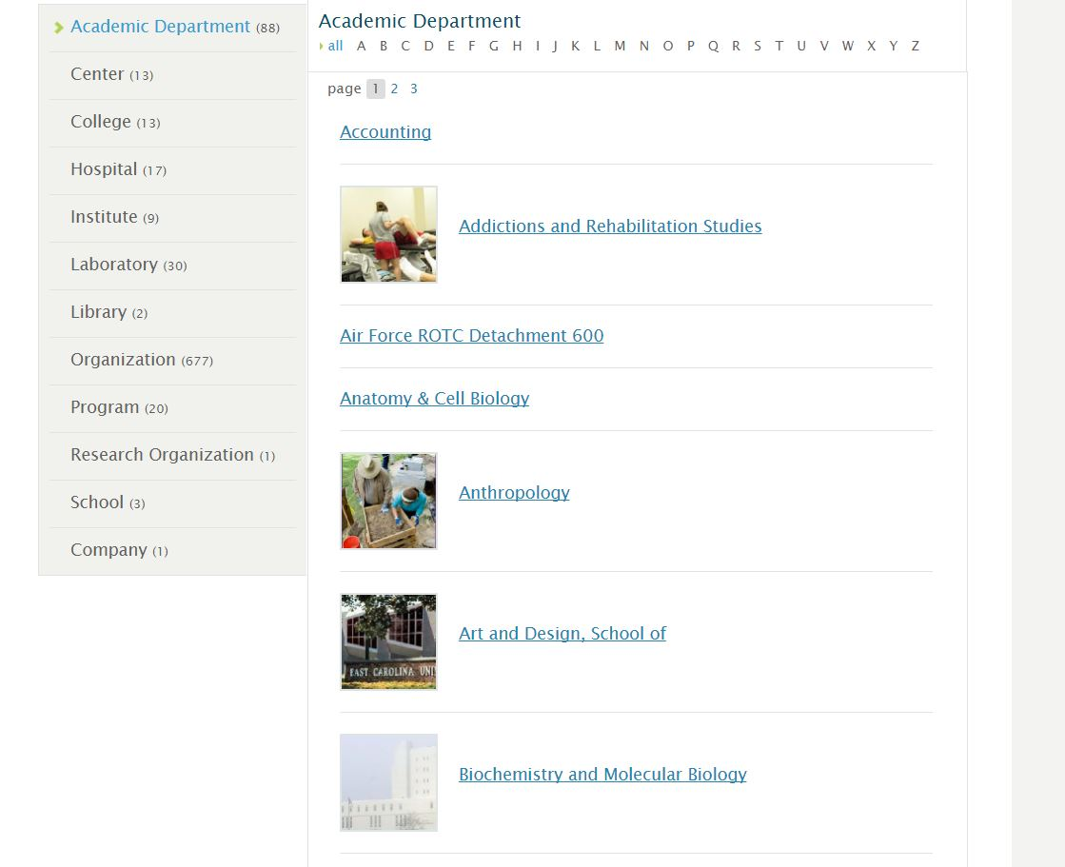

Slide 10
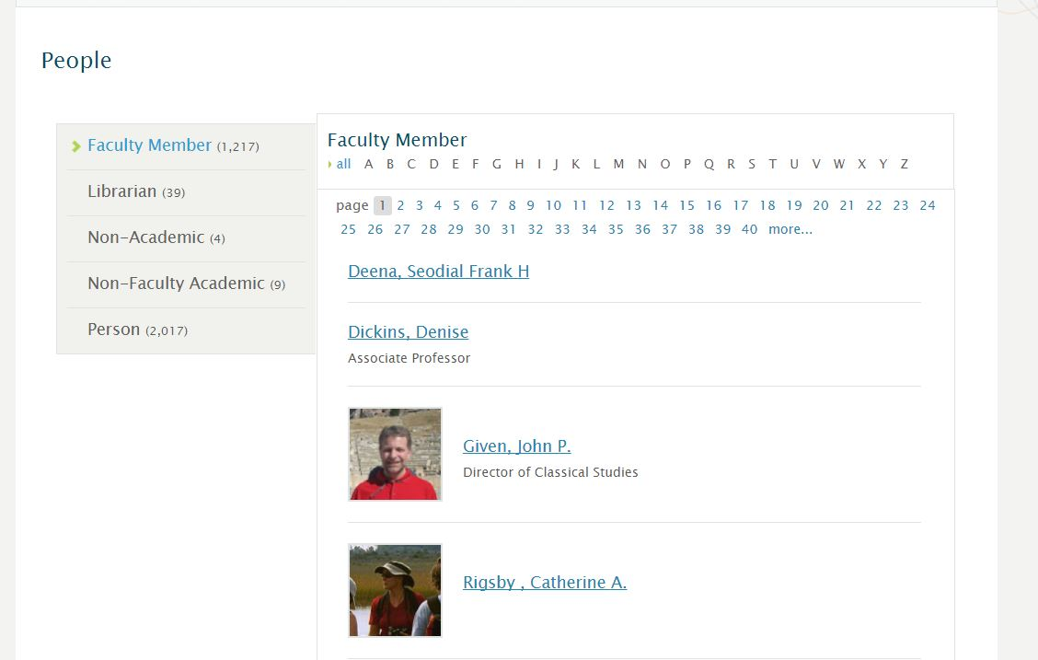

Slide 11
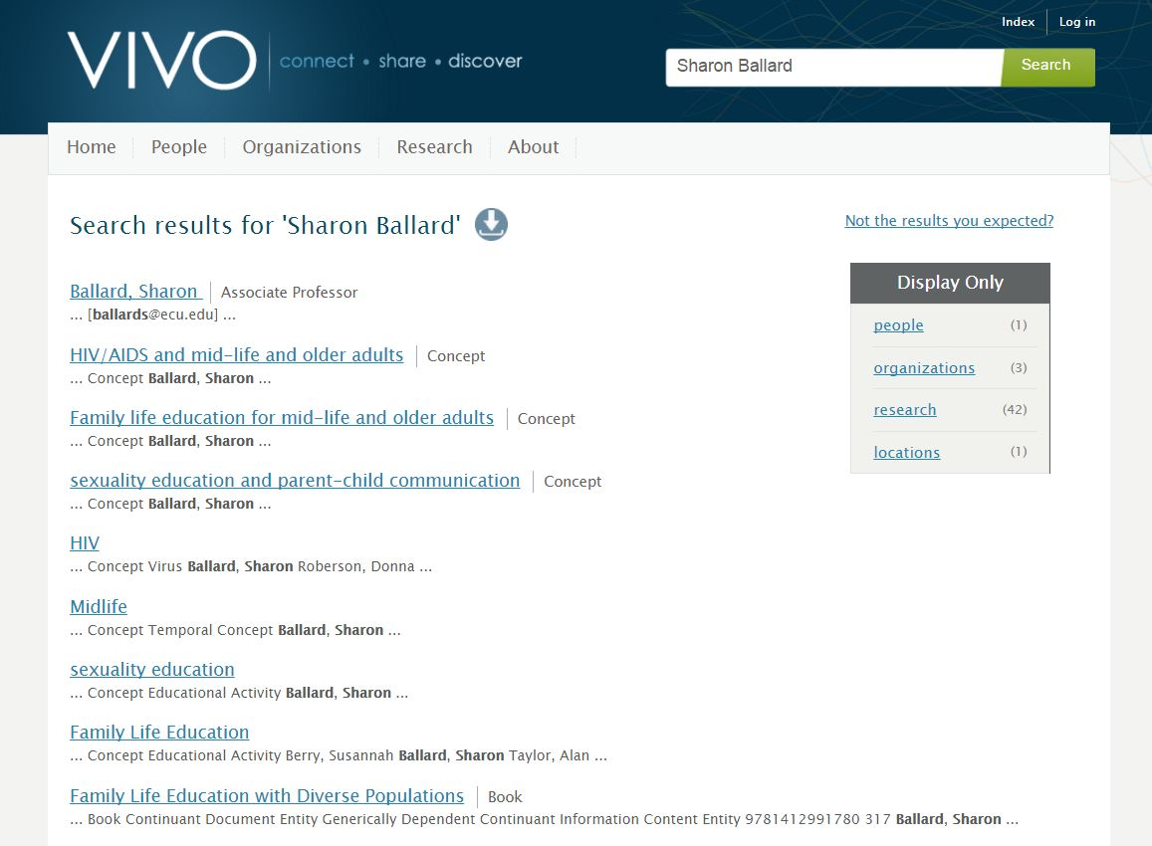

Slide 12
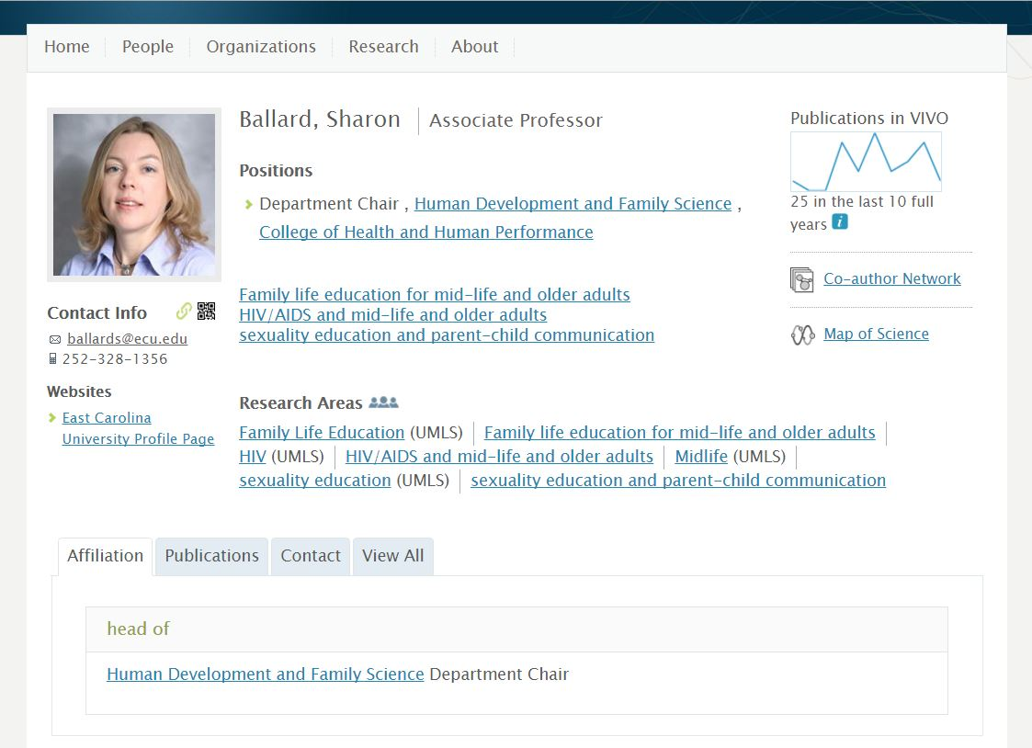

Slide 13
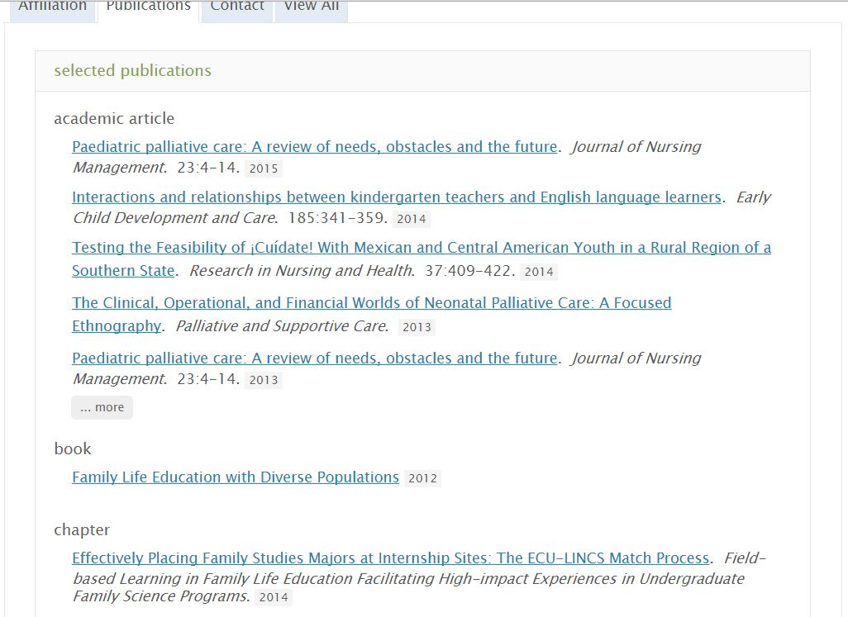

Slide 14
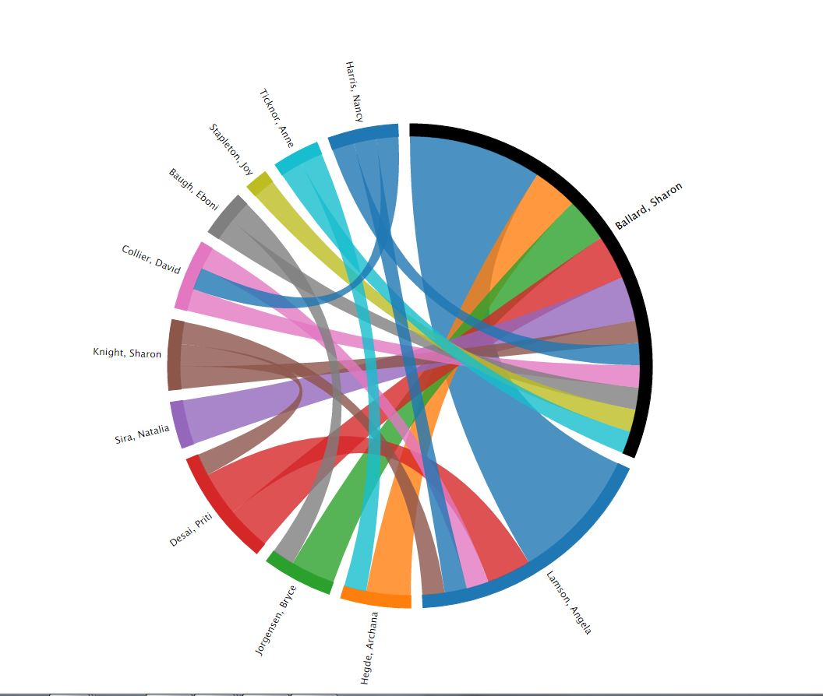

Slide 15
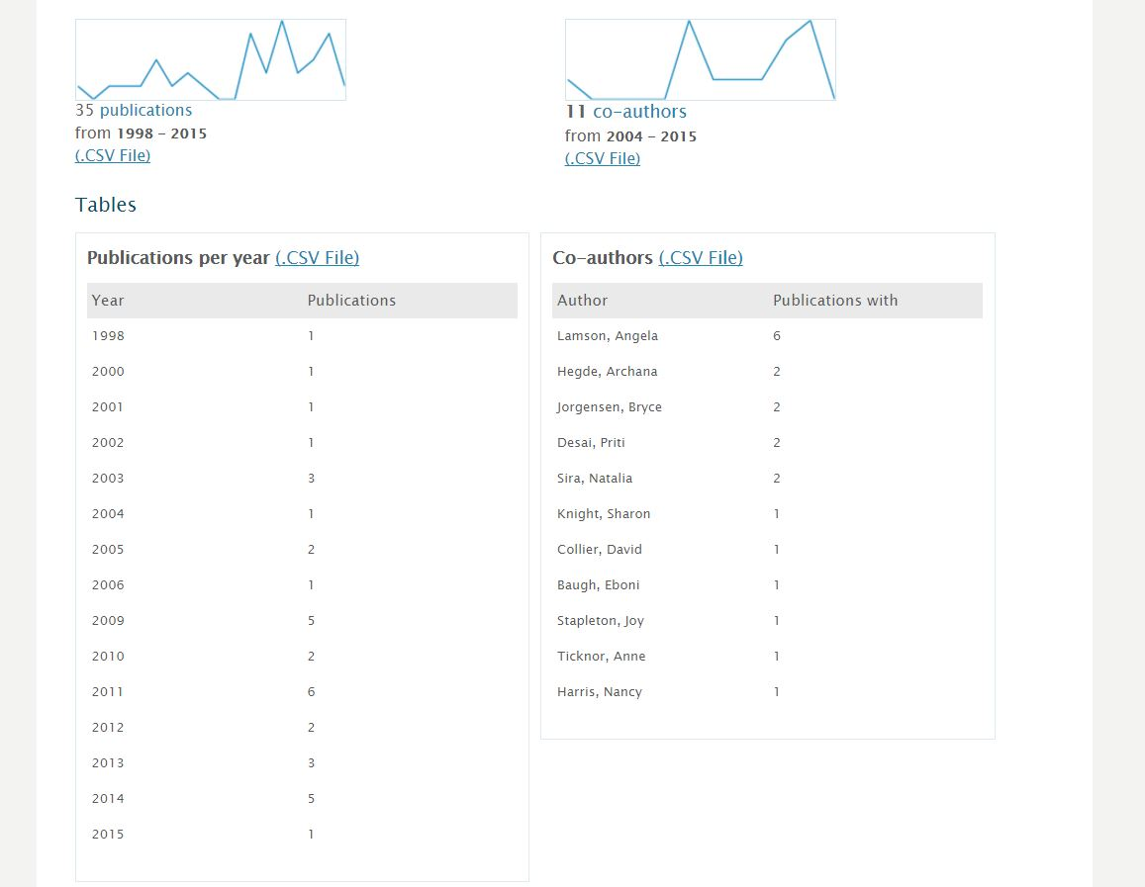

Slide 16
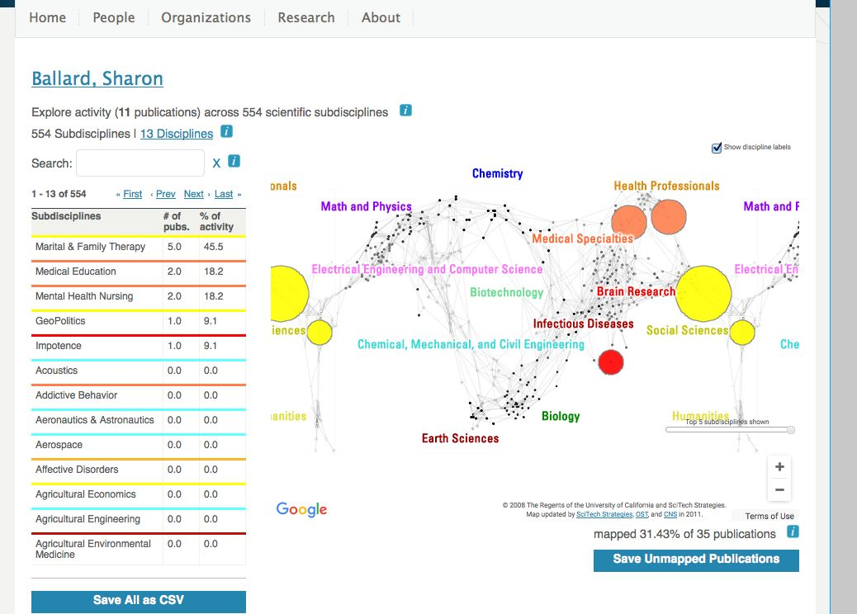

Slide 17
Benefits of using Vivo
Administrators
  Creates a one-stop shop for publicly-available institutional data. Institutional attitudes often come into play when determining what data is incorporated, however.
  Showcase rich research output (showcase publications, grants, etc.) data is easily reusable - so opportunities to restructure the data are endless.
  Assist with locating experts for review panels, symposia, etc.
  Assist journals in locating experts.
  Assists when highlighting research efforts to potential donors (has resulted to real funding for Cornell researchers).
Librarians
  Will help them to stay in touch with their departments and integrate them into various research efforts.
  The semantic web allow them to take our rich research output and make it available, reducing information boundaries (this is what librarians do!)
  Use information gleaned from VIVO to help guide collection development and purchasing decisions.
  Use information gleaned from VIVO to help guide development of new services.
  VIVO's ontology makes information easily findable
https://wiki.duraspace.org/display/VIVO/VIVO+Benefits

Slide 18
Benefits of Using VIVO
Students
Clinicians
Find mentors.
Find research opportunities.
Identify courses of interest.
Useful for recruiting new graduate students, trainees.
Find seminars of interest.
You can individually brand yourself/research
Links can help your search engine rankings rise quickly.
Search for upcoming conferences, seminars, workshops, and trainings
Find resources (labs/facilities) for screening and assessment.
Find related articles, research conducted within an institution.
Gain visibility of work.
Find an expert who specializes in a particular procedure or protocol.
Start discussions about new clinical findings.
https://wiki.duraspace.org/display/VIVO/VIVO+Benefits

Slide 19
Challenges
Where do we get reliable information
Participation
Faculty/Administration Awareness
Speed
Manpower
Maintenance

Slide 20








Vivo collaborates to create ways to represent scholarship and advance knowledge

Slide 21
Brown
https://vivo.brown.edu/
Cornell University
http://vivo.cornell.edu/
Duke
https://scholars.duke.edu/
University of Colorado Boulder
https://vivo.colorado.edu/
Griffith University
https://experts.griffith.edu.au/
United States Department of Agriculture
http://vivo.usda.gov/

Slide 22
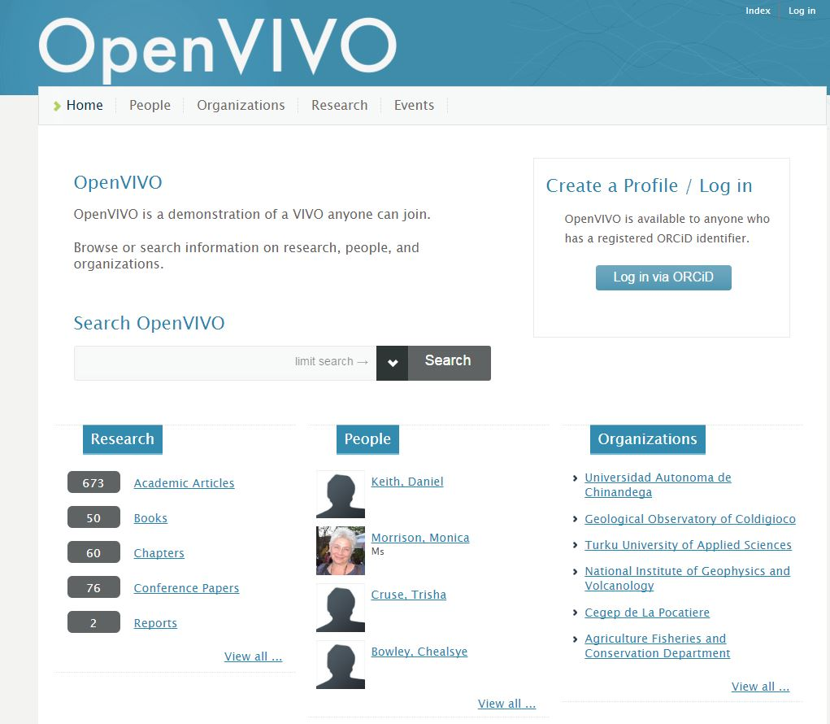
openvivo
OpenVivo was Demonstrated at the Force 11 Conference in Portland in April 2016.
The project will run through August.
There is very little information other than a demonstration on how everyone can join and use VIVO for their needs.

Slide 23
THANK YOU!
Heather Seibert-Racine
Research & Scholarly Communication
1302 Joyner Library, Mailstop 516
252-328-0412
seibertracineh@ecu.edu
scholarlycom@ecu.edu

