Slide 1
Hurricane Earl: A Case Study for the NHC Storm Surge Toolbox
Jamie Rhome
Storm Surge Specialist
National Hurricane Center

Slide 2
NHC Storm Surge Product Decision Support Wedge
NHC Advisory/ NWS Local Statements
Probabilistic Storm Surge
*MEOWs
*MEOWs
*MOMs
*MOMs
Tier 1
Response
< 48 h of landfall
Tier 2
Readiness
48 h – 120 h of landfall
Tier 3
Planning/Mitigation
> 120 h of landfall

Slide 3
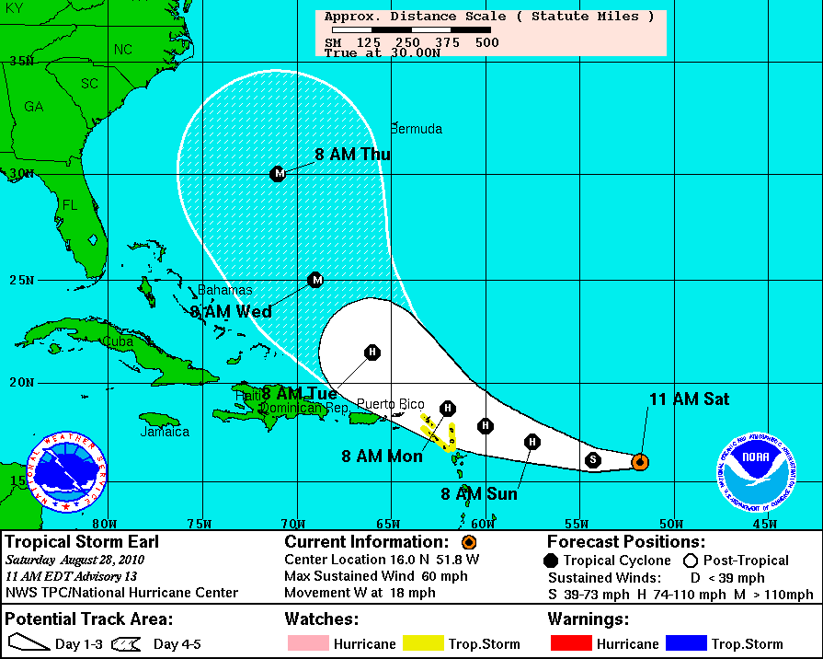

Slide 4
Cat 4 MOM

Slide 5
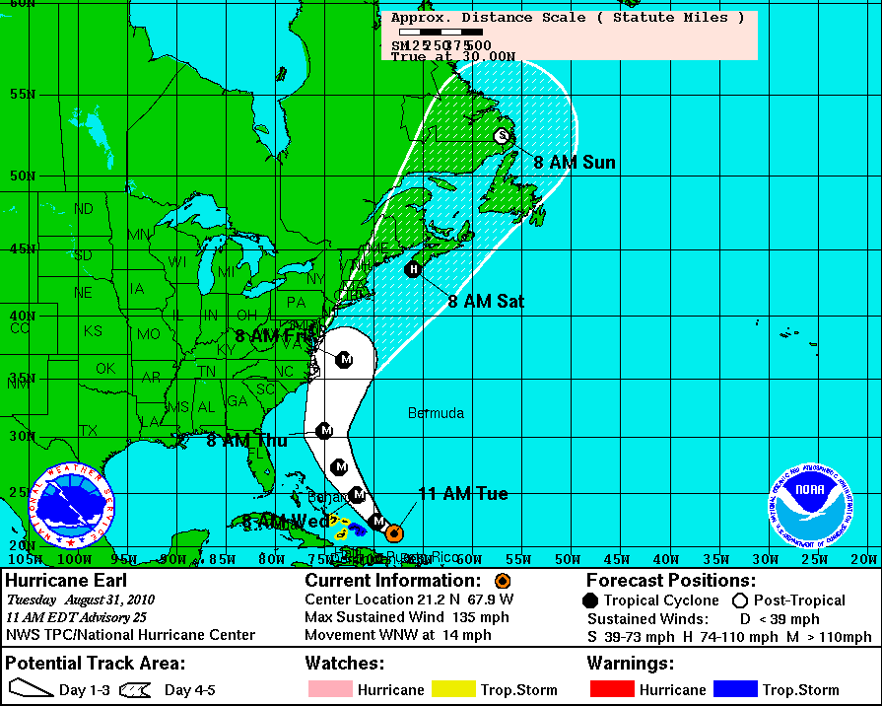

Slide 6
Cat 4 MEOW

Slide 7
Cat 4 MEOW

Slide 8
Cat 4 MEOW

Slide 9
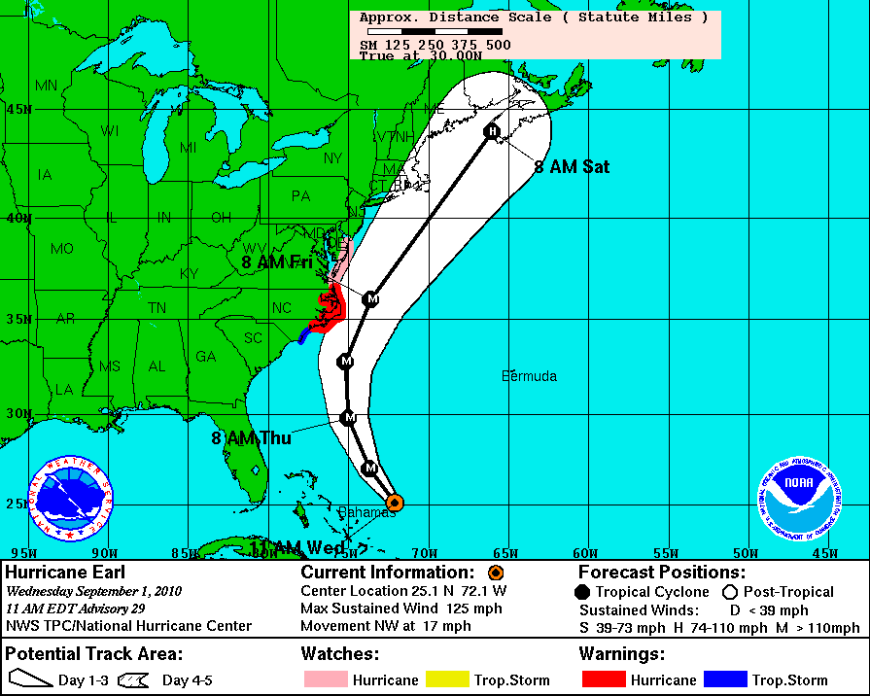
Adv #29 Track

Slide 10
Cat 4 MEOW

Slide 11
Cat 4 MEOW

Slide 12
Cat 4 MEOW

Slide 13
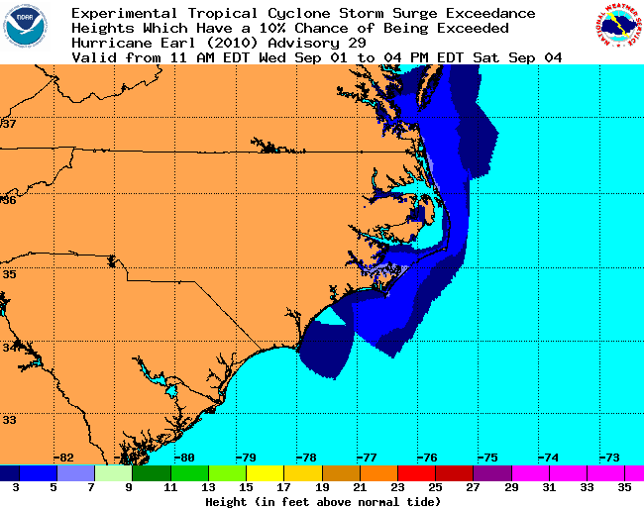
Ensemble/Probabilistic

Slide 14
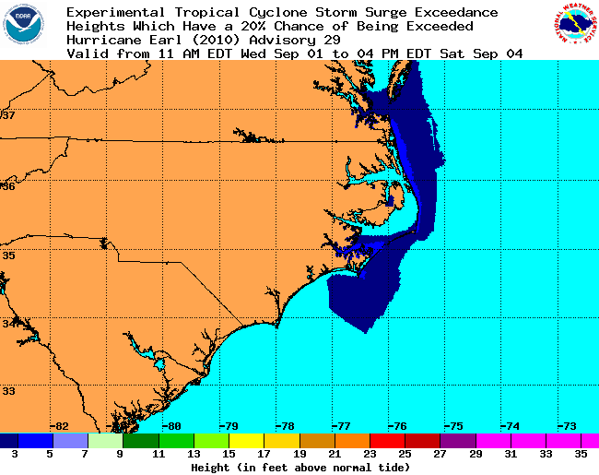
Ensemble/Probabilistic

Slide 15
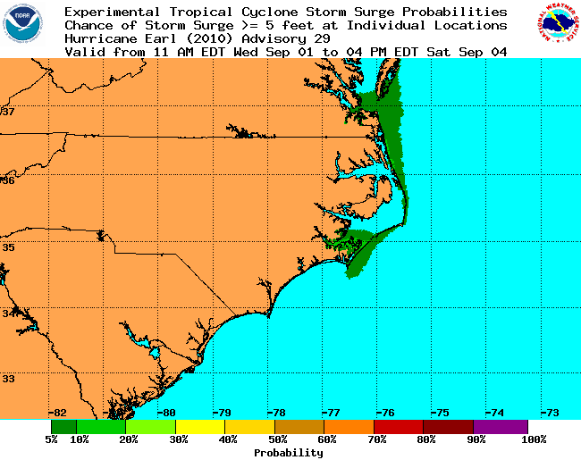
Ensemble/Probabilistic

Slide 16
Deterministic Run

Slide 17
Left Side of Cone

Slide 18
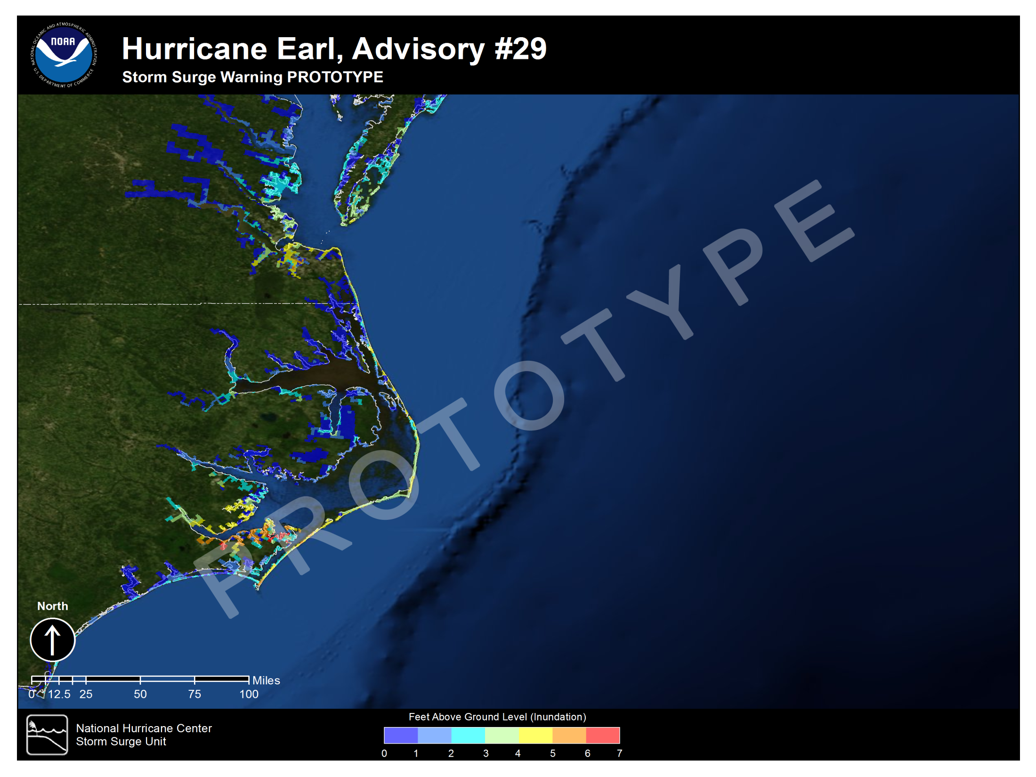

Slide 19
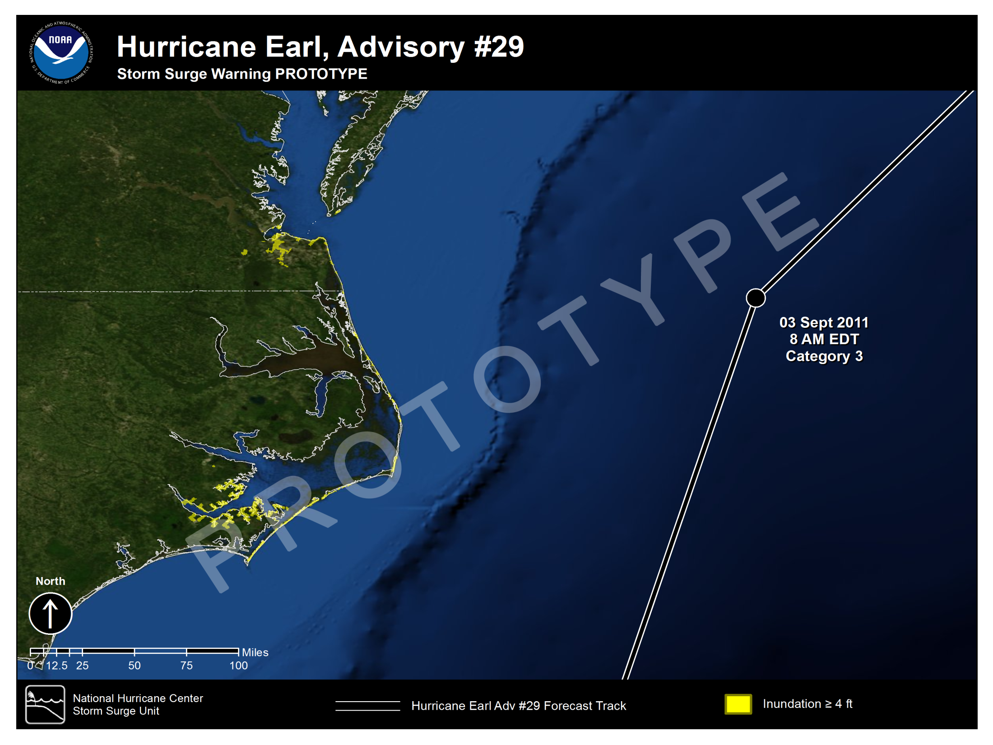

Slide 20
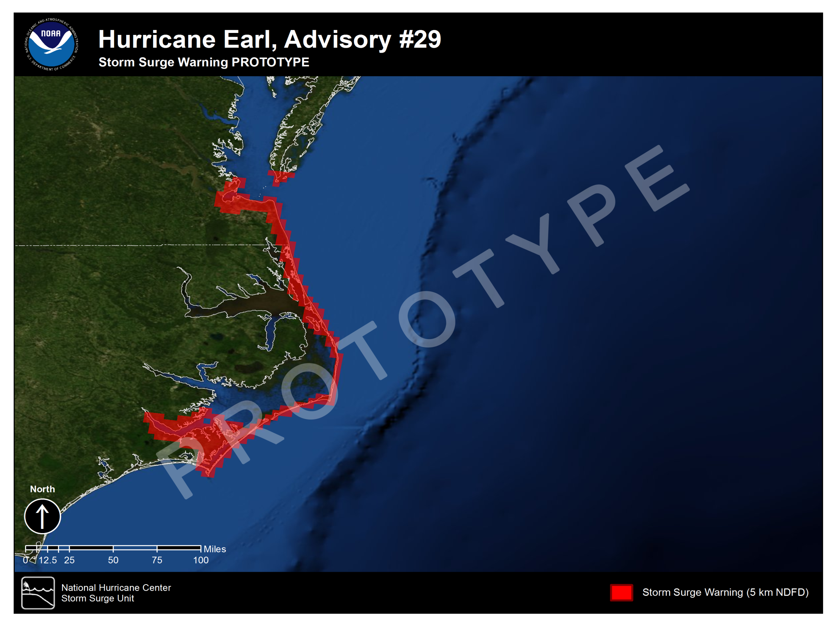
Prototype Warning

Slide 21
MEOW

Slide 22
MEOW

Slide 23
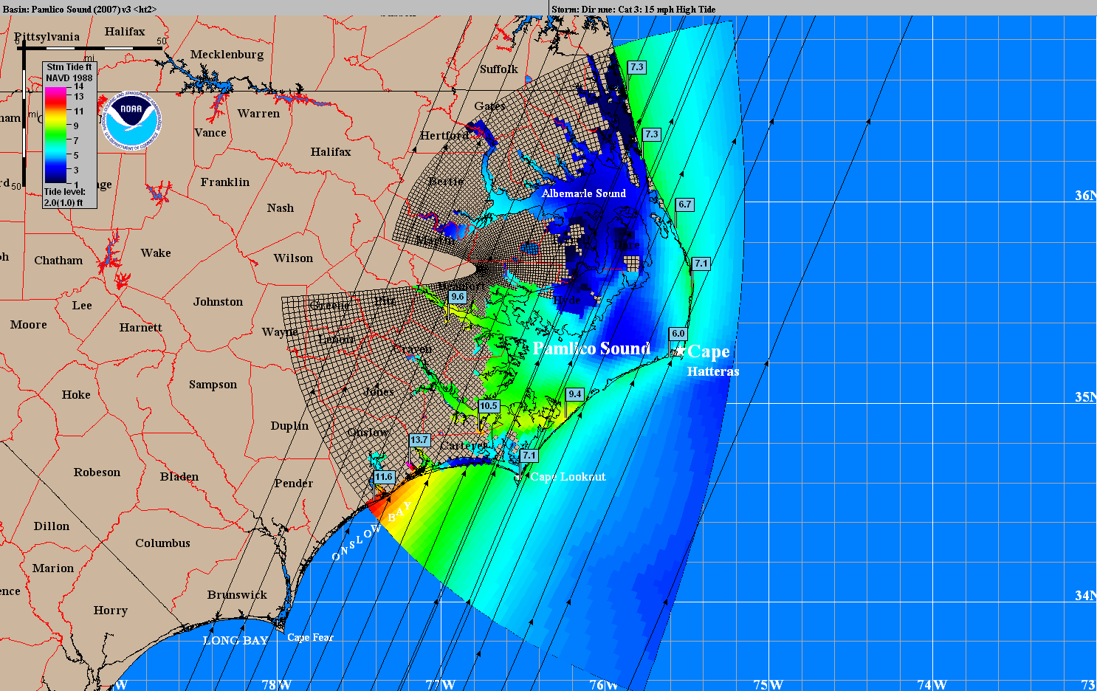
MEOW

